Slide 1
PSB-PS magnet specifications - Update
Existing specifications
Distinction between LHC and HI beams
W. Bartmann
LIU-PSB Meeting, 22nd March 2016

Slide 2

Aperture calculation
$A_{x,y}= {±n}_{sig}∙\sqrt{{k_{β}∙β}_{x,y}∙\frac{ε_{N;x,y}}{γ_{r}β_{r}}} ±$ 2|$D_{x,y}$⋅$σ_{δ}$|$± CO∙\sqrt{\frac{β_{x,y}}{β_{MAX;x,y}}}$
  $n_{sig}$= 3
  $k_{β}$ = 1.2
  CO = 3 mm
  $E_{k}=1.4/2.0$ GeV
Emittances
  HIE-ISOLDE: 13/6 um
  HI (PS): 10/5 um
  LHC: 2/2 um
Good field region:
BT.BVT10:
  HIE-ISOLDE: ±26/16 mm
  LHC ±12/10 mm
BT.BVT20:
  HIE-ISOLDE: ±48/15 mm
  LHC ±21/10 mm

Slide 3
Distinguish field quality for beam type
BT.BHZ10
Field homogeneity of 1e-4 rms → max value of ±2e-4
Possible approach:
  use this requirement only for LHC beam size (±19/21 mm instead of ±51.5/51.5 mm)
  → optimize for emittance
  Accept higher field inhomogeneities for HI beams
  as long as they fit into the acceptance
  → optimise for losses

Slide 4
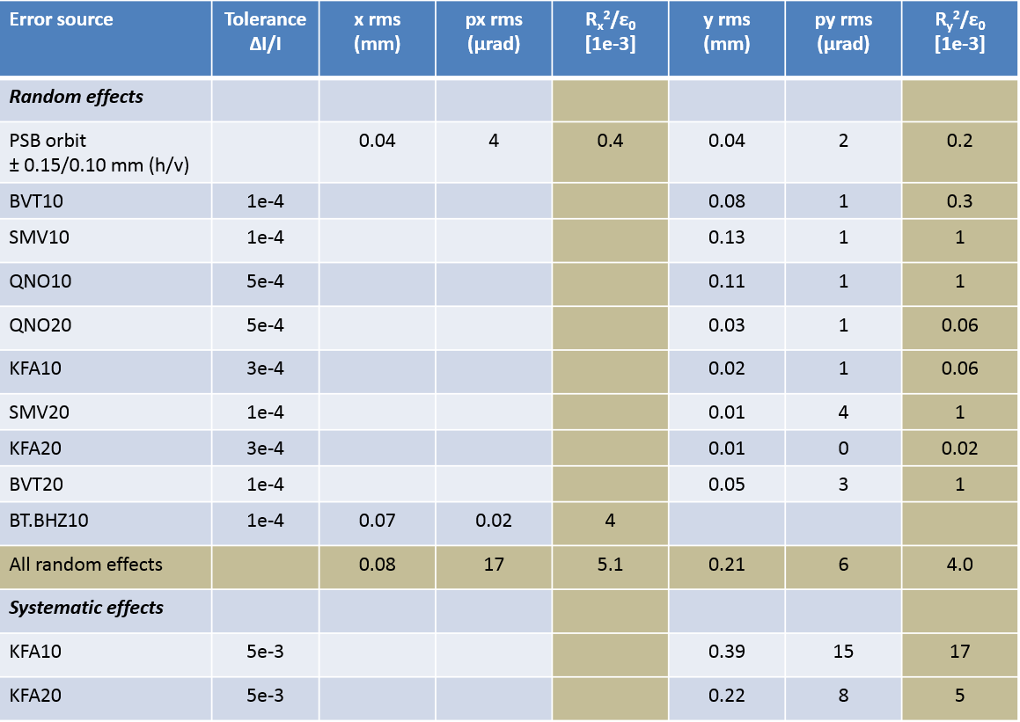
LHC beams - emittance growth
Keep random errors of both planes balanced
  Many small/medium error sources in vertical plane
  One strong error source in horizontal plane
OK for LHC beam
as agreed in review on
24th September 2015

Slide 5
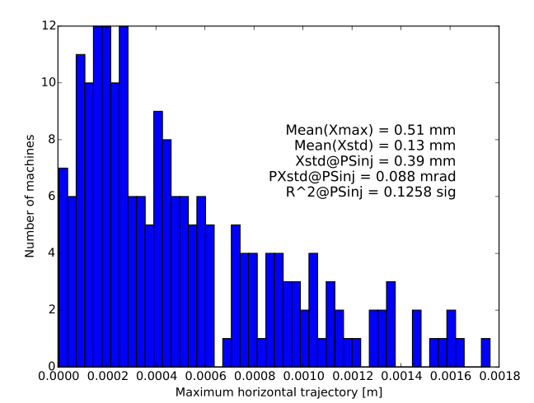
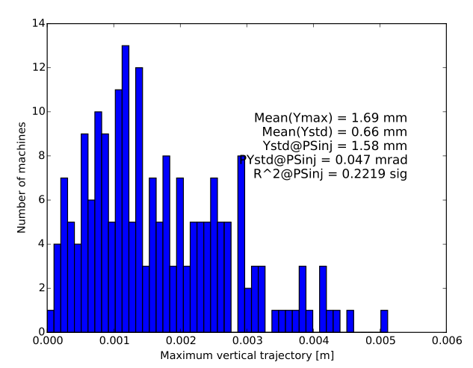
HI beams - particle loss
Assuming ∫ΔB/B for the large GFR
  BT.BHZ10: 5e-4 rms (max at ±1e-3)
  BT.BVT10/20: 5e-4 rms (max at ±1e-3)
Together with other recombination error sources leads to steering error of 0.4 (hor) and 1.6 mm (vert) → comparable to the assumed orbit tolerance of 1.5 mm in the ring

Slide 6
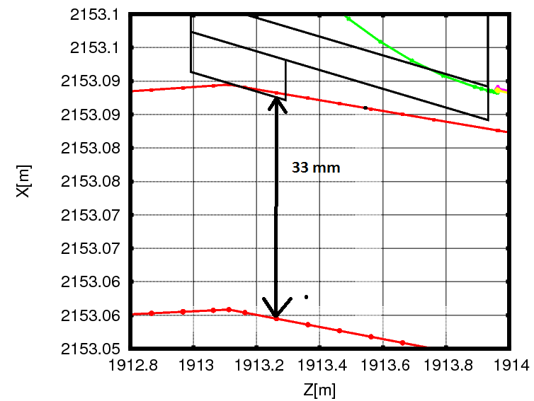
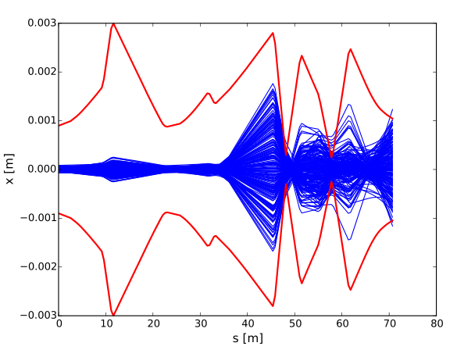
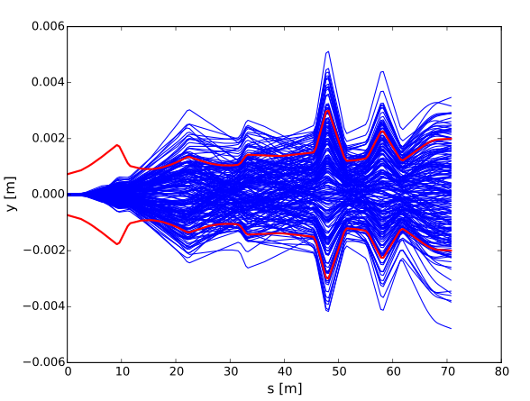
HI beams - particle loss
Aperture bottleneck at PS injection when bump is fully on:
  33 mm radial aperture
  Subtract 2 mm for alignment errors
  3 mm for the orbit already included in beam size
  Fit 3.3 sigma horizontally of HI beam at 1.4 GeV
  New septum will have increased vertical aperture (4.1 sig)
Beam size changes by 0.8% due to optics mismatch after filamentation has taken place
  Bump is collapsed within 500 turns

Slide 7
Conclusions
Up to now used HI beams to define GFR and LHC beam requirements to define field homogeneity
Proposal to distinguish requirements for LHC and HI beams
LHC beams with smaller GFR require tight settings to limit emittance growth
→ keep settings as agreed upon on 24th Sept. 2015
HI beams with large GFR limited by losses/dose
  Relaxed field homogeneity leads to increased trajectory variations at PS injection
  Bottleneck during injection when bump is fully on in horizontal plane
  Fit 3.3 sigma at 1.4 GeV
If agreed, should update specification table in magnet design report
Also add tolerances for as-built and as-measured

