Slide 1
Particle Tracking
Group 3 :
A. Gamelin
G. Baranov
E. Senes
G. Wang
S. Levasseur

Slide 2
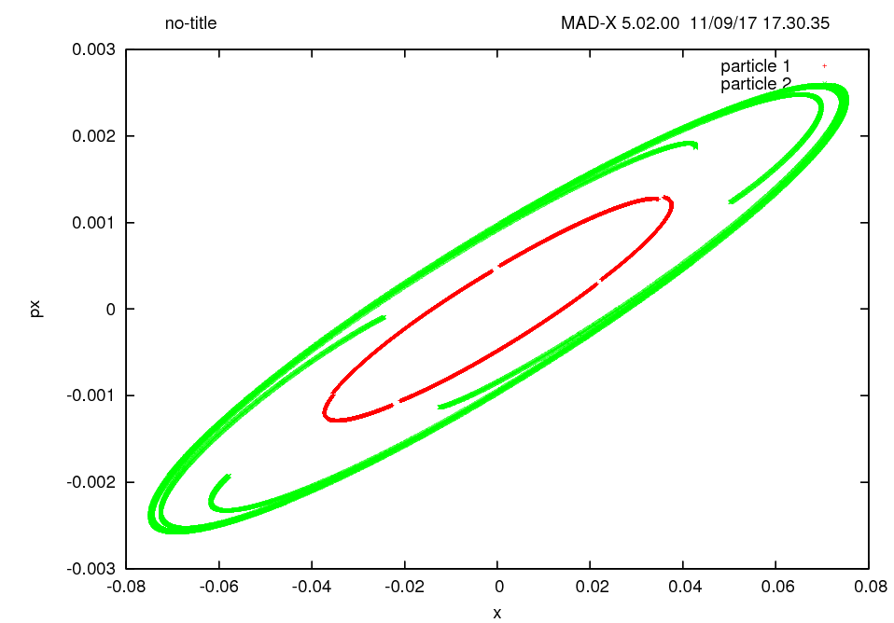
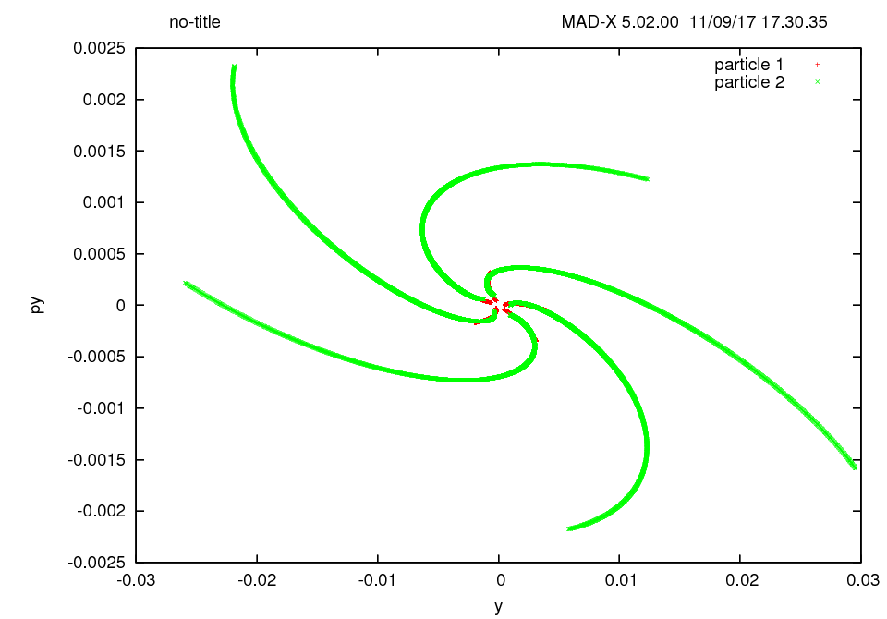

Tracking with thick lenses
Working point:
$$Q_{x}=10.6$$
$$Q_{y}=10.8$$
$$Q_{x}^{′}=−9.11$$
$$Q_{y}^{′}=−10.12$$
Particle tracking for 10 000 turns with thick lens lattice :
X Phase space
Y Phase space

Slide 3
Tracking with thick lenses
Working point:
$$Q_{x}=10.6$$
$$Q_{y}=10.8$$
$$Q_{x}^{′}=−9.11$$
$$Q_{y}^{′}=−10.12$$
Particle tracking for 10 000 turns with thick lens lattice :
Motion seems unstable, what is happening there ?

Slide 4
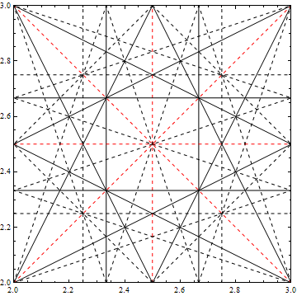
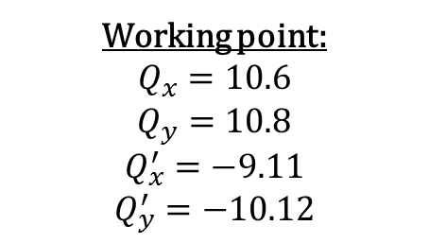
Tracking with thick lenses
Resonances:
2nd order
3rd order
4th order
Working point:
$$Q_{x}=10.6$$
$$Q_{y}=10.8$$
$$Q_{x}^{′}=−9.11$$
$$Q_{y}^{′}=−10.12$$

Slide 5
Tracking with thick lenses
Resonances:
2nd order
3rd order
4th order
Working point:
$$Q_{x}=10.6$$
$$Q_{y}=10.8$$
$$Q_{x}^{′}=−9.11$$
$$Q_{y}^{′}=−10.12$$
5th order
Image from https://www.pgoergen.de

Slide 6
Tracking with thick lenses
Working point:
$$Q_{x}=10.6$$
$$Q_{y}=10.8$$
$$Q_{x}^{′}=−9.11$$
$$Q_{y}^{′}=−10.12$$
Particle tracking for 10 000 turns with thick lens lattice :
Effect of the 5th order resonance, 5 traces in the phasespace

Slide 7
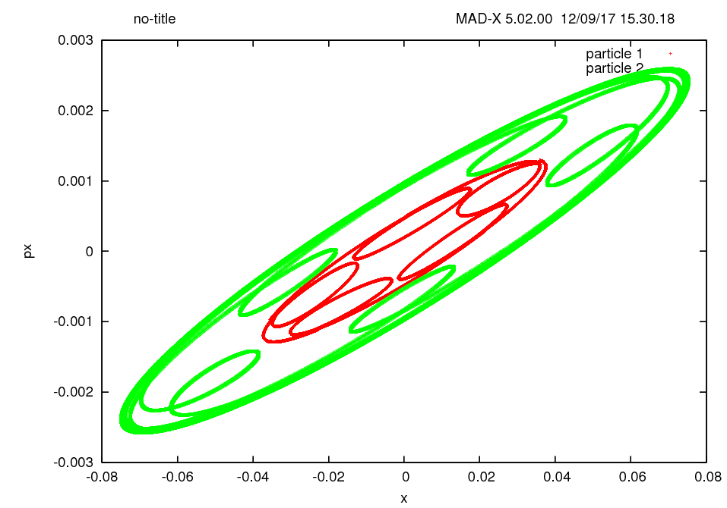
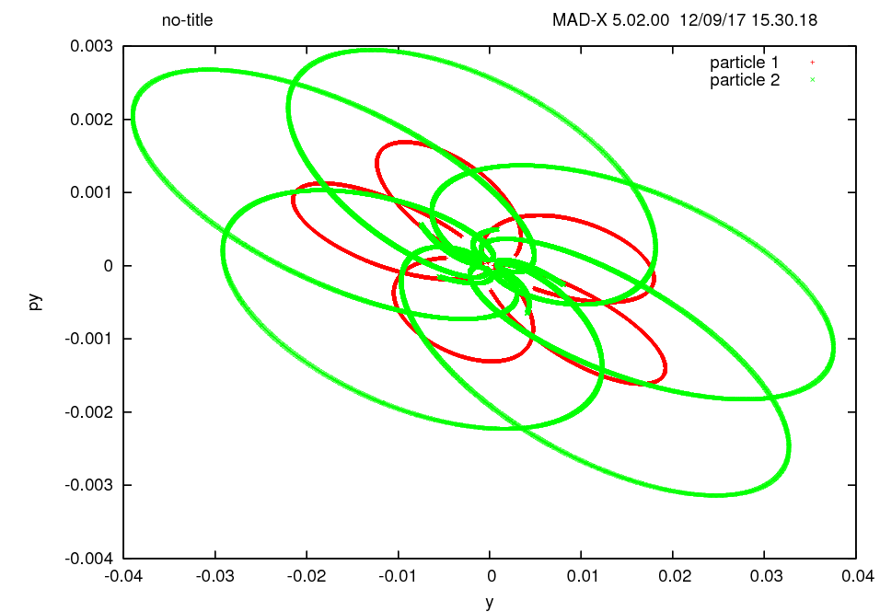
Tracking with thick lenses
Working point:
$$Q_{x}=10.6$$
$$Q_{y}=10.8$$
$$Q_{x}^{′}=−9.11$$
$$Q_{y}^{′}=−10.12$$
Now, tracking for 30 000 turns:
Motion is actually stable !

Slide 8
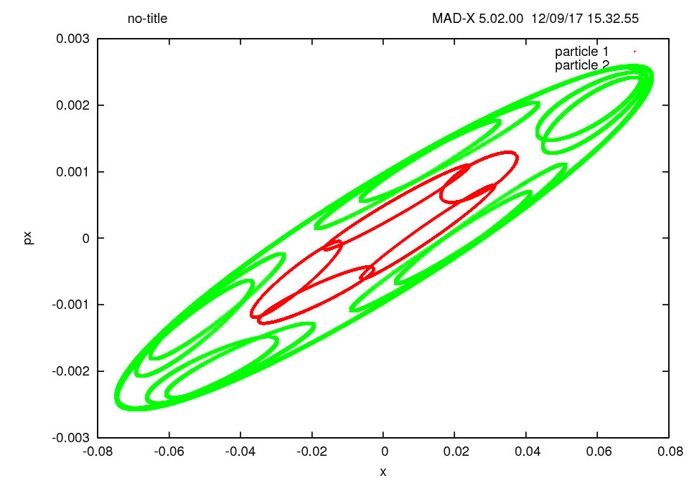
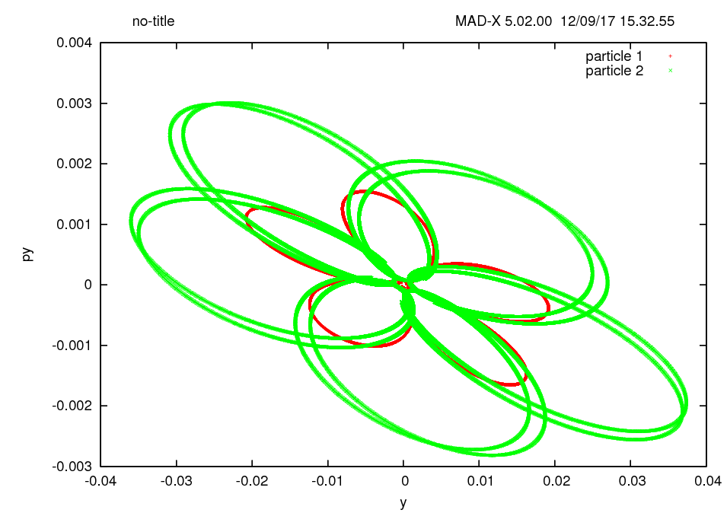

Working point:
$$Q_{x}=10.6$$
$$Q_{y}=10.8$$
$$Q_{x}^{′}=−9.11$$
$$Q_{y}^{′}=−10.12$$
Tracking with thin lenses
Tracking the same lattice with thin lenses for 30 000 turns:
Phase space is different ! Why the thin lens approximation does not hold ?

Slide 9
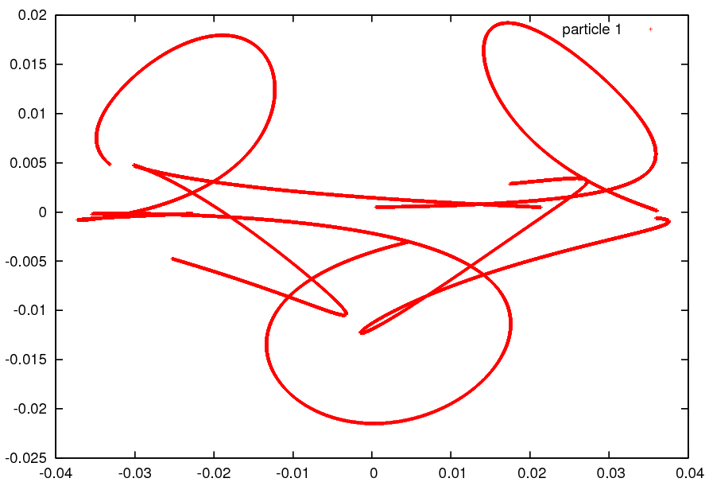
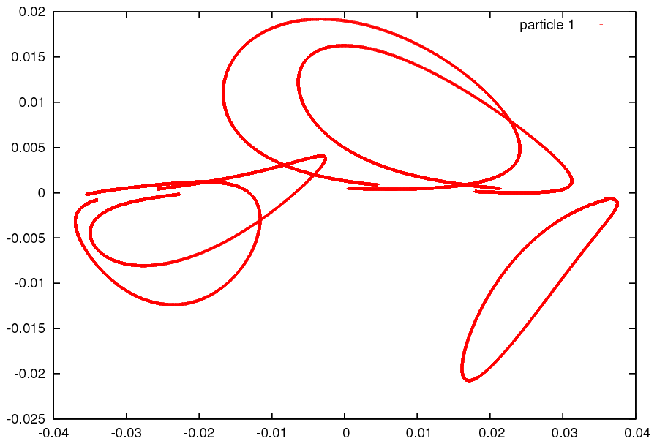

Working point:
$$Q_{x}=10.6$$
$$Q_{y}=10.8$$
$$Q_{x}^{′}=−9.11$$
$$Q_{y}^{′}=−10.12$$
Thin lens approximation
Thin lens approximation is only valid if:
But the tunes matched to $Q_{x}=10.6$ and $Q_{y}=10.8$, the quadrupole are stronger so the focal lens is shorter !
$$f≫L_{quad}$$
The approximation is no longer valid ! We have to use thick lenses.
Thick lenses
Thin lenses
X
X
Y
Y

Slide 10
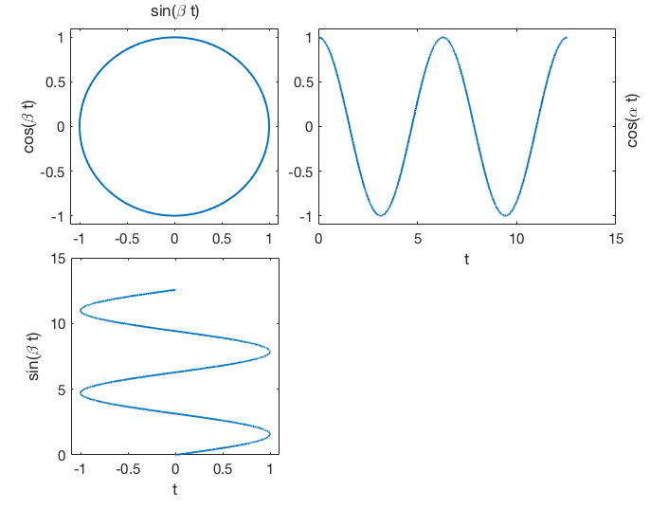
Lissajous figures
a.k.a. what happens when we plot together two harmonic oscillators
The pattern will depend by the ratio of the frequencies (α:β)
and the initial relative phase difference
Trivial case, (1:1) and ɸ=0 is a line
(1:1) and ɸ=pi/2 is a circle
x = cos(βt + ɸ)
y = sin(αt)
Plenty of tools on the web to plot them, I used:
https://www.desmos.com/calculator/tti5dasmc4

Slide 11
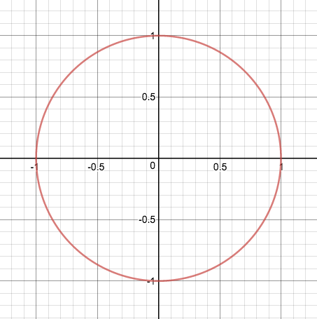
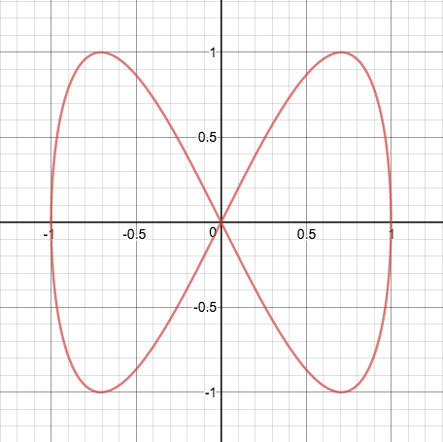
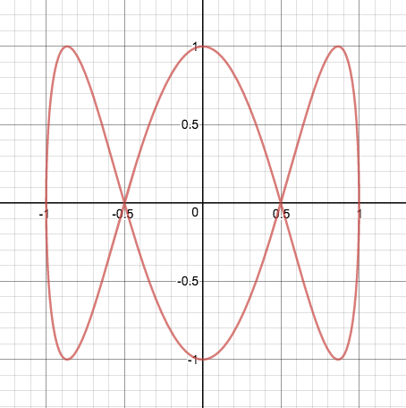
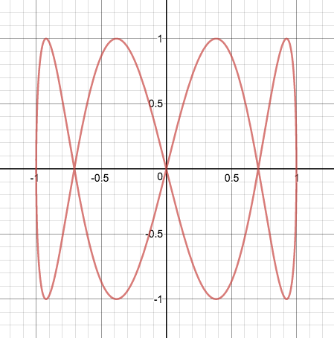
Lissajous figures
(1:1)
(2:1)
a.k.a. what happens when we plot together two armonic oscillators
(3:1)
(4:1)
Can we do it in an accelerator ?
YES ! Avoiding resonances …

Slide 12
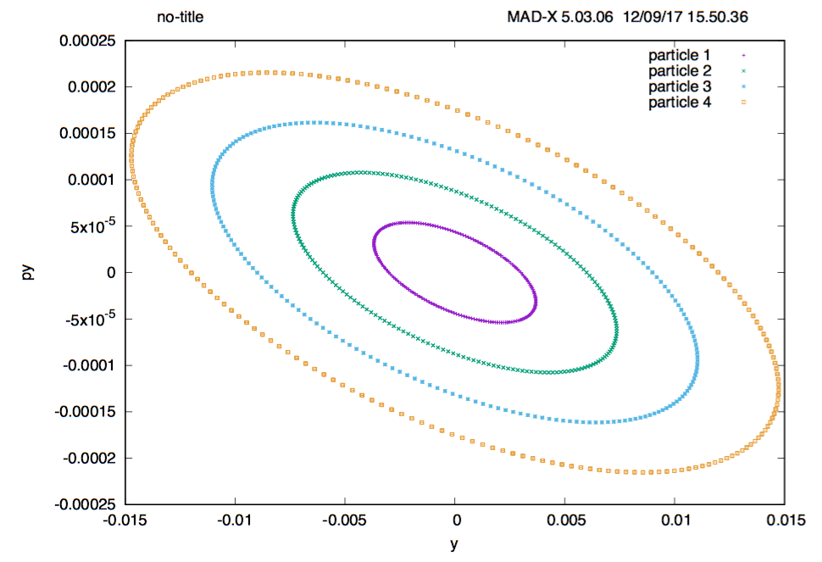
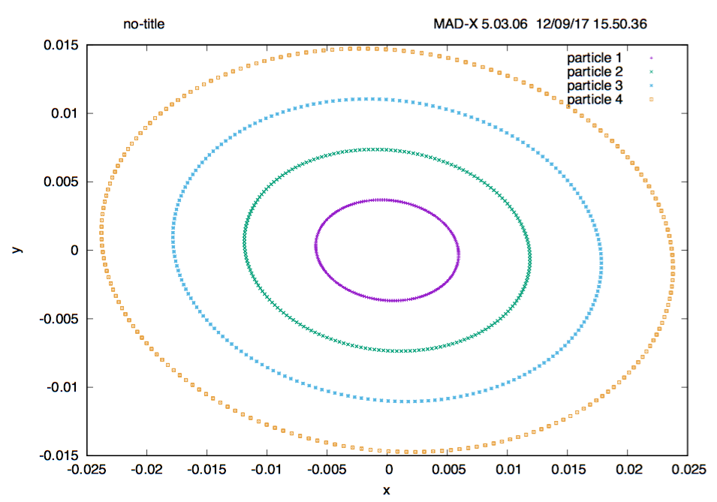
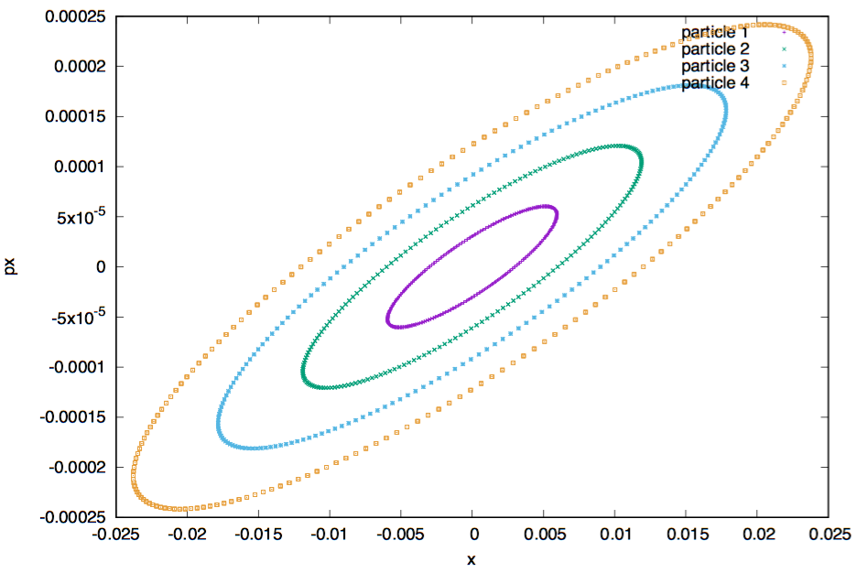
Phase space
Physical space
It’s not a perfect circle → ɸ close to pi/2
Qx=6.09, Qy=6.09

Slide 13
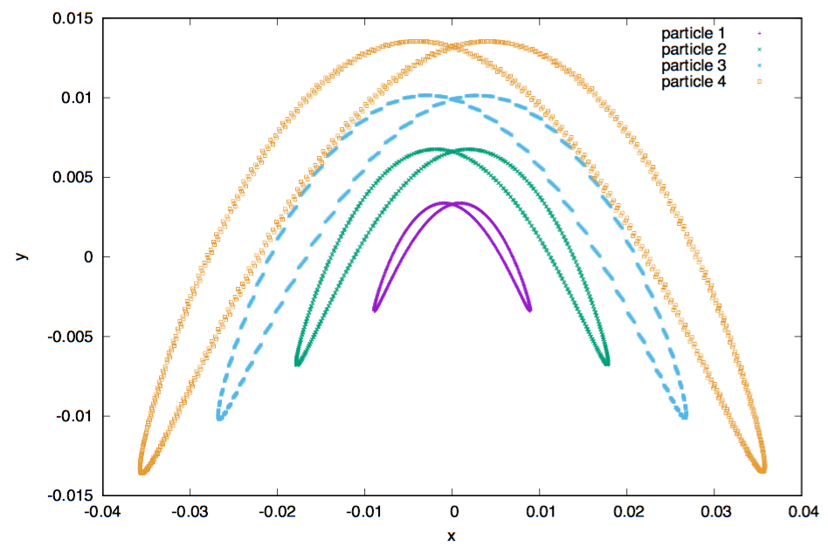
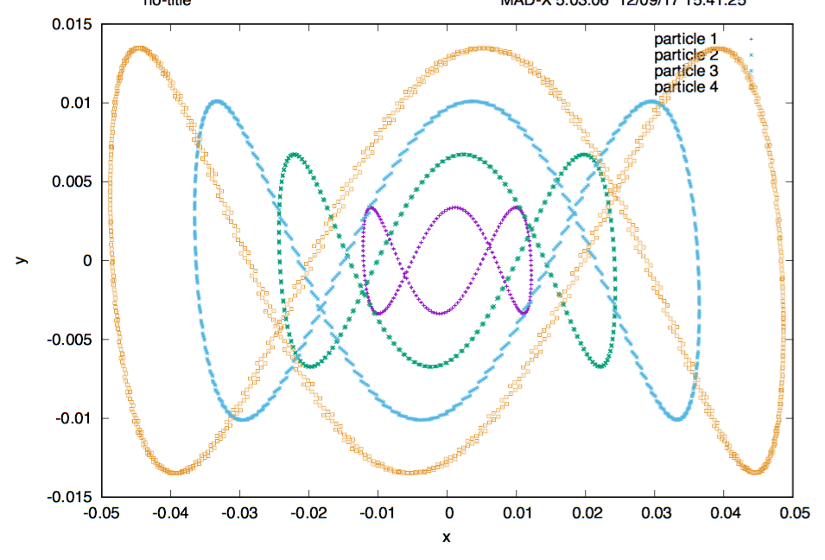
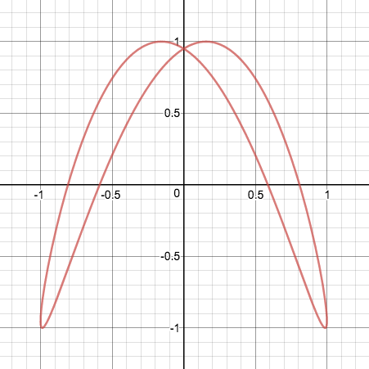
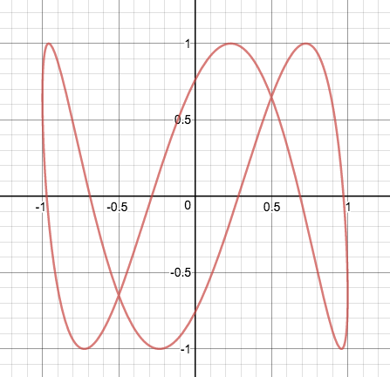
Qx=3.045 Qy=6.09
Qx = 3.045 Qy = 6.09
ɸ=0.7*pi
ɸ=0.6*pi

Slide 14
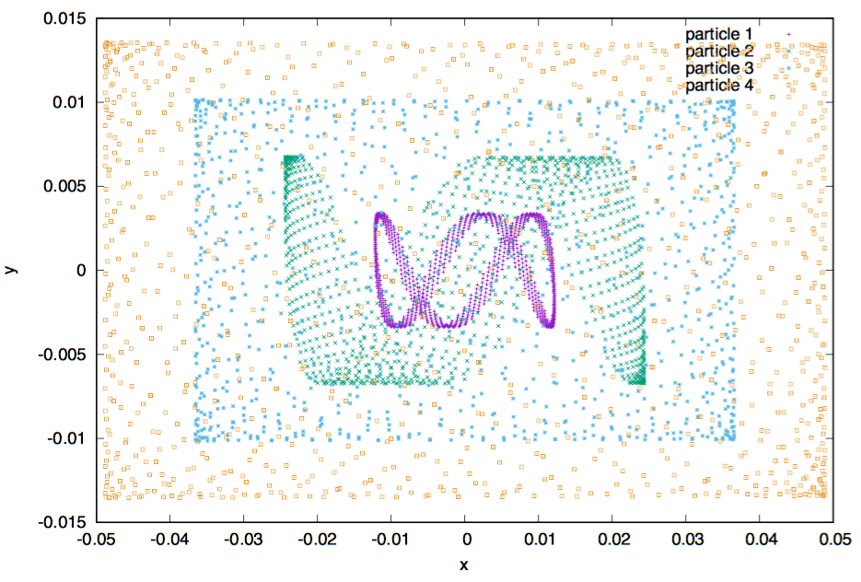
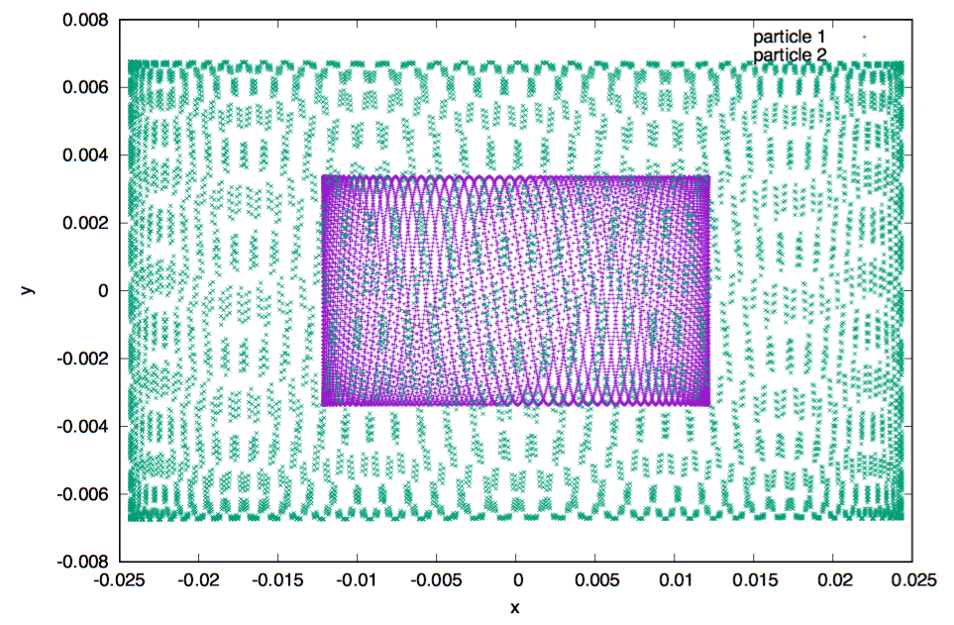
What if we do not correct chromaticity ?
10ˆ3 turns
10ˆ4 turns
Qx=3.045, Qy=9.135
Uncorrected chromaticity
Q’x=52, Q’y=28

Slide 15
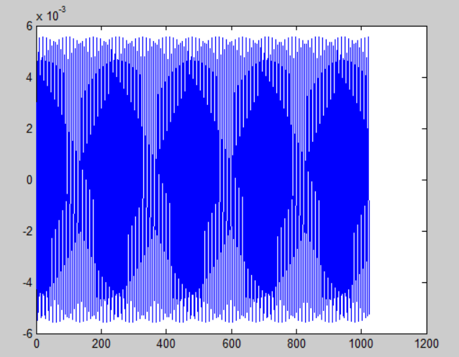
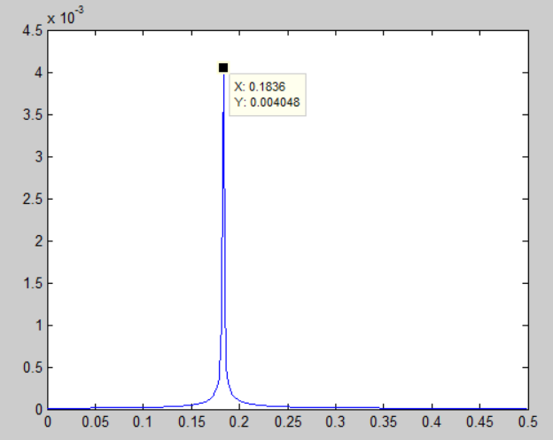
Qx = 6.183
Qy = 6.183
Turn = 1024
No sextupoles
Tune spectrum computation
Horizontal
Beta oscillation
Tune spectrum
Amplitude
Qx = 6.183
X / m
Turn
frequency
As the resolution of FFT is 1/1024, the computed tune (0.1836) is its multiple.

Slide 16
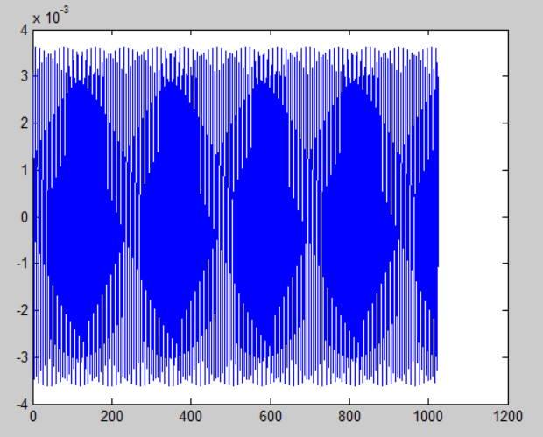
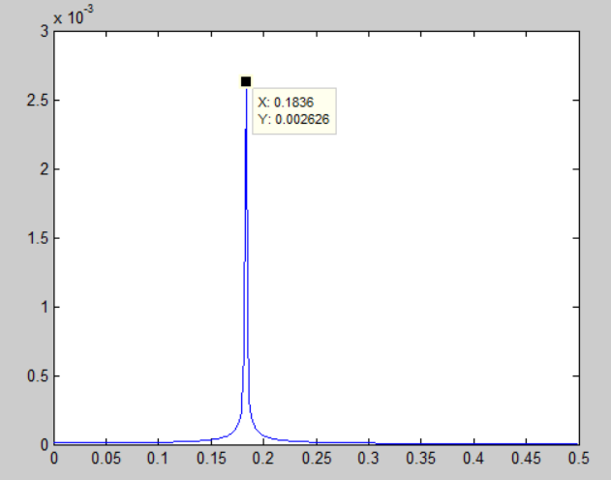
Qx = 6.183
Qy = 6.183
Turn = 1024
No sextupoles
Tune spectrum computation
Tune spectrum computation
Vertical
Beta oscillation
Tune spectrum
Amplitude
Qy = 6.183
Y / m
Turn
frequency
As the resolution of FFT is 1/1024, the computed tune (0.1836) is its multiple.

Slide 17
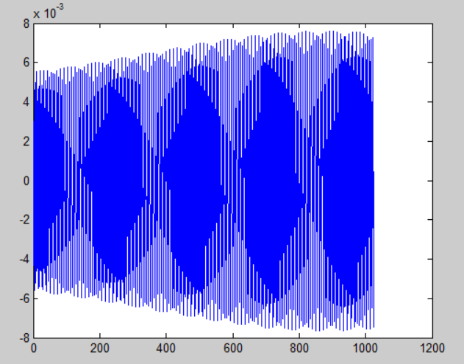
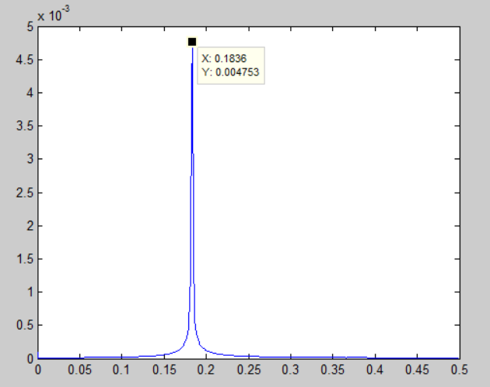
Qx = 6.183
Qy = 6.183
Turn = 1024
With sextupoles
Tune spectrum computation
Tune spectrum computation
Horizontal
Beta oscillation
Tune spectrum
Amplitude
Qx = 6.183
X / m
Turn
frequency
As the resolution of FFT is 1/1024, the computed tune (0.1836) is its multiple.

Slide 18
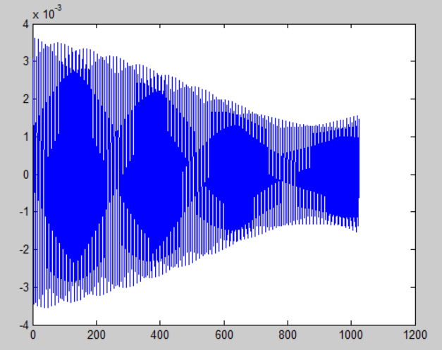
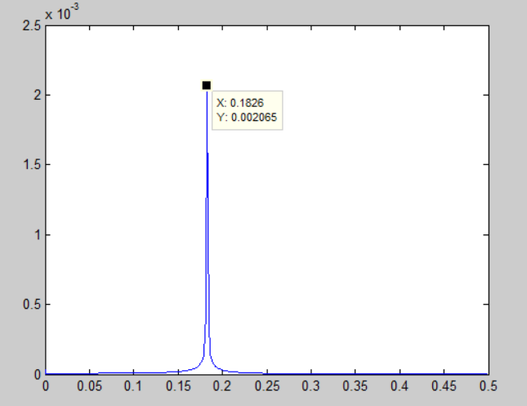
Qx = 6.183
Qy = 6.183
Turn = 1024
With sextupoles
Tune spectrum computation
Tune spectrum computation
Vertical
Beta oscillation
Tune spectrum
Amplitude
Qy = 6.183
Y / m
Turn
frequency
As the resolution of FFT is 1/1024, the computed tune (0.1836) is its multiple.

Slide 19
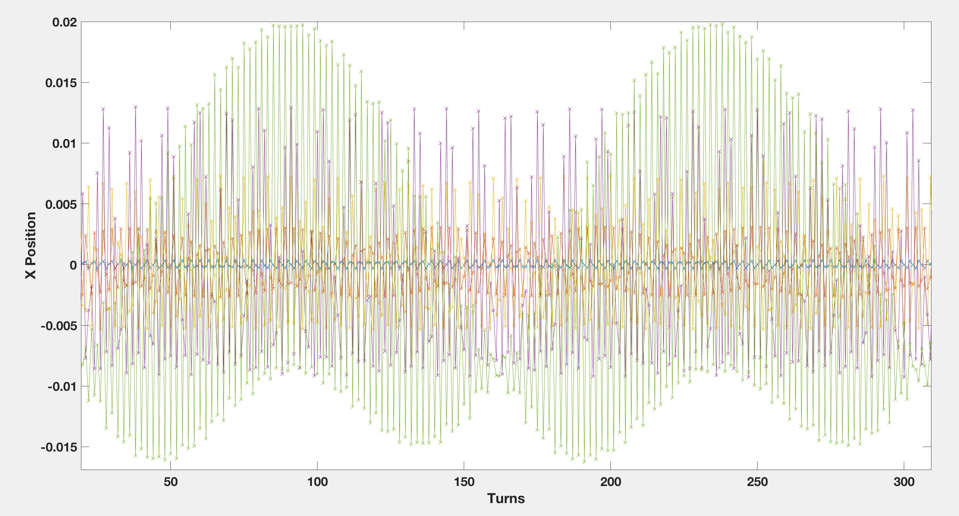
“Working” Point:
Qx = 6.33
Qy = 6.33
Q’x = 914
Q’y = -142
Tune spectrum computation
Tune spectrum computation
Individual particles have different oscillation frequencies

Slide 20
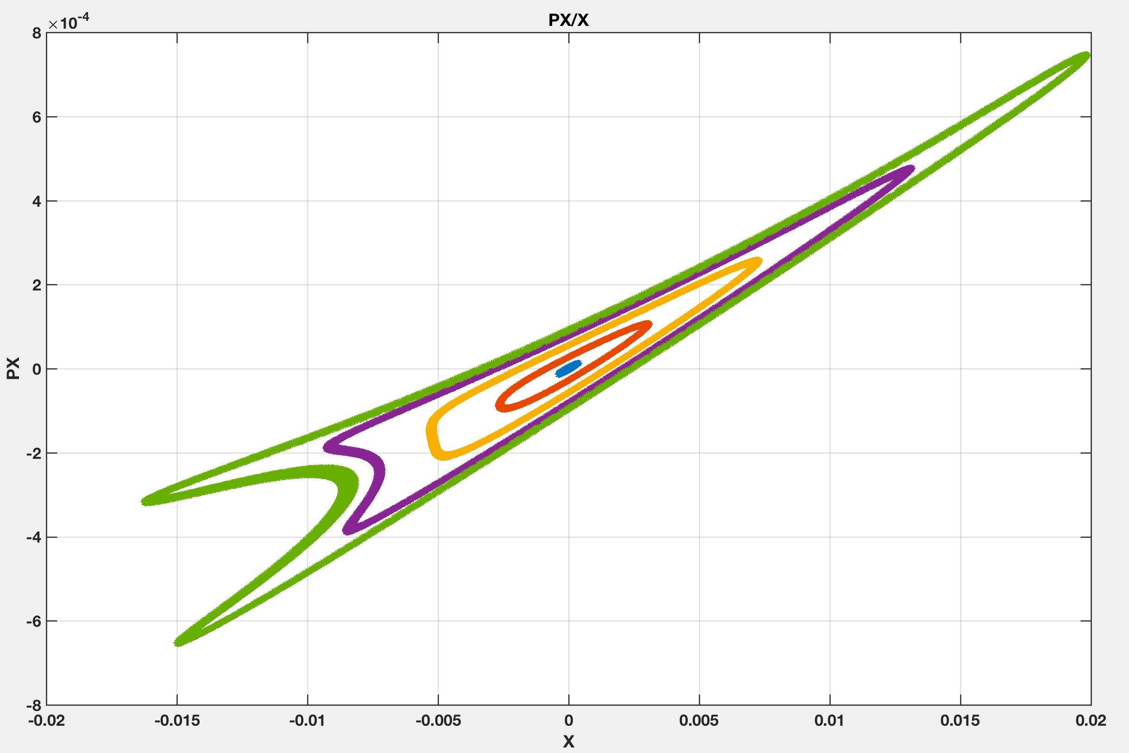
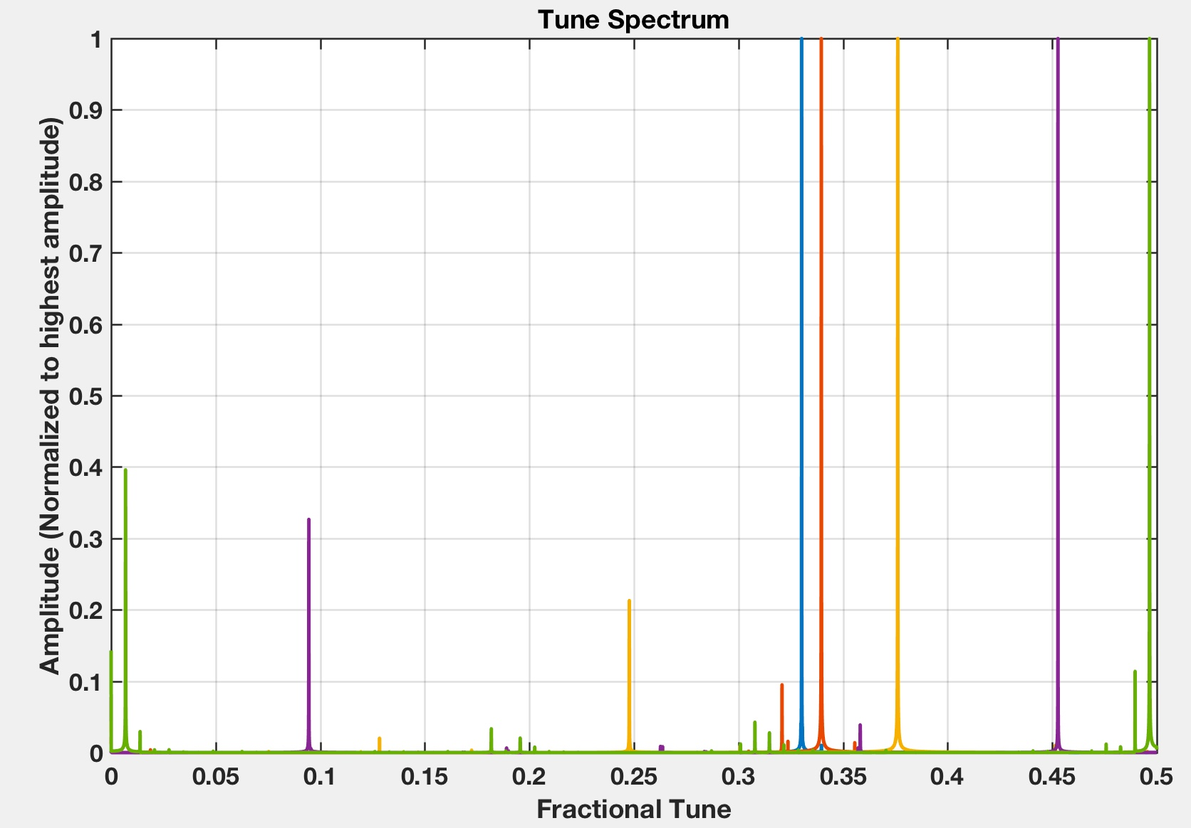
“Working” Point:
Qx = 6.33
Qy = 6.33
Q’x = 914
Q’y = -142
Turn = 20000
Tune spectrum computation
Tune spectrum computation
Phase space and tune spectrum for a working point close to a resonance
with very large chromaticity.
0.3396
0.4527
0.3302
0.3761
0.4965
The further from the ideal orbit, the more the tune spread.

Slide 21
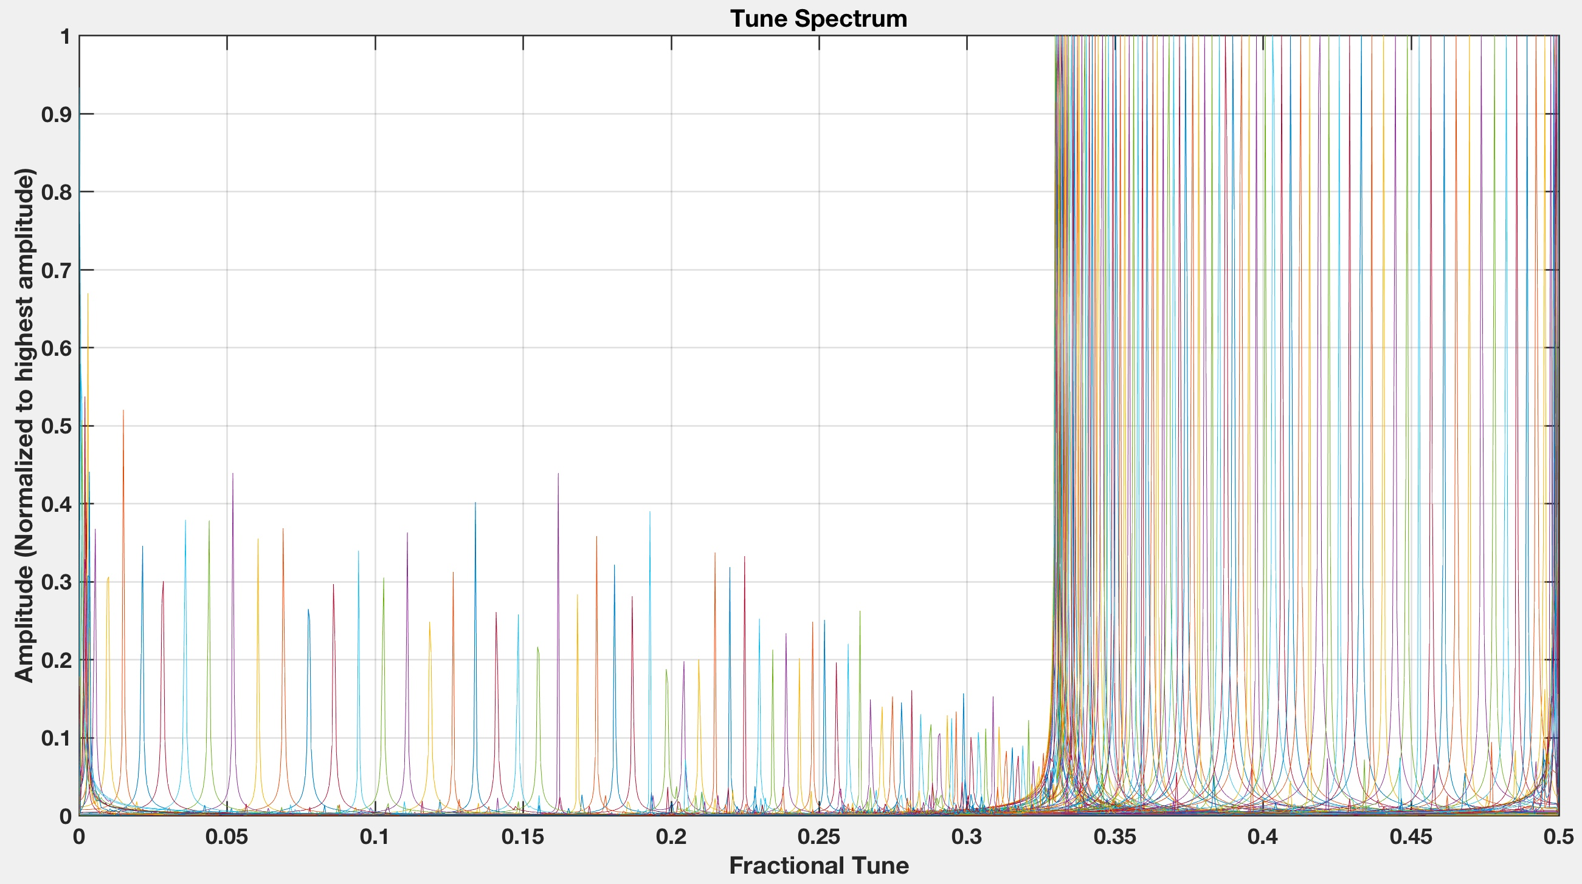
Tune spectrum computation
Tune spectrum computation
Same thing but with more particles (500)

Slide 22
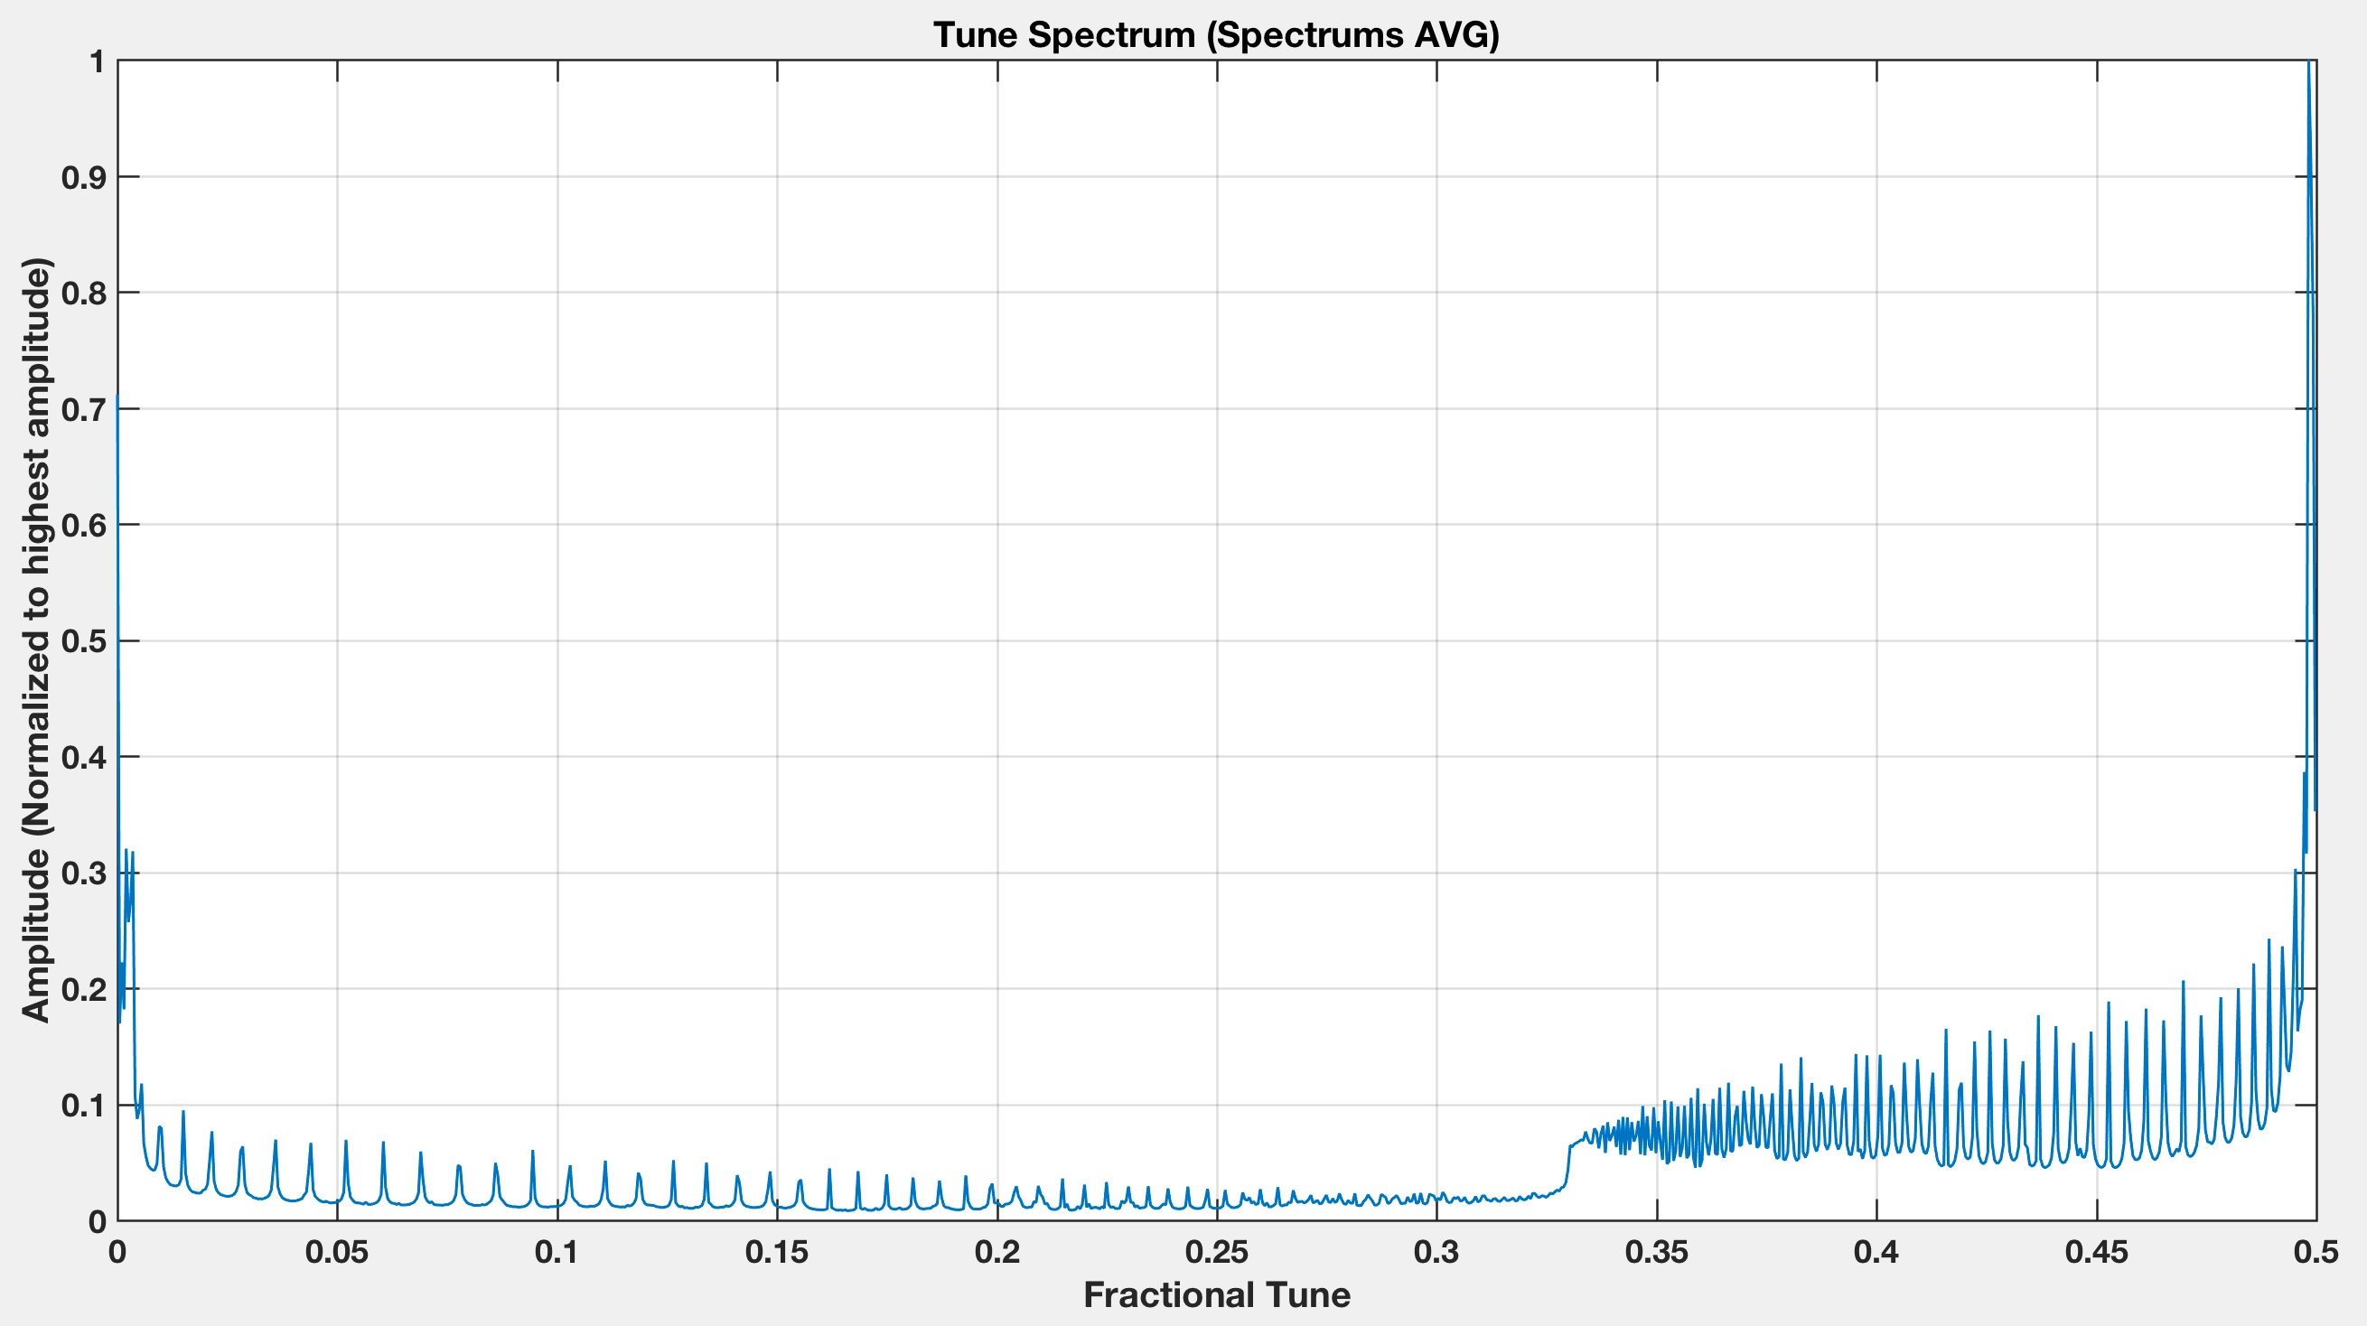
Tune spectrum computation
Tune spectrum computation
Same thing but with more particles (500)
Q = ?
Width = 0.17

Slide 23
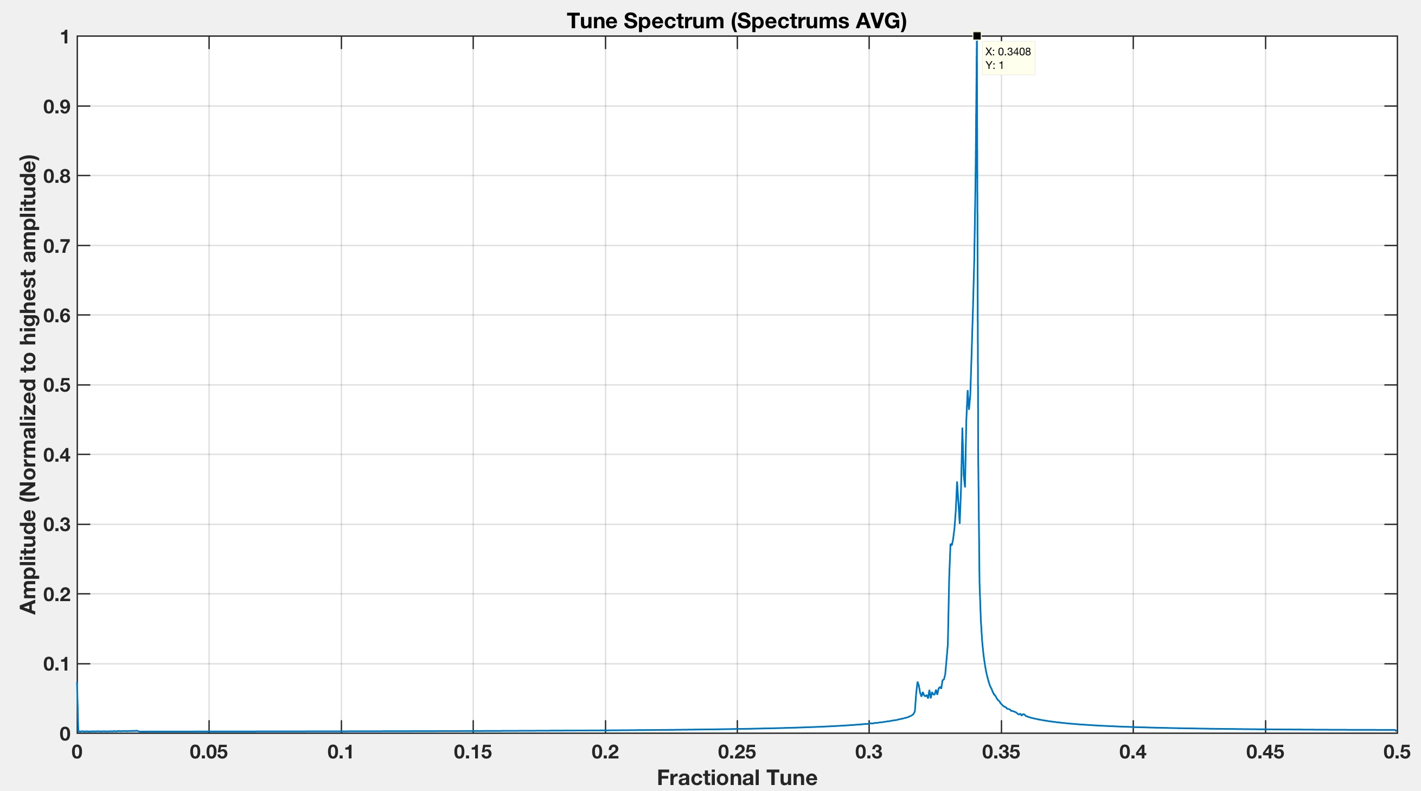
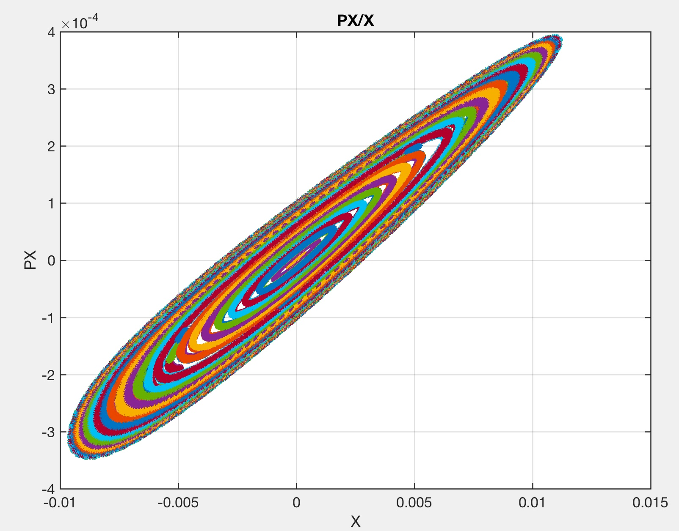
Working Point:
Qx = 6.33
Qy = 6.33
Q’x = 267
Q’y = -49
Turn = 2000
Tune spectrum computation
Tune spectrum computation
Less chromaticity
Q = 0.3408
Width = 0.01

Slide 24
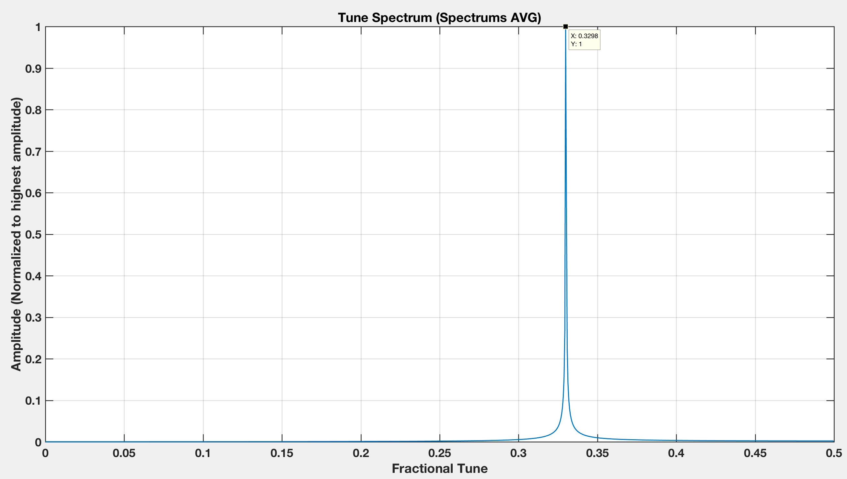
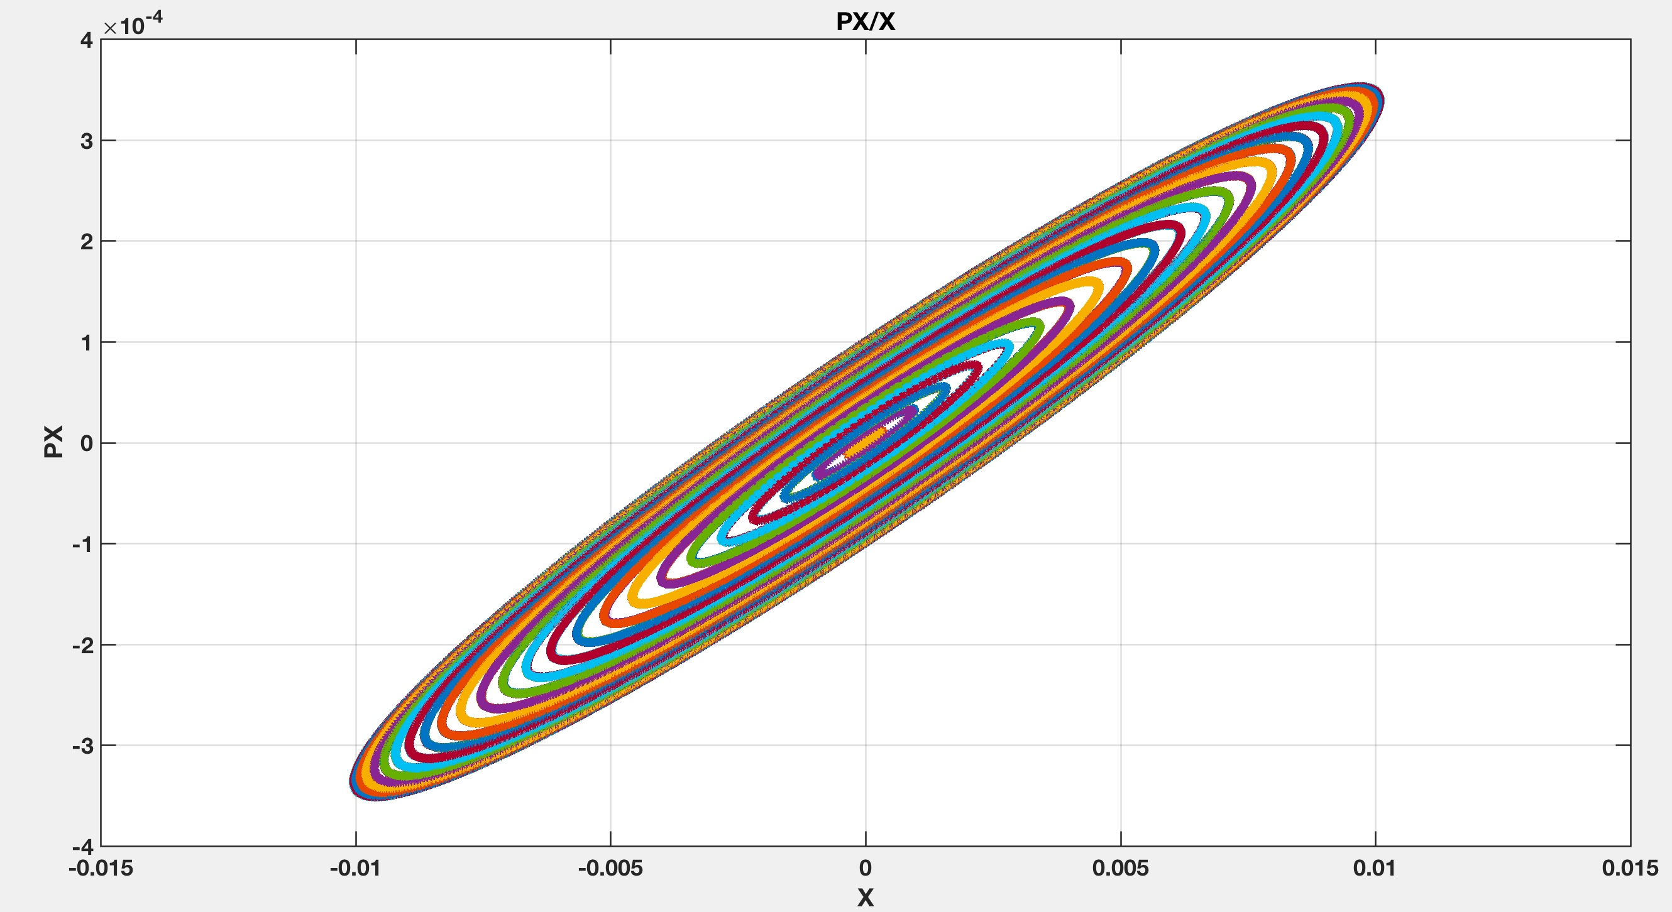
Working Point:
Qx = 6.33
Qy = 6.33
Q’x = 0
Q’y = 0
Turn = 2000
Tune spectrum computation
Tune spectrum computation
Chromaticity corrected
Q = 0.3298
Width = 0.0005

