Slide 2
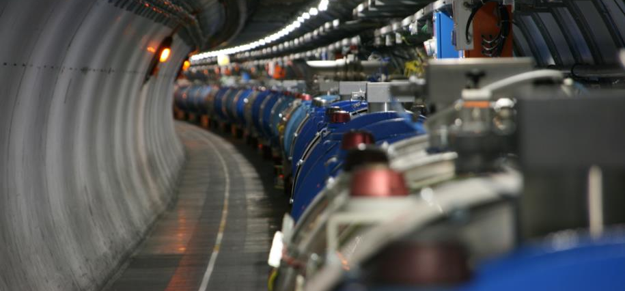
Powering tests preparation_meeting 12
Mirko Pojer and Matteo Solfaroli

Slide 3
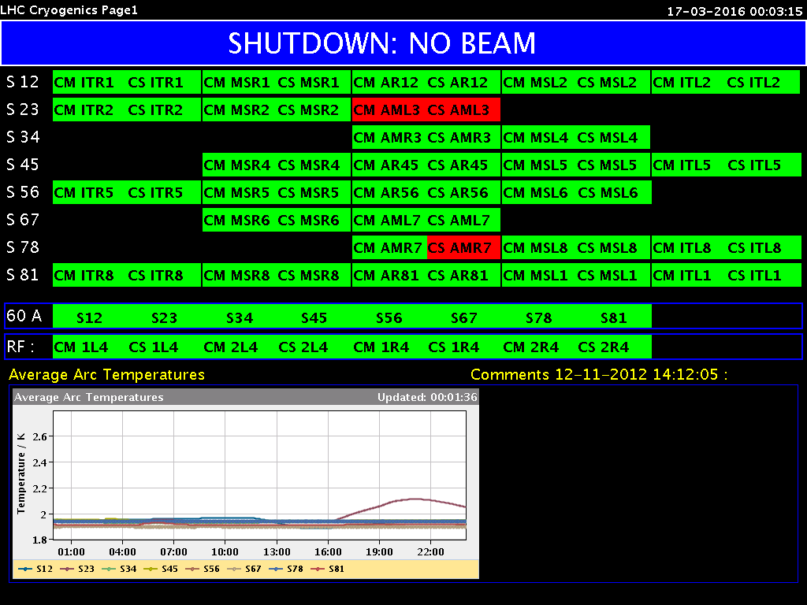
Cryogenics
Beam screen conditioning test done in
S12, S34, S45, S81
S56 and S67 could be done from Friday night
S23 and S78 to be possibly done during
the week-end
“maximum heat load” test ongoing
S78 to be completed – conditions back this evening/tomorrow morning
S23 will be completed tomorrow
2 days will be needed at the end to set S23 and S78 in Run II configuration

Slide 4
Summary status
Circuit type | Completion [%]
RBs | 97% (all done – 2 signatures missing)
RQs | 89% (all done – repeated, sign.missing)
ITs | 100%
IPQs | 99%
IPDs | 100%
600 A | 98%
120-60 A | 99% (just 1 x60 A in S34)
Total | 98% (8479 oo 8592 successful tests)
A couple of QPS/EE issues (detailed list below)
PID parameters for the IT correctors to be improved

Slide 5
Status of RB circuits
RB.A12 OK
RB.A23 OK (1 quench @11040 A (C24R2=2195, 1st quench))
RB.A34 OK
RB.A45 OK
RB.A56 quenched at 11076 A (B33R5=3375, quenched in 2008), then reached 11080 A – fuse changed, tests ongoing
RB.A67 OK
RB.A78 OK
RB.A81 OK

Slide 6
RB FPA at 2 kA on the ramp
FPA at 2 kA on the ramp was asked by EPC, to check the oscillation dumping system of the PC output filter; done on
RB.A12
RB.A23
RB.A34
RB.A45
RB.A56
RB.A67
RB.A81

Slide 7
RQD/F tested with new current
RQD/F.A12 – last step done with new values
RQD/F.A23 – last step done with new values
RQD/F.A34 – last step done with new values
RQD/F.A45 – last step done with new values
RQD/F.A56 – last step done with new values
RQD/F.A67 – last step done with new values
RQD/F.A78 – as soon as cryo is available
RQD/F.A81 – last step done with new values
Tests repeated also to re-measure some busbar segments with slightly higher resistance; pyramid also requested on S23 and S78 (to be done after cryo recovery)

Slide 8
The last test did not trigger the scope acquisition, so after discussing with Mateusz we propose to continue like this:
4) Repeat the 2 kA, 10 A/s test (with new triggering condition)
5) 5 kA, 10 A/s test
6) I_nom+100 A, 0 A/s
7) 10.5 kA, 10 A/s
Once all tests are finished, and the results are correct, then it would be very nice if we could move the scope to one of the RQD/F.A56 circuits so that we also get references curves for the RQ. This of course depends on available time.
If possible, I would propose to do the following tests:
760 A, 0 A/s, 1 A fuse
2 kA, 0 A/s, 1 A fuse
5 kA, 0 A/s, 1 A fuse
I_nom, 0 A/s, 1 A fuse
5 kA, 0 A/s, 200 mA fuse
I_nom, 0 A/s, 200 mA fuse
The resistance of a 200 mA fuse (about 17 Ohm ?) is quite a bit higher than the one of a 1 A fuse (1 Ohm) and therefore strongly affects the earth current (as we already noticed on the PM file of the RB.A56 quench).
After the last test we leave the 200 mA fuse in the RQ circuit (while the RB.A56 will keep the 1 A fuse in).
Cheers,
Arjan

Slide 9
S12
Missing in A12
RQT13.R1B1: Noise in U_HTS – acceptable for QPS…
RQTL11.R1B1 and B2: trip on STRONG 0V crossing Jens working on them

Slide 10
S23
No cryo conditions
Missing in XR2
RCBXH2.R2 – last test done
Precycles performed on available circuits

Slide 11
S34
Missing in A34
RCBV13.L4B2
resistance is double the maximum: Giorgio cleaned the contacts, the connection was changed, but still not good.
RQD.A34 CL T badly regulated
Repetition of series of manual ramps on RCD.A34B1 completed, as requested by MP3+EPC. The circuit completed all the additional tests without trips.
Missing in ML4
RU.L4 – PNO.a3 done; not signed due to “some high U_res value” – not possible to optimize further

Slide 12
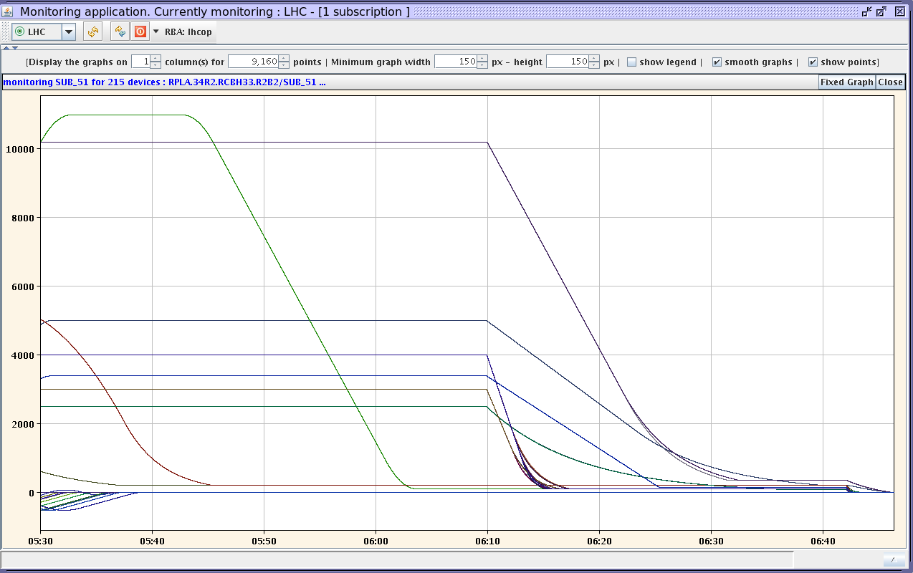
S34

Slide 13
S45
Fully commissioned

Slide 14
S56
Missing in XR5
RCBXH1.R5 – still problem of lead cooling
Missing in LR5
RQ4.R5 – completed, but problem in lead T regulation
RQ5.R5 – completed, but problem in lead T regulation
Missing in A56
RB.A56 – reached 11080 A; series of tests ongoing
Repeat the 2 kA, 10 A/s test (with new triggering condition)
5 kA, 10 A/s test
I_nom+100 A, 0 A/s
10.5 kA, 10 A/s – to be done today

Slide 15
S67
Missing in A67
ROD.A67B1 – tripping at 120 A; nDQQDG A wrong firmware one U_res not moving, the other going to saturation
RQTL10.L7B1 – trip at 56 A, nDQQDG A wrong firmware ongoing
RSS.A67B2 – 0V crossing trip
RQ6.L7B1/2 completed by reducing ramp rate to 0.75 A/s (from 1.2 A/s)

Slide 16
S78
No cryo conditions
Missing in A78
RQS.A78B2
RSS.A78B2
ROF.A78B2 tripping at 56 A “current leads swapped”
RQTL9/10.R7B1/2 – problem with the reset of the board; wrong firmware
RQ6.R7B1/B2 – Jens working on it (blocked till further notice)
RQTL7.R7B2 – 0V crossing trip
RQTL8.R7B2 – quench
RQT13.R7B1
RQT12.R7B1 – trip at 57 A; nDQQDG A wrong firmware
RQTL11.R7B1

Slide 17
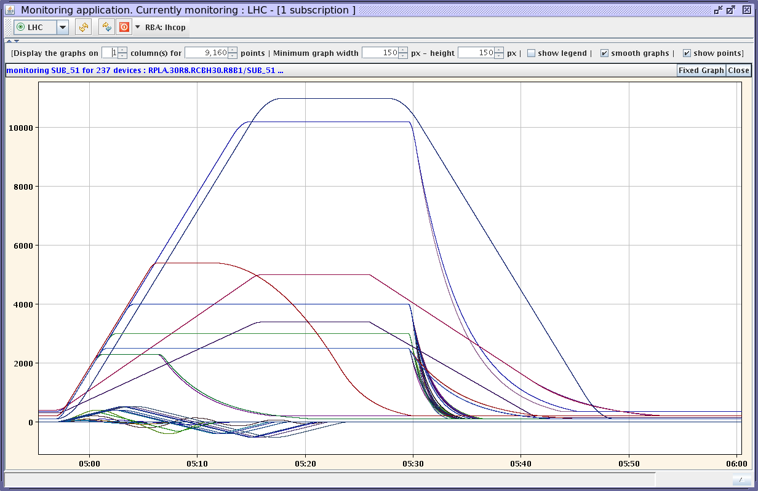
S81
Precycle performed on available circuits
Missing in A81
RQTL11.L1B1 – 0V crossing

Slide 18
Accesses
Thu. 17th March, 19h-21h: commissioning of the smoke detection of UXC55 (no personnel underground as the evacuation sirens will ring in all underground areas, LHC tunnel and CMS caverns)

