Slide 1
future irradiation facilities at CERN
Lucie Linssen PH/LCD - for the Irradiation Facilities WG
http://cern.ch/irradiation-facilities
Outline
Introduction on irradiation facilities
Present situation
User survey
  Future prospects
  Possible implementations
Summary

Slide 2
Irradiation facilities working group
Composition
CERN-wide working group:
R. Assmann – BE/ABP J. Bauche – TE/MSC M. Brugger – EN/STI M. Capeans – PH/DT F. Corsanego – DG/SCG I. Efthymiopoulos – EN/MEF | D. Kramer – EN/STI L. Linssen – PH/LCD (chair) R. Losito – EN/STI M. Moll – PH/DT C. Rembser – PH/ADE M. Silari – DG/SCR |  | Y. Thurel – TE/PO R. Trant – DG/SCH E. Tsesmelis – DG/DG H. Vincke – DG/SCR T. Wijnands – EN/STI
Mandate:
Collect requirements for future irradiation facilities at CERN, taking into account availability of facilities outside CERN
Put these requirements in the context of presently available facilities/infrastructures at CERN.
Propose cost-effective options for future facilities, aiming for a maximum of synergy.
Produce a (yellow) report on the findings

Slide 3
Introduction
Irradiation facilities – what for?
Setup and operate an irradiation facility – what it really involves?

Slide 4
Irradiation facilities
What for?
Test and development of prototypes or final assemblies before installation in a radiation environment
  issues addressed (not exhaustive)
    SEU, radiation damage, performance degradation of electronics
    beam impact or radiation damage on materials
    performance degradation after long exposure (ageing)
    performance evaluation under background/”noise” conditions
  passive or “hot” (i.e. online) irradiations
Test or calibration of components
  radiation measurement/monitoring devices
  feedback data to simulation codes

Slide 5
Setup and operate an irradiation facility
What it really involves?
Deliver the desired beam
  intensity, beam spot, time structure (slow or fast extraction)
  steering : beam and/or equipment (scanning table)
  monitoring of beam intensity and radiation field
    reference maps available to users
Know and control the radiation environment
  provide detailed Monte Carlo simulations in order to have well-defined spectra
  in-situ dosimetry providing information on the actual doses accumulated
  escaping radiation (by shielding) and internal activation (by design) must remain within limits
  for high intensities:
    closed ventilation loop, humidity control
    Impact on infrastructure – optimized maintenance procedures
Access conditions
  pre-test documentation, preparation and optimization: materials, time
  access authorization, training
  traceability : in/out movements, logs, RP control

Slide 6
Setup and operate an irradiation facility
… what it really involves?
Auxiliary installations
  nearby control room for “hot” tests during exposure
  remote handling of equipment and services
  storage area
    initial cool down just after exposure
    medium/long term storage in view of future re-use
  qualified lab to work on exposed materials
    modify for re-use, analysis after irradiation
  flexible detector infrastructure
    E.g. gas systems, cooling
Final product: make scientific results available to the community
    document and spread out the knowledge
    results database: materials, components, ..
  .. and radioactive waste
    must be considered from the beginning !

Slide 7
Present Irradiation Facilities
PS
  Proton irradiation facility in the East Area (since 1992)
SPS
  GIF - Gamma Irradiation Facility in the West Area (since 1997)
  CERF - CERN Reference Facility in the North Area (since 1992)
  (parasitic) irradiation of electronics in CNGS
… and ad-hoc tests – now decommissioned
  (parasitic) irradiation of electronics in the SPS/TCC2 target area
  material test (collimators, targets) in TT40 line
  (parasitic) irradiation of materials or “target units” in ISOLDE
Due to limited time for this talk, please see spare slides for summary on the current/past facilities with their assets and shortfalls

Slide 8
User survey
Survey results
  Requirements, future prospects,
  Possible implementations

Slide 9
User survey
Future needs for irradiation facilities
Web-based questionnaire launched to a very wide community
  Details in : http://cern.ch/irradiation-facilities
  145 replies
    extensive requests from LHC experiments and accelerator groups for present and in view of the upgrade program
Questions asked on:
  Beam type: gamma, proton, mixed field
    particle energy, spill-type, …
  Total dose, irradiation surface, exposure profile
  Dimensions of experimental area, infrastructure
  Access needs during exposure
Thorough analysis of the replies to understand the user requirements.
The WG investigated the possibilities to combine needs and minimize the proposed facilities. Diverse requirements make several facilities necessary.

Slide 10
User survey - conclusions
Identified needs
High-energy and high-density proton (ion) irradiations : 5 replies
    impact of intense pulsed beams to materials
    proposed facility : HiRadMat
    primary use : LHC collimators & absorbers
Gamma irradiations with beam : 37 replies
  study long-term exposure of equipment
  proposed facility : GIF → GIF++
  primary use : muon trackers of LHC experiments, detector or accelerator electronic components, beam diagnostic equipment

Slide 11
User survey - conclusions
Identified needs
High-intensity proton irradiation (slow, slow-fast extraction): 52 replies
  study long-term exposure of equipment
  primary use: inner trackers of LHC experiments, detector or accelerator electronic components, beam diagnostic equipment
  proposed facility: continue with PS East Area → future facility at PS2
Mixed field irradiations : 39 replies
  study impact on system components exposed in radiation fields
  primary use: LHC accelerator and detector components (SEE studies), radiation monitoring calibration
  proposed facility : CNGS, CERF → CERF++
Heavy ions: 12 replies
  the feedback does not indicate the need for a construction of an exclusive Heavy Ion Irradiation Facility. If the availability of ions can be added at low cost to the plans for one of the future CERN irradiation facilities, it should definitely be included.

Slide 12
The HiRadMat Facility
Key assets
Study the impact of intense pulsed beams on materials
  Thermal management (heating)
    material damage even below melting point
    material vaporization (extreme conditions)
  Radiation damage to materials – change of properties
  Thermal shock - beam induced pressure waves
Test bed, important for the design validation of LHC near-beam components before installation in the machine
Requires LHC-type beam from pilot to 288 nominal bunches

Slide 13
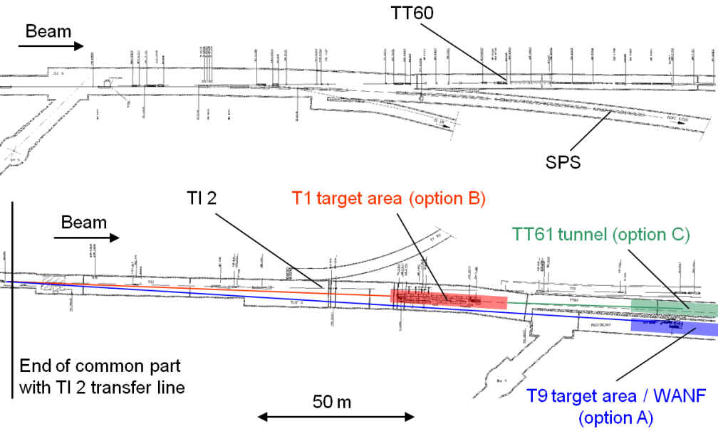
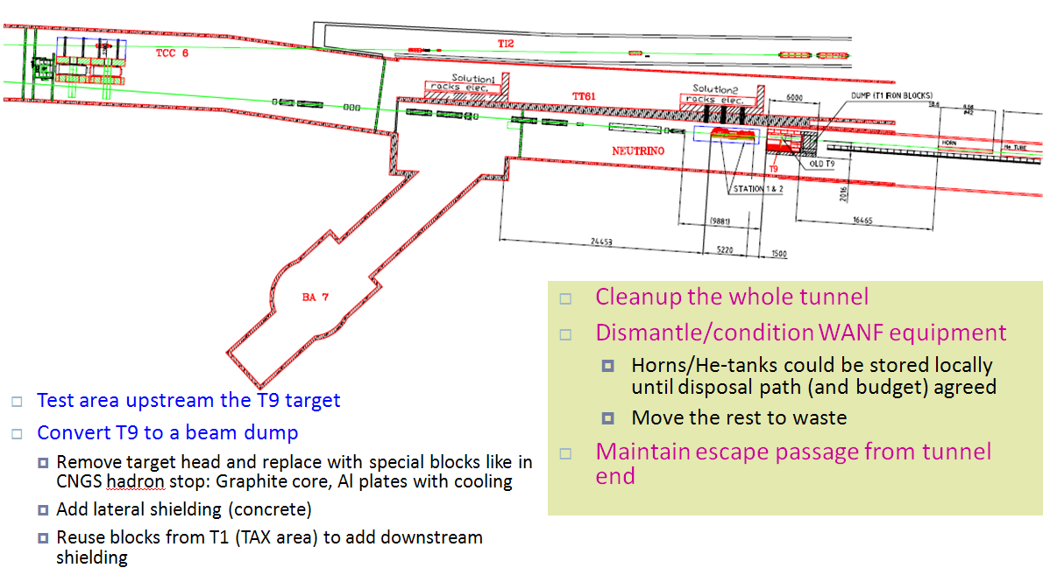
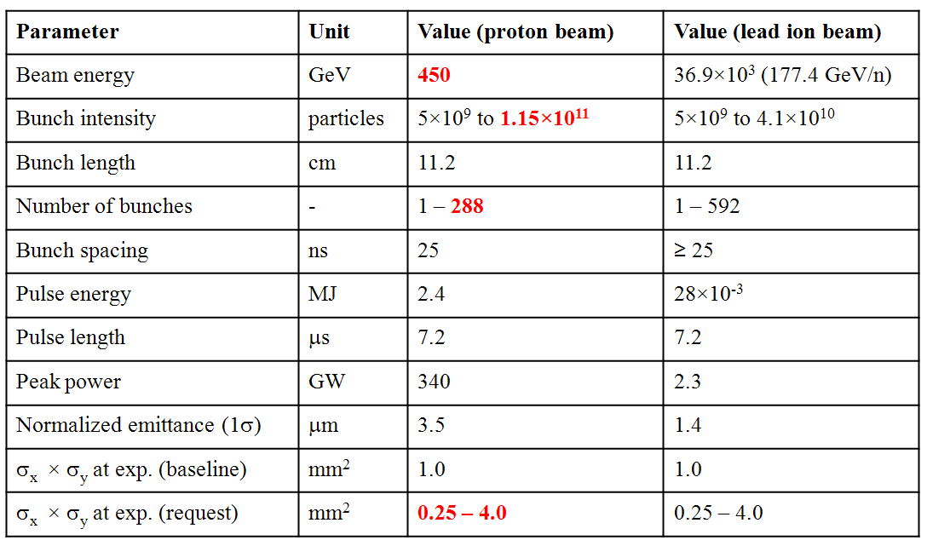
The HiRadMat Facility
Possible implementation in the TT60/WANF tunnel
modify the TI2 extraction line to deflect an LHC-type beam towards the old WANF area tunnel
max intensity: 1×10¹⁶ prot/year
  10 experiments, 1×10¹⁵ prot/exp
  foreseen start of operation: 2011
    to be adapted to the new LHC schedule and long 09/10 shutdown

Slide 14
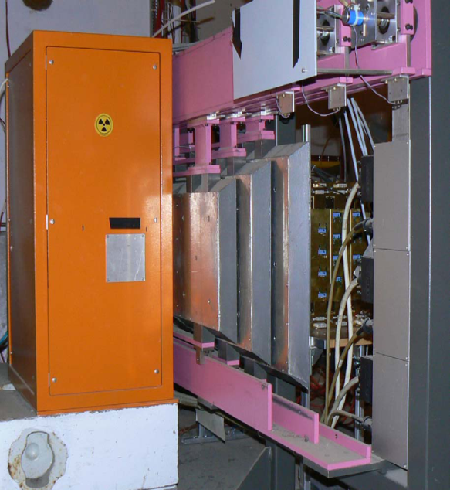
GIF++ facility
New GIF++ facility in the SPS North Area – H4 beam line
Source
  Cs¹³⁷ (662 keV) 10TBq (GIF in West-area: 740GBq)
  movable filters, as present source
    attenuation down to F=10⁵
  second irradiation facility (pointing upstream)
Secondary beam – H4 line
  muon beam
    100GeV/c, ~10⁴ μ/spill, 10x10cm²
  electron beam
Shielding
  Cs¹³⁷: 2 Gy/h at 50 cm for a 10 TBq source
  radiation limits for supervised area -> requires 1.6m concrete
Requested start of operation : 2010

Slide 15
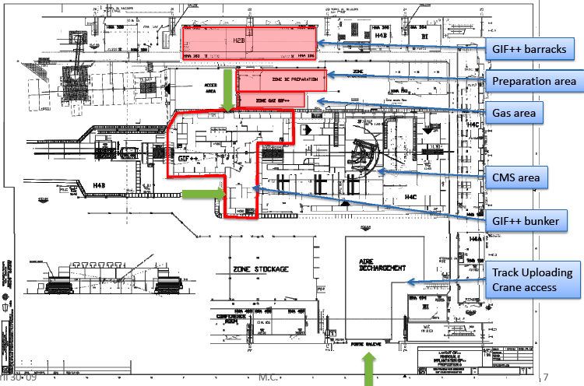
GIF++ facility
New GIF++ facility in the SPS North Area – H4 beam line
H4

Slide 16
Proton irradiation
Proposal
Maintain with minimal investment the PS East Area facility
  improved duty time to gain x2 in integrated rate (scheduling?)
  upgrade in the beam monitoring systems
  upgrade in the mobile trolley and cabling
Plan for a high-intensity proton irradiation facility coupled to the future PS2
  PS2 facility at 20 GeV is preferred
    20 GeV is already conveniently used at the PS
    allows placing several samples in the beam at the same time
  Flux: 1.1×10¹² protons/pulse (16.8 s interval)
  Fluence: 2x10¹⁶ p/cm² over ~5 cm² to be reached in two weeks
  Future PS2 proton and mixed field irradiations could co-exist

Slide 17
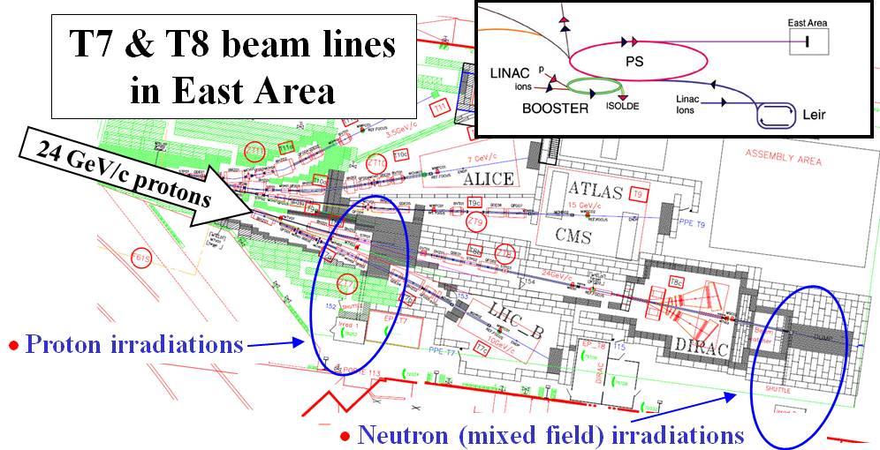
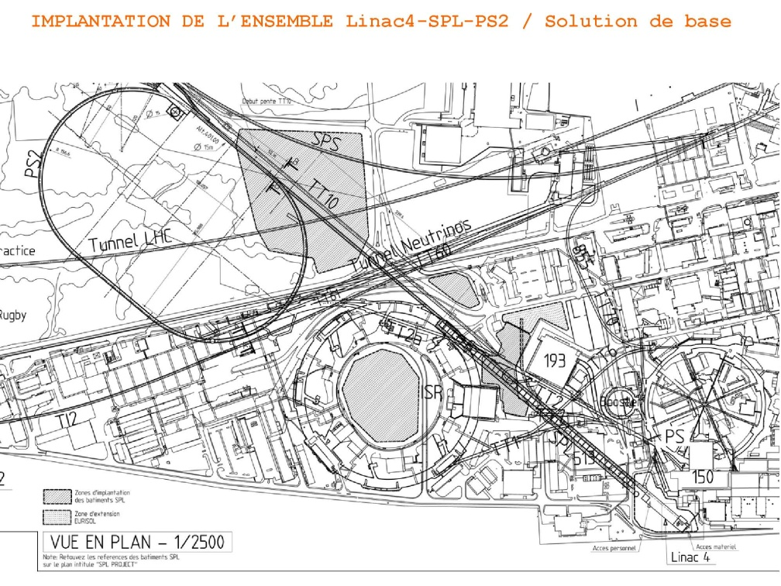
Proton irradiation
Current facility and proposed solution for the future
Current PS east hall facility
Requested future PS2 facility
20 GeV
>10¹² protons per spill

Slide 18
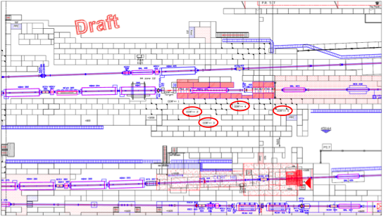
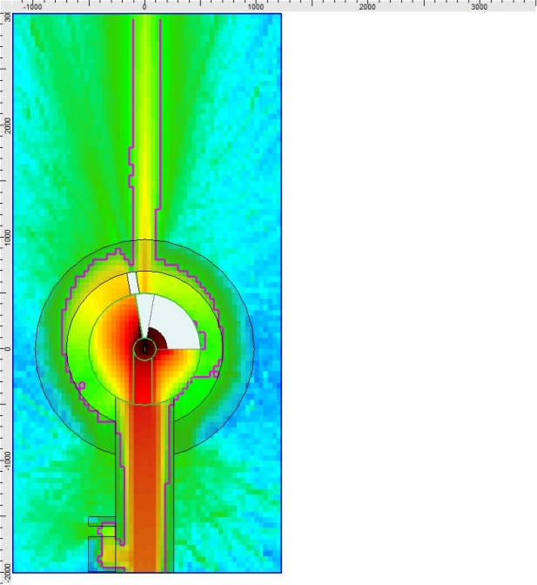
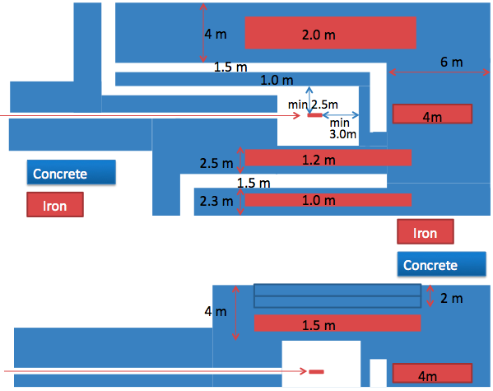
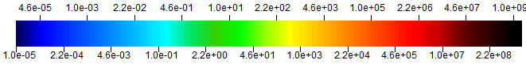
CERF++ mixed field irradiation facility
Possible CERF++ implementation in the H4 beam line
Transport an attenuated proton beam in the H4 beam line up to the entrance of EHN1 hall
  Feature last used for NA31 in 1986
Beam intensity : <1×10¹¹ p/spill
measurement locations around the thick target
FLUKA Simulation
10¹⁰ particles/spill @ 450 GeV/c
Contour = 15 μSv/h
Implementation studies for this facility are just starting
Eduard.Felbaumer@cern.ch
Requested start of operation : 2010

Slide 19
Summary of required facilities
The WG investigated the possibilities to combine needs and minimize the proposed facilities. Diverse requirements make several facilities necessary:
Proton and ion irradiations at high energy and high density (fast extraction)
  HiRadMat at WANF (implementation plans)
Gamma irradiations in the presence of a muon beam
  GIF++ at SPS north area H4 (implementation plans)
Proton irradiations at high intensity (slow extraction)
  Continuation of PS east hall facility with minor upgrading
  Future PS2 proton irradiation facility
Mixed field irradiations, slow extraction
  CERF++, SPS location currently under study

Slide 20
Summary
The WG was a good opportunity to bring together experts from various departments to promote collaboration and common solutions
A complete survey of the needs of the whole community for irradiation facilities was made. A summary report is under preparation
Short and long term needs identified, supporting the request for improved facilities in view of the current LHC (machine and detectors) and the upgrades
Next steps: advance from the feasibility studies to implementation and technical designs for all 4 facilities
Survey shows that facilities (GIF++, CERF++, HiRadMat) are needed “as soon as possible” (by 2010/2011)

Slide 21
Spare slides

Slide 22
Present Irradiation Facilities
PS
  Proton irradiation facility in the East Area
SPS
  GIF - Gamma Irradiation Facility in the West Area
  CERF - CERN Reference Facility in the North Area
  (parasitic) irradiation of electronics in CNGS
… and ad-hoc tests – now decommissioned
  (parasitic) irradiation of electronics in the SPS/TCC2 target area
  material test (collimators, targets) in TT40 line
  (parasitic) irradiation of materials or “target units” in ISOLDE
Summary of current/past facilities with their assets and shortfalls

Slide 23
Proton irradiation in the PS East Area
Layout

Slide 24
Proton irradiation in the PS East Area
Characteristics
Protons and mixed field irradiations
Intensities
  max 10¹¹ protons/extraction (slow or fast-slow extraction)
  up to 10¹⁴ protons/(cm²hr) on a 2×2 cm² surface
  up to 10¹² neutrons/(cm²hr) on a 30×30 cm² surface (1 MeV equiv.)
In operation since 1992
  up to 1500 irradiated samples per year
  mainly used by detector communities: trackers, electronics
Drawback:☹
  parasitic operation to DIRAC, access via primary beam area, personnel exposure, limited space, limited rate

Slide 25
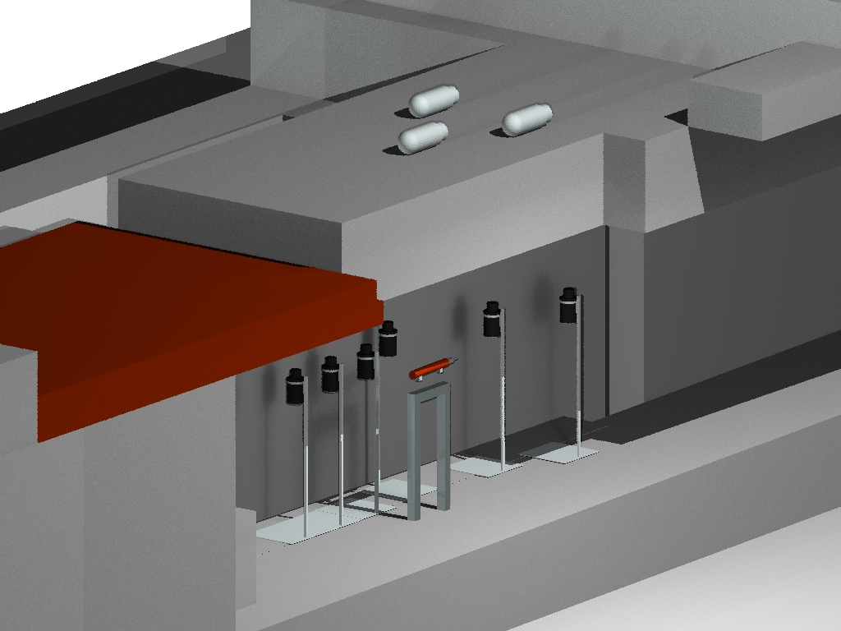
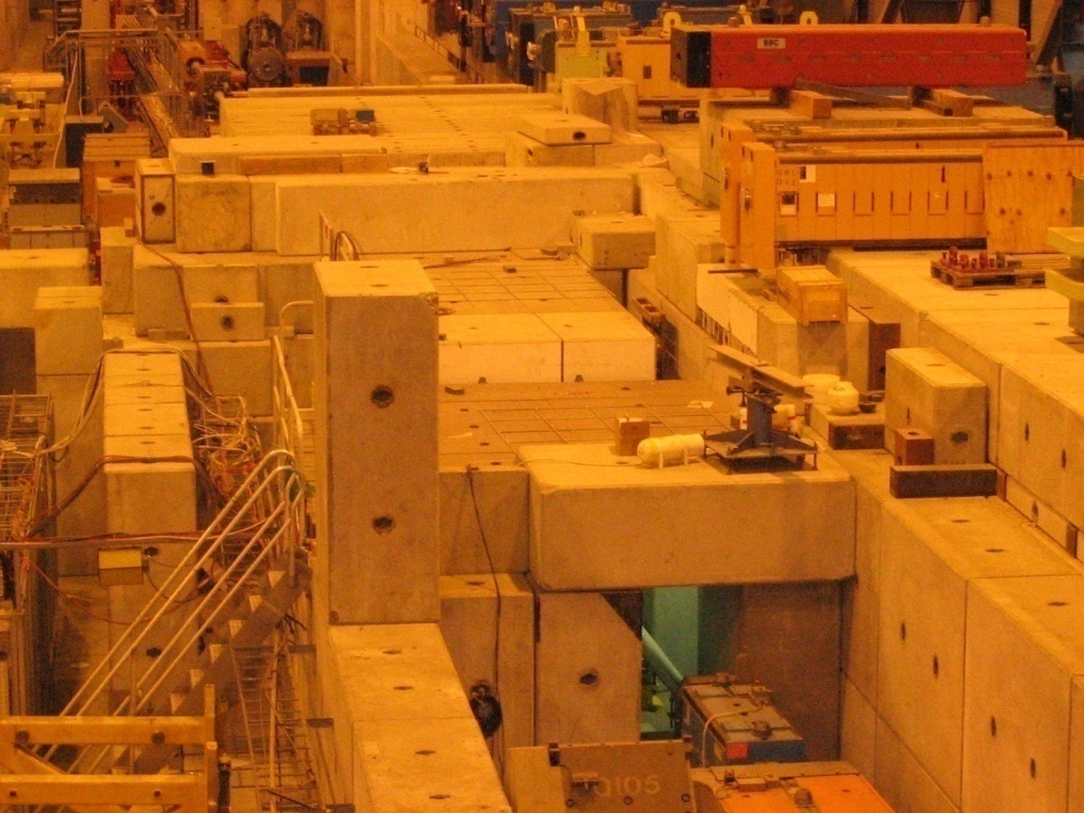
CERN Reference Facility – SPS NA
H6 beam in the SPS North Area EHN1 experimental hall
reference locations
Detectors
Concrete shielding
Hadron beam
Copper target
H6 beam
1 m

Slide 26
CERN Reference Facility – SPS NA
Characteristics
SPS H6 secondary beam, 120 GeV/c hadrons
  56% protons, 39% pions + 5% Kaons
  well defined and simulated mixed radiation fields
Intensities
  max 10⁸ protons/pulse (5s) (slow extraction)
In operation since 1992, 1-2 weeks/year
  mainly used for test/calibration of passive and active detectors for dosimetry or radiation monitoring
  ~20 teams/week, internal and external users
  FLUKA benchmarking, beam loss monitor studies
Drawback: ☹
  limited dose rates, muon background from TCC2 (reduced since 2006)

Slide 27

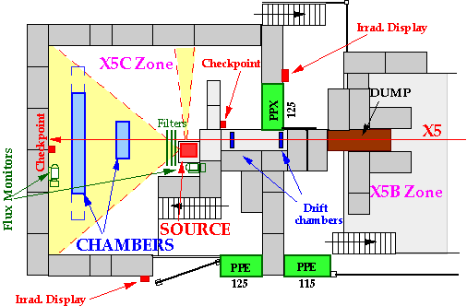
Gamma Irradiation Facility – West Area
Area layout
The Cs¹³⁷ source container
The external screens and collimators

Slide 28
Gamma Irradiation Facility – West Area
Characteristics
740 GBq Cs¹³⁷ source, irradiation over large surfaces
Combined with (muon) beam from X5 line
In operation since 1997
  all year (source), some weeks (beam)
  mainly used for tests of muon detectors for LHC experiments
    ageing tests, performance under “background” conditions (photons from the source)
Drawback: ☹
  more intensity would be desirable (accelerated ageing) , combined with higher muon beam energy
  space issue in bat.190 → space needed for LHC magnet lab

Slide 29
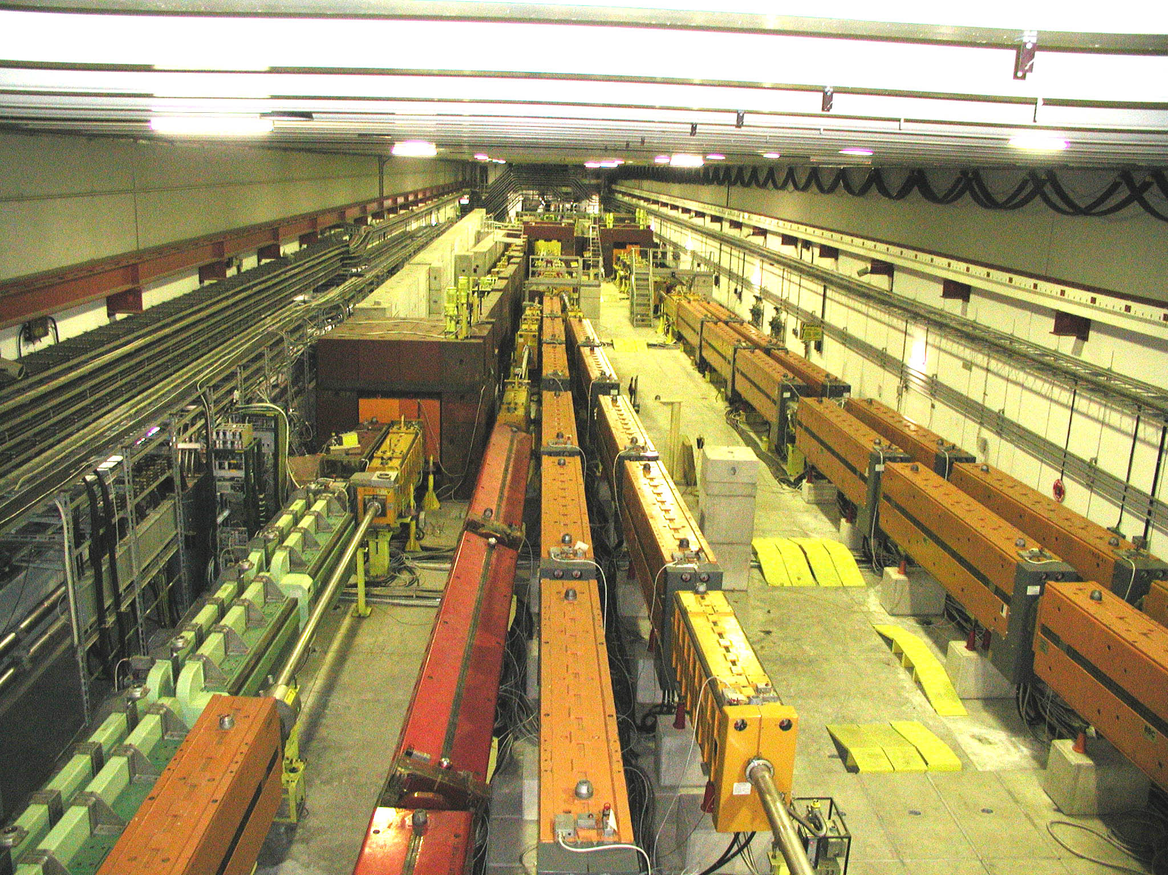
Irradiation of electronics – SPS/TCC2
Parasitic mixed field irradiations – layout
Mixed field irradiation, high doses within reasonable time
Clients: LHC accelerator groups, testing components and electronics
  up to 25 experiments/year
  sufficient space to test complete systems
Drawback: ☹
  Parasitic ad-hoc test
    no reproducible radiation conditions
    high residual dose rate in the area (access, safety)
T6 target

Slide 30
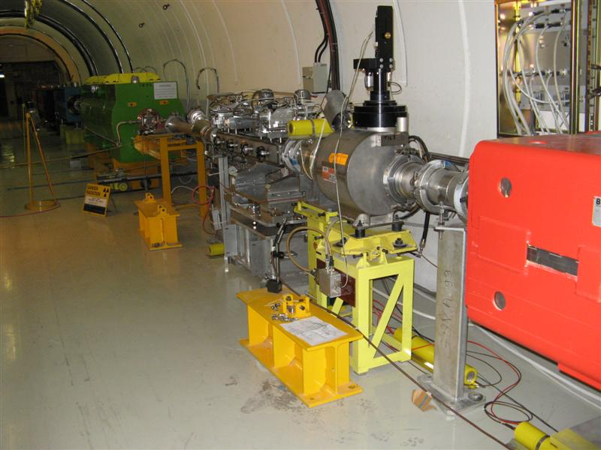
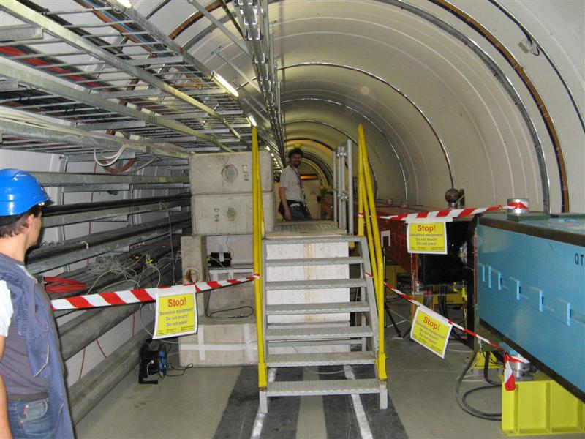
Pulsed proton irradiation – TT40 line
Intense proton beam irradiation - layout
Used for LHC collimator studies and material tests in 2004 and 2006
Short pulses at 450 GeV/c
  up to 3.3×10¹³ppp (approx. 2 MJ)
Drawback: ☹
  limited space
  interference with CNGS operation and LHC fill
  area not ideal in terms RP aspects
    production of radioactivity close to beam line elements
    access conditions
Collimator under test

Slide 31
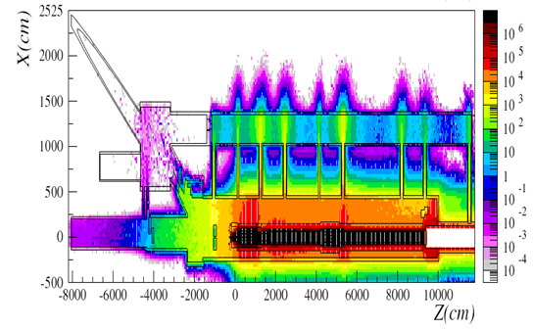
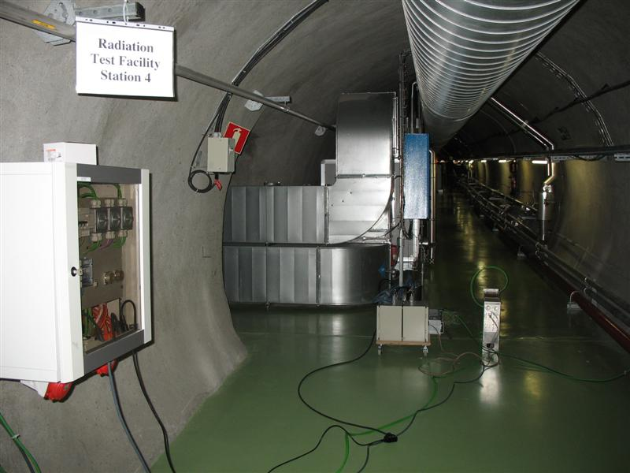
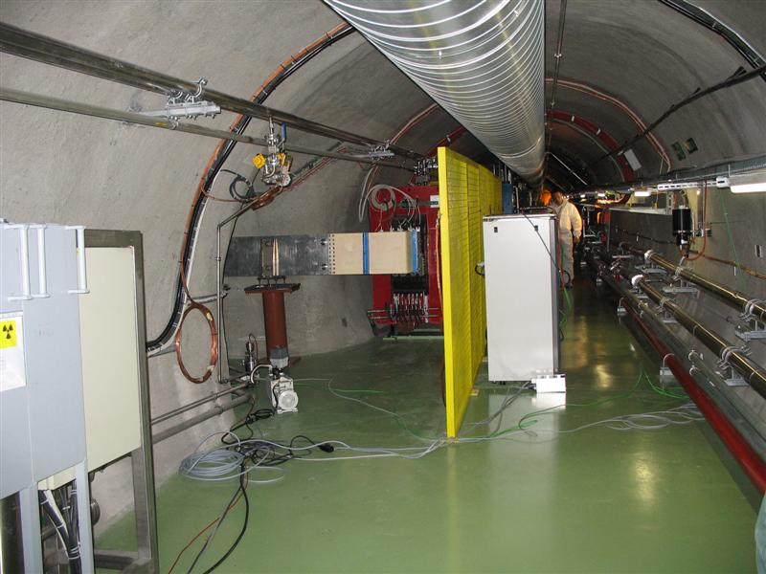
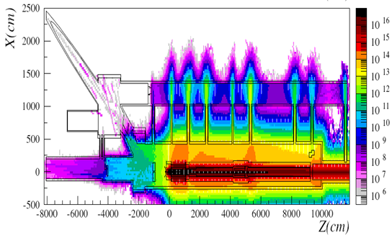
CNRAD electronics irradiation - CNGS
Parasitic mixed field irradiations CNGS service gallery - layout
Total dose (Gy/y) – FLUKA sim.
High energy (>10MeV) neutron flux – FLUKA sim.
Test stations in the service gallery

Slide 32
CNRAD electronics irradiation - CNGS
Characteristics
Exposure to mixed high-energy radiation fields, well-known field thanks to extensive FLUKA simulations
Mainly focused for SEE on installed LHC electronics
  four stations fully equipped for remote control and readout of components
  possible to test complete systems (crates)
Dose rates :
  CNGS : 1 to 150 Gy per week
  LHC ARC-DS : 1 to 200 Gy per year
Drawback: ☹
  Parasitic to CNGS, access conditions, long access tunnel, safety

