Slide 1



Performance of the Liquid Xenon Detector for the MEG experiment
Yasuhiro NISHIMURA
Hiroaki NATORI
The University of Tokyo
MEG collaboration
Outline
μ → e γ and MEG experiment
Design of detector
Calibration
Performance in run 2008
The 12th Vienna Conference
on Instrumentation
19/Feb./2010

Slide 2
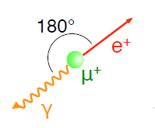
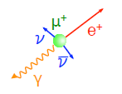
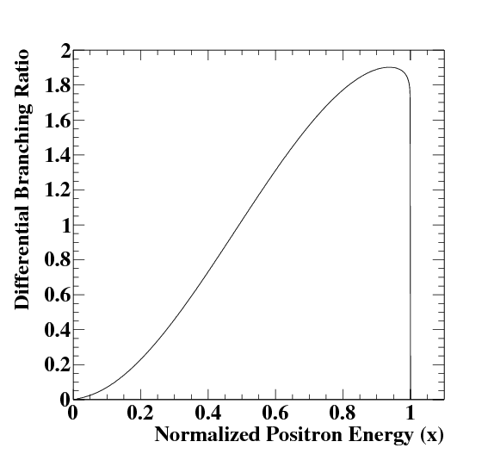
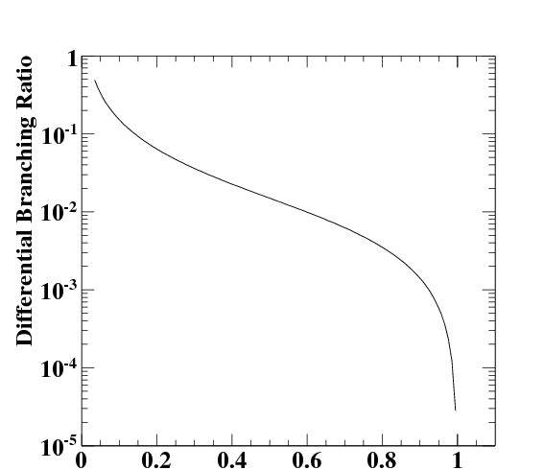
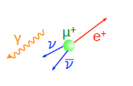

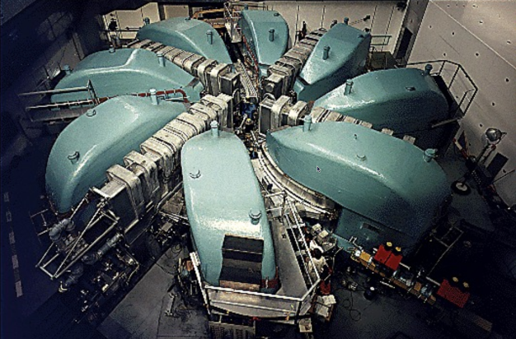
Search for μ → e γ
μ → e γ is a clear 2 body decay
Br(μ→eγ) < 1.2×10⁻¹¹ (90%C.L.)
given by MEGA experiment
Charged lepton-flavor mixing is not observed yet.
Many extensions of standard model predict μ → e γ
  SU(5) or SO(10) models in SUSY-GUT, etc.
Backgrounds
μ → eννγ
<<
Accidental background
is dominant
Background energy [mμ/2] of e⁺ and γ
e⁺ from μ → eνν
γ from μ → eννγ
Br_{(accidental)} = R_{μ}・f_{e}⁰・f_{γ}⁰・(δωeγ/4π)・(2δteγ)
The innovation in MEG experiment for μ → e γ discovery
  Excellent performance of a liquid xenon (LXe) γ–ray detector
  World's most intense ~10⁸/sec DC μ beam
  at Paul Scherrer Institut (PSI) in Switzerland
    3 ×10⁷ μ⁺ / sec stop in target
  Positron spectrometer operational at high rate
Proton ring-cyclotron
Aim at 10⁻¹³ branching ratio in MEG experiment
590MeV, 2.2mA max.

Slide 3
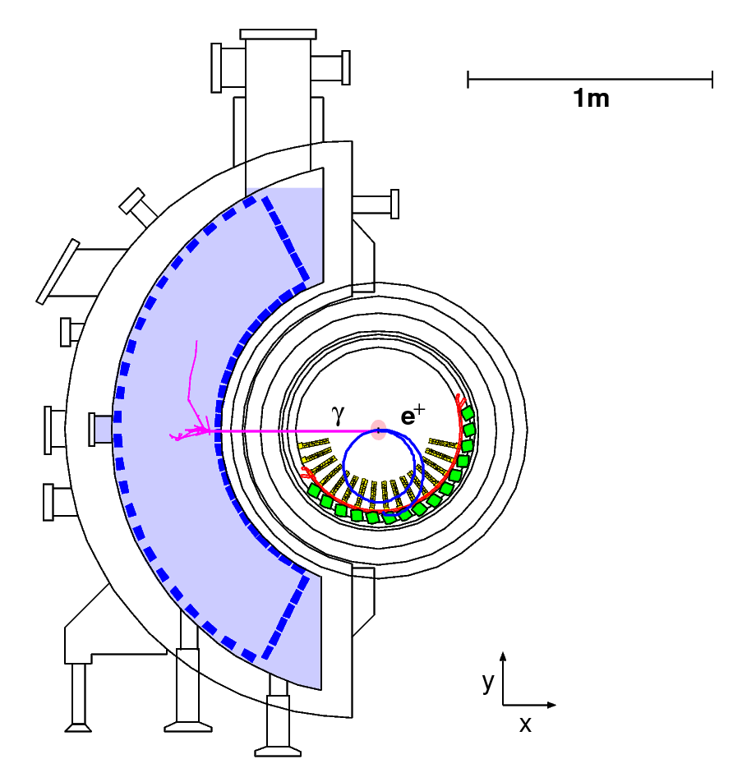
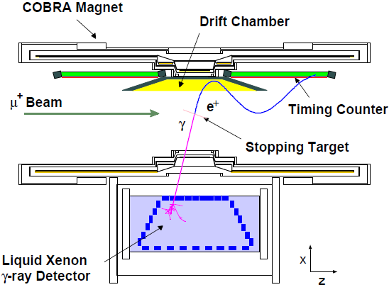
MEG Detector
γ-ray detector
  900 liters LXe scintillator for the γ ray detector
Positron detector
  COBRA (COnstant-Bending Radius) magnet
    B=1.27T, 20% X0
  Drift chamber
  Timing counter

Slide 4
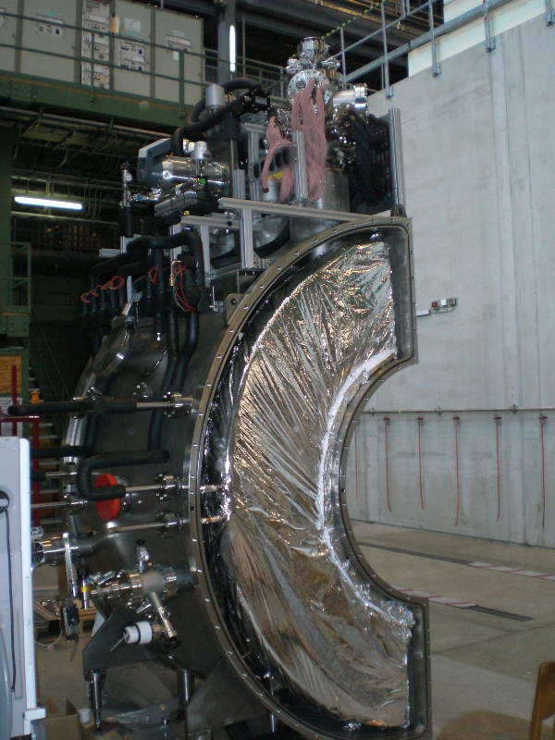
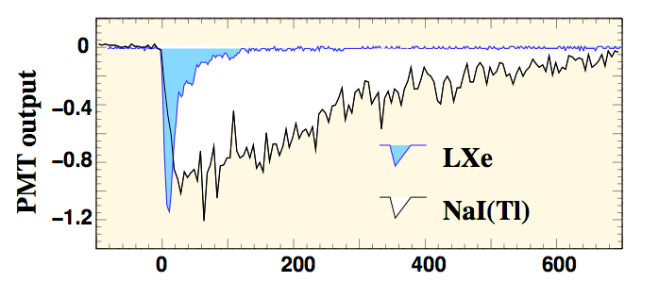
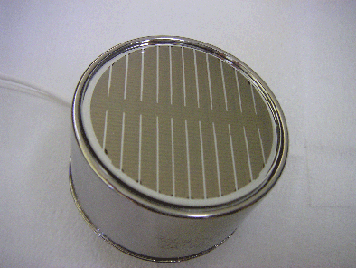
Liquid xenon detector
Merits of liquid xenon
  High stopping power 2.98g/cm³ , X0 = 2.8cm
  No self-absorption of scintillation light
  High light yield (75% of NaI(Tl))
  Fast scintillation process
    4.2, 22, 45ns components
Difficulties
  Short wave length λ~178nm (VUV)
  Low temperature within 161~165K
  Scintillation light absorbed by O2, H2O, etc.
  LXe is expensive
Pulse tube
refrigerator
Signal
Feedthru.
HV
Feedthru.
Developed
photomultiplier
tube (PMT)
[ns]
HAMAMATSU
Inner
cryostat
Design
  900 liters (800 liters active volume)
  11% solid angle, 14X0
  846PMTs of 2'' size on 6 faces
  Waveform taken for all channel
Vacuum
vessel
to purifier

Slide 5
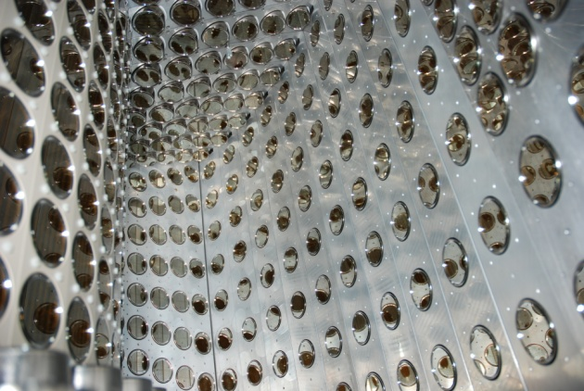
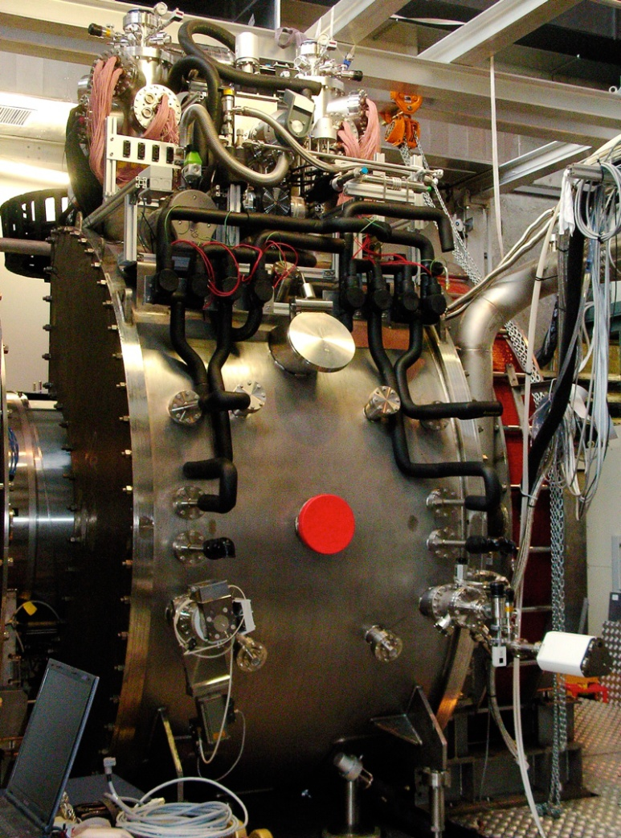
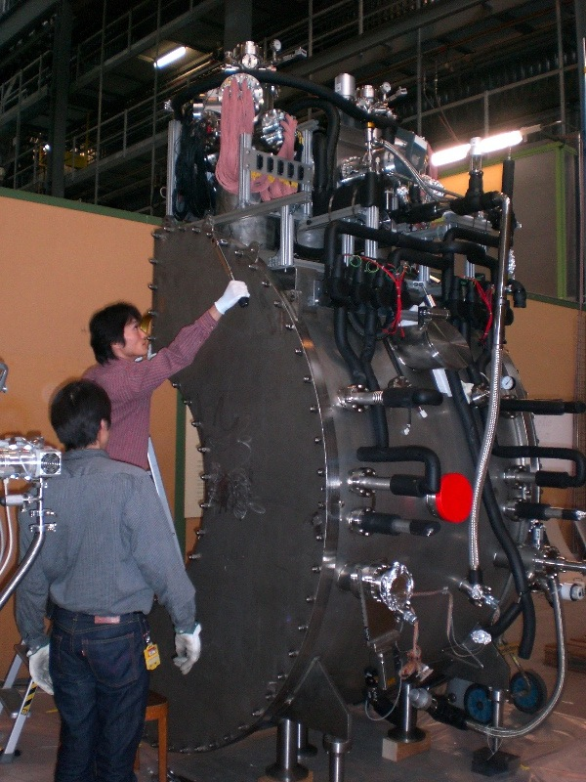
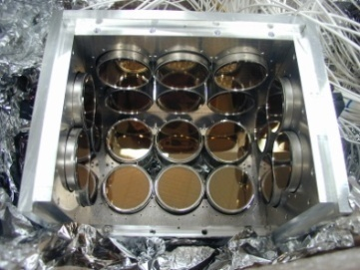
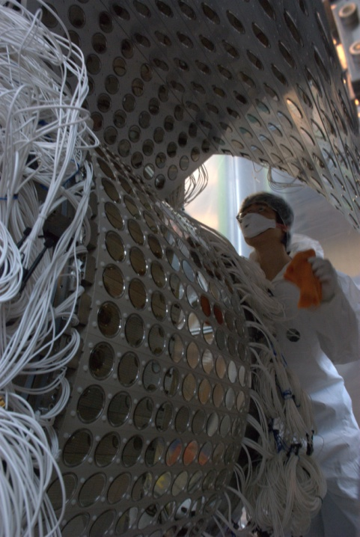
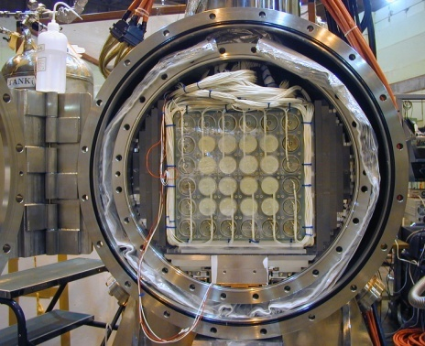
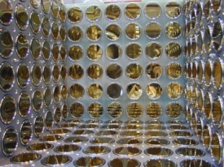
Development of liquid xenon detectors
Small prototype
  2.3liters active volume
  32PMTs
  1998 -
LXe detector
  active 800 liters / Total 900 liters volume (3t), 846PMTs
Large prototype
  68.6liters active volume
  228PMTs
  2000 -
  Ready at the end of 2007
  Operated in 2008 for MEG run

Slide 6
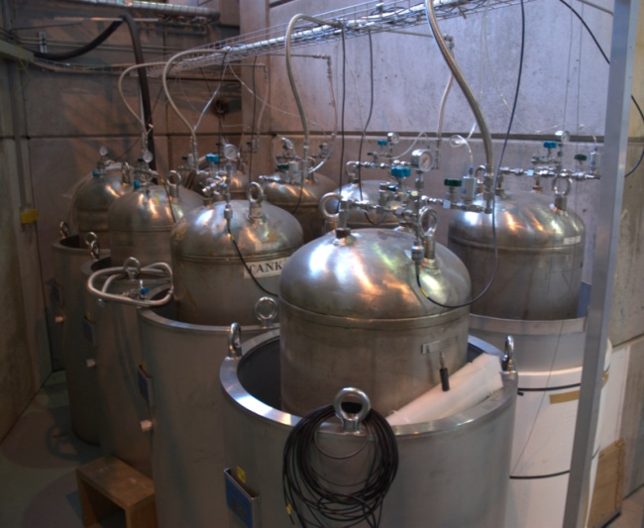
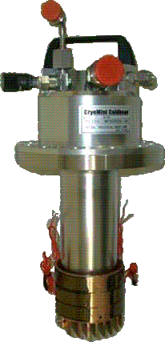
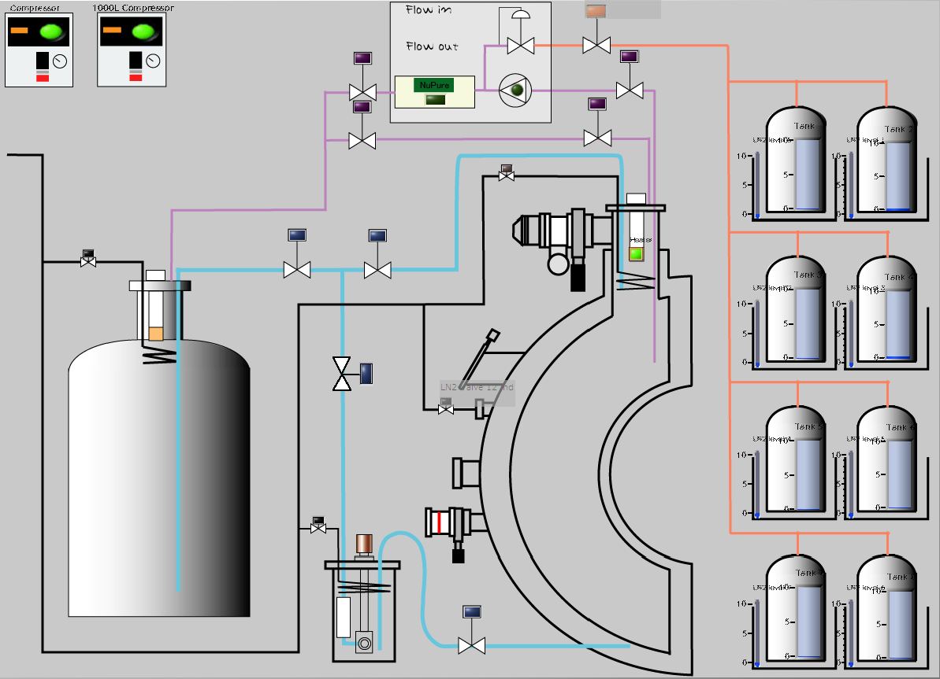
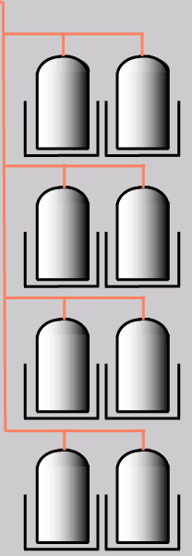
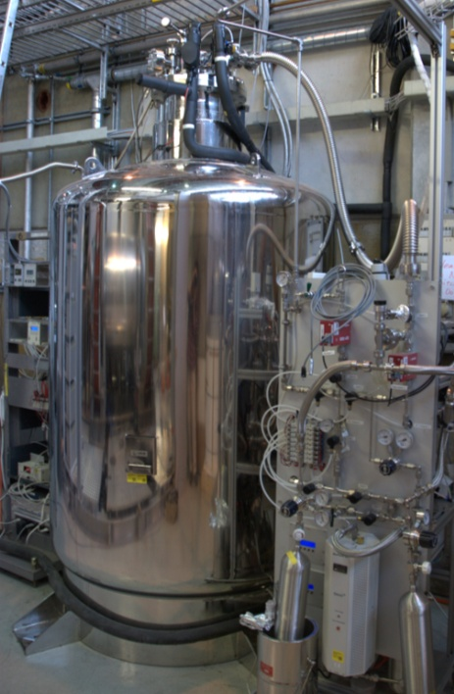
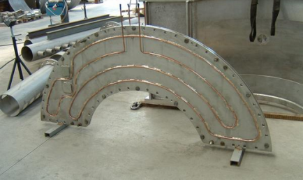
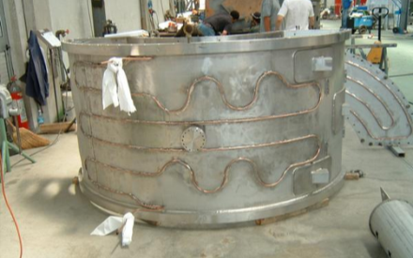
Cryogenic System
gas
Storage
  Gas and liquid
Cooling
  Pulse-tube refrigerator and LN2
pulse-tube
refrigerator
developed for MEG
8 × 250L gas
storage tank
liquid
Cooling pipe
with liquid nitrogen
LN2
900L
LXe detector
1000L liquid
storage tank

Slide 7
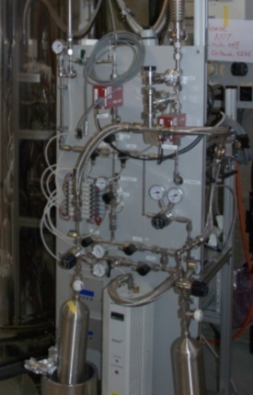
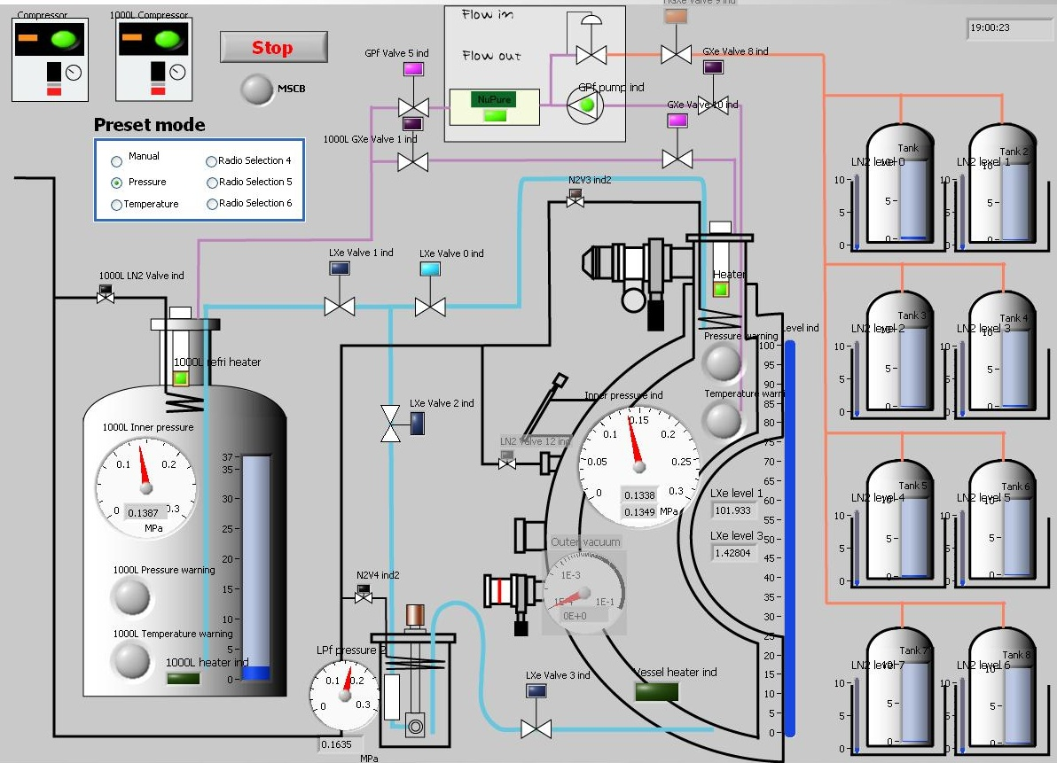
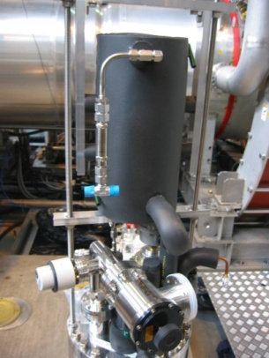
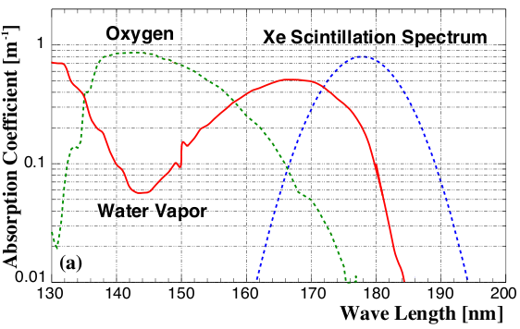
Purification system
Gaseous purification
  A getter removes H2O,O2,CO,CO2,H2,N2 and hydro carbon molecules. (10 to 50 l/min)
Liquid purification
  By a molecular sieves and O2 getter, water and O2 are removed. (100l/h)
Gas phase
Water and oxygen absorb
scintillation light
Liquid
phase
900L
LXe detector

Slide 8
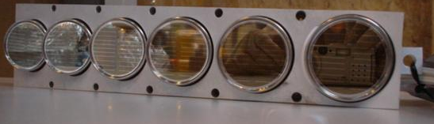
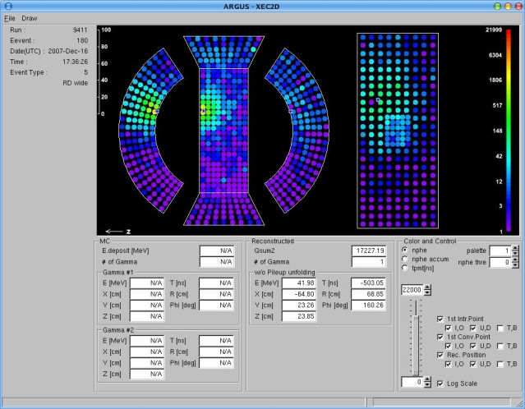
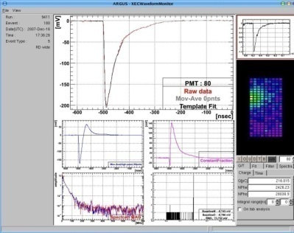
Calibration and Monitor in 2008
Run 2008
Calibration of PMT
  Gain
  Quantum efficiency
Monitor
  Set up
  Light yield and purification

Slide 9
Run 2008
Engineering run in 2007
2008
  - Mar. Maintenance
  Jun. Installation
  Jul. Purification and Monitor of the light yield
  Aug. π⁰ run for the calibration of LXe detector
  Sep. Trigger setup and started physics run
  Oct. Taking physics data, purification again
  Nov.
  Dec. π⁰ run again at the end of Dec.
purification
π⁰ run
physics run
LXe detector successfully operated in 3-month physics run !

Slide 10
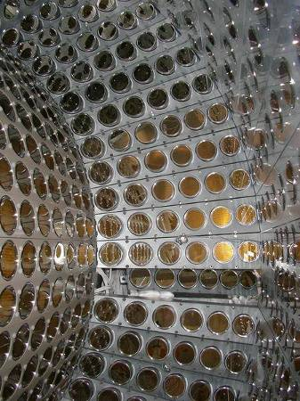
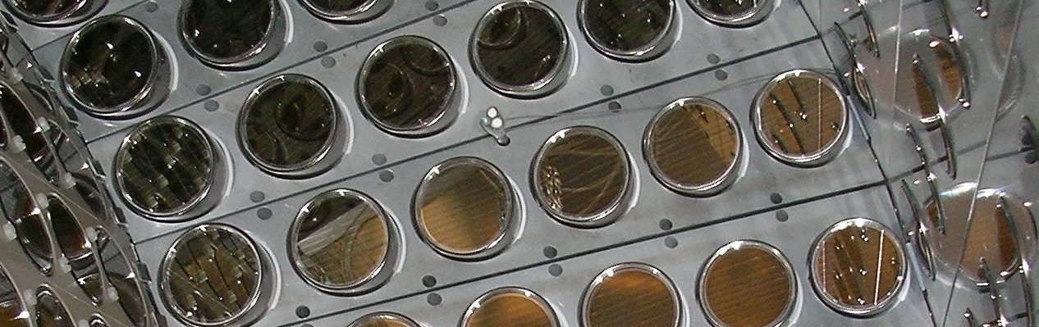
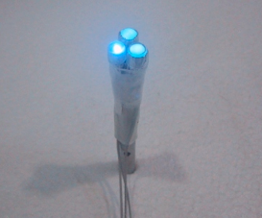
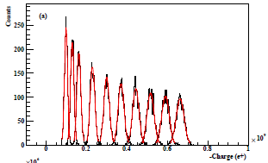
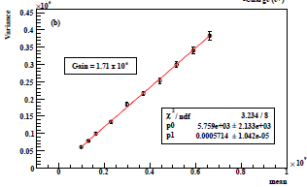
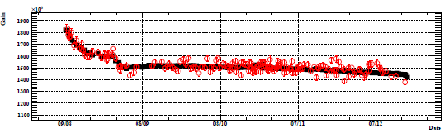
PMT gain calibration with LEDs
LEDs at 5 positions on both sides
  3 different intensities by attenuation
Calculate absolute gain by mean-variance relation
  9 steps of different intensity by changing current
  σ² = Gain × Mean × e/C(const.) + const.
Gain monitor with stable LED
Slope = gain
Absolute gain
LED peak
σ ²
1 month
Charge
Charge
Date
1/2hour calibration everyday and LED flushing in physics run for the monitor

Slide 11
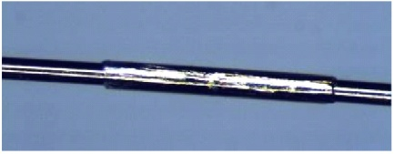
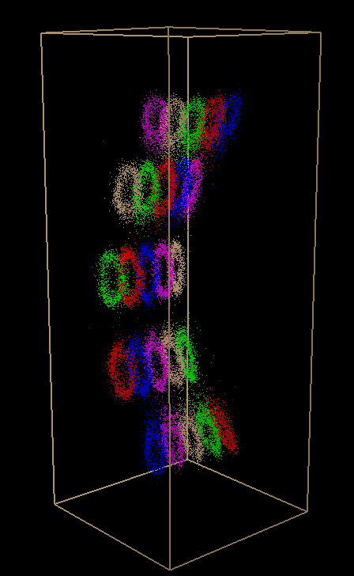
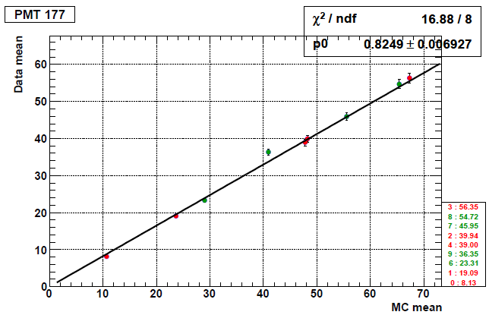
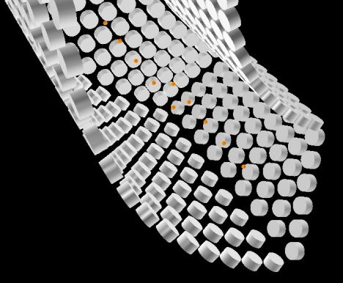
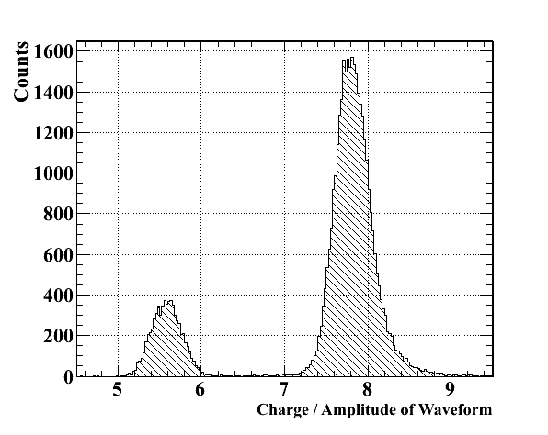
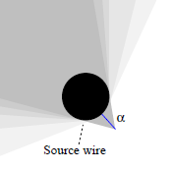
Q.E. calibration with ²⁴¹Am α source
For the estimation of quantum efficiency (Q.E.) of PMT
5.5MeV α from ²⁴¹Am source (200Bq, 432years)
  25 sources, 5 on a wire, immersed in liquid xenon
  Q.E. derived from the comparison between observed charge and expectation in Monte Carlo simulation
reconstructed α events
Data - MC
100μm diameter, 2mm length
²⁴¹Am
Q.E.
Separate signal of α
from γ by the shape of waveform
α γ
100μm
~40μm
Shadow of wire makes ring by reconstruction
Charge / height of waveform

Slide 12
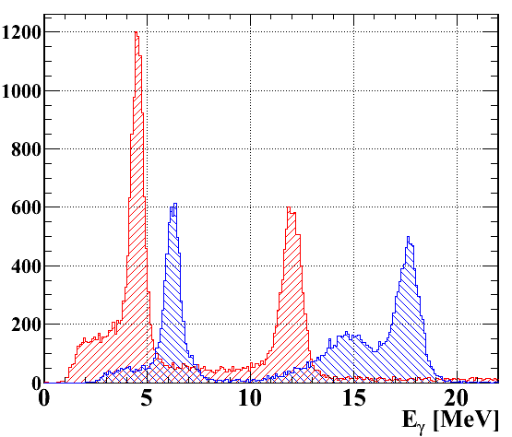
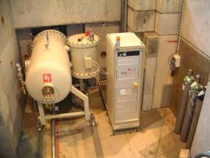
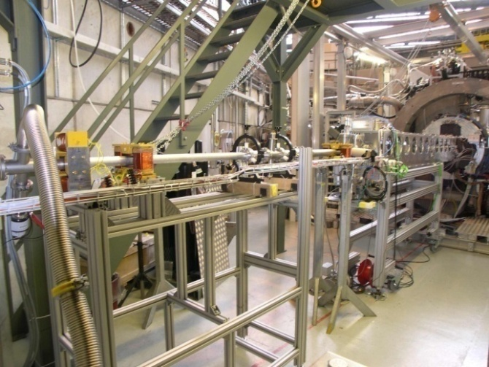
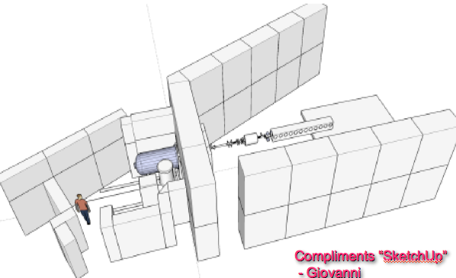
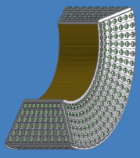
Cockcroft-Walton accelerator
For the light-yield monitor
and to know the uniformity of γ energy
B
Energy of γ - ray
in LXe detector
Accelerator and power module
Beam line at opposite of μ
F
B
Li
LXe detector
muon
proton
1MeV Cockcroft-Walton accelerator
  Provide proton beam ~10¹² / sec
  Li(p, γ)Be 14.6, 17.6MeV
  B(p, γ)C 4.4, 11.7, 16.1MeV
  Proton target quickly switched from μ target ~20min.
  3 times / week
Cosmic ray and AmBe source are also useful for the monitor
beam line

Slide 13
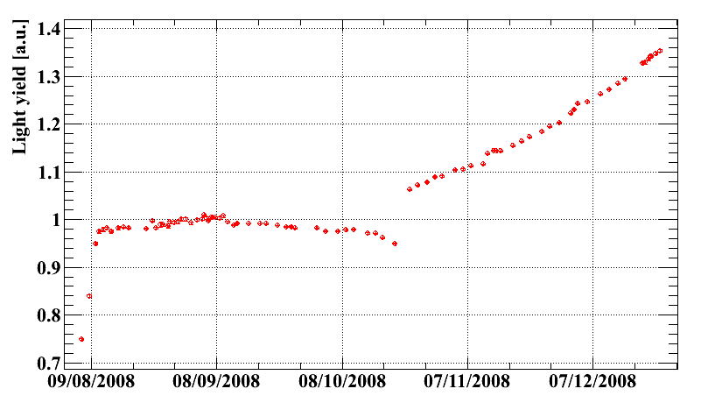


Light yield in 2008
The light yield improved by purification
  Monitor by Li 17.6MeV, 54.9MeV γ from π⁰ decay, cosmic ray
π⁻ beam
Physics data
π⁻
Gas phase purification
+ Liquid phase purification
α−γ separation
This increase of the light yield gives
  Shape of waveform changing
  Better α−γ separation by waveform
α γ
Start / End of run 2008
Waveform
In 2009 the light yield completely recovered and stabilized.

Slide 14

Performance of γ ray measurement
Reconstruction of γ ray
Set up for π⁰ run
Evaluate the performance around 53MeV signal γ-ray
  Energy
  Timing
  Position
  Detection efficiency
Measurement of μ decay

Slide 15





Reconstruction in 2008
Energy
  Detected photons
  = Σ (weight×charge / Q.E. / Gain)PMT
  Correct the change of light yield and non-uniformity, eliminate pile-up photons
Timing
  Time of each PMT subtracted with
    Propagation in LXe
    Time-walk effect
    Effect of PMT face by incident angle
    Offset of channel
  Average time weighted with the number of photoelectrons of each PMT
Position
  Light distribution of PMTs
  Use PMTs around conversion point to avoid effect of shower and pileup
  3d-position fitted with solid angle of each PMT
LXe detector
LXe inner
surface
Deep event
(10cm)‏
Shallow event
(1cm)‏
LXe detector can reconstruct all property of γ !

Slide 16



π⁰ run for γ-ray around signal energy
Concept
  Acquire performance of energy, timing and position around signal energy (53MeV)
  Obtain monochromatic γ (55 or 83MeV) by tagging another γ from π⁰ → 2 γ at opposite side
  Determine energy scale near the signal γ-ray
LXe energy [GeV]
n
p
~60%
π0
(98.8%)
π⁻
γ
γ
54.9 ~ 83.0MeV
θ
opening angle
Set up
~40%
8.9MeV + 129.4MeV
NaI energy [MeV]
Select
back-to-back events
LXe energy [MeV]
In 2008, π⁰ run in Aug. for 1 month
and short π⁰ run in Dec.

Slide 17






Detectors to tag γ from π⁰
Energy : 3×3 NaI(Tl) crystals with 9 Avalanche photodiodes (APDs)
  Control APD temperature by a peltier device and Pt100
  APD enables constant gain wherever in the magnetic field
Timing : Pre-shower counter in front of NaI
  2 plastic scintillators with 4PMTs and lead converter
Thermal control (18 ℃, ΔT< 0.1 ℃)
Plastic scintillators and NaI detector
Radiator
APD, amp.
NaI
heat
62.5 x 62.5 x 305 mm (12X0)
x 9 bars
Peltier dev. LED
APD and amplifier
NaI
APDs
60 x 60
x 7mm
Magnet
APD 1cm x 1cm, HAMAMATSU
Light guide
How to measure whole acceptance of LXe detector?

Slide 18






Set up for π⁰ run
Mover system to scan whole acceptance of LXe
Liquid hydrogen target inserted from down stream
L = 75mm
φ = 50mm
Δ < 6.5º
60o
120o
π⁻ (1MHz)
μ⁺
target
60o
LXe
detector
Use the same beam line as μ⁺ beam

Slide 19



Energy resolution
55MeV energy peaks at each position
Lower tail of energy spectrum from :
  Escape of shower in a shallow event
  Interaction with material before reaching LXe
Fit with (Exponential + Gaussian
+ Difference of pedestal between π⁻ and μ⁺)
  Deeper events than 2cm, in acceptance
  2.0±0.15% σ of upper tail, important to identify the signal
  5.8±0.35% FWHM
Map of σ (upper tail) on LXe inner surface
55MeV γ-ray
0 1 2 3 4 5
σ [%] of upper tail

Slide 20

Linearity and energy scale
Good linearity
  Within 0.5%
    B (4.4MeV, 12.0MeV), Li (17.6MeV),
    π⁰ decay (54.9MeV, 83.0MeV)
  Include the uncertainty of
  the light-yield correction
Energy scale
  Determined at only 55MeV
  Uncertainty < 0.4%
    Due to the correction of light yield, gain, etc.
π⁰→2γ
Li
B

Slide 21



Timing
Use pre-shower counter as a reference
Difference of LXe – pre-shower counter
135ps σ at 55MeV
127ps σ at 83MeV
LXe detector
Pre-shower counter
(2 plastic scintillator )
γ
γ
However…
  Time difference of 2 detectors contains
  Spread of π⁰ decay point in target : 58 ps σ
  Resolution of reference counter : 93 ps σ
    Time difference of 2PMTs attached with the same scintillator
Timing resolution
78 ps σ = 135 Ө 58 Ө 93 ps at 55MeV
  Better resolution (68ps σ) at the end of run 2008
  due to the light-yield recovery
80±6 ps σ at signal energy (53MeV)
after correction of energy dependence

Slide 22





Position
Use Monte Carlo simulation for whole acceptance
Partially confirmed by π⁰ run with lead collimators in front of LXe
  18mm thickness with 10mm slits
  55~83MeV in π⁰ decay
Projection on surface
lead slit
lower – upper [cm]
along beam axis [cm]
5mm σ along the LXe surface
  Fit with 2 error-functions + 3 gaussians + floor
  6.8mm σ average
  Beam spread of ~8mm σ in target
  → ~2mm σ on detector surface
  Projection of slit ~ 14mm
6mm σ along radial direction
from Monte Carlo simulation
simulation
data
[cm]
lower – upper [cm]

Slide 23



Detection efficiency
3 methods to estimate the detection efficiency
Monte Carlo simulation of signal γ ray
Count γ from radiative μ decay
π⁰ → 2γ tagged with NaI opposite to liquid xenon detector
  Count γ around 55MeV tagged with around higher 83MeV at tagging NaI detector
  Subtract neutron background which comes from tail of 129MeV(π ⁻ → n γ) in NaI
neutron
Monte Carlo simulation of π⁰
?
83MeV γ
55MeV γ
All consistent within a few percent
Efficiency estimated by Monte Carlo simulation
  Including analysis efficiency (pile up, cosmic ray, etc.)
  Eγ > 46MeV
Detection efficiency : 63±4%

Slide 24


γ measurement in physics run 2008
γ ray from μ⁺ decay
pile up
γ background in μ decay
Time difference between e⁺ and γ
(μ → eννγ)
Successfully operated during physics run !

Slide 25
Conclusions
Successful construction of the 900L liquid xenon detector
First evaluation of the performance around signal γ
  Energy 2.0% σ, 5.8% FWHM
    Studying discrimination of pile-up and reconstruction, etc.
  Timing 78ps σ
    Almost enough for our requirement
  Position 5mm σ on surface, 6mm σ along depth
    Better estimation of Q.E. and gain is the candidate for the improvement
Took first physics data for 3 months in 2008
with stable operation and proper calibration !
MEG experiment will run for next few years
to reach 10⁻¹³ branching ratio sensitivity.

Slide 26






Our MEG collaborators

Slide 27

End of slides
2008 data
in analysis box

Slide 28
Back up slides

Slide 29


Light yield in 2009
Preliminary look at 2009 data
  Light yield
  α - γ separation
    Enabled identification in trigger level
Cosmic ray, Li 18MeV
2009
stable
2008 start / end
α
γ
2009
2008

Slide 30


Correction for non-uniformity
Detected scintillation photons in current reconstruction is not independent on the position
  Estimated by Li 18MeV peak
  Prepared 2 set of correction in 2008 separated by the light yield
Peak map
on LXe inner surface
Peak dependence along radial direction
Lower light yield
Higher light yield
Better uniformity after the correction

