Slide 1


Study of timing performance of Silicon Photomultiplier and application for a Cherenkov detector
G. Ahmed, P. Bühler, J. Marton, K. Suzuki
Stefan Meyer Institute for Subatomic Physics, Vienna
G. Ahmed, 12th -VCI 2010 18.Feb, 2010

Slide 2

Outline
Motivation.
SiPM timing performance.
Cherenkov counter prototype.
Beam test and results.
Summary & conclusion.
12th -VCI 2010 18.Feb, 2010

Slide 3

Motivation
Start detector working in a magnetic field with
time resolution in the range of 100 ps is highly
required, this motivated us to think about using
SiPM for this purpose.
Readout of promptly emitted Cherenkov light with SiPM is a promising combination, the idea is to benefit from the promptly emitted light to study the performance of the Cherenkov counter prototype based on the SiPM readout.
If such a counter works and demonstrates a sufficient timing performance, it could be a valuable alternative for a beam line TOF-start counter, due to the advantages like cheapness, compactness, magnetic field resistance and simple operation.
3
12th -VCI 2010 18.Feb, 2010
3

Slide 4
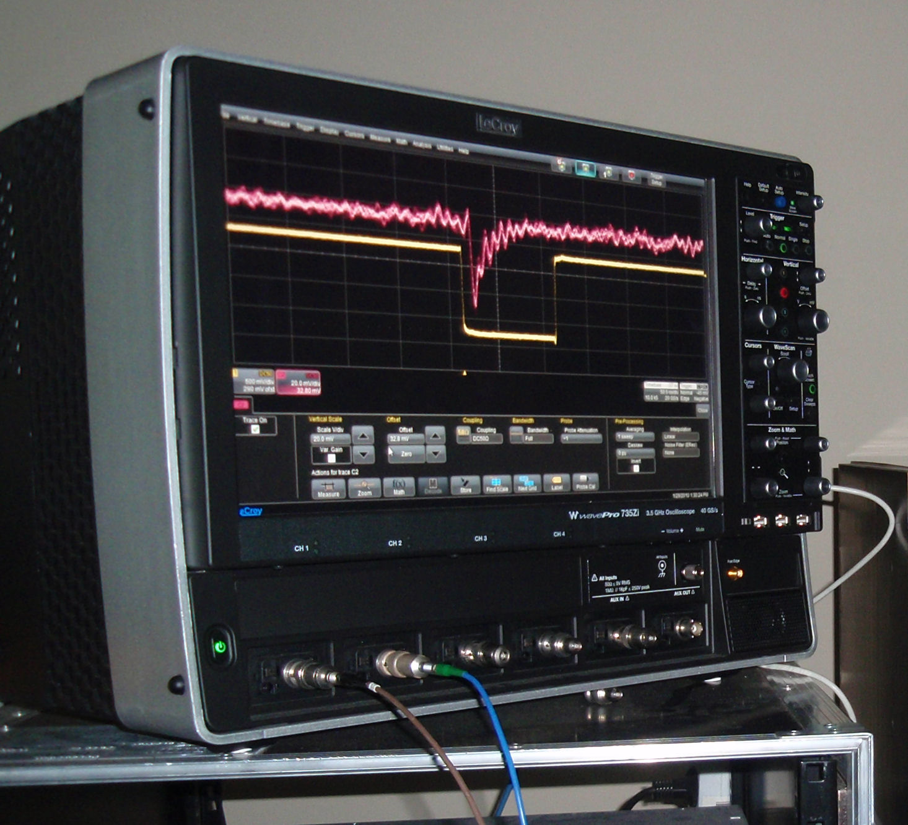
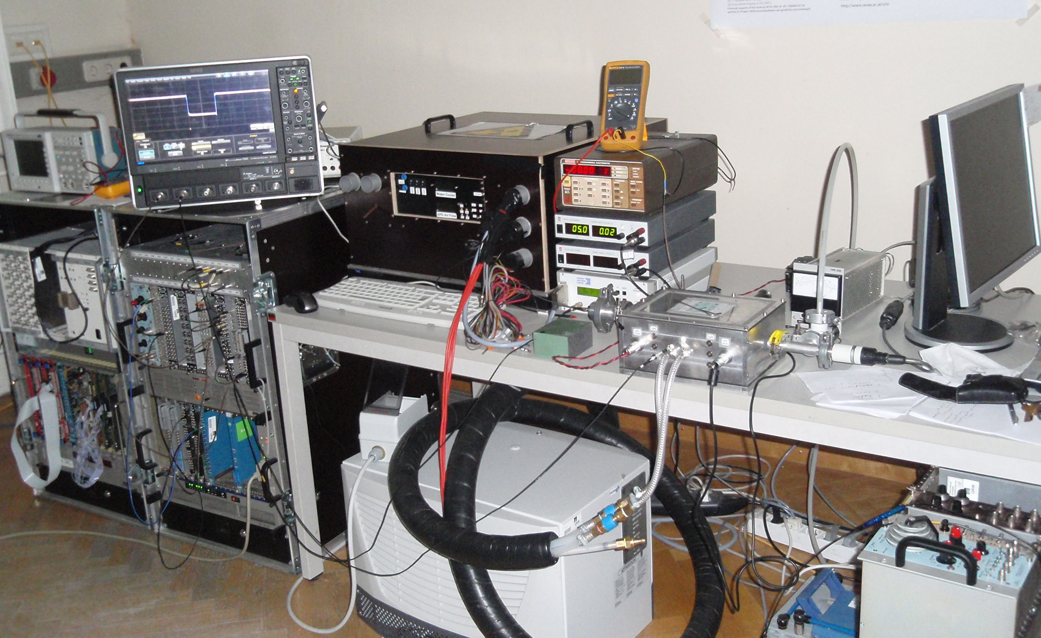
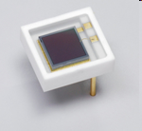
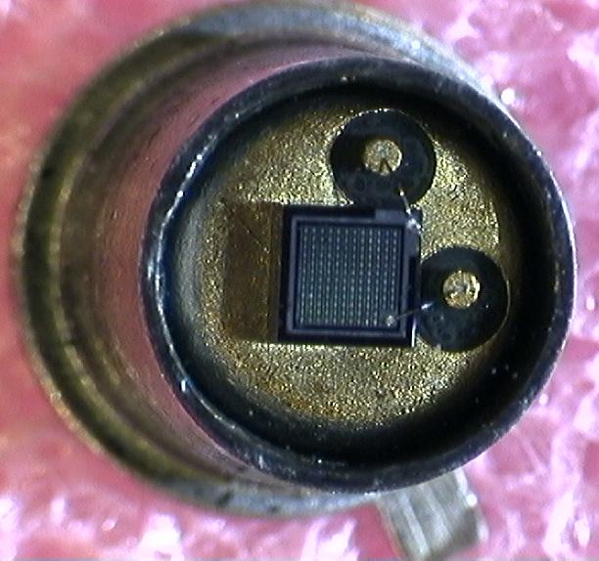
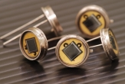
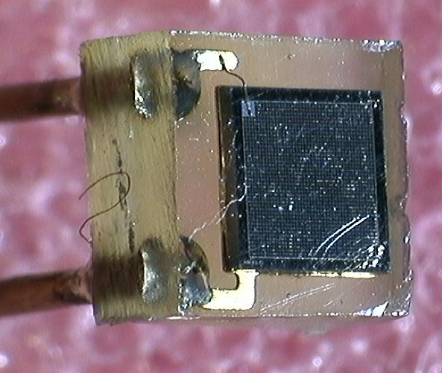
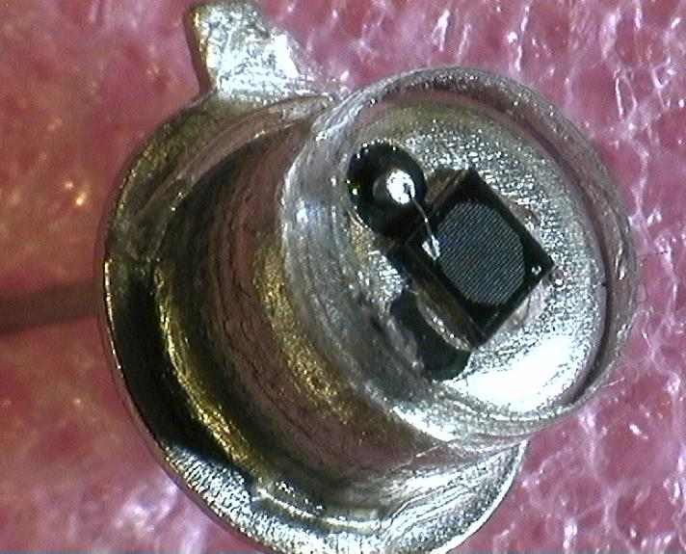
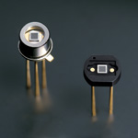
SMI activities
Test different types of SiPM
(MAPD-Zecotek, SiPM-Photonique, MPPC-Hamamatsu, ….)
3.5 GHz, 40GS/s.
CAMAC system.
Water Cooling system.
Hamamatsu MPPC, Zecotek MAPD different sizes
Dark box, Keithley 617 programmable electrometer,
Pico second laser system
12th -VCI 2010 18.Feb, 2010
4

Slide 5
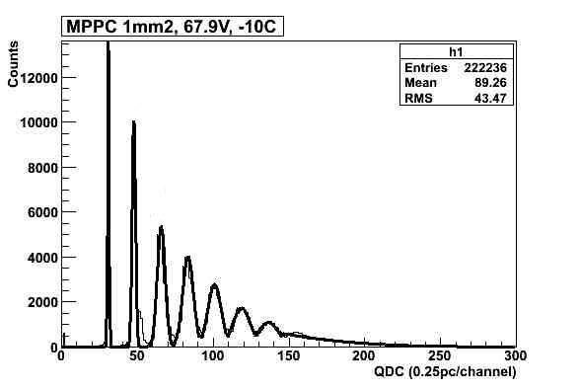

SiPM parameter measurements
Dark current vs Bias Voltage
Excellent single photoelectron resolution
Pedestal
1 p.e.
(S10362-33-100C)
2 p.e.
d
3 p.e.
4 p.e.
5 p.e.
6 p.e.
Gain vs Bias Voltage
Breakdown Voltage
Hamamatsu
(S10362-33-100C)
Breakdown Voltage
(S10362-33-100C)
(S10362-33-100C)
12th -VCI 2010 18.Feb, 2010
5

Slide 6
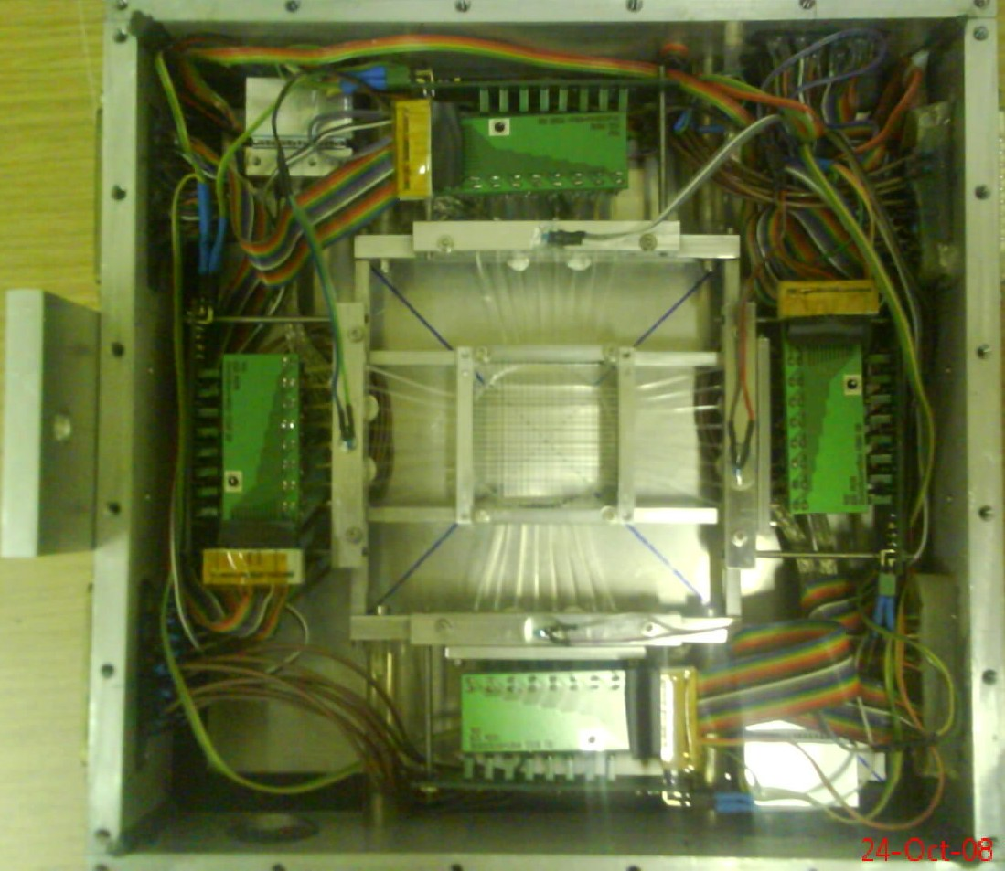
Beam profile monitor
SiPMs in combination with a 16×16 scintillating fiber grid in 2 planes were used for a beam profile monitor for the FOPI experiment (1).
Beam profile monitor mounted at FOPI/GSI (2).
Proton beam profile measured in x-and y-axis (3).
(1)
(3)
(2)

Slide 7
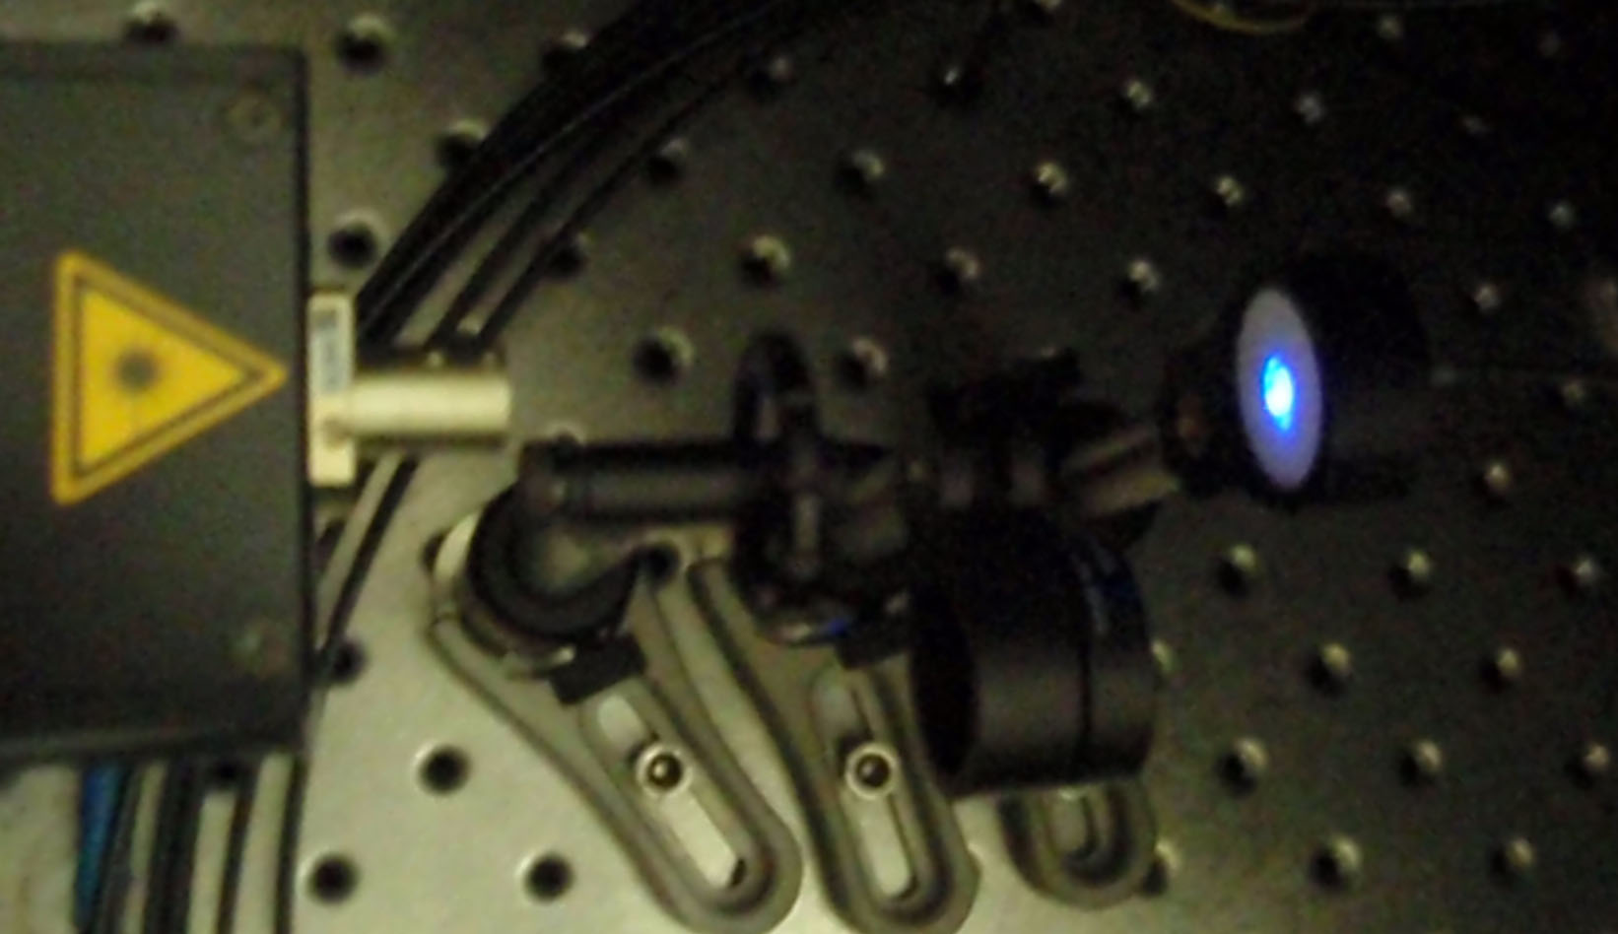
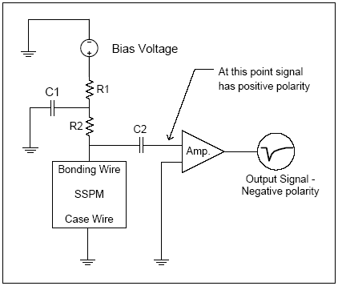
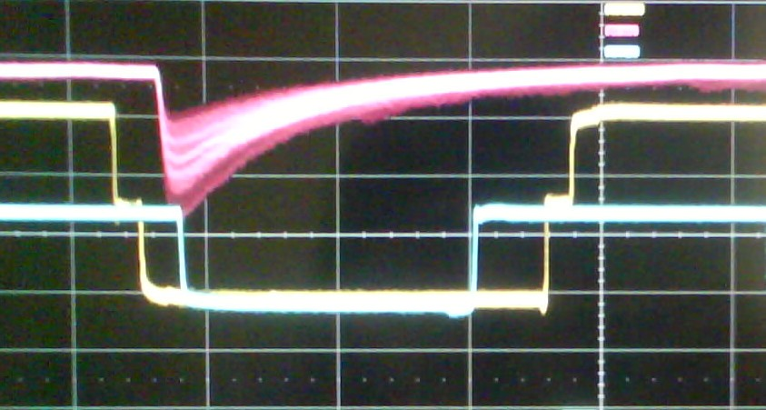
SiPM time resolution measurements
Time resolution was studied by illuminating SiPM with blue laser light pulse width 32 ps at wave length 408nm.
Signal
Discriminator
Variable light attenuator
Splitter
Al Case
QDC
SiPM
Laser trigger signal
Gate generator
TDC
Laser
10 n F
10 n F
10 n F
1 k Ohm
1 k Ohm
1 k Ohm
10 n F
1 k Ohm
Start signal
SiPM signal
1 k Ohm
1 k Ohm
1 k Ohm
1 k Ohm
10 n F
10 n F
(700 ps)
50 mv/div
Stop signal
50 ns/div
Photonique preamplifier (AMP-0611)
12th -VCI 2010 18.Feb, 2010

Slide 8
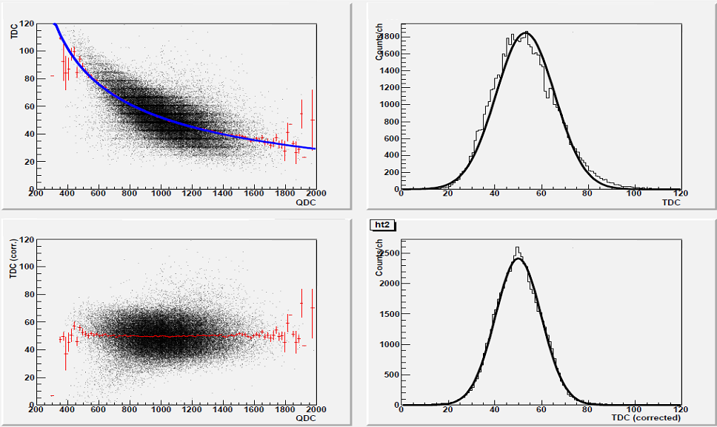
Time resolution measurements
Time resolution was calculated after slewing time corrections as sigma (σ) value by Gaussian ﬁtting for TDC distribution.
(TDC/QDC) before correction
σ = 315 ps
(TDC/QDC) after correction
σ = 246 ps
MPPC 9 mm², 67.1V, -12C
8

Slide 9
Time resolution measurements
MPPC (1, 3 mm²)
Hamamatsu.
MAPD-3N, Zecotek.
Time resolution improves with increasing the number of photons and/or operating voltage.
12th -VCI 2010 18.Feb, 2010
9

Slide 10
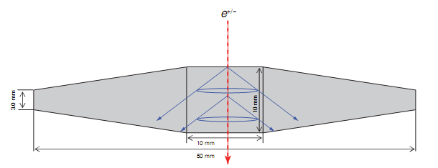
Cherenkov counter prototype
A radiator made of quartz, 1 cm thick and 5 cm long, optically coupled on both sides to 3×3 mm² MPPCs(S10362-33-100C) Hamamatsu, this devices was primarily selected because of its large active area.
The other series (S10362-11) has potentially better intrinsic timing performance, however due to the smaller sensitive area (1mm²), the reduction of photon collection will have a negative impact on the overall timing performance.
12th -VCI 2010 18.Feb, 2010
10

Slide 11
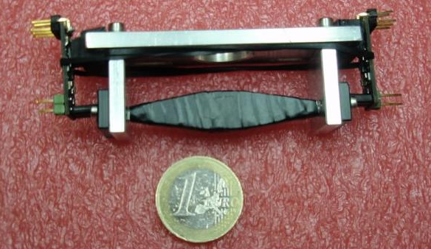
Cherenkov counter prototype
Preamplifier
MPPC
Radiator
Photograph of the prototype Cherenkov counter
In order to reduce the losses due to imperfect reflection the radiator is wrapped with an aluminum foil and covered with light- tight black tape.
MPPC signals are ampliﬁed with fast preamp, AMP_0611, while attached directly to the preamp board to minimize electronic noise pick-up.
12th -VCI 2010 18.Feb, 2010

Slide 12

Cherenkov counter prototype
We estimate ~20 detectable photo-electrons on each photosensor due to radiator interaction with 500 MeV electron beam, considering light losses due to transmission, absorption and photosensor efficiency.
Based on the number of photons, the expected time resolution is ~200 ps, according to our previous laboratory measurements.
For a comparison, scintillating fiber gives ~20 photons/1 mm² but presumably photon is generated “slowly” (~2 ns) compared to the Cherenkov process (~30 ps). It’s interesting to see if the SiPM can exploit that.
12th -VCI 2010 18.Feb, 2010

Slide 13
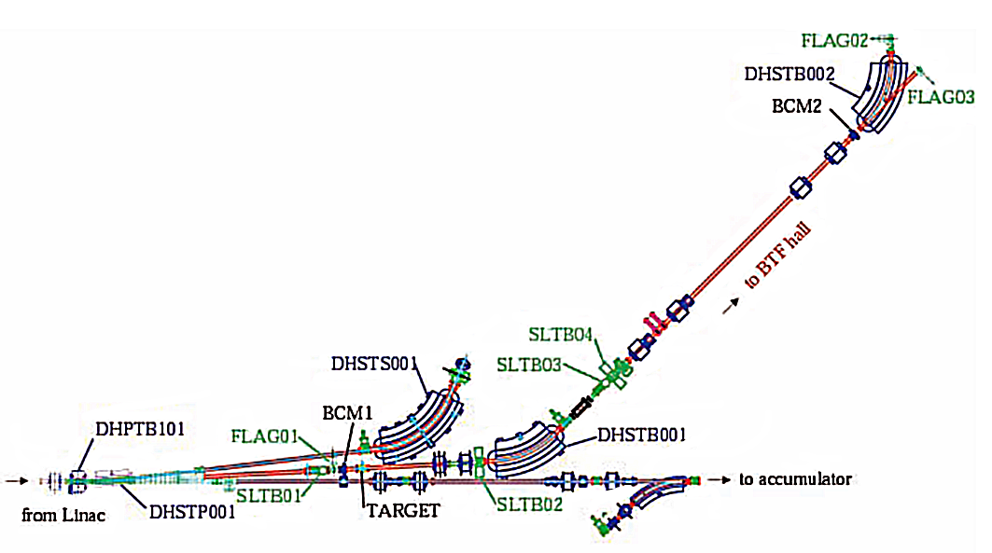
The Beam Test Facility (BTF)
The DAFNE Beam Test Facility (BTF) initially optimized to produce single electrons and positrons in 25 – 750 MeV energy.
Beam line was tuned to maximize single-particle
events with repetition rate 50 Hz with a maximum
particle flux of 1 kHz, so that the maximum
multiplicity is 20 particles per pulse.
BTF magnets were set to select e+/− with
energy of ~ 490 MeV.
Layout of the BTF transfer line and its main components.
12th -VCI 2010 18.Feb, 2010
13

Slide 14
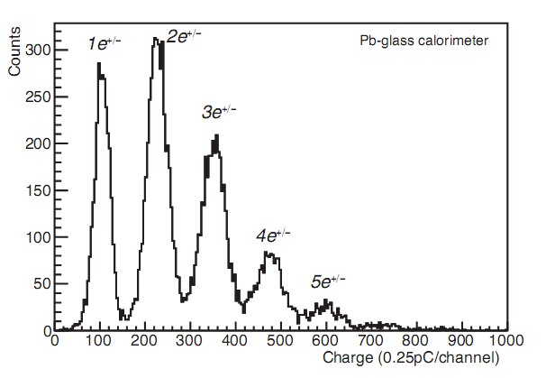
Test at the BTF
The beam diagnostics elements at BTF include a Pb-glass calorimeter. The beam particles are totally absorbed in the calorimeter so that the integrated signal from detector provides a measure of the beam particle multiplicity.
The separate peaks correspond to beam pulses of 1, 2, 3, and more beam particles. This information allows to select beam pulses of a specific multiplicity by software in later analysis.
Calo typical energy spectrum of BTF beam at low multiplicity was acquired with charge ADC.
12th -VCI 2010 18.Feb, 2010

Slide 15

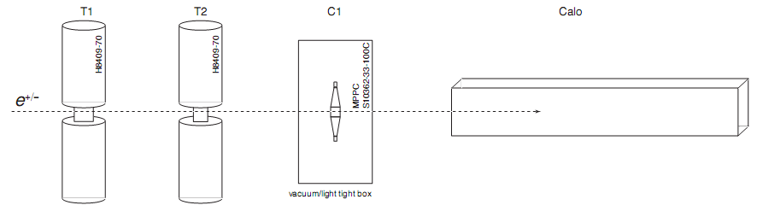
Detector setup
Four detectors were installed for the measurements.
T1 & T2 are the reference counters for the TOF
measurements, consist of scintillators (BC-408: 2, 1 cm)
and read out on both ends by PMTs (Hama- H8409-70).
The Cherenkov counter C1 is placed between T2 and
the Calo.
Data taking was triggered by a coincidence between T1, T2
and extraction signal provided by the accelerator.
12th -VCI 2010 18.Feb, 2010
15

Slide 16
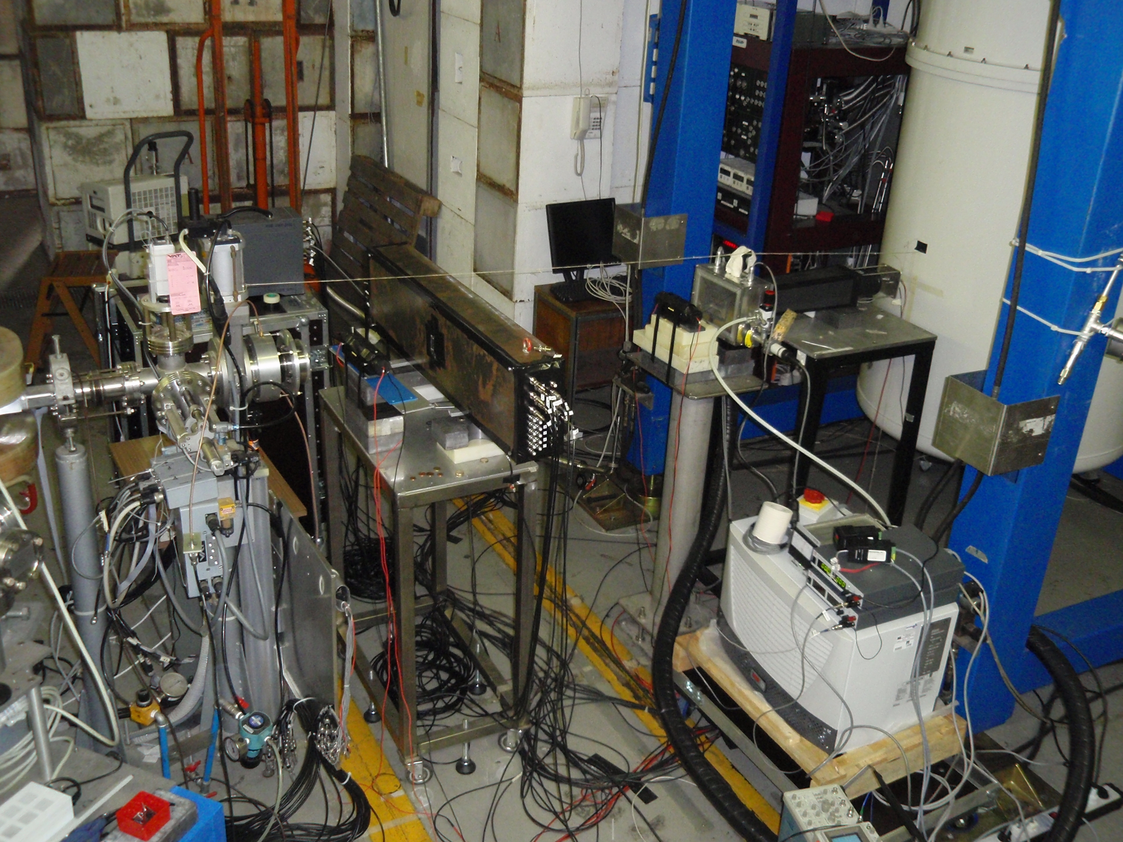
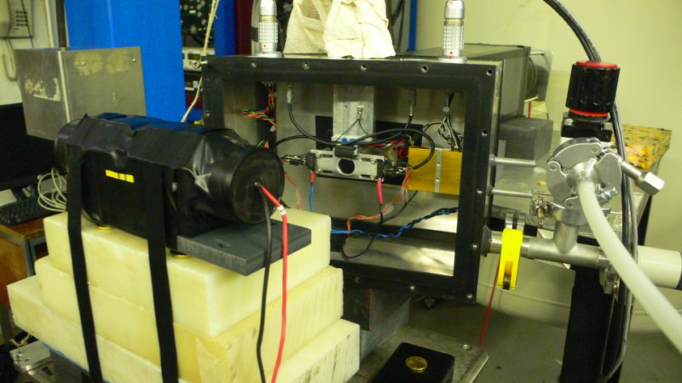
Test at the BTF
For testing the Cherenkov counter is mounted in a light and vacuum tight aluminum box, SiPMs are thermally coupled to water-cooled peltier elements, which allows to regulate the temperature of the device down to approximately −20◦C.
In order to avoid condensation the box is evacuated to a pressure of ≈ 10⁻³ mbar.
Detector setup (BTF-hall)
Cherenkov Counter Al box
Start counter (T1)
Analoge signal out.
Bias connectors
Start counter (T1)
Start counter (T1)
(e^{-/+}) beam direction
Calorimeter (Calo)
Vacuum valve
Water cooling sys,
Bias voltage sys, temp. controller
Cherenkov Counter (C1)
Vacuum valve

Slide 17

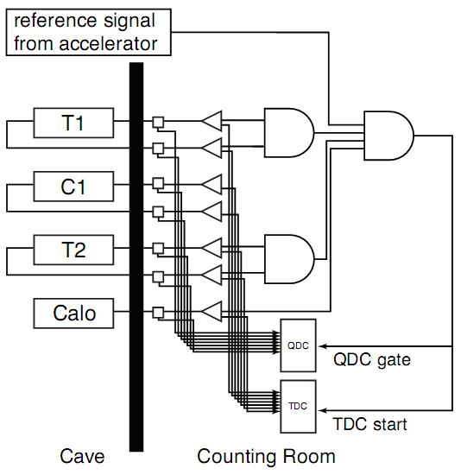
Readout electronics
The readout electronics was set up to measure
charge spectra and TOF between the reference
and Cherenkov counters.
Each counter signal output was split into two lines.
One was connected to a QDC for the charge measurement.
The other line was fed into a leading edge
discriminator and the outputs were fed into a TDC
for the time measurements, and were also used to
produce a gate signal for the QDC and a common
start signal for the TDC.
17

Slide 18

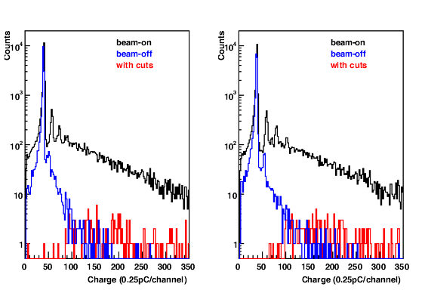
Beam test and results
All the QDC and TDC signals were recorded to PC
via CAMAC PCI bus interface and stored for ofﬂine
analysis.
Figure shows Cherenkov counter recorded charge spectra for each MPPC side, while black and blue lines represent the charge distributions measured while beam-on and beam-off conditions.
In response to the penetrating particles, each MPPC sensor was able to detect an average number of 8 photons.
18

Slide 19
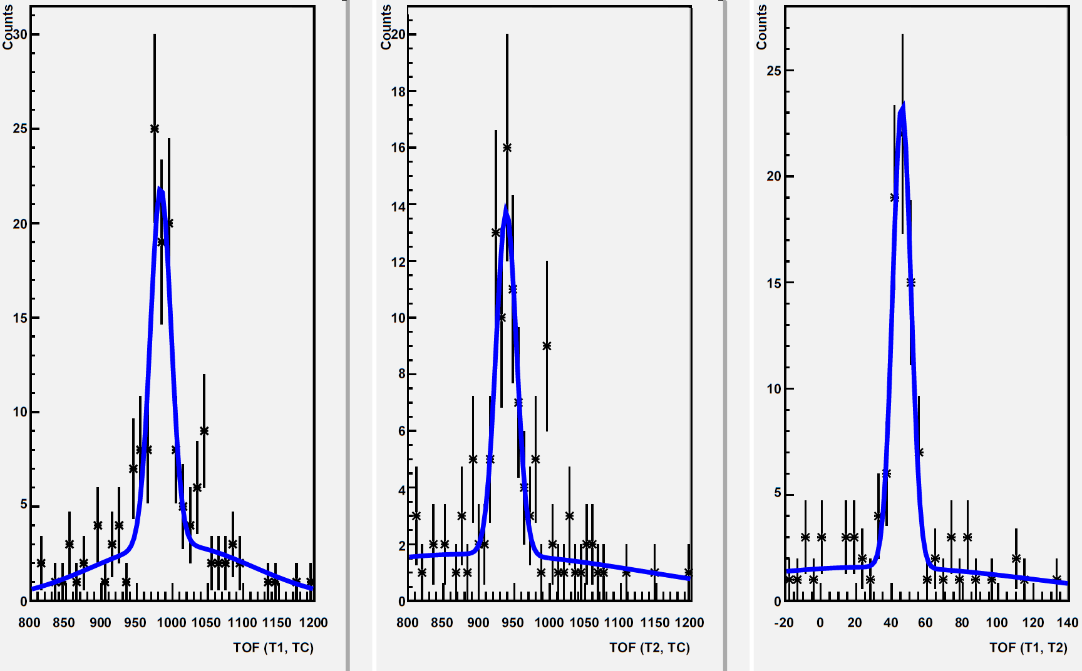
Beam test and results
TOF(T1-T2) = 130 ps. T1 and T2 performance
good enough ( ~100 ps) to evaluate C1.
Cherenkov counter time resolution is 350 ±100 ps.
The result not overwhelming but in agreement .
Accuracy of the measurements was limited by the low statistics.
For data analysis, we selected only single particle
(e^{+/−}) events using the calorimeter energy spectrum.
We measured TOFs between the three possible pairs of counters T1, T2 and C1 in order to disentangle intrinsic timing resolution for each counter.
σ = 360 ps
σ = 365 ps
σ = 130 ps
Time difference between T1 and TC
Time difference between T2 and TC
Time difference between T1 and T2
19

Slide 20

Summary
Cherenkov counter was able to detect 8 photons in comparison with ~20 photons expected.
The achieved time resolution is 350 ± 100 ps in comparison with 280 ps measured in the lab.
The detected photons are lower than the expected, however the achieved time resolution is in an agreement with
the expectation at the given number of photons.
Signal rise time turned out to be slow.
AMP_0611 has 2-3 ns risetime depending on the
input pulse height, instead of what is claimed (700 ps).
Risetime measurement of raw SiPM output on the way.
12th -VCI 2010 18.Feb, 2010

Slide 21

Conclusion
We are evaluating SiPM in terms of timing measurement.
According to our measurement time resolution is not great, though there’s inconsistency with Hamamatsu catalog.
Simple Cherenkov counter with SiPM was constructed and tested using e^{+/−} beam. The aim was to make a proof of principle and to obtain a first measure of the timing resolution of this device with a TOF measurement in a real accelerator environment.
Sub-nanosecond (~350 ps ) time resolution has
been achieved.
Current limitation seems to come from the
detector performance itself, though there is a room
for improvement (preamp, more carefully designed
radiator and light guide).
12th -VCI 2010 18.Feb, 2010
21

Slide 22

Thank You for your attention !
12th -VCI 2010 18.Feb, 2010
22

Slide 23
Spare

Slide 24
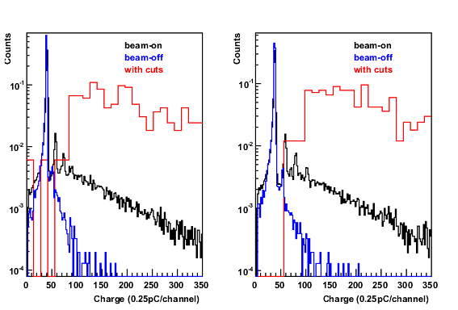

Slide 25
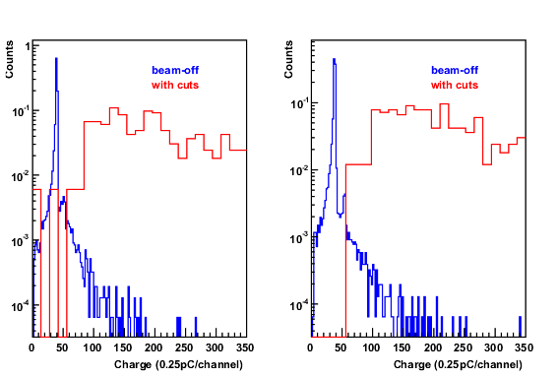

Slide 26
Cherenkov Radiation. The angle θc of Cherenkov radiation, relative to the particle’s direction, for a particle with velocity βc in a medium with index of refraction n is
The number of photons produced per unit path length of a particle with charge ze and per unit energy interval of the photons is

Slide 27
Calculate the number of emitted Cherenkov radiation if electrons with energy 489 MeV bathing throw 1 cm quartz glass of refractive index (n = 1.46).
According to the relativistic dynamics,

Slide 28
TOF
Ti = (TiLeft + TiRight)/2 average mean time for each detectors.
TOF (Tc, T1) = T_{T1} – T_{C.}
The intrinsic timing resolution of each counter is obtained by solving three linear equations of the TOF resolutions among three counters, the Tc, the T1 and the T2
σ²TOF (T_{C}, T₁) = σ²T_{C} + σ²T_{T1}
σ²TOF(T_{C}, T₂) = σ²T_{C} + σ²T_{T2}
σ²TOF(T₁, T₂) = σ²T_{T2} + σ²T_{T1}
σT_{C} =
σT_{T1}=
σT_{T2=}

Slide 29
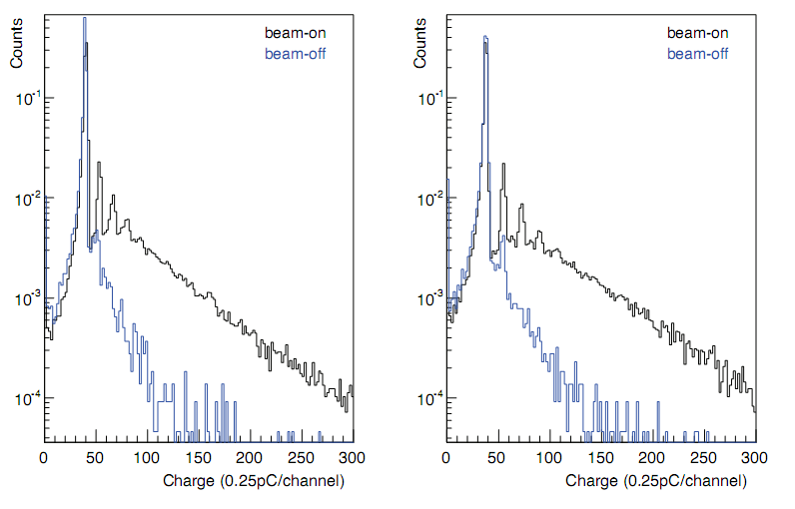
Beam test and results
All the QDC and TDC signals were recorded to PC
via CAMAC PCI bus interface and stored for ofﬂine
analysis.
Figure shows Cherenkov counter recorded charge spectra for each MPPC side, while black and blue lines represent the charge distributions measured while beam-on and beam-off conditions.
In response to the penetrating particles, each MPPC sensor was able to detect an average number of 8 photons.
29
29

Slide 30
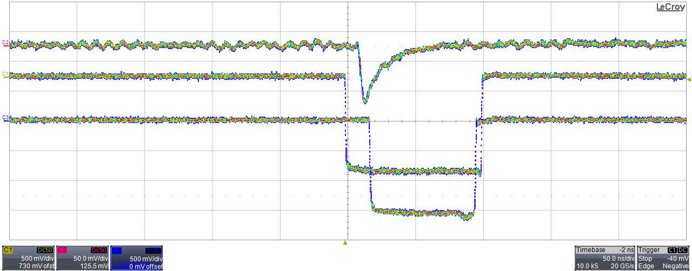
SiPM signal
Start signal
Stop signal

Slide 31
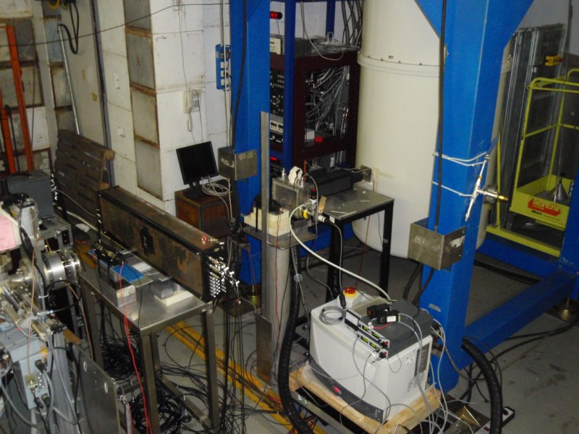
Detector setup (BTF-hall)
Analoge signal out.
Bias connectors
Start counter (T1)
Start counter (T1)
Cherenkov Counter Al box
Start counter (T1)
Calorimeter (Calo)
(e^{-/+}) beam direction
Vacuum valve
Cherenkov Counter (C1)
Vacuum valve
Water cooling sys,
Bias voltage sys, temp. controller

Slide 32
Detector setup (BTF-hall)
Analoge signal out.
Bias connectors
Cherenkov Counter Al box
Start counter (T1)
Start counter (T1)
Start counter (T1)
(e^{-/+}) beam direction
Calorimeter (Calo)
Vacuum valve
Vacuum valve
Water cooling sys,
Bias voltage sys, temp. controller
Cherenkov Counter (C1)

