Slide 1


Demonstration of an Axial PET concept for Brain and Small Animal Imaging
Vienna Conference of Instrumentation 2010
Paolo Beltrame CERN - PH/DT
The AX-PET concept
The Demonstrator
Characterization
Simulation and Reconstruction
Next steps and future plans

Slide 2

The AX-PET Collaboration
Istituto Nazionale di Fisica Nucleare Bari (INFN)
Ohio State University (OSU)
European Organization for Nuclear Research (CERN)
University of Michigan
University of Rome La Sapienza (INFN)
Instituto de Fisica Corpuscular (IFIC)
Paul Scherrer Institute (PSI)
Eidgenössische Technische Hochschule (ETH)
P. Beltrame, A. Braem, V. Fanti, C. Joram, T. Schneider,
J. Séguinot, C. Casella, G. Dissertori, L. Djambazov, W. Lustermann,
F. Nessi-Tedaldi, F. Pauss, D. Schinzel, P. Solevi,
J. F. Oliver, M. Rafecas, R. De Leo, E. Nappi, E. Chesi, H. Kagan, A. Rudge,
P. Weilhammer, D. Renker, N. Clinthorne, E. Bolle, S. Stapnes , F. Meddi

Slide 3
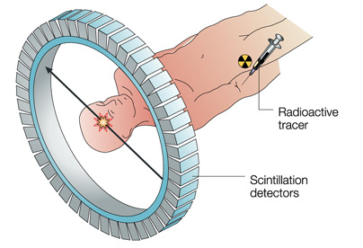
General introduction
PET: Positron Emission Tomography
metabolic active molecule marked with
isotope β⁺ emitter
e⁺e⁻ annihilation:
back to back photons of 511 keV

Slide 4
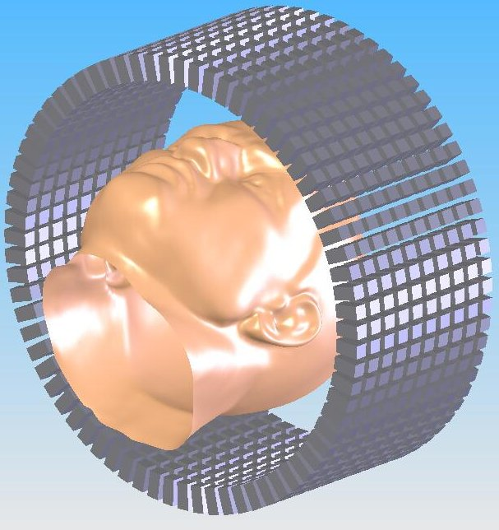

The standard PET
L
Radial
resolution
Detection Efficiency
δ_{p}
α
Short, radially oriented crystals
Readout in blocks by PMTs
No Depth of Interaction
(some exceptions)
No Depth of Interaction knowledge
→ Parallax error
Detection efficiency

Slide 5
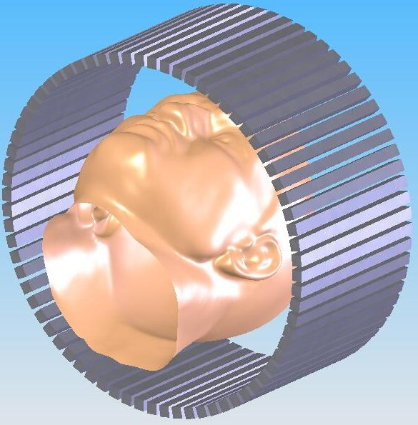
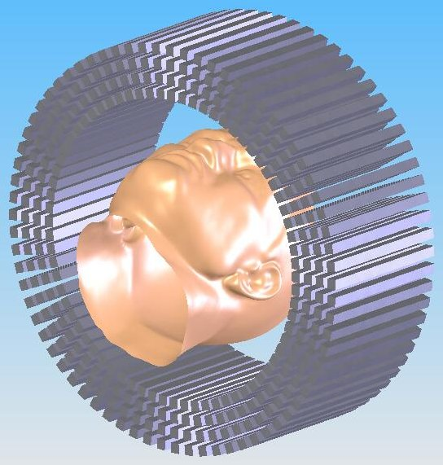
From PET to AX-PET
From
short radial oriented,
block readout
crystals
… to
long axially oriented,
individually readout
crystals

Slide 6
The concept and the demonstrator

Slide 7
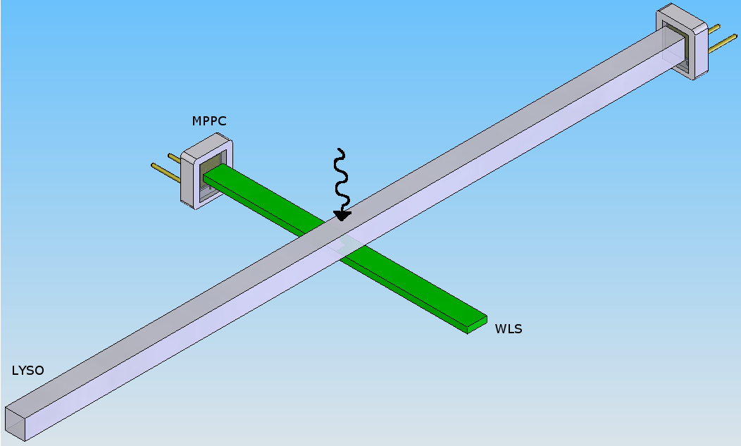
The crystal+WLS “grid”
x
How to measure
the axial coordinate?
scintillation light
z
wavelength shifted light
Light transport along the bars and the strips by means of total internal reflection
Light detection
- crystals: energy and x,y-location
- WLS strips: z-position along the crystal
y
MPPC
MPPC
Crystal
WLS

Slide 8
The crystal+WLS “read out”
x
How to read
the crystals?
scintillation light
z
wavelength shifted light
Light detection by
novel photo detectors G-APD = MPPC = SiPM
High PDE: ~50%
Very fast: <1 ns peaking time
Immune to B-field
(used in combination with MRI and CT)
y
MPPC
MPPC
Crystal
WLS

Slide 9
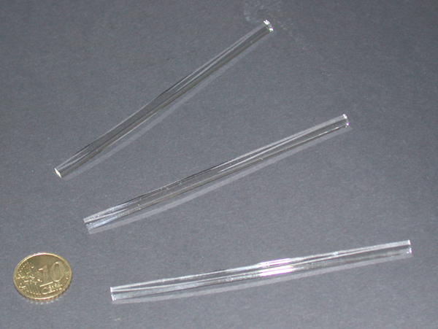
The AX-PET components: LYSO
Crystal material:
LYSO
Manufacturer:
Saint-Gobain
Dimensions:
3 × 3 × 100 mm³
Prelude 420TM
Chemical composition: Lu₉YSiO₂₅
Non hygroscopic
Density: 7.1 g/cm³
Absorption length: 1.2 cm
Peak emission spectrum: 420 nm
Refraction index (420 nm): 1.81
Light yield: 32 photons / keV
Decay time: 41 ns, single exponential

Slide 10
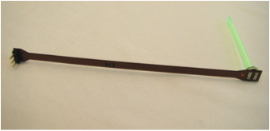
The AX-PET components: WLS
WLS material:
Polyvinyltoluene + dopant
Manufacturer:
ELJEN Technology
Dimensions:
0.9 × 3 × 40 mm³
EJ 280
Shifts blue light into green one
Density: 1.023 g/cm³
Maximum absorption: 425 nm
Maximum emission: 490 nm
Refraction index: 1.58
Decay time: 8.5 ns
QE (fluorescent material): 0.86%
Doping: 10x with respect to standard
Kapton cable
MPPC

Slide 11
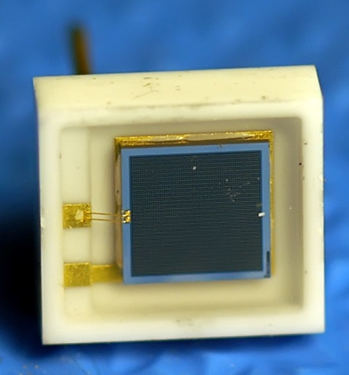
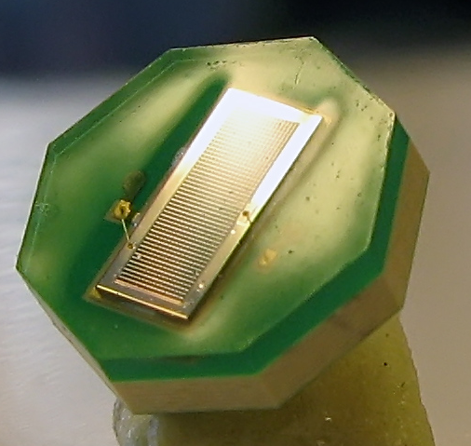
The AX-PET components: photo detectors
MPPC
Manufacturer: Hamamatsu
Operational voltage: ~70 V
Crystal readout
MPPC LYSO: S10362-33-50-C
active area: 3 x 3 mm²
3600 pixels of 50 x 50 μm²
Gain: 5.7 x 10⁵
Ceramic package 5.9 x 6.6 mm²
WLS readout
MPPC WLS: MPPC-OCTAGON-SMD
custom made
active area: 3.22 x 1.19 mm²
1200 pixels of 70 x 70 μm²
Gain: 4 x 10⁵
Octagonal plastic package

Slide 12
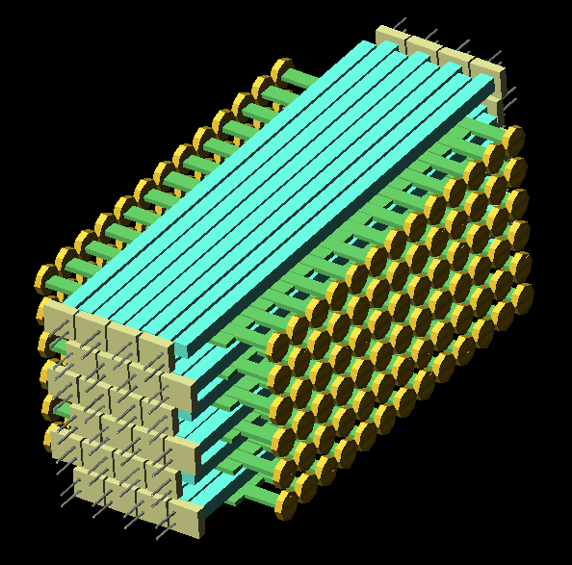
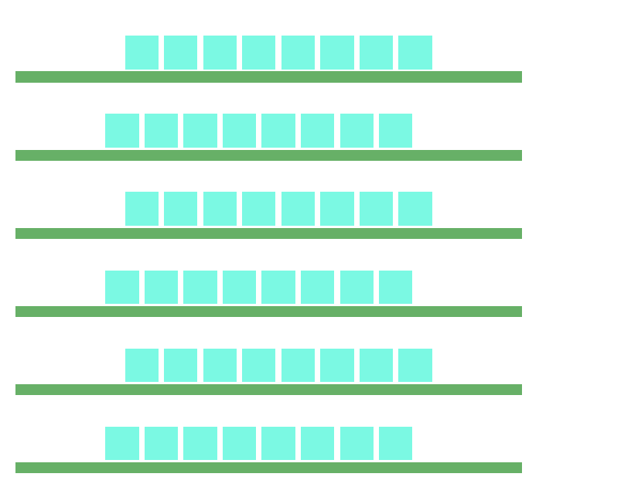
The Demonstrator
Two identical modules. Each module:
      48 LYSO bars (6 layers x 8 crystals)
  - 156 WLS strips (6 layers x 26 strips)
2 modules -> 408 channels
WLS
strips
LYSO
bars
1.75 mm
staggering
WLS
MPPC
LYSO
MPPC
layer
6
1
7 mm distance
between layers
Crystals and WLS strips
read out on alternate sides
to allow maximum packing density
Layers optically
separated
3.5 mm
LYSO pitch
3.2 mm
WLS pitch

Slide 13
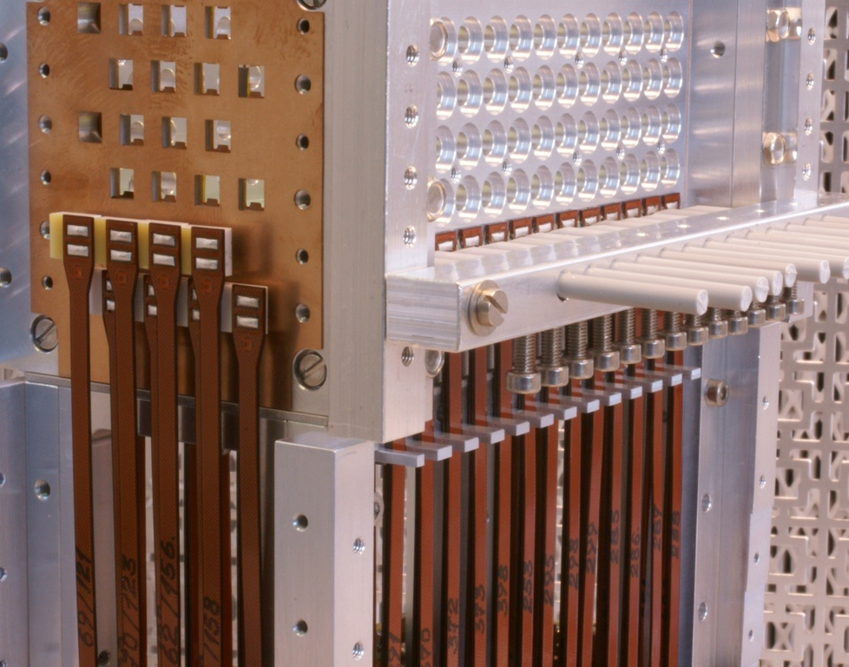
Putting everything together

Slide 14
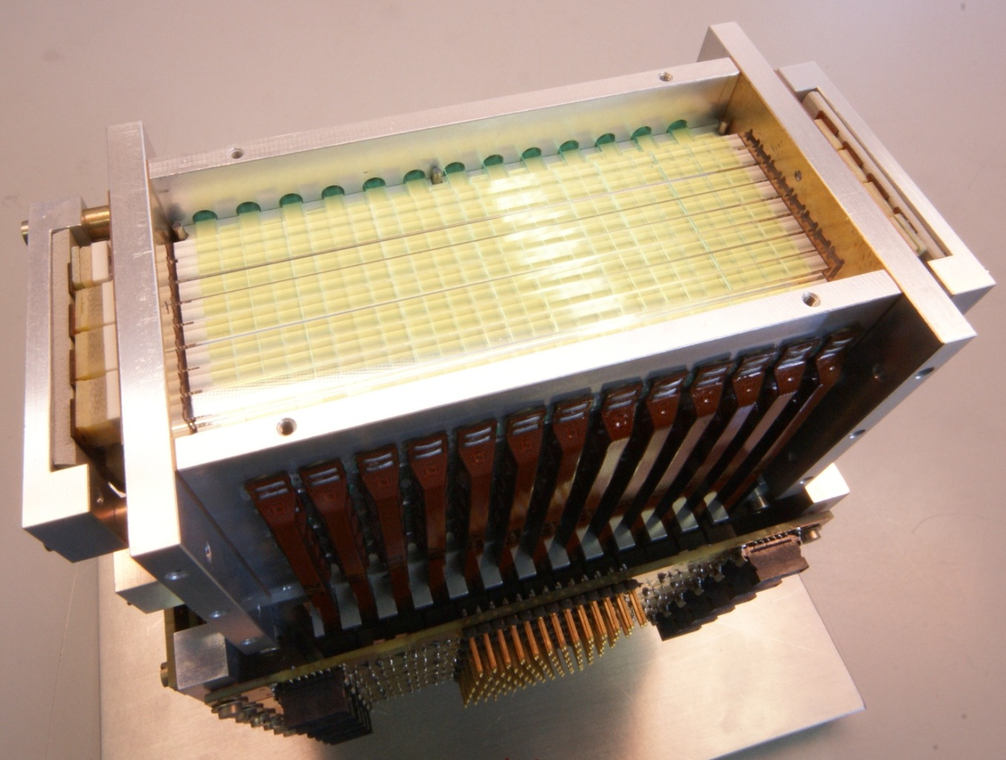
Fully assembled module

Slide 15
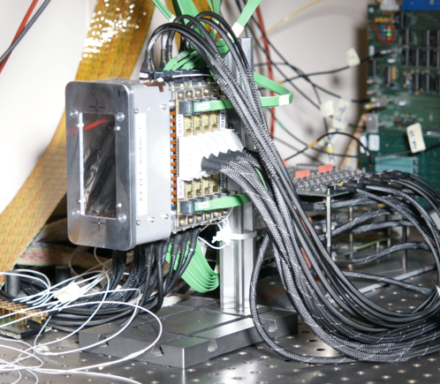
… with light protection cover and cables

Slide 16


Front-End electronics
1 channel (simplified)
test
Σ_{E} (crystals only)
MPPC
fast
Channels
above threshold
OPA486
Bias
Analog output:
Light per
crystal / WLS
‘slow’
S&H
VATAGP5 (128 ch.)
Analog readout of crystals and WLS strips
Sequential or sparse (only channels above threshold)
Fast energy sum of all crystals of 1 module
Trigger on 2 x 511 keV deposition in 2 modules

Slide 17
chaRacterization

Slide 18
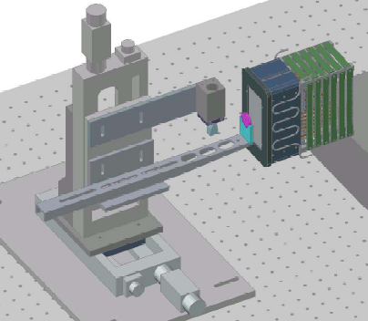
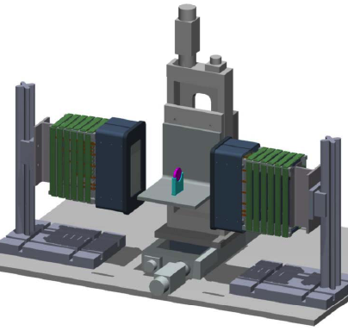
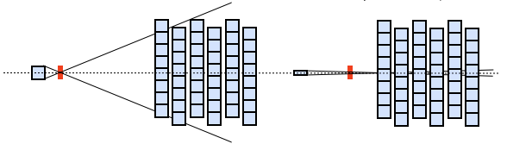
Test set up
²²Na source (ø = 250μm; A = ~900 kBq)
Single module characterization
Two module characterization
2D
moving station
PMT
2D
moving station
Module
Module 1
Tagger
Module 2
Source
Source
Module in coincidence with a tagging scintillator
Use of different tagging crystals
Distance between modules = 15 cm

Slide 19
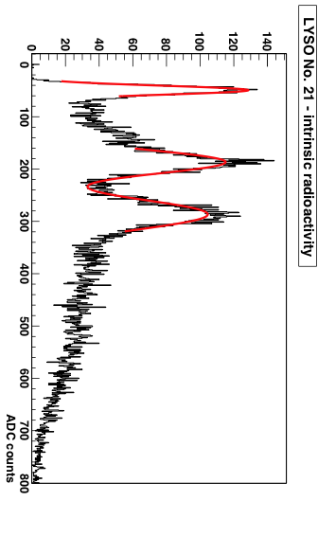
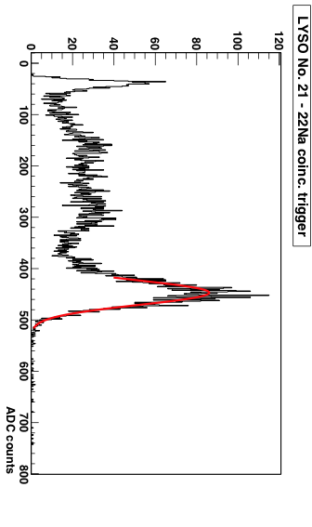
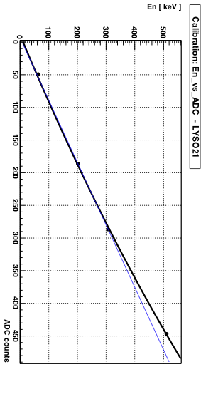
Energy calibration
Intrinsic Lu radioactivity + Photopeak → “self-calibrating” device
[511 keV]
Deviation from linearity due to MPPC saturation (3600 pixels), ~5% effect
Parameterization: logarithmic function
[303 keV]
[202 keV]
[63 keV]

Slide 20
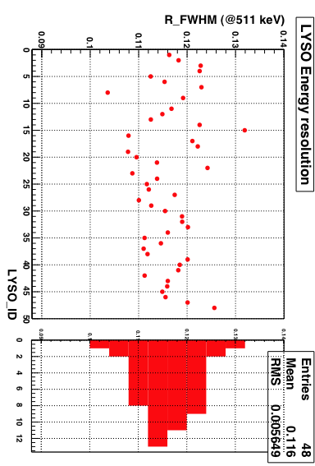
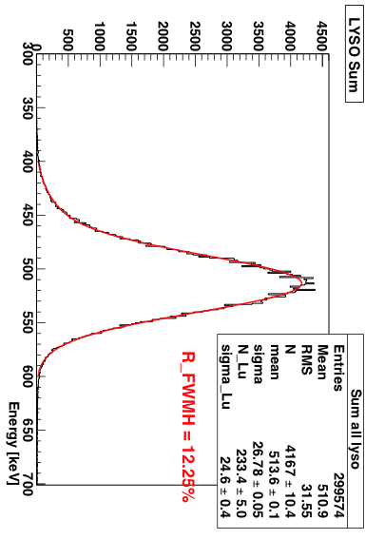
Energy resolution
Individual crystals:
< R_FWHM > ~11.6% @511 keV
(averaged on all crystals)
Sum signal (48 crystals)
R_FWHM_Sum ~12.25% @511 keV
(on the summed distribution)

Slide 21
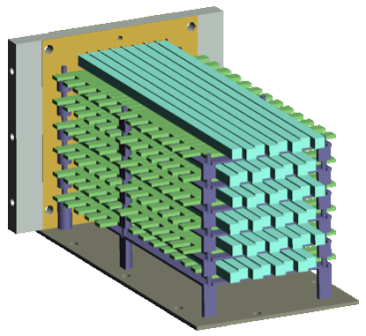
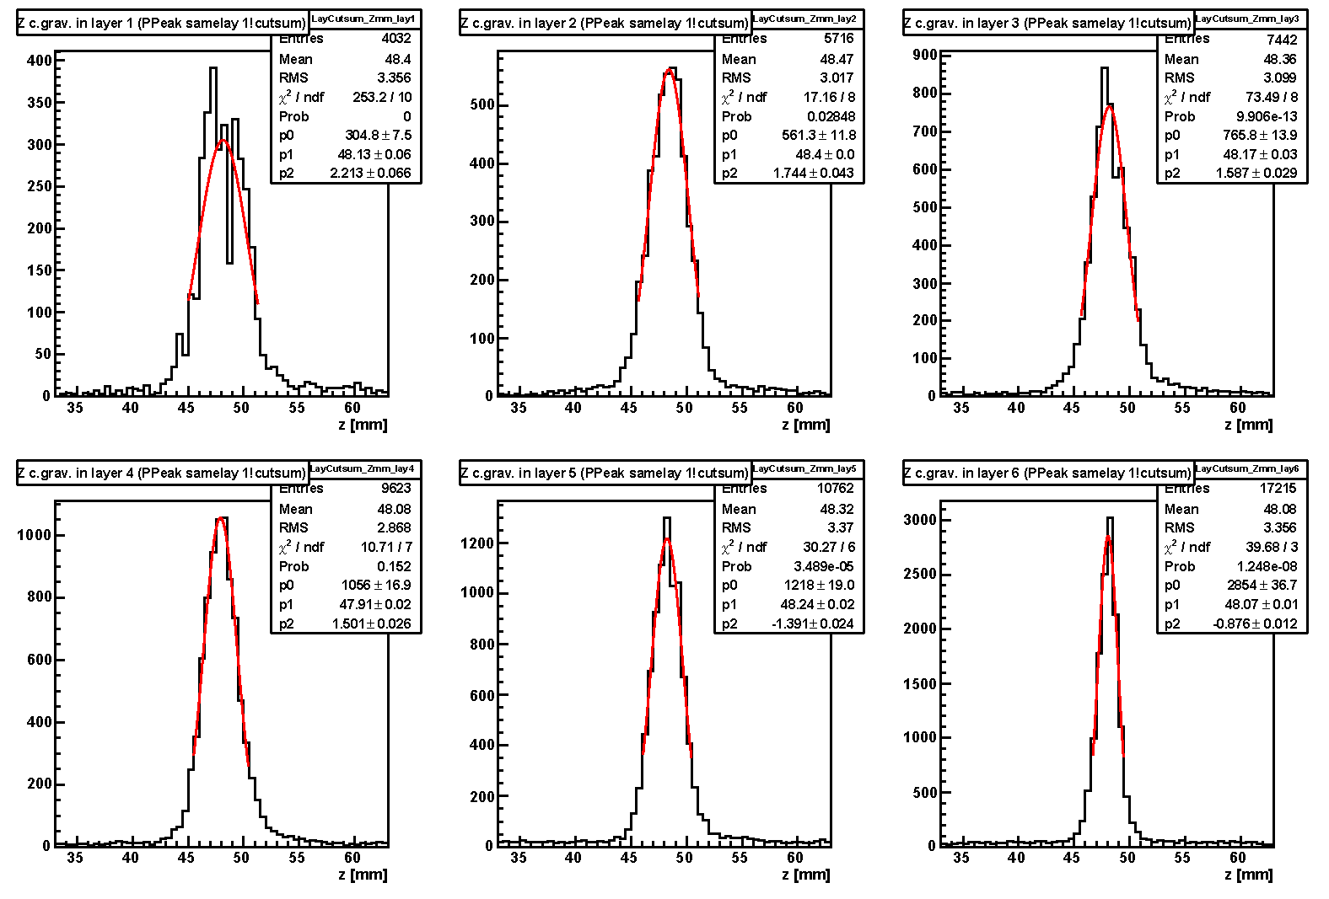
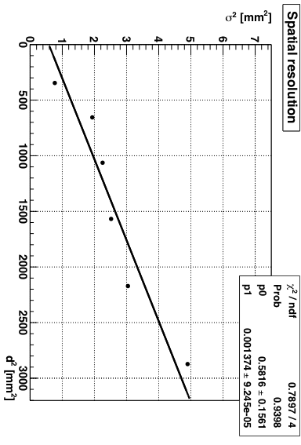
Axial (z) resolution
layer
6 ←→1
z coordinate = CofG of hit WLS strips (typically 2-4)
z
x
lay6
lay5
lay4
γ
y
lay3
lay2
lay1
σ_{i} [i=1,6] include:
intrinsic spatial resolution
beam spot size on each layer
σ(d=0) ~0.76 mm
FWHM ~1.8 mm
(still includes size of source)

Slide 22
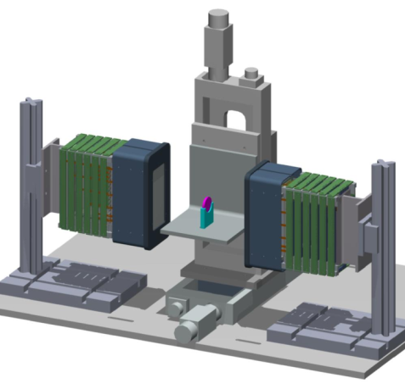
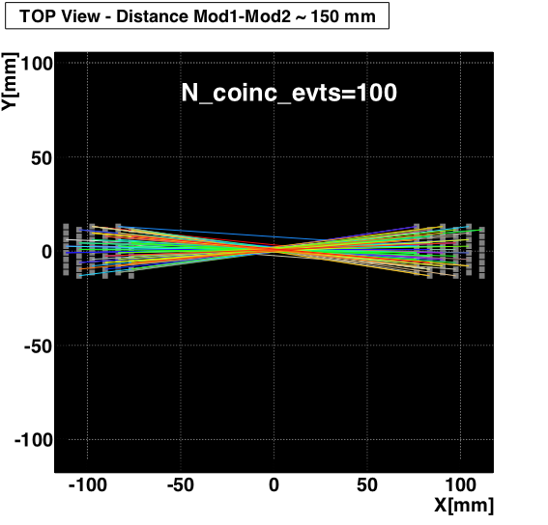
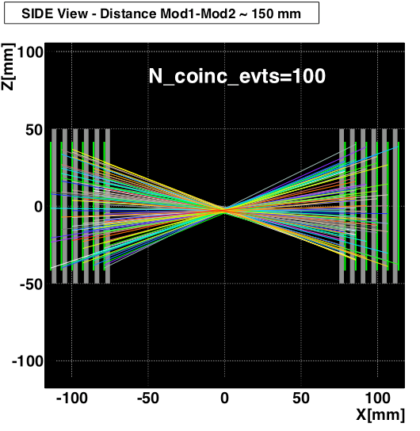
First coincidence measurements
Photoelectric events only (1 hit crystal per module)
Draw “LOR” (pure geometrical)

Slide 23
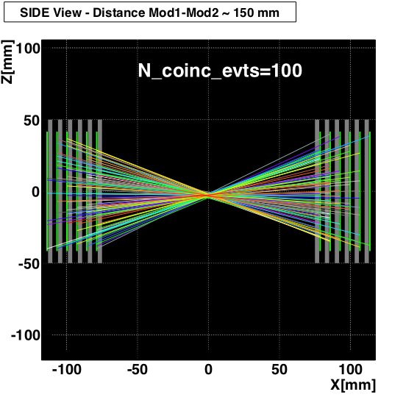
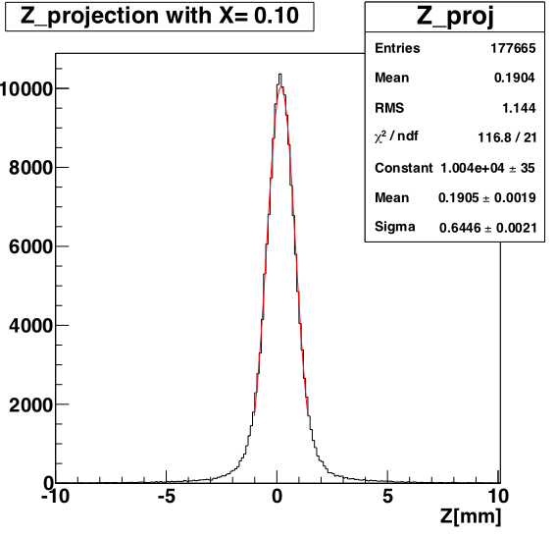
Estimate of axial resolution
Intersection
with central plane
FWHM = 1.5 mm
Resolution still includes size of source.
Finite positron range
(in water: <range> = 0.6 mm)

Slide 24
Simulation and reconstruction

Slide 25
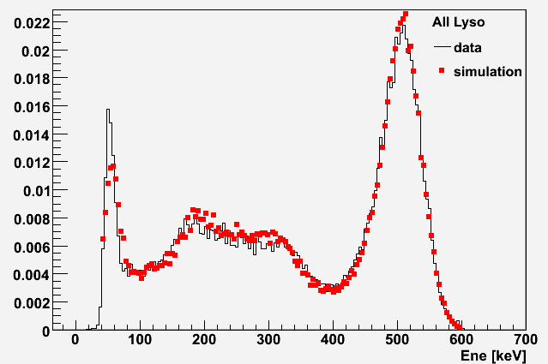
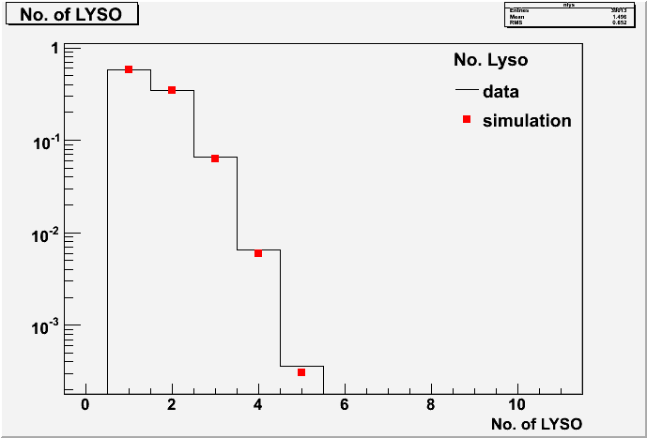
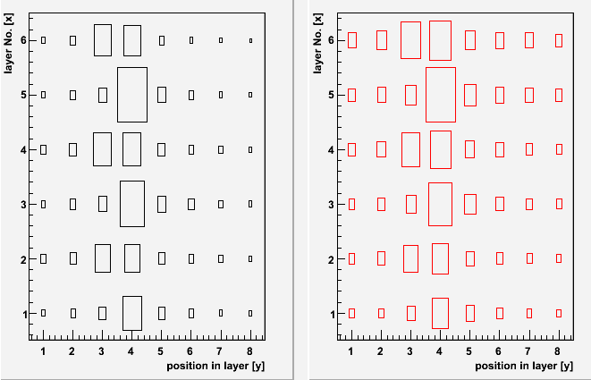
Simulation
Geant4: multi-purpose Monte Carlo tool
(optical transport, dedicated geometry)
GATE: PET dedicated MC
(time dependent phenomena, scanner rotation,
source/phantoms...)
Energy - E_{LOW}=40 keV, E_{SUM}=[400,600] keV
Excellent data/MC
agreement

Slide 26
Reconstruction
Dedicated reconstruction code, based on MLEM (Maximum Likelihood Expectation Maximization)
Geometrical component of the System Matrix computed using Siddon's ray-tracing technique. In addition, crystal attenuation and penetration effects also taken into account in the System Matrix
Code tested with several Monte Carlo phantoms
Monte Carlo data
for a cylindrical source:
D = 10 mm, h = 10 mm
FOV: 25 x 25 x 25 mm³
Voxel: 25 x 25 x 25 vox³
#steps = 6
Distance = 10 cm
10 mm
10 mm
Projections (x, y, z)
3D image

Slide 27
Summary
+
Next steps and future plans

Slide 28
Summarizing the AX-PET main features
3D localization of photons parallax-free
Optimization of spatial resolution (reducing crystal and WLS strip dimensions) and sensitivity (adding layers) can be done independently.
Possibility of identification a significant fraction of Compton interactions (Inter Crystal Scatter).
ICS events can either be discarded (resolution fully maintained) or reconstructed (increased sensitivity).
Scaling in size and in number of layers to match specific needs: brain PET, small animal PET, PEM (mammography), full body PET.
Concept and components are in principle MRI compatible and TOF extendable.

Slide 29
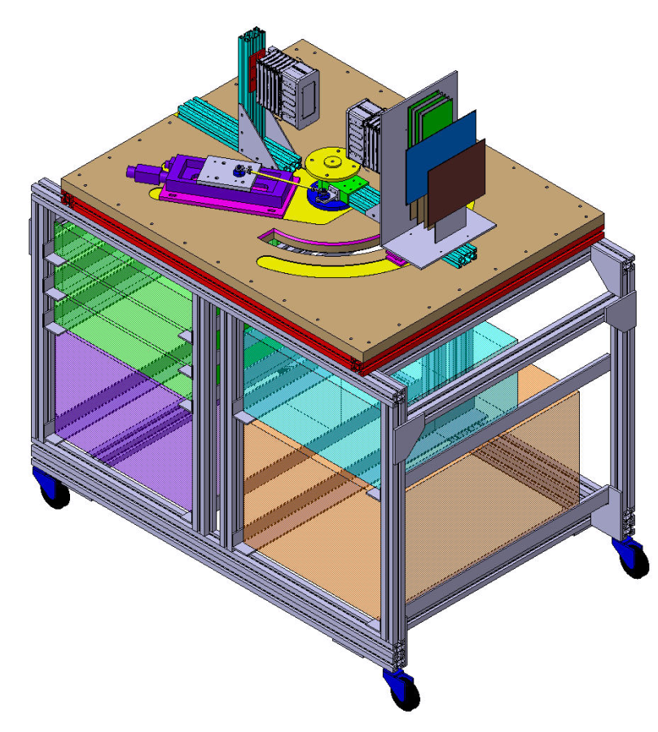
What’s next
At CERN
Mount set-up on a horizontal gantry (rotating source + 1 module rotation +/- 60°)
At ETH Zurich in cooperation with Centre for radio-pharmaceutical Science
April 2010
Tomographic reconstruction of small animal phantoms (FDG)
Optimization of Monte Carlo and reconstruction code
Time scale 1 year
Performance extrapolation (Monte Carlo) to full scanner and specific geometries

Slide 30
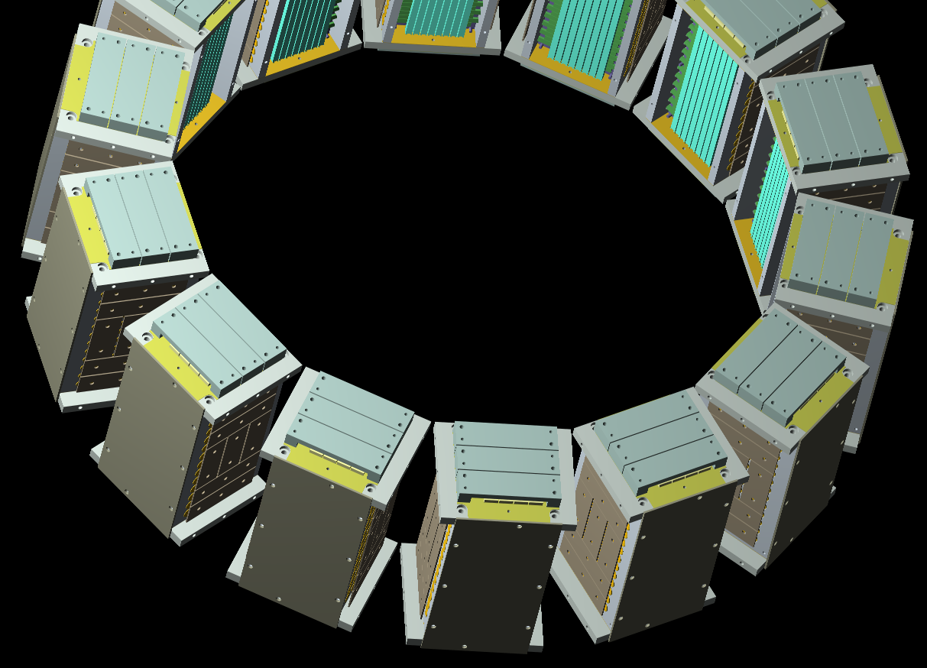
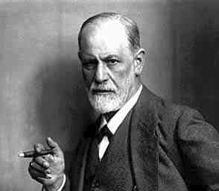
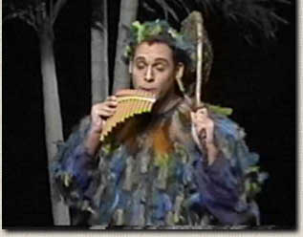
AX-PET a novel concept for …
brain
small animals
thanks for your attention

Slide 31
back-up slides

Slide 32
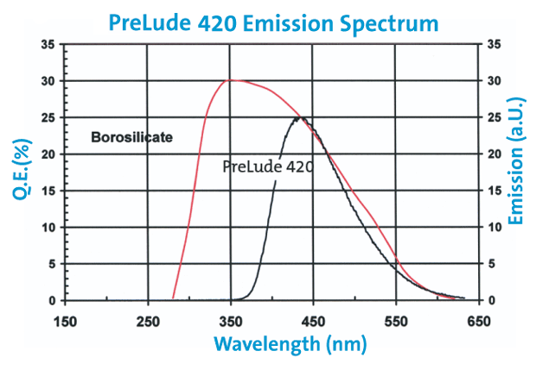
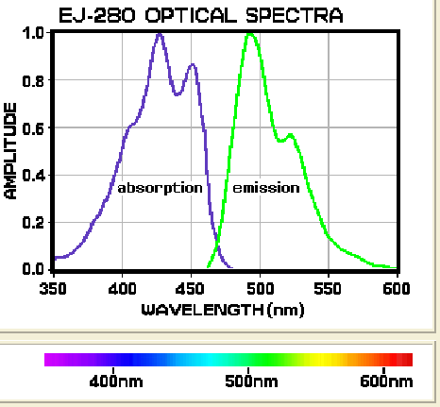
LYSO and WLS
Density [g/cm3] | 7.1
Attenuation length for 511 keV [cm] | 1.2
Wavelength of maximum emission [nm] | 420
Refractive index at W.L. of max. emission | 1.81
Light yield [photons/keV] | 32
Average temperature coefficient [%/K] | -0.28
Decay time [ns] | 41
Intrinsic energy resolution [%, FWHM] | ~8
Natural radioactivity [Bq/cm³] | ~300
Effective optical absorption length [mm] | ~420

Slide 33
Read Out Electronics
  Preamplifiers
  Fast operational amplifiers
  (~1 GHZ gain x bandwidth)
  50 ohm input impedance
  ~50 cm away from the modules,
  co-axial cables (50 Ω)
  Sum signals of one module
  Coincidence Trigger
  Bias supply (custom designed)
  256 channels (from 0 to 100 V)
  AD5535; 32 channel HV DAC
  Precision ~10 mV
  after individual calibration of all channels
  USB interface
  Coincidence Trigger
  Coincidence of sum of module signals
  with the other module
  Thresholds set using oscilloscope
  e⁺e⁻ annihilation events
  Self Triggering VATA GP5
  Moderate threshold
  → LYSO intrinsic radioactivity
  Low threshold
  → pedestal measurement
  DAQ… VATA GP5
  128 channel charge integrating amplifier
  (64 channel used)
  Shaping time ~250 ns
  Fast shaper ~40 ns plus discriminators
  → self triggering
  Hit register
  → sparse mode readout

Slide 34
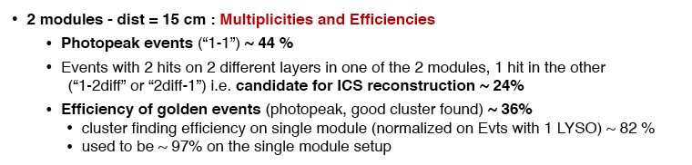

Slide 35
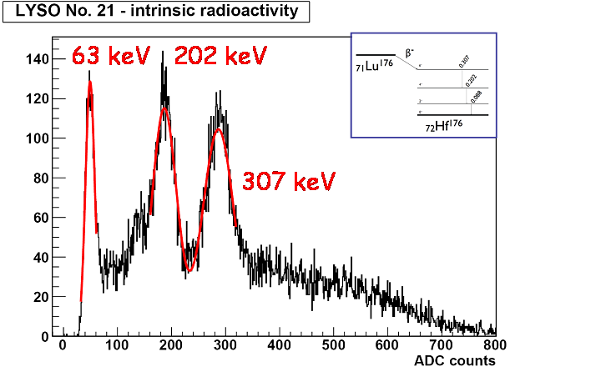

Slide 36
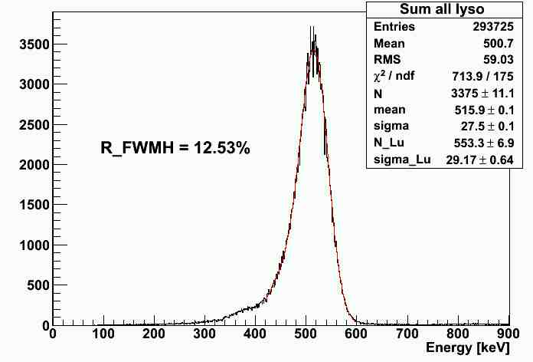
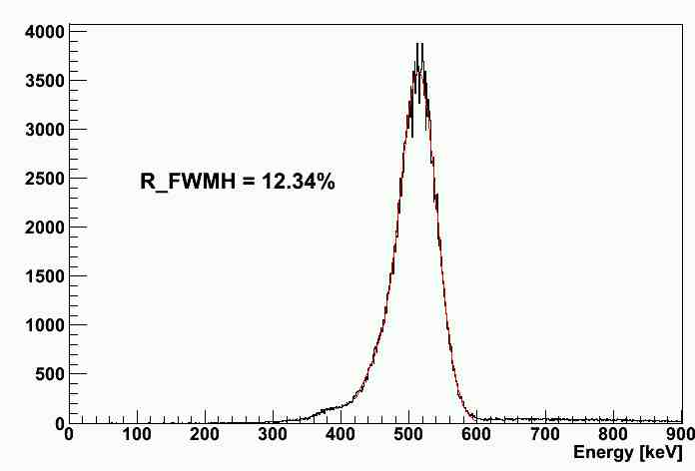
Energy calibration
Fit a double Gaussian distribution
to the sum of the energy depositions of all crystals of one module with mean values:
E_{p} = photo peak energy
E_{p} – 63 keV
  to take into account the Luthetium K_{α} escape line at 63 keV
Sum of energy depositions
in crystals of one module
Module 2
Energy resolution:
12.34% FWHM (Module 1)
12.53% FWHM (Module 2)
Module 1
Peak Position:
(511.7 ± 0.6) keV (Module 1)
(511.8 ± 0.6) keV (Module 2)

Slide 37
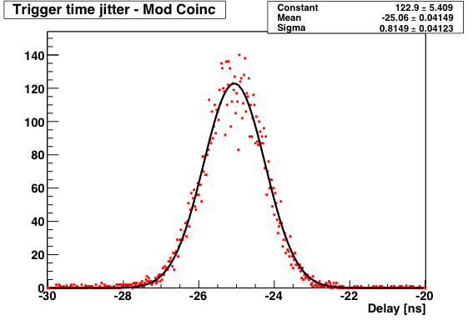
Time performances
First estimate of the time resolution:
measure delay of coincidence wrt Module2
measurement from the scope [Lecroy Waverunner LT584 L 1GHz]
MODULE1
LYSO SUM
Trigger
MODULE2
LYSO SUM
Time resolution : σ ~800 ps
Notes:
- Also time resolution is quite important and we perform a first estimate of it

Slide 38
