Slide 1

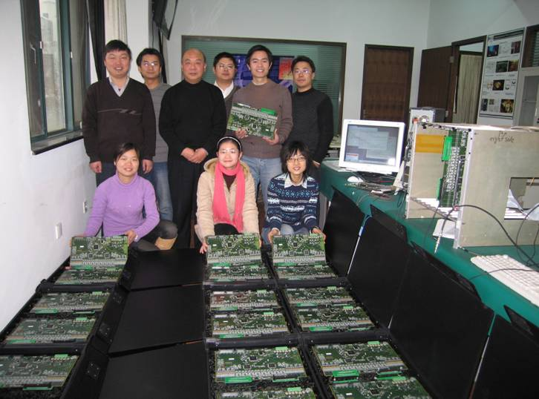
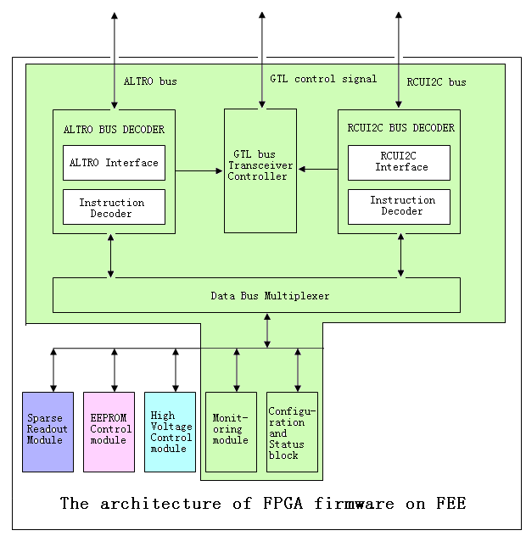
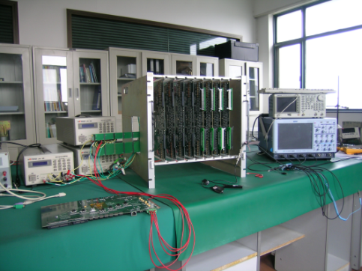
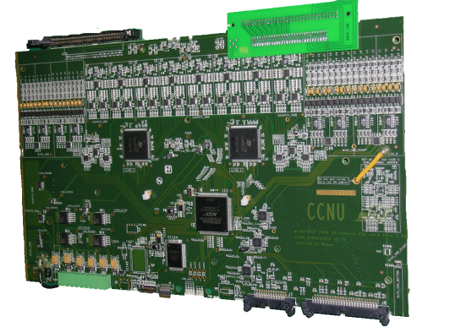
Huazhong Normal University (Wuhan) activities within RD51 scalable readout project
Firmware of PHOS/TRU trigger cards
FEE card produced in Huazhong Normal University for ALICE/PHOS project
Readout Electronics Test Setup
Altro-based FEE card for APD readout
Board Controller Firmware of FEE &
Participation in ALICE RCU firmware

Slide 2
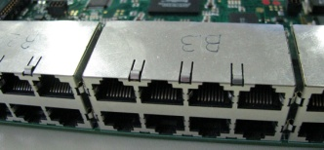
Simple SRU system
PC
New: Readout link instead of a GTL bus:
-up to 36864 channels:
36 FEE x 8 x ASICS x128 channels
Gigabit ethernet
SRU
CAT6 cables, max 15 m
FEE
FEE
….max 36
FEE
…
…
…
Frontend ASICS
typically 8 per FEE

Slide 3
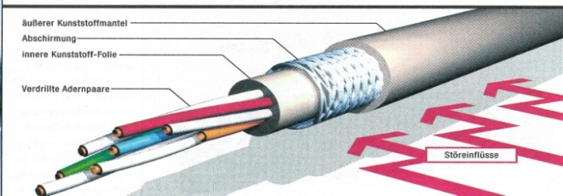
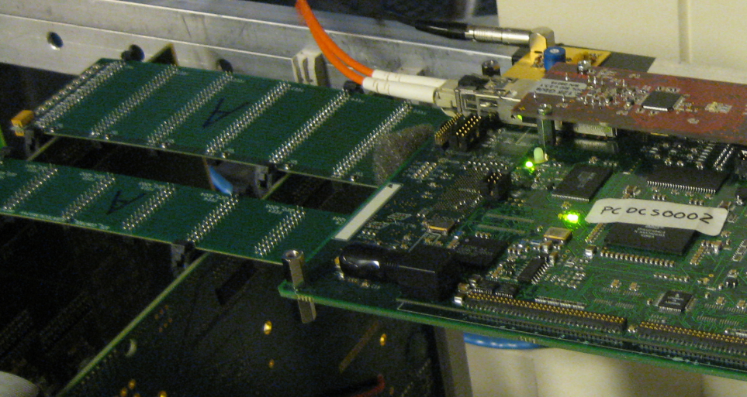
From readout bus to readout link
Point to Point link architecture:
well defined impedance both ends, longer distance than bus
single node failure does not influence other nodes
parallel transfers on all links, i.e. higher total BW
cheaper by using off the shelf cables
Much less contacts , longer life
Status so far:
tested with 280MHz clk and 15 Meter over CAT6 cable
use simple packet protocol
BUS

Slide 4

SRU<->FEE: serial LVDS
max 15 m @ 280 Mbit/s
clock
data
CAT 6 cable
4 x twisted pairs
select
return
34 x
RJ45
FEE
FPGA
RJ45
4
SRU
Reversible LVDS drivers/receivers
FPGA
chip Interface bus
4
Board Controller Firmware
Input data stream from
36 FEE’s ~ 10 Gbit/s
10 GBE

Slide 5
Serial readout/contol modes
2 modes of operation defined by SCU clock
Board controller senses clock to switch mode
Readout mode: clock = 40 MHz ( or other )
data = 200 Mbit/s
select = readout-trigger to FEE
return = local trigger from FEE
Control mode: clock <= 4 MHz
data = Serial data out
select = Serial data in
return = coded status

Slide 6
=>ALICE case study* for PHOS, EMCal, etc.
Ethernet backbone
LED monitoring
DCS
DAQ
HLT
DAQ
HLT
. . .
Test systems only:
Control
PC
Clock
&
Trigger
CTP & LTU
Copy to HLT via optical splitter
or loopback , eventually insert optical switch layer
Single mode fiber
Int. BUSY
Event , DCS, Flow Ctrl
New: Readout link
Instead of a GTL bus
Clock & timing
ethernet
10 GbE-ethernet: MM fiber
RCU * => SRU
RCU* =>SRU
Control
. . . .
Pre-Trigger
GTL bus area
FEE
FEE
FEE
FEE
FEE
FEE
* Also Non RCU based detectors could
go for scalable proposal based on SRU

Slide 7
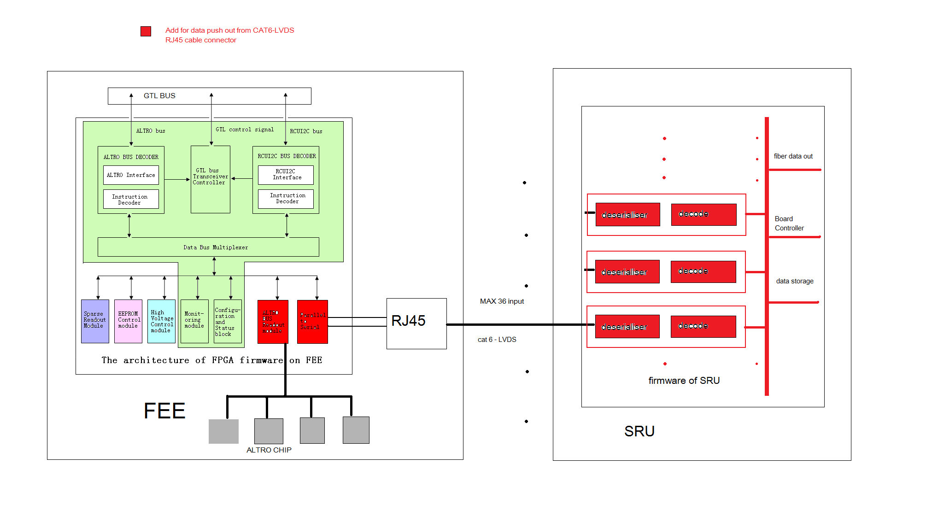
Upgrade Board Controller FPGA firmware
New feature of ALTRO CHIP read and serial data push out will be added in the FEE Board controller
The deserialiser and decoding part will be revised from the PHOS/TRU firmware

