Slide 1
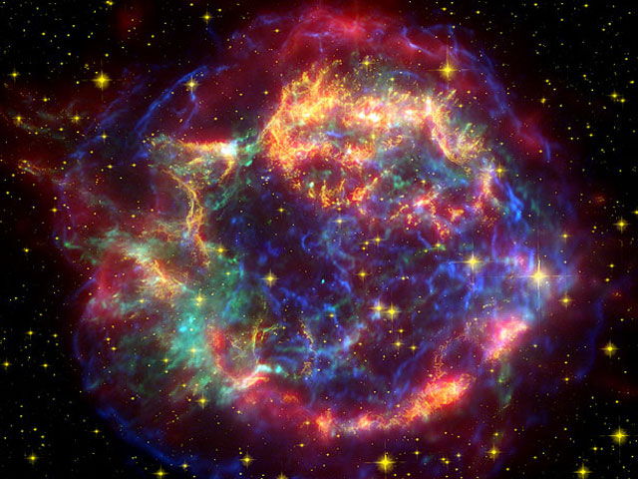
Experimental astroparticle physics in Sweden
Olga Botner, Uppsala university
2016-05-20

Slide 2
Observational astroparticle physics in Sweden
Olga Botner, Uppsala university
2016-05-20

Slide 3





OVERVIEW
Stockholm U., Royal Inst. of Techn. (KTH), Uppsala U., Linneus U., Växjö/Kalmar
12 faculty + 6 researchers +20 postdocs + 16 PhD students (astroparticle/astronomy)
  participation in world-class projects
  significant and active involvement in large international collaborations
externally financed by
  Swedish Research Council (VR)  investments, salaries, run. costs
  Private foundations (ex. KAW)  investments, salaries
  Swedish National Space Board (SNSB)  investments, salaries, run. costs
SU + KTH became VR ”strong research environment” in 2005
Notes:
… implying a longterm influx of funds.

Slide 4
SCIENCE SCOPE
Dark matter | Violent universe | Cosmology |  | UU | SU/KTH | LnU
 |  |  | SCP
 |  |  | IceCube
 |  |  | Fermi
 |  |  | H.E.S.S. CTA (?)
 |  |  | PAMELA PoGOLite
 |  |  | XENON
 |  |  | ARIANNA
 |  |  | ALTO

Slide 5
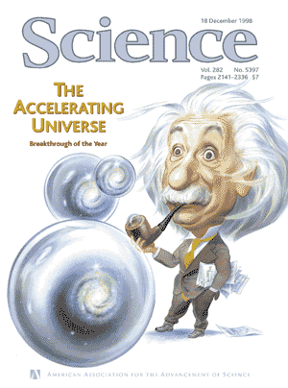
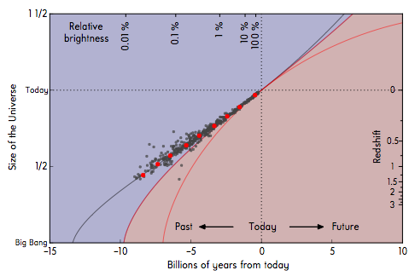
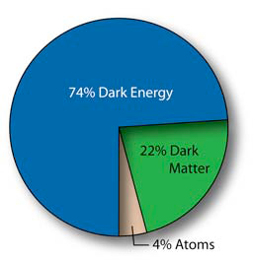
SNe and THE ORIGIN OF THE ACCELERATED COSMIC EXPANSION
Might DE be a link between the physics of the very
small and the very large?
  new force?
  weird behaviour of virtual particles?
The Type Ia Supernova Hubble Diagram 2016
Notes:
The stu

Slide 6
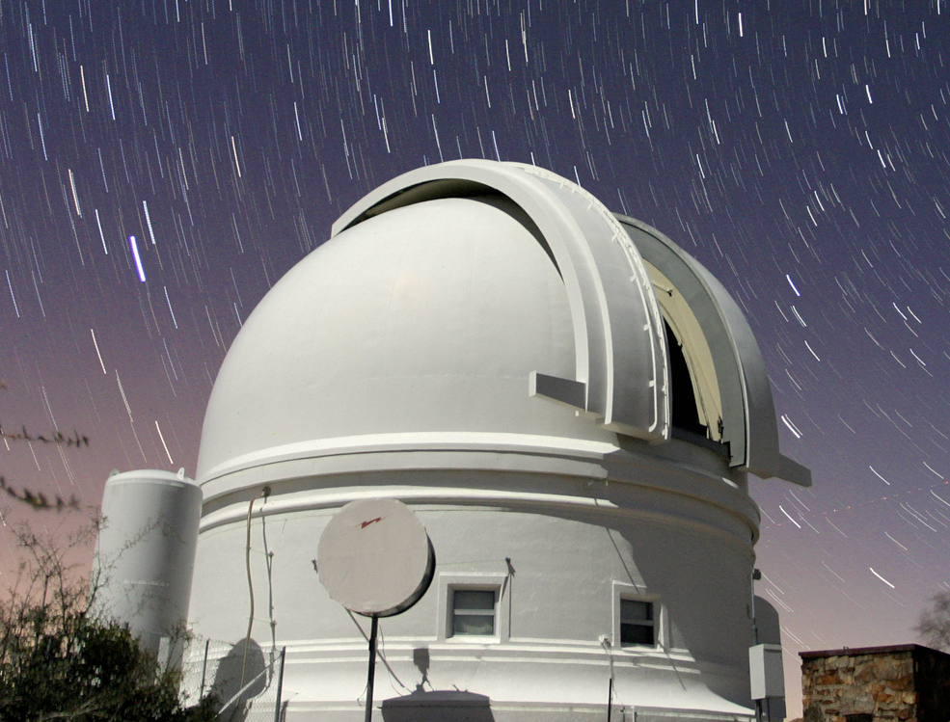
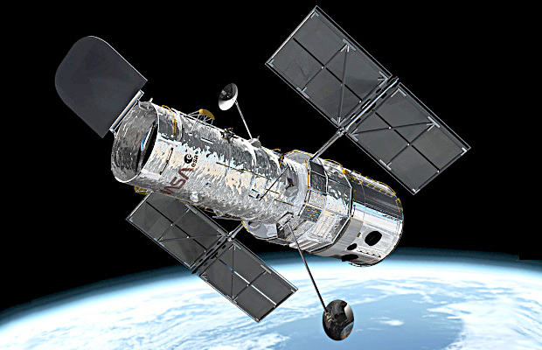
SNe and THE ORIGIN OF THE ACCELERATED COSMIC EXPANSION
WHAT IS THE ORIGIN OF THE COSMIC ACCELERATION?
Cosmological constant, consistent with existing data but is >10⁶⁶ times lower than the expected vacuum energy
Completely new physics?
Combined studies of low- and high-redshift SNe provides the key for testing models for the cosmic acceleration: studies of the time-evolution
Current: HST programs for high-redshift, Future: satellite projects EUCLID and WFIRST
Zwicky Transient Facility (2017-2020) for studies of low-redshift SNe. Financial support from KAW (32 MSEK).
Sweden is leading the SN Ia effort
The Type Ia Supernova Hubble Diagram 2016
Zwicky Transient Facility at Palomar
HST

Slide 7
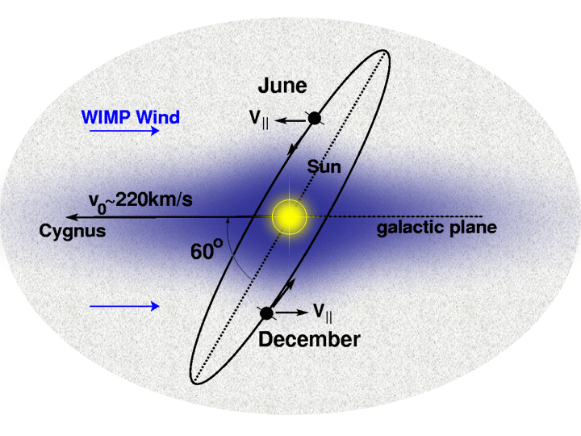
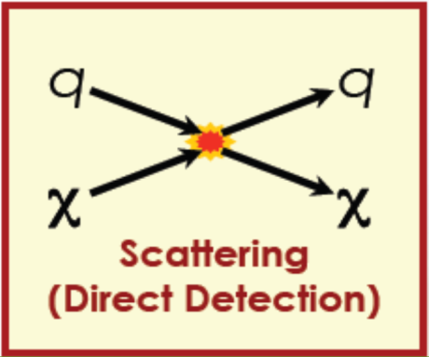
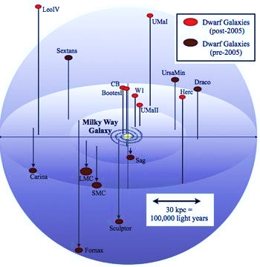
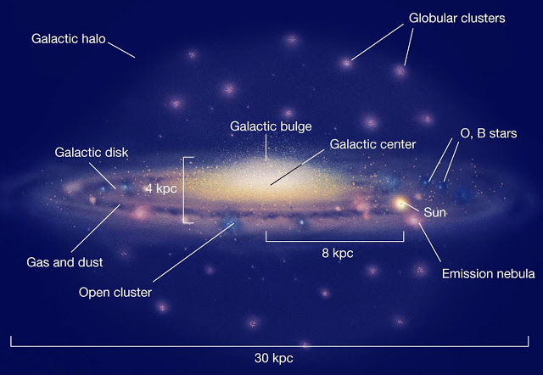



DARK MATTER SEARCHES
WIMPs predicted in extensions of the SM like SUSY
Dwarf spheroidal galaxies
Galactic Halo
Galactic Center
Sun/Earth

Slide 8
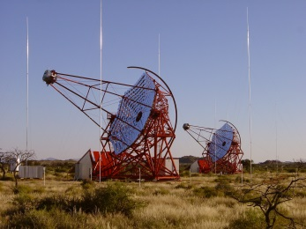
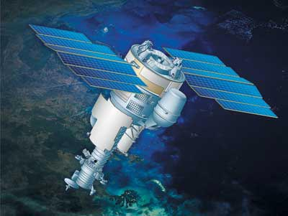
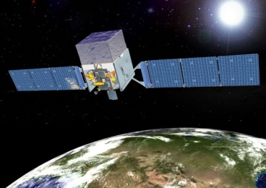
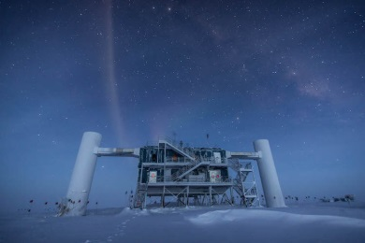
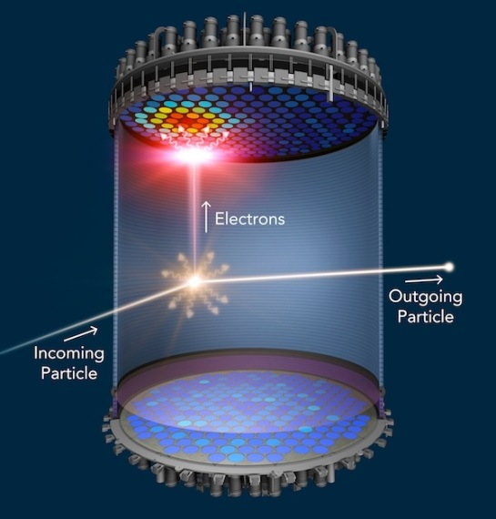
DARK MATTER SEARCHES
H.E.S.S.
indirect detection
DM annihilation produces SM particles
☞ neutrinos, γ-rays, anti-protons, positrons
PAMELA
FERMI
rate depends on
- annihilation cross-section
- particle physics
IceCube
direct detection
DM particle scattering off nuclei
cryogenic detectors
noble liquid detectors
rate depends on
- nuclear physics
Notes:
Annihilation of DM particles into SM particles …
Direct detection is novel …

Slide 9
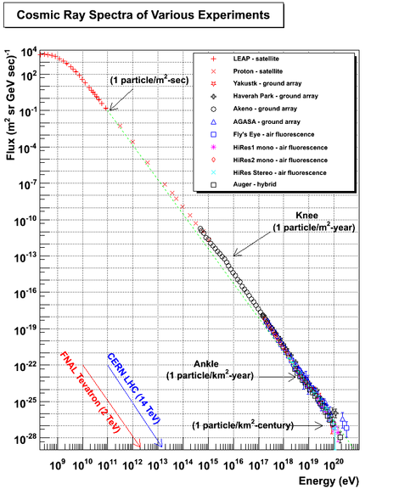
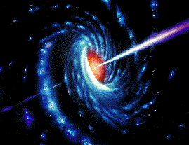
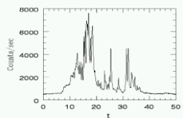
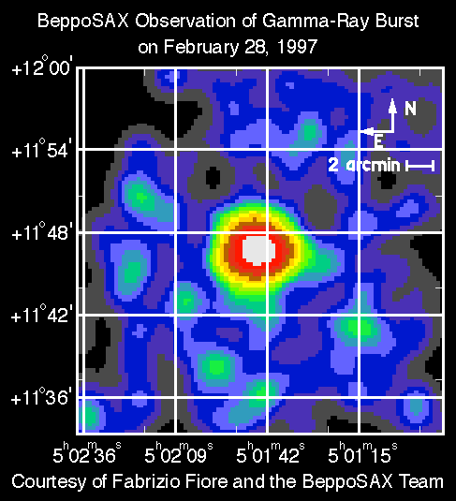
PROBES OF THE VIOLENT UNIVERSE
CR’s observed at Earth with immense energies
What are the sources?
What is the acceleration mechanism?
Active Galactic Nuclei
~ 50 Joule
Gamma Ray Bursts

Slide 10
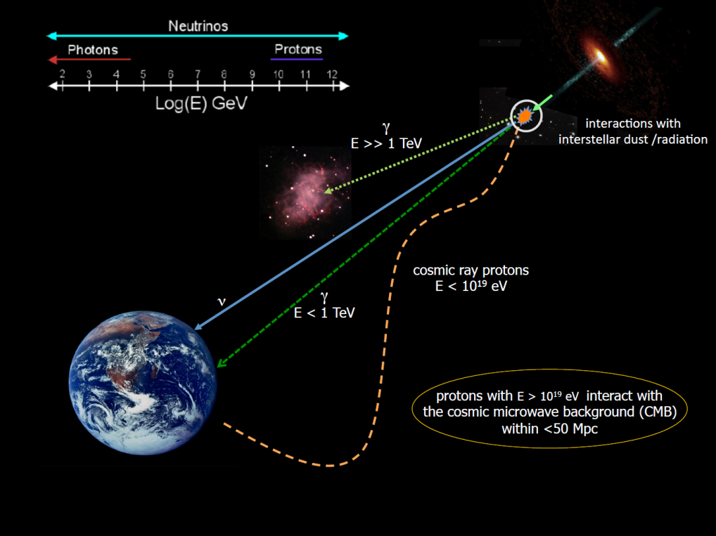
MULTI-MESSENGER APPROACH
To identify the sources of highest energy CR’s – must use as many astrophysical messengers as possible
CR’s
high-energy γ’s
high-energy ν’s
gravitational waves
E < 10¹⁹ eV CR’s do not point back
E > 10¹⁹ eV CR’s interact with CMB
γ’s interact with dust and radiation
ν’s travel essentially unhindered
difficult to catch
MAGIC
In Sweden: CR’s, high-energy γ’s, high-energy ν’s
Notes:
To pinpoint the sources … and to learn about the acc mech we need to combine info from as many astrophys messengers as possible. Each has its difficulties.
In Sweden we work with the first three.

Slide 11
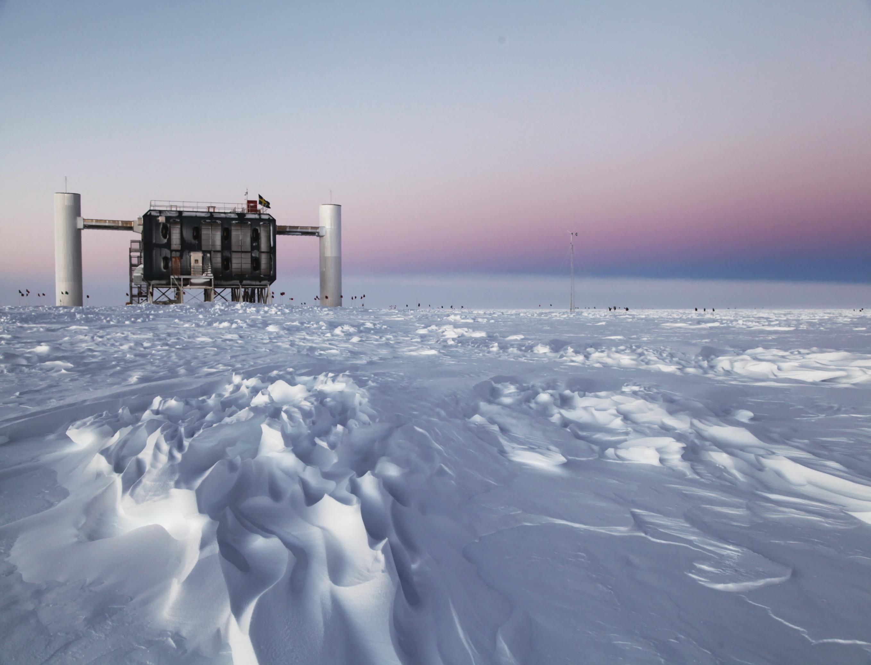
ICECUBE
Notes:
IceCube is the flagship …

Slide 12
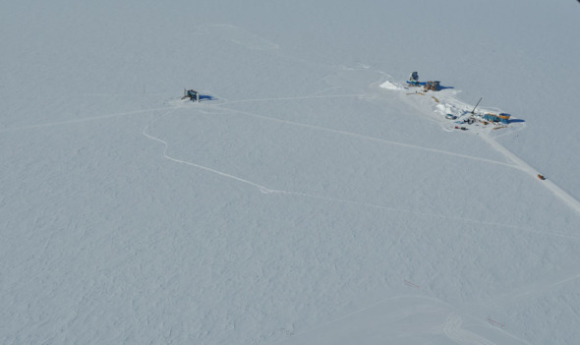
IceCube is the world’s leading neutrino observatory
  unique – ice-based, volume 1 km³
  performance – superior to expectation

Slide 13
IceCube is the world’s leading neutrino observatory
  unique – ice-based, volume 1 km³
  performance – superior to expectation
US and Sweden pioneered ice-based ν astronomy
  decisive Swedish contributions since prototype stage
  – detector components, understanding the ice
  – sizeable Swedish contributions to IceCube construction
  5 labs/2 countries (1992) → 47 labs/12 countries (2016)

Slide 14
IceCube is the world’s leading neutrino observatory
  unique – ice-based, volume 1 km³
  performance – superior to expectation
US and Sweden pioneered ice-based ν astronomy
  decisive Swedish contributions since prototype stage
  – detector components, understanding the ice
  – sizeable Swedish contributions to IceCube construction
  5 labs/2 countries (1992) → 47 labs/12 countries (2016)
Sweden makes decisive contributions to IceCube to-day
  Swedish scientists lead 4 out of 10 science working groups + TFT
  2/total 5 IceCube spokespersons – from Sweden

Slide 15
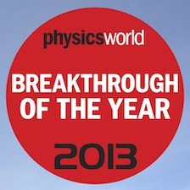
IceCube is the world’s leading neutrino observatory
  unique – ice-based, volume 1 km³
  performance – superior to expectation
US and Sweden pioneered ice-based ν astronomy
  decisive Swedish contributions since prototype stage
  – detector components, understanding the ice
  – sizeable Swedish contributions to IceCube construction
  5 labs/2 countries (1992) → 47 labs/12 countries (2016)
Sweden makes decisive contributions to IceCube to-day
  Swedish scientists lead 4 out of 10 science working groups + TFT
  2/total 5 IceCube spokespersons – from Sweden
IceCube has discovered the hypothesized flux of high-energy cosmic ν’s
    key to neutrino astronomy, imagined in the 1960’s

Slide 16
IceCube is the world’s leading neutrino observatory
  unique – ice-based, volume 1 km³
  performance – superior to expectation
US and Sweden pioneered ice-based ν astronomy
  decisive Swedish contributions since prototype stage
  – detector components, understanding the ice
  – sizeable Swedish contributions to IceCube construction
  5 labs/2 countries (1992) → 47 labs/12 countries (2016)
Sweden makes decisive contributions to IceCube to-day
  Swedish scientists lead 4 out of 10 science working groups + TFT
  2/total 5 IceCube spokespersons – from Sweden
IceCube has discovered the hypothesized flux of high-energy cosmic ν’s
    key to neutrino astronomy, imagined in the 1960’s
IceCube’s science goals include
    astrophysics, cosmic ray physics, dark matter, SNe
    neutrino properties

Slide 17

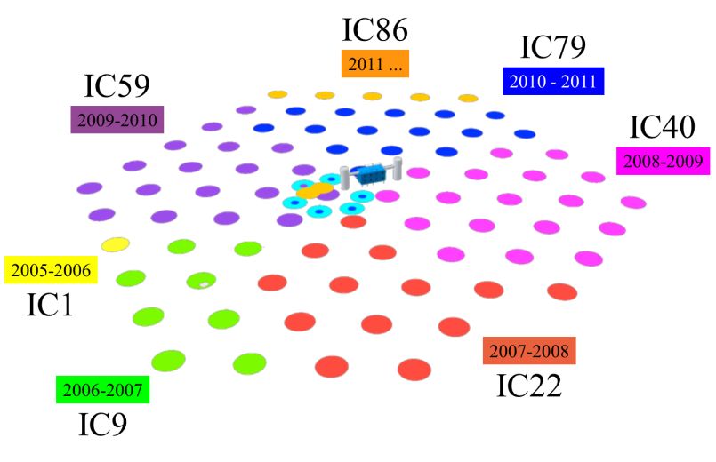
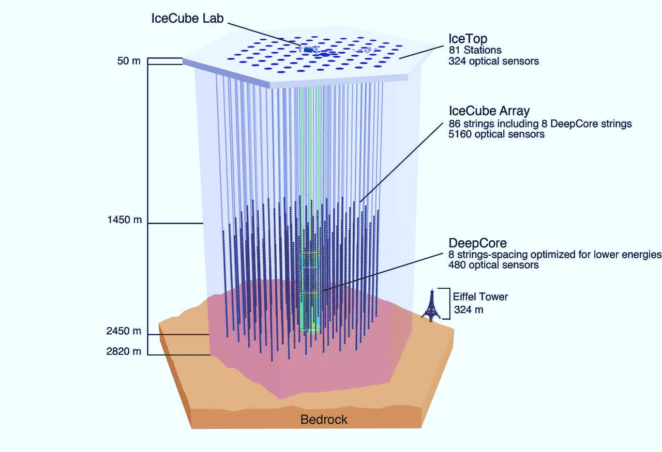
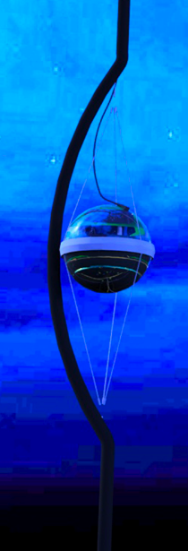
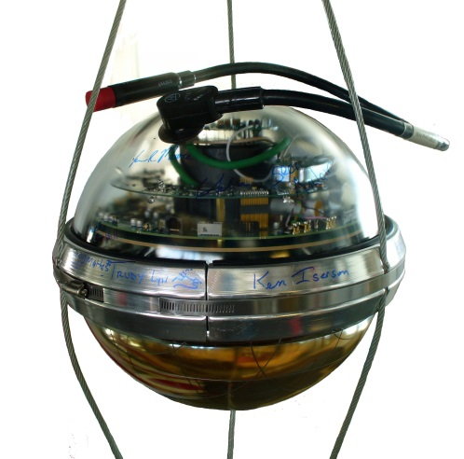
WORLD’S LARGEST NEUTRINO OBSERVATORY
5160 DOM’s in ice
1km³ = 1 Gt instrumented volume
started full operations in May 2011
Extended Air Shower detector
cosmic ray physics 10¹⁴ – 10¹⁸ eV
electronics
DeepCore
20 Mt low-energy ext.
threshold: 10 GeV
PMT
Digital Optical Module

Slide 18
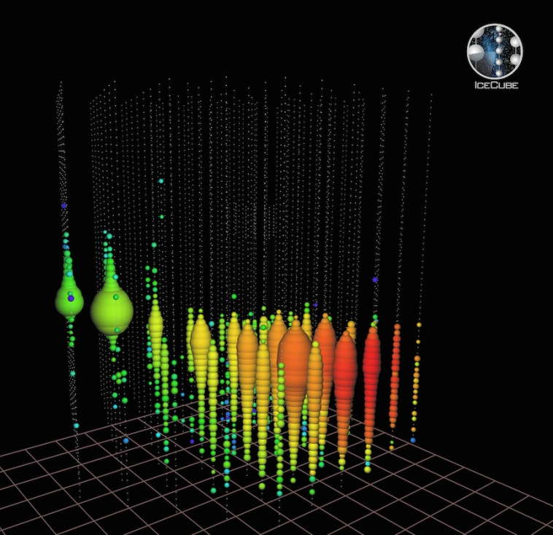
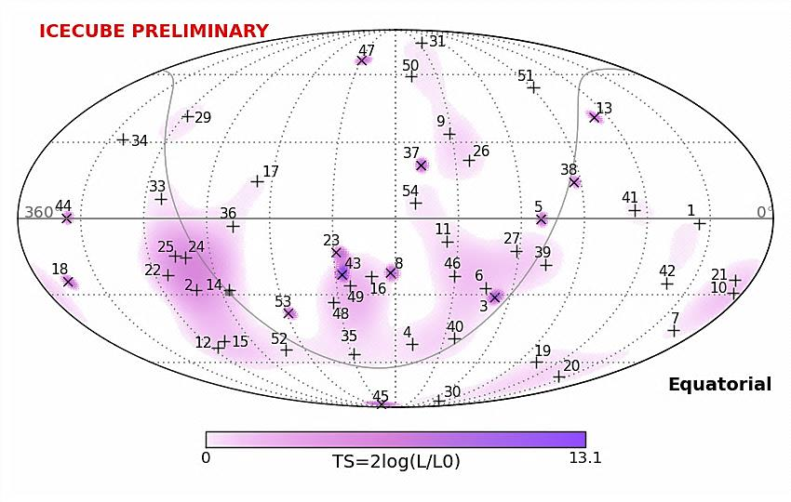
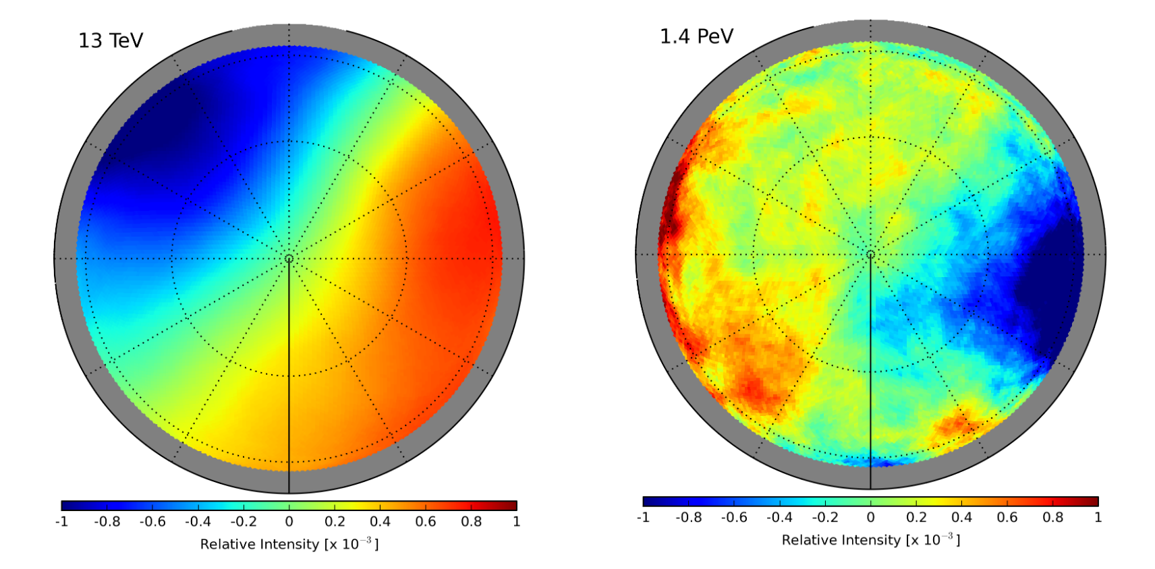
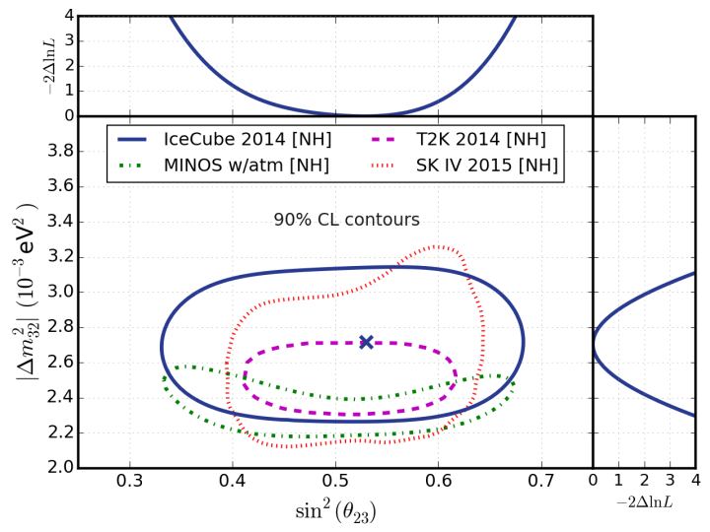
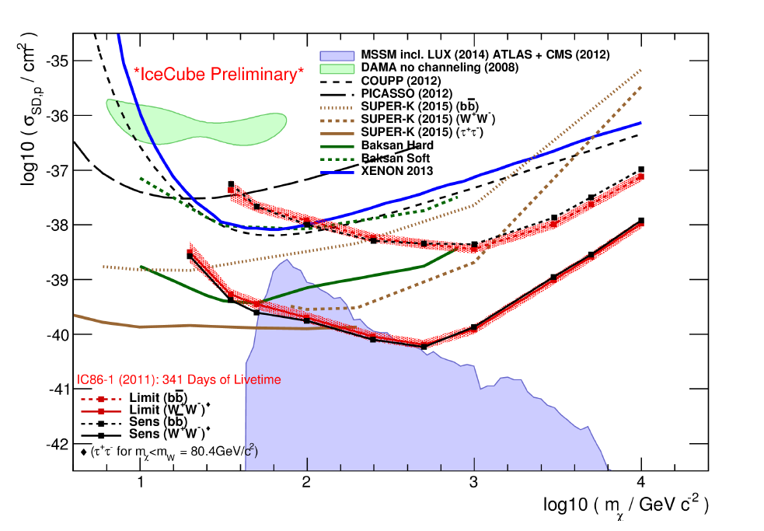
SOME OF THE SCIENCE RESULTS
the highest energy ν
ever observed
deposited 2.6 ± 0.3 PeV
Galactic plane
SD WIMP-proton cross-section limits
ν oscillation parameters
CR anisotropies

Slide 19
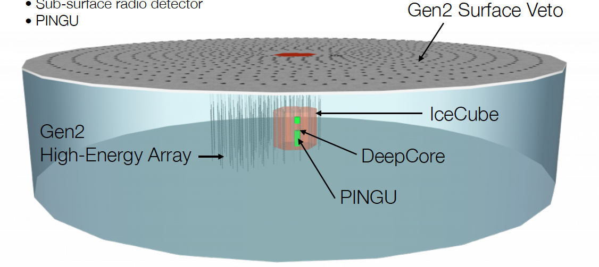
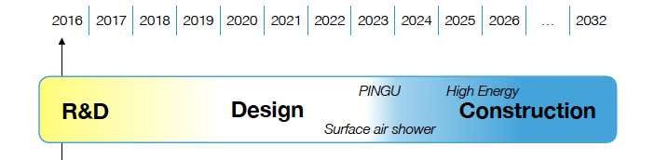
A MULTI-COMPONENT NEUTRINO OBSERVATORY
Surface air shower array
In-ice Gen2 high-energy array
PINGU
Sub-surface radio array?
IceCube-HEA

Slide 20
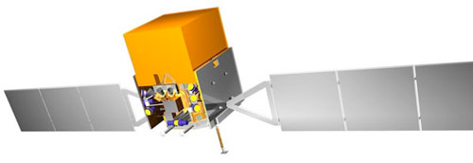
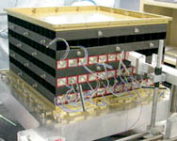
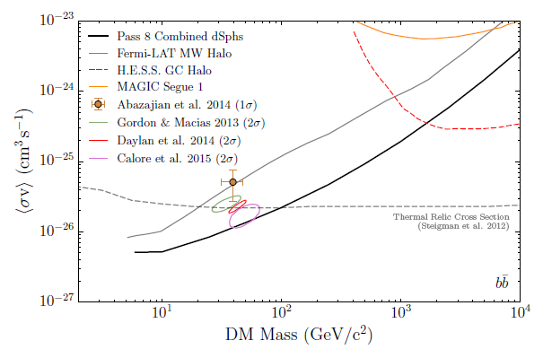
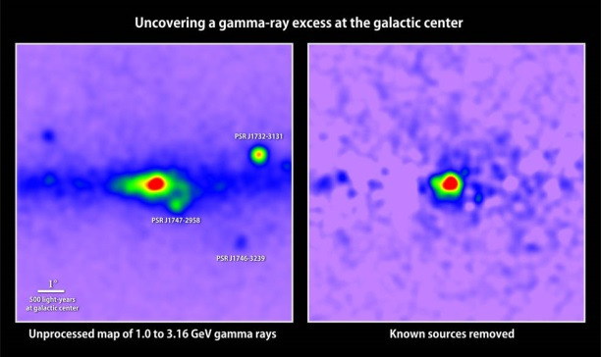
FERMI-LAT – dark matter
Sweden participates since late ’90s
calorimeter crystals – financed by KAW
16 modules of 96 crystals
operations financed by SNSB+VR
running until ~2018
Sweden leading DM searches
PRL 115:231301 (2015)
highlights:
dwarf galaxy constraints
Galactic Centre excess
Map of γ-rays with energies between 1 and 3.16 GeV. Removing all known γ-ray sources reveals excess emission. DM annihilation?
Astrophys. J. 819:44 (2016)
Notes:
Since late 1990’s, Sweden participates in FERMI, having contributed …
A highlight is the limit on the DM annihilation cross-section from a stacked search including 15 spheroidal dwarf galaxies. … excludes … and constrains the parameter space for potential signal if the excess at the GC is interpreted as DM

Slide 21
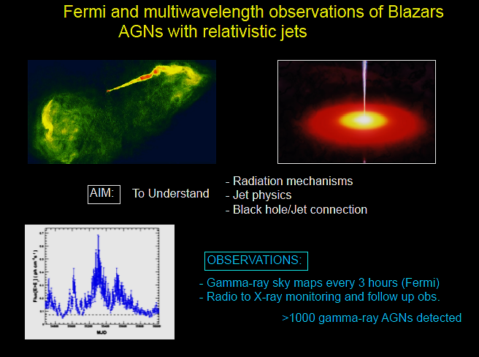
FERMI – gamma rays
Notes:
Fermi observations can also be used to investigate …

Slide 22
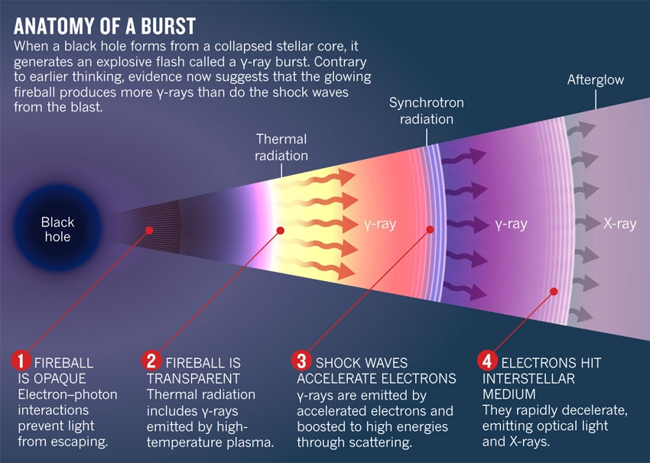
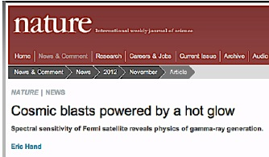
FERMI – gamma ray bursts
most powerful explosions in the universe
energetically probable sources of UHE CRs
PARADIGM SHIFT
Emission from the photosphere of a jet is now considered main candidate for explaining the prompt emission in GRBs
Notes:
Since its launch in 2008, FERMI has registered hundreds of GRBs. … accelerating hadrons through interaction with shocks in the jets …

Slide 23
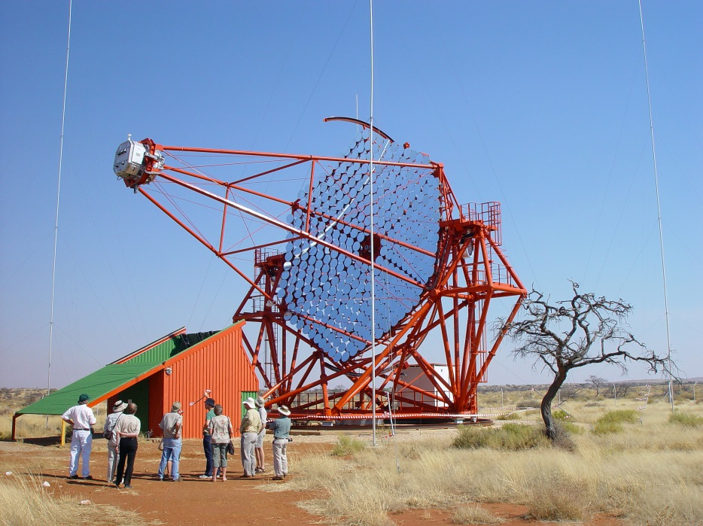
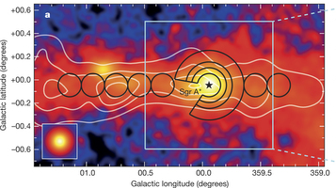
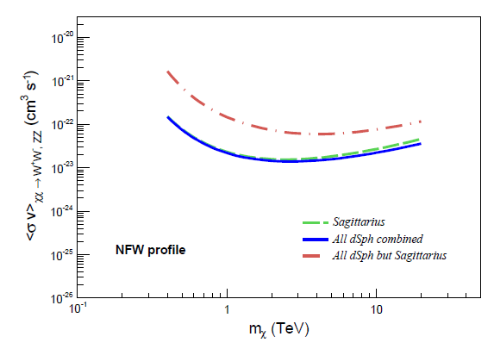
H.E.S.S.
main mission:
to resolve sources of high-energy γ-rays
Phys.Rev. D90:112012 (2014)
DM working group leadership
(2013-2014)
dwarf galaxy constraints
Notes:
The High Energy Spectroscopic System consists of 5 telescopes in Namibia. Its main mission …

Slide 24
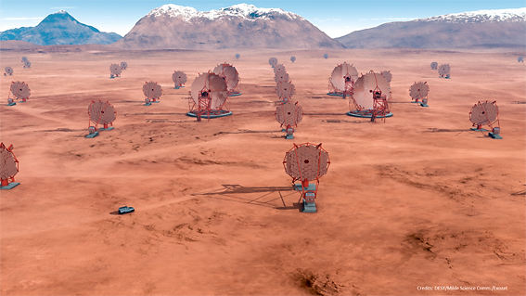
CHERENKOV TELESCOPE ARRAY
next generation γ-ray observatory
aiming at sensitivity 5-10 x H.E.S.S.
10’s GeV < E < 100 TeV
on ESFRI’s road map
interest in Sweden in high-energy astrophysics, DM searches
Swedish contributions
  calibration devices for the Large Size Telescope (LST)
  camera test facility
  fundamental physics wg leadership 2008-2015
Notes:
The logical next step …

Slide 25
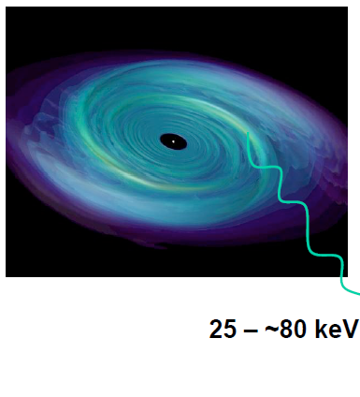
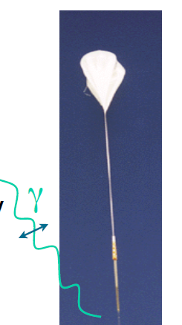
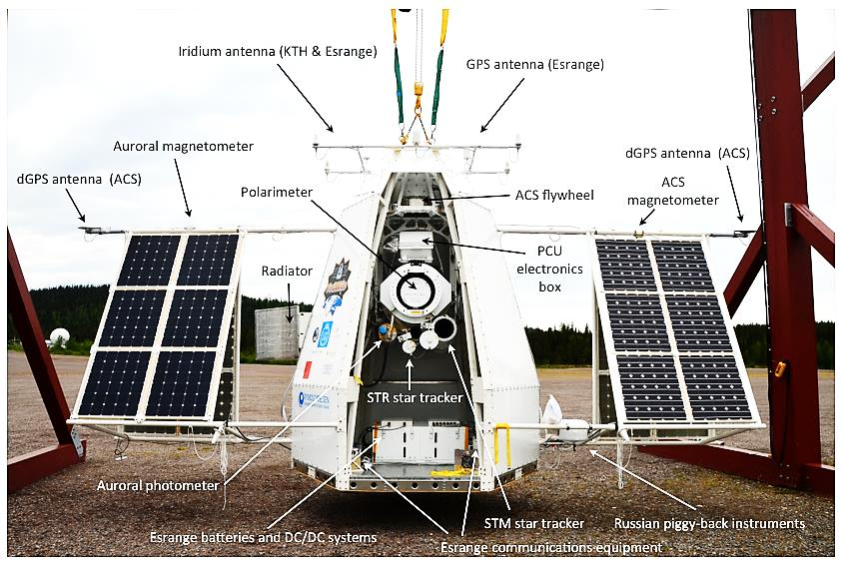
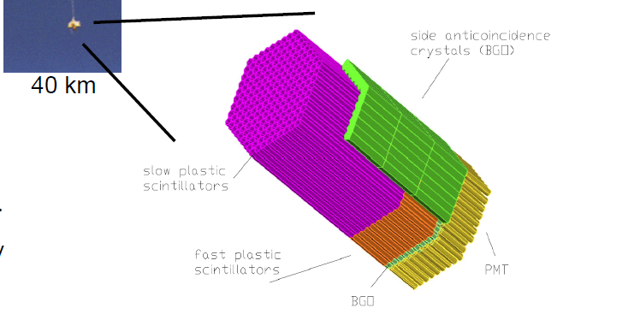
PoGoLite
PoGoLite is a balloon-borne hard X-ray (25-240 keV) polarimeter optimized for point sources like the Crab pulsar or Cyg X-1
polarization measurements
– a powerful diagnostic for source
emission mechanisms
geometrical and physical effects can be disentangled
Where does high-energy emission occur in the Crab magnetosphere?
Notes:
PoGoLite is the latest in a series of space borne experiments initiated by KTH.

Slide 26
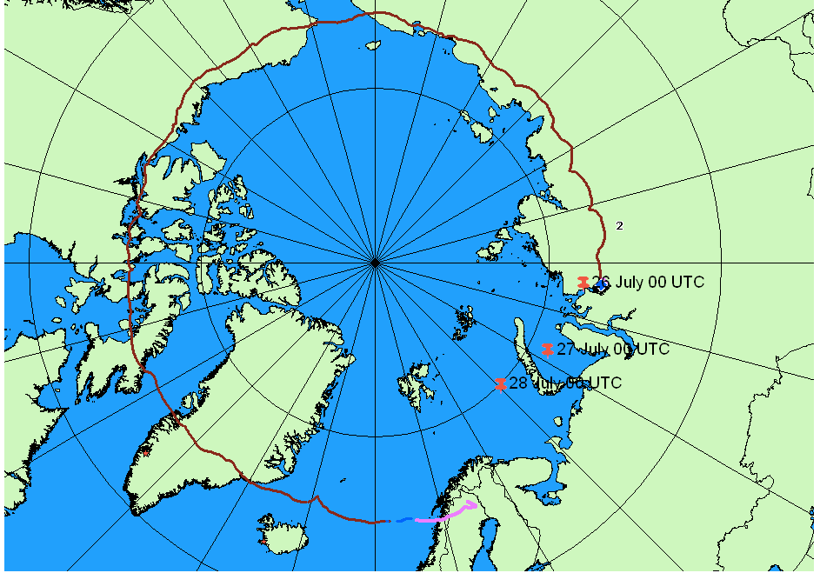


PoGoLite
Landing
2013-07-26
Norilsk
Launch
2013-07-12
Esrange
Π = (18.4+9.8-10.6)% Ψ=(142.2±16.0)°
M. Chauvin et al, MNRAS Lett. 456:L84 (2016)
polarization results in hard X-ray band
from PoGoLite 2013 flight
upgraded mission POGO+ flies summer 2016
miniaturized instrument concept proposed for
a national satellite SPHINX, for GRB polarization
measurements

Slide 27

XENON
Sweden members since 2015
Contributions:
European analysis facility (SU/KTH)
computing infrastructure LNGS
various physics analysis
Status:
XENON1T inaugurated: Nov 17, 2015
now filling XENON!
☞ XENONNT (~ 7 t upgrade)
first parts purchased
Finance:
KAW (29 MSEK)
fully funded until 2020
Notes:
As already mentioned, XENON is a novel project on the Swedish scene …

Slide 28



in-ice antarctic radio detector
existence of UHE CRs guarantees flux of cosmogenic neutrinos
discovery requires ~100 km³ instr.
p+γ_{CMB} → Δ⁺ → n+π ⁺
ARIANNA (at the Ross Ice Shelf)
→ μ⁺+ν_{μ}
−
funded for protoyping
energy threshold ~ 10¹⁶ eV
radio attenuation length  300 – 500 m
acceptance  horizontal/down-going
→ e⁺+ν_{e}+ν_{μ}
ν’s produced close to the source - revealing
Notes:
Figure 3. Projected 5 calendar year sensitivities for ARIANNA (36*36 stations) and 50 MHz ARIANNA option. For ARA37 the projected 3 year sensitivity from [10] is given as well as a rescaled 5 year estimate, see text for explanation. The 5 year sensitivity of the IceCube EHE analysis is shown as well as a selection of current limits and range of predictions for the flux of

Slide 29


ALTO
a new wide-field, high-altitude water Cherenkov project (cf. HAWC)
proposed by LnU
goal – 5 x HAWC sensitivity
design study 2016-2017
financed by the Crafoord Foundation
keep the detector simple
  with easily replaceable components
expression of interest from the US, France, South Africa
full prototype in Växjö ready in 2017
located close to CTA South (Armazones?)
at 5200 m – to catch the shower maximum
may be part of the CTA upgrade

Slide 30




SUMMARY
Sweden hosts a lively
astroparticle physics activity
participates in world class international projects
achieves international visibility
program focused towards
- dark matter searches
- understanding the violent
universe
future plans aligned with those of the international community

Slide 32

What is the origin of the cosmic acceleration?
Cosmological constant, consistent with existing data but is >10⁶⁶ times lower than the expected vacuum energy
Completely new physics?
Combined studies of low- and high-redshift SNe provides the key for testing alternative models for the cosmic acceleration: studies of the time-evolution
Current: HST programs for high-redshift, Future: satellite projects EUCLID and WFIRST
ZTF (2017-2020) for studies of low-redshift SNe

Slide 33
SWEDISH CONTRIBUTIONS TO ICECUBE
Total cost of IceCube construction $279.5 M
  NSF $242.1 M
  BE + GE + SE $ 37.4 M
Operations: NSF core grant for M&O $7 M/year
Sweden contributed 55.8 MSEK (~ $7 M)
  18 MSEK from VR
  37.8 MSEK from KAW including 19.8 MSEK for DeepCore
  built and verified 20% of all DOMs
deployment (supported by Swedish Polar Research)
contribution to common fund $13 650 per PhD per year (VR)
project grants (VR) ~ 2 MSEK/year: salaries, travel
Swedish participation currently
SU: 2 faculty + 1 postdoc + 3 PhD students
UU: 3 faculty (+1 researcher) + 2 PhD students + 1 engineer

Slide 34

DARK MATTER SEARCHES
WIMPs predicted in extensions of the SM like SUSY
Dwarf spheroidal galaxies
Galactic Halo
Galactic Center
Sun/Earth

Slide 35

PoGoLite
polarization measurements in the X-ray band
geometrical and physical effects can be disentangled
allows model independent investigation of underlying processes
where does high-energy emission occur in the Crab magnetosphere?
PoGoLite is a balloon-borne hard X-ray (25-240 keV)
polarimeter optimized for point sources.

Slide 36


MULTI-MESSENGER APPROACH
CR’s, high-energy γ’s, high-energy ν’s
gravitational waves
E < 10¹⁹ eV CR’s do not point back
E > 10¹⁹ eV CR’s interact with CMB
γ’s interact with dust and radiation
ν’s travel essentially unhindered
difficult to catch
TeV γ-rays first detected in 1989 – IACTs
☞ astronomy since 2003 with VERITAS, MAGIC,
H.E.S.S.
MAGIC
cosmic ν’s first detected in 2013
gravitational waves first detected in 2015
Notes:
To pinpoint the sources … and to learn about the acc mech we need to combine info from as many astrophys messengers as possible. Each has its difficulties.
In Sweden we work with the first three.

