Slide 1
CMS communications
Update for IPPOG
May 2016
Krakow

Slide 2
CMS Public Data

Slide 3
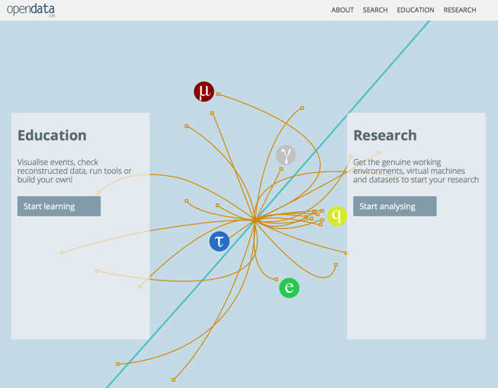
CMS Public Data
New release of CMS data to the public
CMS has released half of 2011 data (~2.5 1/fb) via the CERN Open Data Portal along with…
Monte Carlo
trigger and validation information
example code
virtual machine with computing environment
new event display
http://opendata.cern.ch

Slide 4
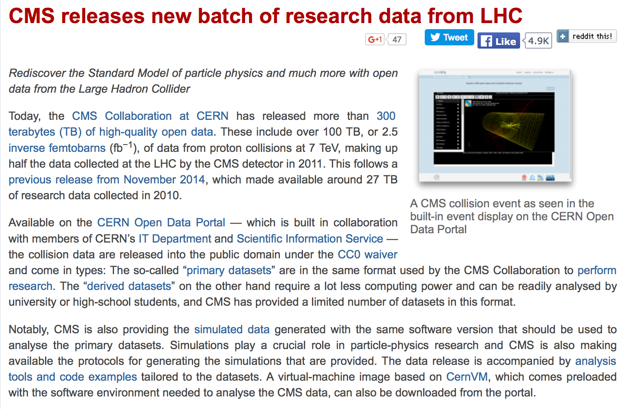

CMS Public Data
http://cms.web.cern.ch/news/cms-releases-new-batch-research-data-lhc

Slide 5
MULTIMEDIA

Slide 6
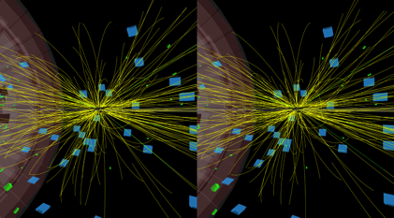
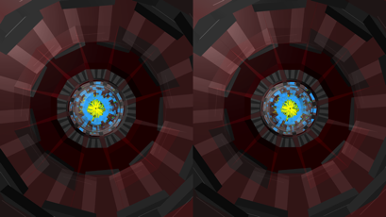
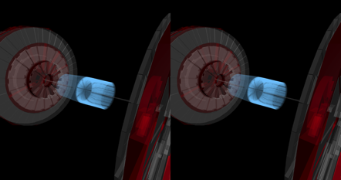
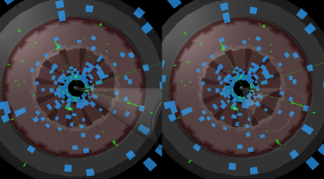
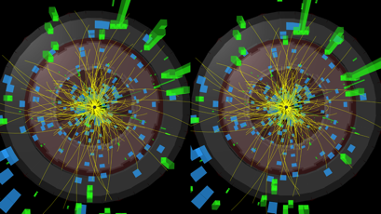
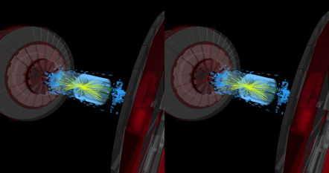
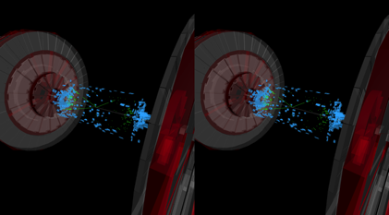
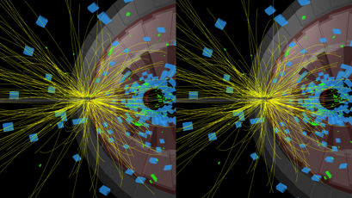
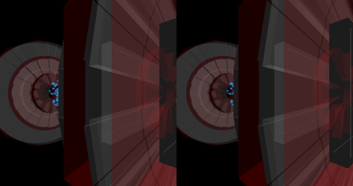
4 clips produced for CMS 3D cinema at P5
CMS Multimedia
Three 4-lepton Higgs candidate events
One di-photon Higgs candidate event

Slide 7
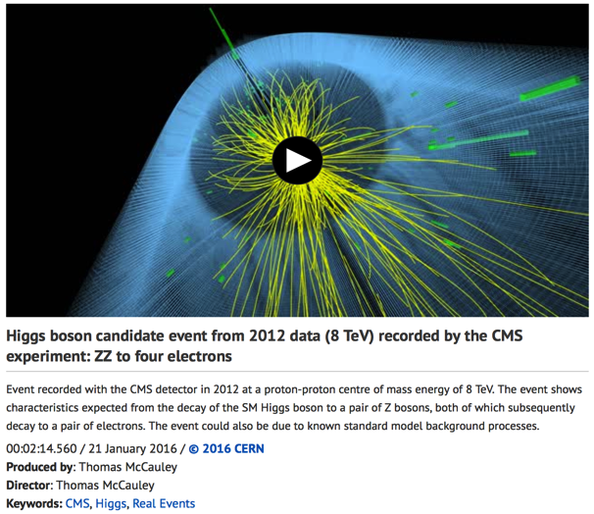
CMS Multimedia
Williamson Gallery in Pasadena, California
UNCERTAINTY exhibition October 13, 2016 - January 15, 2017
Multiple works of art, objects, and artifacts that ignite curiosity about the different meanings engaged by "uncertainty" in science and in common usage.
In the exhibition, it is anticipated that a video sequence drawn from 3-D particle collision imagery at CERN's LHC will be featured in a room-sized projection onto a gallery wall or rear-screen, in a continuously looping cycle.
https://cds.cern.ch/record/2126012
More information: https://cms-docdb.cern.ch/cgi-bin/DocDB/ShowDocument?docid=12792; A version with the CMS logo is available on CDS https://cds.cern.ch/record/2126016

Slide 8
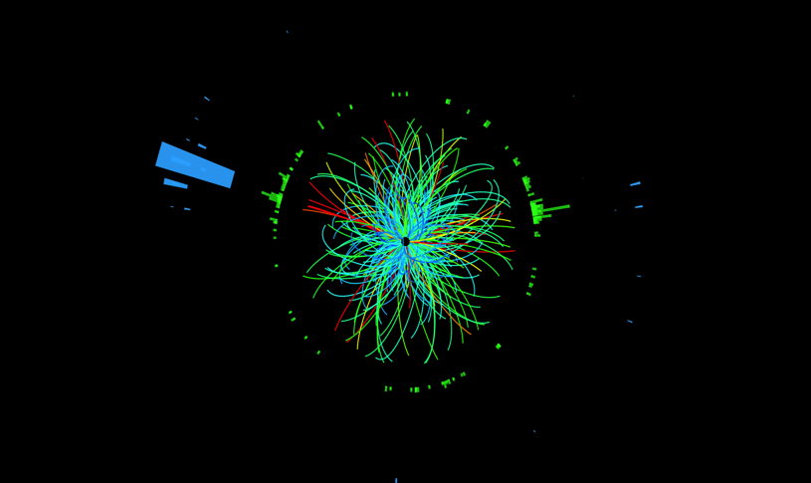
CMS Multimedia
Film about LHC and CERN
120 images of CMS collisions were produced for Valerio Jalongo, an Italian filmmaker working on a film about the LHC and CERN.
  SVG format
  collisions on July 7 2015
  1st collisions at 13 TeV with 3.8 T

Slide 9
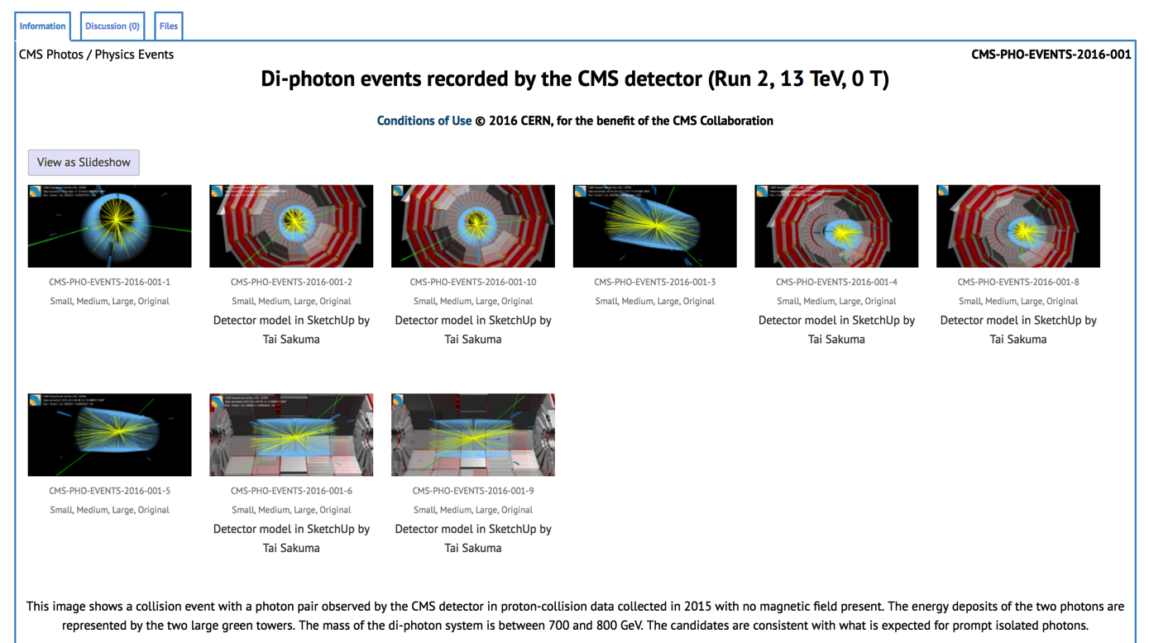
CMS Multimedia
Event displays for the public
Di-photon events recorded by the CMS detector (Run 2, 13 TeV, 0 T): https://cds.cern.ch/record/2139792
Commissioning with low-intensity beams… http://cds.cern.ch/record/2148222
Collisions recorded by the CMS detector on 7 May 2016 at the start of the year's physics runhttp://cds.cern.ch/record/2151078

Slide 10
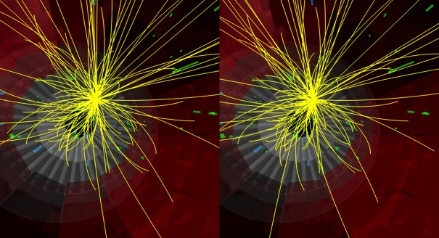
CMS Multimedia
iSpy-WebGL
2 new releases since last IPPOG: http://cern.ch/ispy-webgl
CMS masterclasses use a special version of iSpy-WebGL starting this year
CMS Cardboard, an application for Google Cardboard https://www.google.com/get/cardboard that runs in a mobile browser and shows animated collisions in 3D: http://cern.ch/cms-cardboard
CMS cardboard

Slide 11
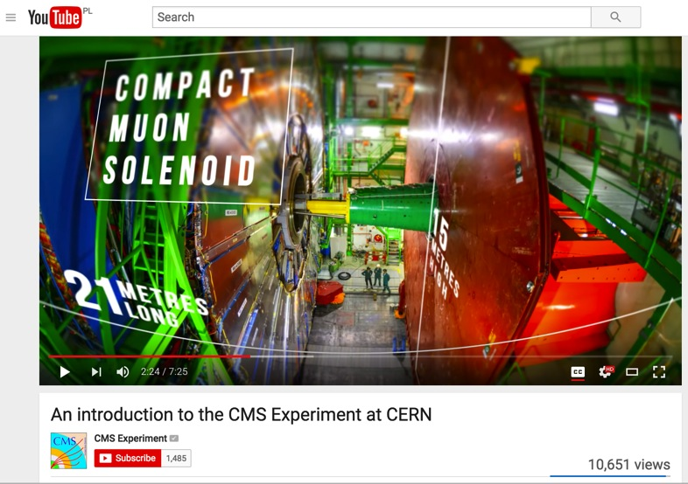
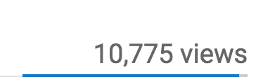
CMS video produced in cooperation with Dell
CMS Multimedia
Published March 2016
Features nice infographics
Produced mainly for CMS visits
Used by guides as introduction to CMS during CMS visits, included in the preparatory material before CMS Virtual Visits…
Subtitles translated to 13 languages: Arabic, Bulgarian, Chinese simplified, Chinese traditional, Dutch, Italian, Polish, French, Persian, Serbian, Russian, Spanish, Turkish, more to come…
Thanks to our collaborators for help in translations!
https://www.youtube.com/user/CMSExperimentTV

Slide 12
CMS visits

Slide 13
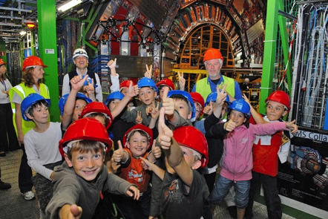
CMS Visits
Welcoming visitors throughout the year
    2011 – 3,000 visitors
    2012 – 10,384 visitors
    2013 – 30,000 visitors (LS1)
    2014 – 38,000 visitors (LS1)
    2015 – 20,668 visitors(LS1 and run2)
9226 Visitors that visited the detector (January to April 2016)
Collaborating with the CERN Local Communications team, we organized
15 group visits from schools in the local area
Typical CMS visitors:
Scientist Schools Universities CERNois Politicians

Slide 14
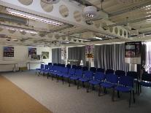
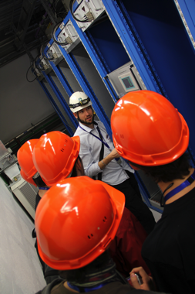
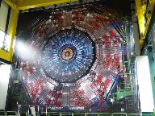
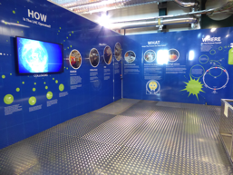
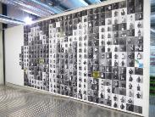
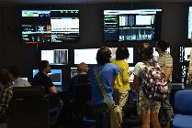
CMS Visits
Visiting CMS at Point 5
During data taking CMS is the only facility where visiting groups can go underground.
Our aim is to provide an insight and understanding of CMS, CERN, and the LHC.
Videos and presentations
Peter Sharp Conference room
CMS real-size poster
Introducing LHC
to the visitors
Going underground to where the data is collected!
CMS Collaboration portraits
The CMS Control room

Slide 15
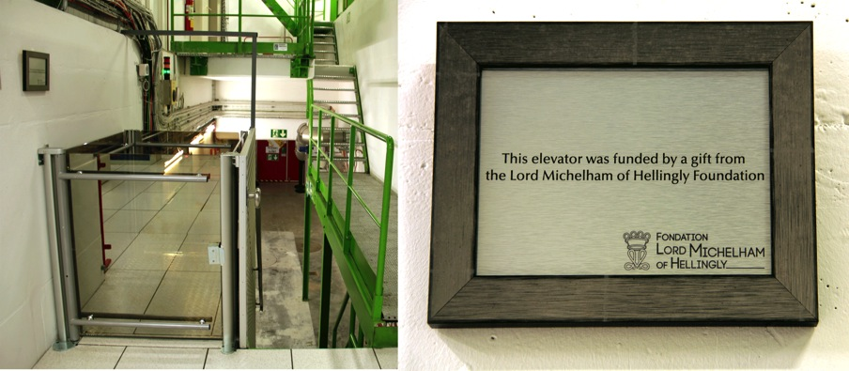
Point 5 visits infrastructure
CMS Visits
Monthly CMS guides training session (New!)
  Join the CMS guides! https://espace.cern.ch/CMSguides
2D videos of LHC Long Shutdown 1
3D videos available in CMS 3D cinema (New!)
3D image based on lenticular lenses (in production)
The CMS detector is now wheelchair accessible!
  Lift sponsored by Lord Michelham of Hellingly Foundation
  Installed fall 2014

Slide 16
CMS Virtual Visits

Slide 17
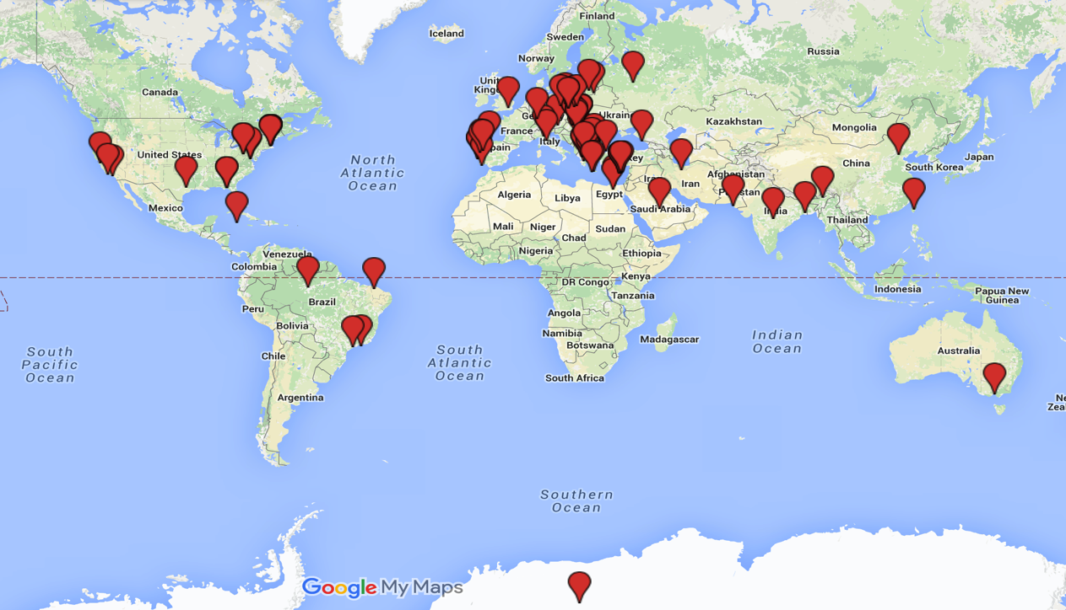
CMS Virtual Visits
>15.7k participants worldwide
Sept. 2014 – May 2016
Thanks to CMS Guides!

Slide 18
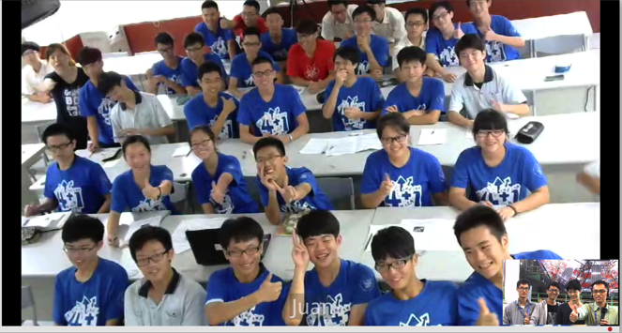
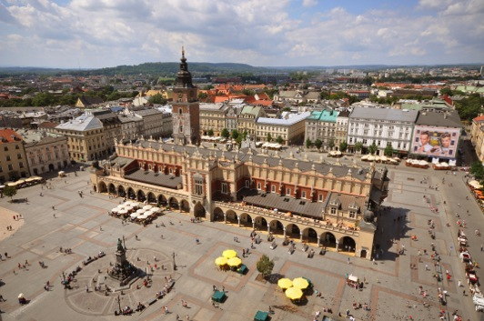
CMS Virtual Visits
New countries:
Breaking news!
Lebanon (April 2016)
Australia (Oct. 2015)
Taiwan (July 2015)
Planned: Korea & Hong Kong (June 2016)
  CMS Virtual Visit from the main square at the Krakow Science Festival ☺
  Friday 20th May 13:30-14:30
  https://cds.cern.ch/record/2154619?ln=en

Slide 19
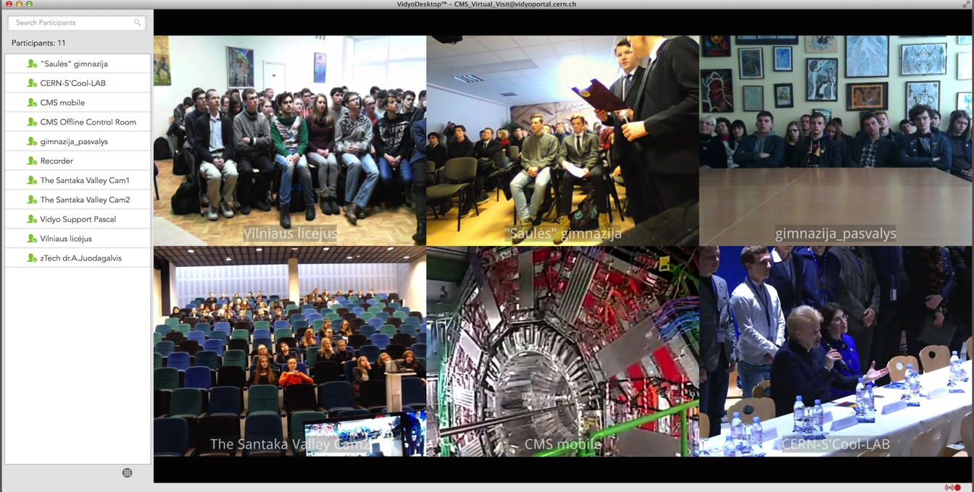
CMS Virtual Visits
Lithuanian President, Dalia Grybauskaite, connected to a CMS Virtual Visit during her diplomatic visit to CERN, to greet students from 5 Lithuanian schools.

Slide 20
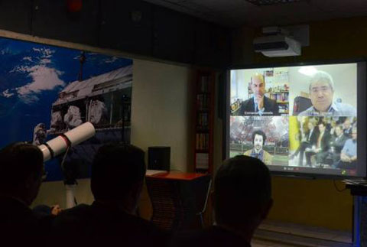
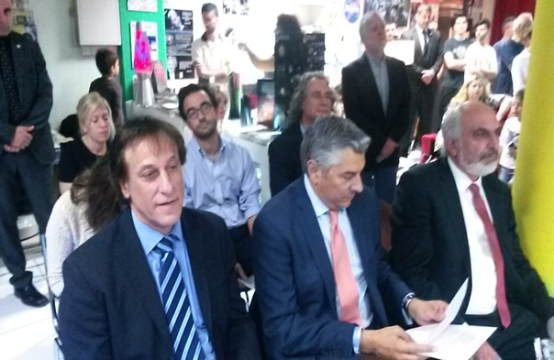
Inauguration of the first Science Café in Nicosia, Cyprus
CMS Virtual Visits
Inauguration of the first Science Café in Nicosia, Cyprus (25 April 2016) with presence of:
The President of the Republic of Cyprus, Nikos Anastasiadis, along with three ministers, the Mayor of Nicosia and more than 150 members of general public
Prof. Paris Sphicas, CMS Deputy Spokesperson
Prof. Emmanuel Tsesmelis, Head of CERN Associated and Non-Member States

Slide 21
Art@CMS

Slide 22
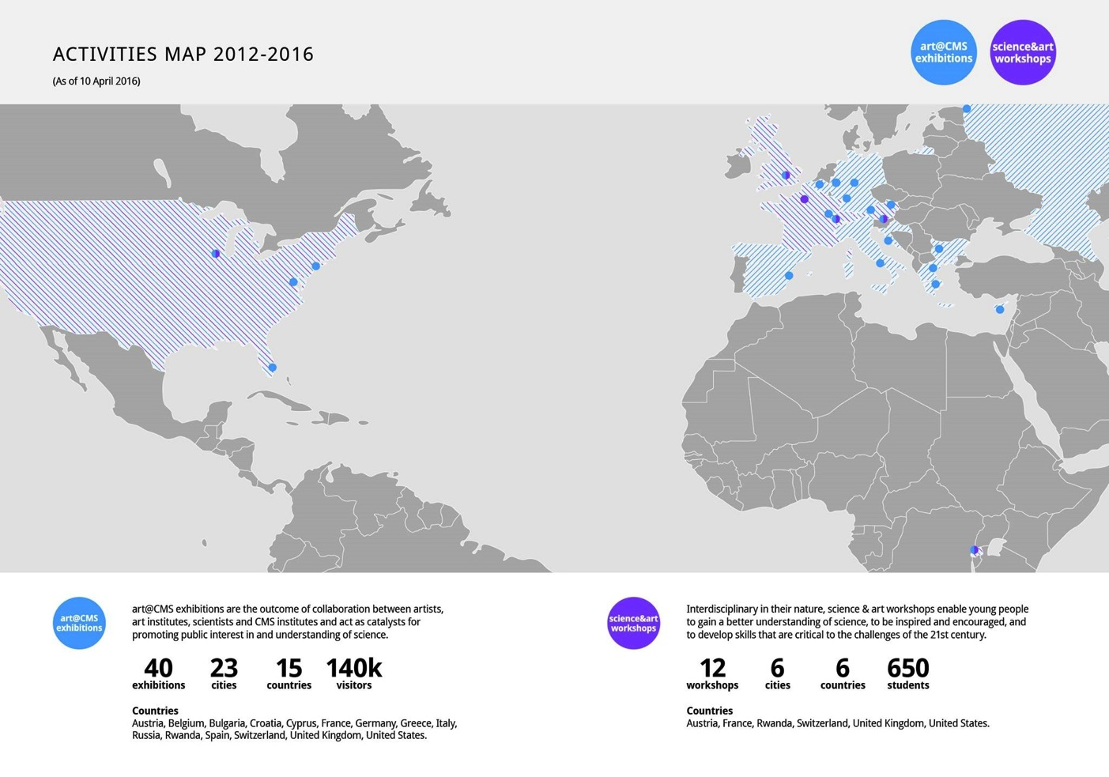
art@CMS

Slide 23
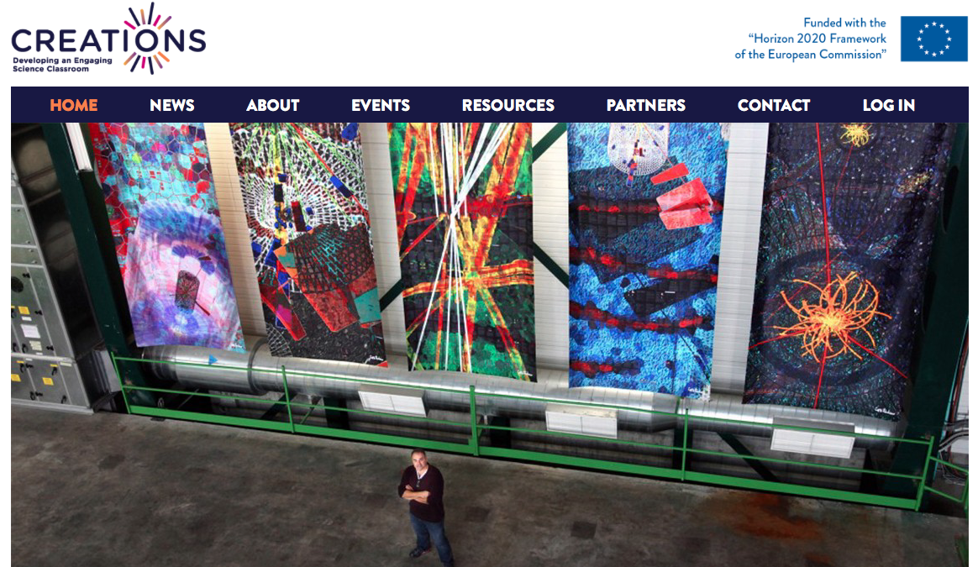

art@CMS

Slide 24
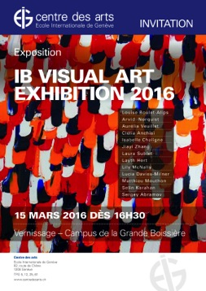
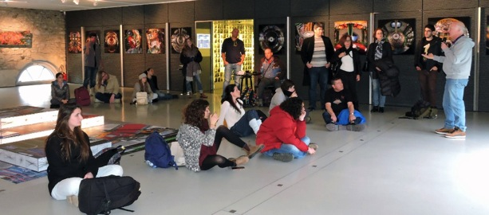
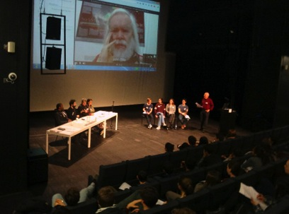
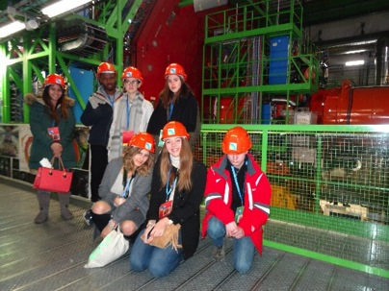
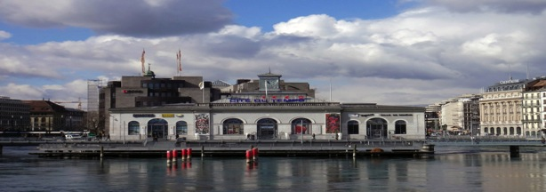
art@CMS
ECOLINT LGB Geneva sciART
Oct 2015 – Feb 2016
workshop
final exhibition
Q&A session
Final exhibition : March 15th – 31st
Cite du Temps Geneva Switzerland
February 28th – April 10th 2016
  exhibition,
  presentation
  lectures to public and school groups
  book presentation
  guided tours

Slide 25
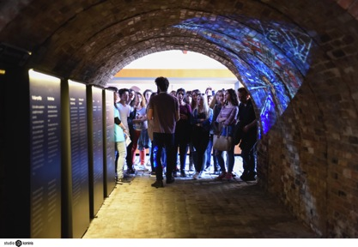
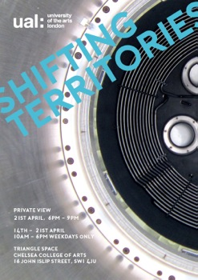
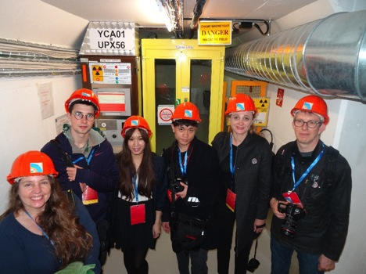
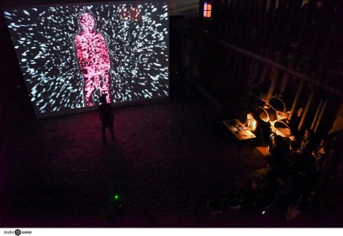
art@CMS
http://www.athens-science-festival.gr/en
ATHENS Science Festival, Greece
(April 5th - 10th 2016)
  Number of visitors 31 000 total / 7300 school students
  The Gift of Mass: An interactive multimedia installation
  "CERN: “Accelerator” of life?”
  10^-22 sec: An interactive dance performances
  CREATIONS “Learning Science through Arts” workshop
  John Ellis closing keynote
Uni. of Arts London sciART collaboration
(Oct 2015 – April 2016)
Collaboration with the UAL – Chelsea College of Arts
Final exhibition : “Shifting Territories” April 14th – 21st

Slide 26
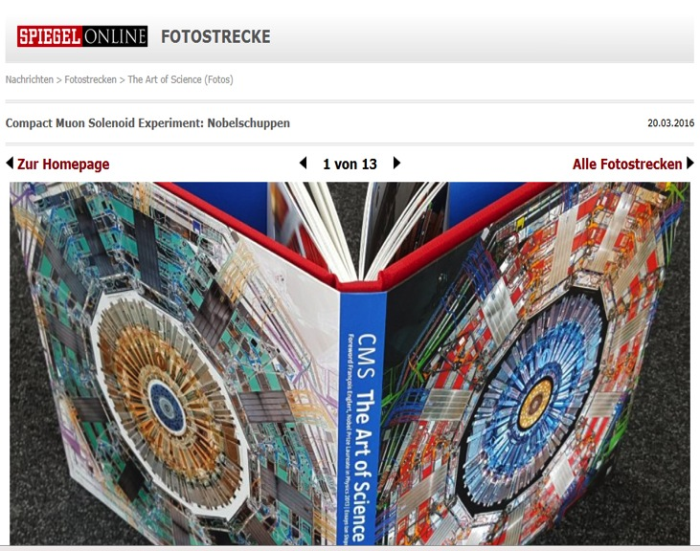
“CMS The Art of Science” Book
art@CMS
PRESS COVERAGE
SPIEGEL online
GOSSEE creative news services
WhiteWall Magazin
PROFIFoto.de
CERN Bulletin
CMS web page
Magazin ESCAPADA.CH
Available at the CERN library / viewing CMS secretariat

Slide 27
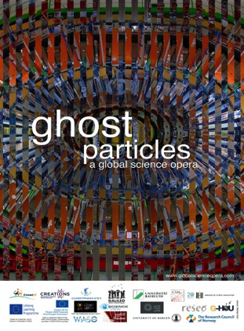
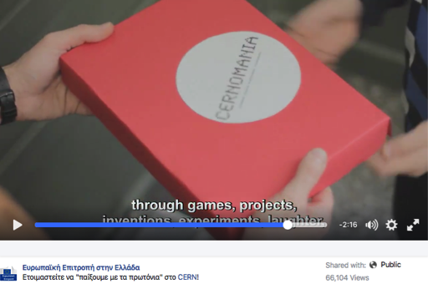


Ongoing & upcoming events
art@CMS
Vico Equense NAPLES INFN art@CMS exhibition
April 29th - May 8th 2016
US Science Festival (http://www.usasciencefestival.org/)
April 16th - 17th 2016
Indian Science Event
May 6th 2016
DUBNA JINR 60 years
April – June 2016
exhibition “Art of Science / Beauty in Creation”
CREATIONS Project
CREATIONS Summer School, Athens, 3-8 Jul
(http://creations.ea.gr)
Playing with Protons course, CERN, 17-22 Aug
art@CMS exhibition, Stord, 22-28 Aug
Ghost Particles Science Opera, 19 Nov

Slide 28
CMS new public website

Slide 29
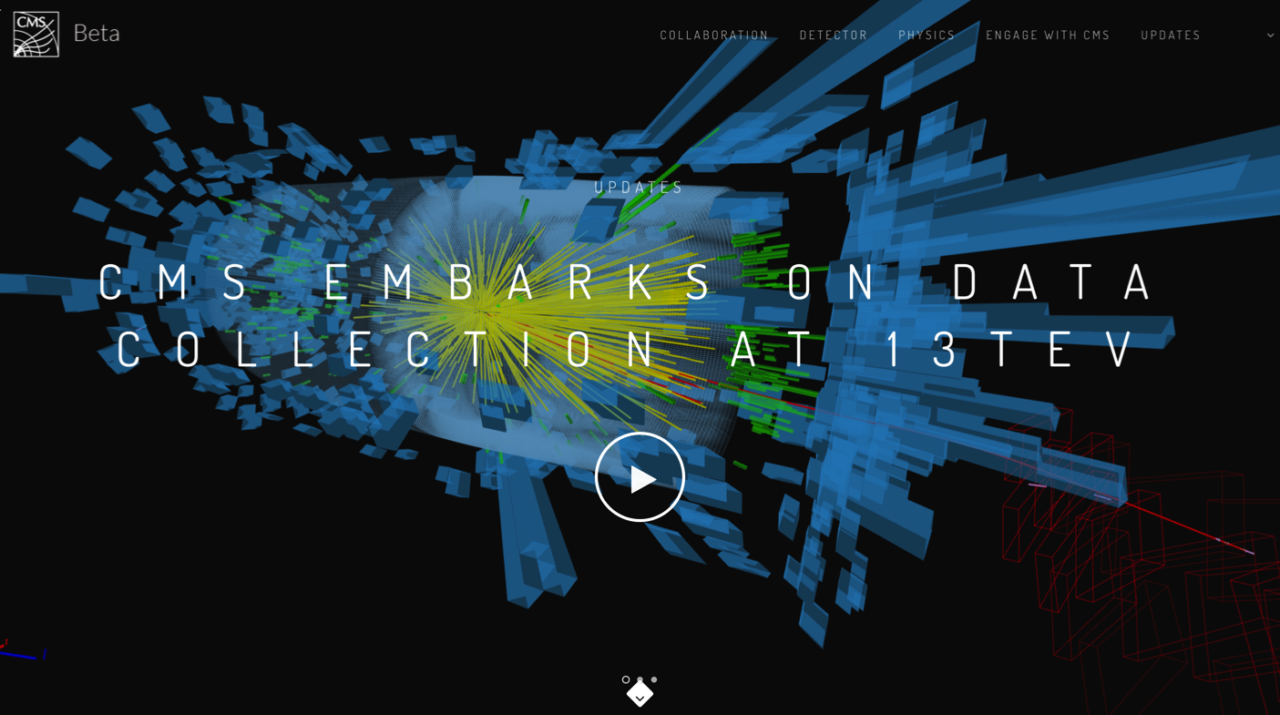
Public website
http://test-cms-public.web.cern.ch/
Beta version will be live in June.

Slide 30
Communications sessions

Slide 31
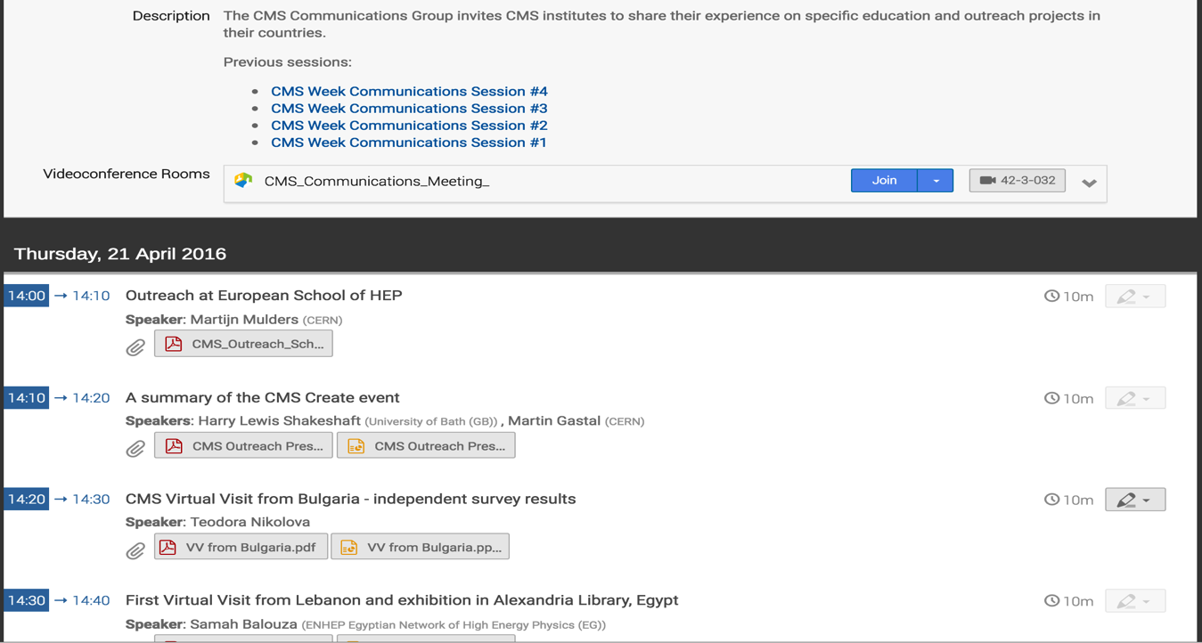
Comm sessions
The CMS Communication Group invites CMS institutes to share their experience on specific education and outreach projects in their countries.
Organised during CMS Week
Open to everybody at CMS
5 sessions until now (start: June 2015)
Aimed at keeping the CMS institutes informed with existing outreach projects
Involve CMS community to share best practices and define synergies in outreach matters

Slide 32
CMS Voices / social media

Slide 33
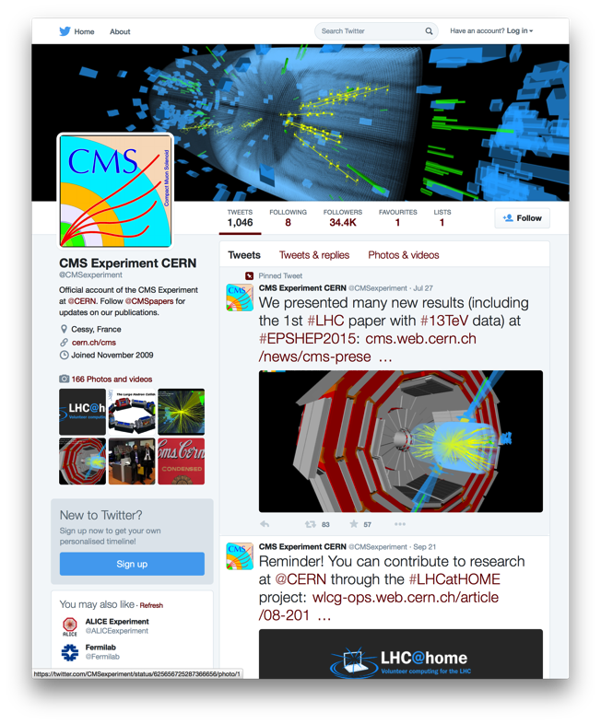
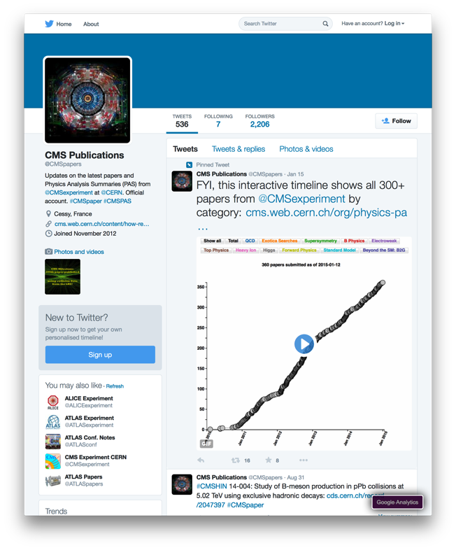
CMS presence
@CMSexperiment
@CMSpapers

Slide 34
Not using “social” part of “social media”
CMS presence
A “brand”/“corporate” voice
  Lacks personality
Restrictions on type/source of content being shared
  Only content from CMS, CERN or partner institutions shared (VERY few exceptions)
One-way communication despite two-way nature of Web 2.0
  No interactivity/interaction

Slide 35
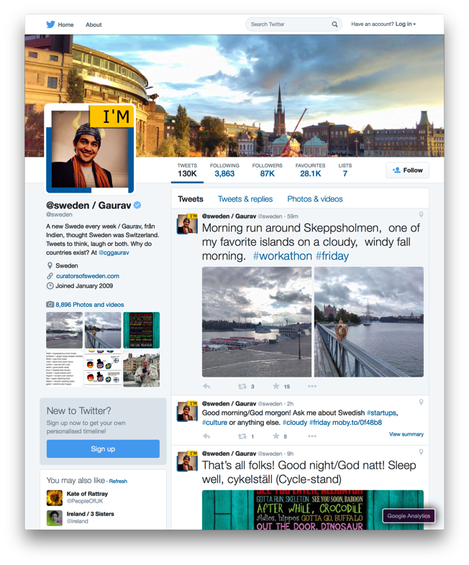

“Rotation Curation”
@sweden
@realscientists

Slide 36
This account:
@CMSvoices
is controlled by a new CMS person every month
allows us to show the flavours and colours in our large collaboration
enables members of the public to engage directly with a “CMS” person instead of tweeting to the @CMSexperiment account without response
will NOT be used for sharing confidential/controversial/embargoed content

Slide 37


On the web
@CMSvoices
cern.ch/cms-voices

Slide 38
So far…
First voices
Seth Zenz: @sethzenz – October ’15
Matt Bellis: @matt_bellis – November ’15
André David: @drandredavid – December ’15
Camilo Carillo: @miloc – January ’16
Rebeca Gonzalez Suarez: @1crebeca – February ’16
Tristan du Pree: @tristan_dupree – March ’16
Salvatore Rappoccio: @srrappoccio – April ’16
Freya Blekman: @freyablekman – May ’16

Slide 39
The Higgs Boson Goose Game

Slide 40


CMS Game
Inspired by the traditional Game of the Goose
Illustrating CMS activities and goals
The underlying idea is that the progress of building and operating a detector at the LHC is similar to the progress of the pawns on the game board it is fast at times, bringing rewards and satisfaction, while sometimes unexpected problems cause delays or even a step back requiring CMS scientists to use all of their skill and creativity to devise new solutions.
Produced with CMS Bologna group.
Board game (available for purchase in CMS Secretariat)
Floor game. Used during events, etc.

Slide 41
CMS TEDx TALKS

Slide 42


TEDx Talks
Exploring the Higgs-Boson Particle
Dave Barney
@TEDxYouth@Zurich
21 April 2015, Zurich, Switzerland
http://tedxtalks.ted.com/video/Exploring-the-Higgs-Boson-Parti
How to turn LHC data into music Angelos Alexopolos
Konstantinos Vasilakos
@TEDxAUEB
5 Mar 2016, Athens, Greece
https://www.youtube.com/watch?v=wqnWPNiu9jI

Slide 43
CMS Brochures

Slide 44



New Brochures
Global Collaboration
Each brochure focuses on different subject:
Fundamental Physics
Science and Technology

Slide 45
Upcoming priorities

Slide 46
Upcoming priorities
Preparations for ICHEP
  Communication of physics results
Release of CMS Public Website
CMS participation in outreach sessions
  LHCP (June)
  ICHEP (August)

