Slide 1

New concepts for introducing the standard model
Michael Kobel
TU Dresden
IPPOG Meeting
Krakow, 20.05.2016

Slide 2
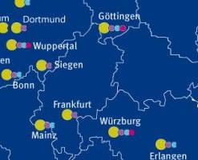
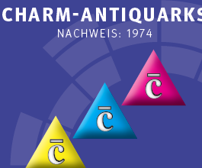
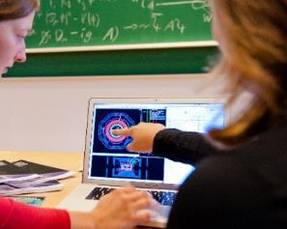

  Netzwerk Teilchenwelt
  Material Development
  Teaching
  Particle Physics
  Summary

Slide 3

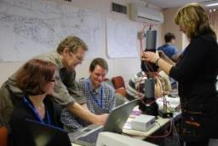
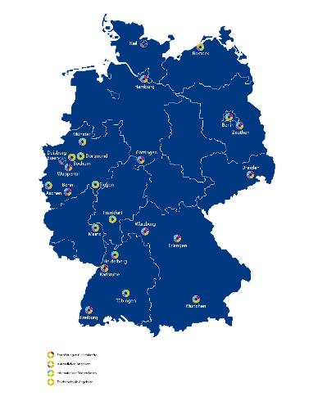
1. Netzwerk Teilchenwelt
Multi-level program for
  high school students, aged 15-19
  teachers/trainers
at schools, school labs, science centers…
  170 – 200 events per year
26 research labs + CERN
  central organization: TU Dresden
Two Core actions
  Events and activities on all levels
  analyzing real (even own) research data
  Developing written materials
  for teaching and science communication
Notes:
NTW is organized as a multi…
The specific strength

Slide 4

Network Community 2013
Students:
4000 involved in activities in 2013
330 qualification level or higher
Scientists:
> 100 (young) scientists
activities
experiments
scientists‘ perspectives
Staff:
6 staff
management
coordination
communication
Teachers:
400 involved in activities 2013
130 qualification level of higher
Alumni:
85 registered
40 at first meeting in 2013
studying physics (and other)
bring in own activities
Notes:
Students normally short-time involvement

Slide 5
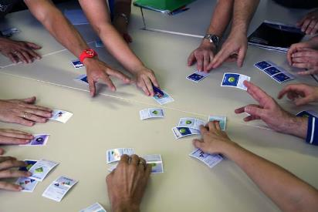
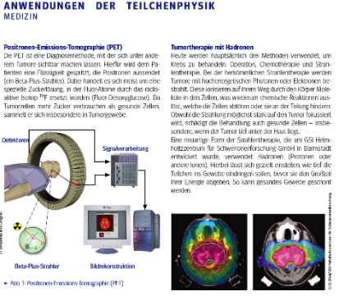
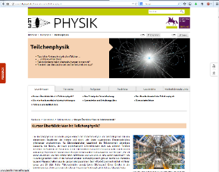

2. Material development
i. Accompanying netzwerk activities
  Supporting material for facilitators
  and teachers
  Particle Profiles
  Background information and worksheets
  Freely available as Printed versions
  Download at www.teilchenwelt.de/material
ii. Web pages for students
  Hosted on Largest German Physics Portal
  for schools: http://www.leifiphysik.de/kern-teilchenphysik/teilchenphysik
  Relaunch of particle physics section 2014
Notes:
on
methods
applications
cosmology
….

Slide 6
iii. Teaching Material
particle physics for schools,
  comprising > 300 pages of texts,
  exercises, work sheets,
  curricular aims, didactic hints
  Establishing a
  standardized terminology
4 Volumes
  Concept of the Standard Model
  Research methods
  Cosmic radiation (appeared)
  „Stand alone“ topics (appeared)

Slide 7
3. Teaching Particle Physics
Strength and Chances
  Fascination of fundamental questions
  Fascinating notions (Big Bang, Antimatter, Dark Matter, …)
  Fascinating experiments
  Fundamental research as cultural and intellectual gain
Challenges
  Large number of new terms
  Many new concepts and perceptions
  Many answers to never-posed questions
  Relation to everyday world to be established
Last not least: No established teaching terminology

Slide 8
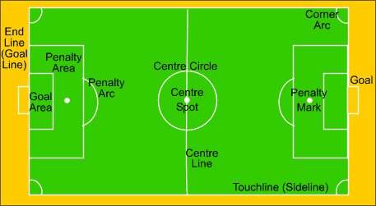
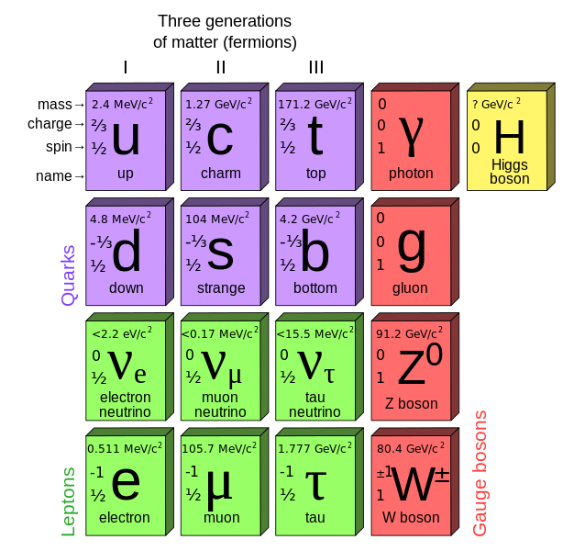
How to explain something unknown
Example soccer (wikipedia)
  Law 1: The Field of Play
  Law 2: The Ball
  Law 3: The Number of Players
i.e. you do not start with the number of players,
but with the aims and rules!
→ And: you do not mention
each single player
so why do we always start with this:
when explaining the Standard Model?

Slide 9
What is the Standard Model, after all?
A theoretical framework of Symmetries SU(3)_{C} x SU(2)_{I} x U(1)_{Y}
  Based on charges
  Ordering particles
  Requiring interactions
So, the SM is a theory of interations, (=rules) after all
And: the particles (=players) cannot even be predicted !
Charges
-- generate ->
<- conserve --
Interactions
-- undergo ->
<- act between-
Particles
-- „carry“ ->
<- order --

Slide 10
Tell apart: theory input and prediction
Standard Model Theory prediction
  Basic principle: symmetries → interactions
  *All* features of interactions follow uniquely from symmetries
    allowed interaction vertices
    number and charges of messenger particles (8 gluons, 3 weak Bosons, 1 γ)
    i.e. „rules of the game“ follow from theory!
Standard Model Theory input
  On the contrary, particles can *not* be predicted by theory
    Representations not unique, e.g. (e⁻ ⁻ , e ⁻ , ν_{e} , e⁺ , e⁺⁺ ) allowed in SU(2)
    and predictions could be made, like e⁺⁺ → e⁺ + e⁺ + ν_{e}
    number of generations not unique (why 3 ?)
    i.e. „players“ do *not* follow from theory
→ so why start with SM = 6 quarks + 6 leptons?

Slide 11
Reduction of Physics
Basic Concept:
Interaction
= Force + Transfomation +
Production + Annihilation
All processes can be described by 4 fundamental interactions
„Force“ is just one aspect of interaction
Hangabtriebskraft,
Wasserkraft,
Gasdruck,
Radiowellen,
Benzinmotor
Luftreibung,
Radioaktiver Zerfall
Brennen der Sonne
…
4 Fundamental
Interactions

Slide 12
Basic Concept: Interaction
Basic Concept:
Interaction
= Force + Transfomation +
Production + Annihilation
Basiskonzept
Wechselwirkung
= Kraft + Umwandlung + Erzeugung + Vernichtung
Force is always Interaction (Actio = Reactio)
Now: Interaction is more! → new basic concept
Comprises the phenomena
  Force (z.B. Coulomb-Force)
  Creation of Matter+Antimatter (z.B. Electron+Positron)
  Annihilation to „Field Quanta“ (z.B. PET: e⁺ e⁻ → 2 Photons)
  Transformation of particles (z.B. β-Transformation (“decay“))
Aim: Learn of 4 fundamental interactions
  Each one comprises a force, but sometimes other aspects dominate
Tell apart clearly Force from Interactions
  Please speak of „force“ only, if You really mean force (3dim - vector!)

Slide 13
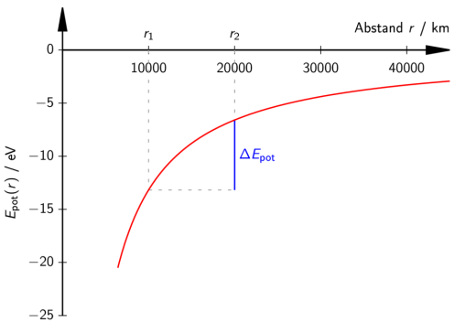

Start with well-known „hub“: Gravitation
Here still : Interaction ~ Force
Potential Energy between Earth and O₂-molecule
  Approx. for small heights above surfave: E_{pot} = mgh
  Instructive to compare with E_{kin} = 3/2 k_{B}T = 0,04 eV
http://1234gifs.de

Slide 14
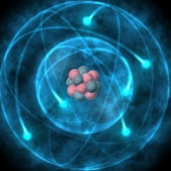
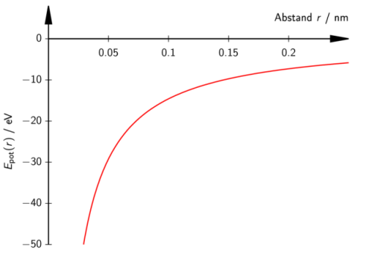

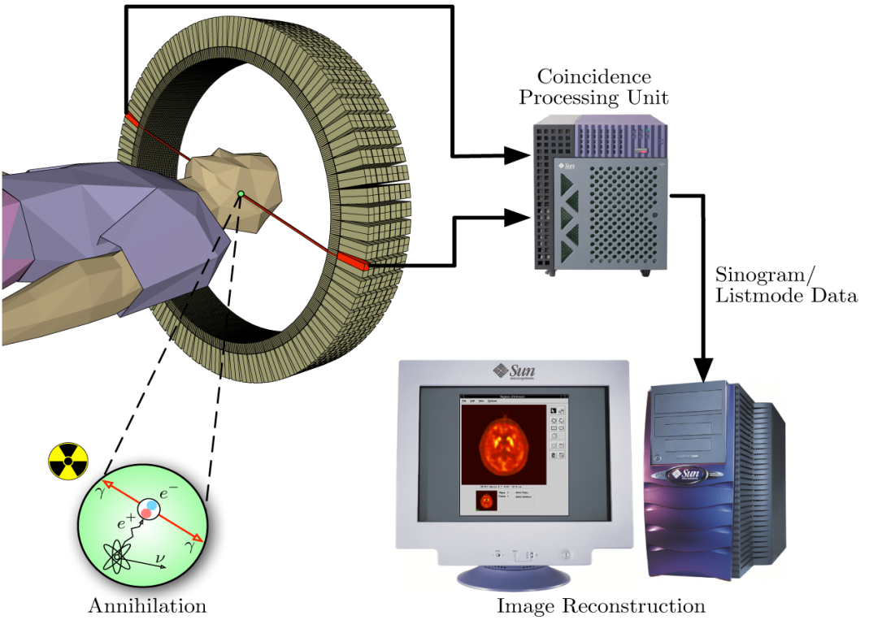
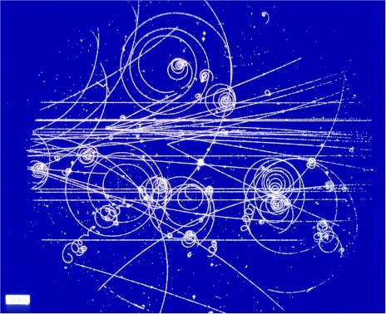
Tell a Story: Start with 2 best known interactions
Electromagnetic (e.g. Atoms, r ~ 10⁻¹⁰ m)
Gravitation (O₂ by Earth, r ~ 10⁷ m)
eV
eV
www.precisionillustration.co.uk
http://1234gifs.de
Electromagnetism can create and annihilate particles

Slide 15
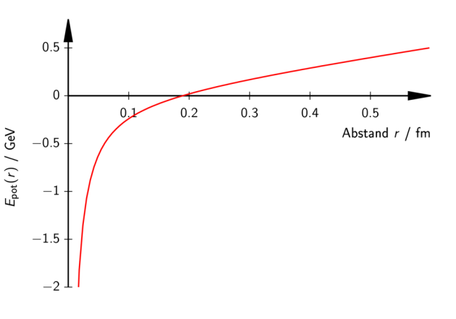
Tell a Story: Add more interactions, as needed
Electromagnetic (e.g. Atoms)
Gravitation (O₂ by Earth)
eV
eV
www.precisionillustration.co.uk
http://1234gifs.de
What keeps (anti-)quarks
together (or nucleons)
against electric repulsion?
introduce: strong interaction
GeV !

Slide 16
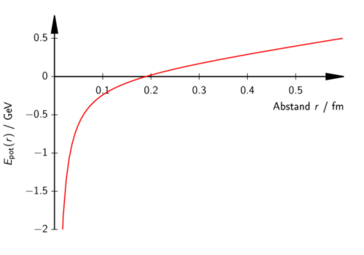
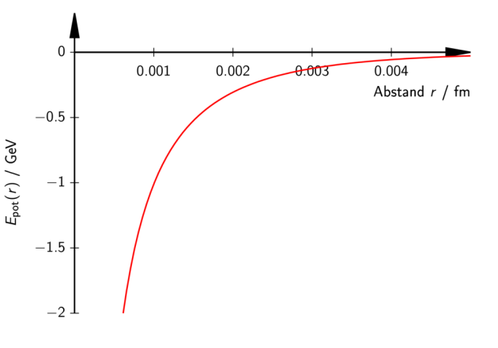
The 4th fundamental interaction
Electromagnetic
Gravitation
Strong interaction
What transforms neutrons and protons in one another?
introduce: weak interaction
GeV

Slide 17

Overview of potential energies
(similarities and differences)
electromagnetic
Gravitation
weak interaction
strong interaction

Slide 18
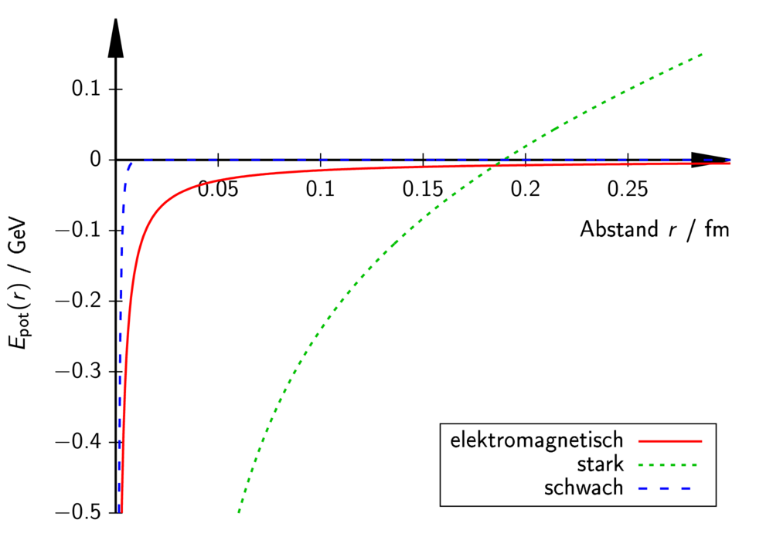
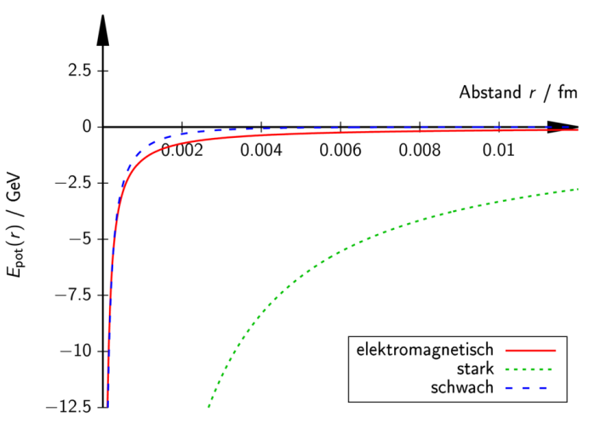

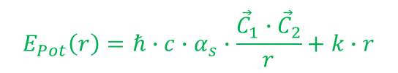

Synopsis on different scales
Electromagnetic potential is invariant under scale variations
-> infinite range
Weak and strong interaction
have characteristic length
all behave like 1/r
for small enough distances
Quantitative description with
  Charges
  Strength parameter α
  Char. Lengths λ_{w} = 0,002 fm
  and √(ħcα_{S}/k) = 0,2 fm
$$E_{Pot}\left(r\right)=ℏ∙c∙α_{em}∙\frac{q_{1}∙q_{2}}{r}$$
$$E_{Pot}\left(r\right)=ℏ∙c∙α_{s}∙\frac{{\vec{C}}_{1}∙{ \vec{C}}_{2}}{r}+k∙r$$
$$E_{Pot}\left(r\right)=ℏ∙c∙α_{w}∙\frac{I_{1}∙I_{2}}{r}∙e^{\frac{−r}{λ_{w}}}$$

Slide 19

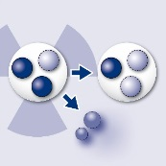
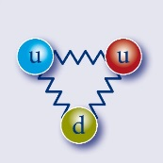


Basic Concept: Charges
For each interactions exists a corresponding charge
charges are characteristic properties of particles
known:
    Electric Charge electric charge number
new:
    Weak (Isospin-)Charge weak charge number
    Strong (Color-)Charge strong charge vector
product of two charges can be positive or negative (attraction or repulsion)
Charges are:
  additive
  conserved
  quantized
$$q$$
I
$$\vec{C}$$
Notes:
Analog zur elektrischen Ladung existieren weitere Ladungen.
-schwache und starke Ladung
Ebenfalls sind die
-schwache Ladungszahl, und der
-starke Farbladungsvektor charakteristische Teilcheneigenschaften.
Ein Teilchen lässt sich anhand seiner elektrischen- und schwachen Ladungszahl, seiner starken Farbladungsvektoren und seiner Masse eindeutig charakterisieren.

Slide 20
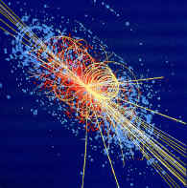
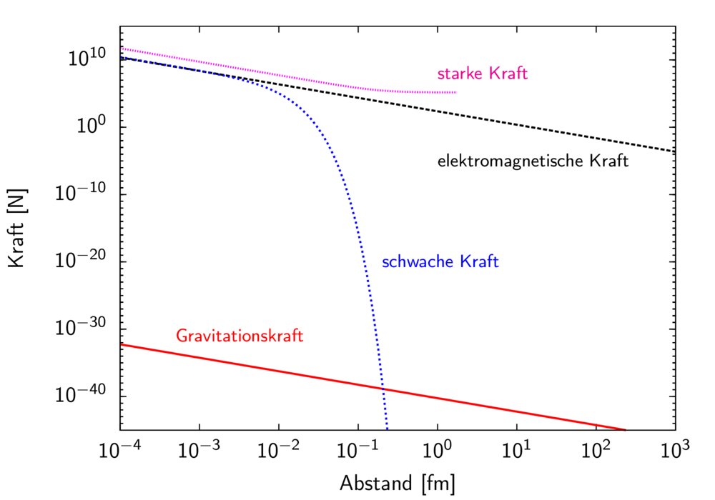
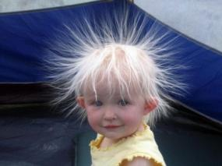
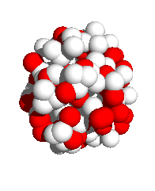
Comparison of Forces for e⁺e⁻ (strong:‾qq)
Particle physics
„Us“
Nuclear physics
www.schmunzelmal.de

Slide 21
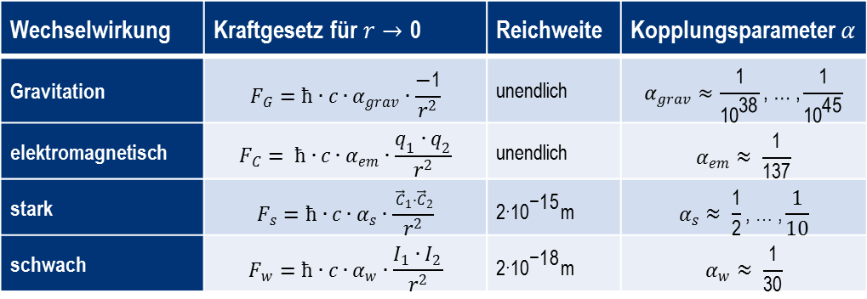
Conclusions
Ranges are different
For small distances F~1/r²
Sequence of strength
  Cannot be defined
  for forces due to F(r)
  Can be defined only
  for interactions: α !
All interaction strengths similar,
except *extremely* weak gravitation
Finite Range
of strong force
due to confinement
Sequence of
coupling strengths
(would become
even more similar at smaller distances)
Finite Range
of weak force
due to mass of
W/Z force carriers
Interaction |  | Range
Gravitation |  | infinite
electromagnetic |  | infinite
strong
weak
Notes:
Abbildung:
Kräfte als Funktion des Abstands der wechselwirkenden Teilchen.
Für die elektromagnetische Kraft, schwache Kraft und Gravitationskraft ist jeweils die Kraft
zwischen zwei Elektronen dargestellt. Für die
starke Kraft wurde als Beispiel die Kraft zwischen Quark und Anti-Quark bzw. die kovalente Kraft zwischen zwei Nukleonen gewählt.

Slide 22
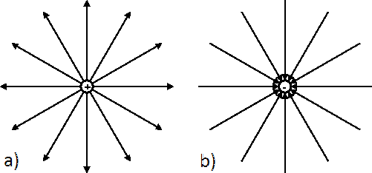

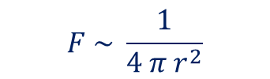
Why are forces ~ 1/r² ?
Classical Physics: field lines
Density of field lines ~ field strength ~ force
1/r² is consequence of 3-dim space !
1/r^{n-1} wohl be the force law for n-dim space
$$F=Q ∙ E$$
$$F \sim \frac{1}{4 π r^{2}}$$
Notes:
Die Fernwirkung der Gravitationskraft sowie der magnetischen und elektrischen Feldkraft werden in der klassischen Physik durch Felder beschrieben.
Elektrische Felder lassen sich durch Feldlinien beschreiben.
Gerade Pfeile zeigen von der positiven Ladung weg.
Die Stärke der „Kraft/WW“ ist proportional zur Dichte der Feldlinien.
Legt man nun eine 3-D-Kugel um die elektrisch positive Ladung, so ist die Kraft proportional zur Oberfläche der Kugel und damit proportional zu 1/r²

Slide 23
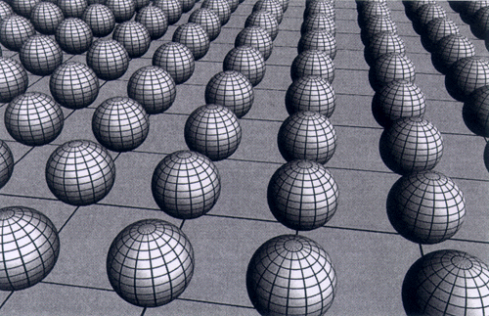
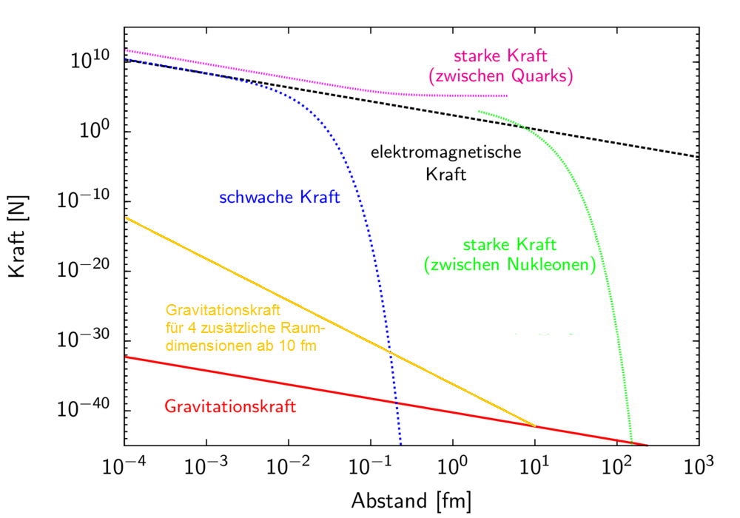
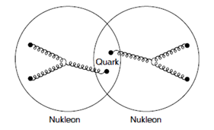
Many Further discussion issues
Unification of interactions maybe possible
for gravity with large extra dimensions
-> steeper decrease at tiny distances
Nuclear „kovalent“ binding
is not fundamental
(like molecular binding)
and only possible in a
very narrow range

Slide 24
Why are all the interactions so similar in their structure?
There are a number of possibilities:
The first is the limited imagination of physicists:
When we see a new phenomenon, we try to fit it in the framework
we already have – until we have made enough experiments
we don’t know that it doesn’t work…
It’s because physicists have only been able to think
of the same damn thing, over and over again.
Another possibility is that it is the same damn thing over and over again – that Nature has only one way of doing things,
and She repeats her story from time to time.
A third possibility is that things look similar because they are aspects of the same thing – some larger picture underneath…
Richard. P. Feynman, “The strange theory of light and matter”
Princeton University Press, 1985
“Die seltsame Theorie des Lichts und der Materie”
Piper Taschenbuch, 9,95€

Slide 25
Charges: Basis of the Standardmodel
Expressed for Scientists:
  Charges generate local gauge symmetries of the Standard Model
  Particles come in multiplet representations of the gauge group
  Symmetries require gauge fields and interactions
  Charge conservation follows from Gauge Symmetry
  The BEH mechanism breaks the electroweak symmetry
  and creates masses for the weak gauge bosons
expressed for high schools (and public?):
  For each interaction (except gravity) there is a corresponding charge
  Charges give a characteristic ordering principle for particles
  Interactions are mediated by messenger particles
  Charge conservation determines allowed processes
  The BEHiggs field is a infinite sea of weak charge and
  causes finite range of weak interaction by screening weak fields

Slide 26
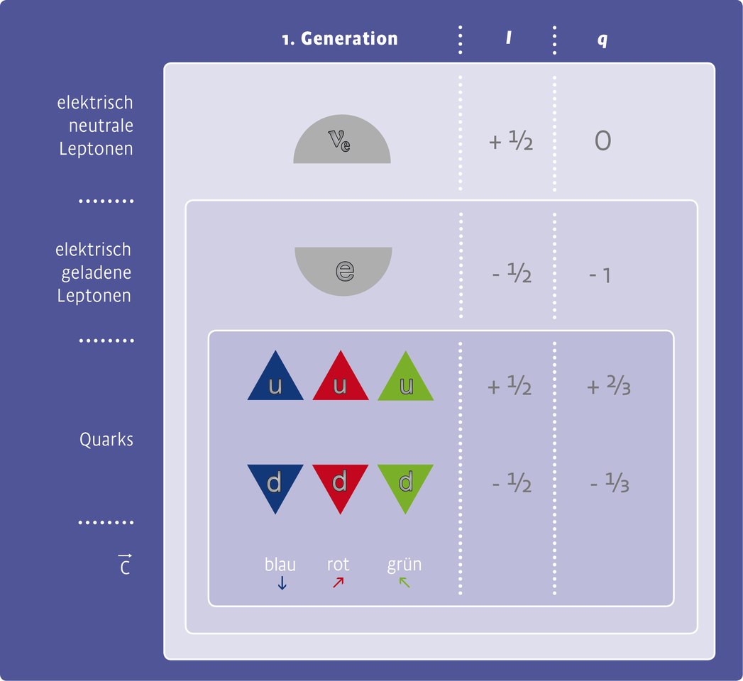
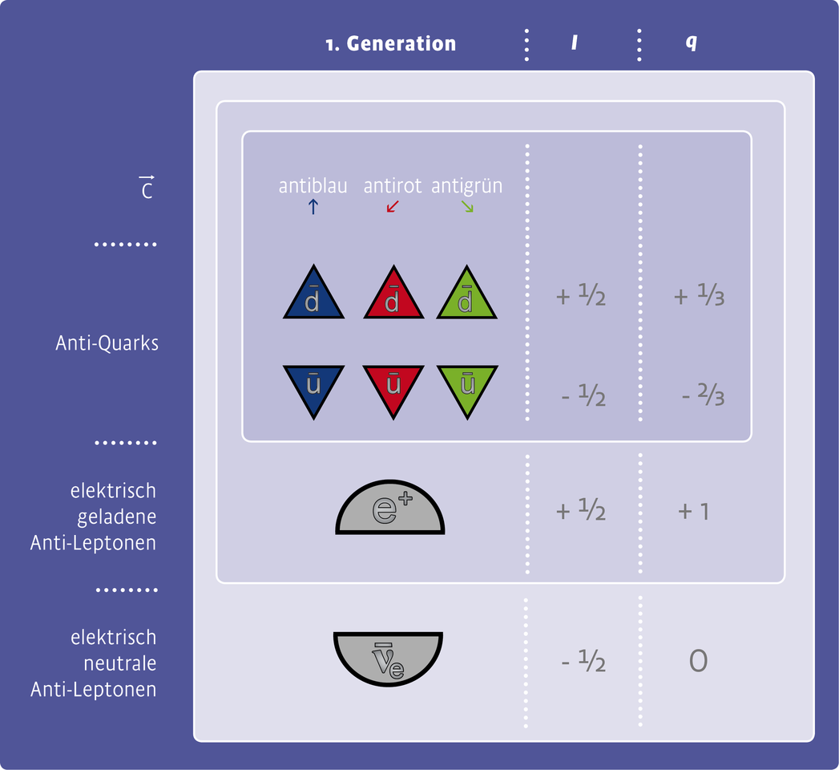
The SM just gives the ordering „cupboard“!
Filling of the possible „drawers“ cannot be predicted
Other matter particle multiplets would have been possible!
but are not observed →nature picks „fundamental representation“
schwache WW
elektromagnetische WW
starke WW
starke WW
elektromagnetische WW
schwache WW
particle | e⁻⁻ | e⁻ | e⁰ | e⁺ | e⁺⁺
I | -2 | -1 | 0 | +1 | +2

Slide 27
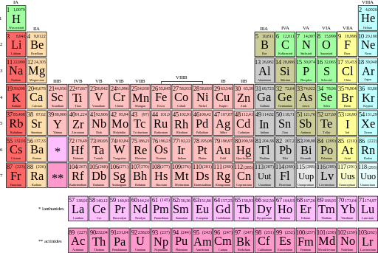
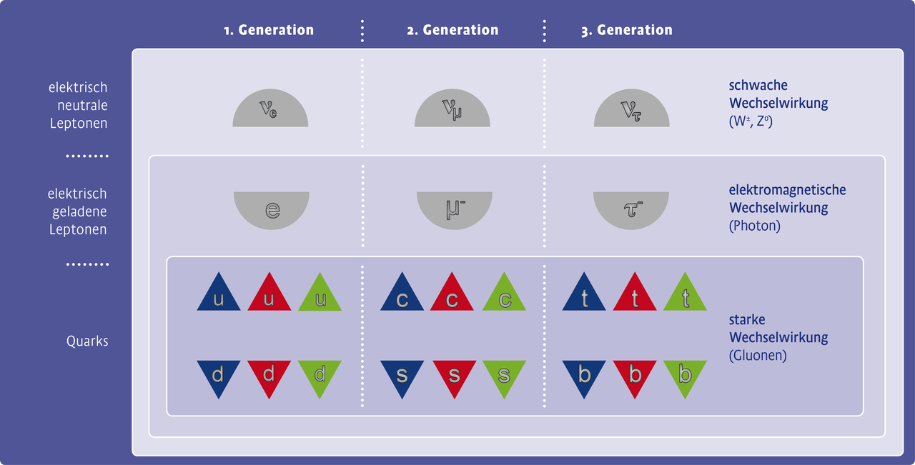
Ordering scheme:
Analogy to periodic system
Same Charges <-> same features
(e.g. lepton universality)
Which „slots“ are filled by particles in nature
cannot be predicted in SM!
Pattern repeats 2x for larger masses (reason unknown!)

Slide 28
Matter Particle Multiplets
Particles are ordered/characterized according to their three charges
Experimentally (this is no SM prediction!) one finds
  doublets wrt weak interaction
  tripletts wrt strong interaction
  singuletts wrt electromagnetic interaction (follows from U(1))
Transformations are only allowed within same multiplet
(for charge eigenstates, mixing into mass eigenstates omitted)

Slide 29
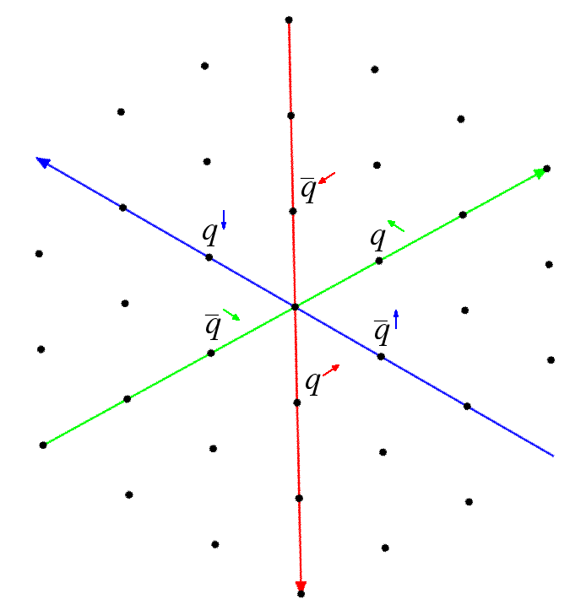
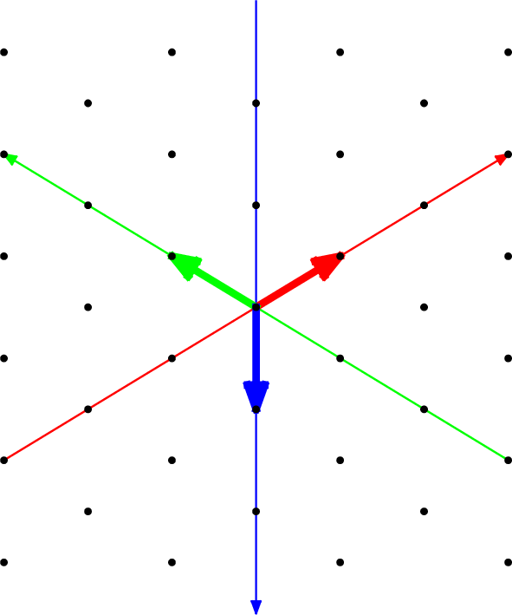
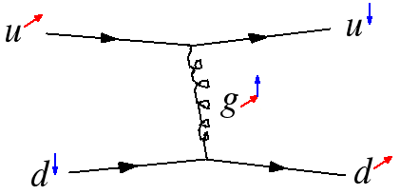
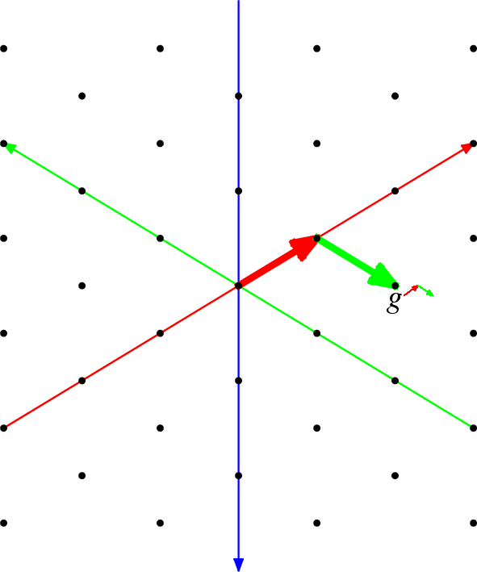
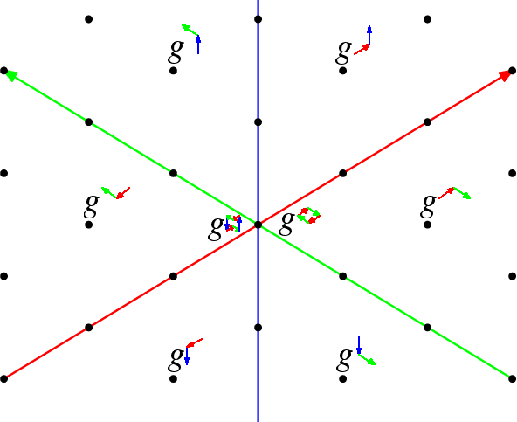
Gauge bosons transform within multiplet
A rotation (gauge symmetry!) of a quark multiplet
has same effect as emission or absorption of a gluon

Slide 30



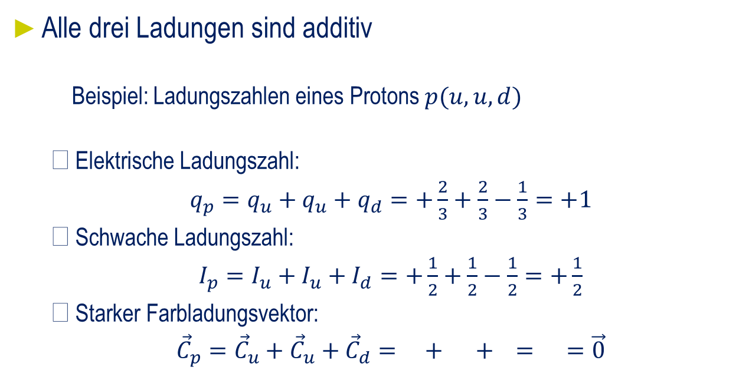


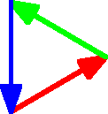
Adding Charges (Example Proton)
  Electric charge number
  Weak charge number
  Strong „color“ charge vector

Slide 31
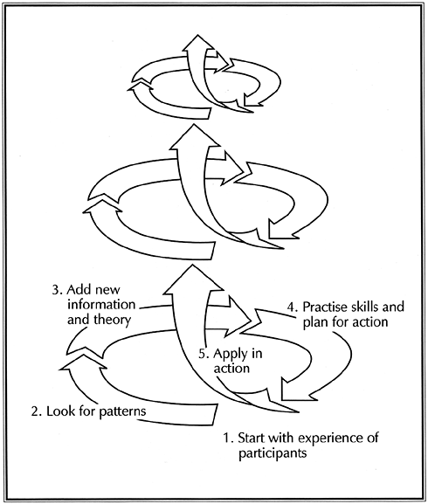
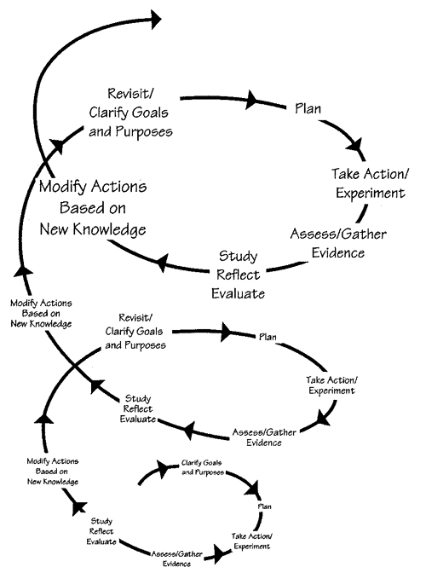
Spiral curriculum concept for Volume 1 (SM)
http://vocalability.com

Slide 32
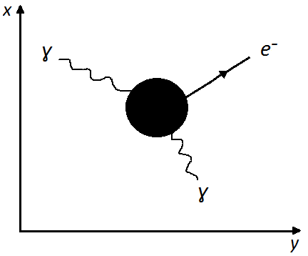
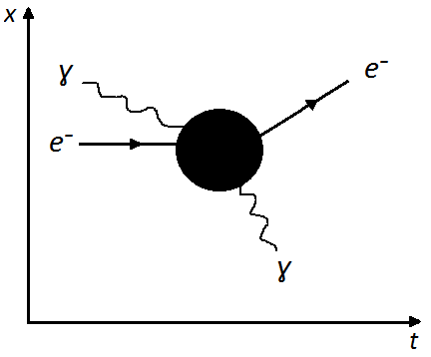
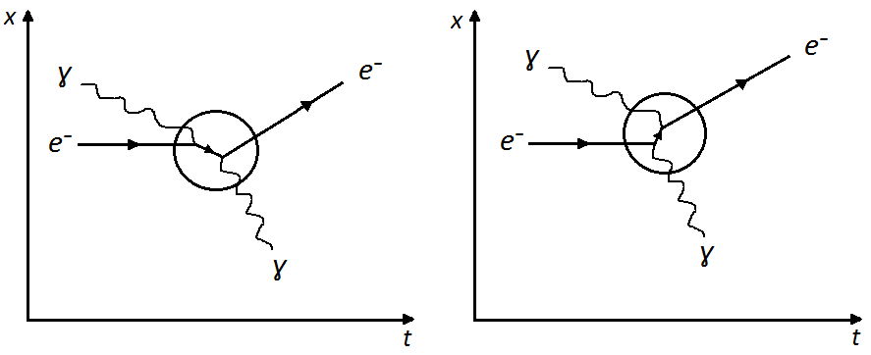
Example: Feynman diagrams in spiral curriculum
Compton-Scattering
  1st level: x-y diagram,
  → visualisation in space (as in detector)
  2nd level: classical x-t diagram
  → charge conservation in initial and final state
  3rd level: Feynman diagram
    Charge conservation at each time
    Fundamental vertices
    Quantum mechanical
    behaviour
    …
Notes:
Oben-Links:
Compton
x-y-Ebene (Stufe 1 Curriculum)
Oben-Rechts:
Compton
Feynman-Diagramm mit Blackbox (Stufe 2 Curriculum)
Unten:
Compton
Feynman-Diagramm ohne Blackbox (Stufe 3 Curriuculum)

Slide 33
Charge conservation (e.g. weak charge I:=I₃^{W})
Neglecting P-Violation, since only left-chiral components matter:
K-electron capture in atoms
+½ -½ +½ -½
-½ +½ -½ +½
First detection of (anti-)neutrinos at nuclear power plants
+½ -½ +½ -½
-½ +½ -½ +½
β⁺ und β⁻ - transformations of nuclei
+½ -½ -½ +½
+½ -½
+½ -½
Conservation of weak charge requires presence of neutrinos
(Lepton number concept not needed, charge conservation does it)
p n
W⁺
e⁻ ν_{e}
p n
W⁻
e⁻ ν_{e}
p n
W⁺
‾ν_{e} e⁺
p n
W⁻
‾ν_{e} e⁺
p n
W⁺
e⁺
ν_{e}
n p
W⁻
e⁻
‾ν_{e}

Slide 34
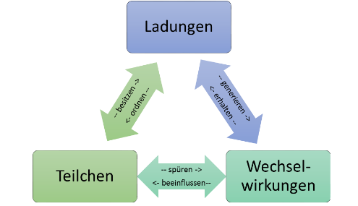

4. Summary
Lots of “Dos and Dont’s”
  Conyev the real SM findings
  Establishing a standardized terminology
    Charges as powerful new principles
    Global view of interactions
    Spiral curriculum
2-year process w/ teachers, finalized 2015
  Vol. 3+4 printed and pdf free on web
  www.teilchenwelt.de/material
  Vol 1+2 in layout, to be printed
  and to be distributed to teachers
Training for teachers started
    CERN, DESY/Zeuthen, Dresden, Bensberg
Notes:
Completed another project:
teaching material for particle physics in schools
comprising 300 pages of texts, exercises and work sheets
Triad of charge, interaction, elementary particles
Charge as organizing principle
avoiding memorization

Slide 35
www.teilchenwelt.de
www.physicsmasterclasses.org

