Slide 1
Enabling Virtual Visits Globally
Marzena Lapka (chair), Steven Goldfarb (sofa), Nicola Arnaud, Valérie Séguin, Daniel Lellouch, Beatrice Bressan, Jon-Ivar Skullerud
Krakow, 20 May 2016

Slide 2
What are virtual visits?
Virtual Visits are
  On Site remote video interaction between scientists and public
Goals
  Interactive engagement with public
  Communication training of collaboration members
Target Audience
  General Public, Teachers, Students
  Typically secondary schools
Messages
  Science exploration is exciting and worthwhile
  Scientists are people, too

Slide 3
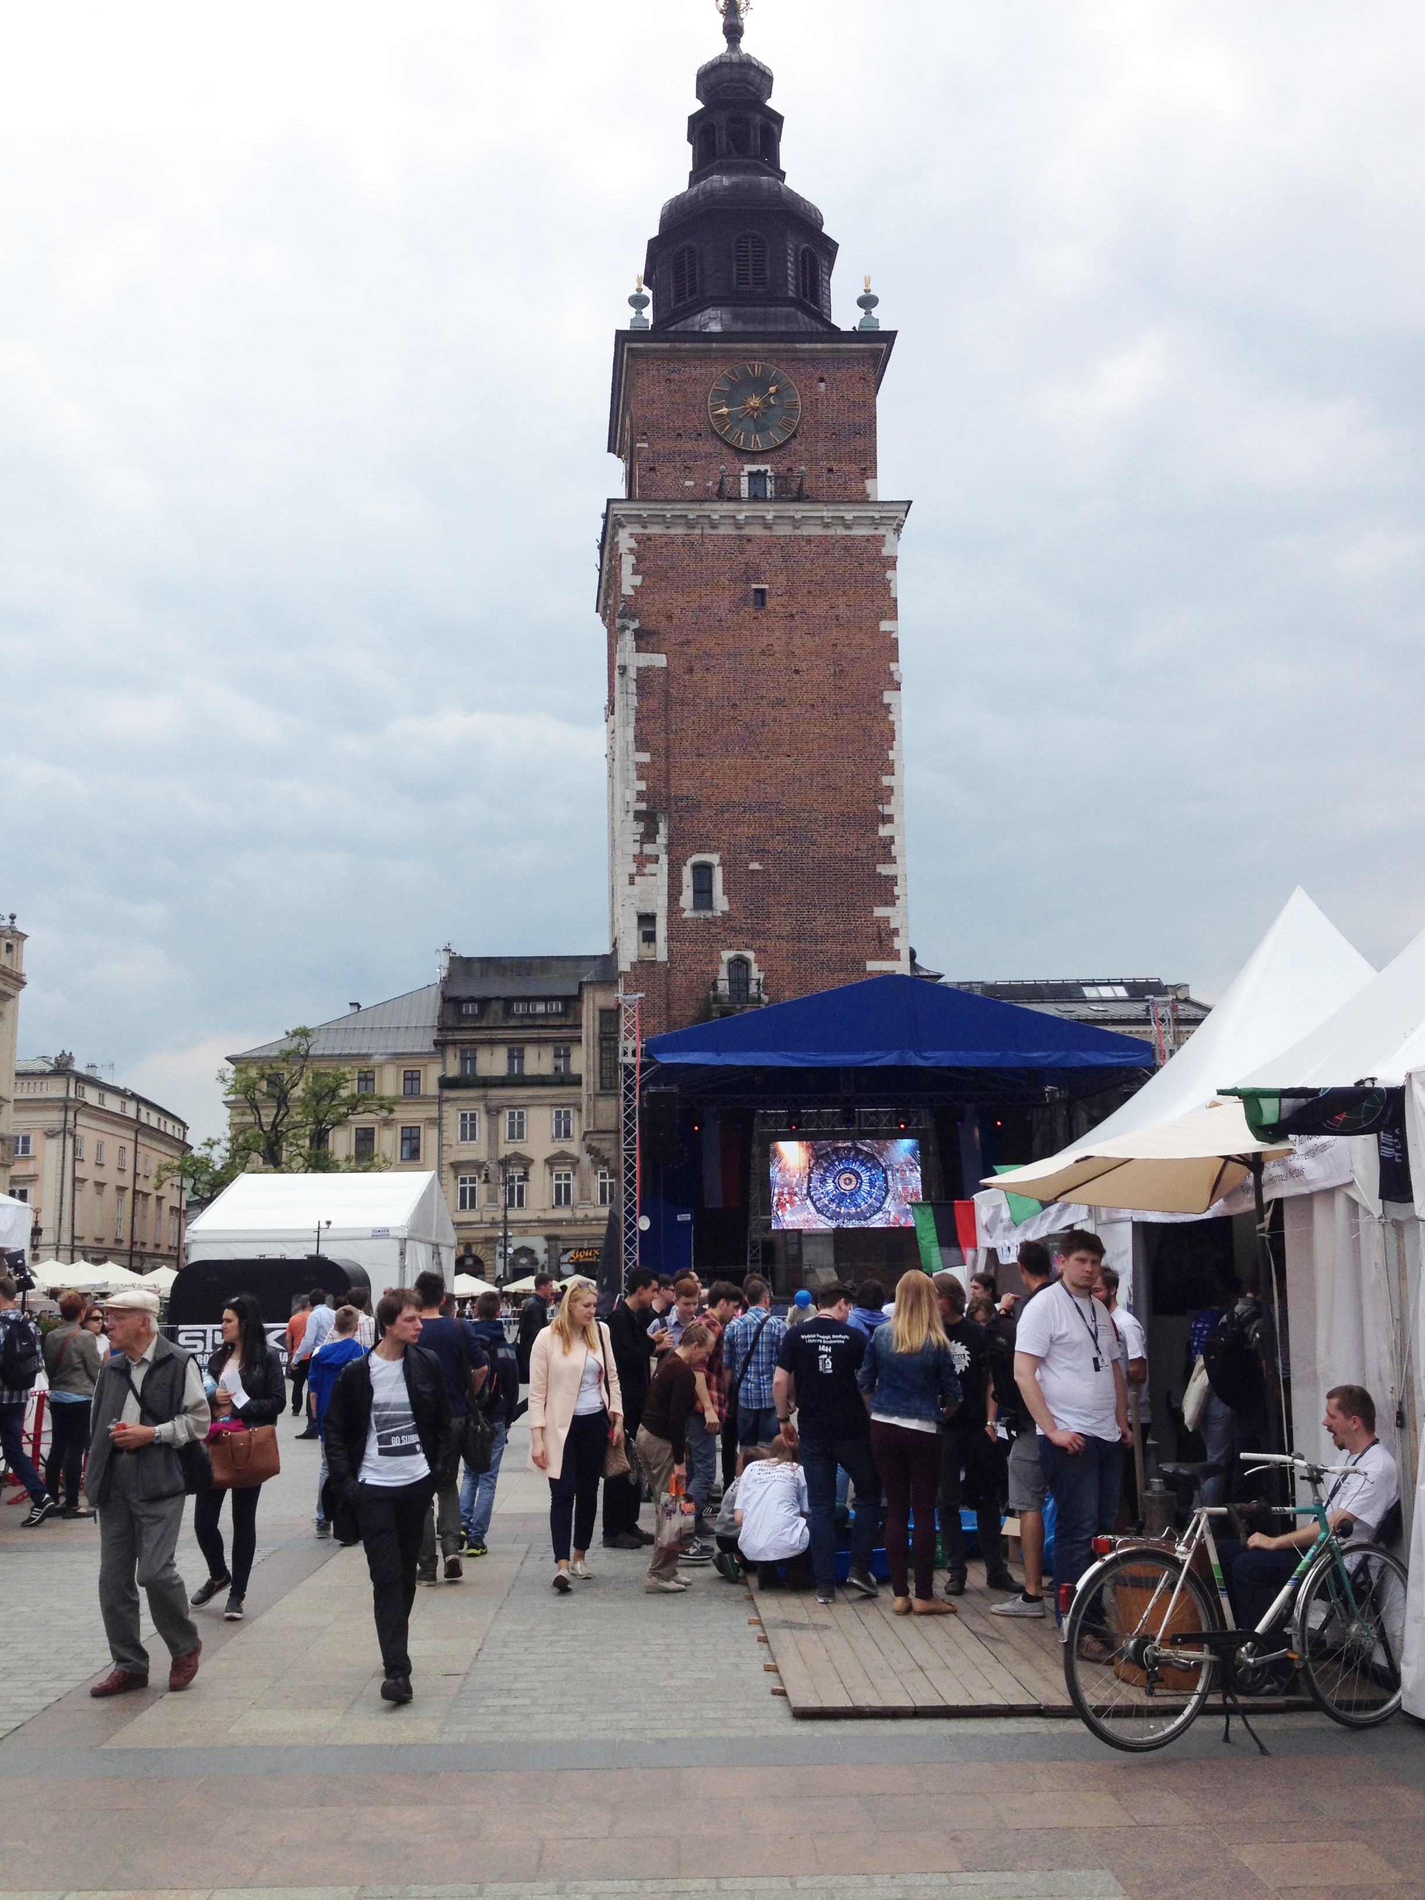

Slide 4
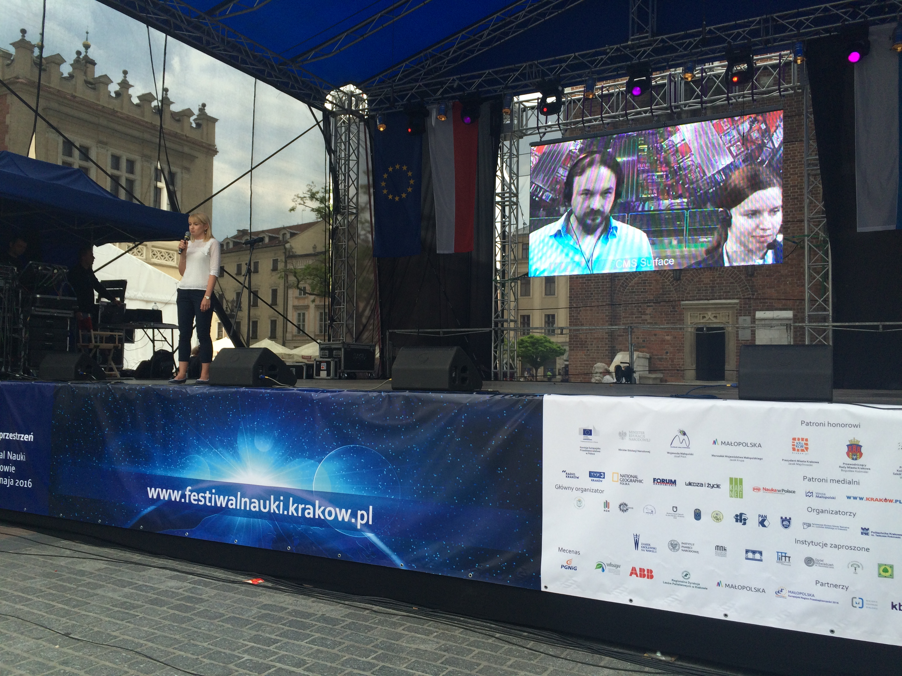

Slide 6
On Site Infrastructure
Site | Equipment | Functionality | Notes
CMS (Marzena Lapka) | Mobile Unit with camera, laptop, phone, headsets | videoconference webcast recording | Underground view, mobile
ATLAS (Claire Bourdarios) | Two fixed HD cameras, headsets, control tablet | videoconference webcast recording | Fixed installation with view of control room
LHCb (Antonis Papanestis) | Two fixed HD cameras, headsets, control tablet | videoconference webcast recording | Fixed installation with view of control room
ALICE (Despina Hatzifotidianou) | Laptop with camera and microphone | videoconference | Considering special equipment
FNAL (Sue Sheehan) | Laptop with camera and microphone | Google Hangout on Air | Working on installation for neutrino experiments
CERN Control Centre (Mirko Pojer) |  |  | Considering
CERN Computing Centre (Mélissa Gaillard) | 360 camera Liquid Galaxy VV Installation |  | No dates yet for plans

Slide 7
Client Requirements
Network
  Preferably Cabled (not necessary)
Access to Client Software
  Vidyo Web Client or Desktop
  Google Hangout
  Skype
Hardware
  Laptop / PC / Tablet / Smart Phone / H.323 Device
  Camera
  Microphone / Speakers (Best if Echo Cancelling)
Always Test Beforehand (under exact same conditions)

Slide 8
Current Ad Hoc Strategy
Booking
  Collaboration members make contacts
  Schools find us through web site / word of mouth
  Some loyal returning clients
Masterclasses
  Schools contact us requesting visits before or during day
Outreach Groups Initiatives
  e.g. Krakow Science Festival
Follow-up
  Recordings, Evaluations, Letters of Appreciation

Slide 9
Toward A Coherent Global Strategy
How Laboratories / Experiments Can Work Together
  Add new sites (ALICE, CCC, CC, …)
  Common Booking
  Common Infrastructure / Operations / QA
  Evaluations and Follow Up
How IPPOG Can Contribute
  Develop strategy with CERN (and all IPPOG partners)
  Have national contacts reach out to teachers from target schools
  Web site encouraging contact for visits, virtual visits
    Links to booking forms & national contacts
  Coordinated scheduling to accommodate national academic year
  Coordination with MC2NC WG?

Slide 10
Resources
CMS
CMS Virtual Visits | http://cms.web.cern.ch/content/virtual-visits
List of Visits (Indico) | https://indico.cern.ch/category/5975
Registration Form | https://docs.google.com/forms/d/19C0UNH9ZWbXe50fjH2gxryjSk11dcJDInTaaia7JPM8/viewform
Pictures from Visits | https://cds.cern.ch/search?ln=en&cc=Photos&p=cms+virtual+visit&action_search=Search&op1=a&m1=a&p1=&f1=&c=Photos&c=&sf=&so=d&rm=wrd&rg=10&sc=0&of=hb
ATLAS
ATLAS Virtual Visits | http://cern.ch/atlas-virtual-visit
List of Visits | http://cern.ch/atlas-virtual-visit/Languages.html
Contact & Booking | http://cern.ch/atlas-virtual-visit/pages/ATLASvv-tech.html
Pictures from Visits | https://cds.cern.ch/search?ln=en&cc=Photos&sc=1&p=atlas+virtual+visit&action_search=Search&op1=a&m1=a&p1=&f1=&c=Photos&rm=wrd

