Slide 1
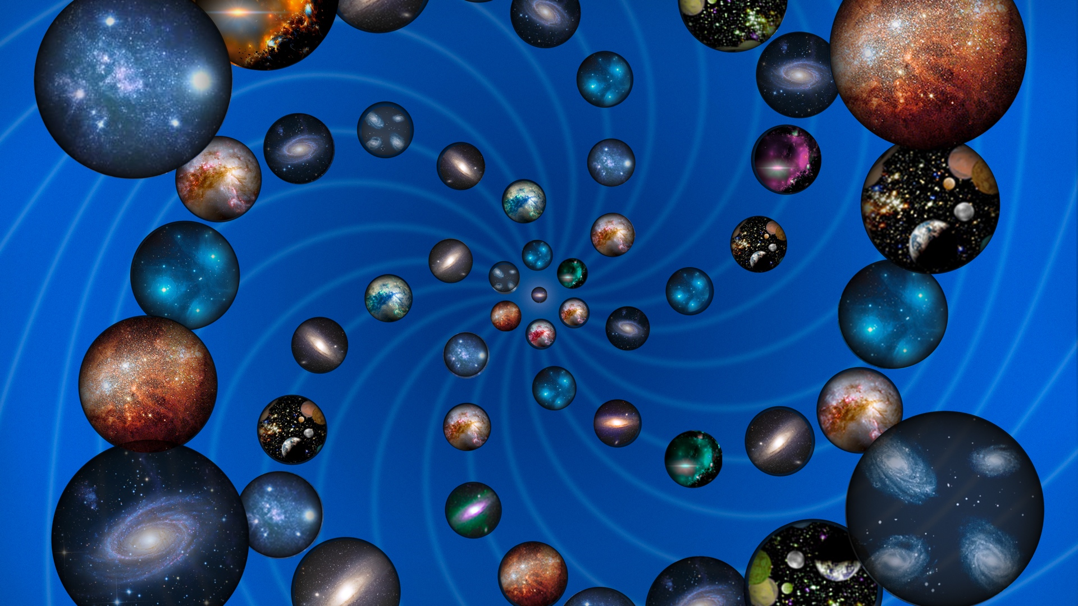
Hypotheses non fingo
To verify or falsify - that is the question
Notes:
Sonate:
Alleg - Largo - Alleg
Meta - Physik - Meta
XL: Hypothesen 2x
Nukleosynthese 2x

Slide 2
Theory panel report
Jon-Ivar Skullerud, Daniel Lellouch, Ivan Melo, Thomas Naumann,
Andrej Gorisek, Uta Bilow, Kenneth Cecire, Hans Peter Beck
Focus on outreach aspects. No epistemology.
This is pure theory. - Avoid negative connotation.
Theory - Hypothesis - Model
  The Standard Model is a theory!
  The Multiverse is a hypothesis: no verification or falsification
  SUSY: theory or hypothesis? verification or falsification ?
Theories have predictive power.
They can and have to be verified or falsified.
This takes time (decades: GUT, SUSY, …) and money.
Theories should state their limits.
They may guide us to the next theory - Kuhn’s change of paradigms.
Understanding our world is an old ambition of mankind.
Theories provide a well-founded, coherent world view.
What are the criteria of truth of a theory? truth & beauty, elegance, …

Slide 3
Theory: from idea to verification
Theoretical physics often makes predictions
decades before their (possibility of) verification.
Theory jam of decades
unique in the history of science:
- Higgs 1964-2012 48 years
- Grand Unification 1974 (Pati, Salam, Glashow)
- SUSY 1974 (Wess, Zumino, ...)
- Superstrings 1984 (Green, Schwarz, ...)
- Extra Dimensions 1919,98 (KK, RS, ADD, ...)
- Inflation 1980 (Guth, Linde, ...)
- Multiverse 199X (Guth, Linde, Tegmark, ...)
- gravitational waves 1916-2016 100 years
- neutrino 1930-56 26 years
difficult to communicate to the public + to funding agencies.
We should explain to the public that
- we follow or even define the ideal of the scientific method but
- this costs time and money.

Slide 4
Theories
Daniel:
What is the difference between a theory in HEP and the UFO "theory“ or that no plane ever hit the WTC ?
Difference between theory and model pre- postdiction
Can one theory be "better" than another one ? truth + beauty
How does a theory replace another one ? Kuhn: paradigm change
Thomas:
theory jam: from theoretical hypothesis to exptl. verification
the freedom of science: allow for hypotheses
Jonivar:
How have HEP results in the past affected everyday life?
What is the timespan from research to daily life impact?
When could we expect the results of current research
to have an impact?
How do HEP theories influence general culture
and the view of the world?

Slide 5
Hypotheses non fingo
Isaac Newton: General Scholium
essay appended to the second (1713) edition of the Principia.
I have not as yet been able to discover the reason for these properties of gravity from phenomena, and I do not feign hypotheses.
For whatever is not deduced from the phenomena must be called
a hypothesis; and hypotheses, whether metaphysical or physical,
or based on occult qualities, or mechanical, have no place in experimental philosophy.
In this philosophy particular propositions are inferred from the phenomena, and afterwards rendered general by induction.
Isaac Newton (1726), Philosophiae Naturalis Principia Mathematica,
General_Scholium. Third edition, p. 943, translation I. Bernard Cohen and Anne Whitman, University of California Press 1999.
Notes:
XL feign - frame

Slide 6
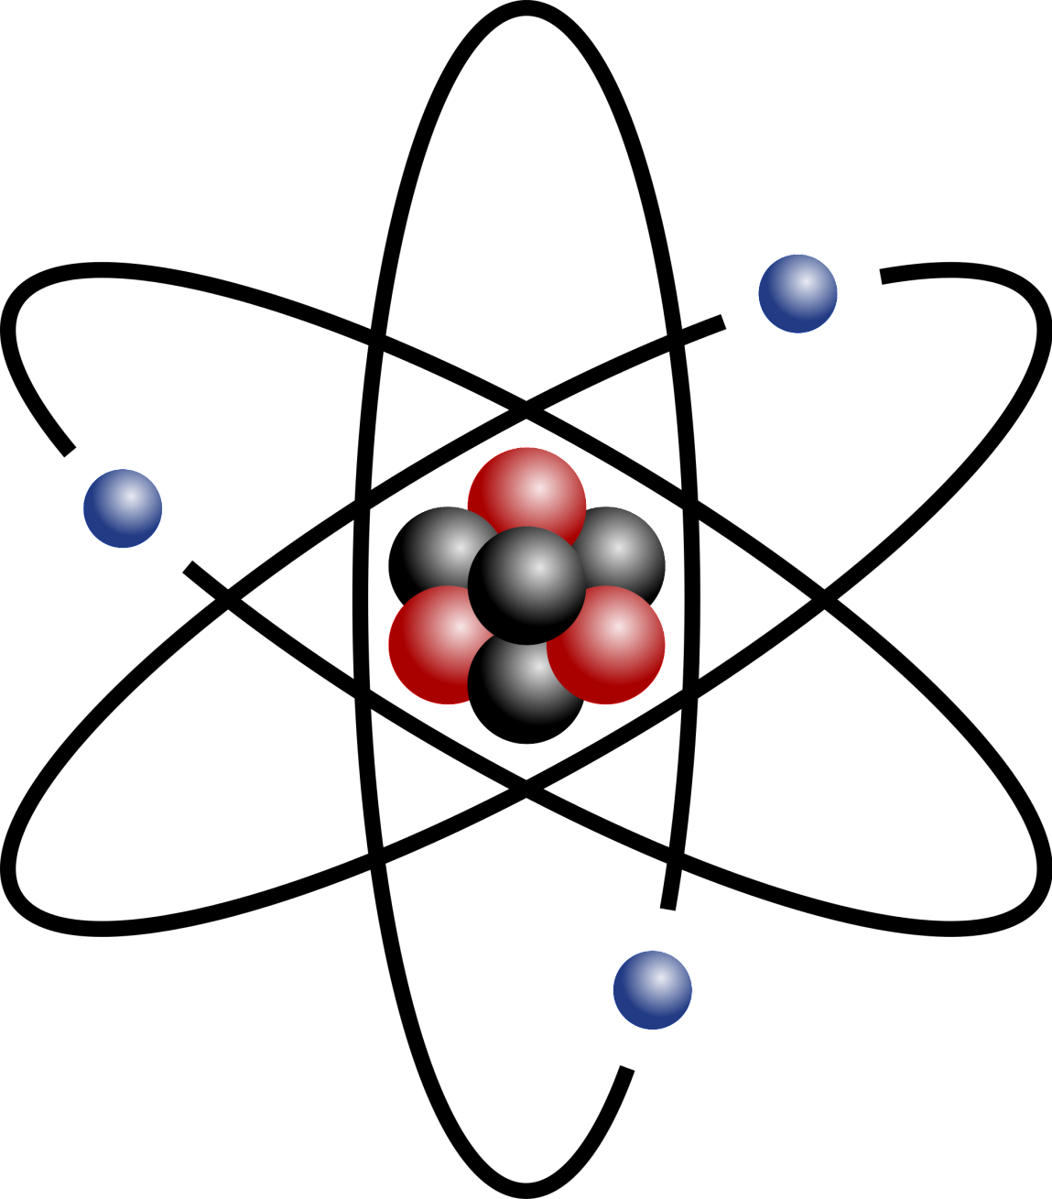
Hypotheses: The Atom
Demokrit: verbal and meta-physical
John Dalton 1808 „A New System of Chemical Philosophy“:
  Observation: Law of multiple Proportions
  Hypothesis: All matter consists of indivisible atoms.
Maxwell 1859, Boltzmann 1871: Atoms in statistical mechanics
Positivists like Mach criticize
  Lenin 1908, Materialism and Empiriocriticism
final confirmation took almost a century:
  Einstein 1905, Brownian motion
  Max von Laue, Bragg Father & Son, after 1912
  crystal structure and atoms visible through X-ray diffraction
Popper: asks for falsifiability for empirical science,
but not for „reinforced dogmatism“
dogmatic ban of hypotheses= End of science
hypotheses temporarily legitimate and necessary,
without being able to immediately give procedures for verification or falsification
Notes:
XL
http://de.wikipedia.org/wiki/Immunisierungsstrategie,
http://de.wikipedia.org/wiki/Verstärktes_Dogma
Karl R. Popper: The Open Society and Its Enemies. 4. Auflage. London 1962, S. 242.

Slide 7
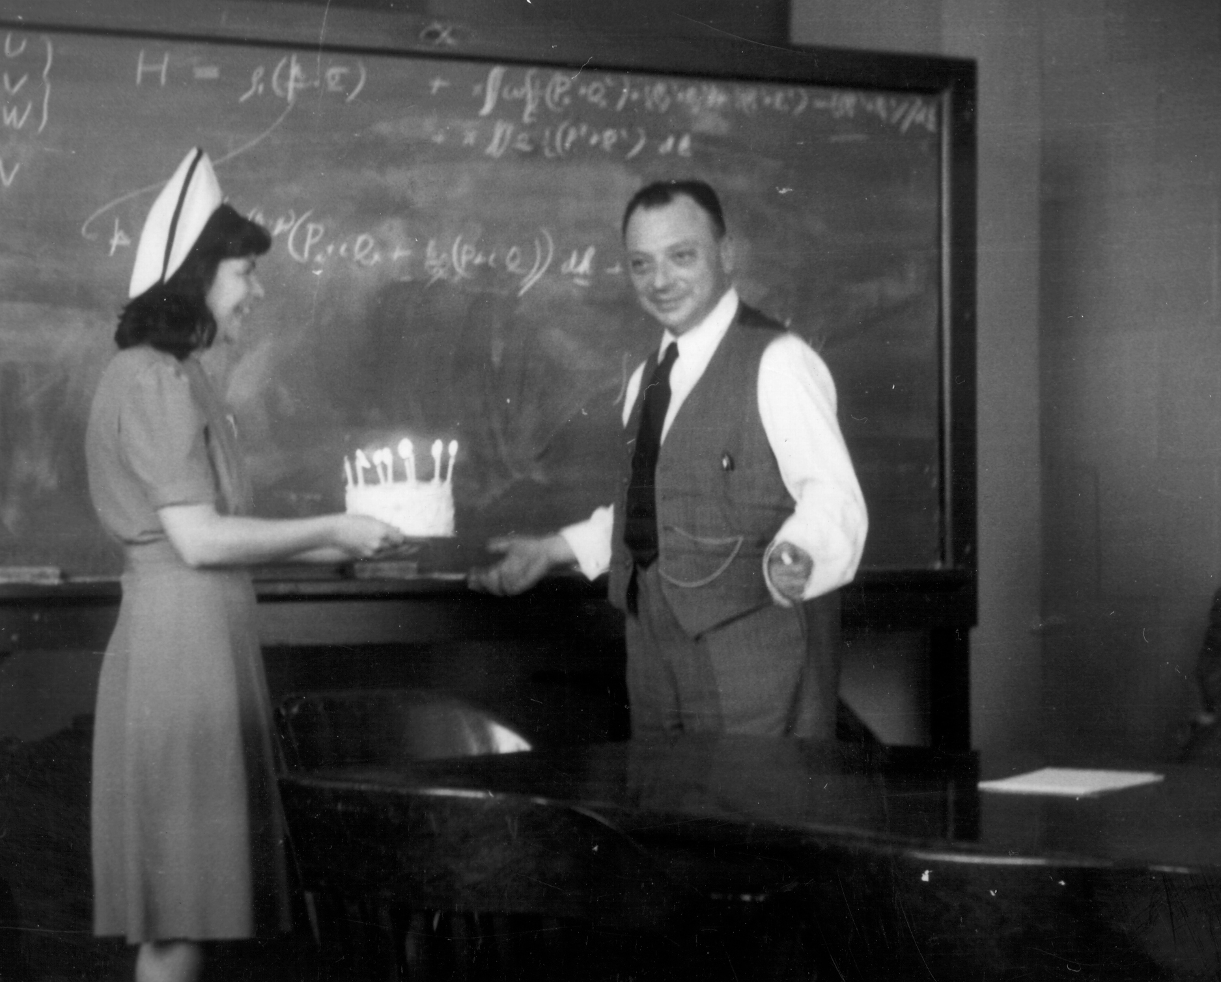
Hypotheses: Neutrino
W. Pauli on the day of the formulation of his neutrino hypotheses (4.12.1930) to the astronomer W. Baade
„Today I did something terrible which no
theoretical physicist should ever do.
I proposed something which can
never be verified experimentally.“
detection 1956 by C.Cowan and F.Reines
Never say never!
Popper: asks for falsifiability for empirical science,
but not for „reinforced dogmatism“
dogmatic ban of hypotheses = end of science
hypotheses temporarily legitimate and necessary,
without being able to immediately give procedures for verification or falsification
Notes:
XL
http://de.wikipedia.org/wiki/Immunisierungsstrategie,
http://de.wikipedia.org/wiki/Verstärktes_Dogma
Karl R. Popper: The Open Society and Its Enemies. 4. Auflage. London 1962, S. 242.

Slide 8
Antropic Principle
Steven Weinberg
A physicist talking about the anthropic principle
runs the same risk as
a cleric talking about pornography:
no matter how much you say you are against it,
some people will think
you are a little too interested.

Slide 9
George Ellis
Does the Multiverse Really Exist?
Scientific American, 1 August 2011, 305 (2011) 38–43.
As skeptical as I am, I think the contemplation of the multiverse is an excellent opportunity to reflect on the nature of science and on the ultimate nature of existence: why we are here...
In looking at this concept, we need an open mind, though not too open. It is a delicate path to tread. Parallel universes may or may not exist; the case is unproved. We are going to have to live with that uncertainty.
Nothing is wrong with scientifically based philosophical speculation, which is what multiverse proposals are.
But we should name it for what it is.

