Slide 1
Panel: Exhibitions
Pedro Abreu Portugal
(LIP Laboratorio de Instrumentacao e Fisica Experimental de Part.)
Despina Hatzifotiadou ALICE experiment
(Universita e INFN, Bologna (IT))
Natascha Hoermann Austria
(Austrian Academy of Sciences (AT))
Achintya Rao CMS experiment
(University of the West of England (GB))
Krzysztof Wieslaw Wozniak Poland
(Polish Academy of Sciences (PL))

Slide 2
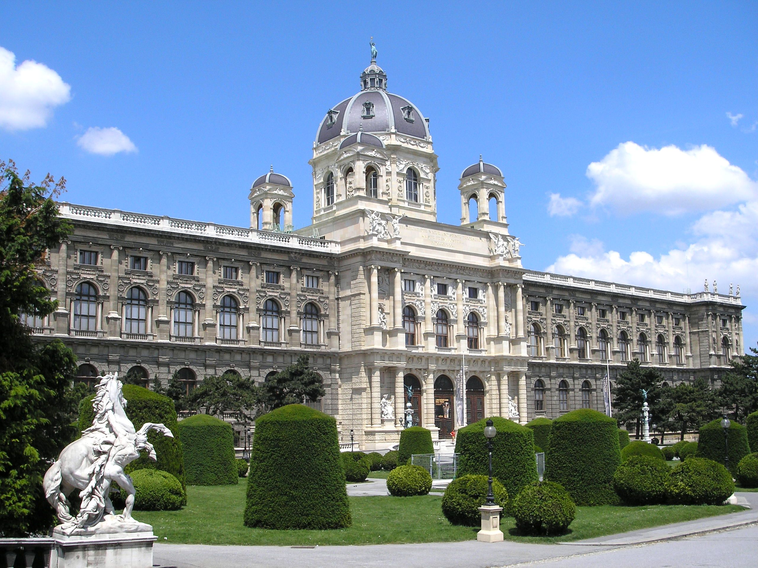
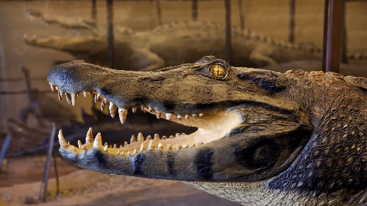
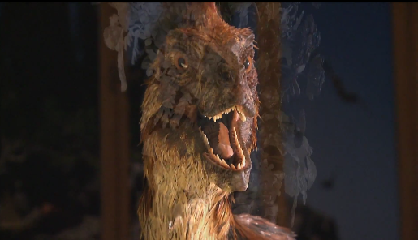
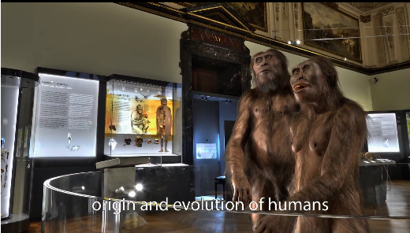
Vienna Museum of
Natural History
50th anniverary of the Institute of High Energy Physics
18th Oct. 2016 –
Aug. 2017
550 m²
space
400.000 visitors expected

Slide 3
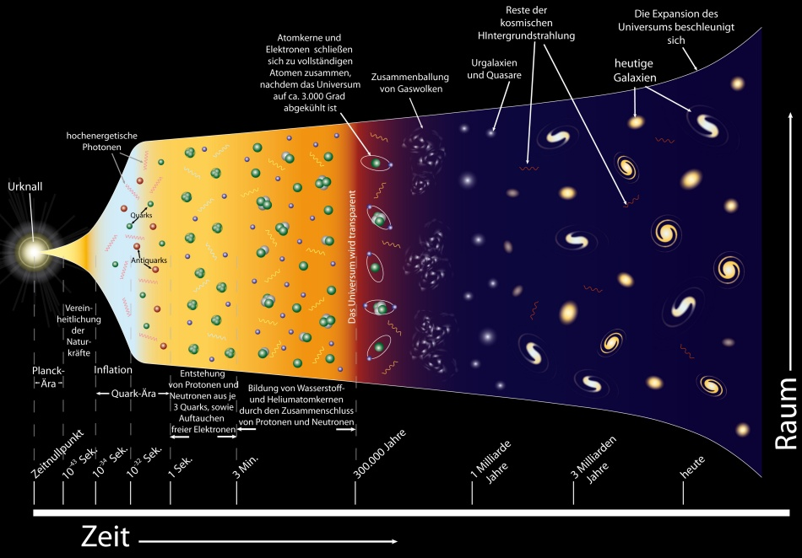
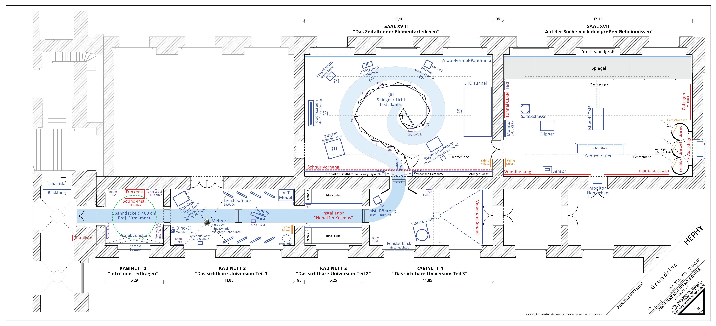
Vienna Museum of
Natural History

Slide 4
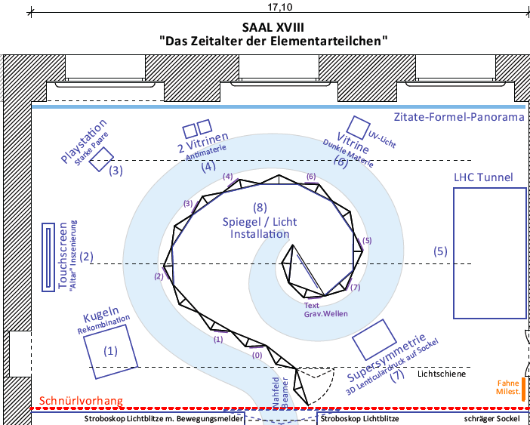
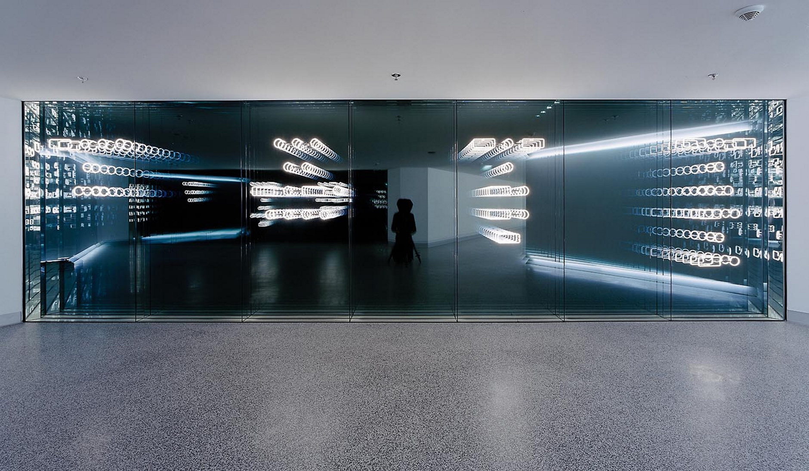
Vienna Museum of Natural History
Light installation “Big Bang”
Brigitte Kowanz (Biennale Venedig 2017)

Slide 5
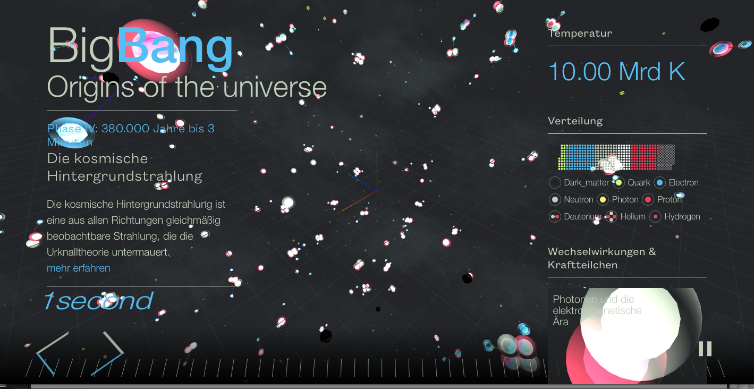
Vienna Museum of Natural History
Interactive Tough-Screen “Big Bang”
2 x 3 m
Julian Roedelius
http://hephy.roedelius.org

Slide 6
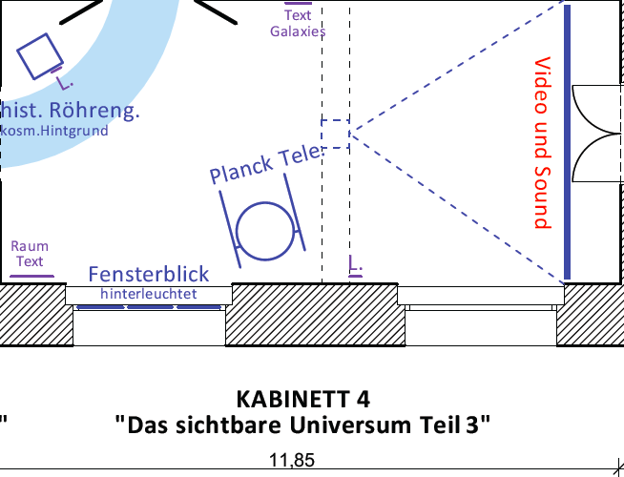
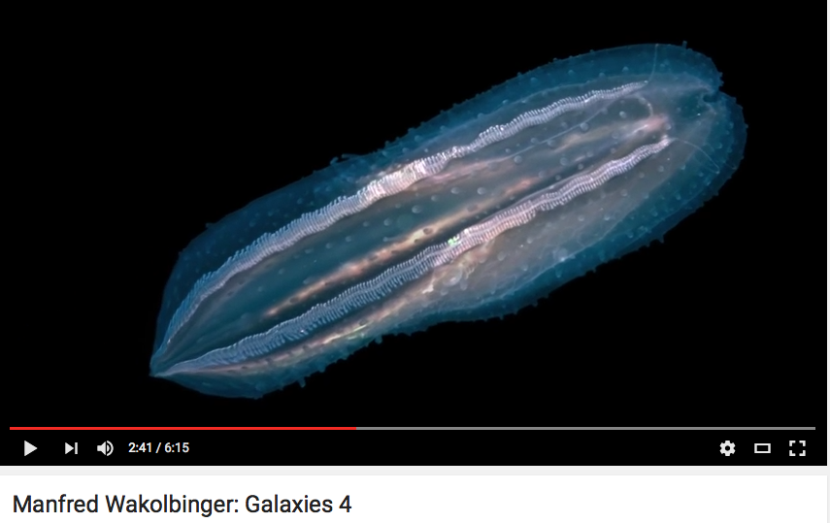
Vienna Museum of Natural History
Video/Sound Installations
Eva Schlegel/Barbara Imhof/Damjan Minovski und Manfred Wakolbinger (Jellyfish)
https://www.youtube.com/watch?v=wtvCw0FV02k

Slide 7


The Exhibition “Partículas”

Slide 8
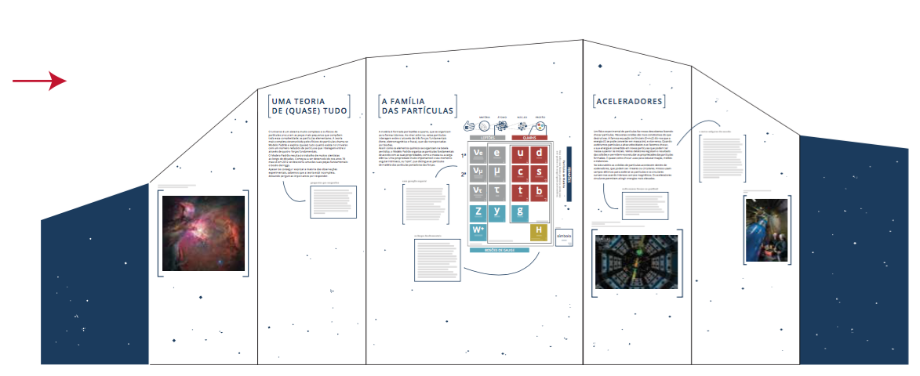
The Exhibition “Partículas”
Modular – 7 modules with 7 panels each,
assembled accordingly to the distribution of available space
Recto/Verso Reading (entrance corridor, left side: Main Theme)
(entrance)

Slide 9
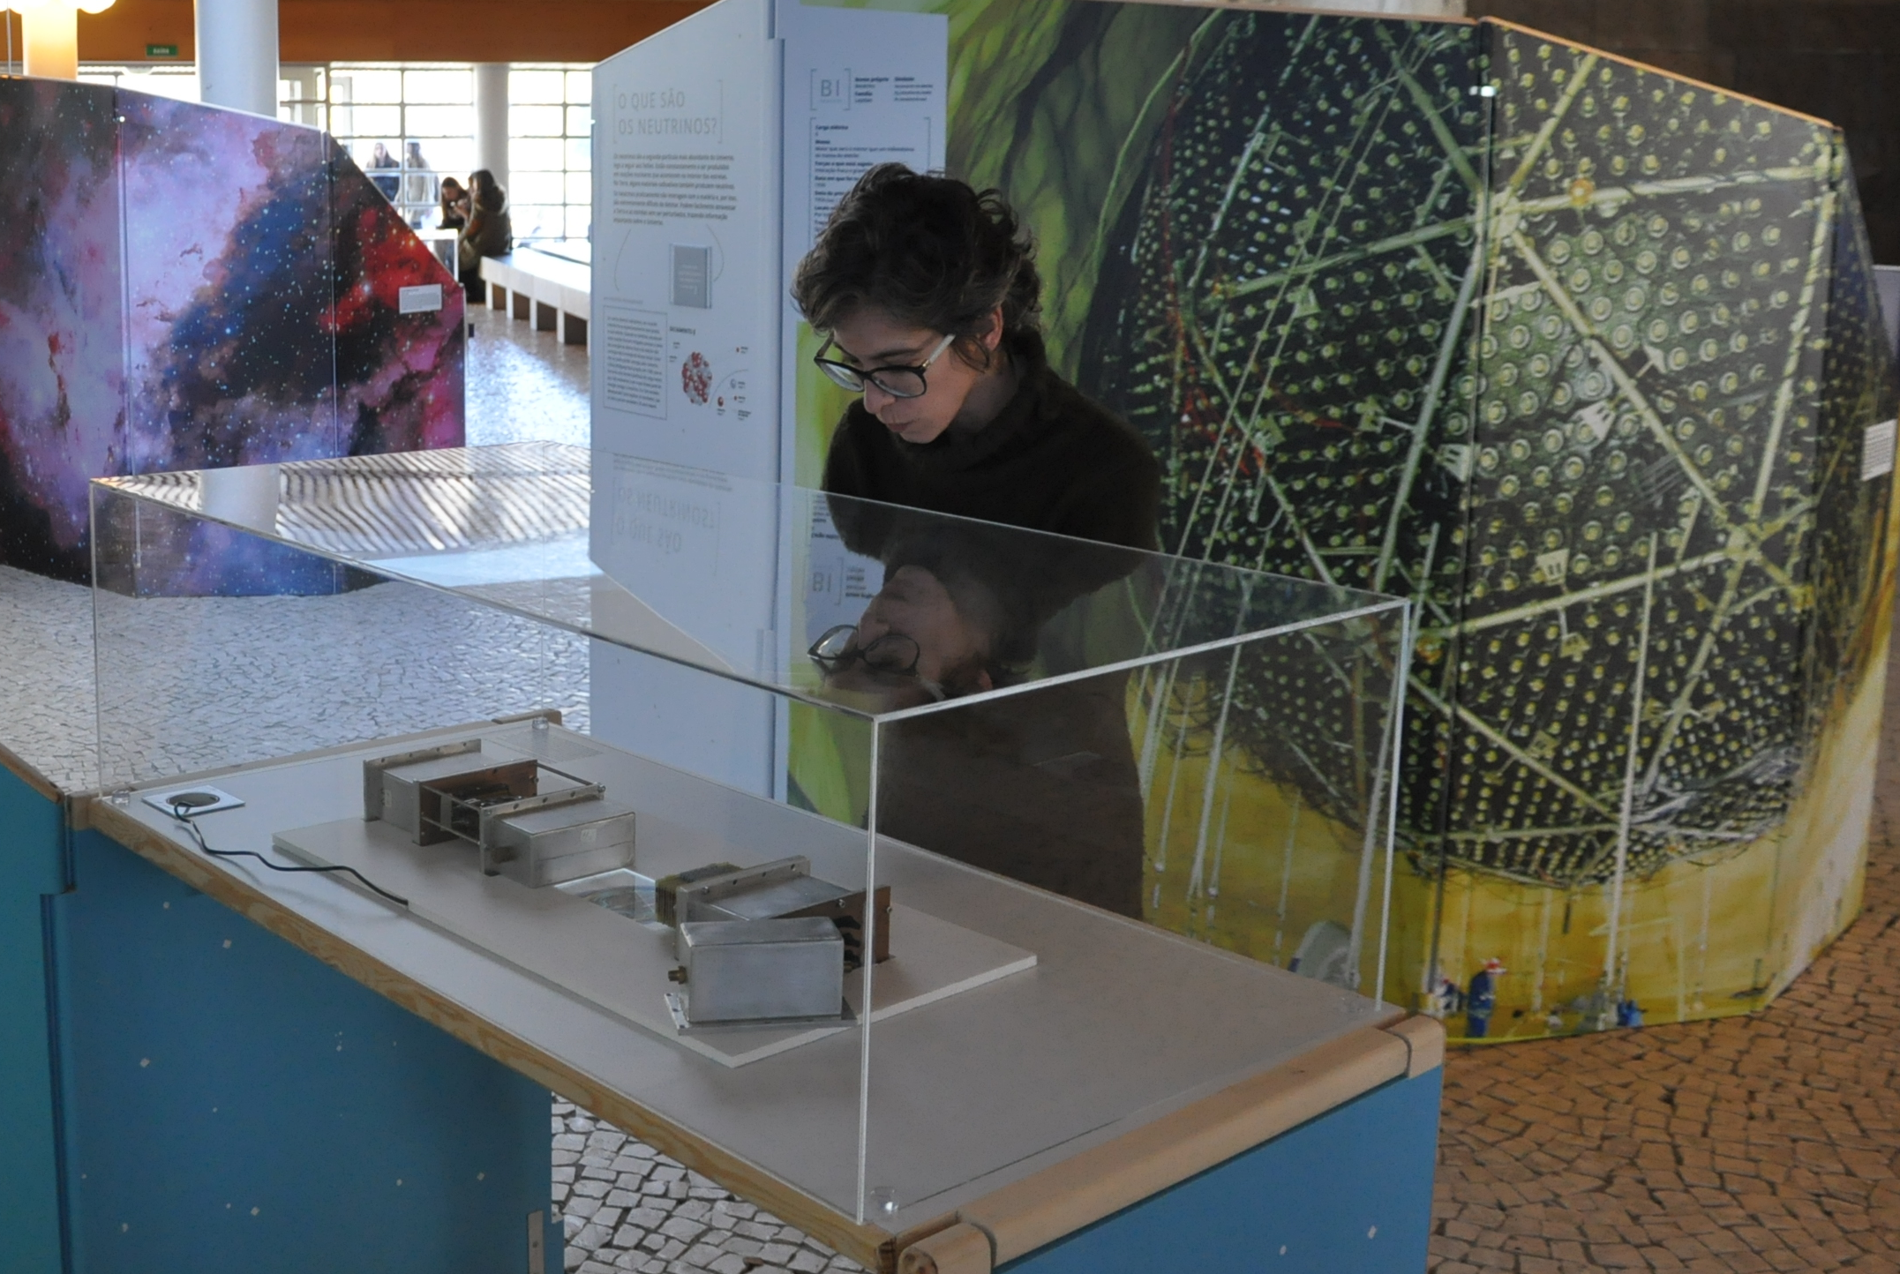
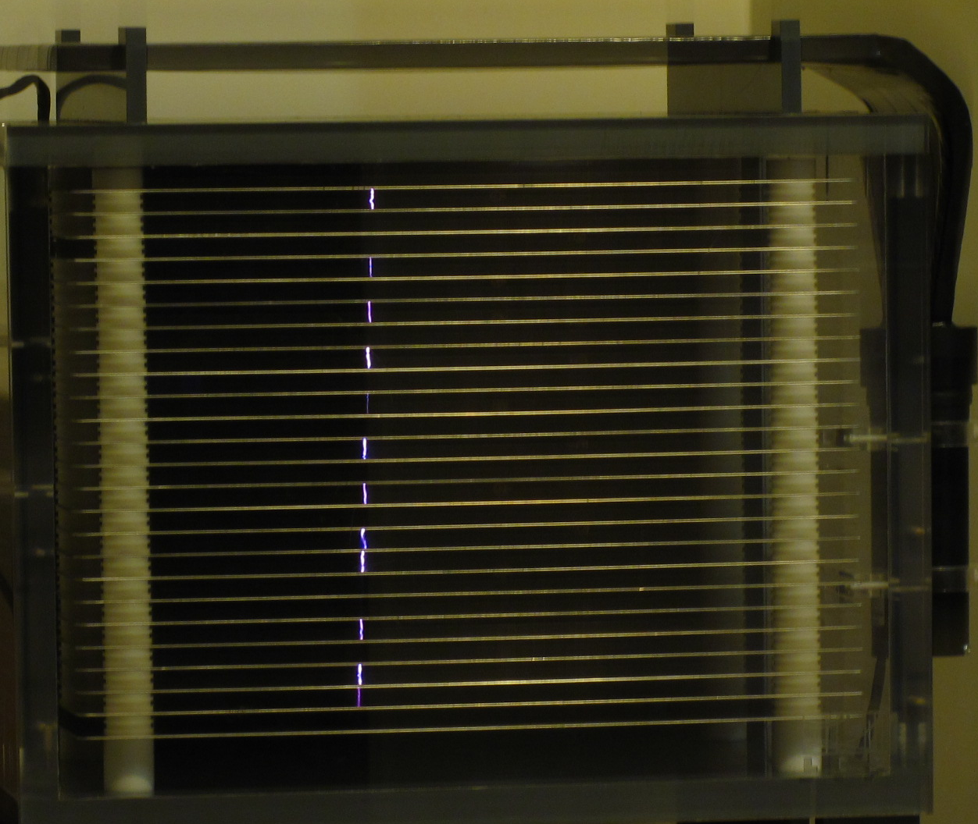
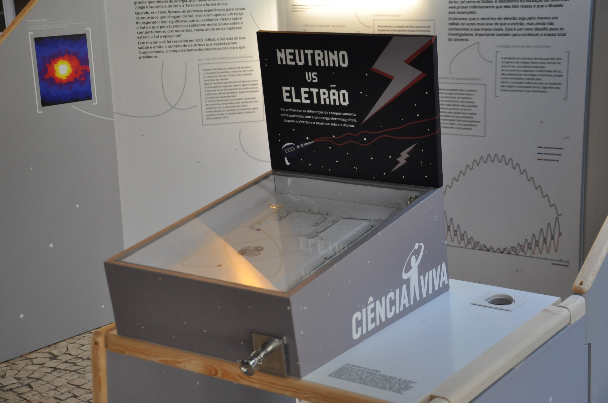
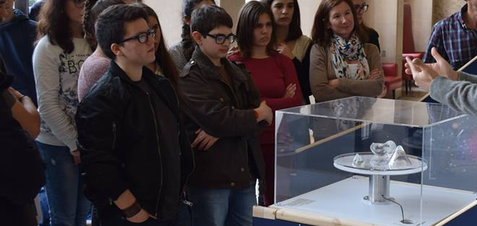
The Exhibition “Partículas”
At the end of each module, a table with some exhibits
LIP’s
Spark
Chamber
Small PET
Detectors
Flippers!
[Gravitational]
Lensing in Dark Matter

Slide 10
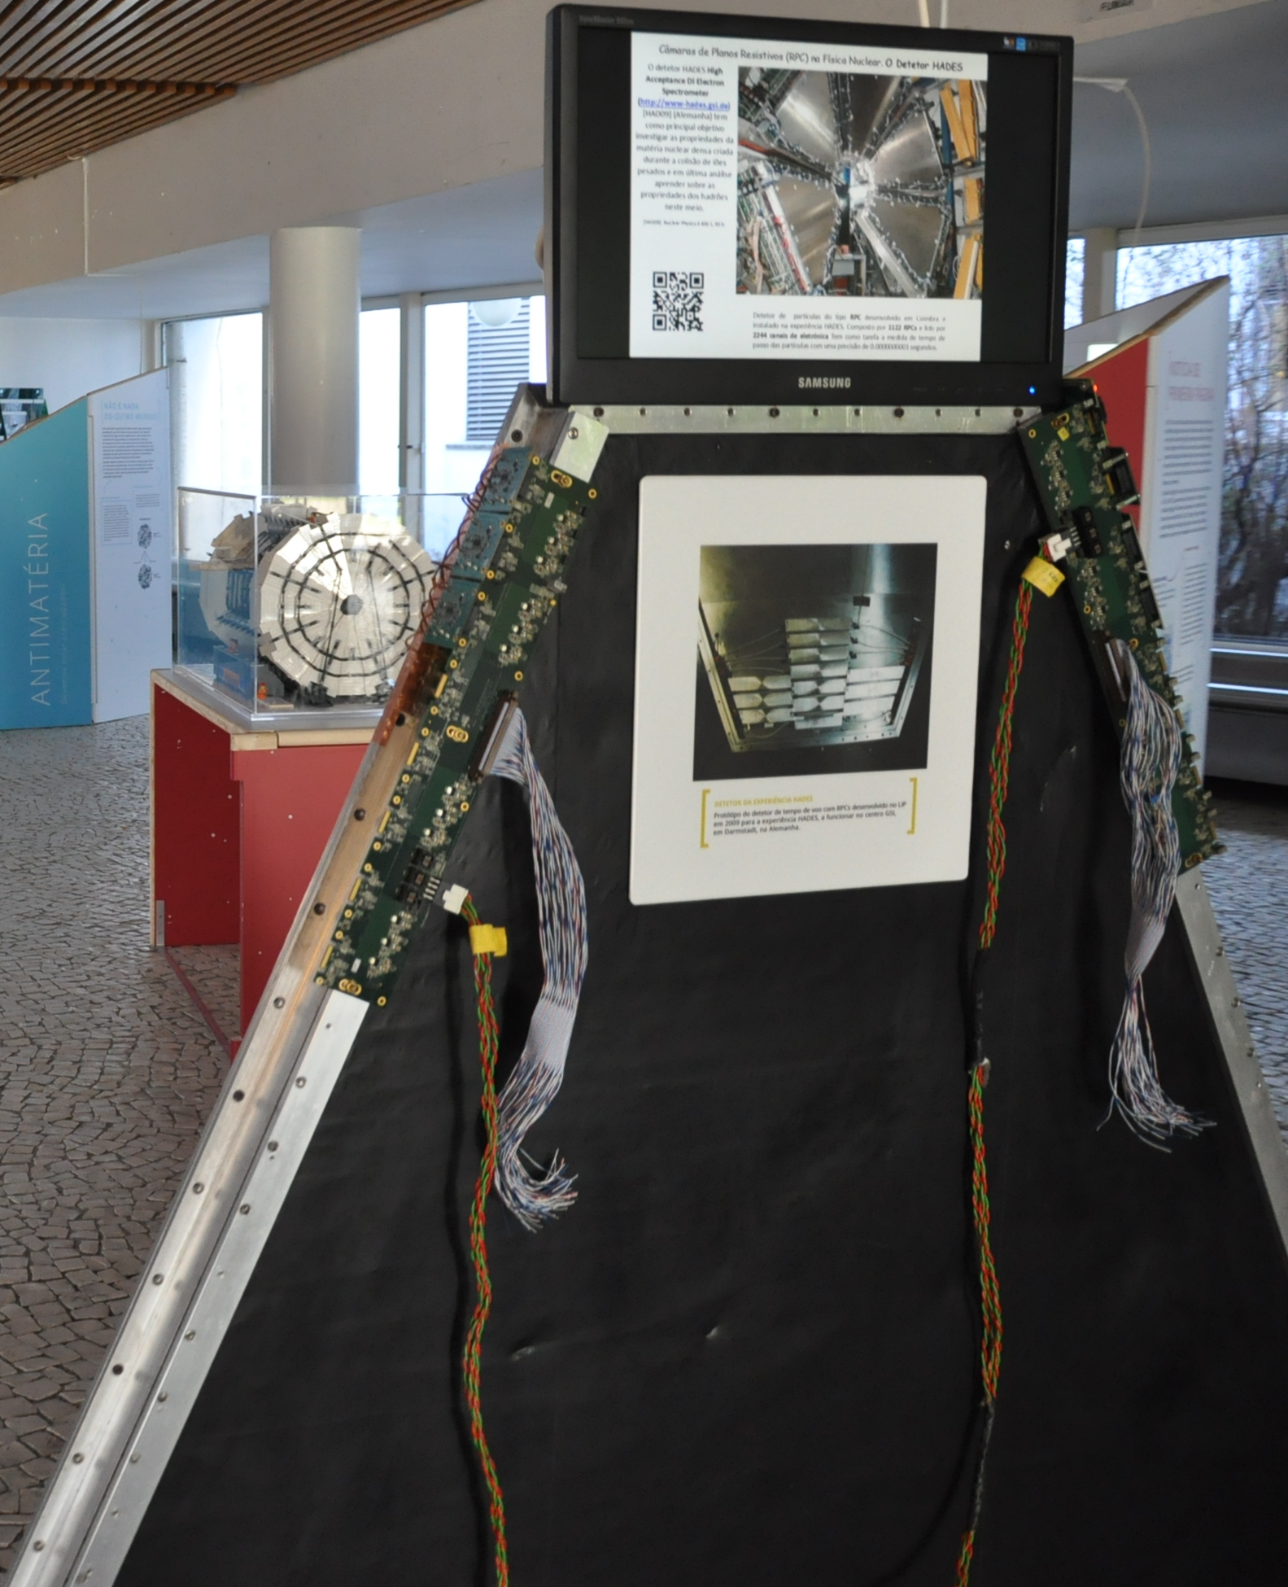
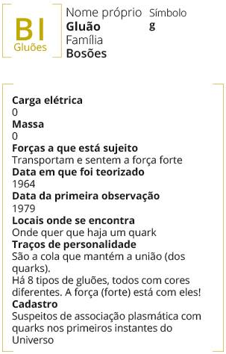
The Exhibition “Partículas”
Other goodies:
A real detector
(RPC module in
Hades/GSI)
Each module features a display –
6 with video/animation shows and
1 interactive touch display
Each module features an identity/citizen “card”,
displaying properties of the particles discussed
  electric charge
  interactions to which it reacts
  date of conception
  date of birth
  places where to find it
  personality characteristics
  criminal record

Slide 11
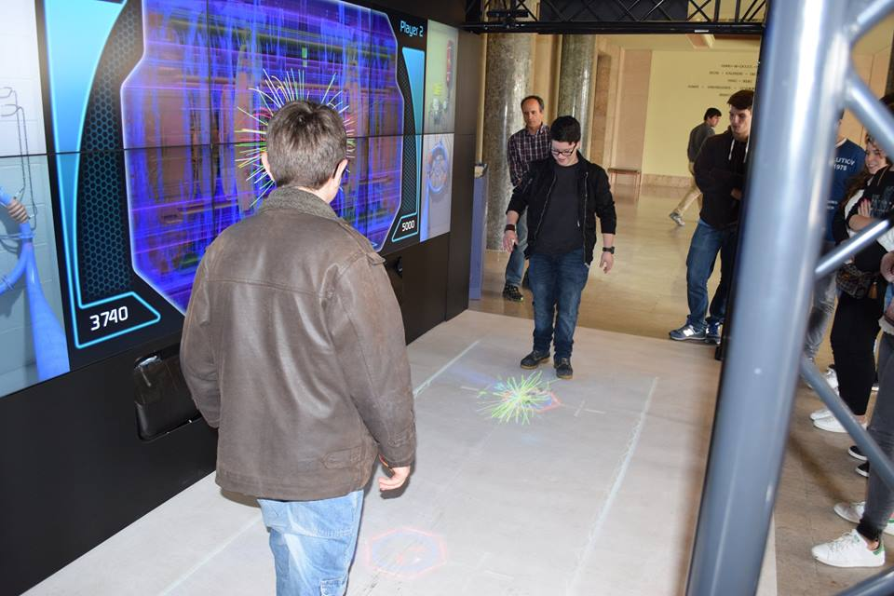
The Exhibition “Partículas”
The CERN MediaLab’s LHC Interactive Tunnel
Central
to the
Exhibition

Slide 12

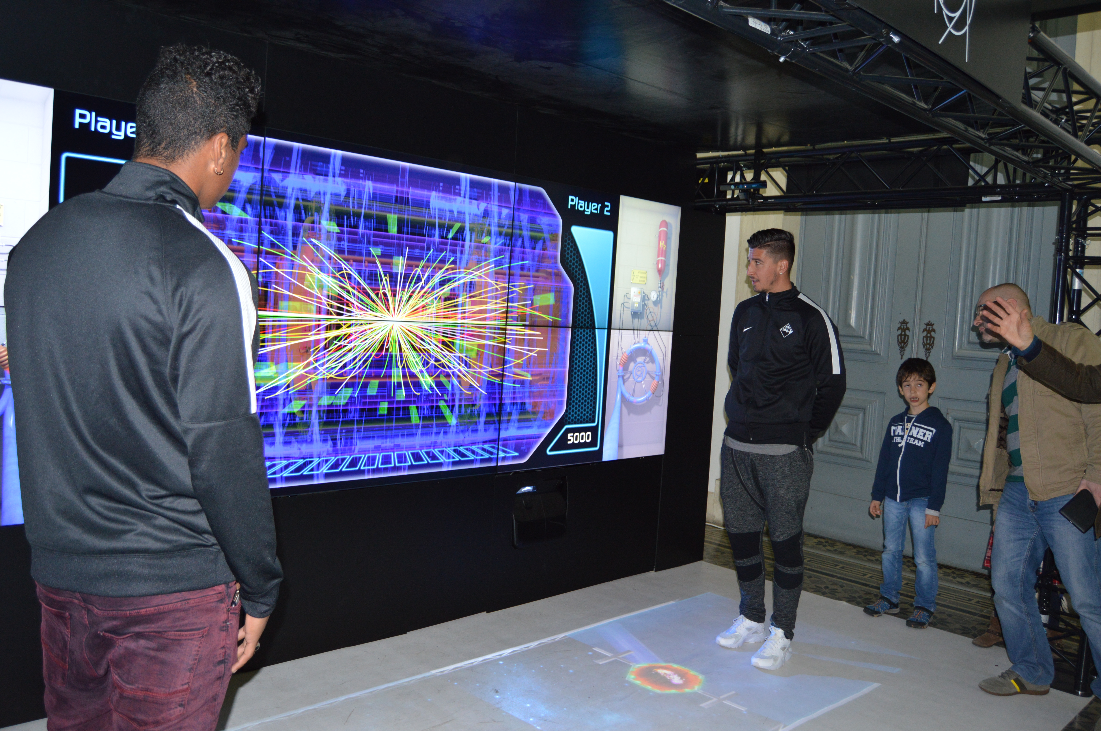
We did managed to appear on the largest circulating newspaper!
by having
Professional football players from a 1st League team to
play “proton football”:

Slide 13
The LHC Walls at Point 5

Slide 14
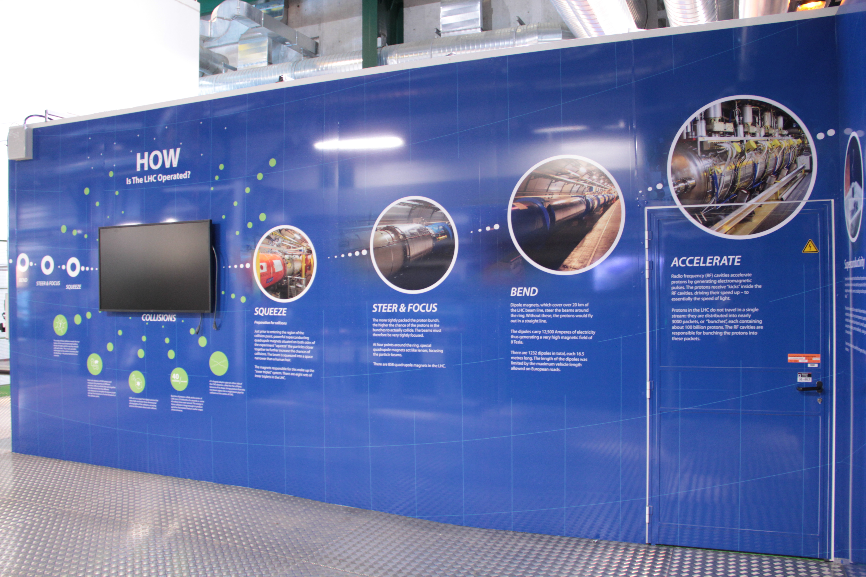
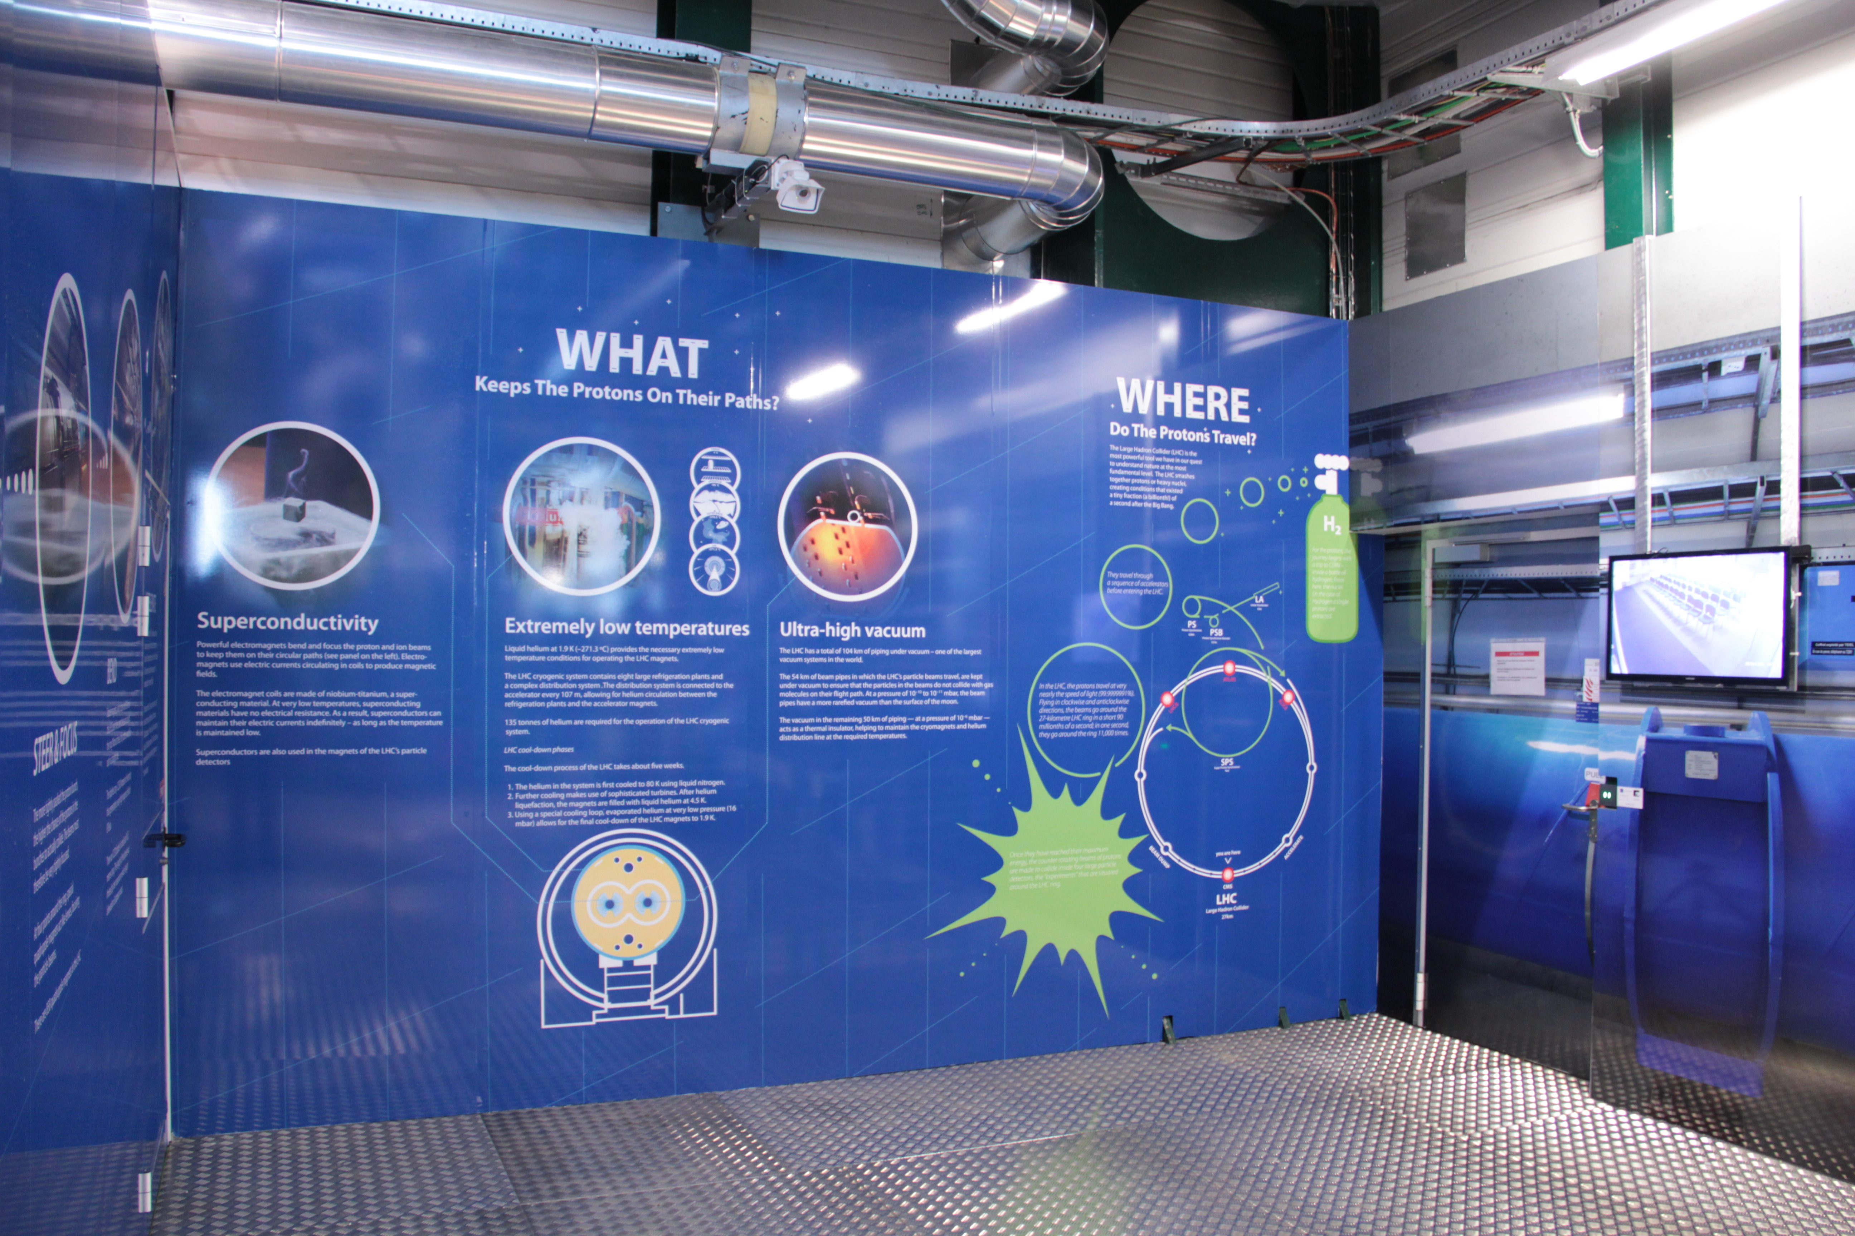
Individual walls

Slide 15
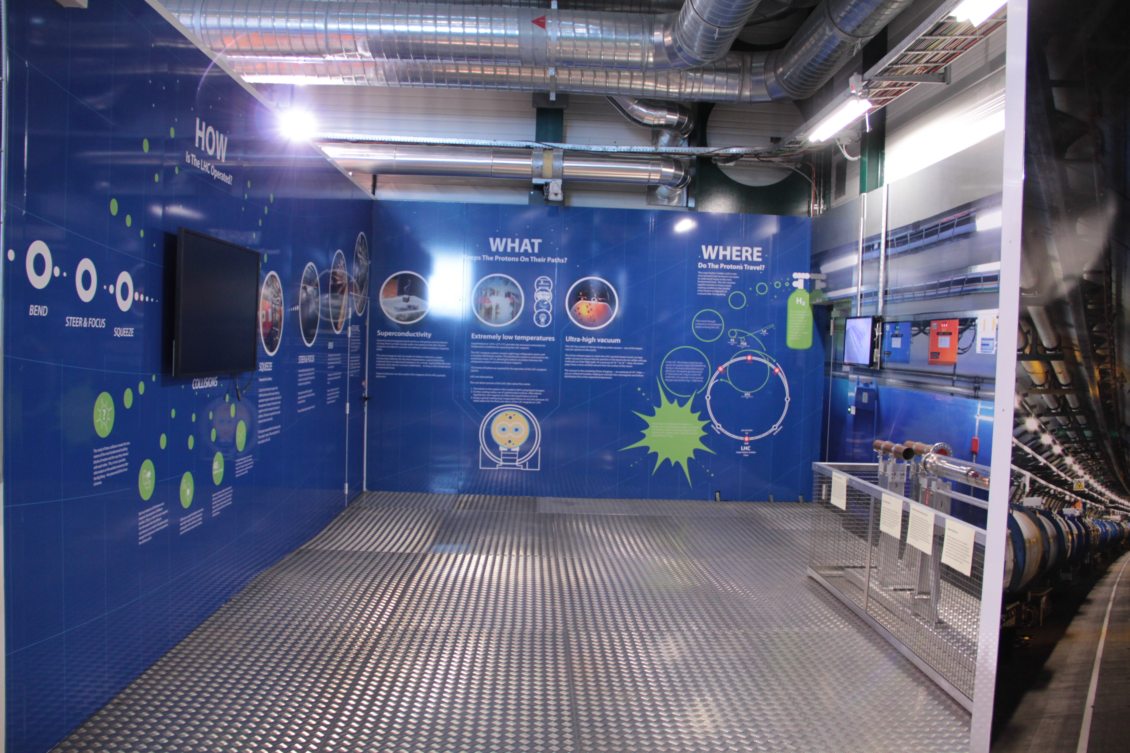
The whole space

Slide 16
Context

Slide 17
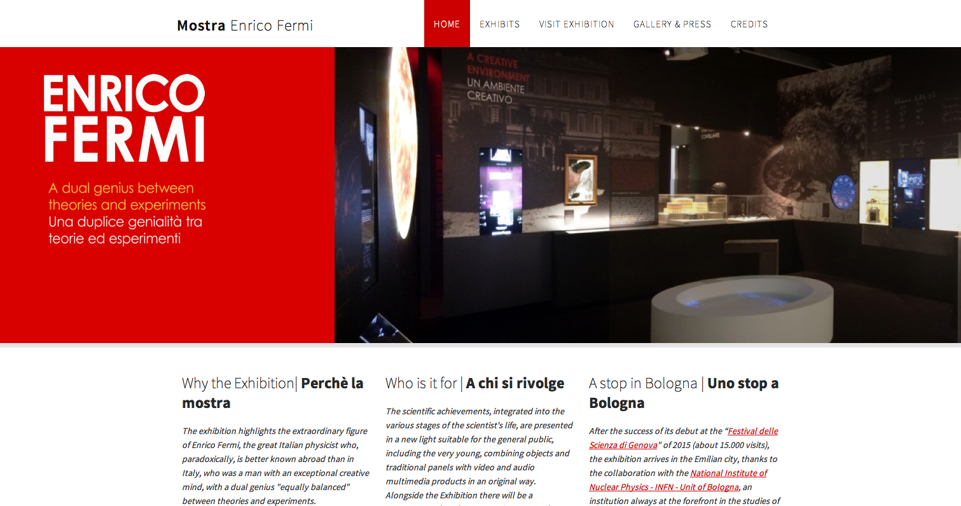
http://www.mostrafermi.it/
By : Museo Storico della Fisica e Studi e Ricerche ”Enrico Fermi” – Rome, SIF and INFN
Inaugurated : Festival della Scienza 2015, Genova (22 Oct 2015 – 16 Jan 2016)
Bologna, ex-chiesa di San Mattia (6 Feb – 22 May 2016)
Final destination : historic building of physics institute at Via Panisperna, Rome

Slide 18
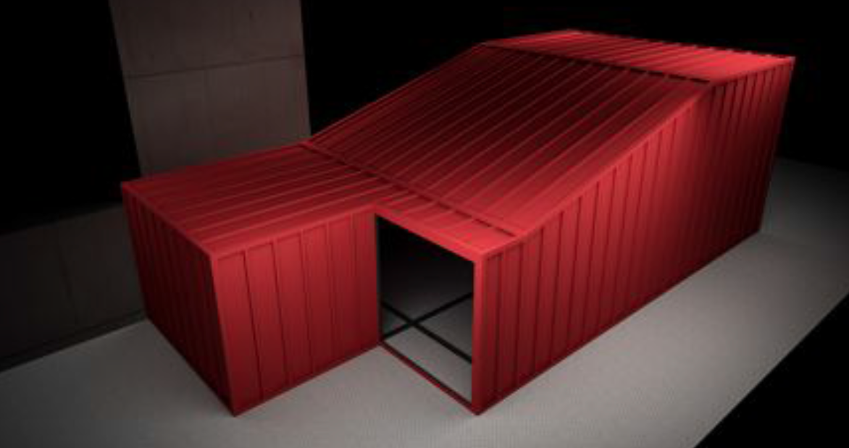
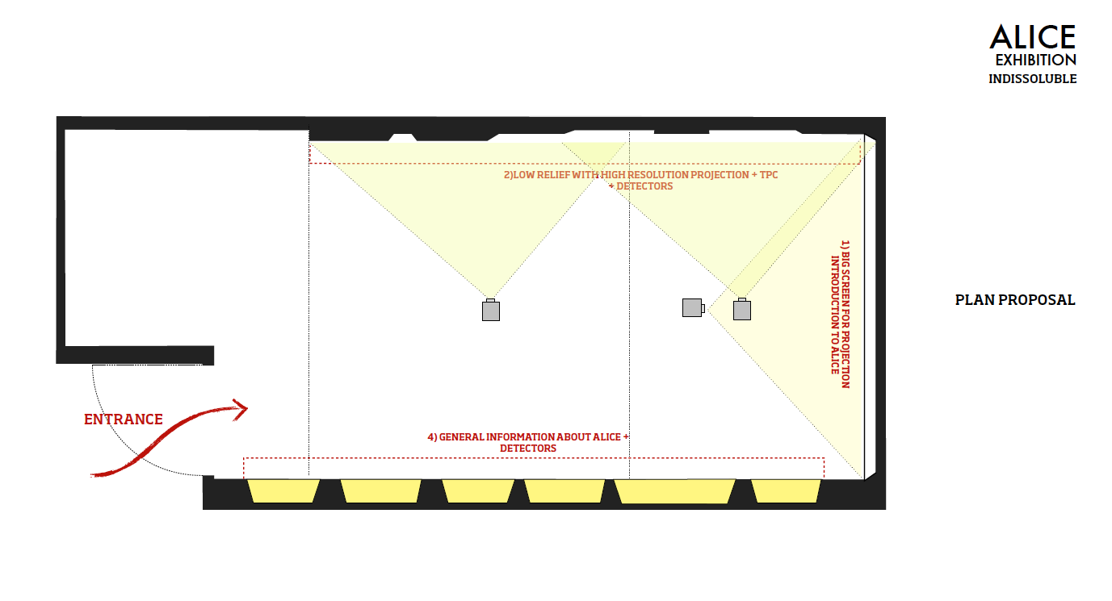
ALICE exhibition
Current plans : end 2016
Close exhibition area
Redo all infrastructure
Introductory presentation on big wall
Video mapping projection on 1 to 1 ALICE mockup
Place detector pieces inside mockup when possible
Additional vitrines

Slide 19
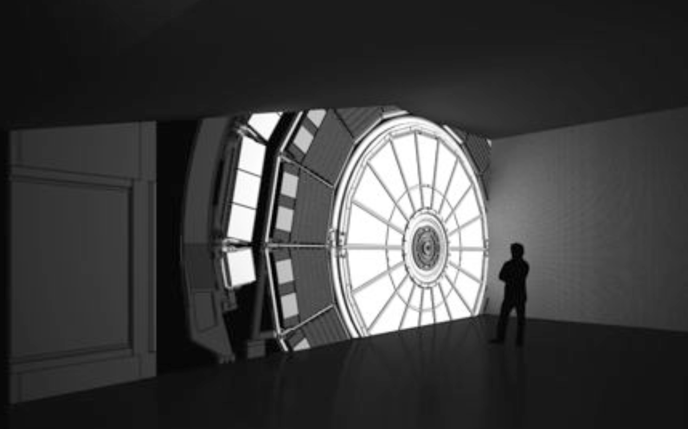

Slide 20
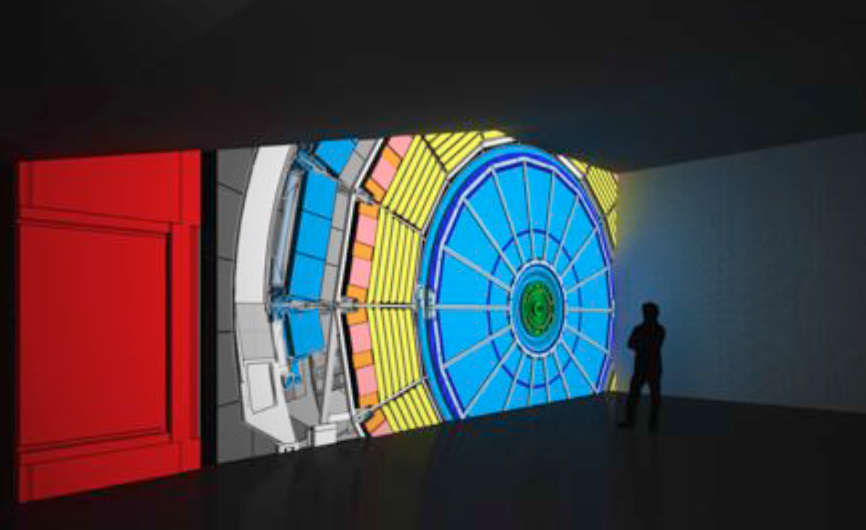

Slide 21
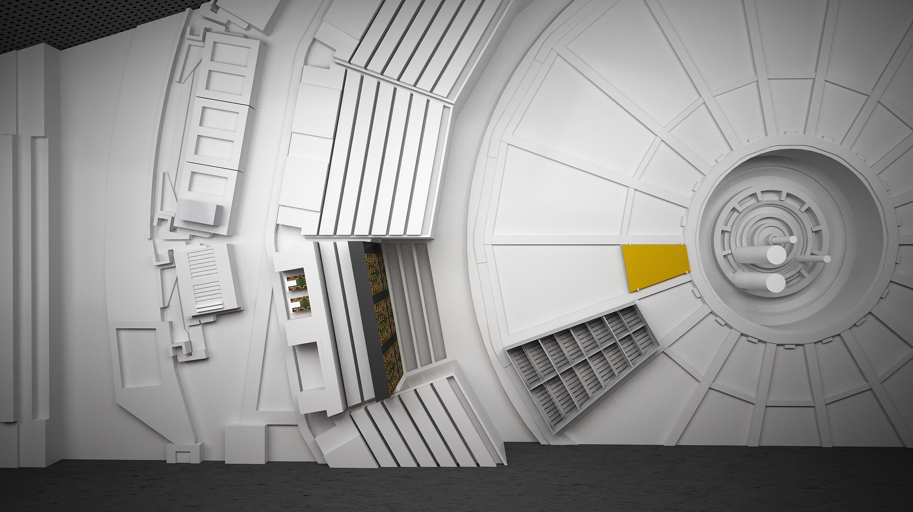

Slide 22
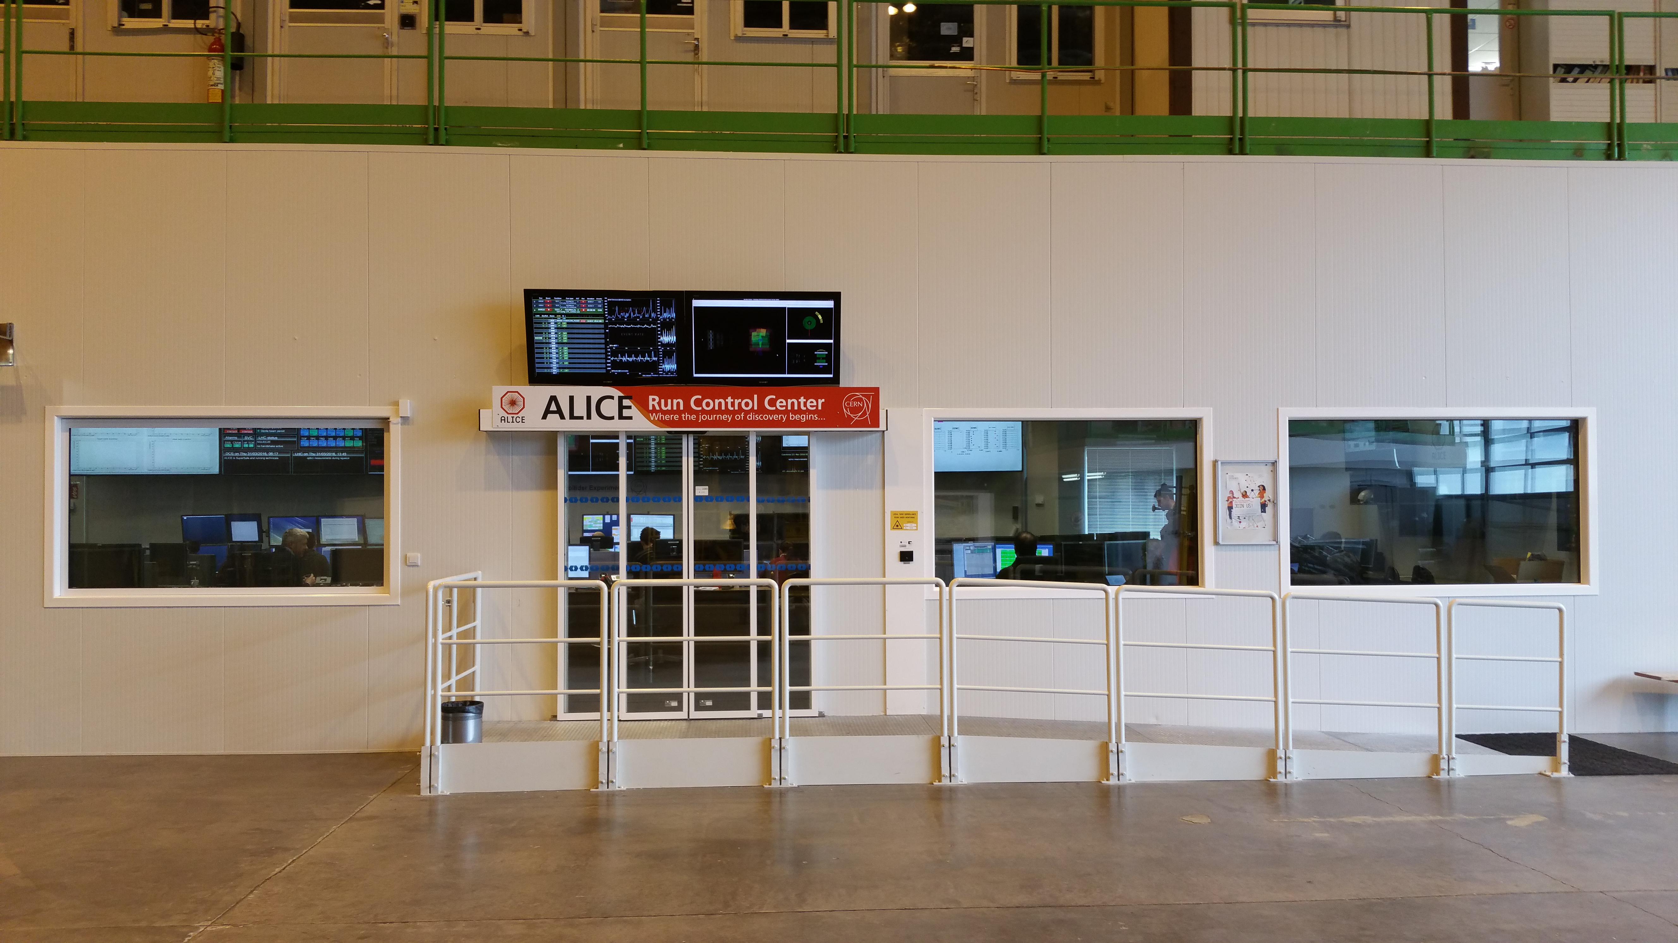
The ALICE Interactive Window
“The Magic Window”

Slide 23
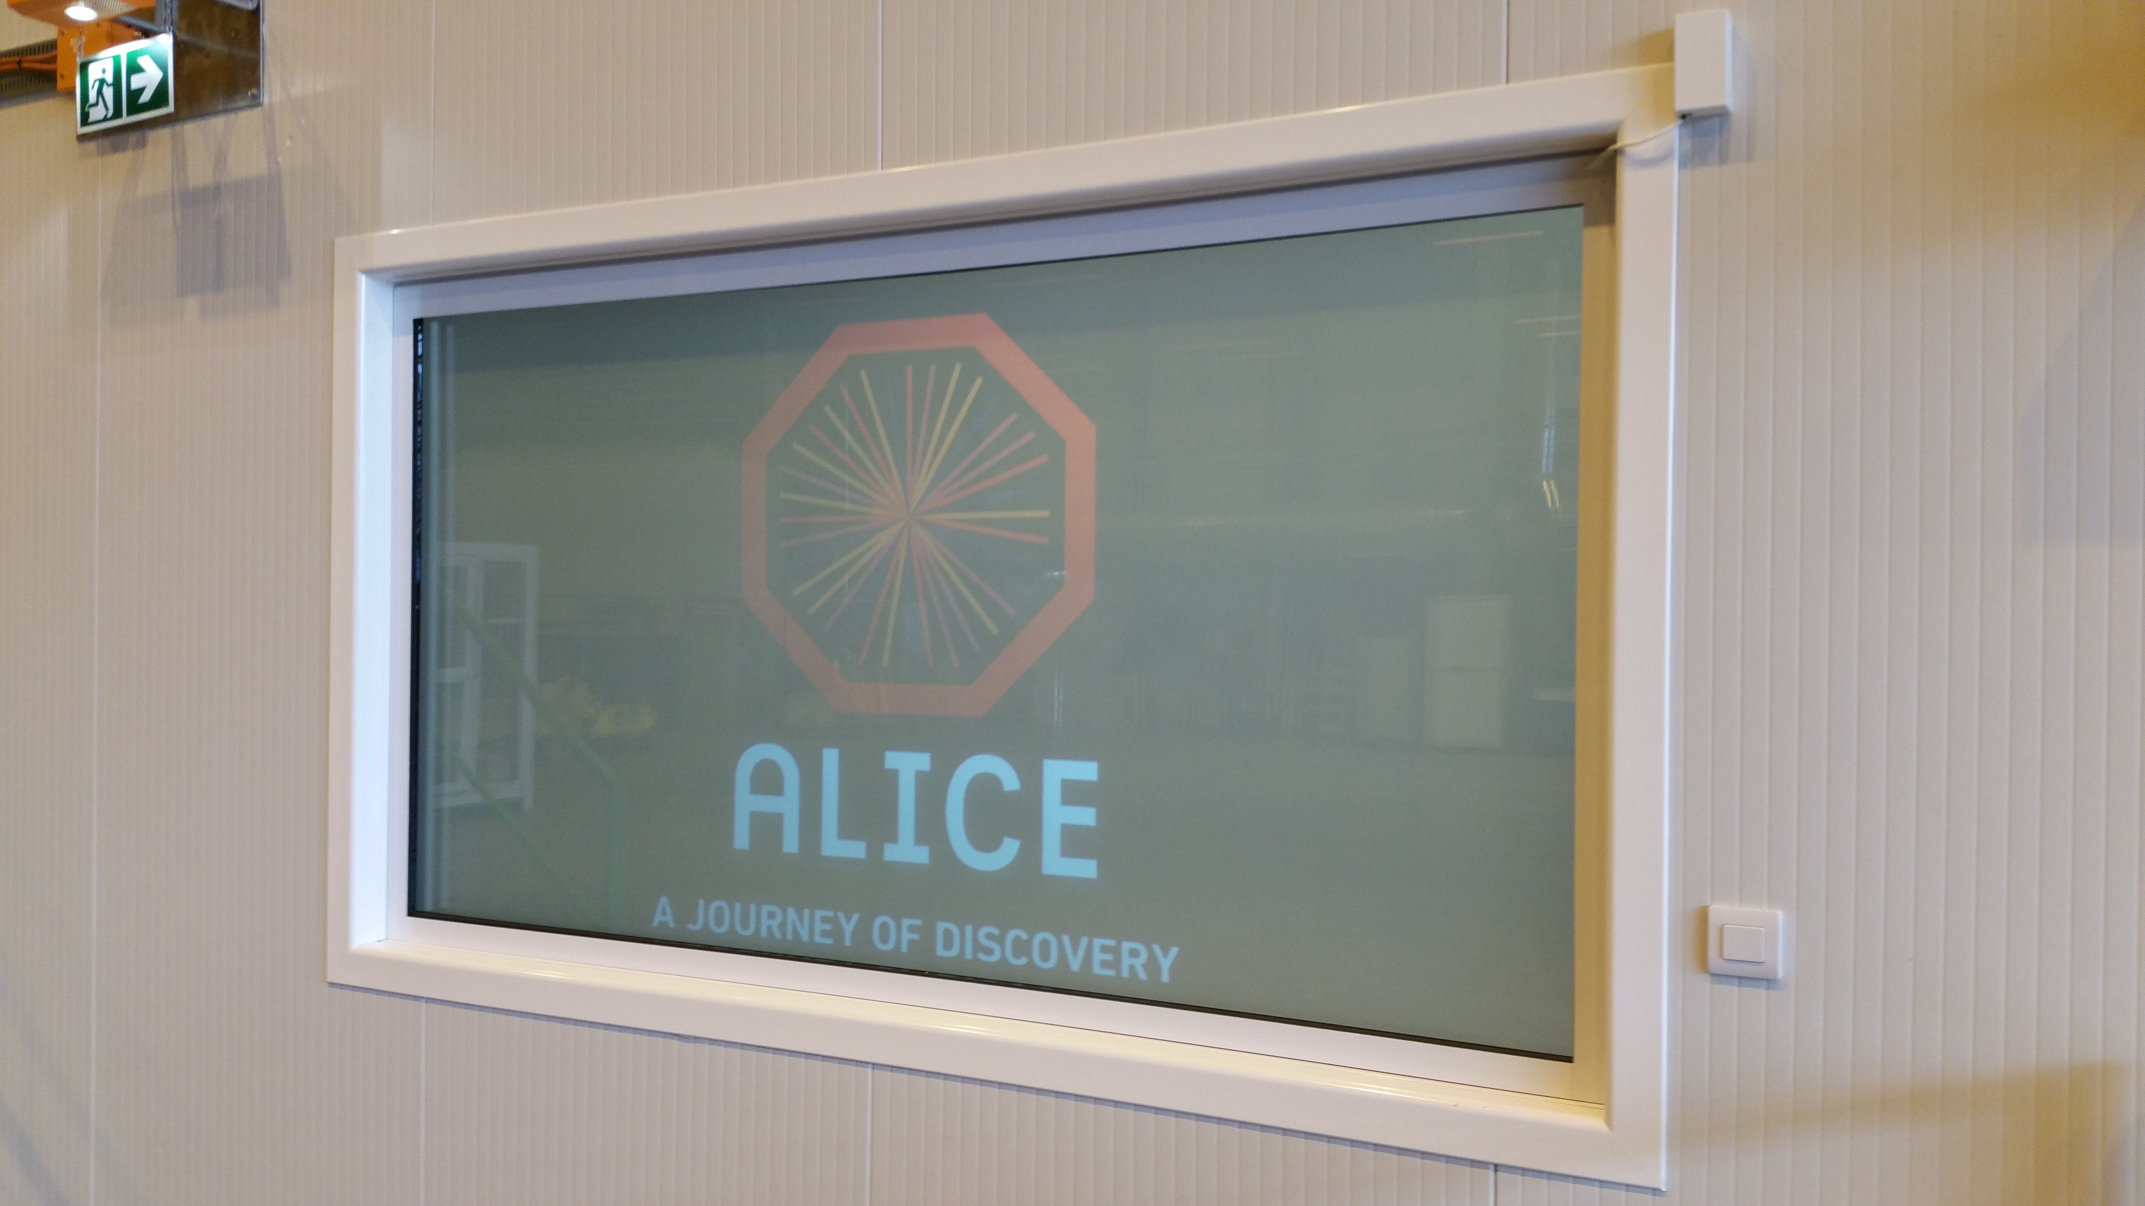
Presentation based on ImPreSS: introduction to ALICE physics, experimental apparatus + sociology (information for each country)

