Slide 1
Ripples of Curiosity
4th Edition

Slide 2
Event details
Date: 5 November 2016 from 14:00
Venue: Main auditorium at CERN (400 guests with satellite events worldwide)
Theme: Ripples of curiosity
Speakers: 12 people (topics ranging from physics and astronomy to life sciences and health, from artificial intelligence to energy, from climate to education)
Focus: worldwide engagement from webcast partners (Institutes, universities, schools, science museums, etc.)

Slide 3
Involvement for the webcast partner
5 simple steps:
Book a room where you can hold the webcast event;
Invite people in your community with whom you can engage in constructive dialogue;
Promote the event in your community by using TEDxCERN posters and press release templates provided by CERN;
Organize a reception after the event;
Send us photos/videos of your event.

Slide 4
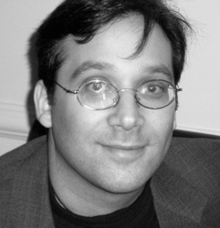
Speakers
Gary F. Marcus is a professor of psychology and neural science at NYU and CEO and co-founder of the recently-formed Geometric Intelligence, Inc. His research on language, computation, artificial intelligence, and cognitive development has been published widely in leading journals such as Science and Nature. He is also the author of four books including The Algebraic Mind, Kluge: The Haphazard Evolution of the Human Mind, and The New York Times Bestseller Guitar Zero. He contributes frequently to the The New Yorker and The New York Times. He is an avid critic of connectionism and deep-learning fever in AI.

Slide 5
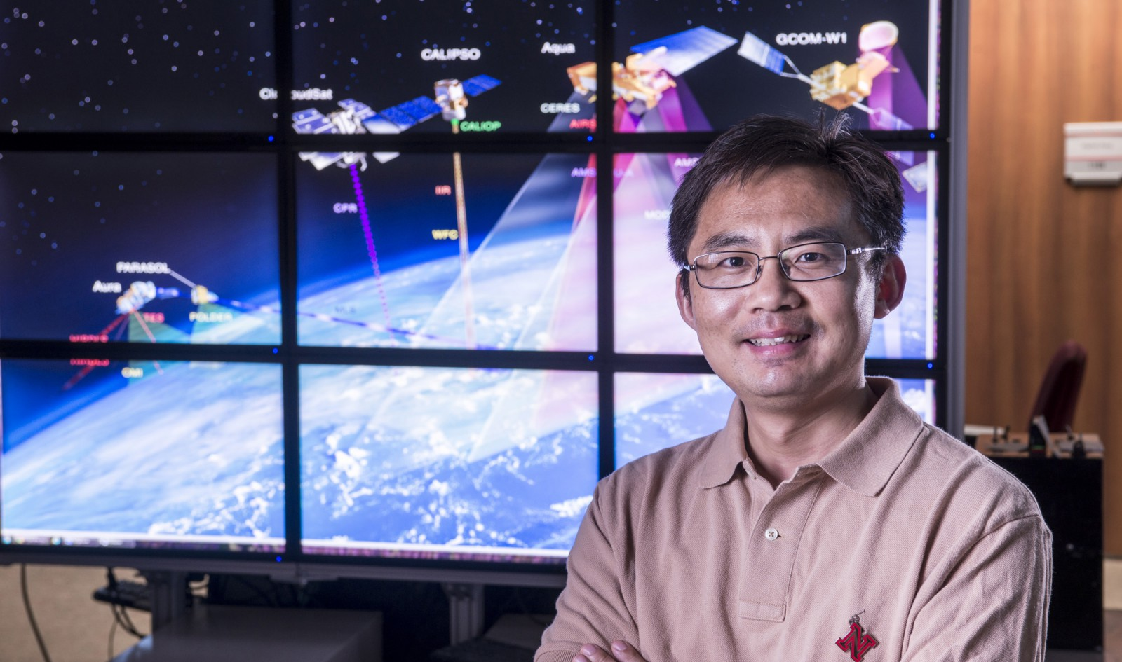
Jun Wang is one of China’s most famous scientists. Wang has led BGI, the genome-sequencing powerhouse since 2007, when it stopped using the name Beijing Genomics Institute and moved its headquarters to Shenzhen. He now plans to devote himself to a new “lifetime project” of creating an AI health-monitoring system that would identify relationships between individual human genomic data, physiological traits (phenotypes) and lifestyle choices in order to provide advice on healthier living and to predict, and prevent, disease.

Slide 6
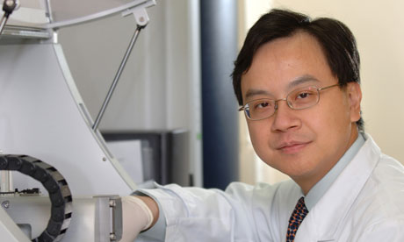
Dennis Lo directs the Li Ka Shing Institute of Health Sciences at the Chinese University of Hong Kong. After 22 years of persistent research, Dennis Lo succeeded in decoding a fetal genetic blueprint found within maternal blood. The advance is already saving lives by allowing pregnant women to be noninvasively screened for genetic abnormalities in fetuses they carry. Lo is currently working on developing a plasma DNA-based test that can be used to detect different types of cancer.

Slide 7
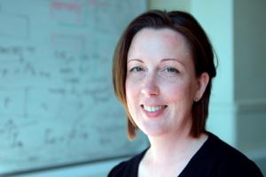
Sheila Rowan is the director of the Institute for Gravitational Research at University of Glasgow and a contributor to the LIGO observatory, the world’s largest gravitational wave observatory and a cutting edge physics experiment. For the first time, scientists have observed ripples in the fabric of spacetime called gravitational waves, arriving at the earth from a cataclysmic event in the distant universe. This confirms a major prediction of Albert Einstein’s 1915 general theory of relativity and opens an unprecedented new window onto the cosmos.

Slide 8
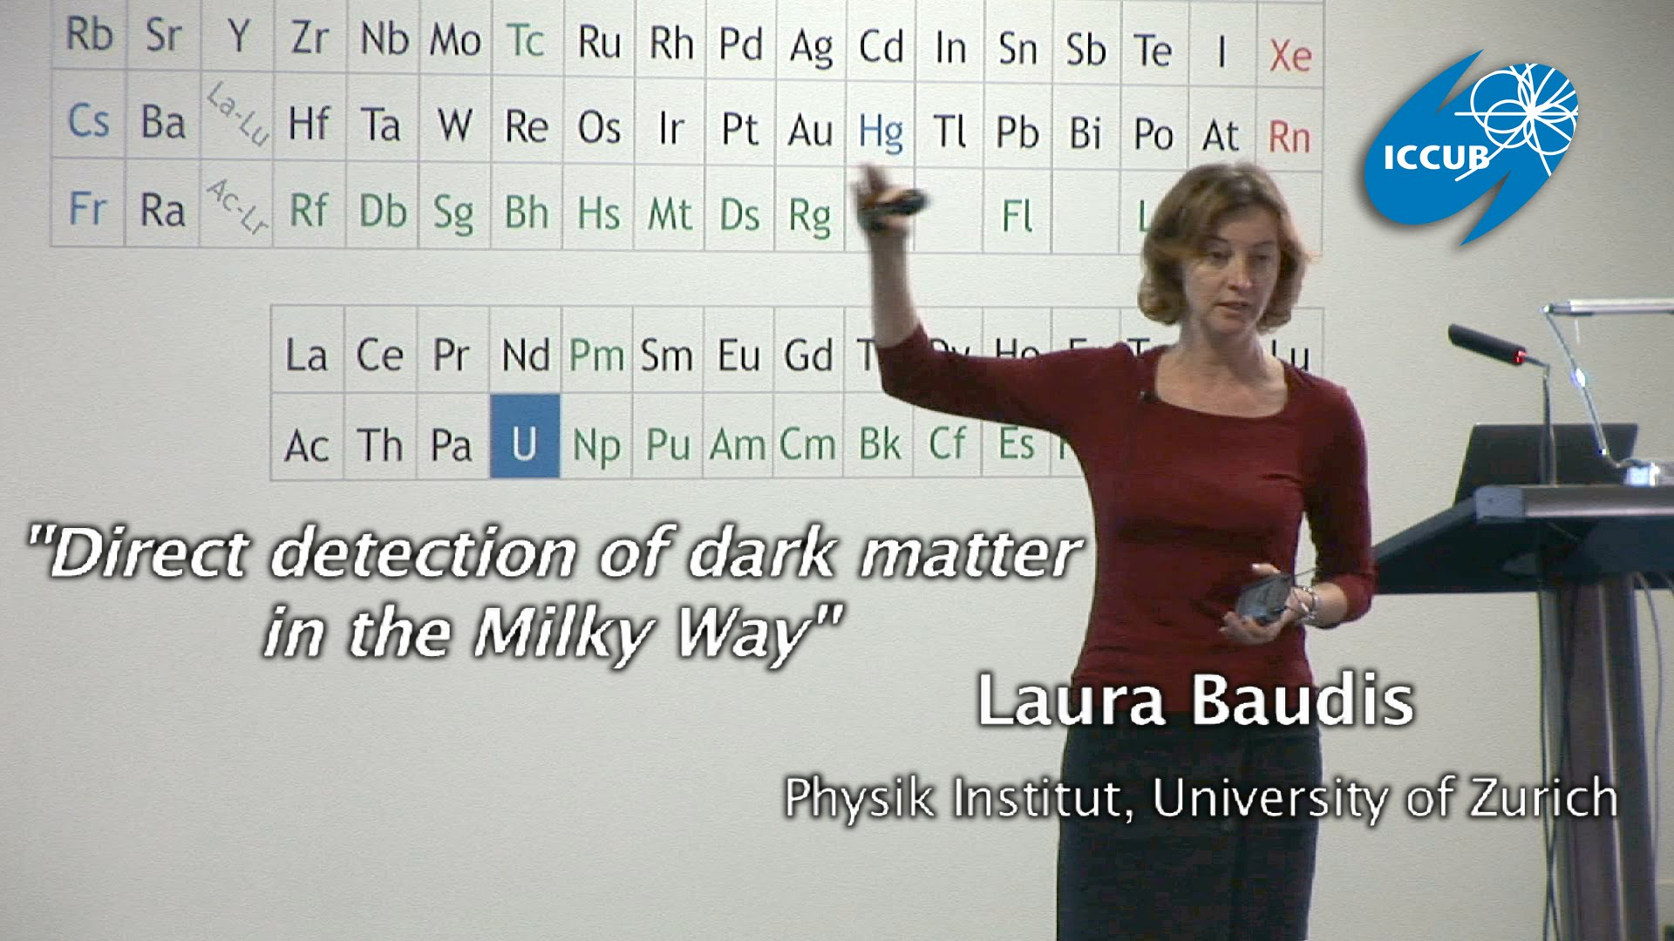
Laura Baudis is a professor at the Physik Institut at the university of Zurich and a specialist in dark matter..

Slide 9
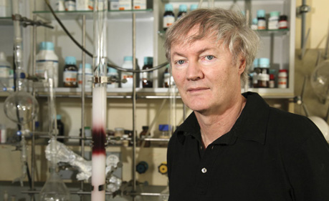
Michael Grätzel is the world’s leading expert on dye-sensitized solar cells, after all, he invented it. His lab’s work on that topic crossed CleanTechnica’s radar back in 2011, when it seemed that the work would lead to “solar skyscrapers” and other building-integrated solar applications, as well as consumer products. You can find dye-sensitized solar cells in many commercial applications today, including a showcase installation in Switzerland, where transparent solar panels form a facade for the new SwissTech Convention Center on the EPFL campus.

Slide 10
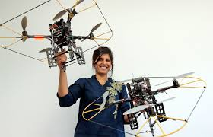
Samira Hayat is a PhD student at University of Klagenfurt, where she has been part of the team that develops drone systems for the good. These systems should save lives in swarms. The autonomous drone system developed by Lakeside Labs and U Klagenfurt is one of «15 novel ideas for 2015» featured by the WIRED magazine.

Slide 11
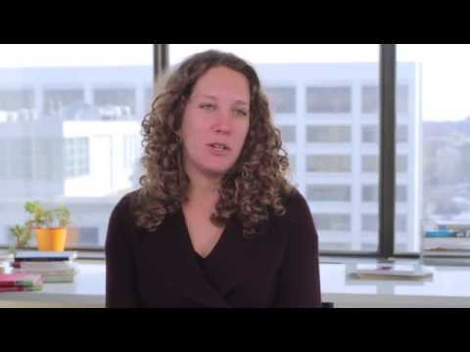
Shannon Dosemagen is Founder of Public lab, a community where you can learn how to investigate environmental concerns. Using inexpensive DIY techniques, they seek to change how people see the world in environmental, social, and political terms.

Slide 12
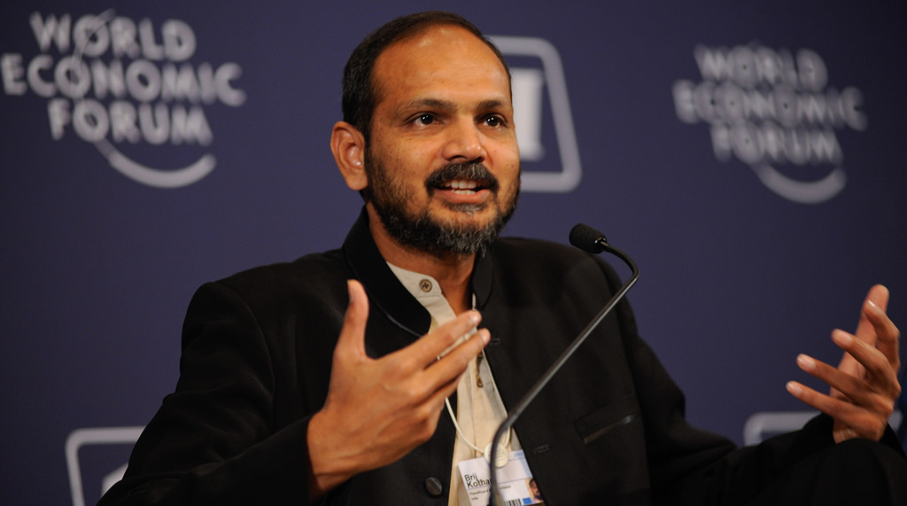
Brij Kothari is the founder of PlanetRead. He believes that “same-language subtitling”—providing subtitles for the lyrics of catchy Bollywood songs—offers valuable reading practice. Brij Kothari has leveraged the ubiquitous presence of television in rural India and the billion-strong Indian population’s voracious appetite for film songs to infuse reading practice into entertainment. By creating a technological tool devoid of any major infrastructural inputs and hence easily replicable, Brij has demonstrated a model that can spread globally.

Slide 13
Each TEDxCERN@WebcastPartner will be an independently live-streamed event connected to TEDxCERN.
For further information, please contact me at: valerie.seguin@cern.ch

Slide 14
