Slide 1
Uta Bilow, TU Dresden
Ken Cecire, QuarkNet
IPPOG meeting, Krakow
20.05.2016

Slide 2
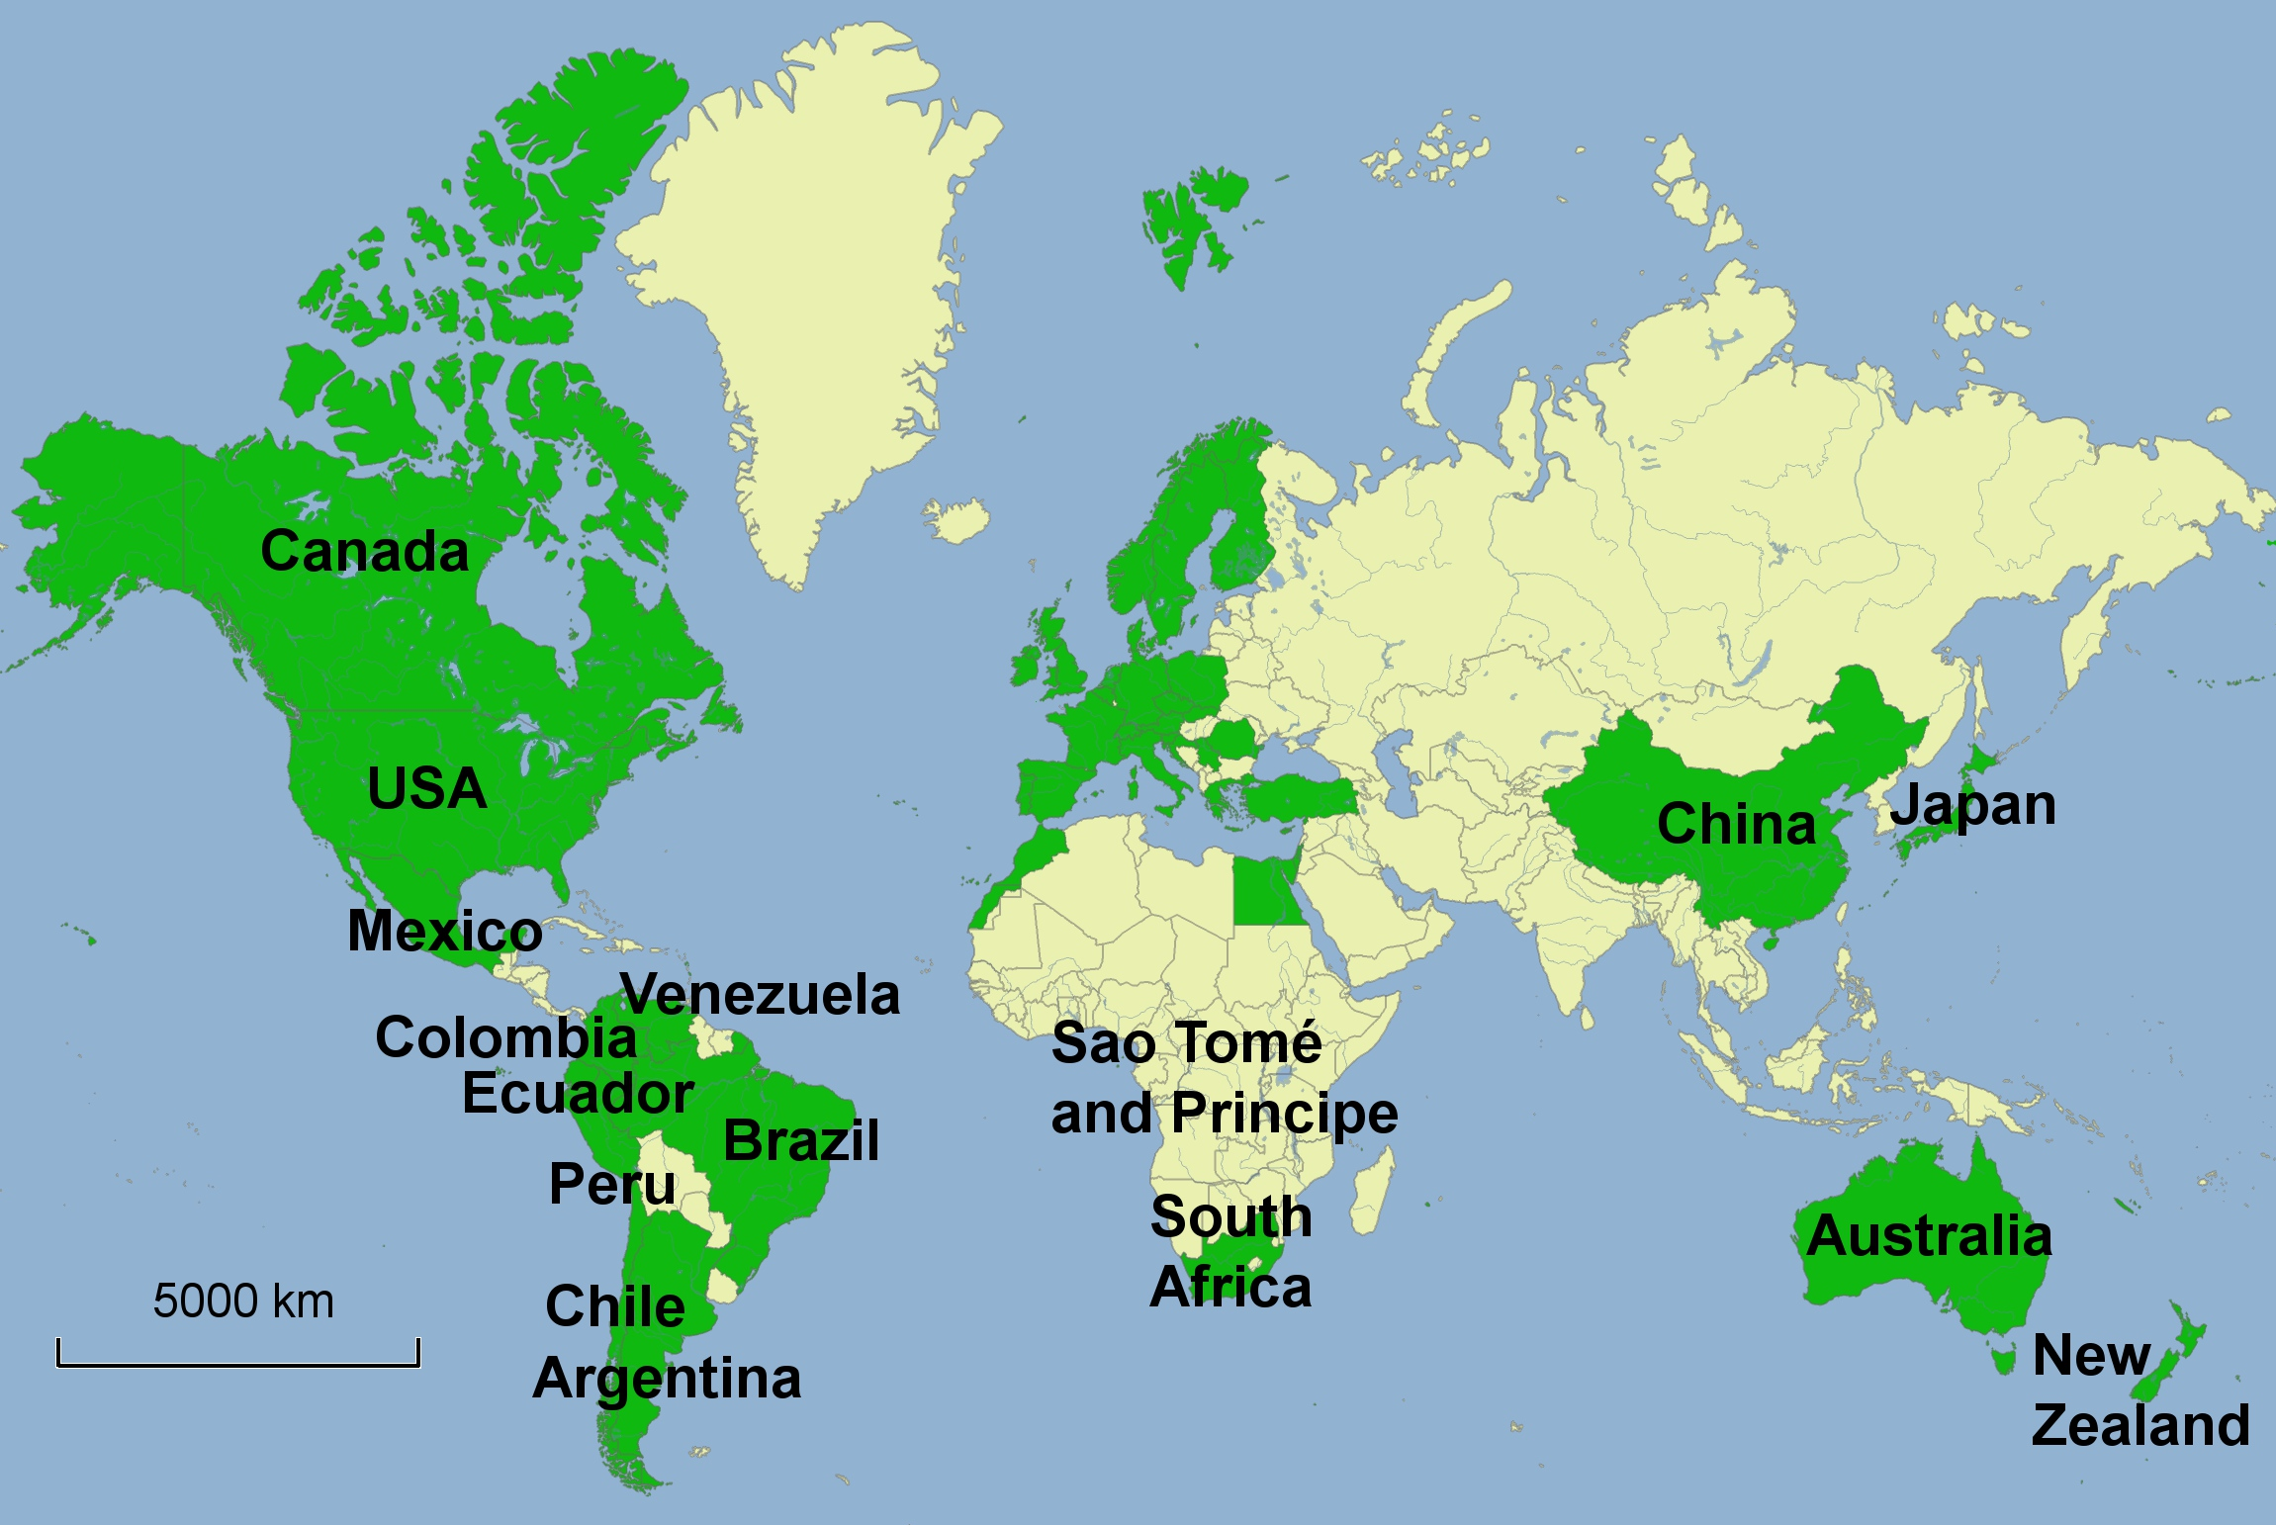
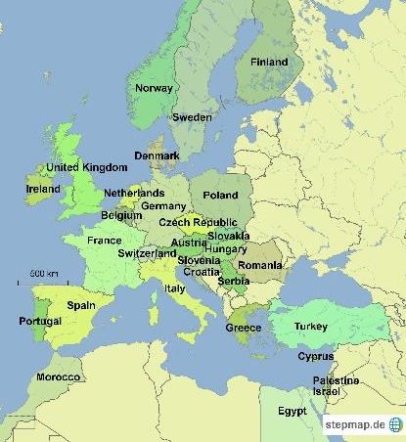
International Masterclasses 2016
11.2. - 23.3.2016
46 countries involved
Coord.: QuarkNet / TU Dresden
169 institutes
228 Masterclasses
  125 ATLAS (42 W, 83 Z)
  49 CMS
  34 LHCb
  20 ALICE
54 video conf. with CERN
11,777 students
1,098 teachers
43 institutes
48 Masterclasses
  33 CMS
  15 ATLAS
21 video conf. with Fermilab
1,183 students
128 teachers

Slide 3
Statistics International Masterclasses
2005
2006
2007
2008
2009
2010
2011
2012
2013
2014
2015
2016
18
countries
46
58
institutes
213
72
masterclasses
276
3k
students
13k
12
video conferences
75

Slide 4
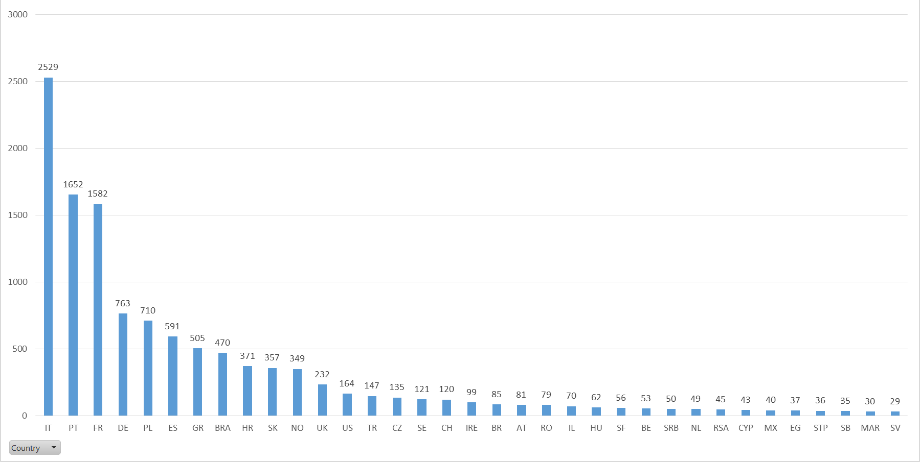
Number of students per country (CERN VC)
Top 5
IT: 2529
PT: 1652
FR: 1582
DE: 763
PL: 710

Slide 5
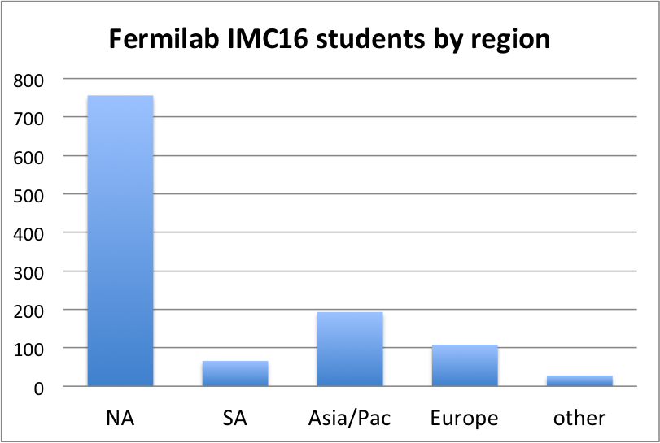

Slide 6
Size of Masterclasses (CERN VC)
Composition: mostly students from various (more than 3) high-schools

Slide 7
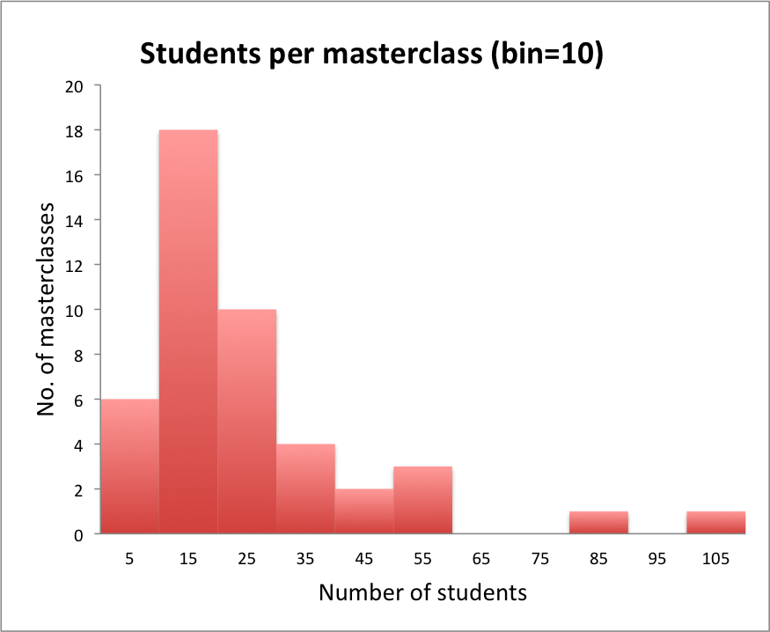

Slide 8
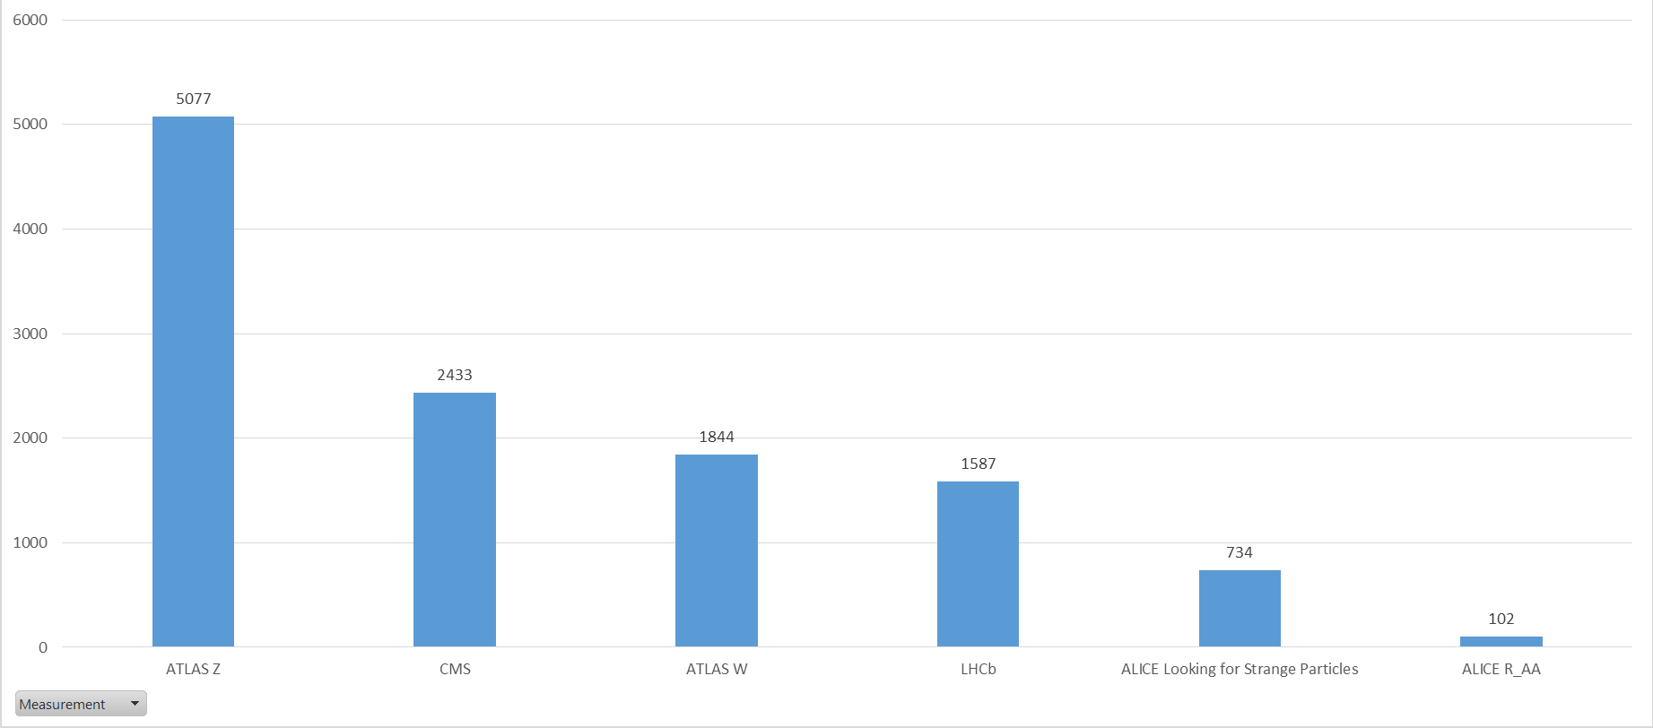
Number of students per measurement

Slide 9
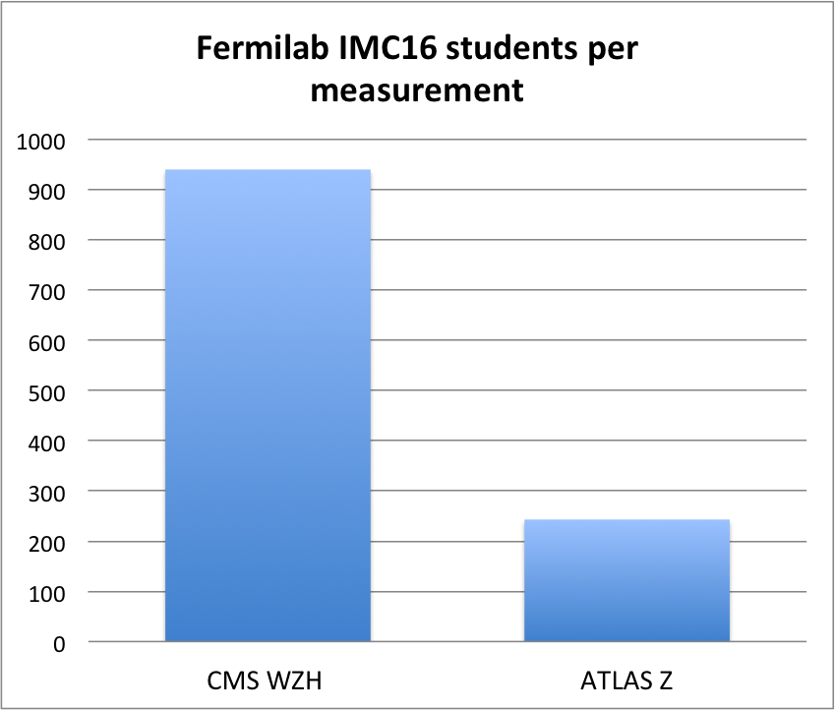

Slide 10
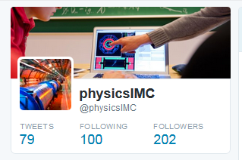
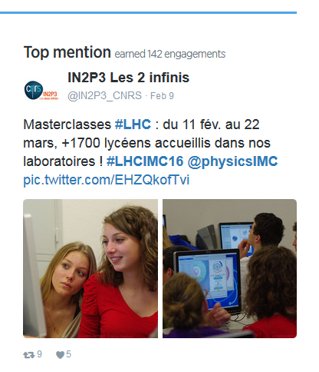
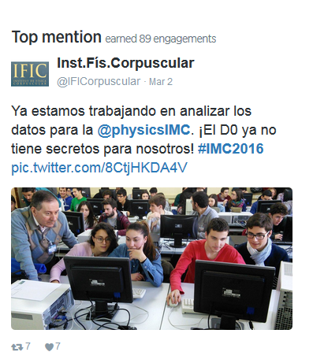
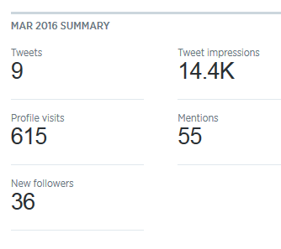
Social media initiative
account @physicsIMC
set up at CERN 11/2015
#LHCIMC16
Ken, Nicolas, Uta

Slide 11
Evaluation
Valuable feedback! Improve:
Concept of video conference
  More Q&A
  Avoid lengthy reports
  More interaction
Quiz
  New questions
Instructions for institutes
  Stress important points
Training for moderators
  Mockup session
  Practice script
  Critical situations

Slide 12

Reports from measurements
What worked
Stable measurements (all)
Stable, working general methods (all)
W+/W- (ATLAS W)
New iSpy-webgl (CMS)
New VC concept with CERN (LHCb)
Connecting to the pit (LHCb)
Overall, masterclasses went very well in 2016!
What can be improved
Refresh measurements? (all)
Some Hypatia default settings (ATLAS Z)
How to handle „zoo“ events (ATLAS Z)
Safari issues (ATLAS W)
Accidental data erasure (ATLAS W)
Instructions for handling large MC data download (CMS)
More data (CMS, ALICE)
Measure Ks lifetime (ALICE)
Simplified measurement (ALICE Raa)

Slide 13
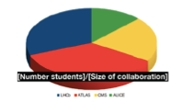
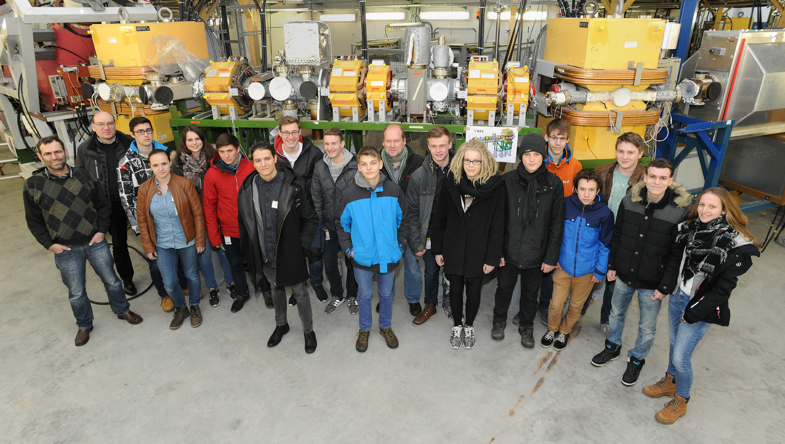
Interesting figures from measurements

Slide 14
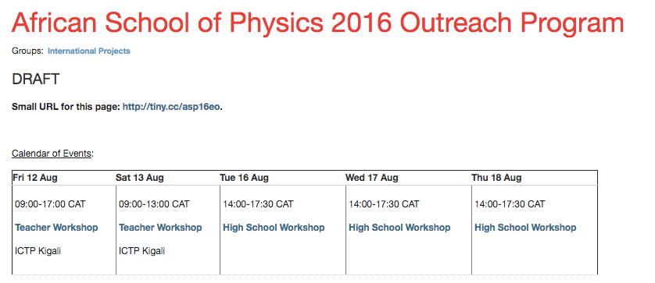
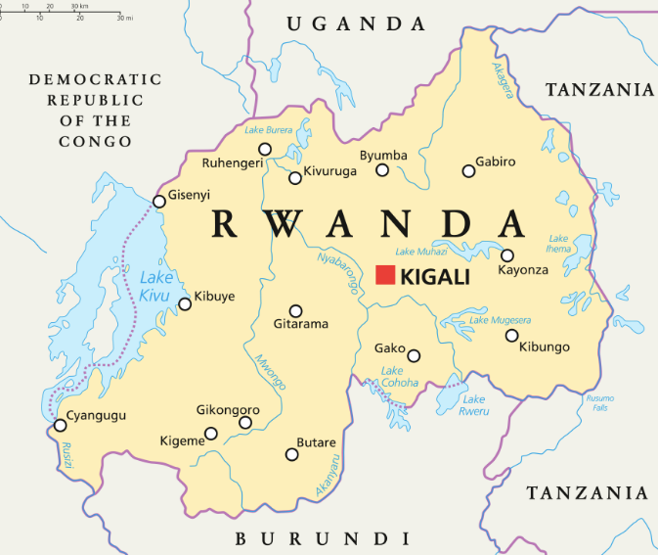
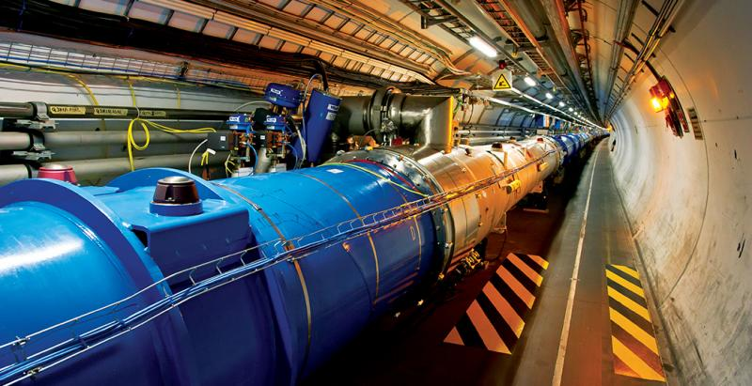

Slide 15
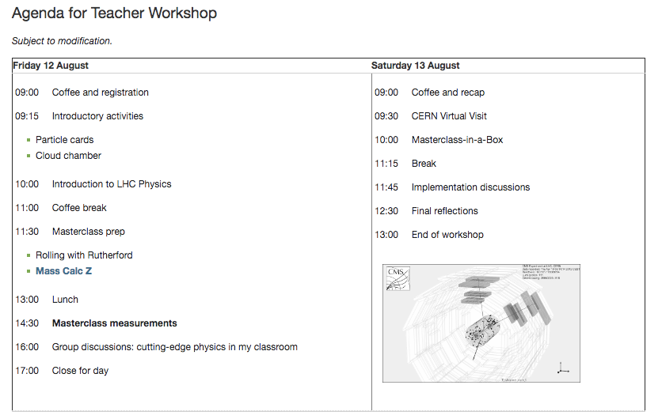

Slide 16
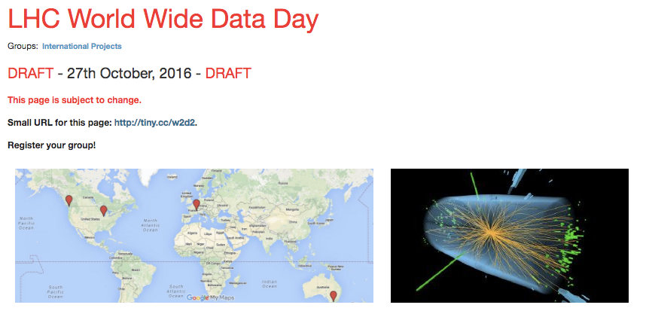
24 hours of VC
Arrange by measurement
Use short/easy measurements
Develop local contacts
Virtual training

Slide 17
Int. Day of Women and Girls in Science
February 11 (2017: Sat)
www.un.org/en/events/women-and-girls-in-science-day/index.shtml
→ encourage girls to pursue a career in science
→ encouraging the development of science education policies and programming
→ recognize the achievements of women in science
IPPOG: MC for girls only on Feb 11
will be advertised to all MC institutes, see how many are interested
  MCs for girls only
  female tutors and moderators at CERN, as much as possible
  adapt focus of the video conference

