Slide 1
The CERN International Relations Sector
and IPPOG
Charlotte Lindberg Warakaulle
  11th IPPOG Meeting
  20 May 2016

Slide 2
Greetings!

Slide 3




Slide 4
Why an IR Sector – and why now?
In a rapidly changing policy environment, our interlocutors and the way we need to communicate with them is in constant change
Traditional interlocutors are relatively becoming increasingly less dominant but new ones appear that can be important supporters of science and our work
Support and budgets cannot be taken for granted
Priorities, approaches and partners need to be reassessed on an ongoing basis
Structures, institutions and processes need to adapt more rapidly than previously
Increasing needs for partnerships as multipliers

Slide 5
Objectives of the new Sector
– supporting a global lab with a global mission
Enable CERN to promote science in our discipline and more generally,
and serve society on a global level, now and for the future
Strengthen CERN’s position as a global centre of excellence in science and research through sustained support from all stakeholders
Help shape a global policy agenda that supports fundamental research, and includes science perspectives more generally
Connect CERN with people across the world to inspire scientific curiosity and understanding
Key task across all three dimensions will be to leverage partnerships and
join forces to multiply and reach further
→ IPPOG will be a key partner in these efforts

Slide 6
The organigramme – no presentation is complete without one….
Strategic planning
and evaluation
Office of the Director
for International Relations
Political Relations
Strategic Planning
and Evaluation
Protocol
Secretariat
Service
IR-REL
Stakeholder
Relations
Education, Communications
and Outreach
IR-ECO
Host State
Relations
Editorial Content
Development
Audiovisual
Production
Design &
Visual Identity
Member State
Relations
Exhibitions & Global
Engagement
Service
Service
Member State
relations
Non-Member
State Relations
Media and Press
Relations
Relations with
International
Organizations
Teacher & Student
Programmes
Merging education and
communications groups
Partnerships and
Fundraising
Visitors and
Local Engagement
Partnership-building
and fundraising

Slide 7
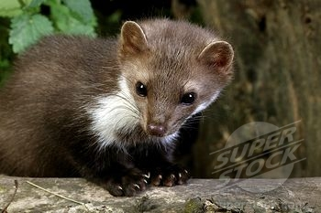
Current projects in the IR-ECO Group
….when we are not occupied with local wildlife, that is……..

Slide 8
Current projects in Education, Communications and Education
Updating and developing the website
Streamlining internal communications: more information in real time and online
Enhancing audiovisual communications
Focused communications on overarching themes through cross-cutting task forces
  Impact
  Sustainability
  Diversity
Improving and expanding the visit options, including virtual tours
Adding opportunities for more student and teacher programmes
Preparing large outreach events during the coming five years (2017 and 2019)

Slide 9
Where does IPPOG fit in all of this?
CERN is a global lab, with a global mission – IPPOG represents a key platform for engaging on a global level, building partnerships within the community and across communities, and for supporting the broader scientific objectives of the Organization
IPPOG represents a platform for information-sharing and for strategic discussions on how to strengthen support for particle physics and fundamental science more broadly
IPPOG can serve as a testing ground for new methods of working, enabling sharing of lessons and good practice
IPPOG brings opportunities to engage with countries that would not otherwise be closely involved with CERN

Slide 10
Where does IPPOG fit in all of this?
Looking forward to discussing how we can work together to make IPPOG serve as a strong partner for all of us in generating support for particle physics and for fundamental science

Slide 11
End of the greetings!

Slide 12
Spares

Slide 13
Key immediate priorities for the IR sector
Reinforce dialogue and exchange with Member States
Enlargement policy: overview and future directions, as input for Council discussion
Strengthen the fundamental research input and the scientific perspective more generally in global policy debates
Develop communications strategy 2016-2020
Enhance and nuance fundraising efforts through ‘CERN & Society’ and ‘Globe Foundation’
Create new Alumni Programme

Slide 14
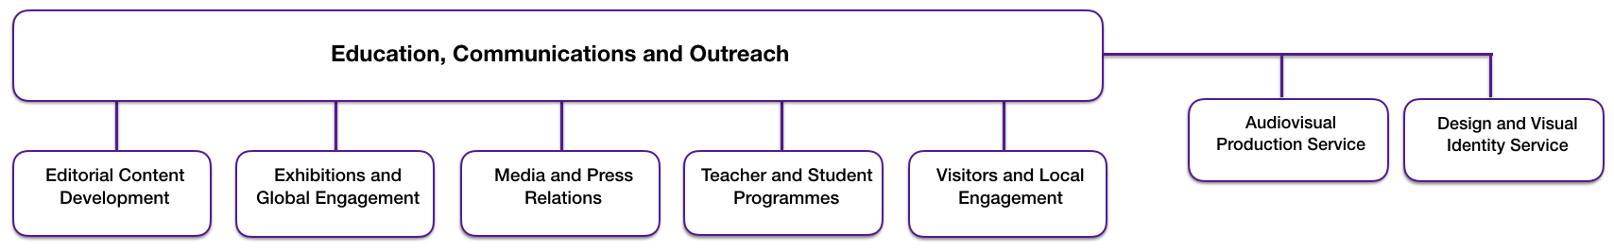
Consolidated and integrated: the IR-ECO Group
  The sections and services deliver together on Education, Communications and Outreach through different types of engagement, in interaction with different types of audiences and using different tools

