Slide 1


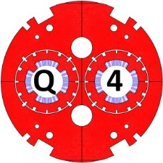
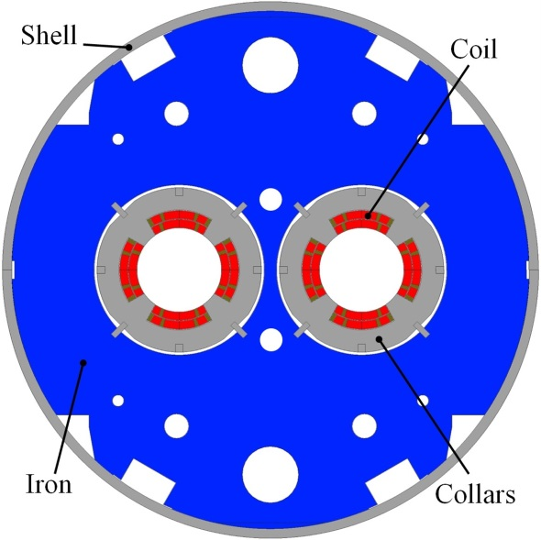
Q4 Protection
Q4 Protection
Preliminary analysis

Slide 2
Introduction
This presentation talks about the protection of the Q4 quadrupole.
A first study of the quench protection for the current design of the quadrupole is proposed. Results are shown for one aperture
The study is realised thanks to the software Qtransit based on the M.N.Wilson quench code and which have been developed by CEA for performing quench simulation

Slide 3
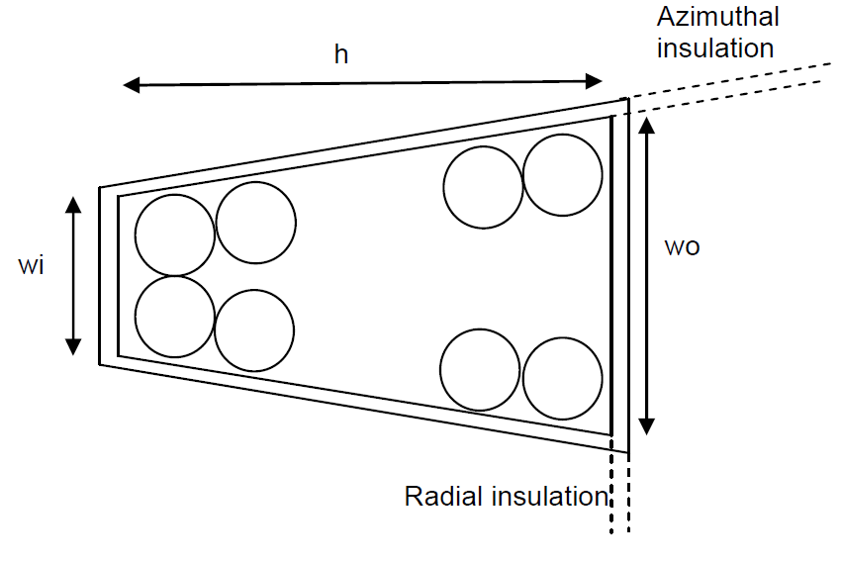
INPUTS
Q4 Cable
h | 8.8 mm
wi | 0.77 mm
wo | 0.91 mm
Strand diameter (d) | 0.475 mm
N strand | 36
Radial insulation (e) | 0.08 mm
Azimuthal inslation (e) | 0.08 mm
Insulated cable crosss section | 8.960 mm²
Detection threshold | 0,1 V | These values have been confirmed by CERN (Mail from E.Todesco 08/03/2016)
Validation time | 10 ms
Maximum Hotspot temperature allowed | < 250K | These values are conservatives (Mail from B. Auchmann 09/03/2016)
Maximum voltage to ground allowed | 800 V

Slide 4
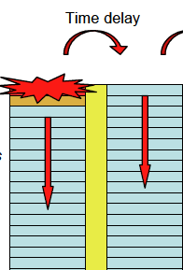
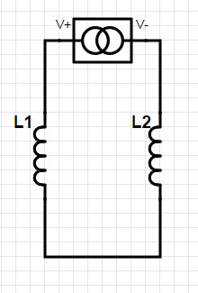
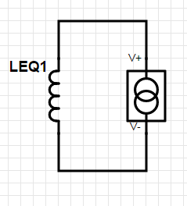

HYPOthesis
To simulate the quench propagation for the Q4 magnets we used a model of two coils where the first coils represent the inner layer of the 4 coils and the second coils represent the outer layers.
The two layers are separated by a G10 shim of 0,5 mm which delays the thermal conduction between the two layers.
The total volume of the 4 coils and the total energy are accounted for. QH are fired on all coils.
=
M12
L1
L2
$$L_{eq1}≈L_{1}+L_{2}+2M_{12}$$

Slide 5
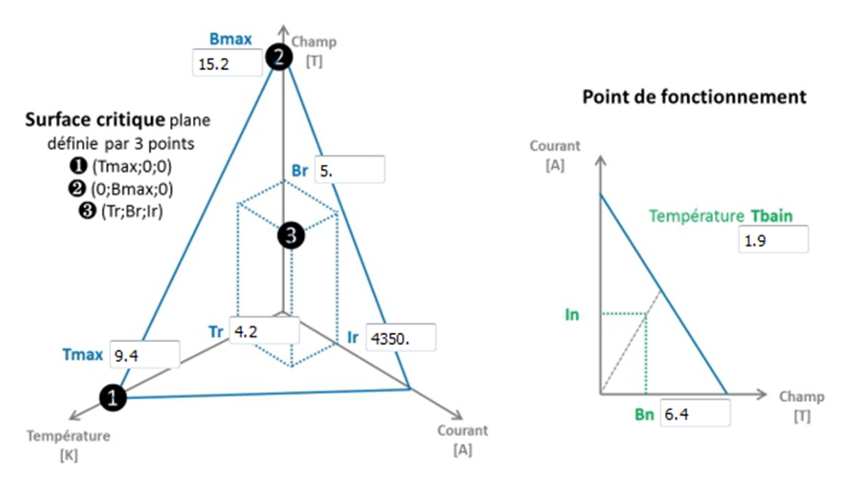
HYPOthesis
The critical surface of the Q4 wire in NbTi is given in the following graph:

Slide 6
Definitions of the various time delays
Case 1:The outer layer quenches before the quench heaters provok a quench
T_{blind}
Time delay
T_{validation}
Inner layer
QUENCH HEATERS PROVOKED THE QUENCH OF THE INNER LAYER
QUENCH
T_{Quenchcoil1}
DETECTION
T_{Quenchbackcoil1}
Time delay
T_{QHdelay}
T_{QH}
Outer layer
QUENCH HEATERS PROVOKED THE QUENCH OF THE OUTER LAYER
T=0s
VALIDATION &
POWER SUPPLY OFF
QUENCH HEATERS FIRED
T_{Quenchcoil2}
T_{Quenchbackcoil2}

Slide 7
Definitions of the various time delays
Case 2: The outer layer quenches when the quench heaters provok a quench
T_{blind}
Time delay
T_{validation}
Inner layer
QUENCH HEATERS PROVOKED THE QUENCH OF THE INNER LAYER
QUENCH
T_{Quenchcoil1}
DETECTION
T_{Quenchbackcoil1}
T_{QHdelay}
T_{QH}
Outer layer
QUENCH HEATERS PROVOKED THE QUENCH OF THE OUTER LAYER
T=0s
VALIDATION &
POWER SUPPLY OFF
QUENCH HEATERS EFECTIVE
T_{Quenchbackcoil2}

Slide 8
Simulation tools: qtransit
Qtransit is a CEA software based on the M.N.Wilson quench code.
The Qtransit program calculate the thermodynamics of a coil when a quench occurs.
The temperature rise at the initial quench point define in the inputs. After calculation the code gives the final temperatures inside the winding and the voltage induced
The geometry and the materials of the cable are given in the inputs

Slide 9
HYPOthesis
The mutual inductances have been found by using the ROXIE code
The layer-to-layer time delay of 75ms has been estimated thanks to a 1D transient finite elements method. The simulations have been made for a time delay of 50ms, 75ms and 100ms
The simulations have been made with and without quench heaters.
Hypothesis
L1 | 9,21^{E-3} H
L2 | 12,34^{E-3} H
M12 | 8,55^{E-3} H
LEQ1 | 37,55^{E-3} H
I | 4590 A
Quench Heater | Placed on the outer layer
T_{quenchcoil1} | 0 s
T_{blind} | 6 ms
T_{validation} | 10 ms
T_{quenchcoil2} | 6+10+40=56 ms
T_{quenchbackcoil2} | 56 ms
T_{quenchbackcoil1} | 75+56=131ms
T_{delay} | ≈ 75ms
T_{QH}+T_{QHdelay} | 40 ms (to be verified)

Slide 10
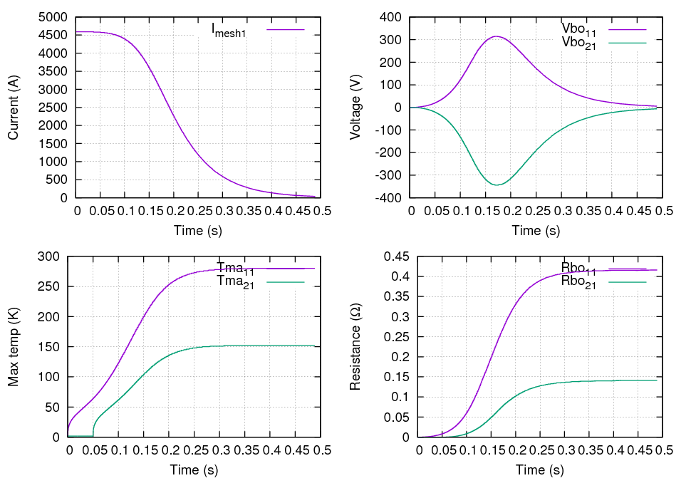
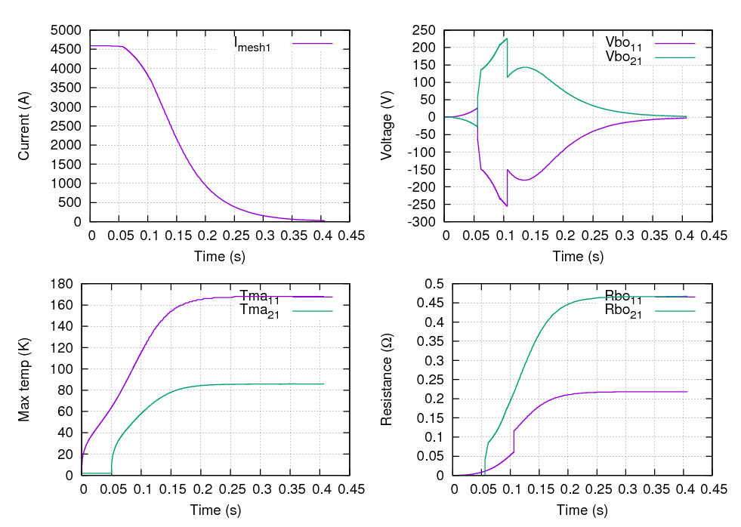
SImulation
Hypothesis
Without quench heater
Time delay | 50 ms
Maximum Hotspot temperature in coil 1 | 279,9 K
Maximum Hotspot temperature in coil 2 | 152,4 K
Maximum voltage to ground | 547,8 V
Voltage accross each layer
Hypothesis
With quench heater
Time delay | 50 ms
Maximum Hotspot temperature in coil 1 | 167,9 K
Maximum Hotspot temperature in coil 2 | 85,8 K
Maximum voltage to ground | 340,2 V
Voltage accross each layer

Slide 11
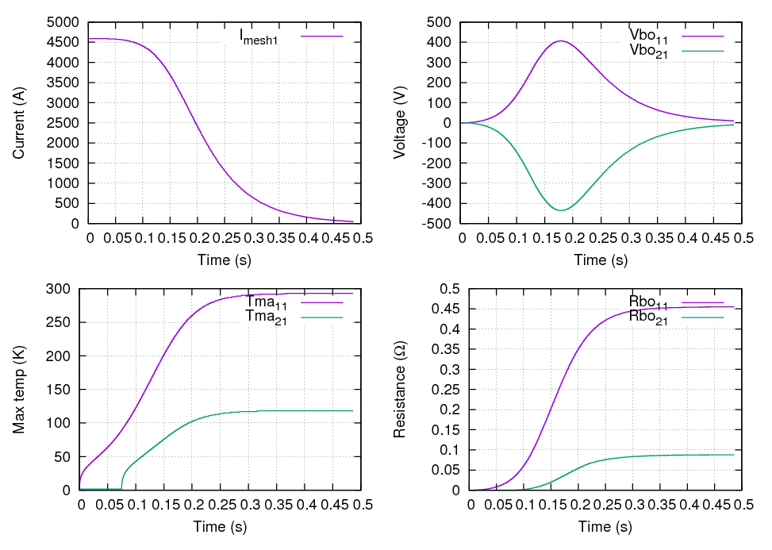
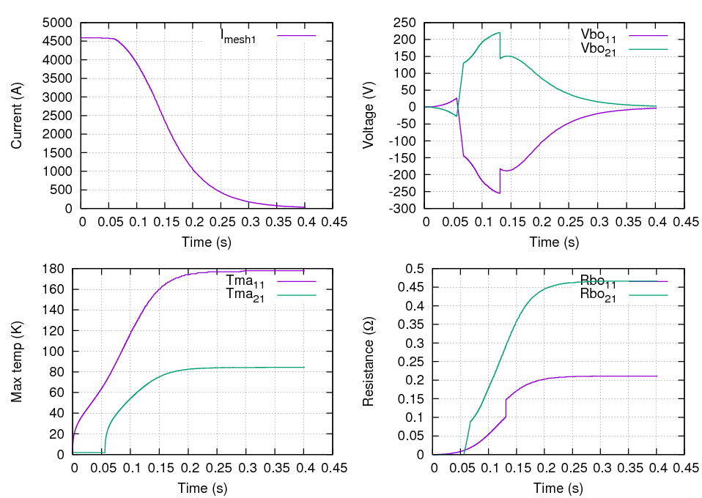
SImulation
Hypothesis
Without quench heater
Time delay | 75 ms
Maximum Hotspot temperature in coil 1 | 293 K
Maximum Hotspot temperature in coil 2 | 118,3 K
Maximum voltage to ground | 594,6 V
Voltage accross each layer
Hypothesis
With quench heater
Time delay | 75 ms
Maximum Hotspot temperature in coil 1 | 177,6 K
Maximum Hotspot temperature in coil 2 | 84,3 K
Maximum voltage to ground | 340,2 V
Voltage accross each layer

Slide 12
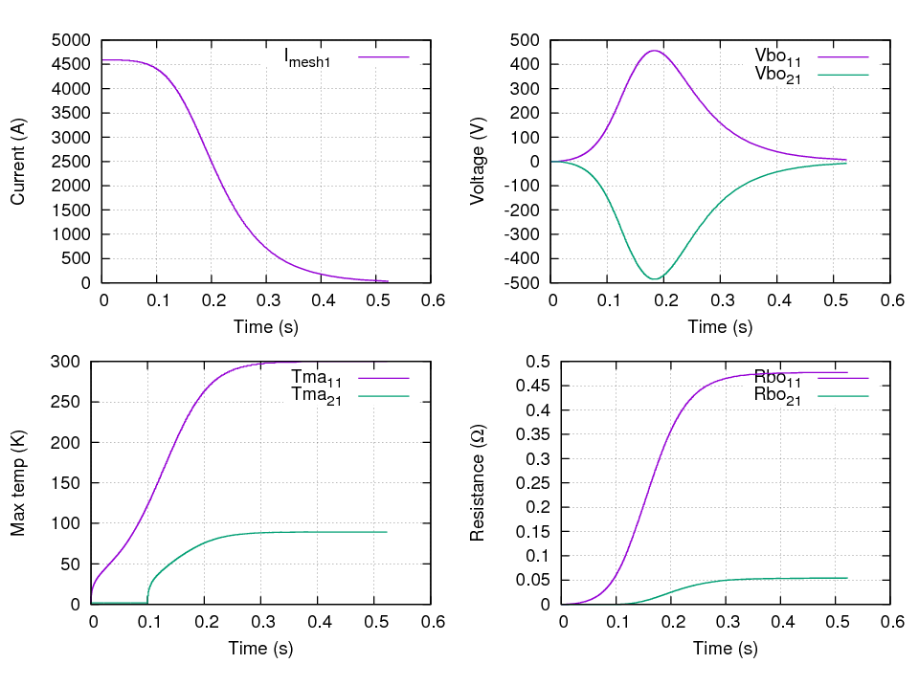
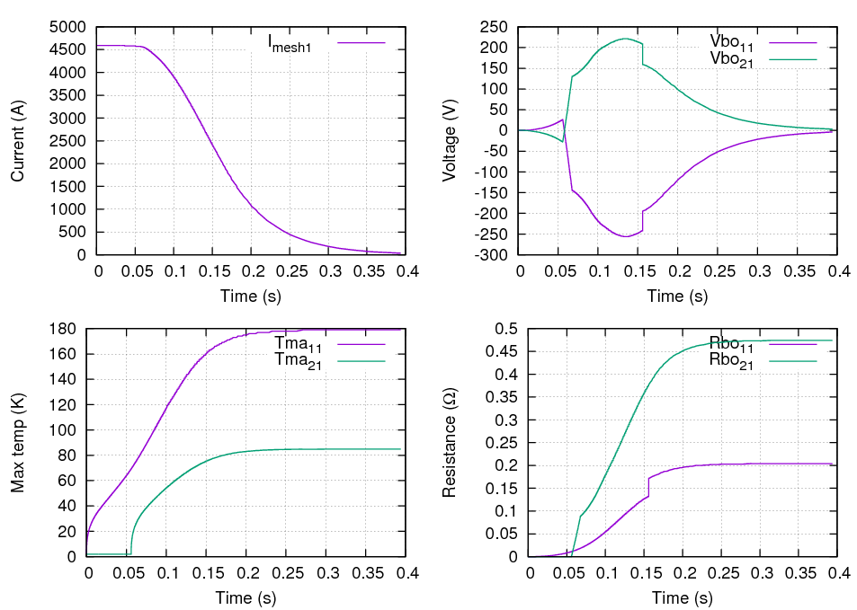
SImulation
Hypothesis
Without quench heater
Time delay | 100 ms
Maximum Hotspot temperature in coil 1 | 300,1 K
Maximum Hotspot temperature in coil 2 | 89,4 K
Maximum voltage to ground | 634 V
Voltage accross each layer
Hypothesis
With quench heater
Time delay | 100 ms
Maximum Hotspot temperature in coil 1 | 178,9 K
Maximum Hotspot temperature in coil 2 | 84,9 K
Maximum voltage to ground | 340,2 V
Voltage accross each layer

Slide 13
RESULTS
Results
 | Without quench heater |  |  | With quench heater
Time delay | 50 ms | 75 ms | 100 ms | 50 ms | 75 ms | 100 ms
Maximum Hotspot temperature in coil 1 | 279,9 K | 293 K | 300,1 K | 167,9 K | 177,6 K | 178,9 K
Maximum Hotspot temperature in coil 2 | 152,4 K | 118,3 K | 89,4 K | 85,8 K | 84,3 K | 84,9 K
Maximum voltage to ground | 547,8 V | 594,6 V | 634 V | 340,2 V | 340,2 V | 340,2 V

Slide 14
Conclusion
The QTRANSIT code has been used on the updated version of Q4.
Simulations with and without QH have been carried out
The highest hot spot temperature (300 K) is reached in absence of QH and with a layer-to-layer time delay of 100 ms.
With QH:
  the hotspot is limited to ~180 K.
  The max V to ground is ~340 V
Next steps:
  Simulation with ROXIE
  Detailed design of the QH: high/low field, strip design and number of circuits

Slide 15
Open questions
Powering scheme of the Q4?
Number of heaters PS

Slide 16
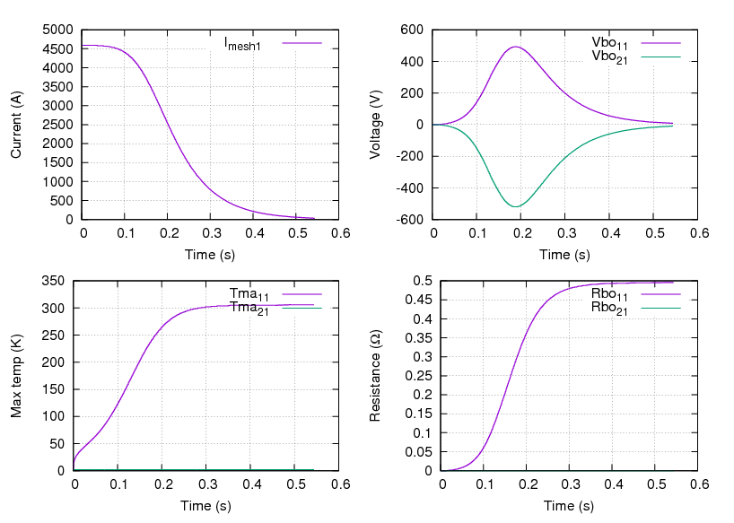
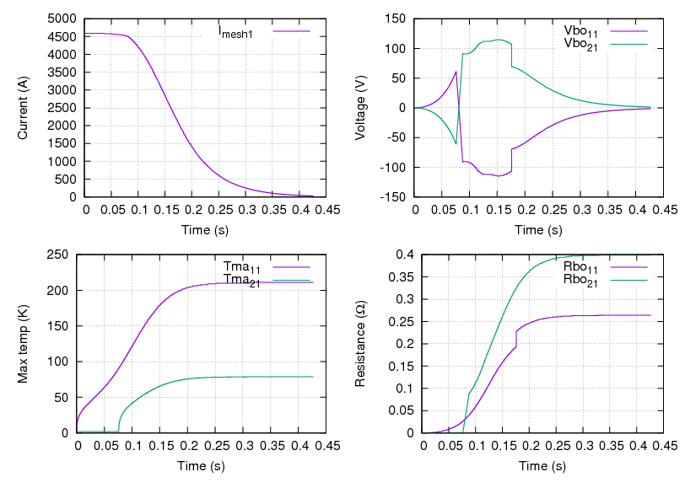
Annex
Hypothesis
Without quench heater
Time delay | infinite
Maximum Hotspot temperature in coil 1 | 305,6 K
Maximum Hotspot temperature in coil 2 | 1,9 K
Maximum voltage to ground | 687,4 V
Hypothesis
With quench heater
Time delay | 100 ms
T_{QHdelay}+T_{QH} | 60 ms
Maximum Hotspot temperature in coil 1 | 210,7 K
Maximum Hotspot temperature in coil 2 | 78,7 K
Maximum voltage to ground | 634 V

