Slide 1
WLCG IPv6 deployment strategy
Alastair Dewhurst
Andrea Sciabà
on behalf of the HEPiX IPv6 WG
07/07/2016

Slide 2
Introduction
IPv6 requirements of the experiments have been discussed at the last GDB
A document has been prepared and almost finalised
  To be submitted at the July MB
A summary is presented here

Slide 3
Motivations
Exhaustion of IPv4 address space
  A real problem at some smaller sites
Some cloud providers may provide only (or charge less for) IPv6-only resources
Opportunistic resources may be IPv6-only

Slide 4
Goals
Eventually, replace IPv4 with IPv6 (for all Internet)!
Allow WLCG sites to deploy IPv6-only CPUs
Provide an upgrade path for sites to plan
  Ideally, minimise the need of dual-stack with respect to IPv6-only, given the constraints
Consequently, make all VO and Grid services contacted by WNs dual stack
  Storage
  Central services

Slide 5
Is the middleware ready?
In short, yes
HTCondor fully supports IPv6
CEs do
  CREAM, ARC-CE, HTCondor-CE
    But still some problems with CREAM client, critical for LHCb and ALICE
xrootd 4, GridFTP, HTTP(s) do
  Xrootd storage and redirection, GridFTP-only storage
Most storage systems (dCache, DPM, StoRM, …) do
  CASTOR does not (and never will) but possible to provide a “gateway” service via xrootd/GridFTP if needed
  EOS does, in versions using xrootd4
All central Grid services do
  MyProxy, VOMS, FTS, CVMFS, BDII, Frontier, …
  Although often not yet deployed in dual-stack

Slide 6
What does this mean for a site?
IPv6-only WNs if needed
  Dual-stack would not address the address exhaustion issue!
IPv6-enabled CEs
  IPv4 irrelevant if VO workload management supports IPv6
Dual-stack storage
  To support all CPU resources doing remote access and transfers to/from all sites
IPv6-enabled Squid caches
  IPv4 desirable if not all Stratum-1’s support IPv6

Slide 7
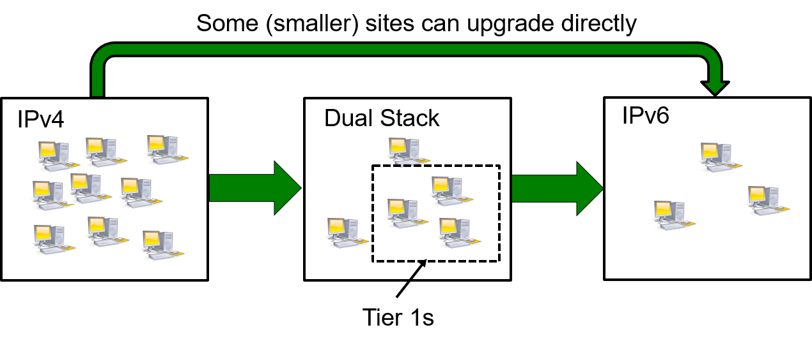
Typical migration path for a site
Deploy IPv6 on the network infrastructure
Deploy a dual-stack perfSONAR instance
Make storage dual-stack
  Applies to all sites, for the sake of allowing others to remotely access data via IPv6
Make all local services dual stack
  In some cases (see batch system) may not be possible, e.g. only IPv4 is supported
  Eventually it should not be necessary, e.g. IPv4 could be decommissioned
Make all WNs IPv6-only
  Allow for a “grace period” during which IPv4 is kept as backup
  Use IPv4 private addresses if needed (e.g. by batch system)

Slide 8
Role of Tier-0/1 sites
Extremely important as they provide access to, and distribute, a lot of data
They run several central Grid and VO services
  FTS, Frontier, Stratum-0/1, VOMS, MyProxy, WM/DM services, ETF, Dashboard monitoring…
Therefore, critical to make services dual-stack
  Even if availability of IPv4 addresses is not an issue at the site
Storage performance and reliability should not depend on the IP protocol version used. Proposed targets:
  At least 1Gb/s and 90% availability by April 2017
  At least 10 Gb/s and 95% availability by April 2018

Slide 9
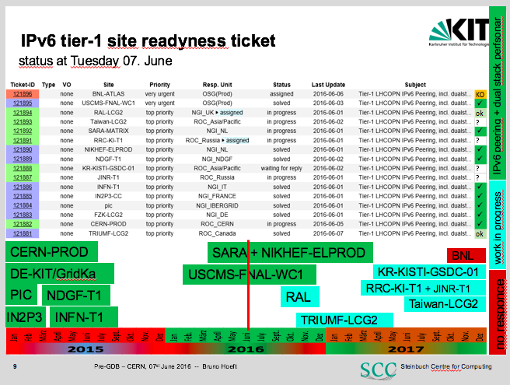
Tier-1 status and plans

Slide 10
ALICE status
ALICE central services are running in dual-stack since more than a year
Storage is fully federated
  Any site can access data from any site
To support IPv6-only resources, all data must be available on some IPv6-enabled storage
All sites must run xrootd4
Current situation:
  1/3 of sites still use xrootd3
  5% of SEs run in dual-stack

Slide 11
ATLAS status
ATLAS WM and DM tools (PanDA, Rucio, …) are based on HTTP and are tested on IPv6
WNs interact via HTTP with PanDA, Rucio, CVMFS and Frontier
Current situation and plans:
  Pilot factories are dual-stack
  Complete migration of services to dual stack by next April
    Production PanDA server nodes
    Rucio Authentication and Production nodes
    Frontier servers at CERN, IN2P3, RAL and TRIUMF
    ARC Control Tower

Slide 12
CMS status
WM is based on glideinWMS and HTCondor, both validated on IPv6
Federated storage via xrootd
DM is based on PhEDEx, which uses the Oracle client for communication with central service
  WNs do not interact with it
Other central services are hosted on the cmsweb cluster, which works in dual-stack
Current situation and plans:
  glideinWMS frontends and factories are dual-stack
  Only ~11 sites support IPv6
    No problems seen in monitoring and computing operations
  CMS has to enable dual-stack on all collectors and schedd’s by April 2017
  Sites have to enable dual-stack on their storage by the end of Run2
  Sites are advised to keep IPv4 as a backup until the end of Run2

Slide 13
LHCb status
WM/DM is based on DIRAC, which supports IPv6
WNs need to access DIRAC central services, storage and optionally one of six VO boxes at Tier-1’s
Current situation and plans:
  Only one Tier-1 and one Tier-2D storage system support LHCb in dual-stack configuration
  Central services are being moved to dual-stack machines

Slide 14
Proposed timeline
By April 1st 2017
  Sites can provide IPv6-only CPUs if necessary
  Tier-1’s must provide dual-stack storage access with sufficient performance and reliability
    At least in a testbed setup
  Stratum-1 service at CERN must be dual-stack
  A dedicated ETF infrastructure to test IPv6 services must be available
  ATLAS and CMS must deploy all services interacting with WNs in dual-stack
  All the above, without disrupting normal WLCG operations
By April 1st 2018
  Tier-1’s must provide dual-stack storage access in production with increased performance and reliability
  Tier-1’s must upgrade their Stratum-1 and FTS to dual-stack
  The official ETF infrastructure must be migrated to dual-stack
  GOCDB, OIM, GGUS, BDII should be dual-stack
By end of Run2
  A large number of sites will have migrated their storage to IPv6
  The recommendation to keep IPv4 as a backup will be dropped

Slide 15
Executive Summary
Sites can provide IPv6-only CPU resources from April 2017 onwards if necessary
Sites can provide IPv6-only interfaces to their CPU resources, if necessary
The VO infrastructure (e.g. central services provided by VOs) must provide an equal quality of service to both IPv4 and IPv6 resources
Any site wishing to deploy IPv6-only CPU should contact the HEPiX IPv6 working group to discuss detailed plans
By April 2018 it should be possible to deploy IPv6-only CPU with relative ease
By the end of Run II enough sites should have upgraded their storage to dual stack to allow almost complete data availability over IPv6

