Slide 2
PS Intensity Limitations for LHC-type Beams
LIU Beam Parameter Working Group
08/04/2016
H. Damerau
Many thanks for input and discussions to:
S. Hancock, G. Sterbini, L. Ventura and many more

Slide 3
Overview
Introduction
  Objectives: 2015 LIU baseline and HL-LHC request
Transverse
  Space charge
  Large longitudinal emittance and low chromaticity
  Transition crossing
Longitudinal
  Direct and 1-turn delay feedbacks
  Coupled-bunch feedback
  PS-SPS transfer with both 40 MHz cavities
Summary

Slide 4
Introduction
  Objectives: LIU baseline, pre-2016
 | Parameter
Injection | Intensity per bunch | 2.8 10¹² ppb (12 × 2.3 10¹¹)
 | Transverse emittances | 1.6 μm
 | Longitudinal emittance | 3.0 eVs
 | Bunch length | 205 ns
PS | Beam loss | 5%
 | Transverse emittance growth | 5%
 | Controlled longitudinal blow-up | ~50%
 | Tolerable space charge tune shift, ΔQ_{y} | -0.31
Ejection | Intensity per bunch | 2.2 10¹¹ ppb
 | Transverse emittances | 1.7 μm
 | Longitudinal emittance | 0.35
 | Bunch length | 4 ns

Slide 5
Introduction
  Objectives: HL-LHC request
 | Parameter |  | achieved
Injection | Intensity per bunch (total: 2 10¹³ ppp) | 3.3 10¹² ppb (12 × 2.7 10¹¹)
 | Transverse emittances | 1.8 μm
 | Longitudinal emittance | 3.0 eVs
 | Bunch length | 205 ns
PS | Beam loss | 5%
 | Transverse emittance growth | 5%
 | Controlled longitudinal blow-up | ~50%
 | Tolerable space charge tune shift, ΔQ_{y} | -0.31
Ejection | Intensity per bunch | 2.6 10¹¹ ppb | 1.7 10¹¹ ppb
 | Transverse emittances | 1.9 μm | 2.2 μm
 | Longitudinal emittance | 0.35
 | Bunch length | 4 ns

Slide 6
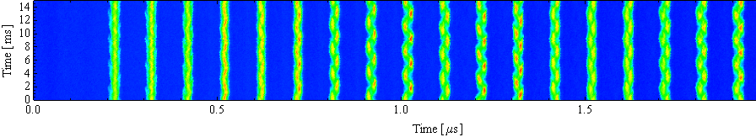
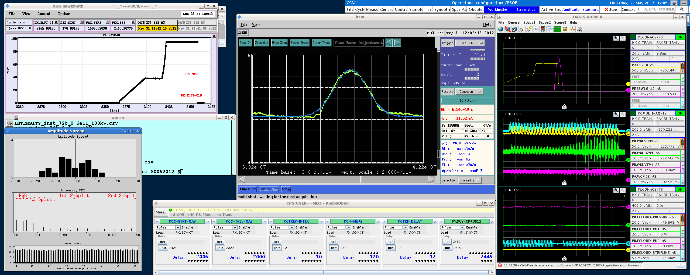
Intensity limiting effects in the PS
Acceleration/Bunch splittings
Longitudinal CBI
Transient beam loading
Transition crossing
Flat top
Longitudinal CBI
Electron cloud
Transverse instabilities
Injection flat bottom
Space charge
Headtail instability
S. Gilardoni

Slide 7
Transverse

Slide 8
Overview – Transverse
Limitation | Mitigation
Space charge | Upgrade of injection energy 1.4 to 2 GeV Reduce space charge by ~1.6 Increase bunch length at flat-bottom Blow-up studies in PSB in 2015
Head-tail instability | Use coupling or transverse damper Past mitigation coupling Upgrade transverse damper Damper operation with present power
Transition crossing | To be defined Beam studies in 2016 (started in 2015)
Electron cloud at flat-top | Keep bunches long enough Present mitigation Transverse damper against oscillation Mitigation/delay shown with beam in 2013
Main brightness gain expected from injection energy increase
Coherent instabilities handled by transverse damper

Slide 9
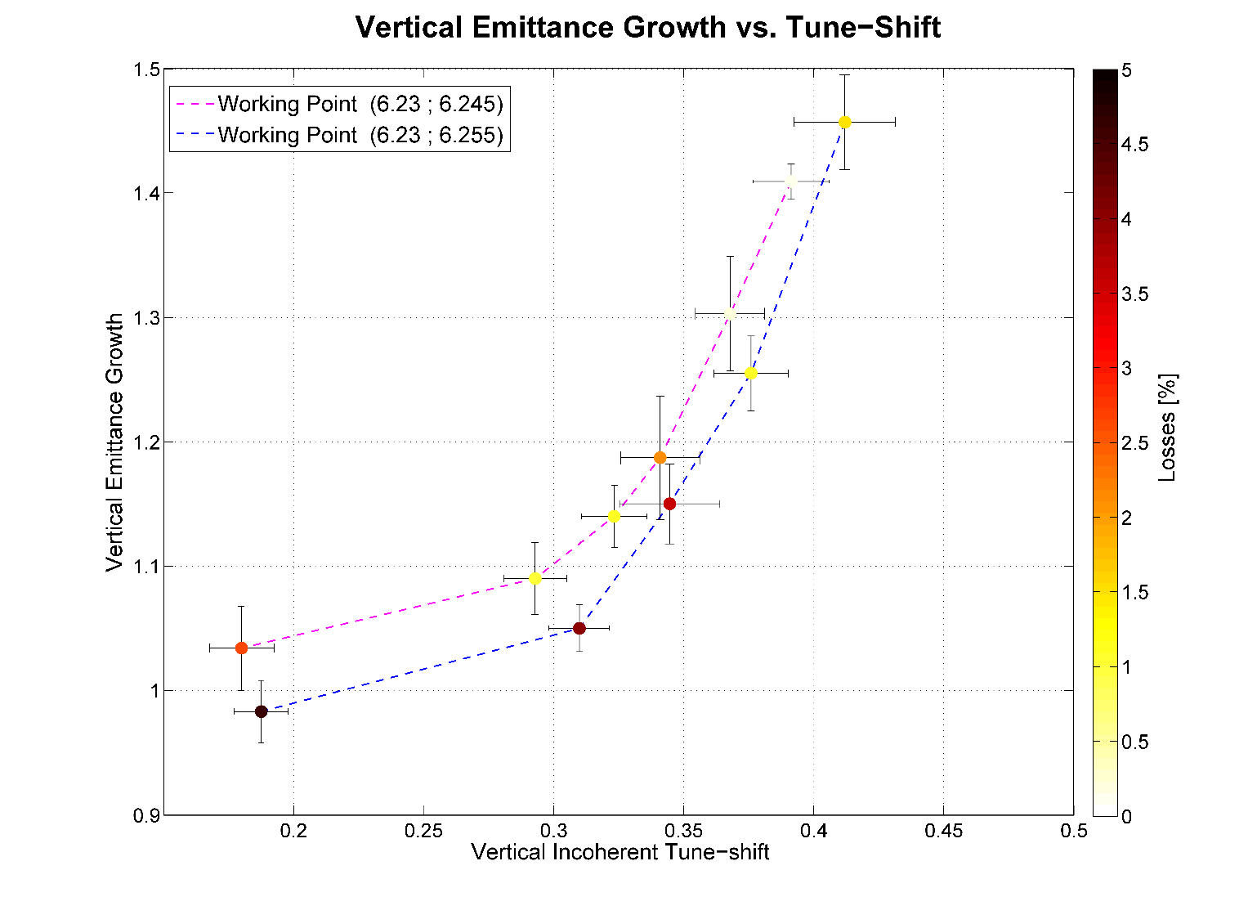
Space charge
With integer tune Q6 vertical tune spread limited to 0.25 by 8q_{v}=50 res.
Compromise of losses versus transverse blow-up
Lower chromaticity
Reduces tune spread
Requires transverse damper
5% loss budget
5% emittance budget
G. Sterbini, R. Wasef
Improve wire-scanner data analysis
Maximum acceptable tune shift based of 0.31 based on measurements
Allow larger loss budget (only at 2 GeV) for smaller emittances?

Slide 10
Space charge, large ε_{l} and small chromaticity
Reaching the HL-LHC request requires large longitudinal emittance (3.0 eVs) and longest possible bunches at flat-bottom ~205 ns
No margin, all scalings must be correct
Higher brightness only available after LS2
Studies:
Change integer working point to Q5/7
Resonance compensation using skew sextupoles (reduce integer resonance)
Vertical dispersion by introducing coupling
Hollow bunches, double harmonic RF (h = 7+14) or lower RF voltage at flat-bottom
Possible issues:
Precision of wire scanner measurement to qualify emittances
Measurement of transverse blow-up during the cycle → BGI
Control of emittance blow-up → tune control during ramp

Slide 11
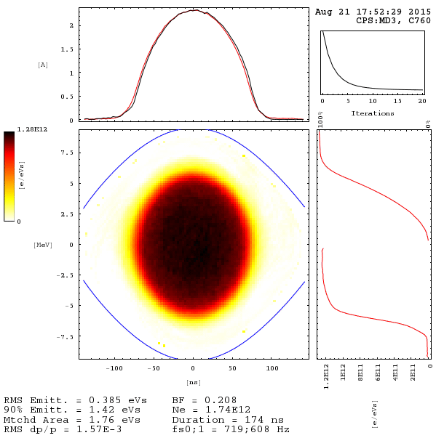
Controlled longitudinal emittance blow-up
Reduce space charge at PS flat-bottom
  Large longitudinal emittance of 3.0 eVs needed for LIU
Extensive beam tests of controlled blow-up in PSB
Maximum emittance of only ε_{l} = 1.8 eVs achieved so far
Close to textbook water-bag distribution: constant phase space density
Studies to continue in 2016 to produce up to 3.0 eVs
Critical for PS space charge
S. Hancock, A. Oeftiger

Slide 12
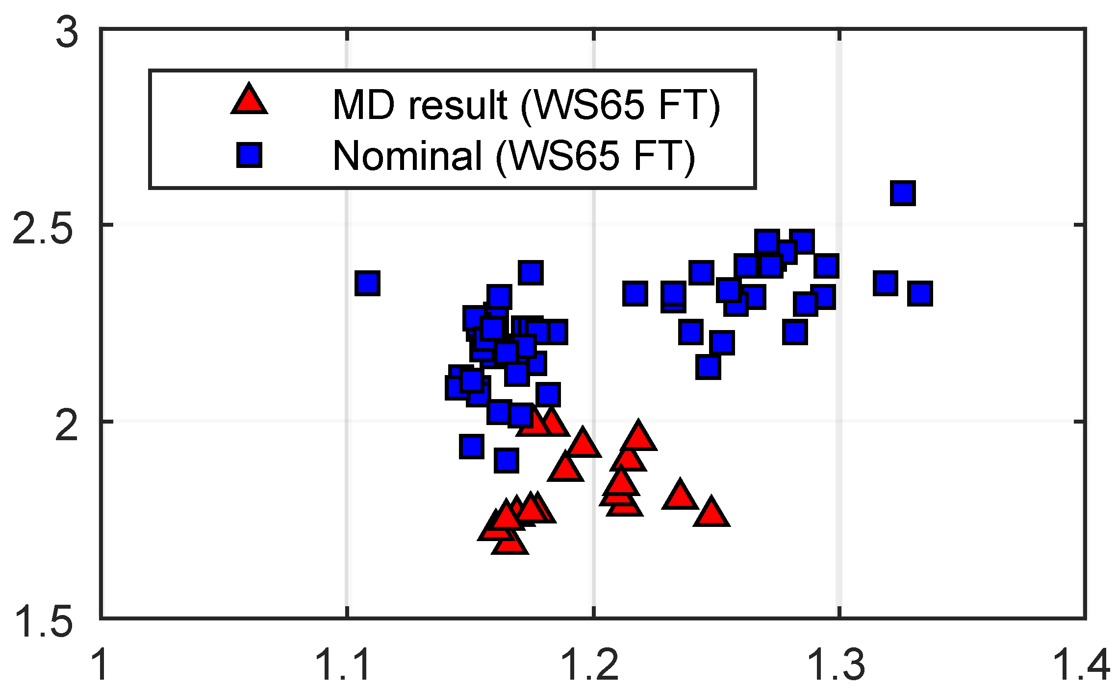
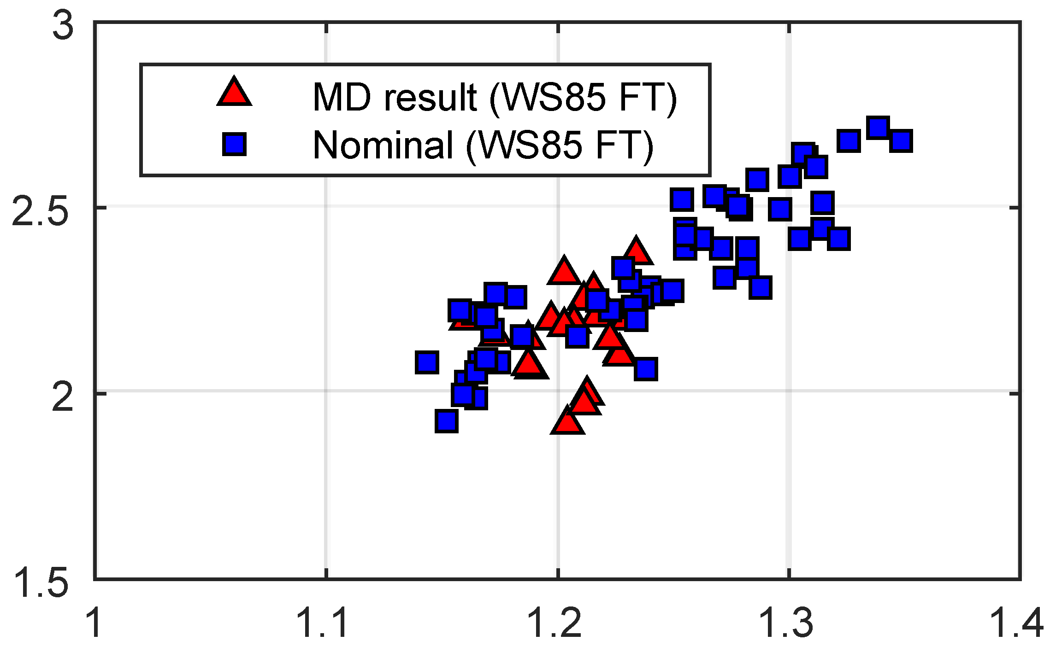
Large ε_{l} and small chromaticity
Promising results from 2015
Horizontal emittance
Vertical emittance
ε_{H} [10¹¹ ppb]
ε_{V} [10¹¹ ppb]
G. Sterbini
N_{b} at ejection [10¹¹ ppb]
N_{b} at ejection [10¹¹ ppb]
~15% reduction of horizontal emittance
Present transverse feedback stabilizes beam with zero chromaticity at 2.5 GeV
Upgrade of power amplifiers required to maintain efficiency in damping injection oscillations

Slide 13
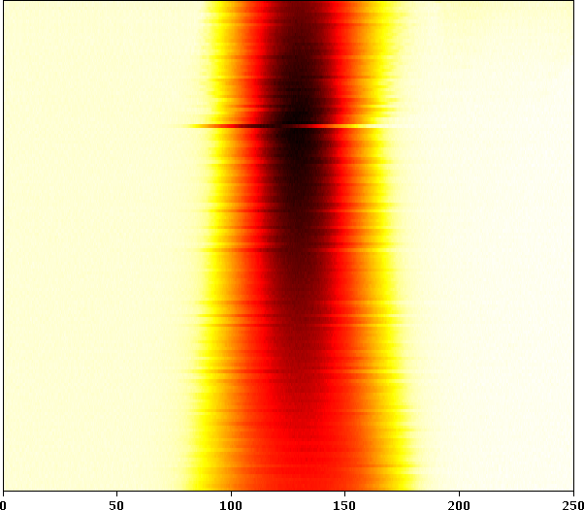
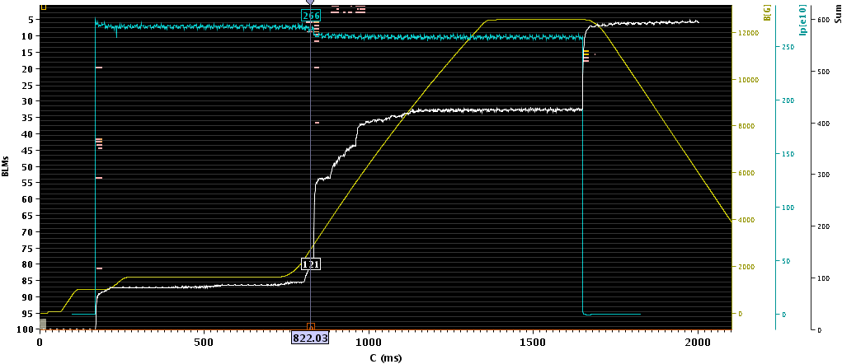
Beam loss at transition crossing
Losses at transition crossing with LHC-type beams for ε_{l} > 1 eVs
  Longitudinal or transverse?
2016: Modify triple splitting to h = 7 → 21 re-bucketing
Pure h = 21
N_{b} > 2.0 · 10¹² ppb in ε_{l} = 1.2 eVs
60 ms
2.7 · 10¹² ppp
Pure h = 7
t [ns]
Losses only at intensities well beyond LIU needs with single-bunch
  Check other RF harmonics than h = 21 and possibly more bunches
Studies to continue in 2016

Slide 14
Transverse MD priorities in 2016
Priorities with protons:
Low-chromaticity/low-coupling along complete cycle
    Commission new transverse damper LLRF
Confirm rise-time of recombination kickers with beam
Working point studies
  Move integer tunes to Q7/7, Q7/5 and Q5/7
  Detailed scan of fractional tune at Q6/6: losses ↔ emittance blow-up
  Possibilities to reduce integer stop band width
Improve analysis of wire scanner data
Space charge studies
  Transverse quadrupolar oscillations (excitation, detection)
Tests with 80b at extraction
  Beyond LIU baseline

Slide 15
Longitudinal

Slide 16
Overview – Longitudinal
Limitation | Mitigation
Longitudinal beam stability Coupled-bunch oscillations | Reduced impedances of all RF cavities Improved wide-band feedback 10 MHz Replaced 1-turn delay feedbacks 10 MHz New 1-turn delay feedbacks for 20, 40 and 80 MHz cavities Dedicated coupled-bunch feedback Wide-band Finemet longitudinal kicker Increased longitudinal emittance PS-SPS transfer with both 40 MHz cav.
Bunch-to-bunch equalization | 1-turn delay feedbacks
Reduce impedance sources and mitigate consequences

Slide 17
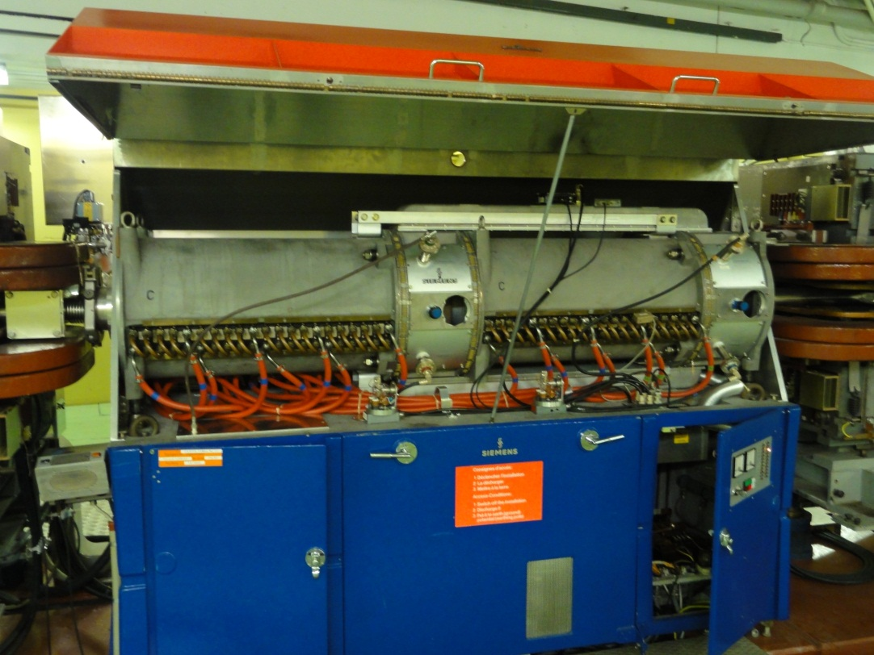
Main 10 MHz RF system
  10 + 1 ferrite loaded cavities, tunable from 2.8…10 MHz
FB ret.
- Fast wide-band feedback
around amplifier (internal)
→ Gain limited by delay
+
Final amp.
Beam
- 1-turn delay feedback
→ High gain at n × f_{rev}
+
1-turn delay feedback
D. Perrelet
Drive
Maximize loop gain of direct wideband feedback
Add 1-turn delay feedback

Slide 18
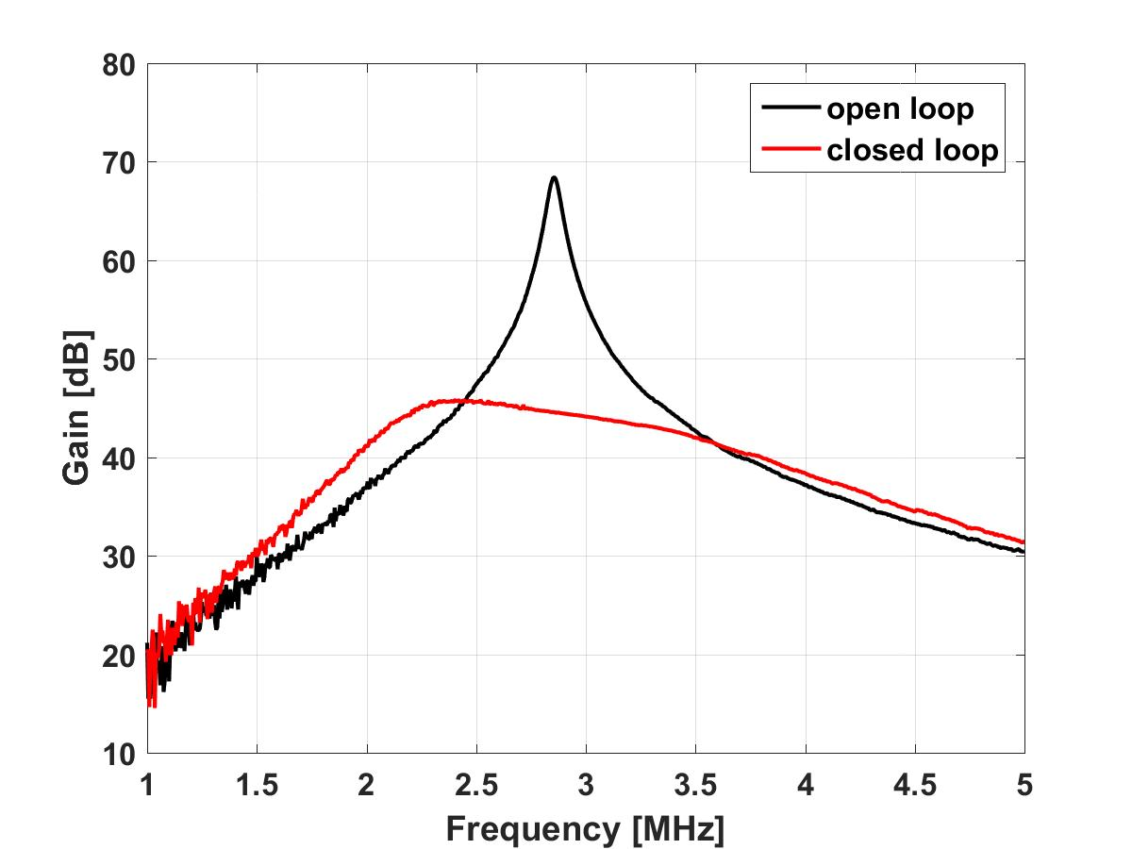
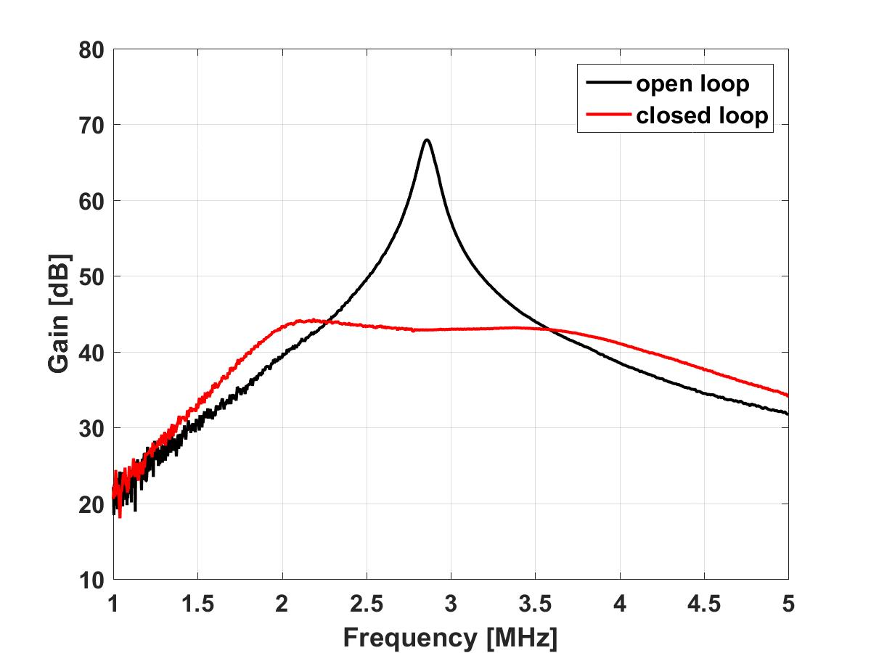
Wide-band feedback of 10 MHz cavities
  Power amplifier upgrade: New working point and grid resonator
    Increased gain of direct RF feedback around amplifier
Standard amplifier: 3 MHz
Upgraded prototype: 3 MHz
~24 dB
~25 dB
Gain [dB]
Gain [dB]
Frequency [MHz]
Frequency [MHz]
Prototype amplifier
  Impedance reduction by factor of ~2 (at 10 MHz → h = 21)
  First cavity being upgraded during YETS2015/16
  Ready for beam tests on one cavity in 2016
Full implementation during (E)YETS and LS2
G. Favia

Slide 19
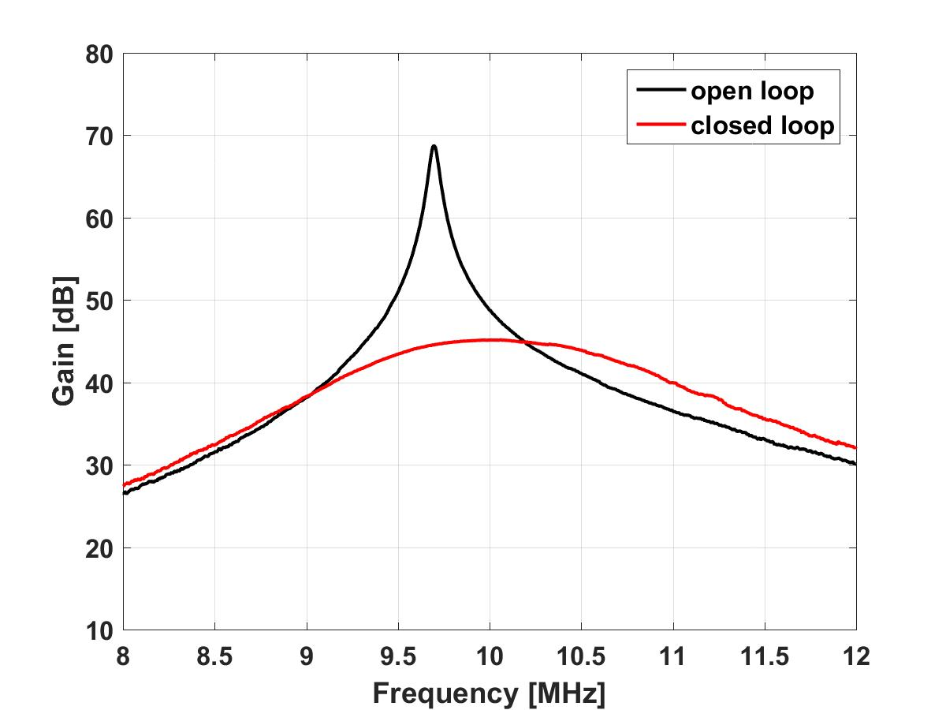
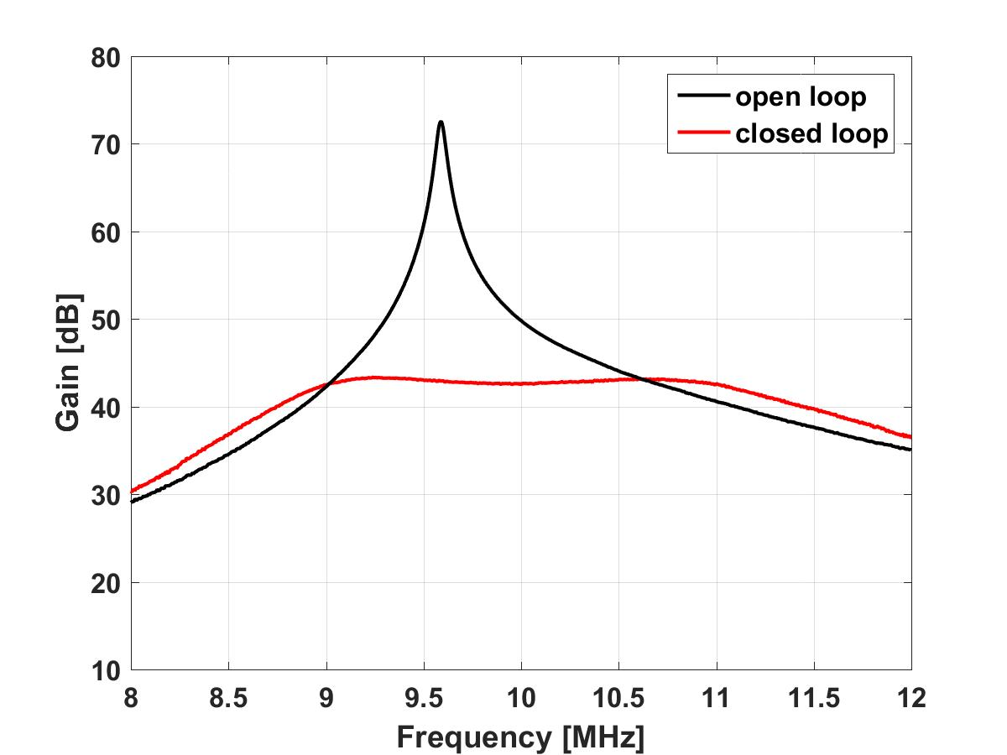
Wide-band feedback of 10 MHz cavities
  Power amplifier upgrade: New working point and grid resonator
    Increased gain of direct RF feedback around amplifier
Standard amplifier: 10 MHz
Upgraded prototype: 10 MHz
~24 dB
~30 dB
Gain [dB]
Gain [dB]
Frequency [MHz]
Frequency [MHz]
Prototype amplifier
  Impedance reduction by factor of ~2 (at 10 MHz → h = 21)
  First cavity being upgraded during YETS2015/16
  Ready for beam tests on one cavity in 2016
Full implementation during (E)YETS and LS2
G. Favia

Slide 20
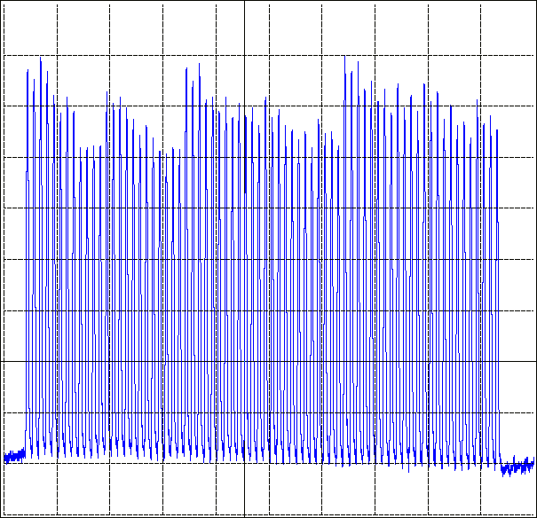
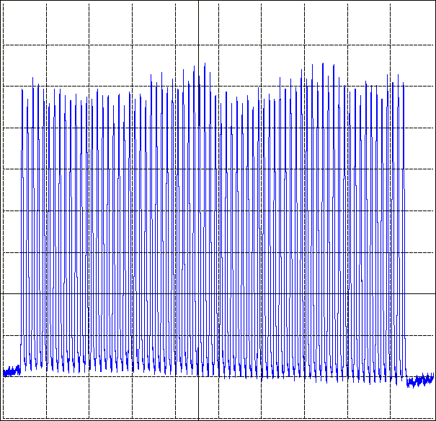
1-turn delay feedbacks 10 MHz (2014)
  Further reduce impedance at harmonics of f_{rev} (comb filter feedback)
    Transient beam loading fully suppressed at 1.3 · 10¹¹ ppb
72 bunches, Feedbacks off
72 bunches, feedbacks on
2 μs
2 μs
Digital 1-turn delay feedback for all 11 main accelerating cavities used for operational beams in 2015
D. Perrelet

Slide 21
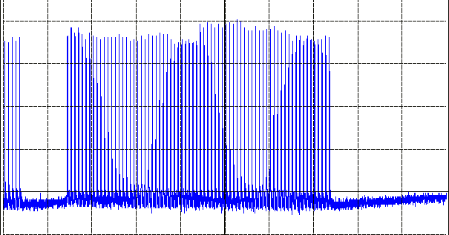
1-turn delay feedbacks 10 MHz (2014)
  Further reduce impedance at harmonics of f_{rev} (comb filter feedback)
    Transient beam loading fully suppressed at 1.3 · 10¹¹ ppb
3 μs
Excellent longitudinal beam quality
Study splitting with lower emittance to scale to higher intensity
New 1-turn delay feedbacks on 20 MHz, 40 MHz and 80 MHz cavities in 2016/17

Slide 22
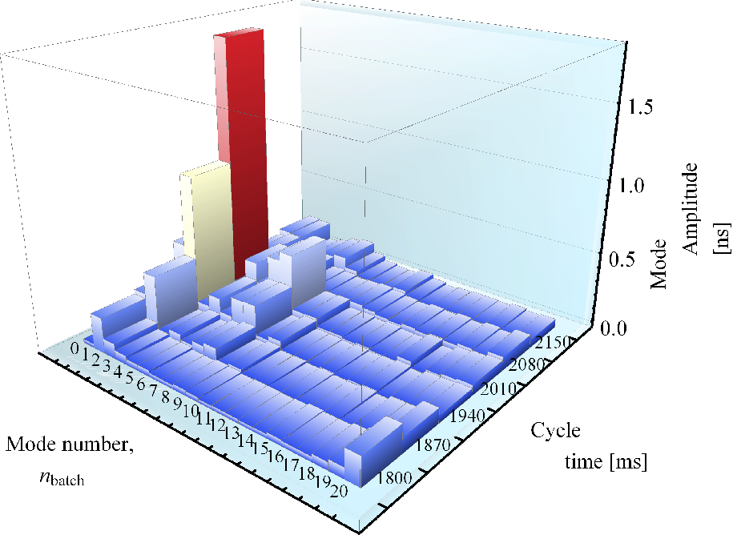
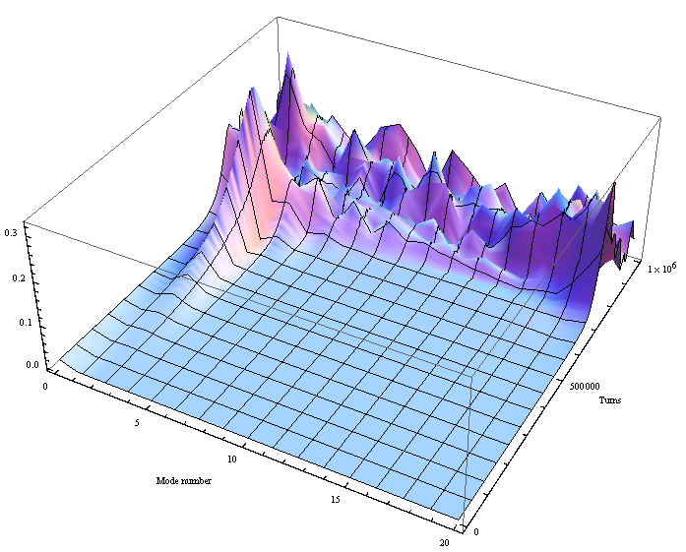
Coupled-bunch instability
  Same mode pattern and strength reproducibly observed (2013 data)
  21 bunch case simulation, main impedance: 10 MHz cavities
Simulations with
10 MHz cavities + Finemet cavity impedance model
Measured mode spectra
L. Ventura
Same mode number n = 2 predicted as observed
Similar growth rate

Slide 23
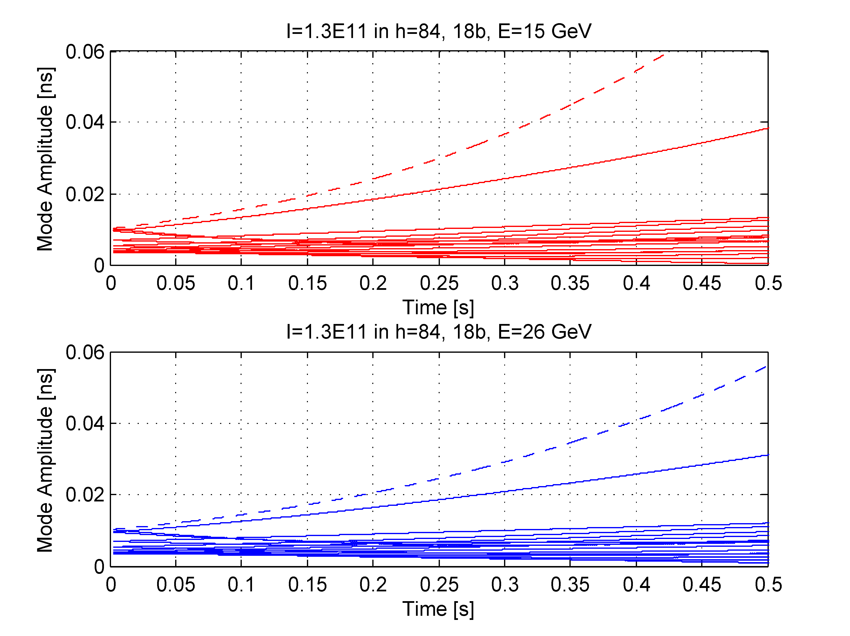
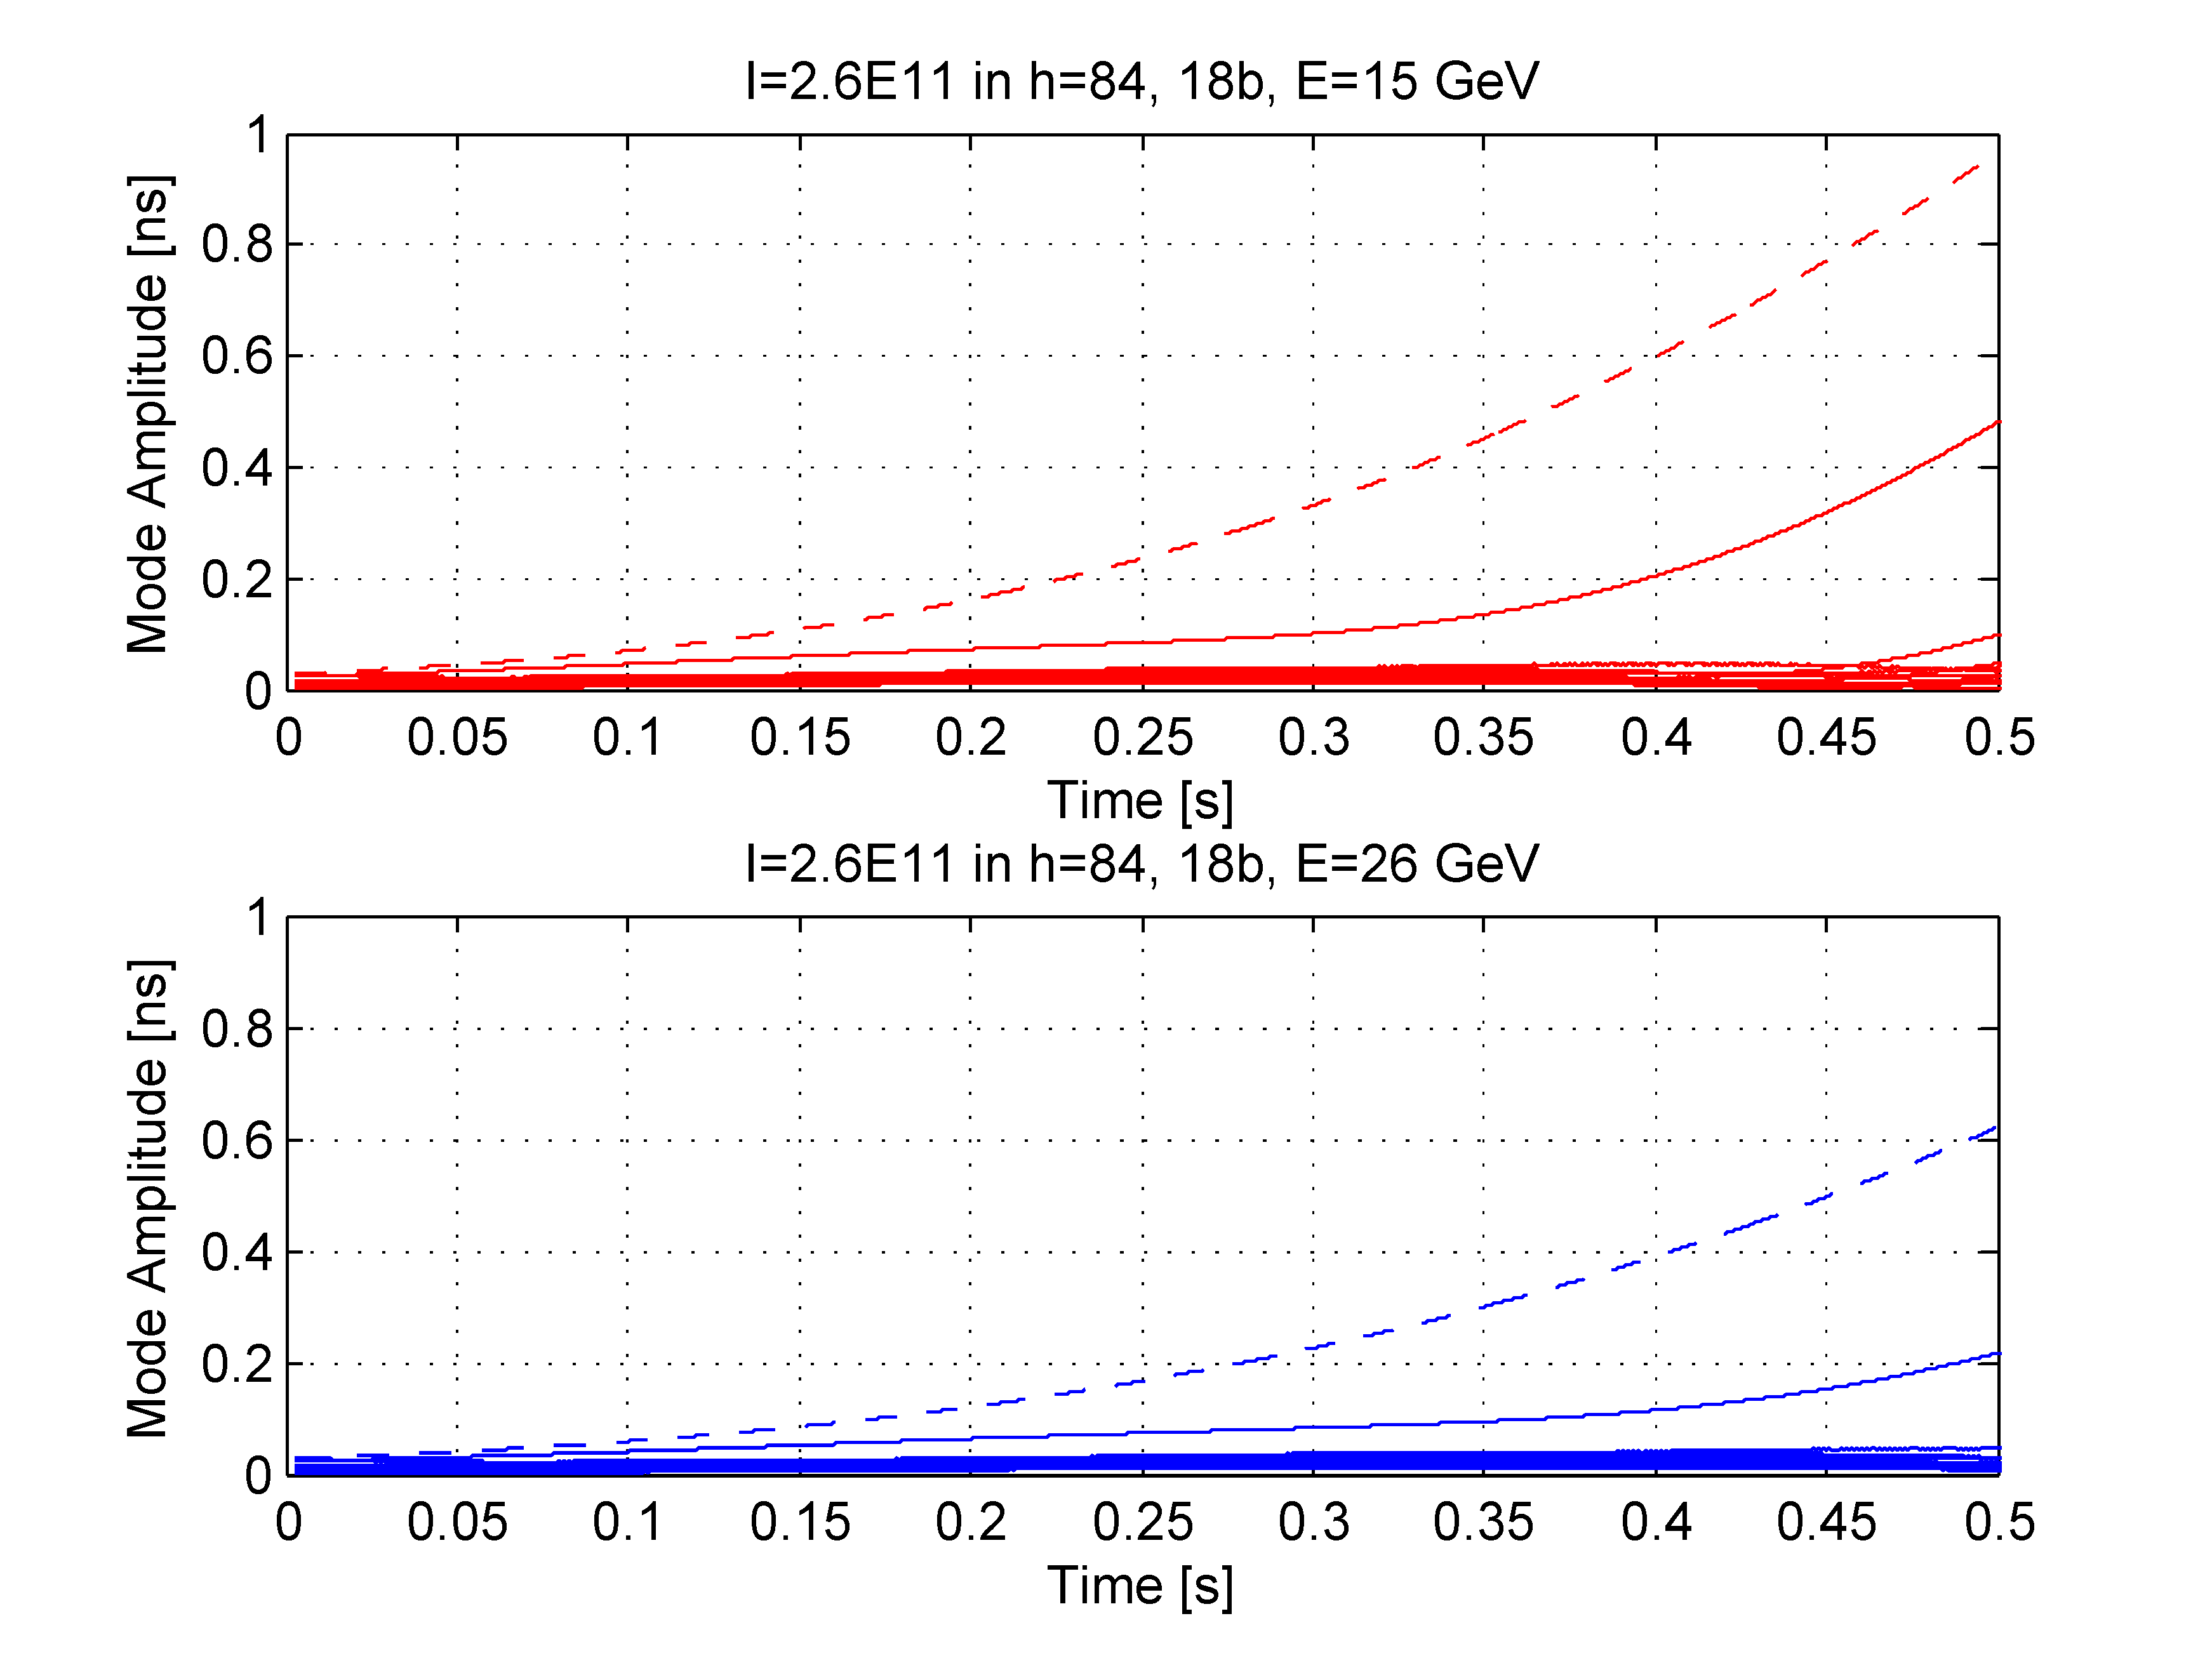
Coupled-bunch instability simulations
Simulations with MuSiC code
Impedance model with 10 MHz RF cavities, little effect of other cavities
L. Ventura
1.3 · 10¹¹ ppb (h = 84), 18 bunches, 15 GeV
2.6 · 10¹¹ ppb (h = 84), 18 bunches, 15 GeV
1/τ = 4.0 s⁻¹
1/τ = 5.7 s⁻¹
n = 1
n = 1
1.3 · 10¹¹ ppb (h = 84), 18 bunches, 26 GeV
2.6 · 10¹¹ ppb (h = 84), 18 bunches, 26 GeV
1/τ = 3.4 s⁻¹
1/τ = 5.3 s⁻¹
n = 1
n = 1
The coupled-bunch feedback is designed to damp all cases
On paper it works

Slide 24
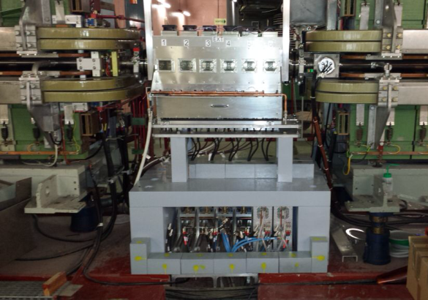
Coupled-bunch feedback
6×
Cavity return sum
Comb. + att.
Prototype Finemet cavity
-3 dB
Beam-loading compensation
Wall current monitor
Coupled-bunch feedback
Splitter + amp.
f_{clk} = 256 f_{rev}
Two feedbacks: 1. Beam → Finemet cavity, 2. Cavity return → cavity
Frequency domain approach
Suppress synchrotron frequency side-bands at n · f_{rev}

Slide 25
Coupled-bunch feedback
 | Finemet cavity
2014 | 1/6 gaps | Beam-loading reduction feedbacks for Finemet cavity
2015 | 4/6 gaps | Excitation of coupled-bunch oscillations 1st damping on single harmonic Function prototype system with 10 processing chains
2016 | 5/6 gaps | Explore beam parameters with feedback Define voltage requirement for final cavity
Functional prototype working at end of 2015:
  Covering all modes simultaneously
  2/3 of the voltage capability of final system
Expected to deliver close to full performance of operational system

Slide 26
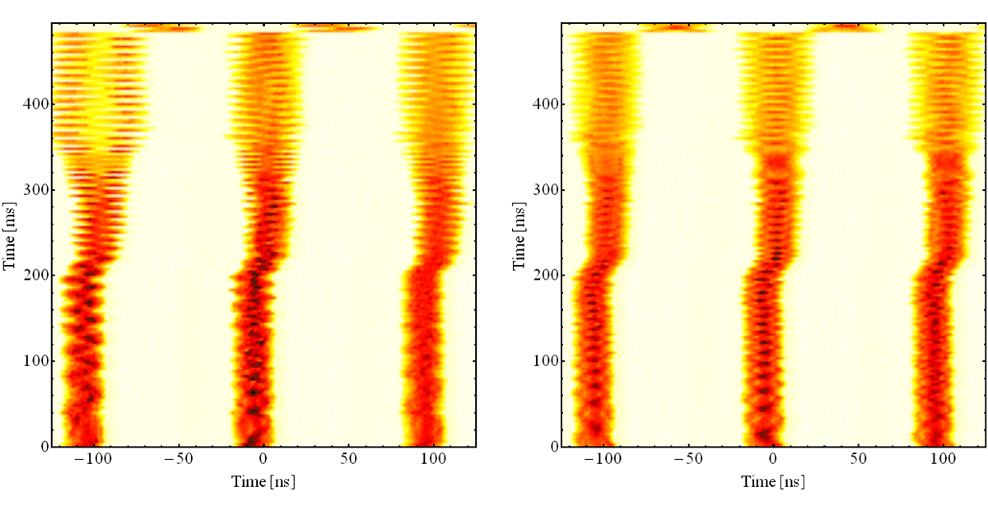
Benefit of coupled-bunch feedback
  Arrival on the flat-top and voltage reduction (splitting disabled)
Feedback off
Feedback on
  Even with feedback not fully stable

Slide 27
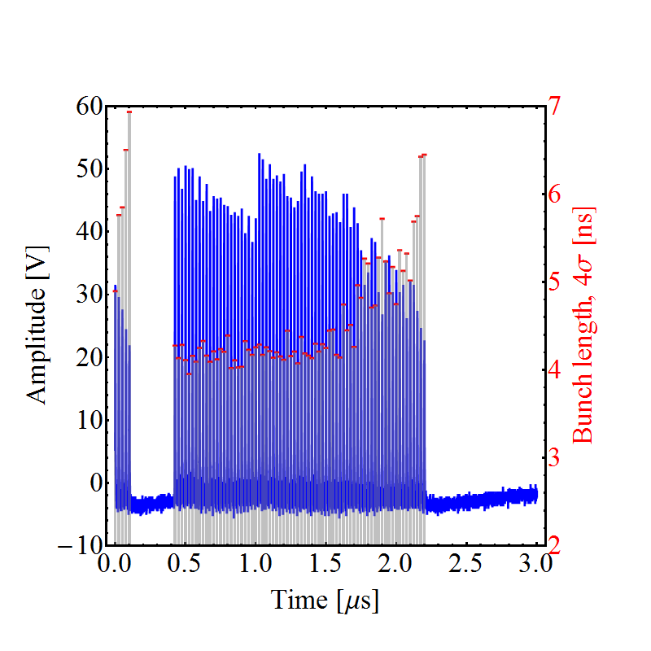
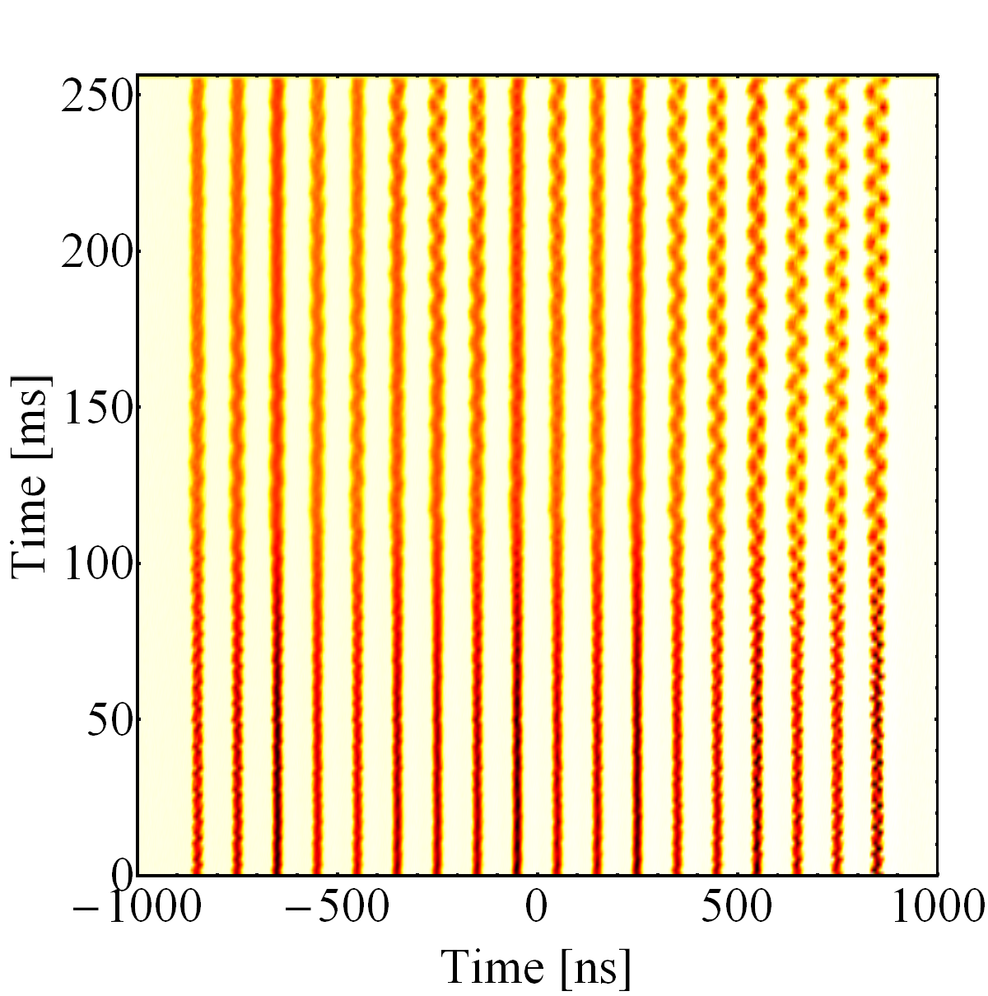
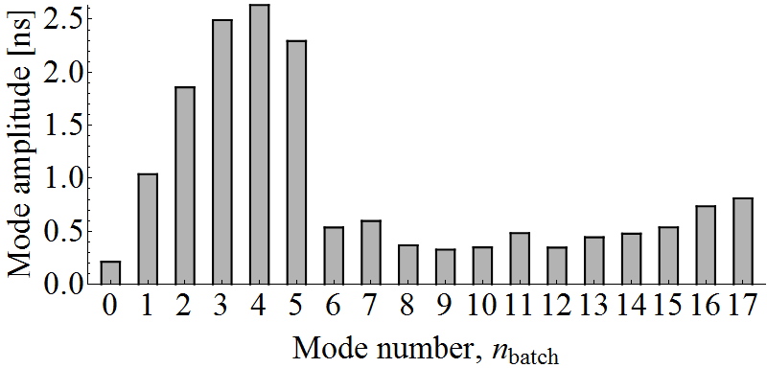
Damping of all 20 modes on the flat-top
  Coupled-bunch instability with wide mode spectrum
Bunches on flat-top, feedback off
Last turn, feedback off
Mode spectrum, feedback off

Slide 28
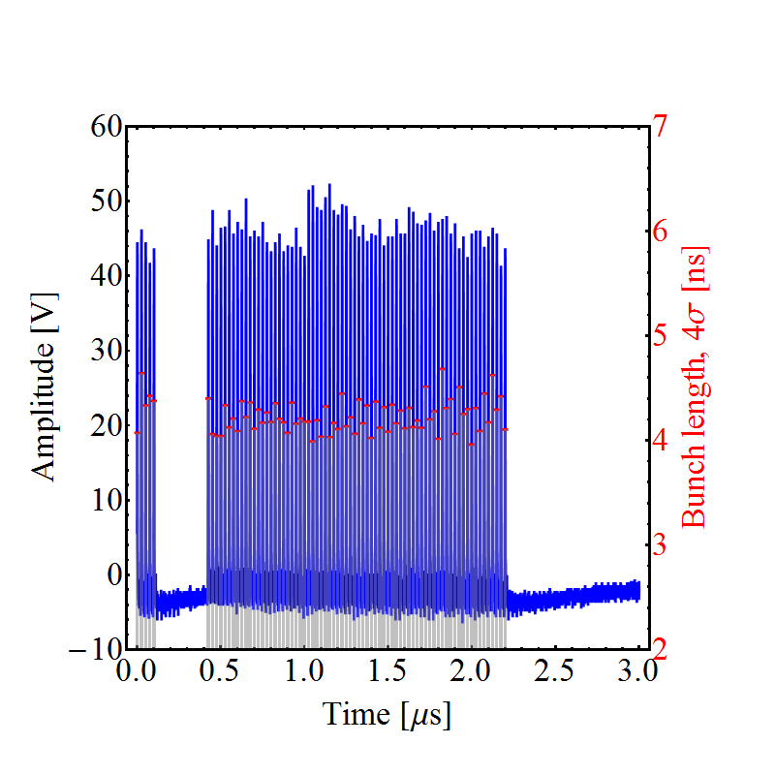
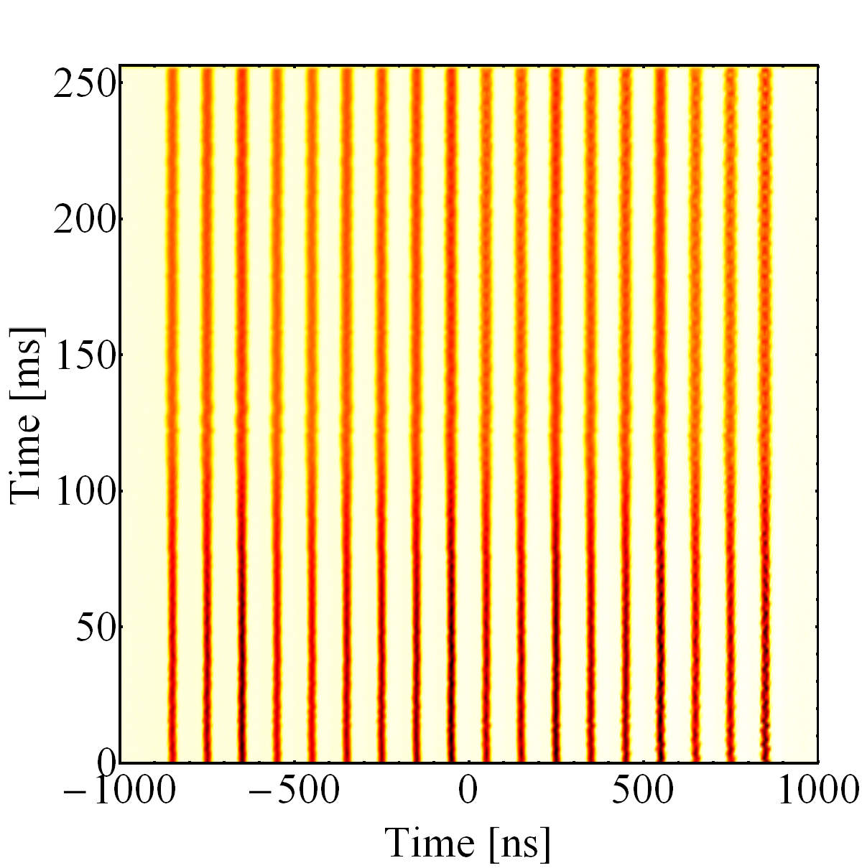
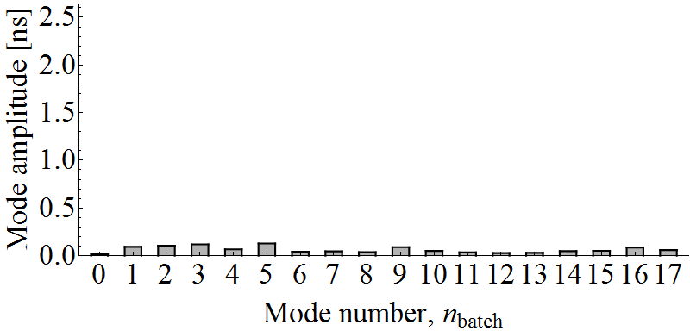
Damping of all 20 modes on the flat-top
  Coupled-bunch instability with many modes
Bunches on flat-top, feedback on
Last turn, feedback on
Mode spectrum, feedback on
Reached 1.7 · 10¹¹ ppb with good longitudinal parameters
Full evaluation of prototype with beam during 2016 run
Critical to reach LIU baseline

Slide 29
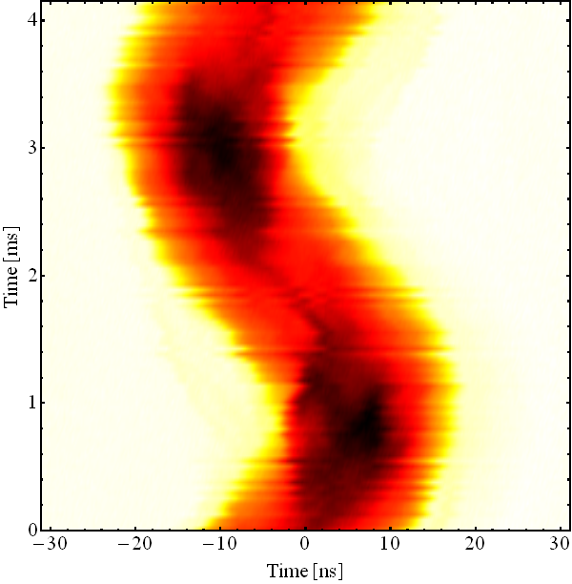
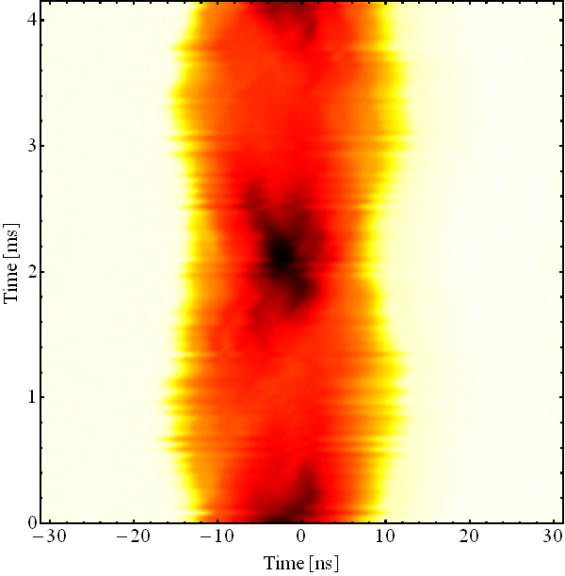
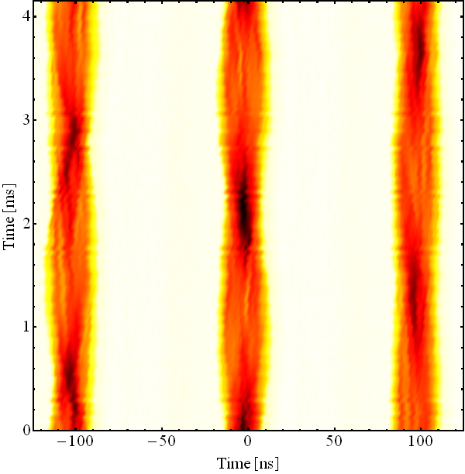
What to expect at higher intensity?
  Dipole oscillations seem well stabilized
  High order modes of instability?
Feedback off
Feedback on
Quadrupolar coupled-bunch?
C2595
C2595
  MD priority: Evaluation of performance during 2016 run
    Maximum intensity with coupled-bunch feedback
    When in the cycle does the instability develops?
    Unstable modes (dipolar, quadrupolar, etc.)?

Slide 30
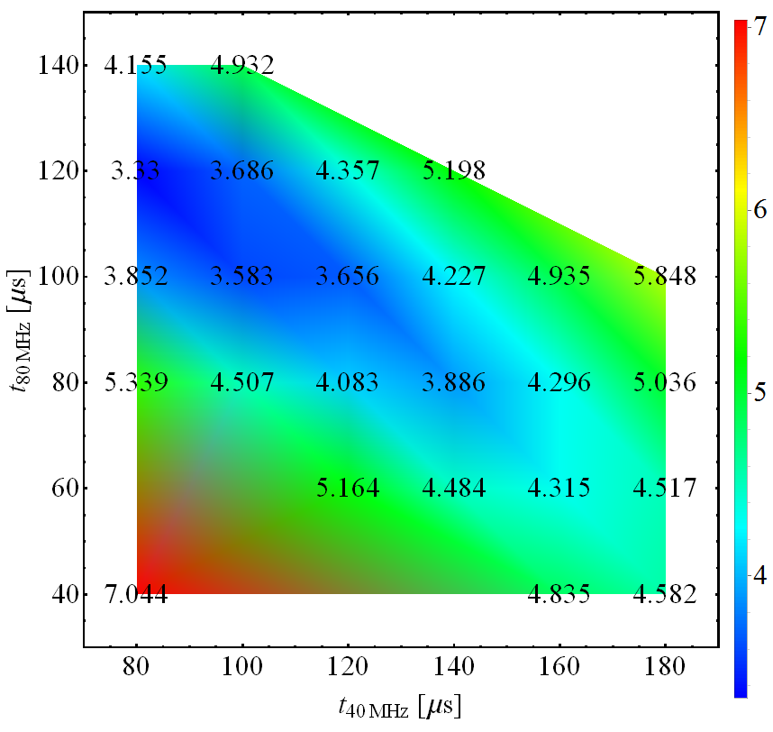
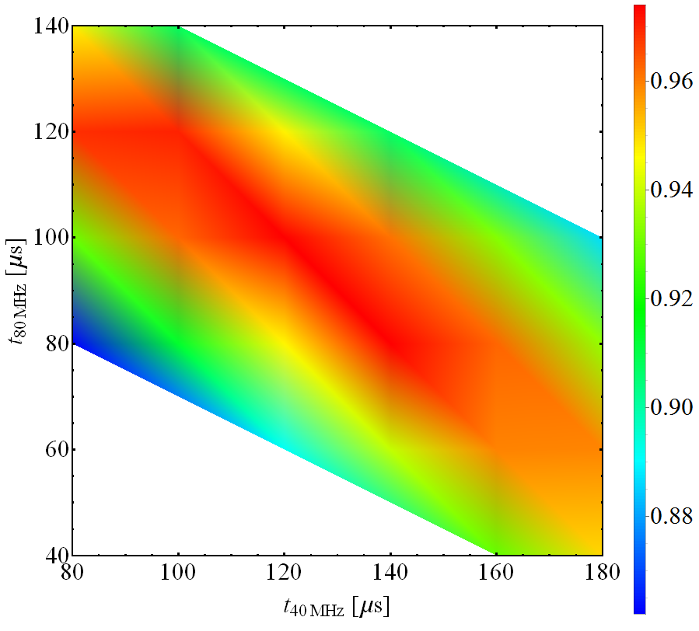
Large longitudinal emittance at transfer
  Passive stabilization: increased longitudinal emittance
  Use both 2 × 40 MHz cavities for bunch rotation
  BUT: 0.4 eVs assumption in SPS leaves little/no margin for PS
H. Timko
Bunch length, 4σ [ns]
Transmission, [norm.]
  Several attempts to complete measurements with larger ε_{l} in 2015
    Cavities not available due to various technical issues
  Complete measurements in 2016

Slide 31
Longitudinal MD priorities in 2016
Priorities with protons:
Validate 10 MHz direct feedback upgrade on C10-11
Explore performance reach of coupled-bunch feedback
Transfer of large longitudinal emittance from PSB (h = 1+2)
Test 1-turn delay feedbacks on high-frequency cavities
PS-SPS transmission with both 40 MHz cavities
Conceptual tests preparing beam control upgrade

Slide 32
Summary
2.6…2.7·10¹¹ ppb with 25 ns spacing for LHC is well beyond present achievements, transversely and longitudinally
  May observe new limitations
No direct limitation built into the upgrades
Need input from beam studies in 2016 to
  conclude on potential beam brightness before and after LS2
  explore longitudinal limitations with coupled-bunch feedback
Major step in brightness only after upgrades during LS2
Need commission and study time after LS2

Slide 33

THANK YOU FOR YOUR ATTENTION!

