Slide 1
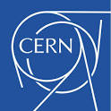

Facilities for radiation testing and technologies for radiation monitoring
Rubén García Alía
On behalf of the R2E project

Slide 2
Outline
Radiation to Electronics (R2E) project overview
The RadMON system
CERN Radiation test facilities
Space application: CELESTA

Slide 3
Outline
Radiation to Electronics (R2E) project overview
The RadMON system
CERN Radiation test facilities
Space application: CELESTA

Slide 4
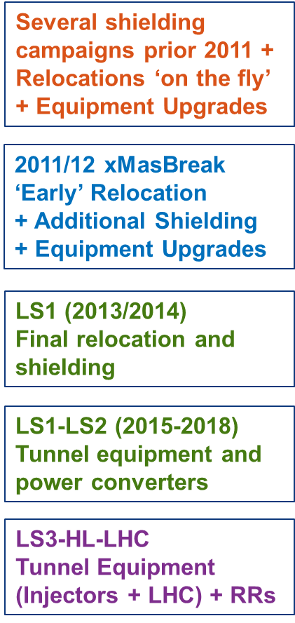
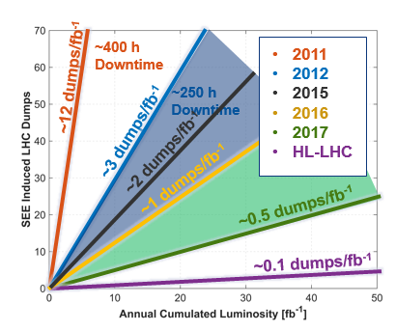
The R2E challenge

Slide 5
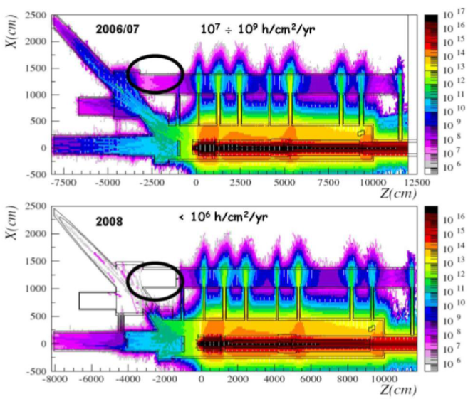
An R2E mitigation example
CERN Neutrinos to Grand Sasso (CNGS) experiment
Muon-neutrinos generated through interaction of 400 GeV protons with target
Shutdown at an early stage due to successive failures in the ventilation system
SEEs in microcontrollers, mitigated by reinforced shielding

Slide 6
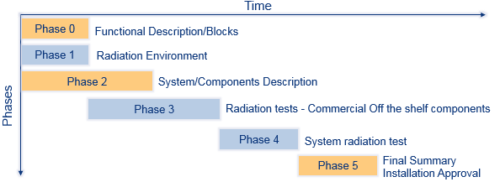
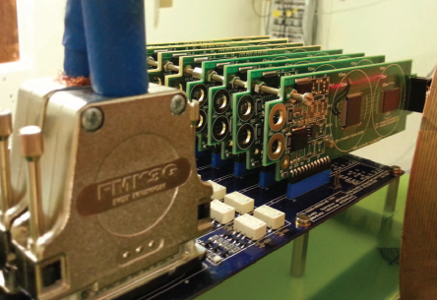
R2E: from mitigation to prevention
In order to push radiation tolerance to levels compliant with HL-LHC requirements (~0.1 dumps/fb⁻¹) mitigation is not enough
A pre-emptive approach needs to be implemented taking into account the response to radiation from a very early stage of the project

Slide 7
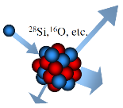
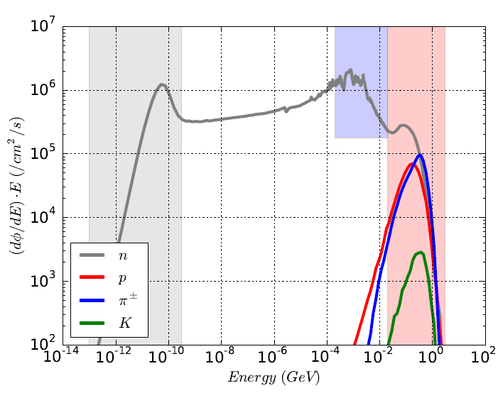
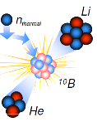
Hadronic environment at CERN
SEEs are induced by indirect energy deposition (nuclear reactions) from hadrons
Two main intervals can be distinguished: thermal neutrons (causing SEEs through ¹⁰B capture) and high-energy hadrons (HEH)
Therefore, the associated fluences need to be calculated and monitored

Slide 8
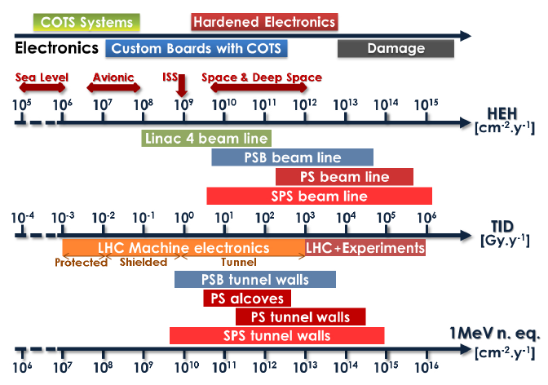
Radiation levels at CERN
For electronics in the LHC, areas with annual HEH fluxes above 10⁷ cm⁻² are considered as SEE non-safe areas owing to the very large amount of equipment installed
TID is typically only a concern above annual levels of ~10 Gy, which corresponds to roughly 5·10⁹ HEH

Slide 9
Outline
Radiation to Electronics (R2E) project overview
The RadMON system
CERN Radiation test facilities
Space application: CELESTA

Slide 10
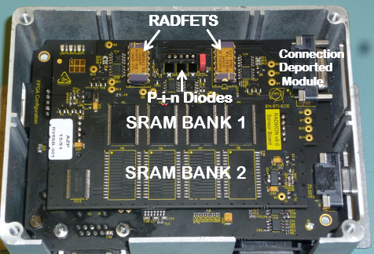
RadMON system
Use of commercial electronics to monitor the radiation environment
HEH and thermal neutron fluence with SRAM memories, TID with RadFET, DD with PIN diode
Need to calibrate in relevant radiation fields

Slide 11
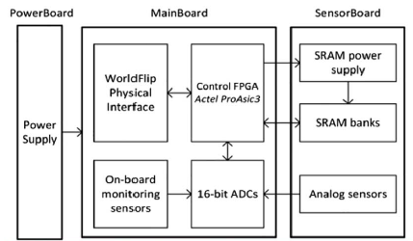
RadMON general architecture and RHA
Power board: AC transformers and linear regulators
Main board: ProAsic3 FPGA with TMR both in registers and internal RAM, ADCs for dosimetry sensors
Sensor board: TID, DD and SEU detectors. Can be connected to Deported Module for TID and DD sensors
FPGA works correctly up to 35-40 krad. Limiting component is ADC, which fails after 25 krad
G. Spiezia et al, IEEE TNS (2014)

Slide 12
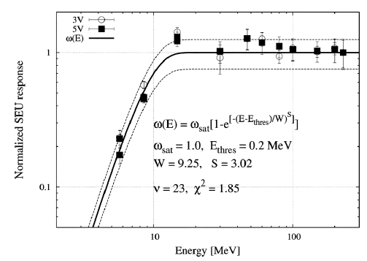
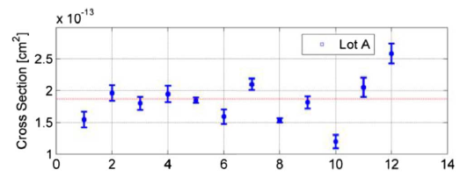
RadMON calibration: SRAM SEU cross section
Monoenergetic cross sections for high energy protons (30-200 MeV, PSI), intermediate energy neutrons (5-15 MeV, PTB) and thermal neutrons (nuclear reactor)
Need to carefully evaluate the sensitivity spread
K. Roed et al, IEEE TNS (2012)
S. Danzeca et al, IEEE TNS (2014)

Slide 13
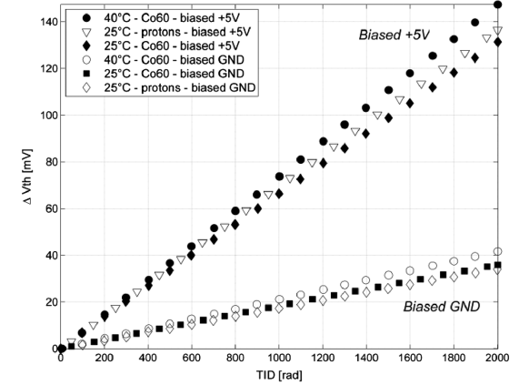
RadMON calibration: RadFET
Performed mainly using ⁶⁰Co but also other particles such as protons
Different oxide thicknesses available, but 100 nm typically used (larger measurement range, better response in mixed field)
Sensitivity can be increased significantly by applying 5V bias
G. Spiezia et al, IEEE TNS (2014)

Slide 14
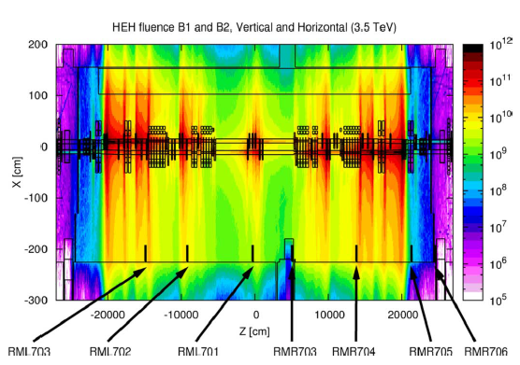
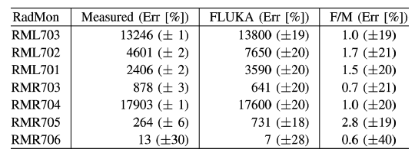
RadMON benchmarking
RadMON is regularly benchmarked against FLUKA Monte Carlo simulations both in radiation test facilities (e.g. CHARM) or in actual operation
Example: RadMONs installed in LHC IR7 for 2010 run
K. Roed et al, IEEE TNS (2012)

Slide 15
Outline
Radiation to Electronics (R2E) project overview
The RadMON system
CERN Radiation test facilities
Space application: CELESTA

Slide 16
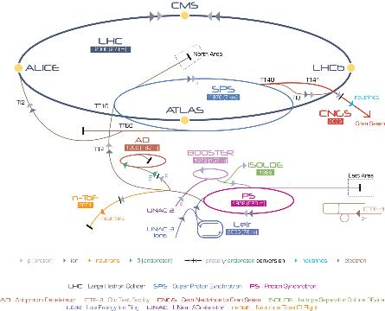
CHARM in the CERN accelerator complex
CERN injector chain to LHC (7 GeV), from SPS (450 GeV) and PS (24 GeV)
PS first accelerated protons in 1959, being CERN’s first synchrotron
It has a circumference of 628 meters

Slide 17
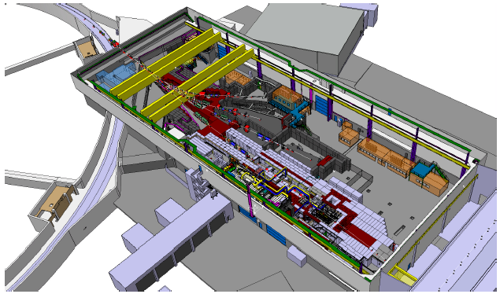
CHARM in the PS East Area
Located in the PS East Area T8 beamline
Typically extracts 24 GeV protons, however heavy ion extraction (Pb, Xe) is foreseen in the near future
Proton arrive in spills of ~350 ms every 10 seconds

Slide 18
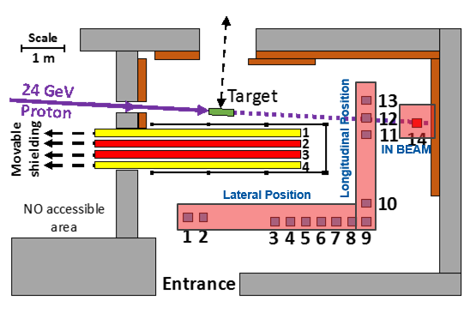
The CHARM irradiation facility
A broad range of test configurations are available in the CHARM irradiation area
Different particle energy spectra and intensities can be obtained by varying the target material, movable shielding and test location
Full internal area is subject to large radiation levels (local shielding is not possible) and cable length to control room is ~40m
Provided the large volume in the irradiation area, full system tests are possible

Slide 19
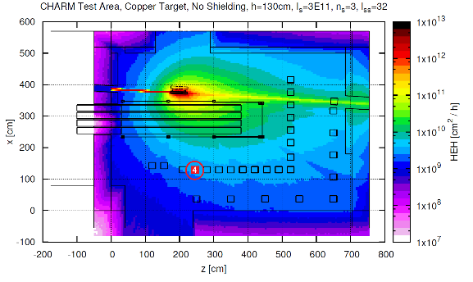
Radiation levels at CHARM
The CHARM radiation levels are simulated using FLUKA and benchmarked against measurements (e.g. RadMON)
HEH fluence levels of 10¹⁰ cm⁻² (e.g. worst-case annual LHC tunnel conditions) can be reached in one hour

Slide 20
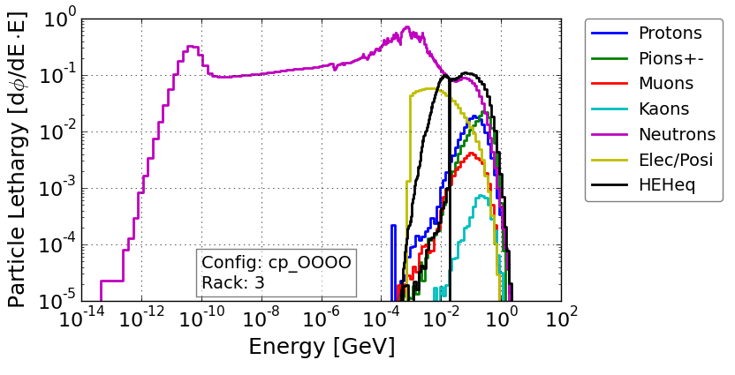
Particle energy spectra
Mixed-field in which the contribution to TID is roughly equally divided between charged hadrons, photons and electrons/positrons
The HEH contribution varies from ~40% pions, ~35% neutrons and ~25% protons for near in-beam positions, to >95% neutrons for shielded lateral locations

Slide 21
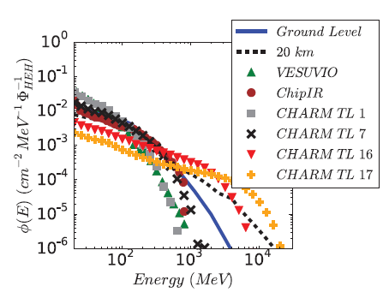
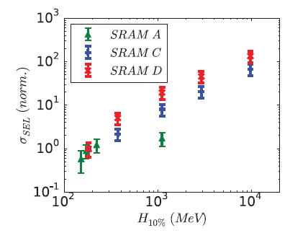
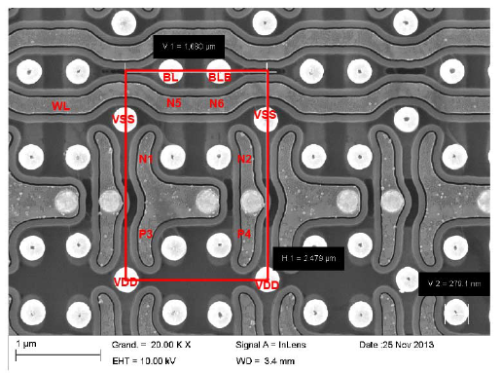
Importance of HEH spectrum hardness
Components with high LET-thresholds and high-Z materials (e.g. tungsten) near their SVs are known to have a strong hadron cross section energy dependence with energy up to the GeV range
Therefore, testing in an environment which is softer than the operational one can lead to a significant underestimation of the associated SEE rate
R. G. Alia et al, IEEE TNS (2015)

Slide 22
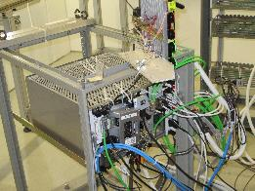
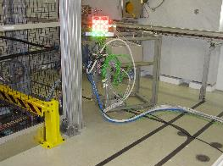
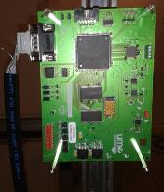
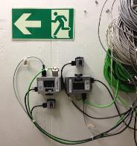
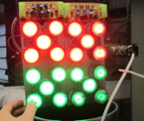
CHARM tests in 2015
Cryogenic crate:
Temperature
Pressure
Liquid He level gauges
Cold Mass Heaters
Beam Screen Heaters
Mechanical Switches
Red and Green LED array:
Current consumption
LED luminosity
CELESTA 1U CubeSat
testBoard:
SEL detection
Current Consumption
Accumulated dose
HEH monitoring
FPGA functionality
RadMON upgrades:
Test new sensors.
Monitor functionality
Validate new firmware

Slide 23
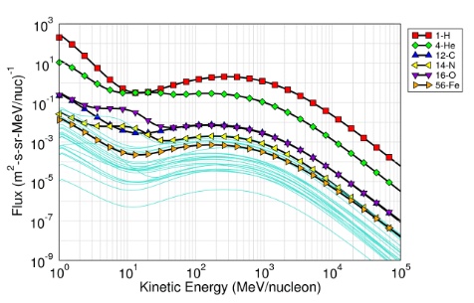
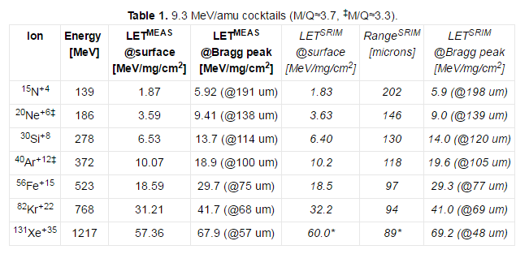
Heavy ions at CHARM
GCR heavy ion spectra typically peak at several hundred MeV/n, whereas ground tests at standard facilities are carried out at ~10 MeV/n (e.g. ranges limited to ~100 um in Si)
At CHARM, heavy ion tests at GeV/n energies are possible, providing mid-LET ion with very large penetration (in the mm range) and therefore enabling access to sensitive region of complex components (e.g. flip chips)
Currently collecting declarations of interest from space community (ESA, CNES…) and a first run might be possible in 2017

Slide 24
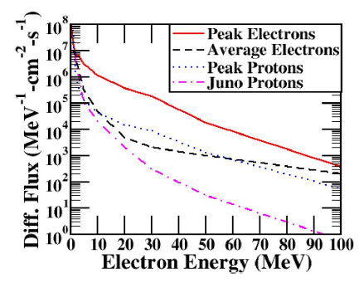
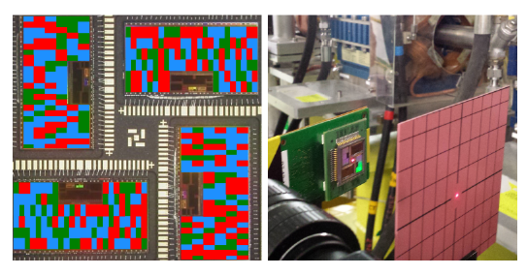
VESPER: 200 MeV electrons for radiation testing
High intensity 200 MeV electron linac, mainly motivated for Jovian environment application (e.g. JUICE)
Facility currently under calibration for radiation effects test purposes
Preliminary results: SEUs observed in 0.25 um SRAM technology (~3 MeVcm²/mg LET threshold) and are attributed to electro-nuclear events
Open to external users! (contact: ruben.garcia.alia@cern.ch)
J. M. Trippe et al, IEEE TNS (2016)
M. Tali et al, submitted to RADECS 2016

Slide 25
Outline
Radiation to Electronics (R2E) project overview
The RadMON system
CERN Radiation test facilities
Space application: CELESTA

Slide 26
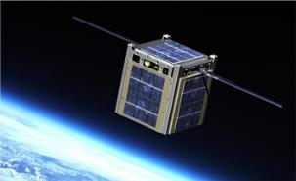

CHARM space applications: CELESTA
CELESTA (CErn Latch-up Experiment STudent sAtellite) is a fully approved 1U CubeSat project
Issued by a collaboration between CERN (providing the payload) and the Montpellier University space Center (CSU) providing the platform based on the ROBUSTA heritage
Main objectives:
  Technical: develop and validate a cubesat radiation monitor based on CERN’s RadMON
  Scientific: determine proton and HI induced SELs through geographical correlation and compare with predictions from CHARM tests

Slide 27
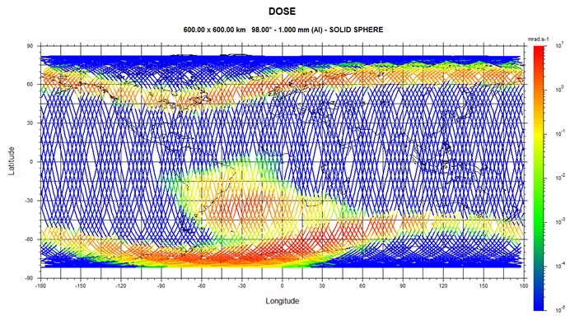
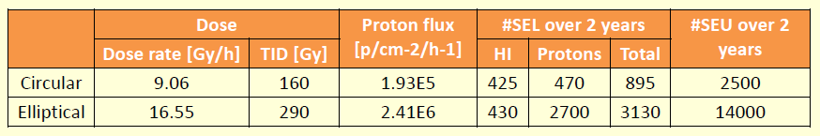
CELESTA orbit
Two baseline orbit scenarios: circular (600 km, 98º) and highly elliptical (300 x 1400 km, 99º)
In both cases, the expected number of SELs for the candidate SRAM memories are statistically meaningful
A. Merlenghi et al, 4S conference (2016)

Slide 28
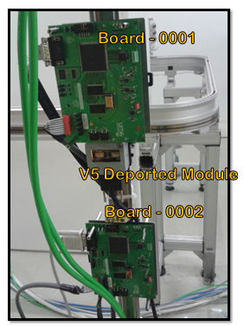
SEL detection and protection system for CubeSats
COTS based, low-cost, low-power and radiation tolerant
Use of an ADC for continuous power consumption monitoring results in a power consumption for affordable for cubesat power budget
Analog circuit (difference amplifier + voltage reference) + counter on FPGA can be used instead
Tested at CHARM, yielding SEL cross section measurements compatible with previous results using “standard” SEL detection approach
TID tolerant for CELESTA mission
R. Secondo et al,
submitted to RADECS 2016

Slide 29
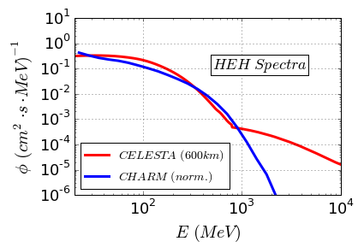
Correlating CHARM with space
The HEH spectrum at CHARM (protons, neutrons, pions) closely resembles that of the trapped proton belt
Under the assumption of SEEs induced by indirect energy deposition, hadrons can (in first approximation) be considered as identical particles, therefore CHARM HEH cross sections can be used to obtain in-flight trapped proton SEE rates
Acceleration factor at CHARM: 2·10⁴

Slide 30
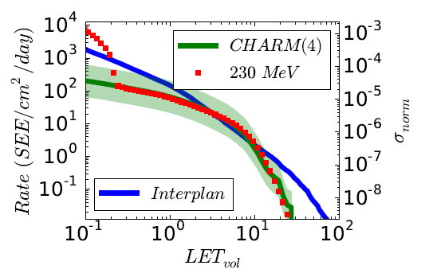
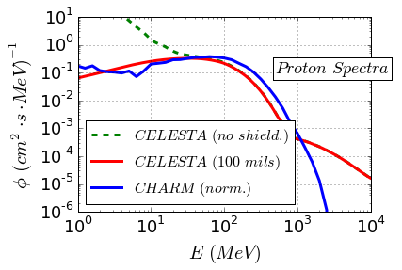
Correlating CHARM with space (II)
Possible applications for direct ionization form singly charged particles (left) or heavy ion effects pre-screening (right) but different metrics (as opposed to HEH approach) are required!

Slide 31
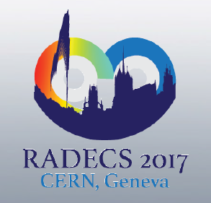
RADECS 2017 at CERN
Looking forward to seeing
you there!

Slide 32
Many thanks for your attention, and questions are welcomed!
ruben.garcia.alia@cern.ch

