Slide 1

SPACE RESERVATION REQUEST
New PS Ring Internal Dumps
EDMS number: 1585135

Slide 2
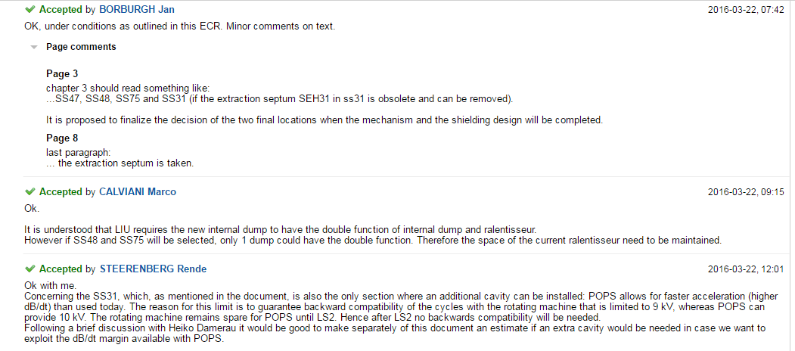



Slide 3
