Slide 1
New Injection Region 1L1
PSB-L-EC-0001
Update after Comments
For Approval
W. Weterings TE-ABT-FPS

Slide 2
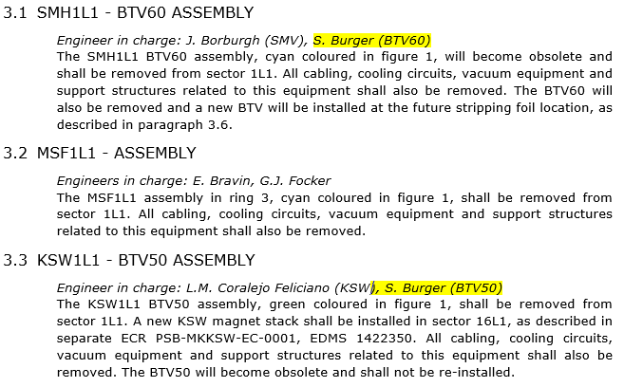

Slide 3

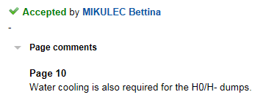



Slide 4



Slide 5

