Slide 1
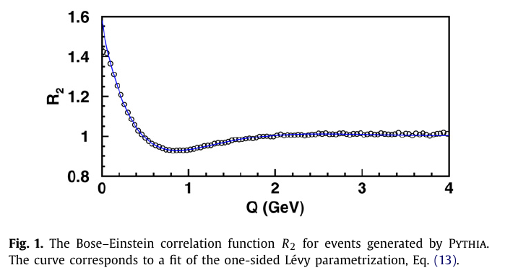
Model independent analysis of nearly Levy correlations
in 1, 2 and 3 dimensions
T. Novák
KRF, Wigner RCP
T. Csörgő
KRF, Wigner RCP
H.C. Eggers and M.B. De Kock
University of Stellenbosh
Modern Fizika Napja, KRF
31 March 2016
OUTLINE
Model-independent shape analysis:
General introduction
Edgeworth,
Laguerre,
Levy expansions
Summary

Slide 2
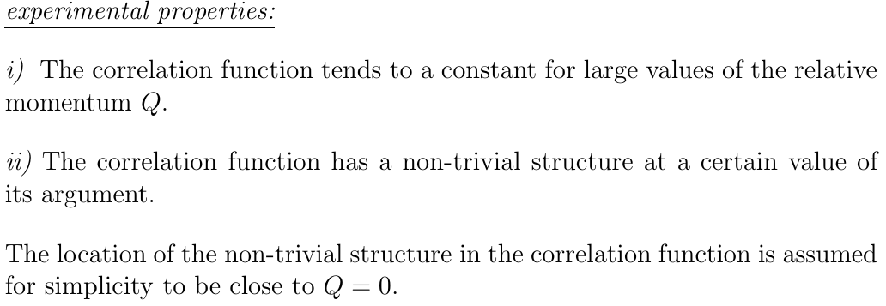
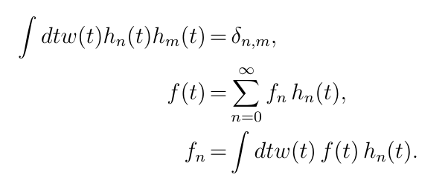

MODEL - INDEPENDENT SHAPE ANALYIS I.
Model-independent but experimentally testable:
w(t) measure in an abstract H-space
approximate form of the correlations
t: dimensionless scale variable

Slide 3
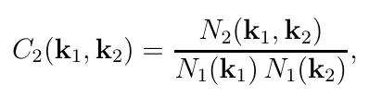

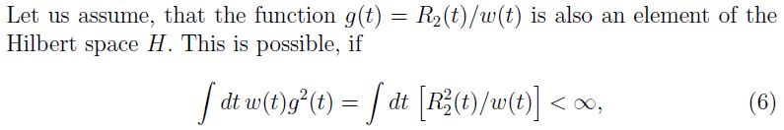
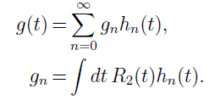

MODEL - INDEPENDENT SHAPE ANALYIS II.
Then the function g can be expanded as
From the completeness of the Hilbert space and from the assumption that g(t) is in the Hilbert space:

Slide 4




MODEL - INDEPENDENT SHAPE ANALYIS III.
Model-independent AND experimentally testable:
method for any approximate shape w(t)
the core-halo intercept parameter of the CF is
coefficients by numerical integration (fits to data)
condition for applicability: experimentally testabe

Slide 5
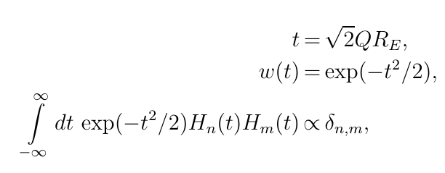
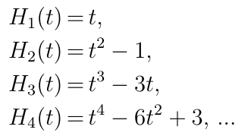
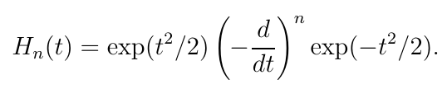
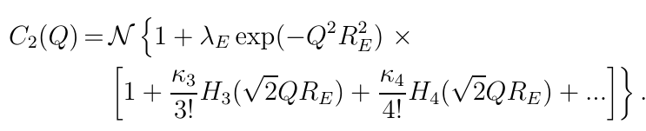
EDGEWORTH EXPANSION: ~ GAUSSIAN
3d generalization straightforward
Applied by NA22, L3, STAR, PHENIX, ALICE, CMS (LHCb?)

Slide 6
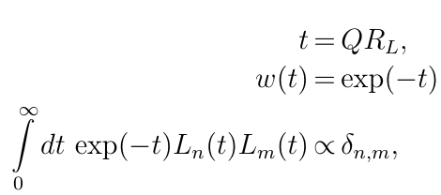


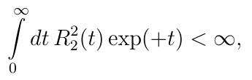

LAGUERRE EXPANSIONS: ~ EXPONENTIAL
Model-independent but experimentally tested:
  w(t) exponential
  t: dimensionless
  Laguerre polynomials
First successful tests
  NA22, UA1 data
  convergence criteria satisfied
  intercept parameter ~ 1

Slide 7
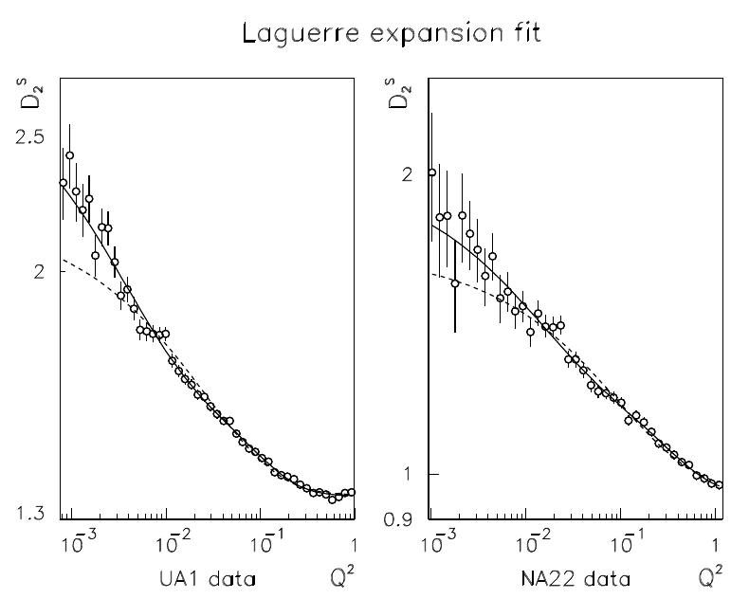
LAGUERRE EXPANSIONS: ~ superEXPONENTIAL
T. Csörgő and S: Hegyi, hep-ph/9912220, T. Csörgő, hep-ph/001233

Slide 8
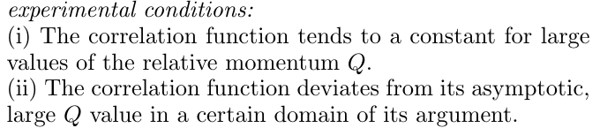




MINIMAL MODEL ASSUMPTION: LEVY
Model-independent but:
  Assumes that Coulomb can be corrected
  No assumptions about analyticity yet
  For simplicity, consider 1d case first
  For simplicity, consider factorizable x k
  Normalizations :
    density
    multiplicity
    single-particle spectra
T. Cs, S. Hegyi, W.A. Zajc, EPJ C36, 67 (2004)

Slide 9



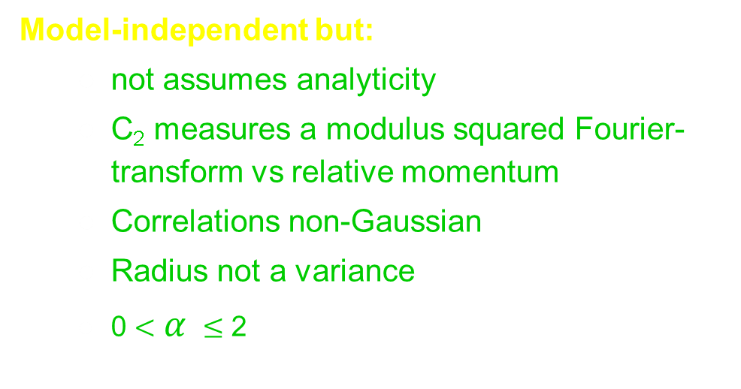
MINIMAL MODEL ASSUMPTION: LEVY
Model-independent but:
  not assumes analyticity
  C₂ measures a modulus squared Fourier-transform vs relative momentum
  Correlations non-Gaussian
  Radius not a variance
  0 $<$ $α$ $≤$ 2
T. Cs, S. Hegyi, W.A. Zajc, EPJ C36, 67 (2004)

Slide 10


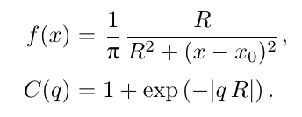
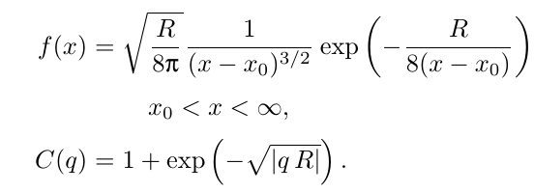
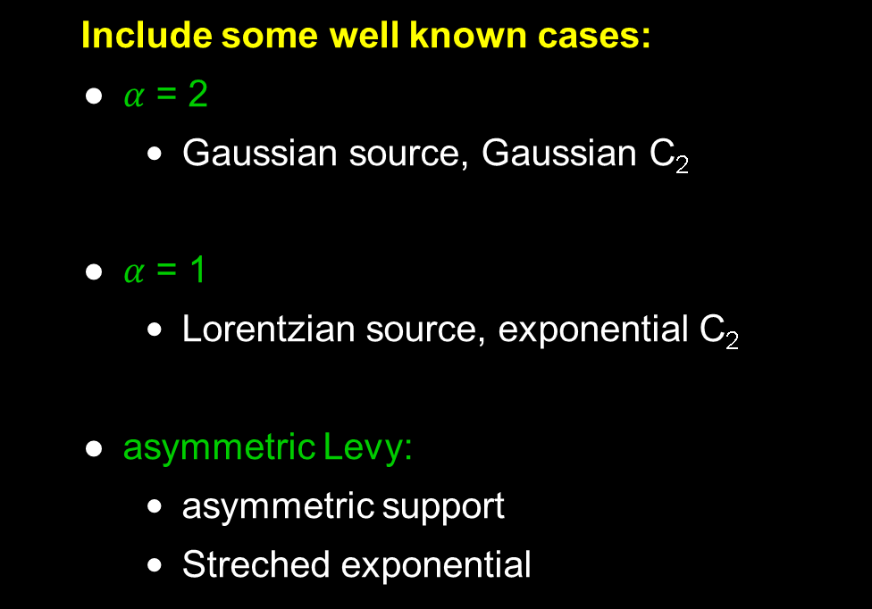
UNIVARIATE LEVY EXAMPLES
Include some well known cases:
  $α$ = 2
    Gaussian source, Gaussian C₂
  $α$ = 1
    Lorentzian source, exponential C₂
  asymmetric Levy:
    asymmetric support
    Streched exponential
T. Cs, hep-ph/0001233, T. Cs, S. Hegyi, W.A. Zajc, EPJ C36, 67 (2004)

Slide 11


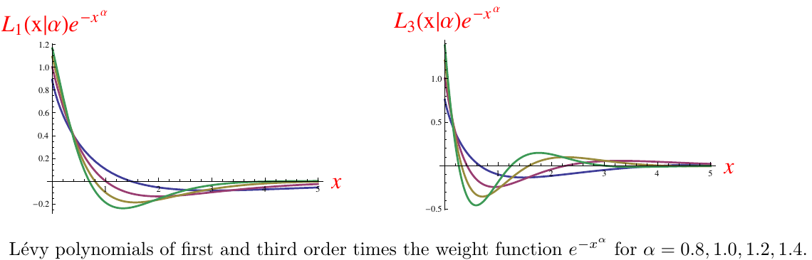

LEVY EXPANSIONS: ~ 1d LEVY
Model-independent but:
  Levy generalizes exponentials and Gaussians
  ubiquoutous in nature
  How far from a Levy?
  Need new set of polynomials orthonormal to a Levy weight
M. de Kock, H. C. Eggers, T. Cs: arXiv:1206.1680v1 [nucl-th]

Slide 12

LEVY EXPANSIONS: ~ 1d LEVY
In case of $α$= 1 Laguerre is ok
These reduce to the
Laguerre expansions and
Laguerre polynomials.

Slide 13
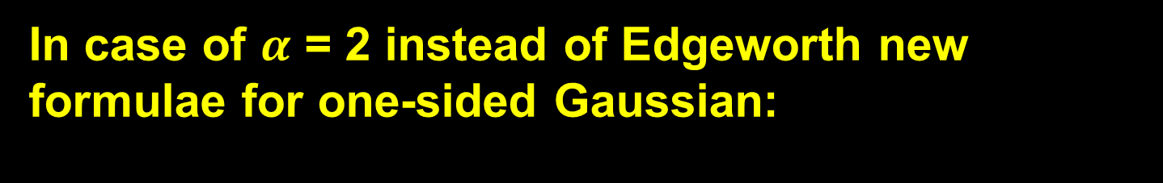
LEVY EXPANSIONS: ~ 1d LEVY
In case of $α$ = 2 instead of Edgeworth new formulae for one-sided Gaussian:
Provides a new expansion around a Gaussian shape
that is defined for the non-negative values of t only.

Slide 14
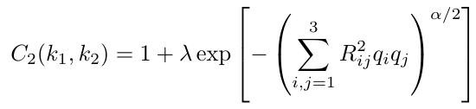
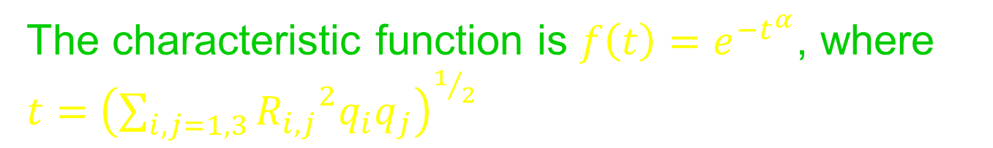

MULTIVARIATE LEVY DISTRIBUTIONS
The characteristic function is $f\left(t\right)=e^{−t^{α}}$, where $t={\left(\sum_{i,j=1,3}{{R_{i,j}}^{2}q_{i}q_{j}}\right)}^{1/2}$
Model-independent but:
  A new parameter alpha generalizes Gauss
  Solved only for symmetric Levy distributions $\left({R_{i,j}}^{2}={R_{j,i}}^{2}\right)$
  Deep open problems in mathematical statistics
T. Cs, S. Hegyi, W.A. Zajc, EPJ C36, 67 (2004)

Slide 15


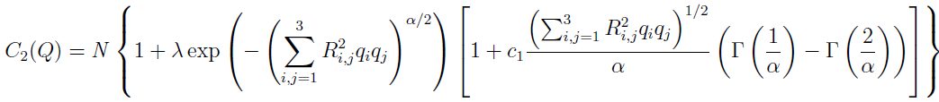
MULTIVARIATE LEVY EXPANSIONS
1st-order Levy expansion
M. de Kock, H. C. Eggers, T. Cs: arXiv:1206.1680v1 [nucl-th]

Slide 16

Possible applications I
Malgorzata’s talk at WPCF2014
$$e_{M}=α/2$$
Levy expansion term could be added.

Slide 17
Possible applications II
Felix’s talk at WPCF2015 (background substraction)
Could be multivariate Levy and
expansion term could be added.
But the form of the background may modify the signal.

Slide 18
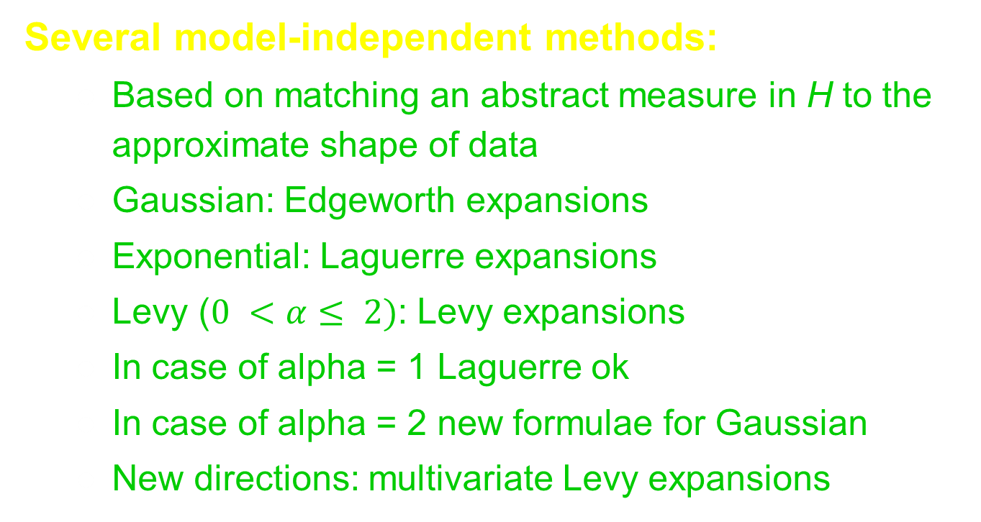
SUMMARY AND CONCLUSIONS
Several model-independent methods:
  Based on matching an abstract measure in H to the approximate shape of data
  Gaussian: Edgeworth expansions
  Exponential: Laguerre expansions
  Levy ($0 <α≤ 2)$: Levy expansions
  In case of alpha = 1 Laguerre ok
  In case of alpha = 2 new formulae for Gaussian
  New directions: multivariate Levy expansions

