Slide 1


Recent PHENIX Results on Bose-Einstein Correlations
T. Csörgő ^{1,2} for the PHENIX Collaboration
¹ Wigner Research Center for Physics, Budapest, Hungary
² KRF, Gyöngyös, Hungary
The PHENIX Experiment
Short summary on HBT Correlations
PHENIX HBT Results on
Comparison of charged pion and kaon femtoscopy
Phys. Rev. C92, 034914 (2015), arXiv:1504.05168
Beam energy and system size dependence of HBT radii
arXiv:1410.2559
Ongoing work: Levy HBT analysis
Summary
For details, see
D. Kincses, for PHENIX
arxiv:1602.04578

Slide 2
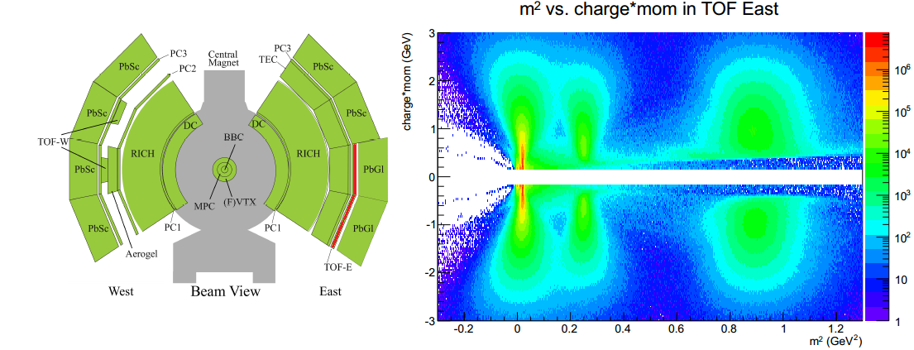
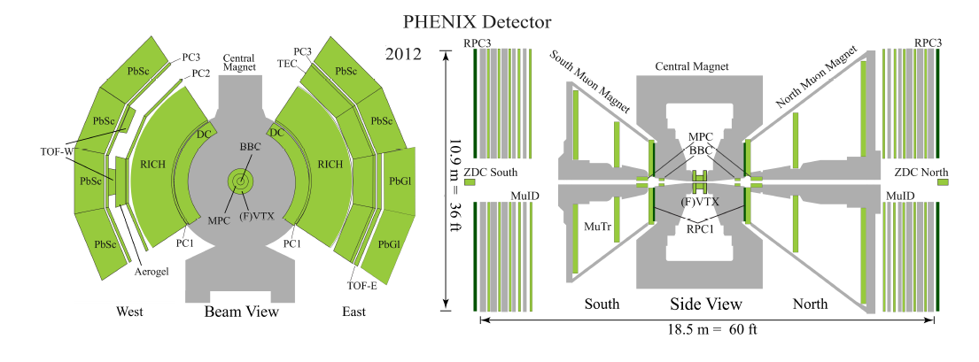
The PHENIX Experiment
Versatility is key to success:
Collisions of pp, d, He, Al, Cu, Au, U
Beam energy scan. from 3.85 to 500 GeV
Charged pion ID from 0.2 to 2 GeV

Slide 3
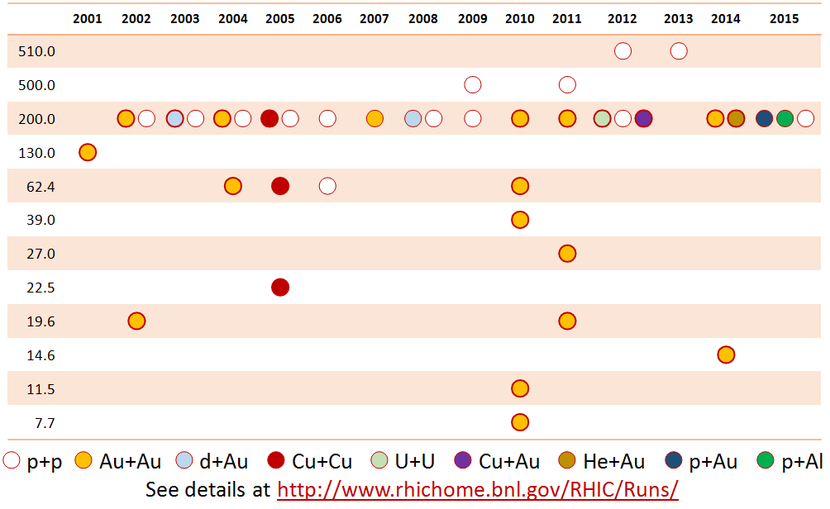
The RHIC Beam Energy Scan

Slide 4
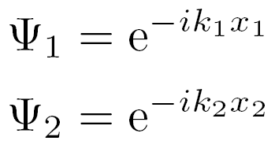
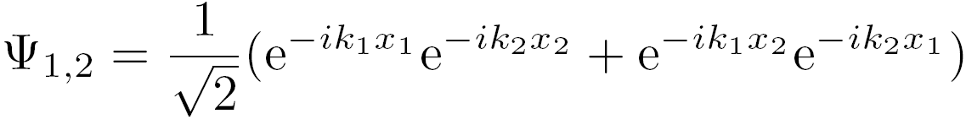

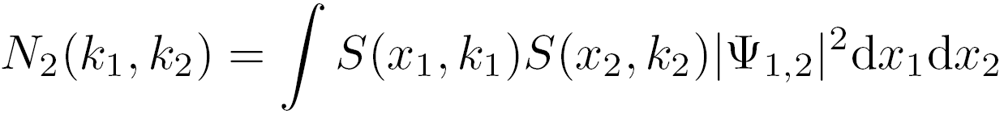
Intro to Bose-Einstein Correlations
source
Two plane-waves:
S(x,k)
x₂
x₁
Bosons: need for symmetrization
Ψ_{1,2}
k₁
k₂
Spectrum:
S(x,k): source function
detector
Two-particle spectrum (momentum-distribution):

Slide 5
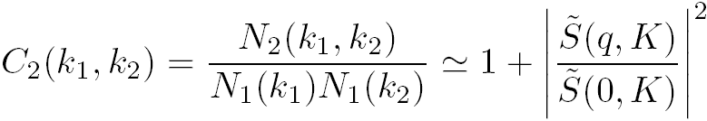
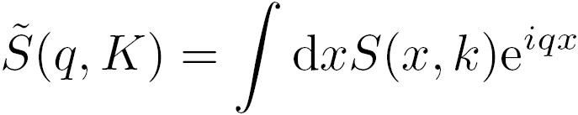
Intro: Bose-Einstein Correlations
Now the invariant correlation function
  Depends on relative and average momenta
Uses Fourier-transformed of the source
We can figure out something about the source!
  In fact, for long times, this was the ONLY tool for mapping the source-function, and it is still unique today
Sometimes this 1+positive definite form fails
(e.g. L3 and CMS data, see also W.Metzger’s talk)

Slide 6
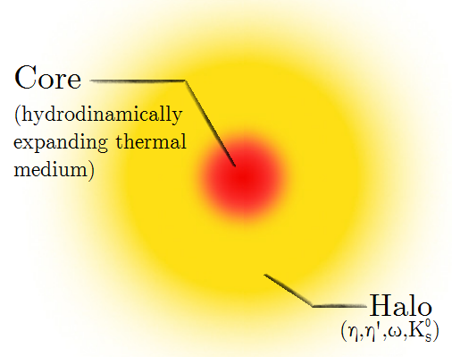
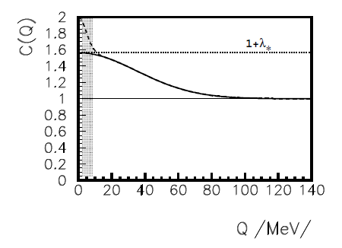
Core-halo picture, resonances, FSI
Final state interactions distort the simple Bose-Einstein picture
identical charged pions - Coulomb interaction
different methods of handling, an usual practice: Coulomb-correction
CBE(q) = K(q) Cmeasured(q)
An other possibility to fit with the effect incorporated in the fitted func.
Pions from long lived resonances reduce BE correlations
S = SC + SH
Primordial pions: Core < 10 fm
Pions from long lived resonances: Halo – unresolvable peak at low q
J. Bolz et al, PRD47 (1993) 3860-3870, T. Cs, B. Lörstad, J. Zimányi, Z. Phys. C71 (1996) 491

Slide 7
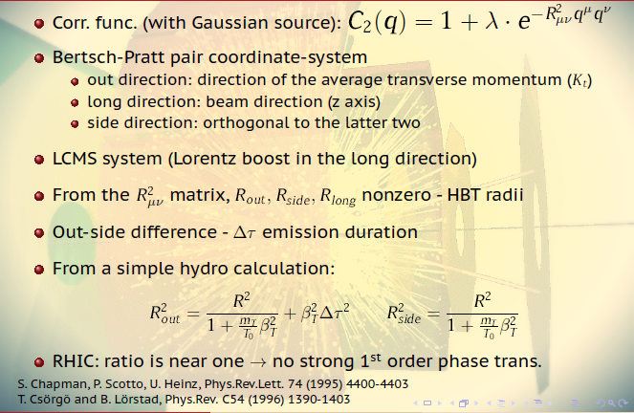
Out-side-long HBT radii, LCMS

Slide 8
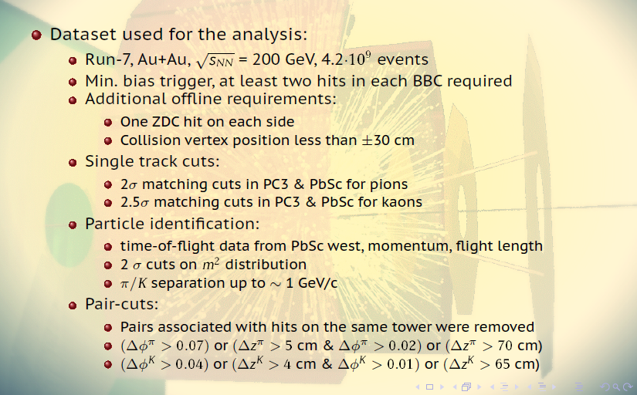
Comparison of charged pion and kaon femtoscopy
Phys. Rev. C92, 034914 (2015), arXiv:1504.05168

Slide 9
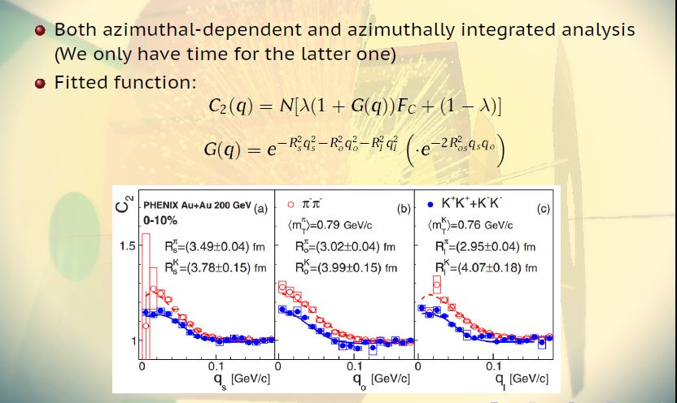
Comparison of charged pion and kaon femtoscopy
Phys. Rev. C92, 034914 (2015), arXiv:1504.05168

Slide 10
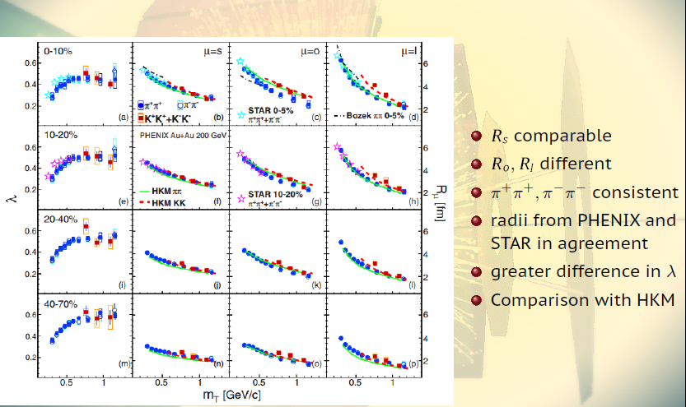
Comparison of charged pion and kaon femtoscopy
Phys. Rev. C92, 034914 (2015), arXiv:1504.05168

Slide 11
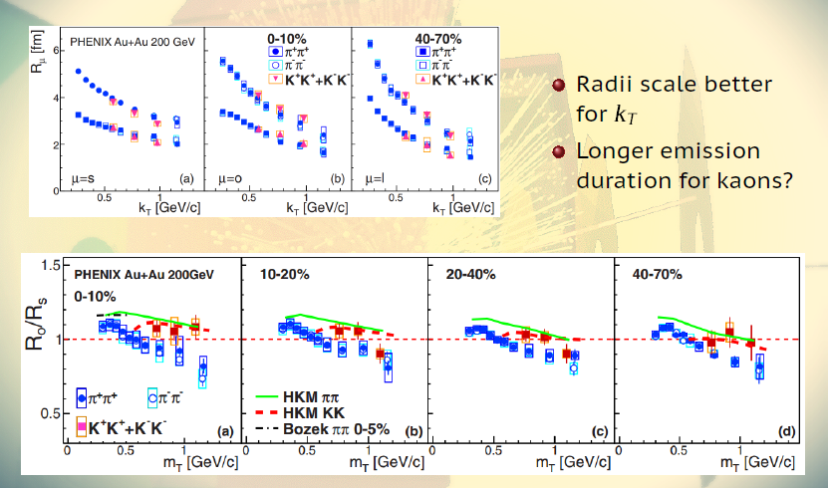
Comparison of charged pion and kaon femtoscopy
Phys. Rev. C92, 034914 (2015), arXiv:1504.05168

Slide 12
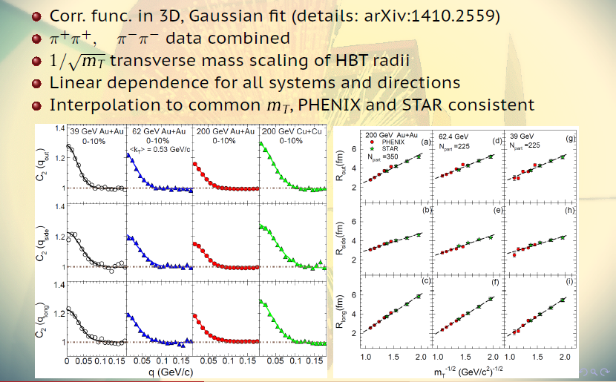
Beam energy and system size dep. of HBT radii
arXiv:1410.2559

Slide 13
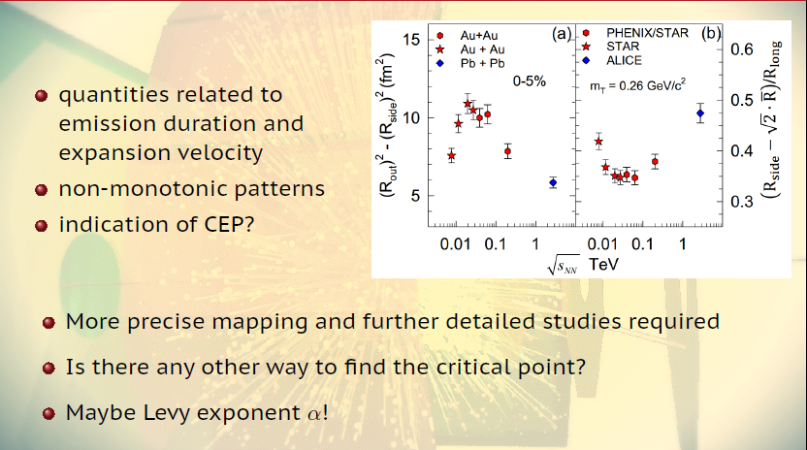
Beam energy and system size dep. of HBT radii
arXiv:1410.2559

Slide 14
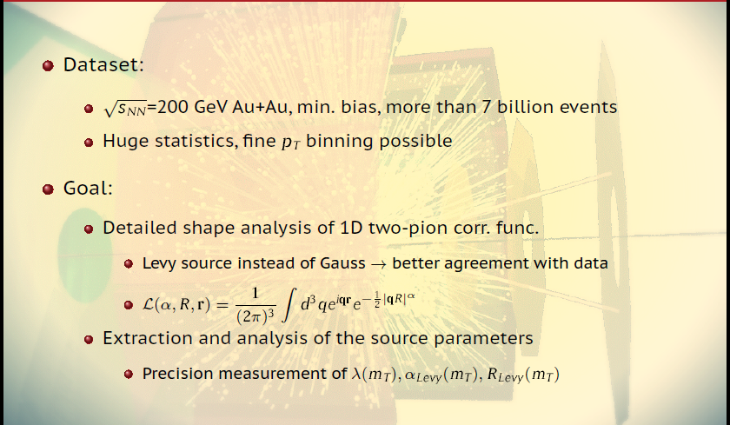
Ongoing work: Levy analysis in PHENIX
(M. Csanád, D. Kincses, M. I. Nagy, T. Novák, W. Metzger, R. Lacey)

Slide 15
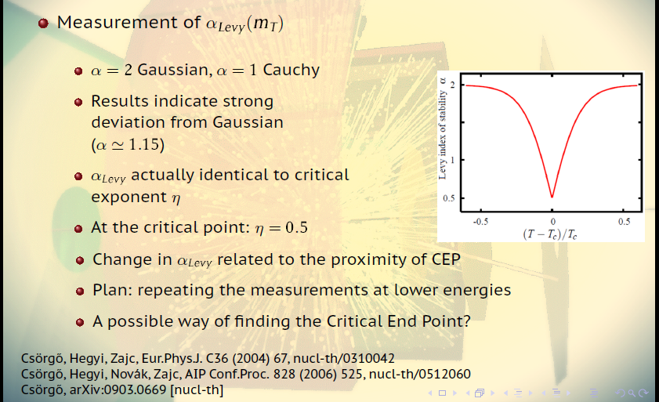
Ongoing work: Levy analysis in PHENIX

Slide 16
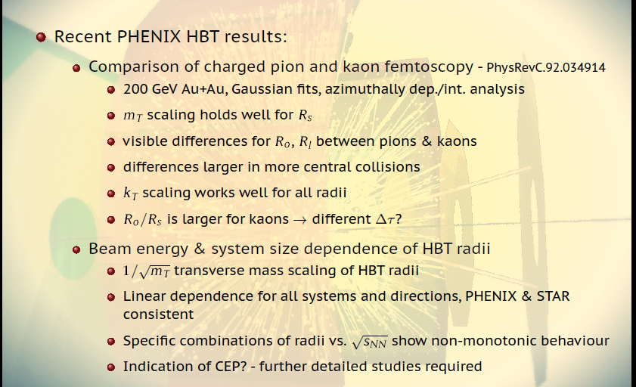
SUMMARY: RECENT BEC RESULTS FROM PHENIX

Slide 17
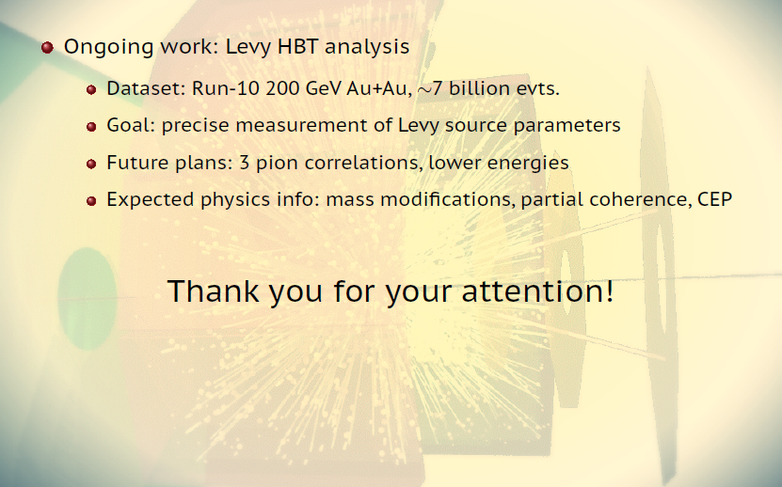
SUMMARY II: ONGOING WORK IN PHENIX

Slide 18
Questions?

Slide 19







Intro: Bose-Einstein Correlations

