Slide 1

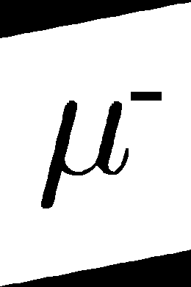
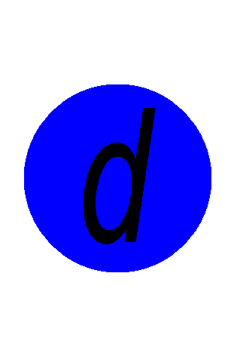
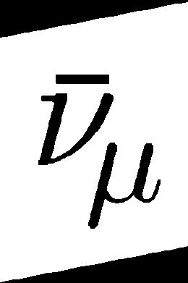

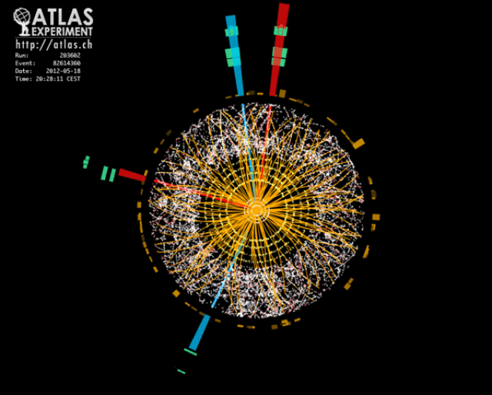
HIGGS BOSON, MADE AT HOME
& Particle Hits!
T. Csörgő^{1,2}, T. Novák², A. Sveiczer³
Wigner RCP, KRF and ELTE
arXiv:1303.2732 [physics.pop-ph]
arXiv:1303.2798 [physics.pop-ph]
+ manuscript in preparation

Slide 2
Home, sweet home
In Hungary: Alma MATer = SECONDARY SCHOOL
Motivation: Observation of decline of science and math education in Hungary (~ radical decrease of hours)
No time to wait – children are growing up (ours too…)
Science Club in Berze Middle School,Gyöngyös, Hungary -
„BerzeTÖK” re-organization
Self-organized:
Patron scientist, teachers, parents, STUDENTS
Forum for student excellence
teachers update
inspired scientists
Friday afternoons
math + physics + sciences + culture
Annual summer camps, 2008-
http://sites.google.com/site/berzetok/

Slide 3
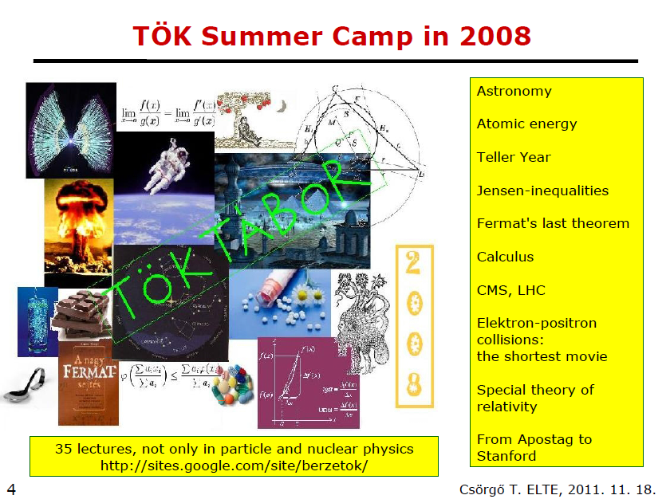
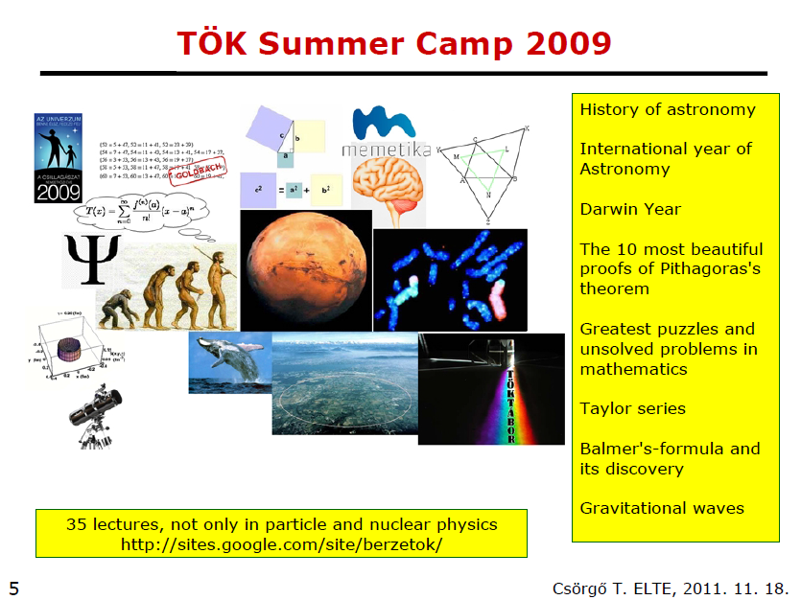
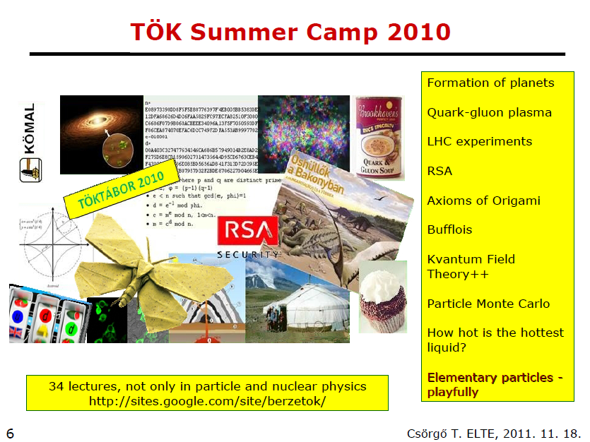
Hungarian science clubS

Slide 4
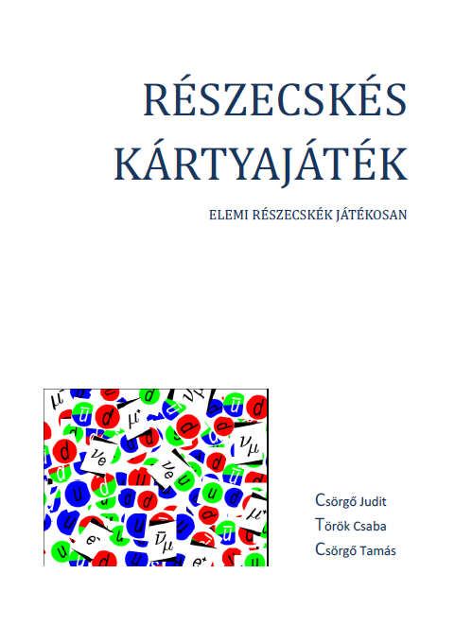
STUDENT IDEA: PARTICLE CARDS
By now:
INNOVATION, PATENT, PRODUCT
66 cards, first 4 games:
  ANTI
  Let us detect!
  Quark Matter (BNL)
  Cosmic Showers
1st edition: an e-book for
„Meet the Scientist” opening talk
Hungarian → English, online at
http://www.lulu.com/

Slide 5
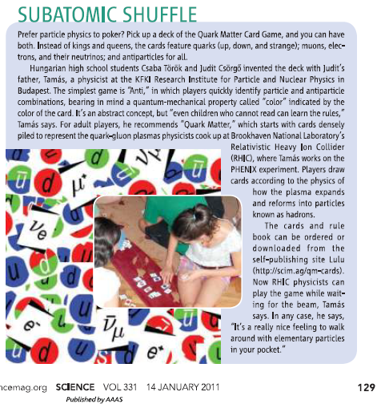
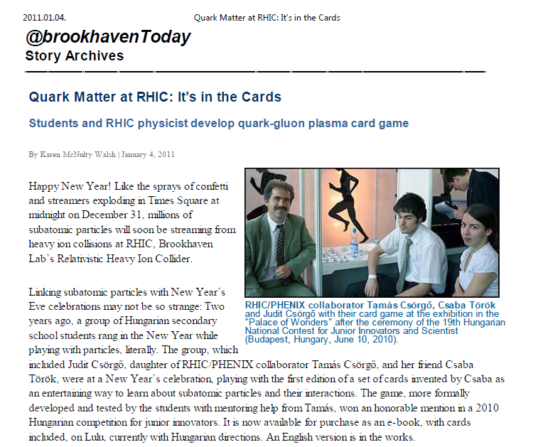
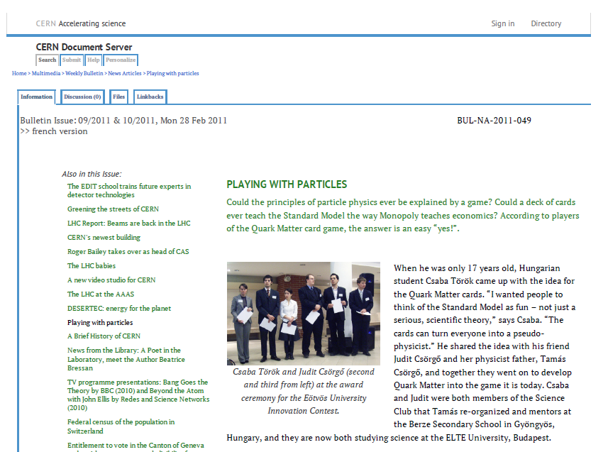
international publicity
Test based awards

Slide 6
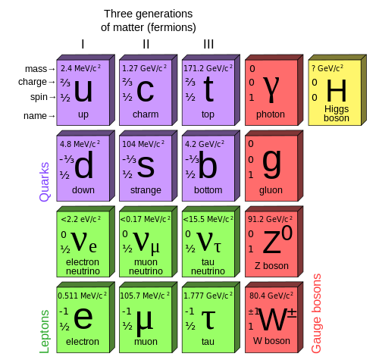




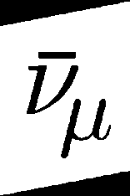
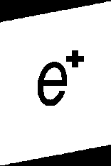
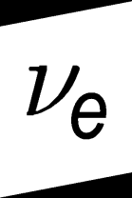
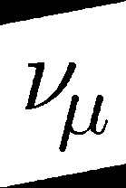
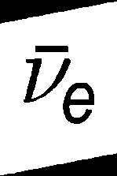

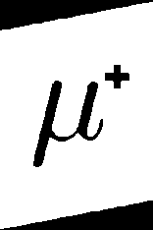
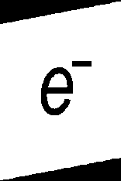
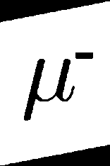
ELEMENTARY PARTICLES
- PLAYFULLY
ANTI-
PARTICLES

Slide 7




SU(3) COLOR AND OPTICAL COLOR
Mesons
(Anti)baryons

Slide 8
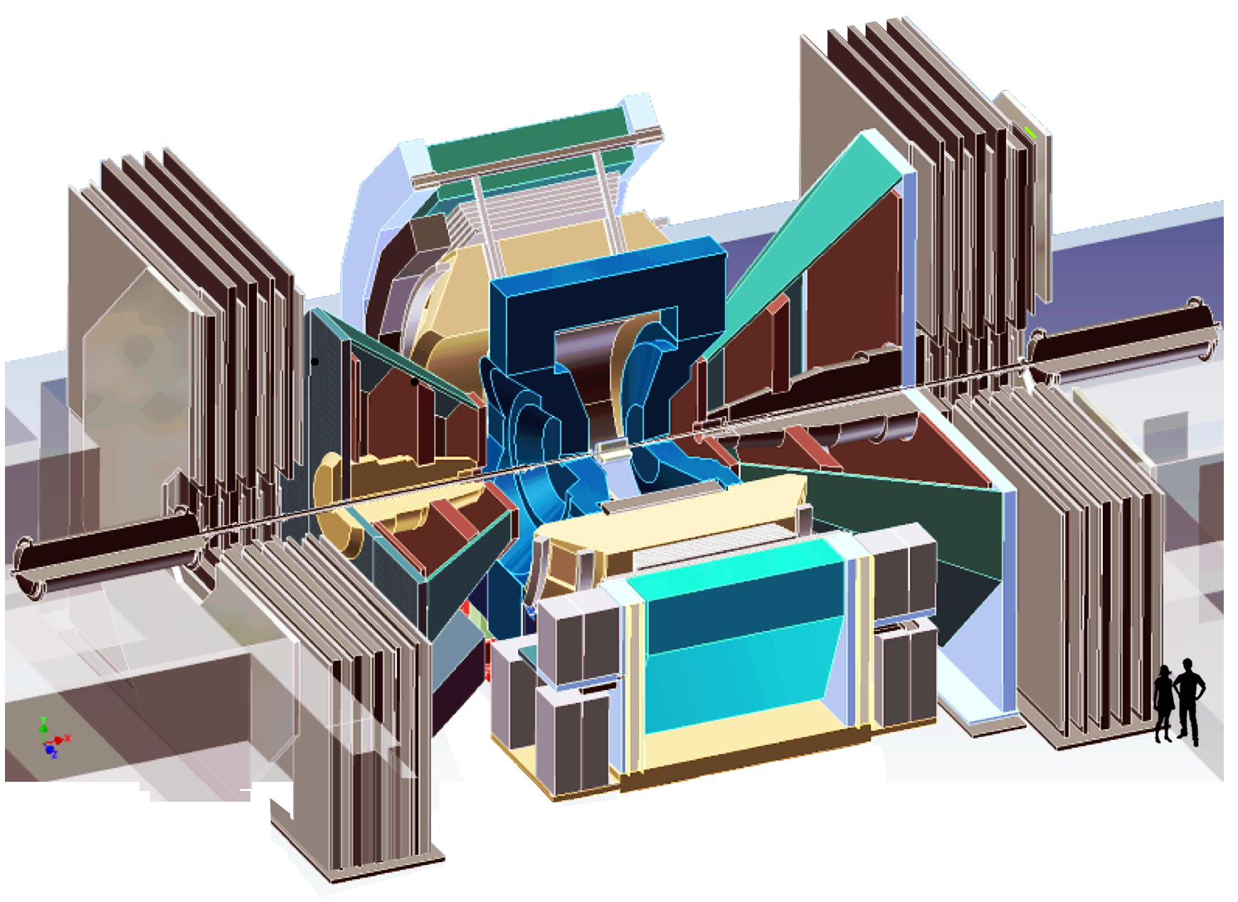
PHENIX EXPERIMENT AT RHIC
QUARTER CUT VIEW

Slide 9
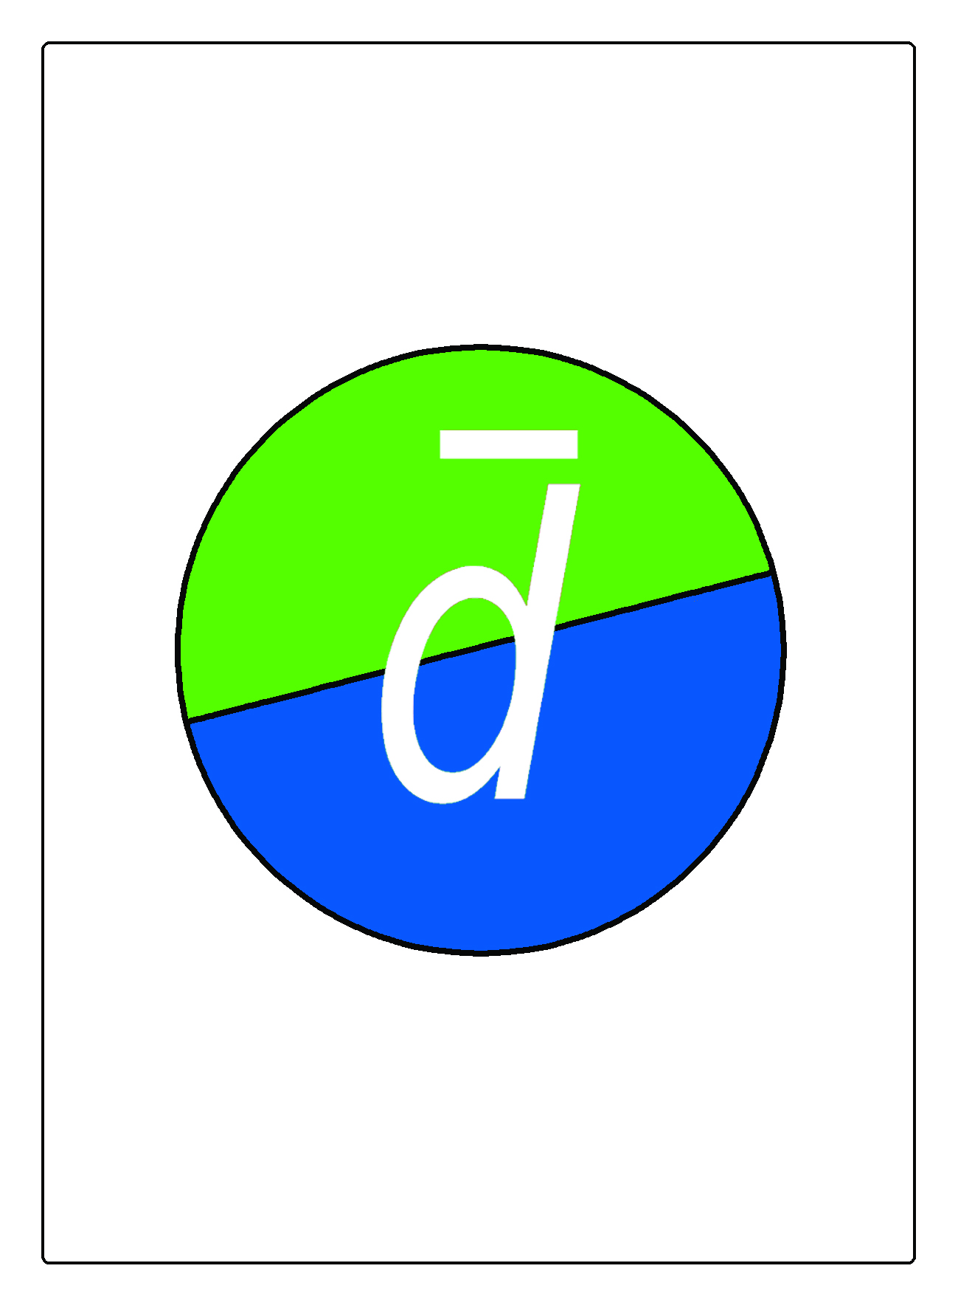
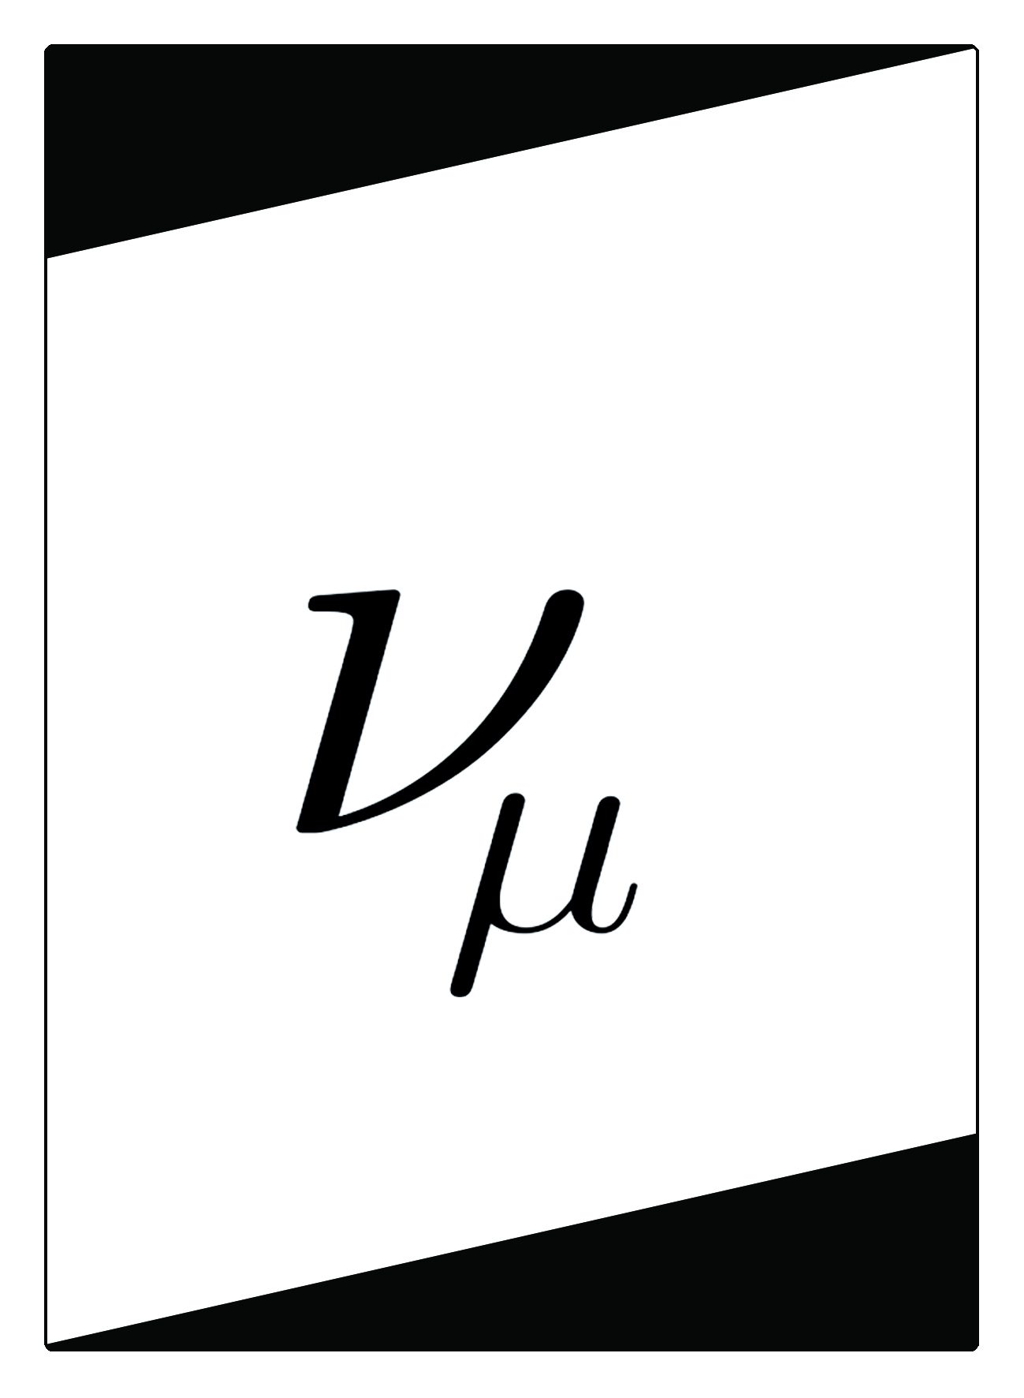

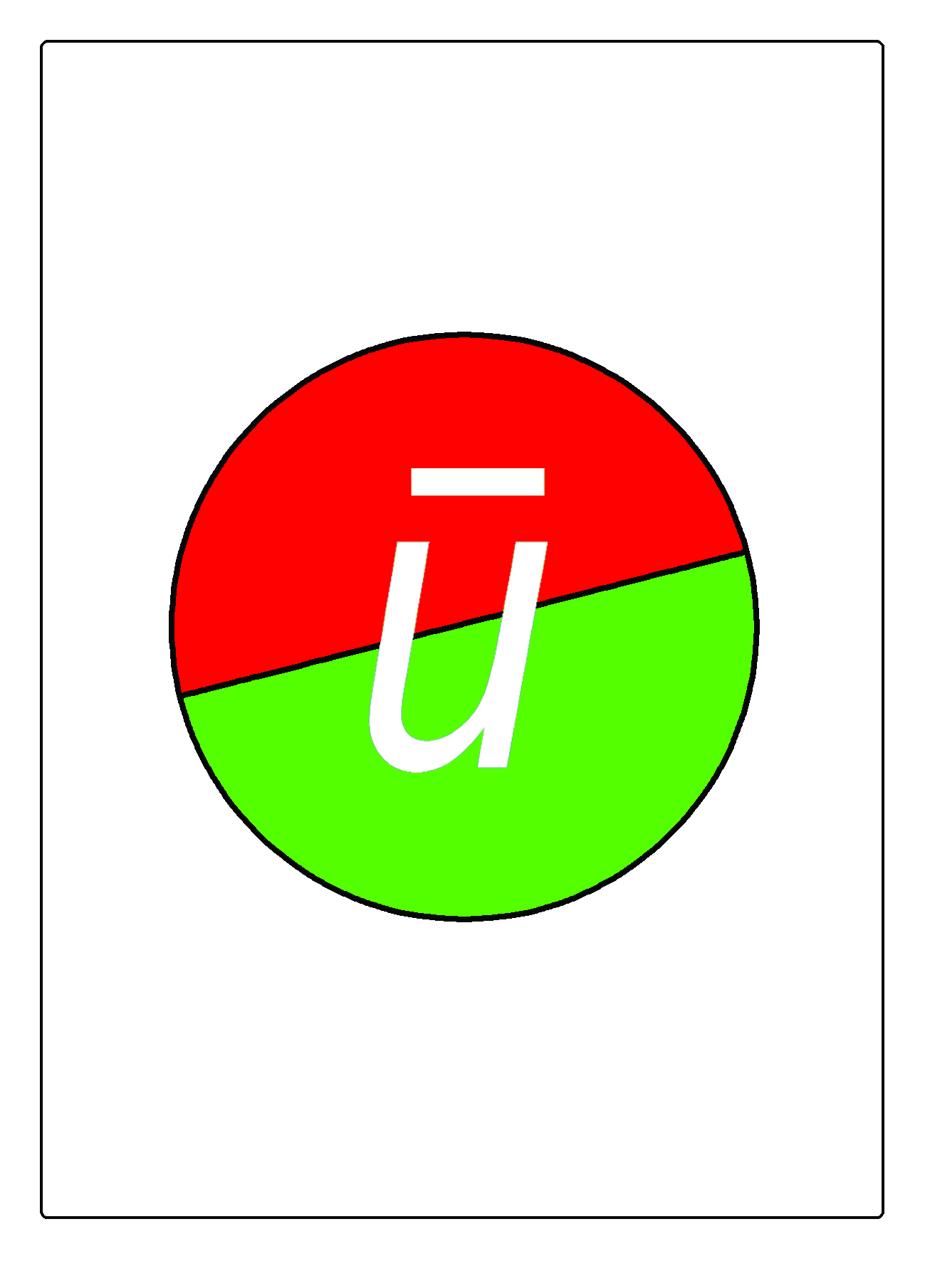
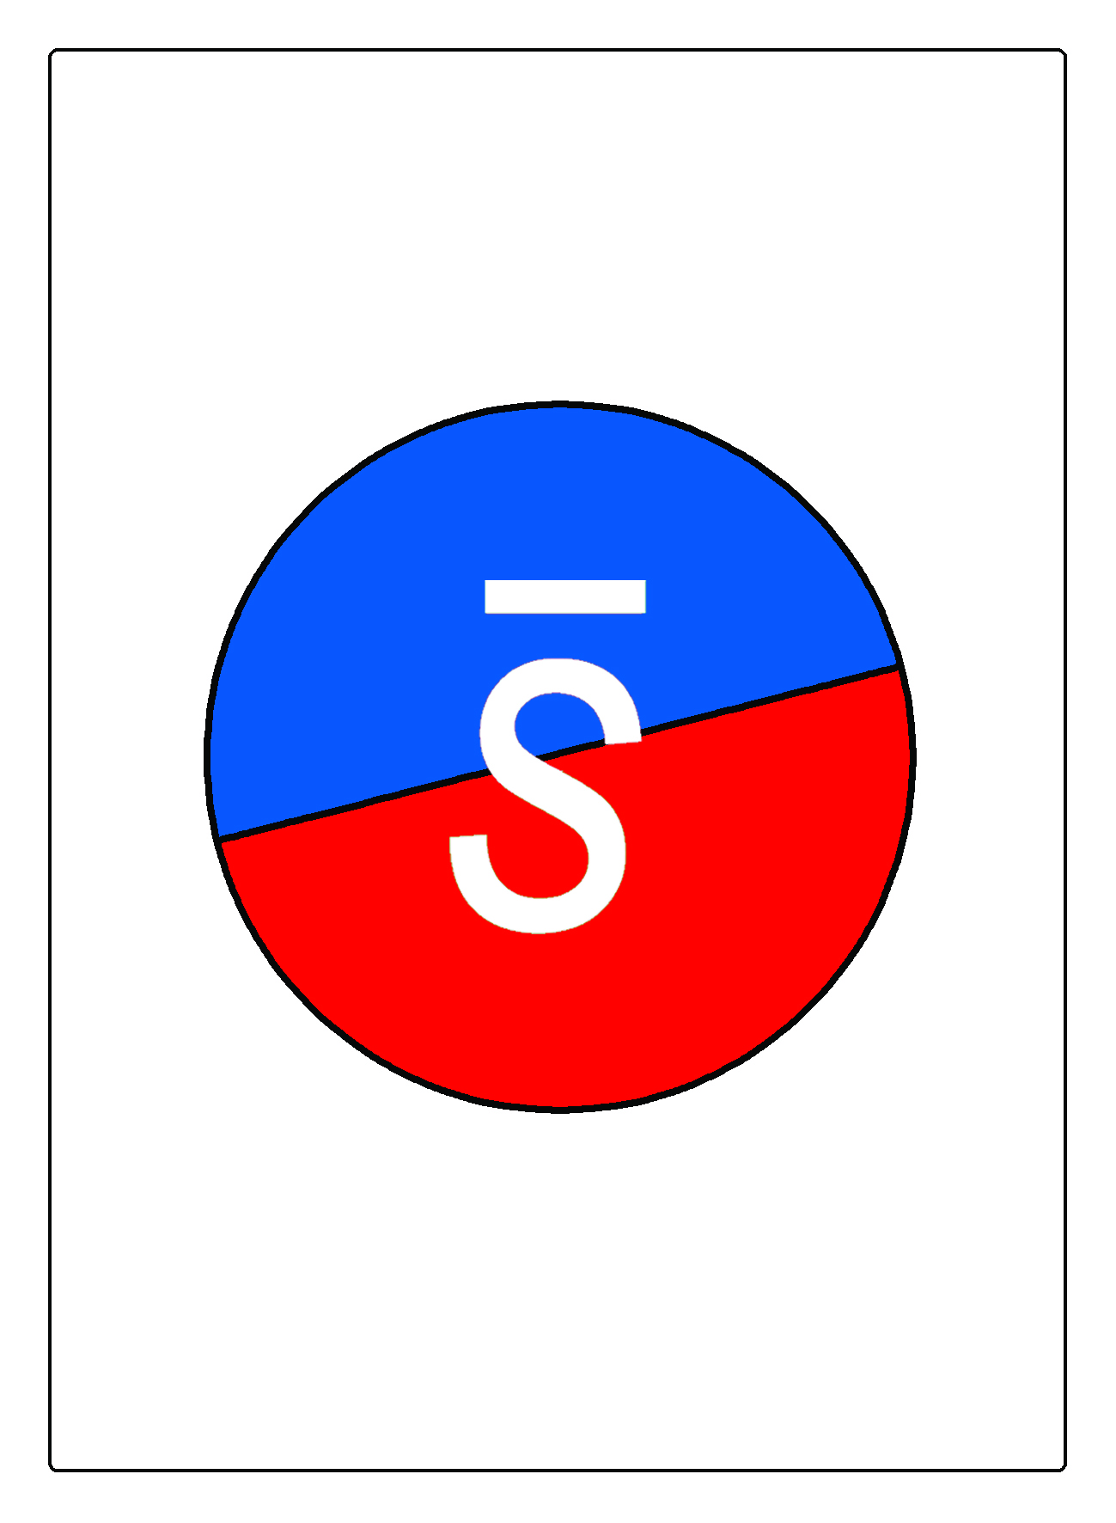

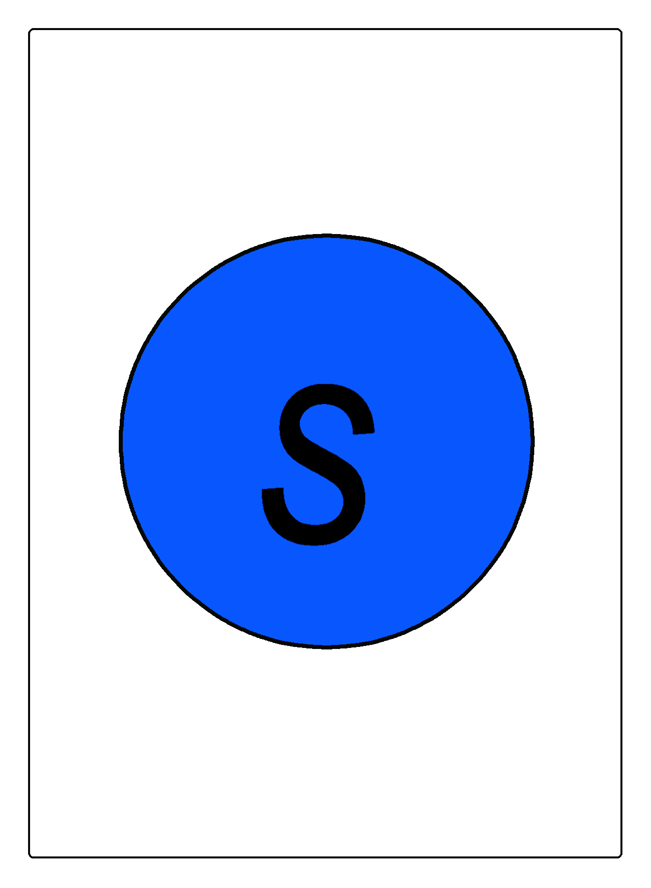

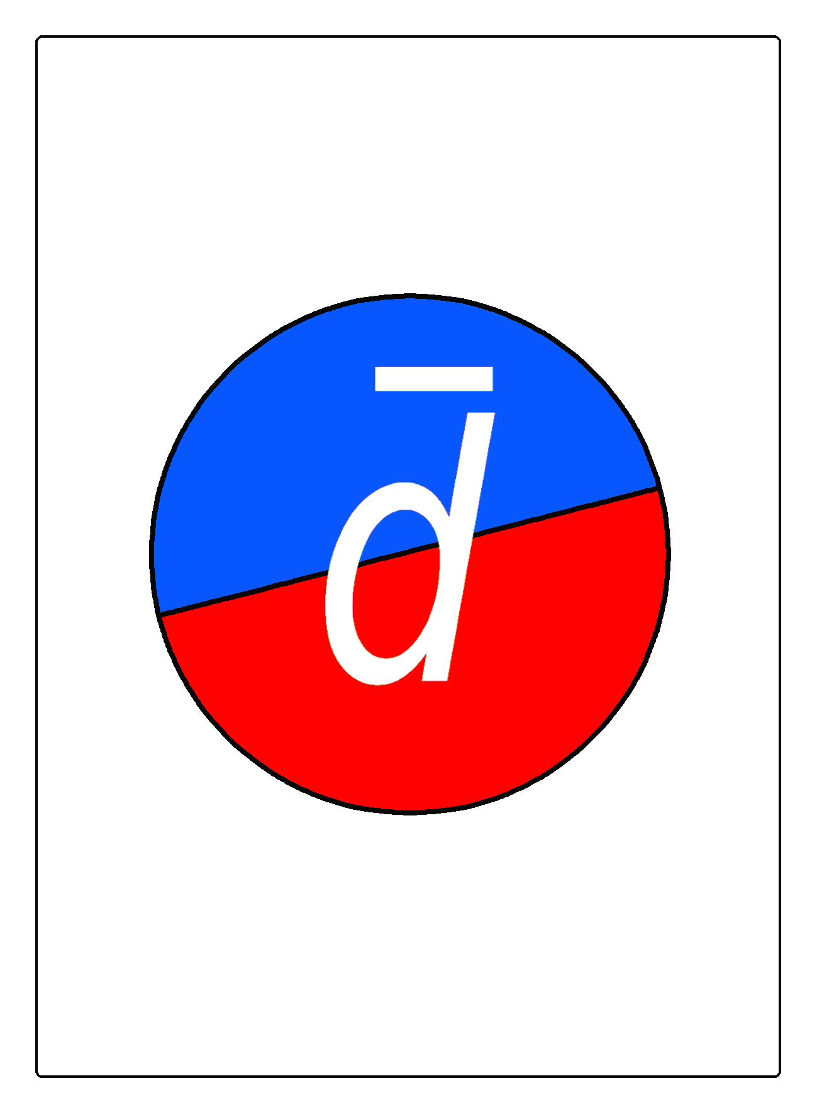
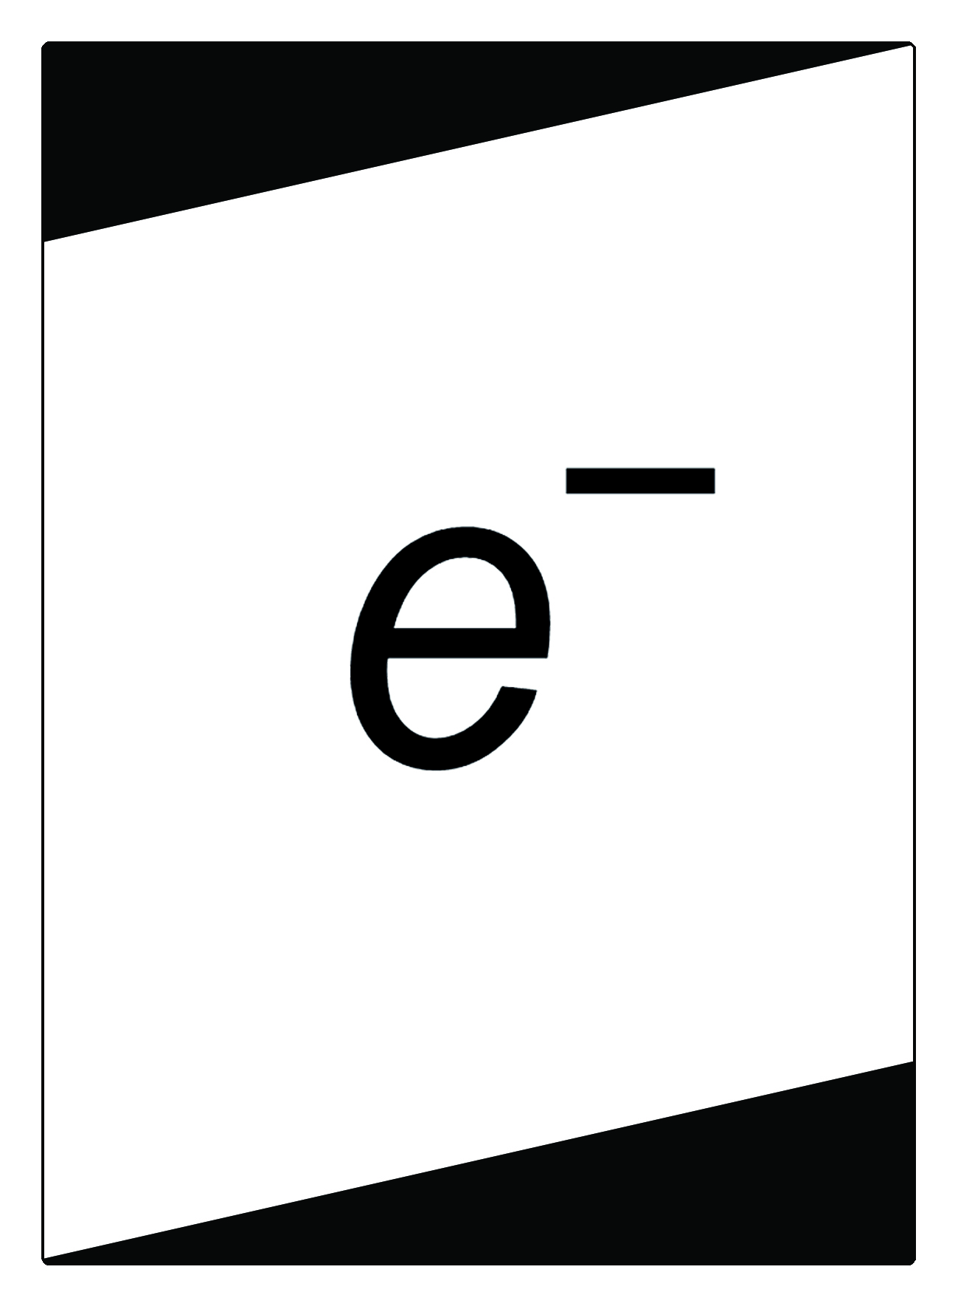
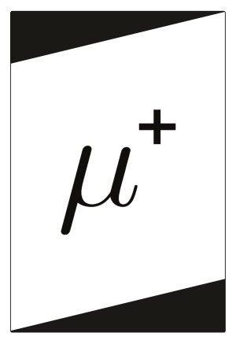
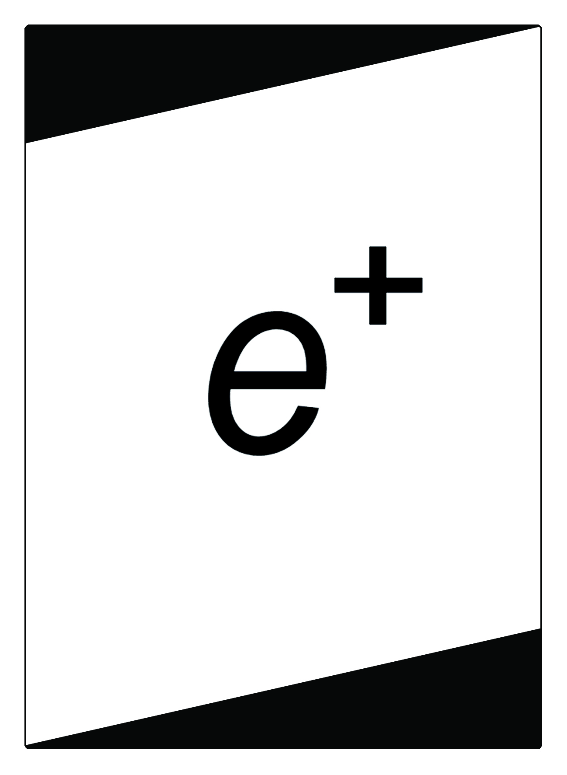
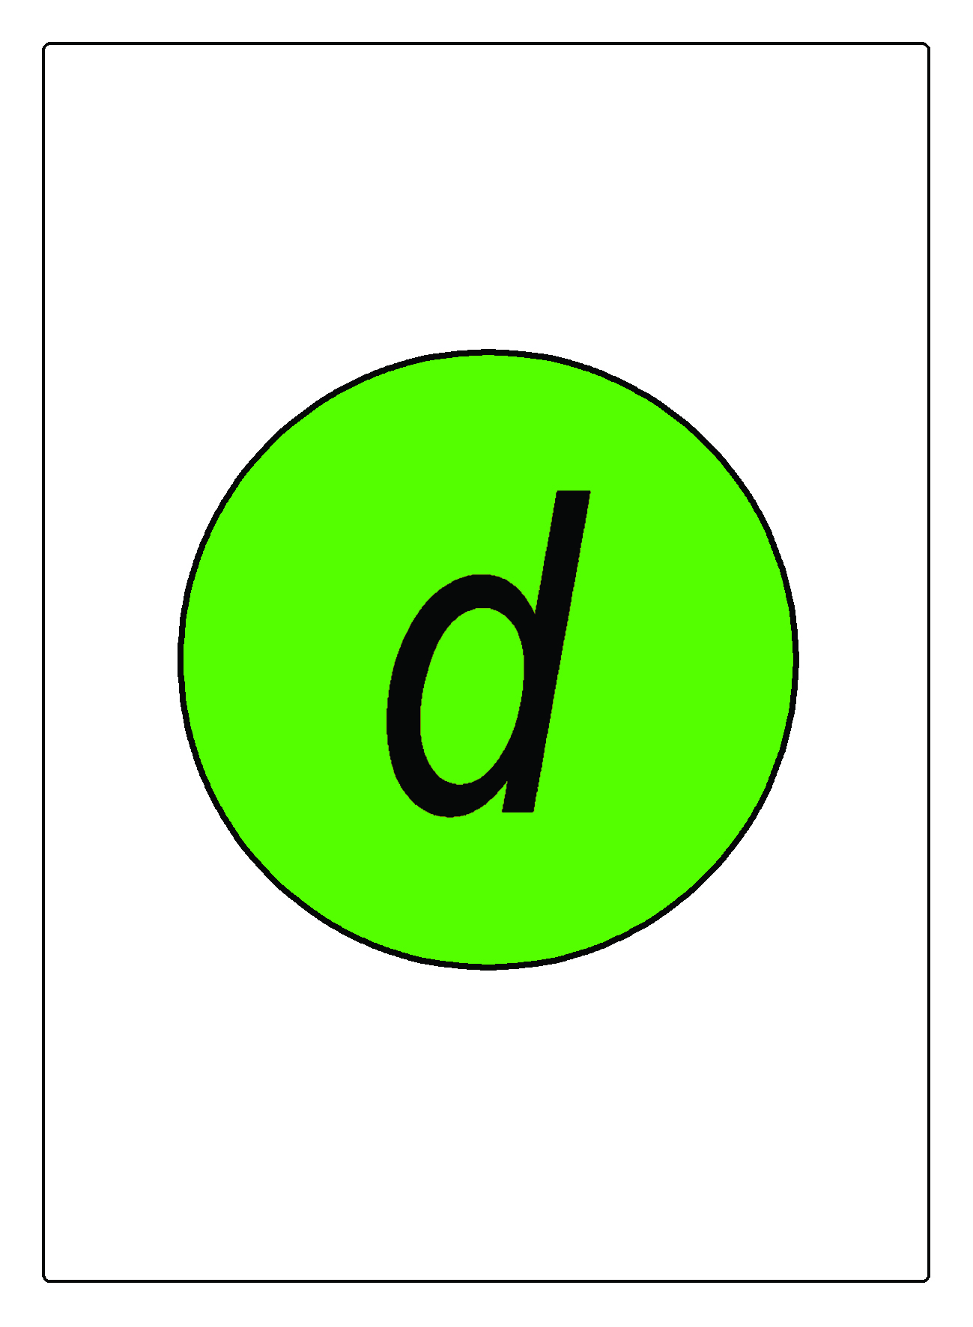
FIND QUARK MATTER WITH PHENIX
- MAHJONGG STYLE, PLAYFULLY
3
3
3
3
3
3
3
3
3
3
3
3
3
3
3
3
3
3
3
3
3
3
PHENIX: 22 x 3 = 66

Slide 10
QUARK MATTER WITH PHENIX
- MAHJONGG STYLE, PLAYFULLY
3
3
3
www.phenix.bnl.gov
3
3
3
3
3
3
3
3
3
3
3
3
3
3
3
3
3
3
3
PHENIX: 22 x 3 = 66
PHENIX: 22 x 3 = 66

Slide 11
HIGGS BOSON - EXPERIMENTALLY
Discovery in 2012-2013 by
ATLAS and CMS at LHC, CERN
PUBLICITY ALL OVER THE WORLD
2013 Nobel Prize in Physics to 2 theorists,
Peter Higgs and Francois Englert
11 | 17

Slide 12
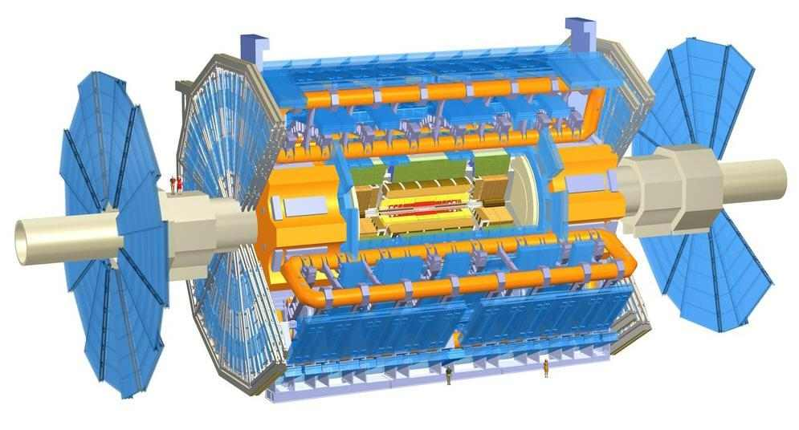
ATLAS @ LHC, MAHJONGG STYLE
4
4
4
4
4
4
3
4
4
4
3
4
4
4
4
4
4
ATLAS: 3 x 5 x 4 + 2 x 3 = 66

Slide 13
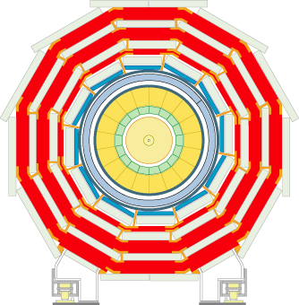
CMS @ CERN LHC
5
5
5
5
5
5
3
3
5
5
5
5
5
5
CMS: 2x3 + 12 x 5 = 66

Slide 14

FIND A LEPTON-PAIR

Slide 15
FIND A MESON

Slide 16
FIND A BARYON

Slide 17
FIND AN ANTI-BARYON

Slide 18
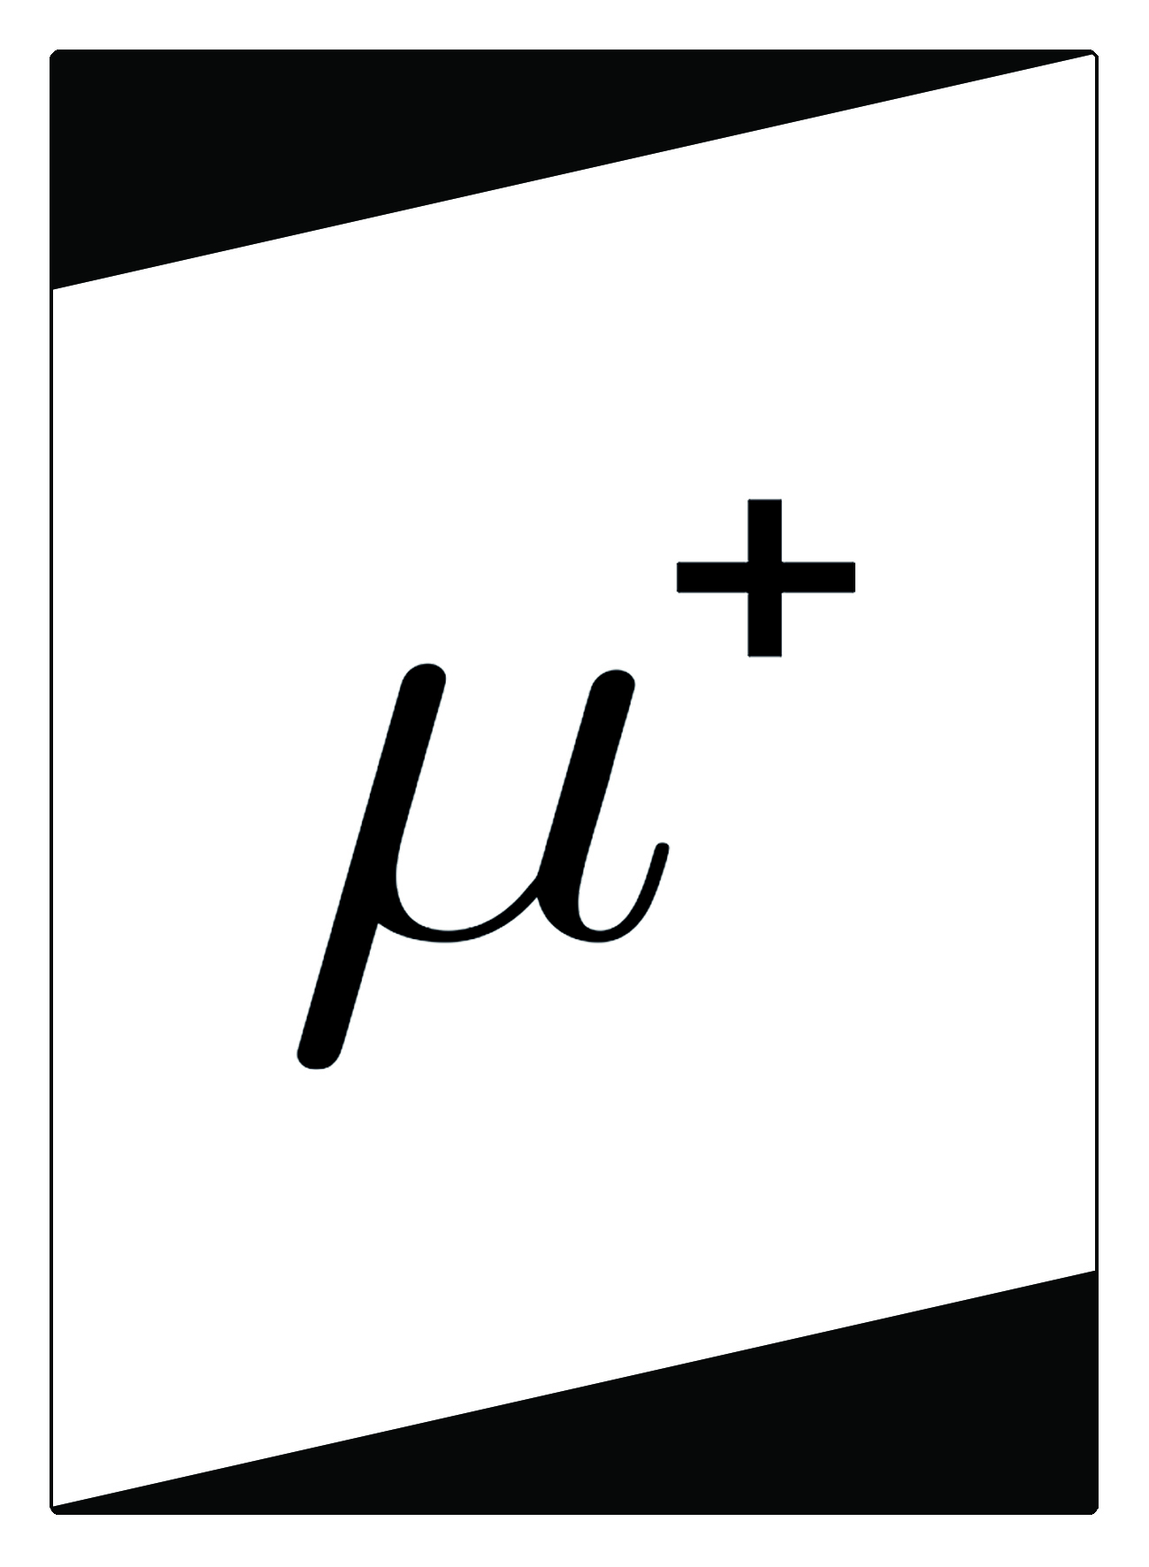
FIND YOUR HIGGS: H⁰ → Z⁰Z⁰ → l⁺l⁻ l⁺l⁻

Slide 19
PARTILE Hits!

Slide 20
CARD GAMES WITH parTiCLES
4 basic games described first:
  1. ANTI
  2. Cosmic Showers
  3. Let’s Detect!
4. Quark Matter
2 new games at 2012 Zimányi Winter School on Heavy Ions
  Memory of Quark Matter: http://arxiv.org/abs/arXiv:1303.2798
  Higgs boson – on your own http://arxiv.org/abs/arXiv:1303.2732
  → Quark Matter Card Game, 3rd English Edition, May 2013
4 additional new gard games
  7. Lang, Ágota: Természet Világa, March 2013 p. 121. (in Hungarian)
  → Quark Wars (T. Cs, T. Novák)
  8. L. P. Csernai, T. Csörgő, M. Vargyas: Particle Poker
  (Academia Europaea, Bergen, Sept. 2012,
  Summer Camp, Berze Science Club, Visznek, Hungary, 2013)
  9. T. Novák, T. Csörgő: Particle 66
  (Summer Camp, Berze Science Club, Visznek, Hungary)
3 additional new (card) games
10. Find Quark Matter with PHENIX – Mahjongg Style (2013)
11. Quark Matter on Rubik’s 3x3 – Perfect Fluid (WPCF 2014, KRF, Gyöngyös)
12. Particle Hits! – from 3 years up (CERN@Wigner Open Days, 2014) …

Slide 21
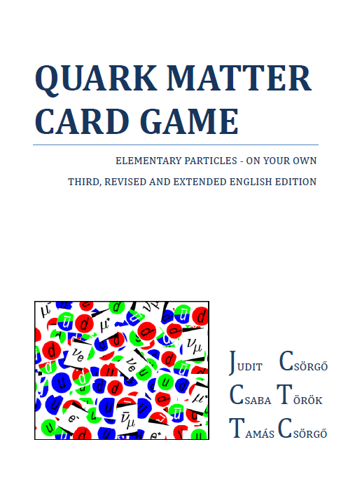
SUMMARY
Science Club + PHENIX + …
Student and science outreach project:
innovation, patent, product
2013: 2 open access science games
2016: 12+ science games, cards + twisting
Successfull test sales in Hungary and also at
BNL (USA)
CERN (Switzerland)
KEK (Japan)
YOUR outreach support requested
To reach out, really…
Thank you for your attention!

