Slide 1
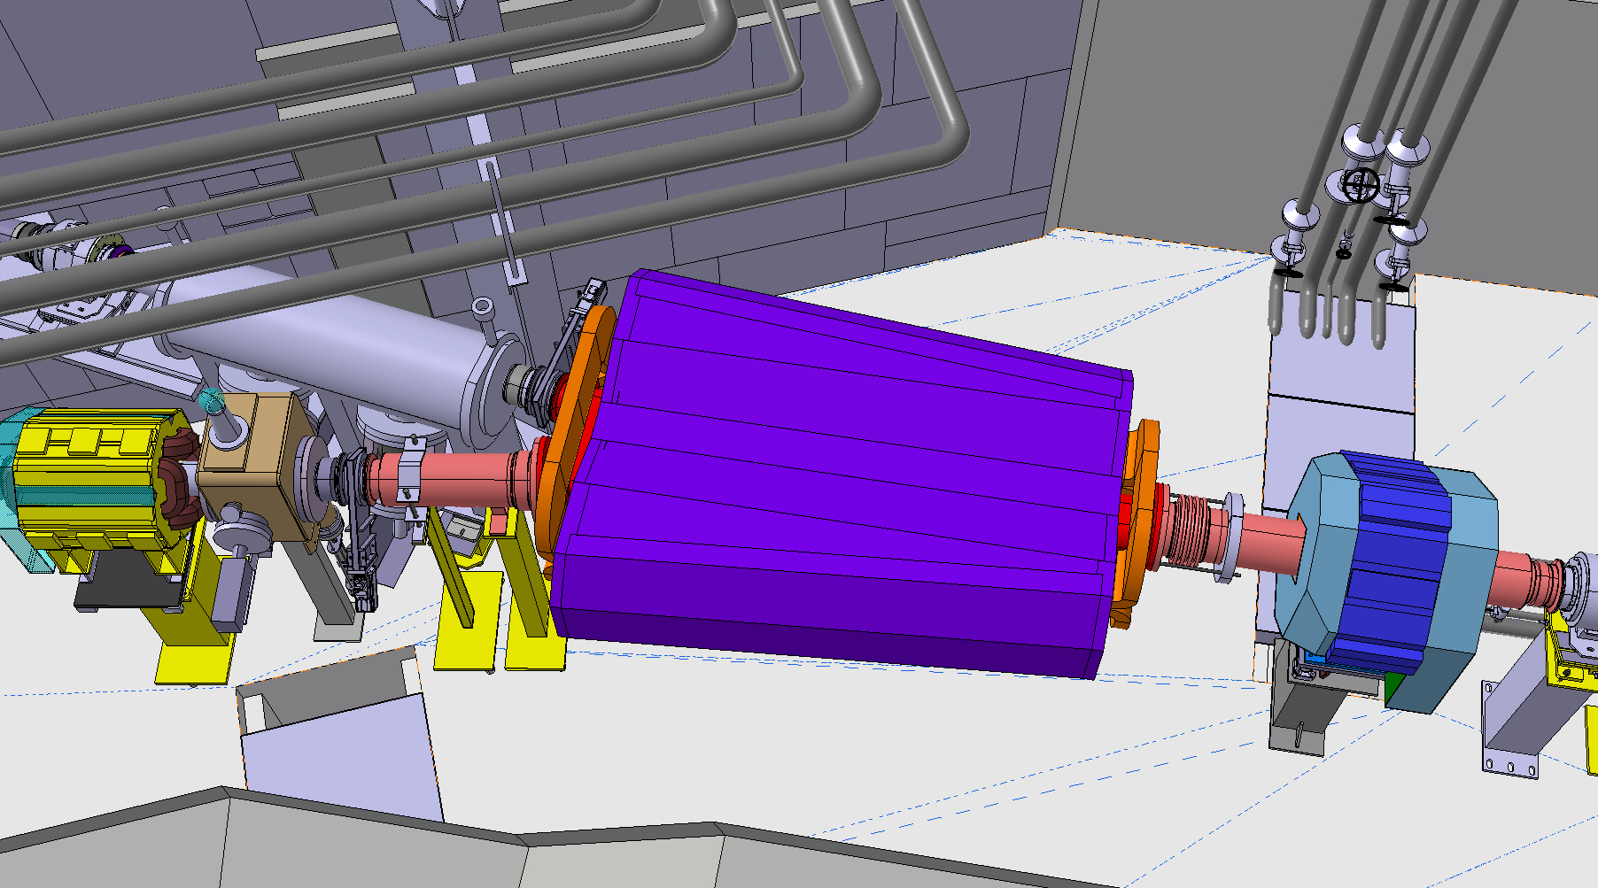
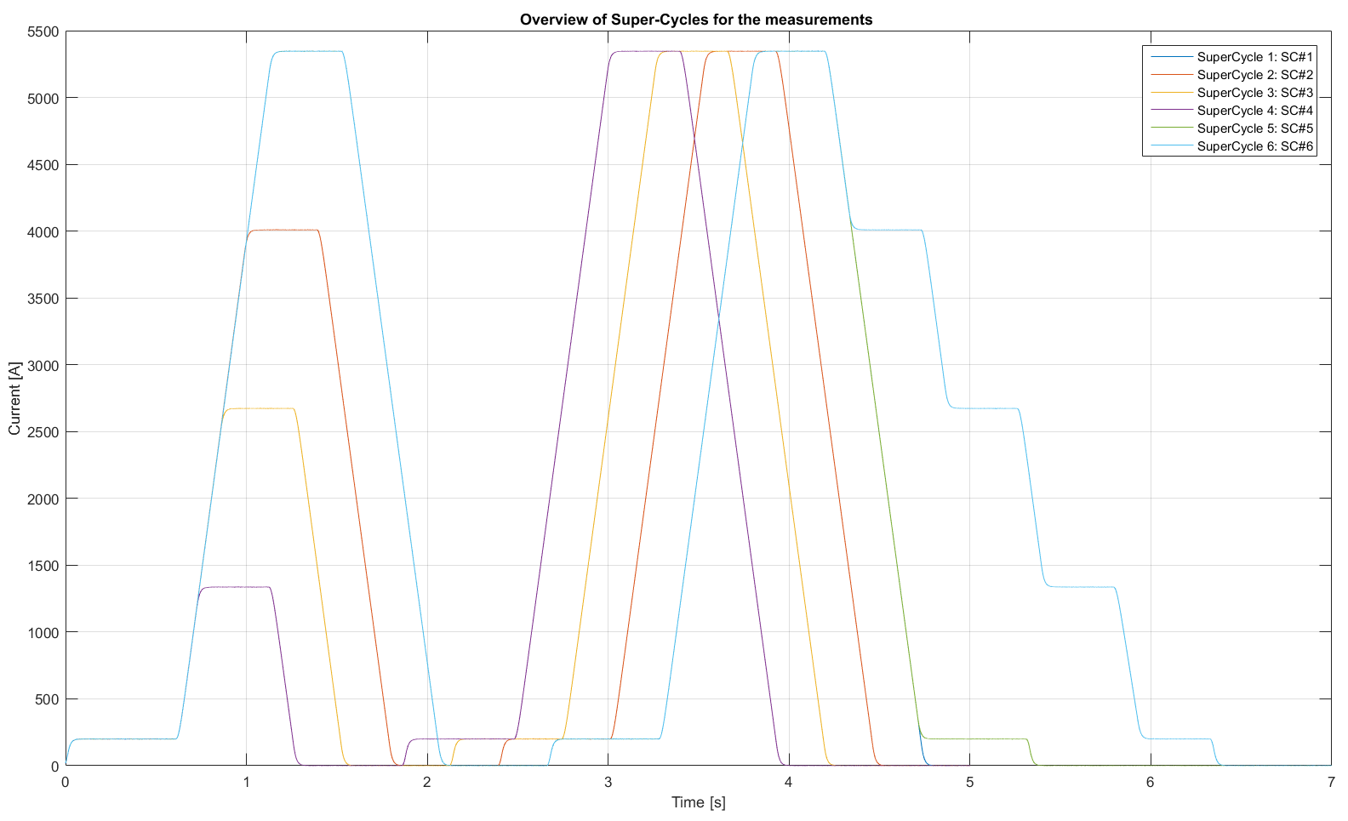
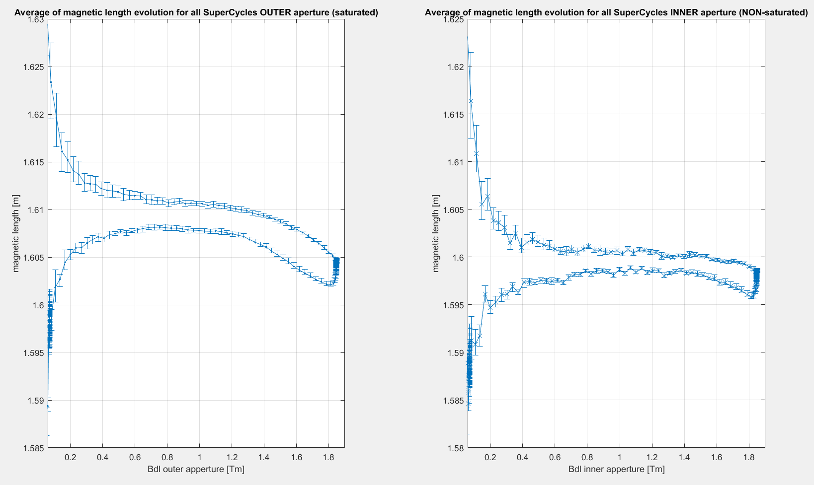
Field Control of TL Switching Dipole
Expected issues:
- history-dependence (∼10⁻³ at low field)
- Compounded by asymmetric field profile →
complex hysteresis and eddy currents patterns
- More difficult to measure and simulate
Variability due to cycling
Main dipole unit test supercycle (different combinations of energy levels in succession)

Slide 2
Possible control strategies
Feed-forward current control: test on the bench, then apply a ΔI taken in real-time from a table:
ΔI = f (E_{current cycle}, E_{last cycle} ) (4 combinations)
ΔI = f (E_{current cycle}, E_{last cycle} , E_{second-to.last cycle} ) (16 combinations)
Possible problems: complex, new energy levels require re-measurement
Field feedback control
Hall probe → FGC3 controller (as in HIE ISOLDE bendings): at best few 10⁻⁴, must be tested
NMR teslameter → Java application (as in ISOLDE HRS): too slow
NMR teslameter → FGC3 controller: planned, but does not exist yet
Full fledged B-train → FGC3 controller: safest solution, subset of the ring system, requires new PCB coils + one field marker
2 X 1 mm thick PCB integral coils
magnet gap

