Slide 1
BE-ABP Information meeting – 31/03/2016

Slide 2
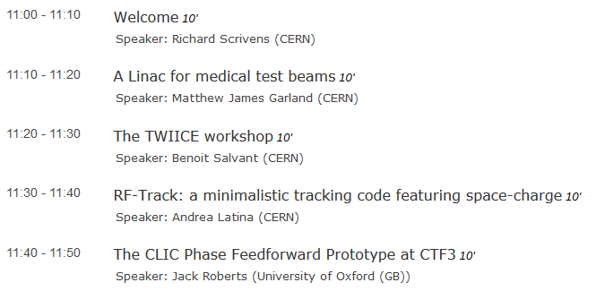
Agenda for Today

Slide 3
New Arrivals
Noé FERNANDEZ ALVAREZ LAT
Davide GAMBA LAT
Enrico MANOSPERTI LAT
Mauro MIGLIORATI HSC
Alexandra TESKA HSS
Marco VALDIVIA GARCIA HSS

Slide 4
Next Meetings
ABP Information Meetings:
April: 28/04/2016

Slide 5
Office reconfigurations
The group has a lot of visitors.
In order to avoid spreading over a larger area, offices in building 9 have been reconfigured for 6 workplaces.
The office layout chosen is the most efficient way to do this (cabling at the side, common area in the middle). Please keep this layout.
The desks and cupboards were delayed, but will be installed between 5-7 April.

Slide 6
