Slide 1
The TWIICE workshop
Benoit for the ABP participants
(Andrea, Gianni, Giovanni, Hannes, Lotta, Stefania, Yannis)
ABP information meeting
March 31st 2016
More extensive report by Giovanni at the 70th HSC section meeting

Slide 2
Agenda
Some facts and figures
General structure and main topics of the workshop
BE-ABP contributions
A subjective summary

Slide 3
Some facts
TWIICE = Topical Workshop on Instabilities, Impedance and Collective Effects, in the frame of the Low Emittance Rings workshop series
The first workshop took place at SOLEIL (France) in January 2014.
Aim of the workshop:
  bring together experts from the scientific community working on collective beam instabilities and related subjects for low emittance machines. This community includes light source storage rings, damping rings, test facilities for linear colliders, B‐factories and future e+/e- circular colliders.
  The theme will be collective effects and their potential limitations/remedies on the performance of running and future low emittance lepton rings.
Indico link: https://indico.cern.ch/event/459623/
3 days → short
61 delegates → small
41 talks + 2 introductions and 5 summaries → very packed!!!

Slide 4
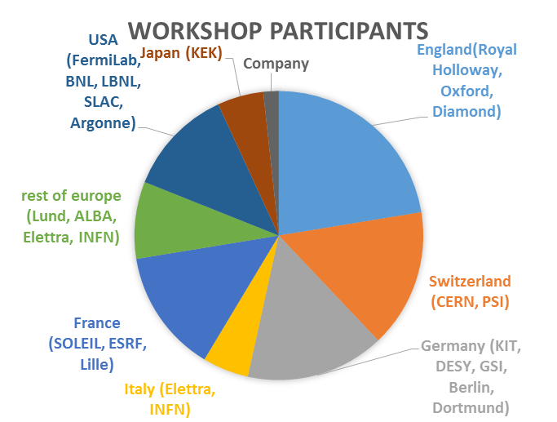
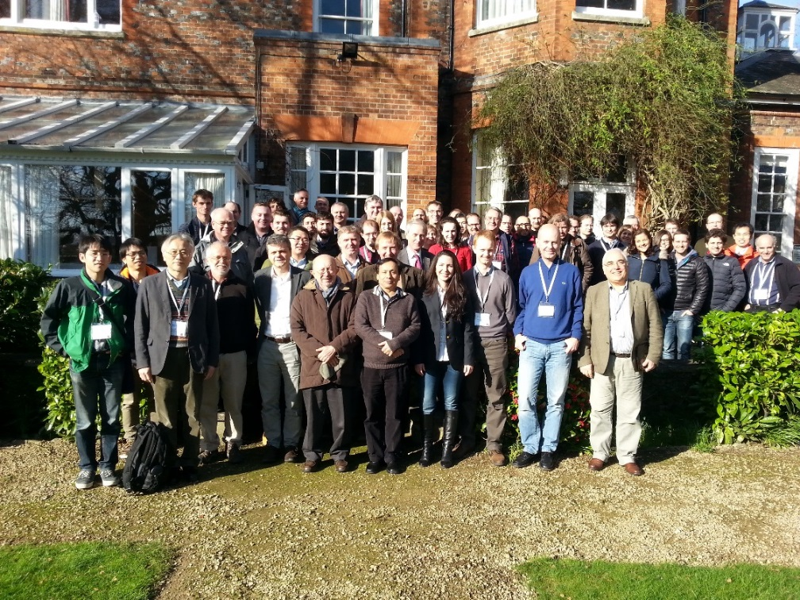
Some figures
Proof that there was sun at some point
Mostly European countries (>80%)

Slide 5
General structure of the workshop
Some general/introductory talks on collective effects
  Reviews of collective effects (V. Vaccaro, K. Bane)
  Coherent Synchrotron Radiation (G. Stupakov, P. Kuske, et al.)
  Role of feedback systems (A. Burov, J. Fox)
Two full sessions devoted to simulations
  Mainly applications to studies for upgrades of the facilities (ESRF, APS, NSLS, SLS, BESSY), but also to MAX IV (in commissioning phase)
  Codes for impedance evaluation, beam dynamics simulations (transverse and longitudinal, single and coupled bunch, under the effect of impedances, ions, etc.), one Fokker-Planck equation solver
One session devoted to diagnostics with focus on use for collective effects
Review talks from different facilities, focused on collective effects (ELETTRA, SOLEIL, ALBA, KEKB and SUPER KEKB, ANKA, Diamond)
Borrowed from Giovanni’s talk

Slide 6
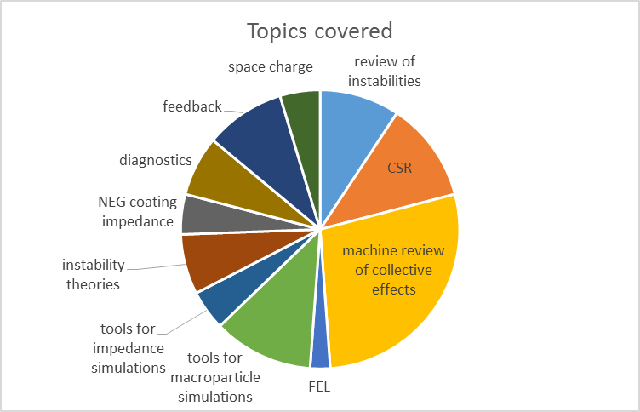
CSR (coherent synchrotron radiation) effects and impedance of NEG are a major concern
for that community
→ Many reviews of collective effects in the different machines
Generalized use of impedance models and macroparticle codes for collective effects
Quite weak on the tools for impedance calculations (only two talks, one on ECHO3D
and another one to benchmark ImpedanceWake2D)

Slide 7
BE-ABP contributions
Four (five) invited talks
  FASTION and its implementation within the PyHEADTAIL framework (Lotta)
  Collective effects in CLIC DRs (Andrea P.)
  First time observed radiation effects for protons in LHC (Gianni)
  Pushing the space charge limit in the CERN LHC injectors (Hannes)
  [[ NEG properties characterization at ultra-high frequencies (Eirini) ]]
Two chairs
  Simulation II session (Giovanni)
  Facility reports and first part of Measurements and Simulations sessions (Benoit)
Borrowed from Giovanni’s talk

Slide 8
Agenda
Some facts and figures
General structure and main topics of the workshop
BE-ABP contributions
A subjective summary

Slide 9
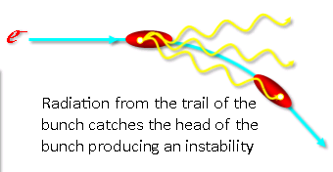
(Subjective) summary: CSR?
CSR: Coherent synchrotron radiation
Synchrotron radiation emitted in a bending magnet by the tail of the bunch catches the head of the bunch and can cause instabilities and blow up
→ intensity limitation for very short bunches
Very active topic for the LER community!!!!
Many theories available (e.g. Bane, Cai, Stupakov)

Slide 10
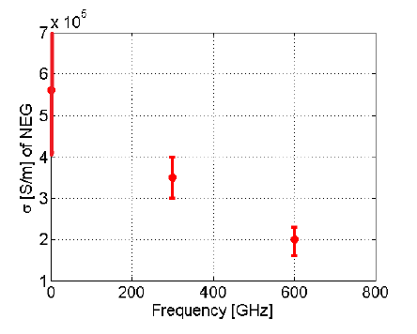
(Subjective) summary: studies on NEG coating
NEG coating extensively used in light sources to improve vacuum.
Need characterization over the whole frequency range to assess the impedance and the associated effects
Characterization performed by waveguide method (Eirini, Carlo, Giovanni et al)
Indicates decrease of conductivity with frequency → should be included in models
Also measured to be very dependent on fabrication process → no universal value

Slide 11
(Subjective) summary
Low emittance rings usually have a very small bunch length compared to most of the machines we are studying at CERN
  The beam spectrum reaches hundreds of GHz, and most is beyond beam pipe cutoff
  Difficulty to use eigenmode solver
  Low impedance elements, high frequency, coatings → CST is not very efficient with these parameters
  However there are also problems with GdfidL (seems to be preferred by the community due to natural parallel implementation)
  Low noise ECHO3D simulation code cannot be used as it lacks a usable mesher.
  It seems no one uses ACE3P
Intense effort in all machines to:
  Identify impedance sources and minimize them at design stage
  Gather them in an impedance model
  Simulate/compute beam dynamics → Several codes used for beam dynamics simulations (transverse and longitudinal, single and coupled bunch, fast ion instability), e.g. sbtrack, mbtrack, PyHEADTAIL, elegant (the latter quite extensively used in the community), FASTION.
  Benchmark with measurements of beam observables
ImpedanceWake2D has become a standard and is widely used in the LER community
  impedance code written by Nicolas Mounet within ABP, based on the pioneering work by Bruno Zotter, Bob Gluckstern and others.
  Request by community to maintain and support the code.

Slide 12
Conclusions
Very interesting workshop
Fruitful discussions and ideas
Potentially new collaborations

Slide 13
Parameter range for various machines
Machine | RMS Bunch length | Transverse emittance | Intensity/bunch | Number of bunches | Total intensity | Frev | Beam freq
SOLEIL | ~20 ps (4.7 ps for low alpha operation) | 3.9 nm.rad | 1.36+5 mA | 312+1 | 0.4 A | 846 kHz | 350 MHz
LHC | ~270 ps | ~2000 nm.rad | ~0.25 mA | ~2000 | ~ 0.5 A | 11 kHz | 20 or 40 MHz
SPS | 300 to 1000 ps | ~2000 nm.rad | 0.25 mA | ~200 | ~0.05 A | 44 kHz | 20 or 40 MHz
CLIC damping ring | 6 ps | 4.8 nm.rad | 0.4 mA | 312 | 0.1 A | 700 kHz | 1 GHz

