Slide 1
Update on the FASTION code development, and new results
L. Mether, G. Rumolo
CLIC Beam Physics meeting March 31st 2016

Slide 2
Outline
The fast beam-ion instability
Simulating the fast beam-ion instability
Code development & new results
  FASTION development and challenges
  CLIC Main Linac revisited
  Fast beam-ion instability with PyECLOUD and PyHEADTAIL
Summary & outlook

Slide 3
Fast beam-ion instability
Gas molecules ionized by beam
Beam electrons accelerated by ions
Coupled electron-ion oscillations
Positive ions oscillate in beam field
Instability
In synchrotrons without clearing gap, ion density builds up over several turns
  Conventional ion instability
For bunch train followed by gap, ions build up only during one train passage
  Fast beam-ion instability (FBII)

Slide 4
Fast beam-ion instability
Ion density increases for every bunch passage – effect stronger at tail of train
Ions transfer information on offsets from bunch to bunch – head and tail of train coupled
Over time can lead to multi-bunch instability, tune shift, emittance growth

Slide 5

FBII theory
Treatment based on linear approximation of Bassetti-Erskine formula
  Velocity kick for ion with mass number A
    N_{b} = bunch intensity, σ_{x,y} = rms transverse beam sizes, r_{p} = classical proton radius
Fast beam-ion instability. I. Linear theory and simulations
Raubenheimer et al. Phys. Rev. E 52, 5, 5487

Slide 6

Ion trapping condition
For a bunched beam, ions will drift between bunch passages
  Using the stability condition of a linear beam trajectory, |Tr(M)| < 2:
    Ion motion is stable if |2 - k*T_{b}| < 2 → kT_{b} < 4
      T_{b} = bunch spacing, k = kick
    Otherwise oscillation amplitude grows monotonically
This leads to a trapping condition for the ion mass number
  Trapping condition must be fulfilled in both horizontal and vertical plane
    For electron machines, typically σ_{y} << σ_{x} → A_{trap} = A_{trap,y}

Slide 7
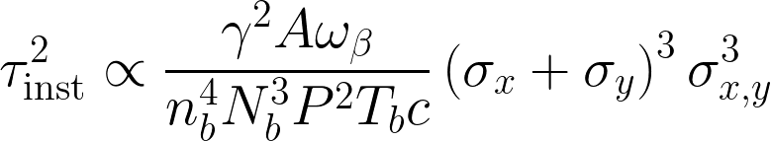
FBII theory
Treatment based on linear approximation of Bassetti-Erskine formula
  For A > A_{trap}, estimated instability rise time
    T_{b} = bunch spacing, n_{b} = nr of bunches, P = pressure, ω_{β} = betatron frequency
  High pressure, long train, high intensity, small beam → short rise time
Fast beam-ion instability. I. Linear theory and simulations
Raubenheimer et al. Phys. Rev. E 52, 5, 5487

Slide 8
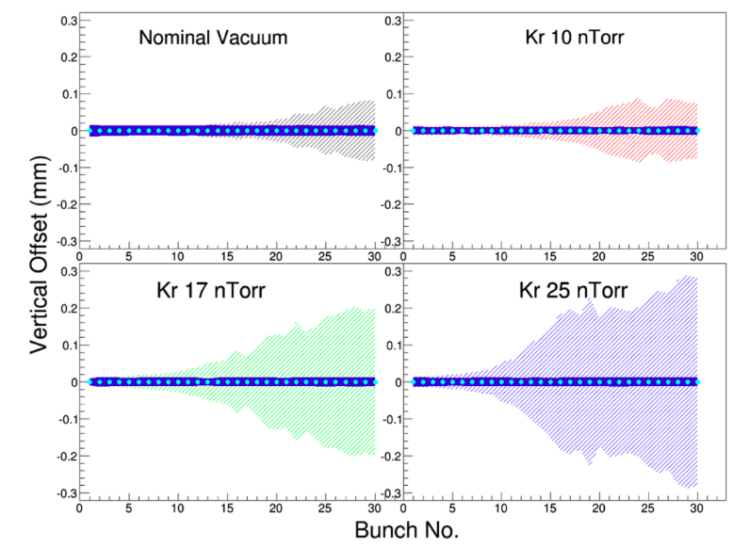
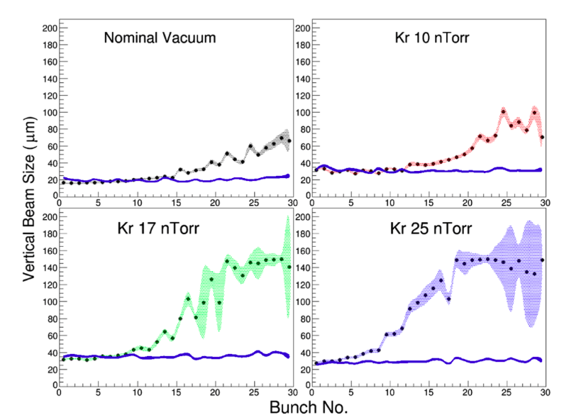
Observations
Observed in several machines under vacuum degradation
Measurements at CESR-TA with injected gas (Dec. 2013, Apr 2014)
  Varying ion species, pressure, bunch charge, train structure, feedback etc.
Feedback on
Feedback on
A. Chatterjee et al. Phys. Rev. ST Accel. Beams 18 (2015) 6, 064402

Slide 9
Numerical FBII studies
Aim to estimate the effect of parameters on instability rise-time
  Beam parameters: intensity, emittance, etc.
  Vacuum pressure and composition
Simulation with multi-bunch macro-particle (PIC) tracking code
CERN simulation tool: FASTION
  Self-consistent strong-strong, 2D
  Developed by G. Rumolo
  Written in C
  Based on HEADTAIL for electron cloud
  Used e.g. for CLIC linear structures, CESR-TA
  Currently working on adapting to future synchrotrons

Slide 10
Simulation outline
The machine lattice is divided into a number of interaction points (IP)
  An electron bunch train is tracked through the lattice
  In every IP, the beam-ion interaction is simulated
IP

Slide 11
Simulation outline
In every interaction point, the beam is passed bunch by bunch
Calculate e-fields
Generate ions
Give velocity kick
Introduce bunch

Slide 12
Simulation outline
In every interaction point, the beam is passed bunch by bunch
Represent ions generated between two IP’s
Electric fields of ions and electrons calculated separately on same grid
Calculate e-fields
Generate ions
Give velocity kick
Ion densities given by partial pressures and ionization
x-sections, or field ionization
Calculate e-fields
Velocity kicks applied according to e-field of opposite particles
(no self space charge)
Ion distribution
σ_{ion} = σ_{beam}
Generate ions
Give velocity kick
Drift ions
Transport bunch
Introduce bunch
Transport bunch
Introduce bunch

Slide 13
Simulation outline
In every interaction point, the beam is passed bunch by bunch
Represent ions generated between two IP’s
Electric fields of ions and electrons calculated separately on same grid
Calculate e-fields
Generate ions
Give velocity kick
Drift ions
Ion densities given by partial pressures and ionization
x-sections, or field ionization
Velocity kicks applied according to e-field of opposite particles
(no self space charge)
Ion distribution
σ_{ion} = σ_{beam}
Introduce bunch
Transport bunch

Slide 14
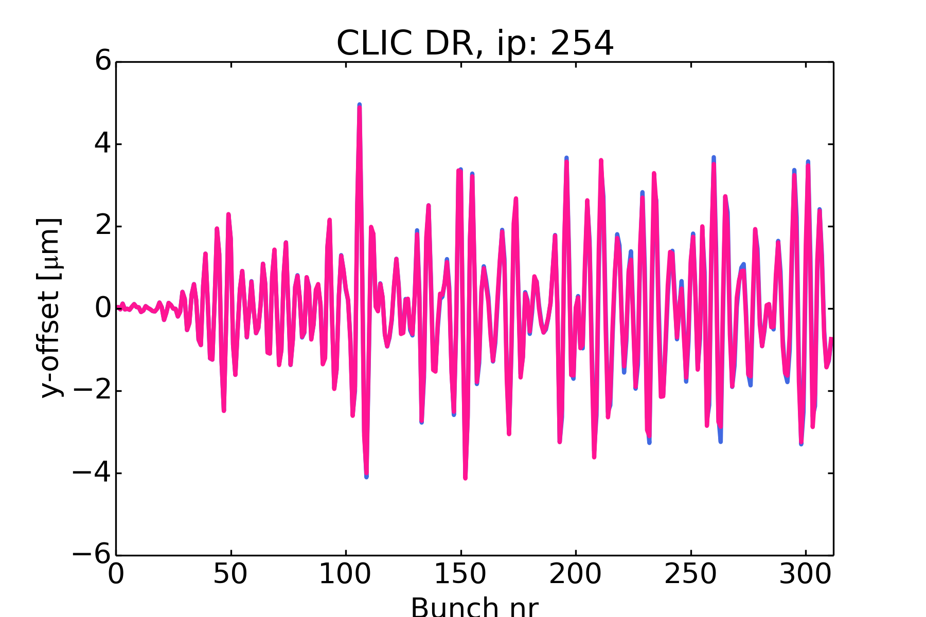
FASTION development
Main objective: modify code to be practically applicable to rings
  Implement required additions and modifications
    Full twiss matrices, radiation damping, synchrotron motion, feedback…
Main challenge: run-time performance
  Synchrotron radiation damping can help prevent instability
  want to be able to simulate at least over a damping time, τ_{d} ≈ 1400 turns
    Test case: 1 turn, 27 min → 26 days for 1400 turns (on fast desktop)
  After basic code optimization
    Test case: 1 turn, 16 min → 15 days
    Still too long for systematic scans
  Solutions?
    Parallelization
    Compromise on number of IP’s

Slide 15
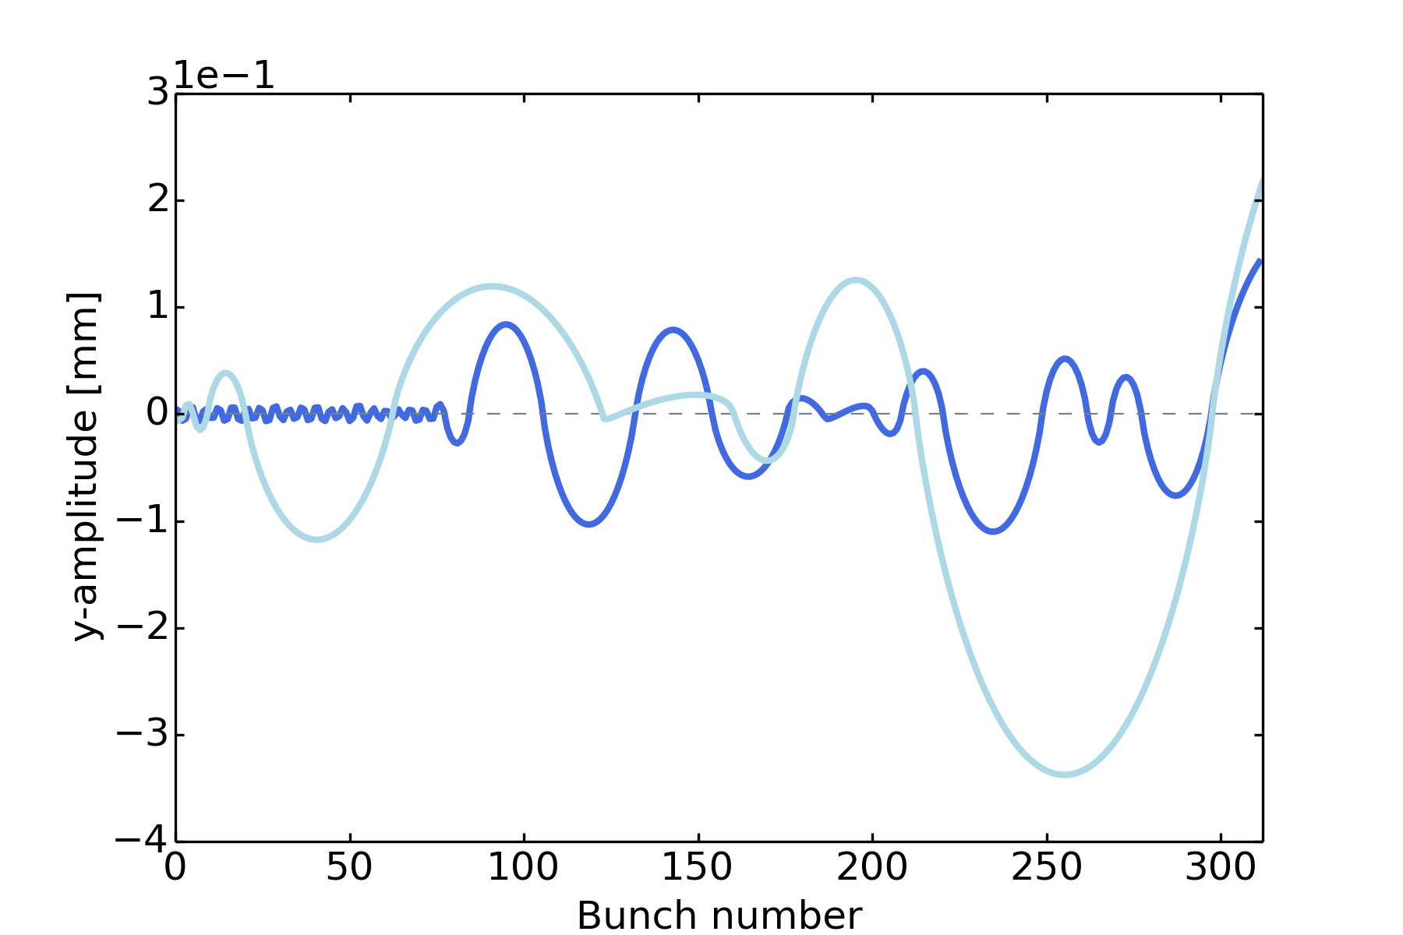
Beam resolution
Unexpected challenge: resolution
  Ion trajectories can extend far beyond beam
    Linear approximation only good if A >> A_{trap}, but need to scan all vacuum components
Sample ion trajectories, H₂O
CLIC Damping ring

Slide 16
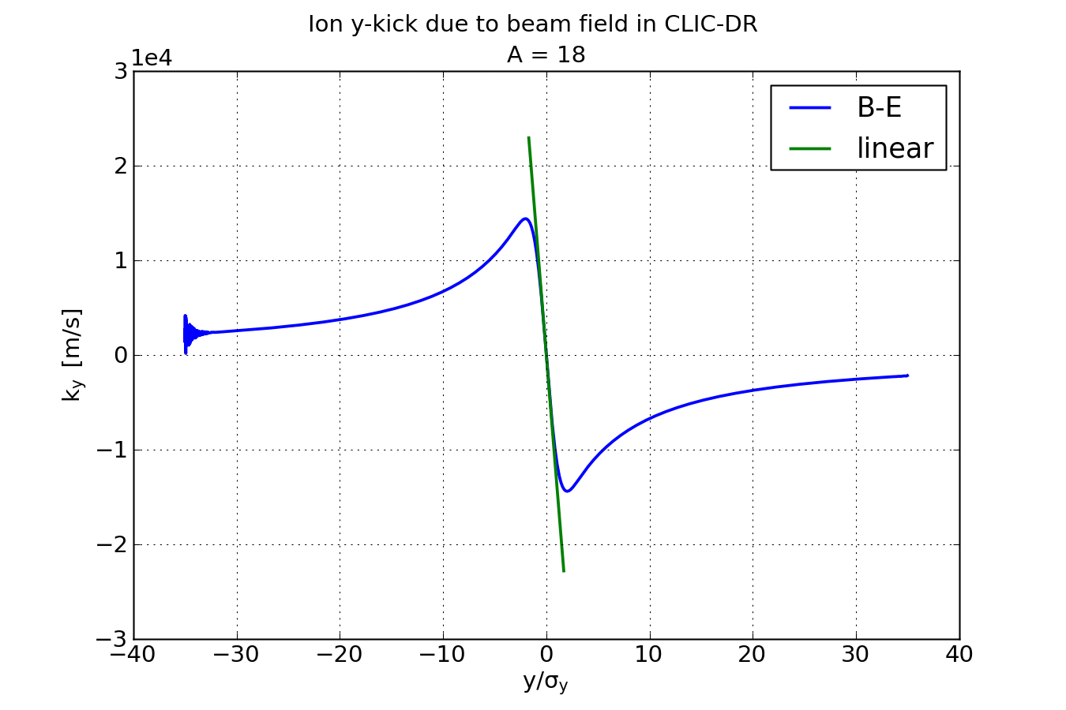
Beyond linear approximation
Linear approximation is only good in a small region around centre of beam

Slide 17
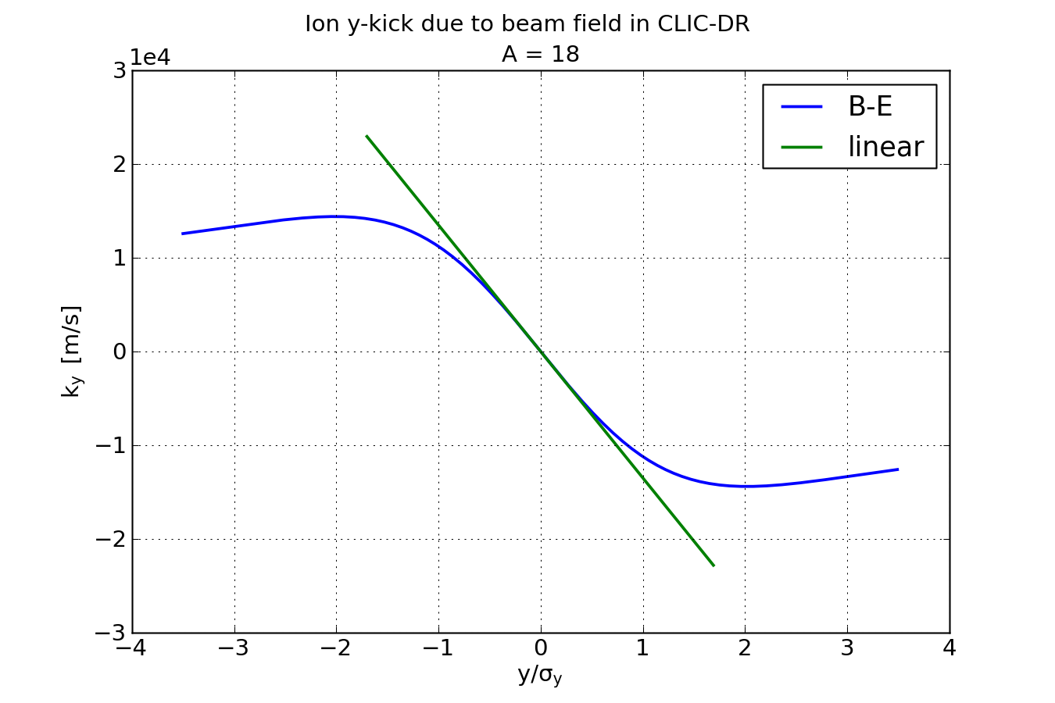
Beyond linear approximation
Linear approximation is only good in a small region around centre of beam

Slide 18
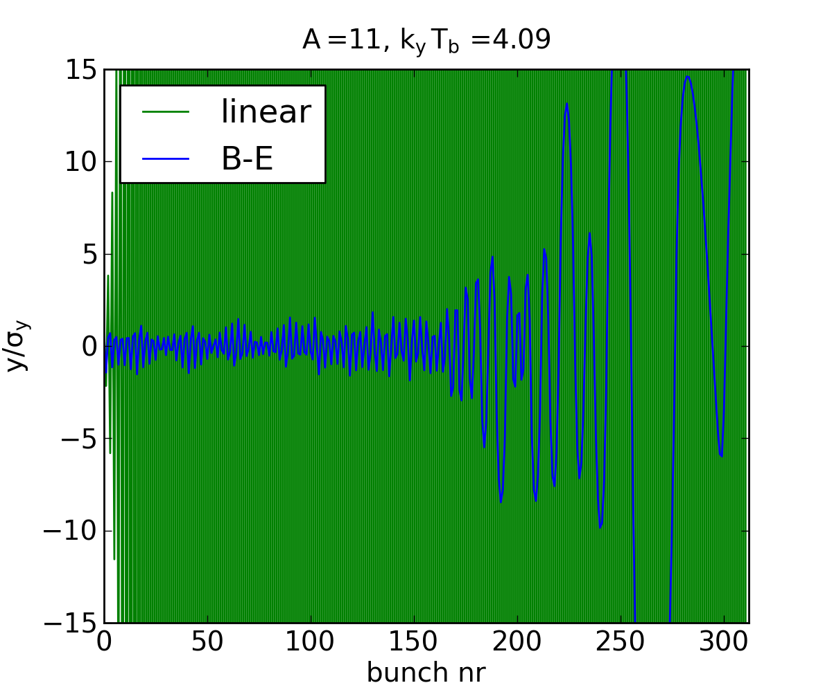
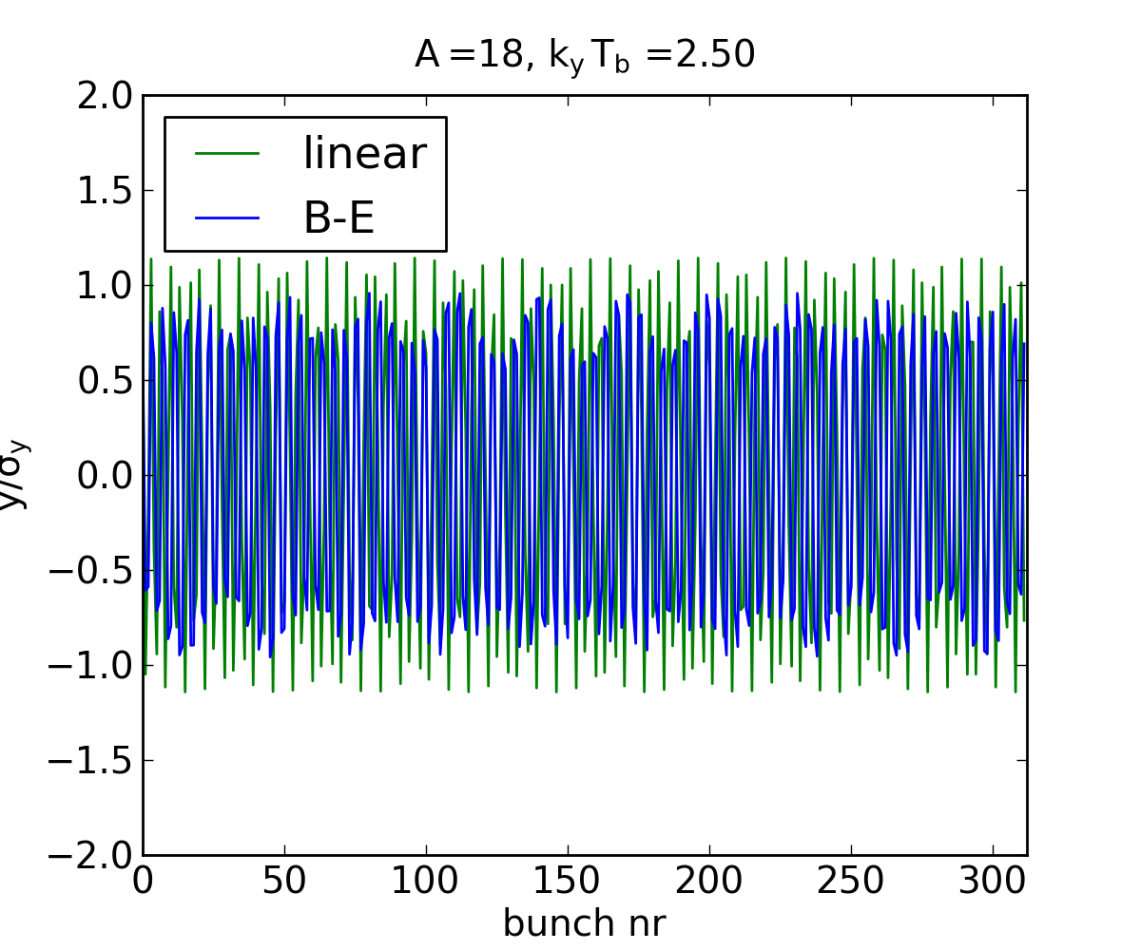
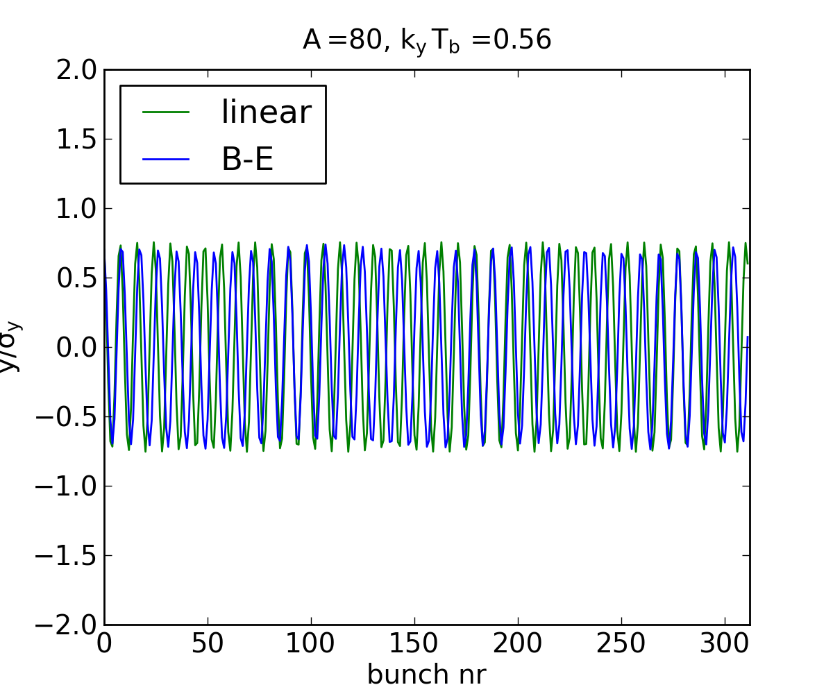
Beyond linear approximation
Stability condition and ion trapping
Trajectories for ion of mass A, during the passage of one CLIC-like bunch train
  x₀ = 0.7σ_{x}, y₀ = 0.7σ_{y}
Beyond trapping, kT_{b} > 4
Weak trapping, kT_{b} = 2.5
Strong trapping, kT_{b} = 0.56

Slide 19
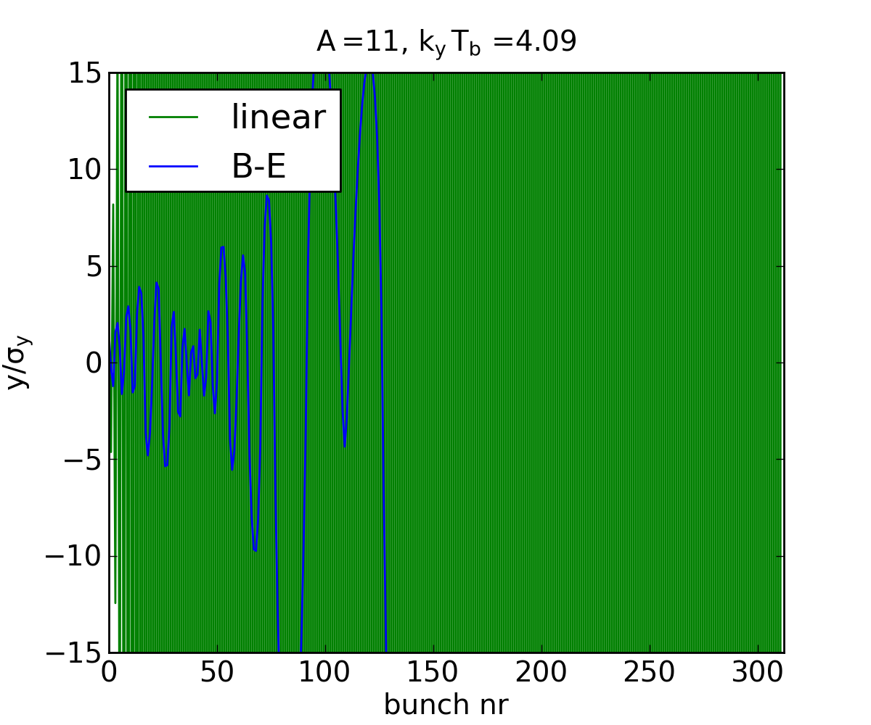
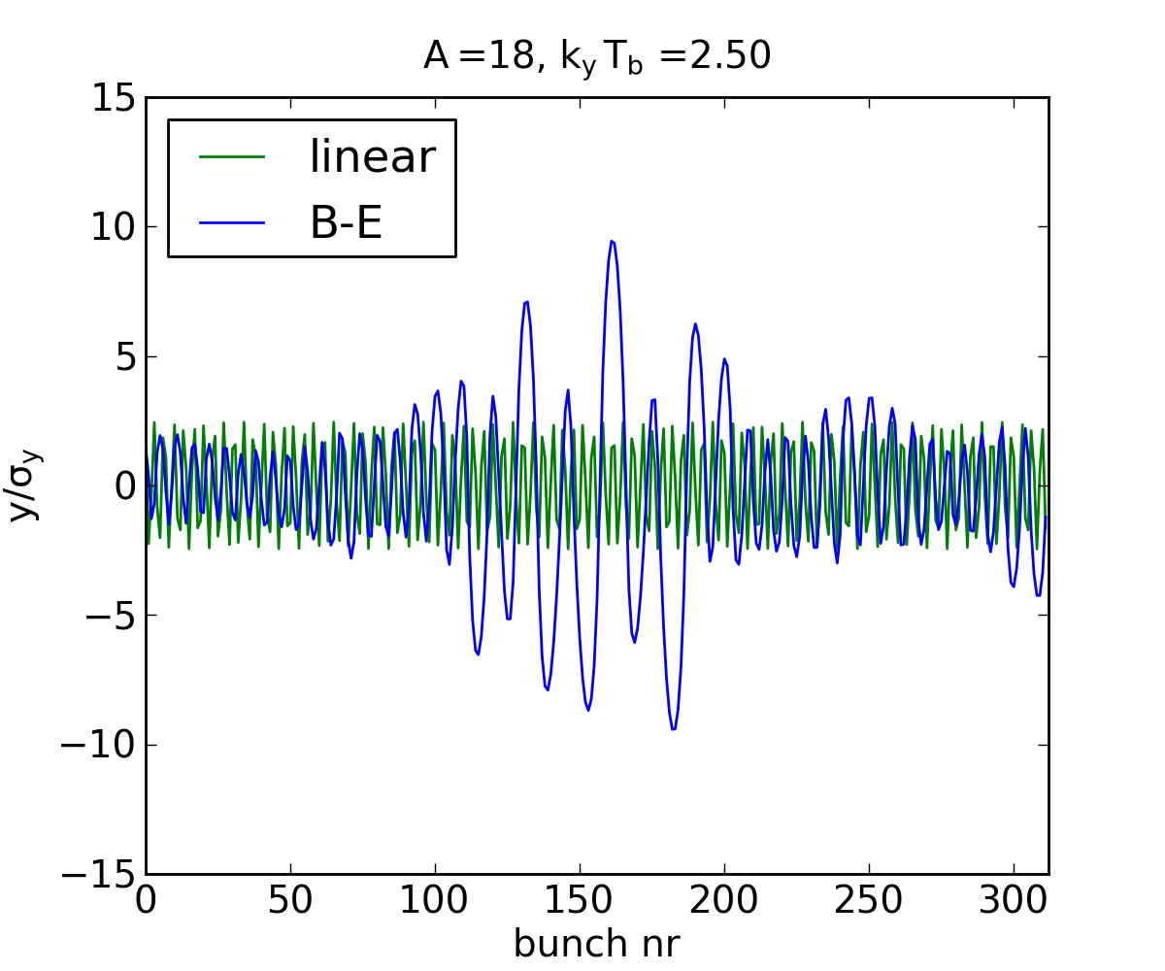
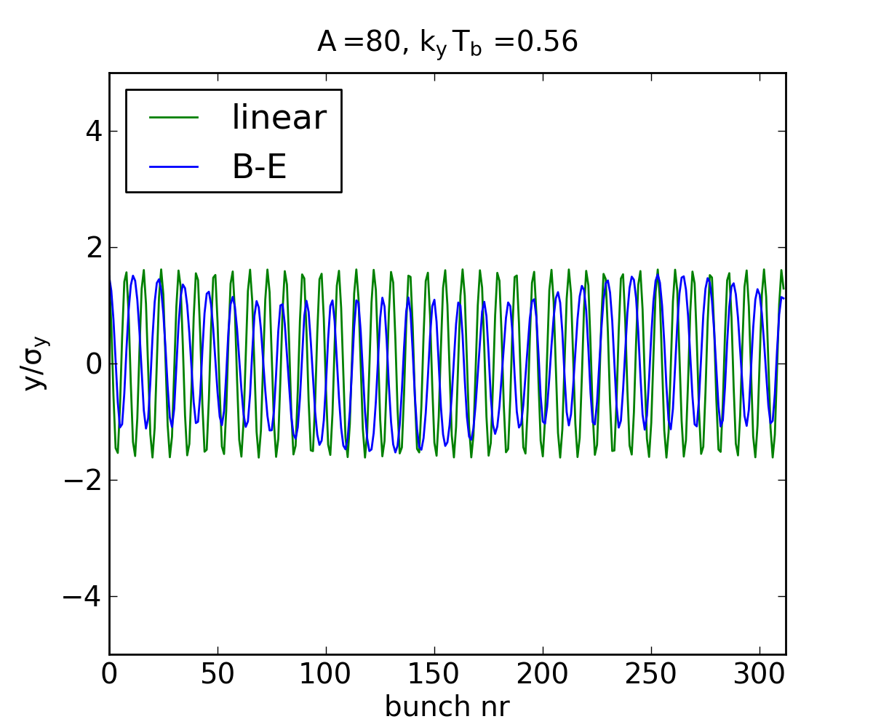
Beyond linear approximation
Stability condition and ion trapping
Trajectories for ion of mass A, during the passage of one CLIC-like bunch train
  x₀ = 1.5σ_{x}, y₀ = 1.5σ_{y}
Beyond trapping, kT_{b} > 4
Weak trapping, kT_{b} = 2.5
Strong trapping, kT_{b} = 0.56

Slide 20
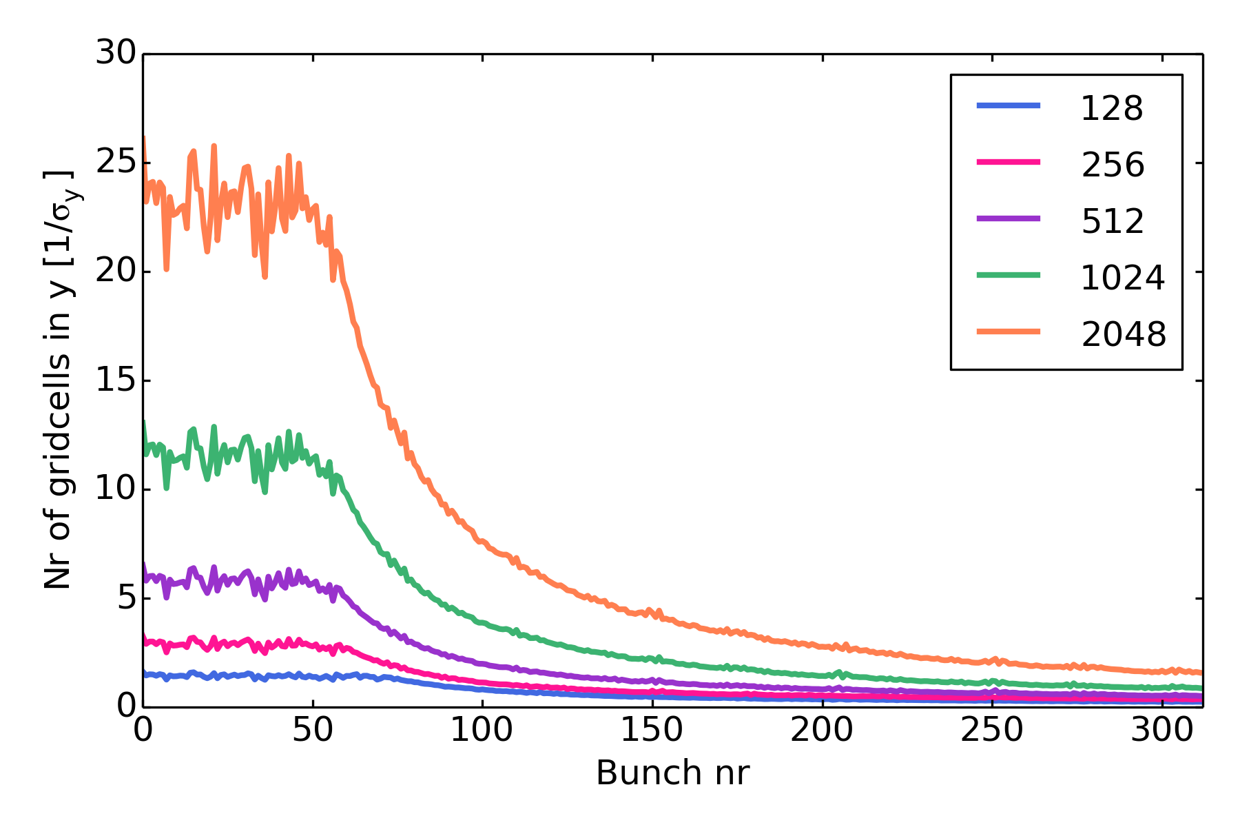
Beam resolution
Unexpected challenge: resolution
  Ion trajectories can extend far beyond beam
    Linear approximation only good if A >> A_{trap}, but need to scan all vacuum components
  Adapting grid to expanding ion distribution to track ions
  → poor resolution, even for very large grids
  → impossibly long run-time for large grids
CLIC Damping ring
Sample ion trajectories, H₂O
CLIC Damping ring

Slide 21
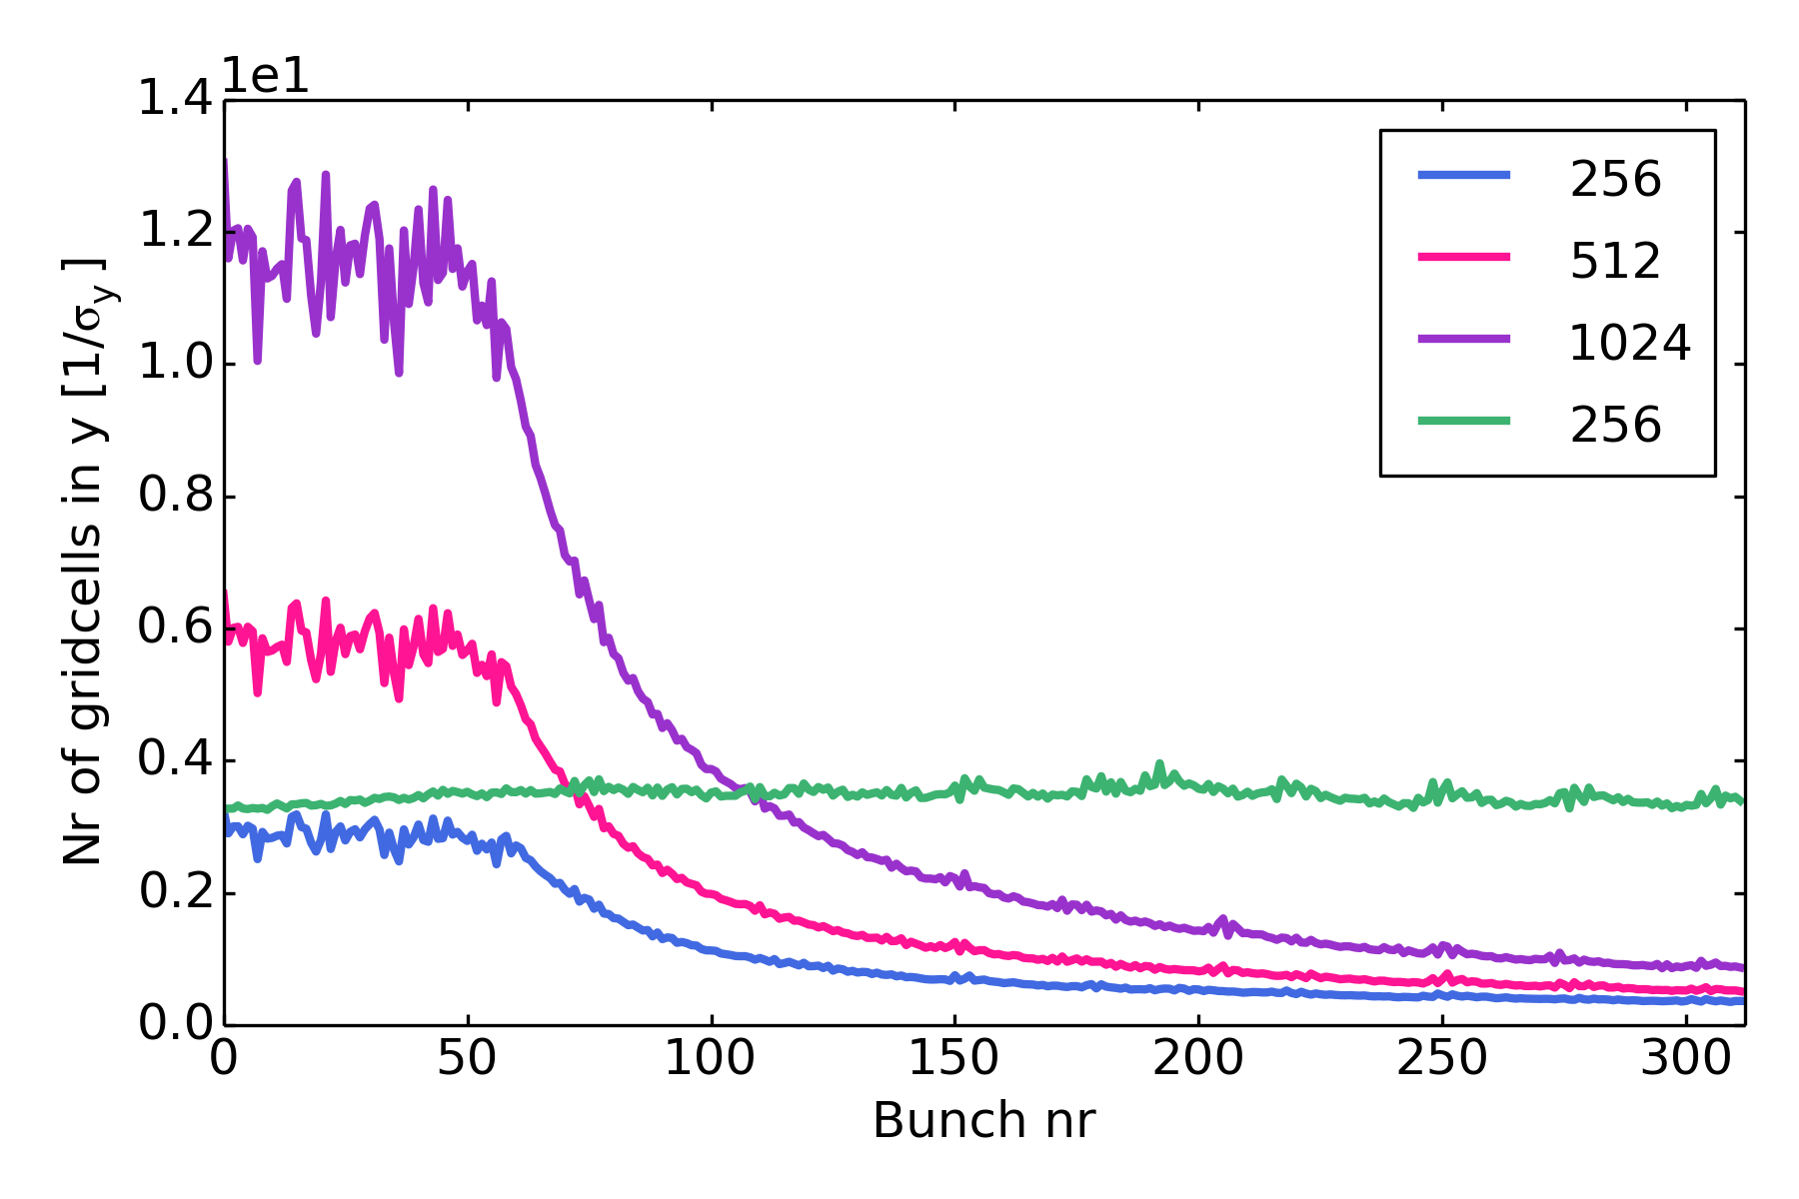
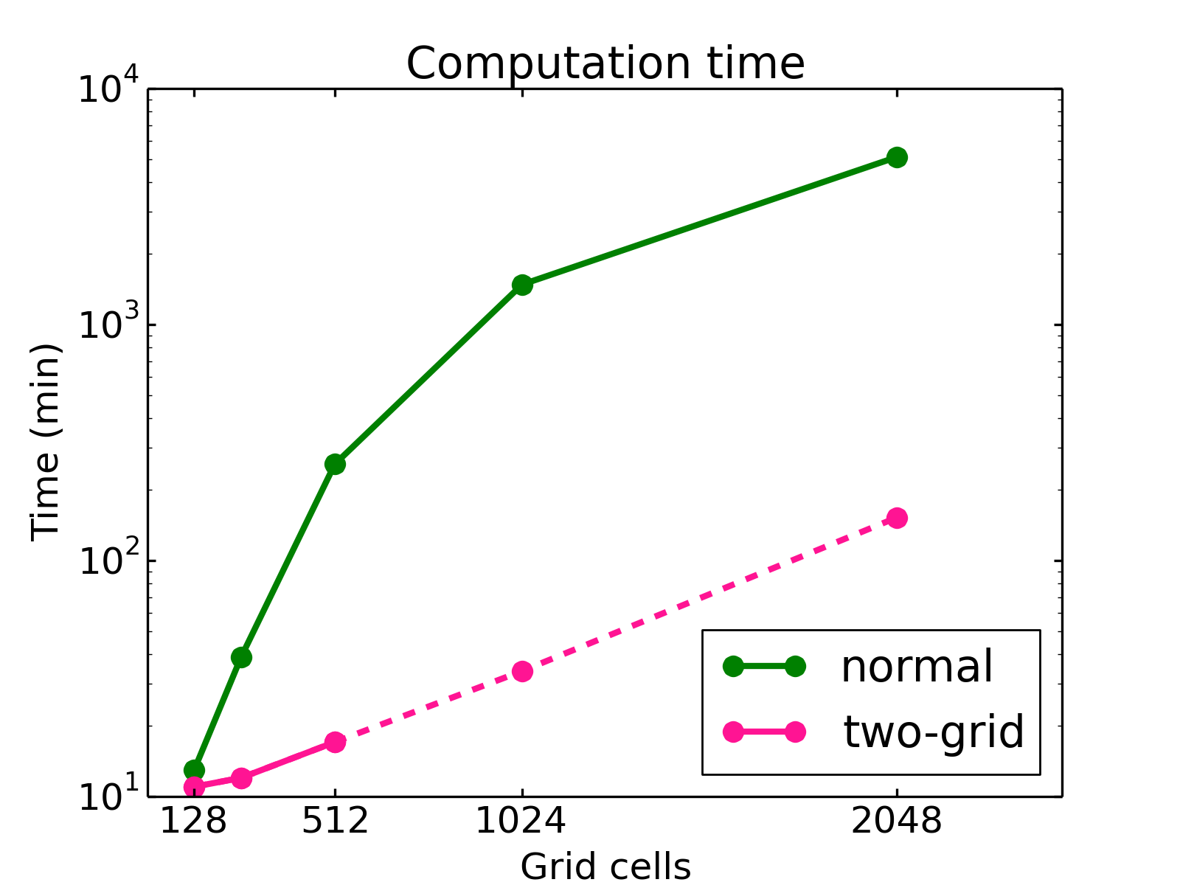
Two-grid method
Solution:
  Keep inner grid around beam fixed
  Use second, coarser grid to track ions outside
    Treat inner grid as usual, but add correction to beam from outer grid
  Performance
    1 turn, 15 min → 14 days for 1400 turns
    With much improved resolution
Two-grid

Slide 22
CLIC Main Linac revisited
FBII in linear CLIC structures has been studied with FASTION in the past
  Revisited with improved simulation resolution
  Especially for Main Linac, past results did not agree well with theoretical expectations:
    Instabilities, and ion trapping even for A << A_{trap}
    Instability rise time in horizontal < vertical
    e.g. CLIC-Note-930, 2011
CLIC Main Linac (2012)
Length [km] | 22 | Normalized emittances [nm] | 660, 10
Injection energy [GeV] | 9 | Bunch population, N_{b} | 4 x 10⁹
Collision energy [GeV] | 1500 | Bunches per train, n_{b} | 312
 |  | Bunch spacing , Τ_{b} [ns] | 0.5

Slide 23
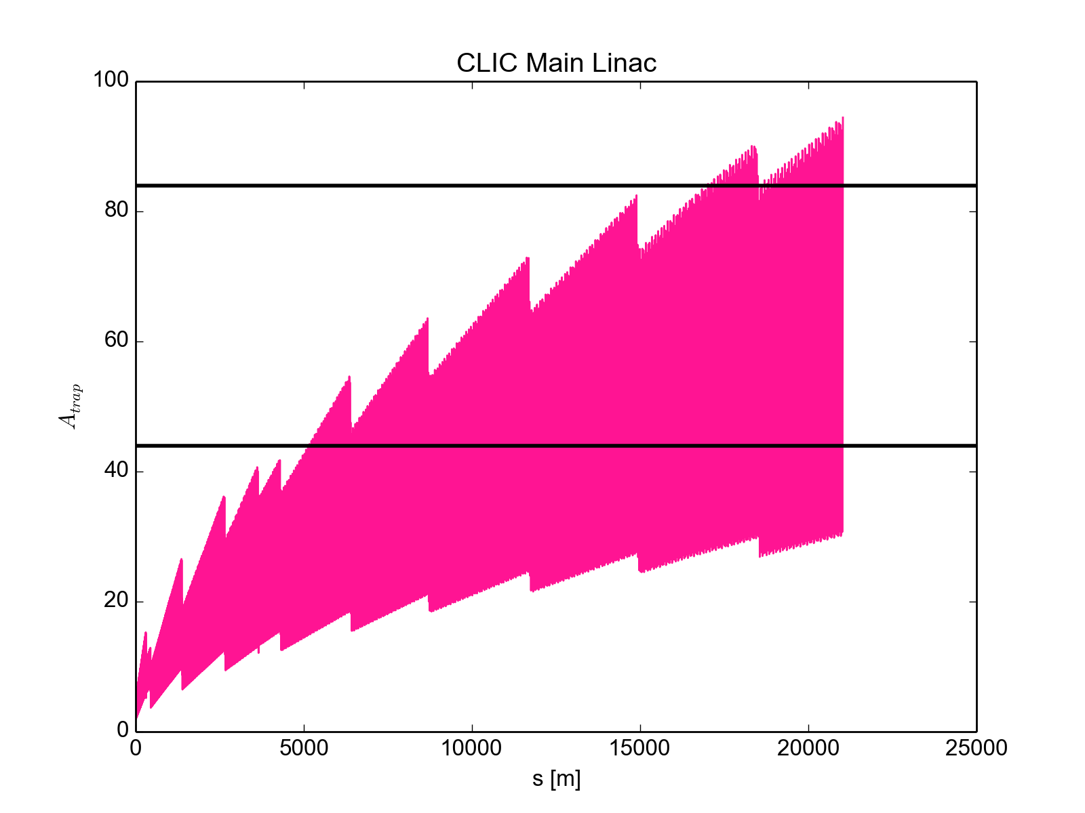
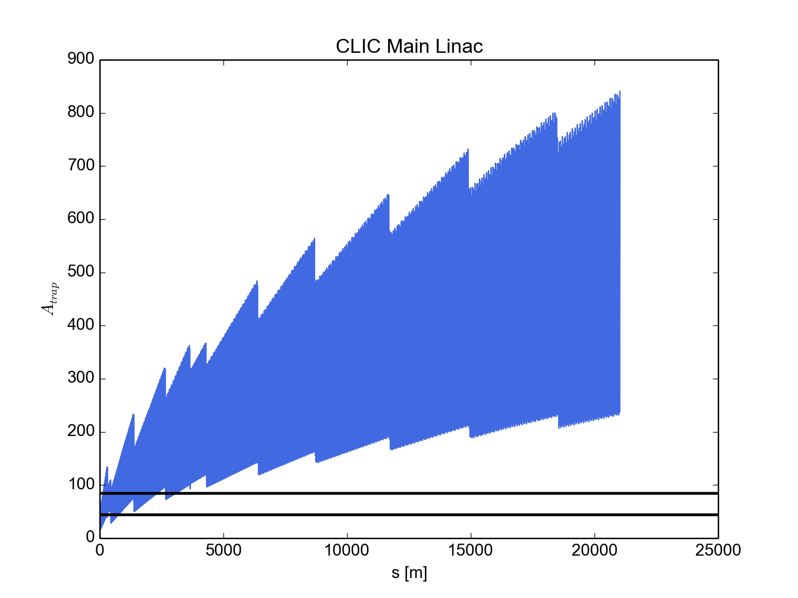
Beam size and ion trapping
Due to acceleration, beam size decreases along linac
  A_{trap} increases along linac
  Due to small vertical beam size, ions are not trapped along most of linac
Kr
A_{trap}
A_{trap}
CO₂
Kr
CO₂

Slide 24
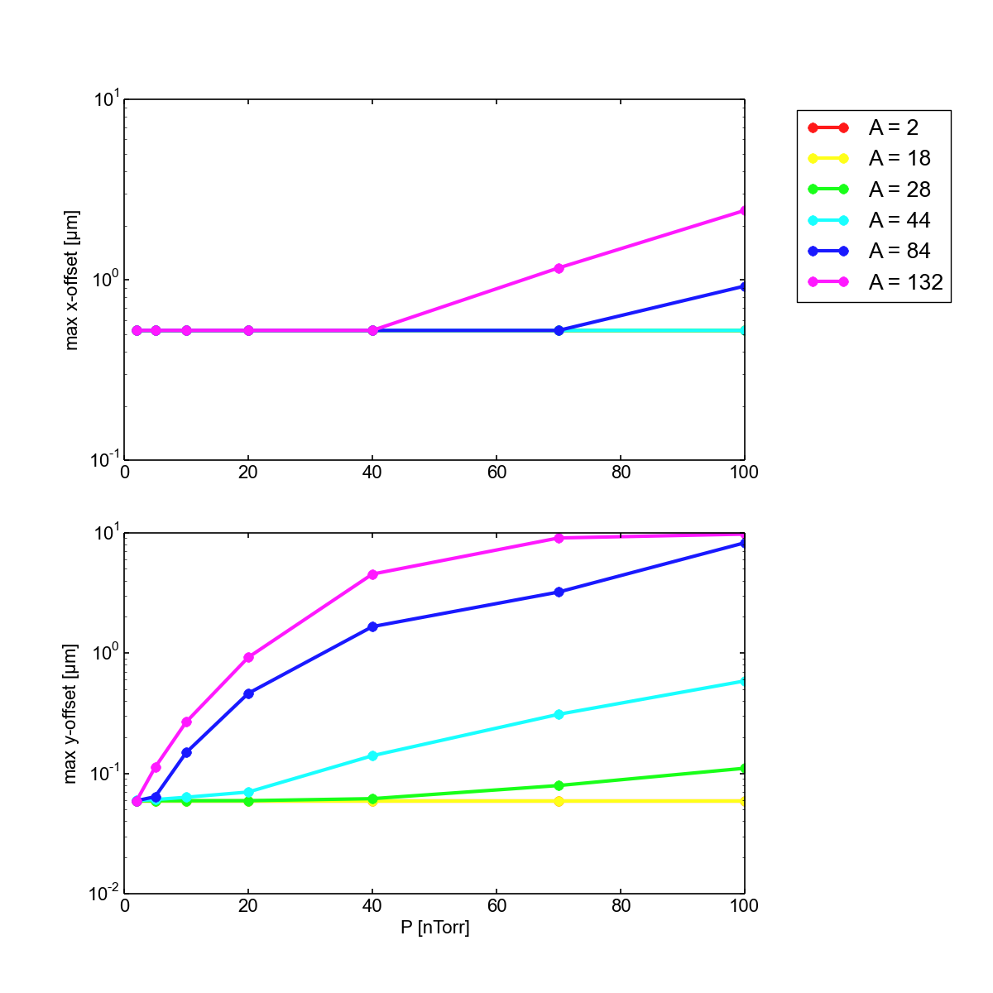
New results
Simulation scan with single vacuum species, with varying A and P

Slide 25
New results
Simulation scan with single vacuum species, with varying A and P
New results agree well with theory
  Constraints on vacuum less stringent than previously, due to limited trapping

Slide 26
FBII with PyECLOUD and PyHEADTAIL
Several CERN beam dynamics codes re-designed in the past few years
  Aim to make codes more user friendly, maintainable and flexible
  Electron cloud build-up: ECLOUD → PyECLOUD
  Collective effects: HEADTAIL → PyHEADTAIL
Decision to incorporate fast beam-ion instability simulations into
framework of PyECLOUD and PyHEADTAIL codes
coupled

Slide 27
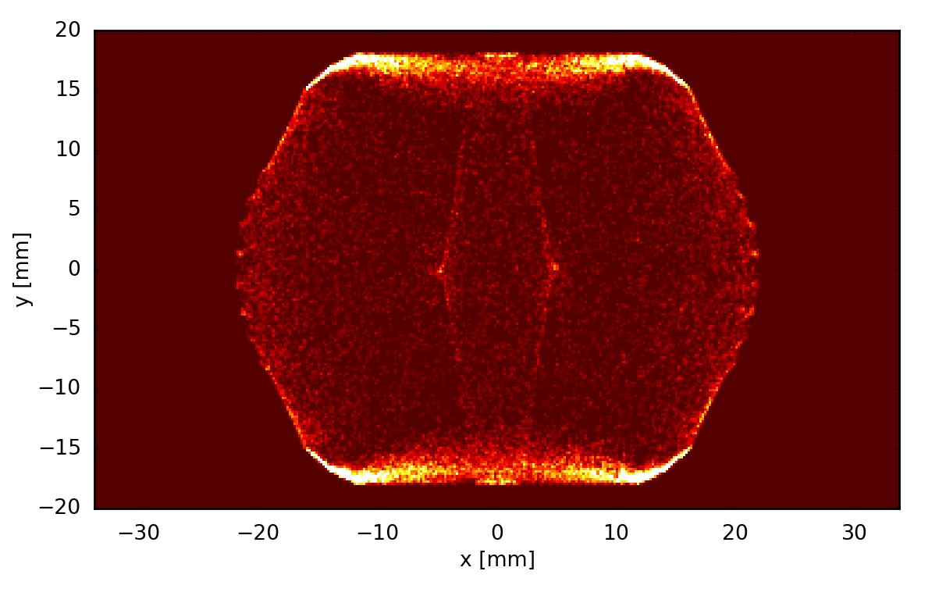
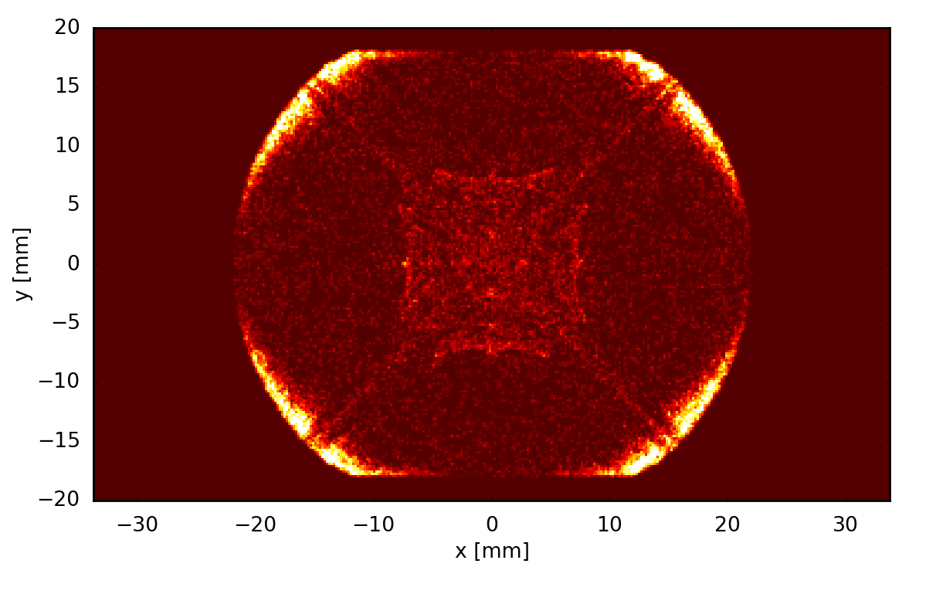
PyECLOUD
Simulation code for electron cloud formation
  Developed and maintained at CERN since 2011 by G. Iadarola
  Following the legacy of the ECLOUD code (F. Zimmermann et al., 1997…)
  2D macro-particle code
  Written in Python with Fortran (f2py) and C (CYTHON) extensions
Features
  Gas ionization
  Boris algorithm for moving particles in magnetic fields
  PIC module with multiple solver methods for arbitrarily shaped chambers
E-cloud pinch: Dipole
E-cloud pinch: Quadrupole
G. Iadarola

Slide 28
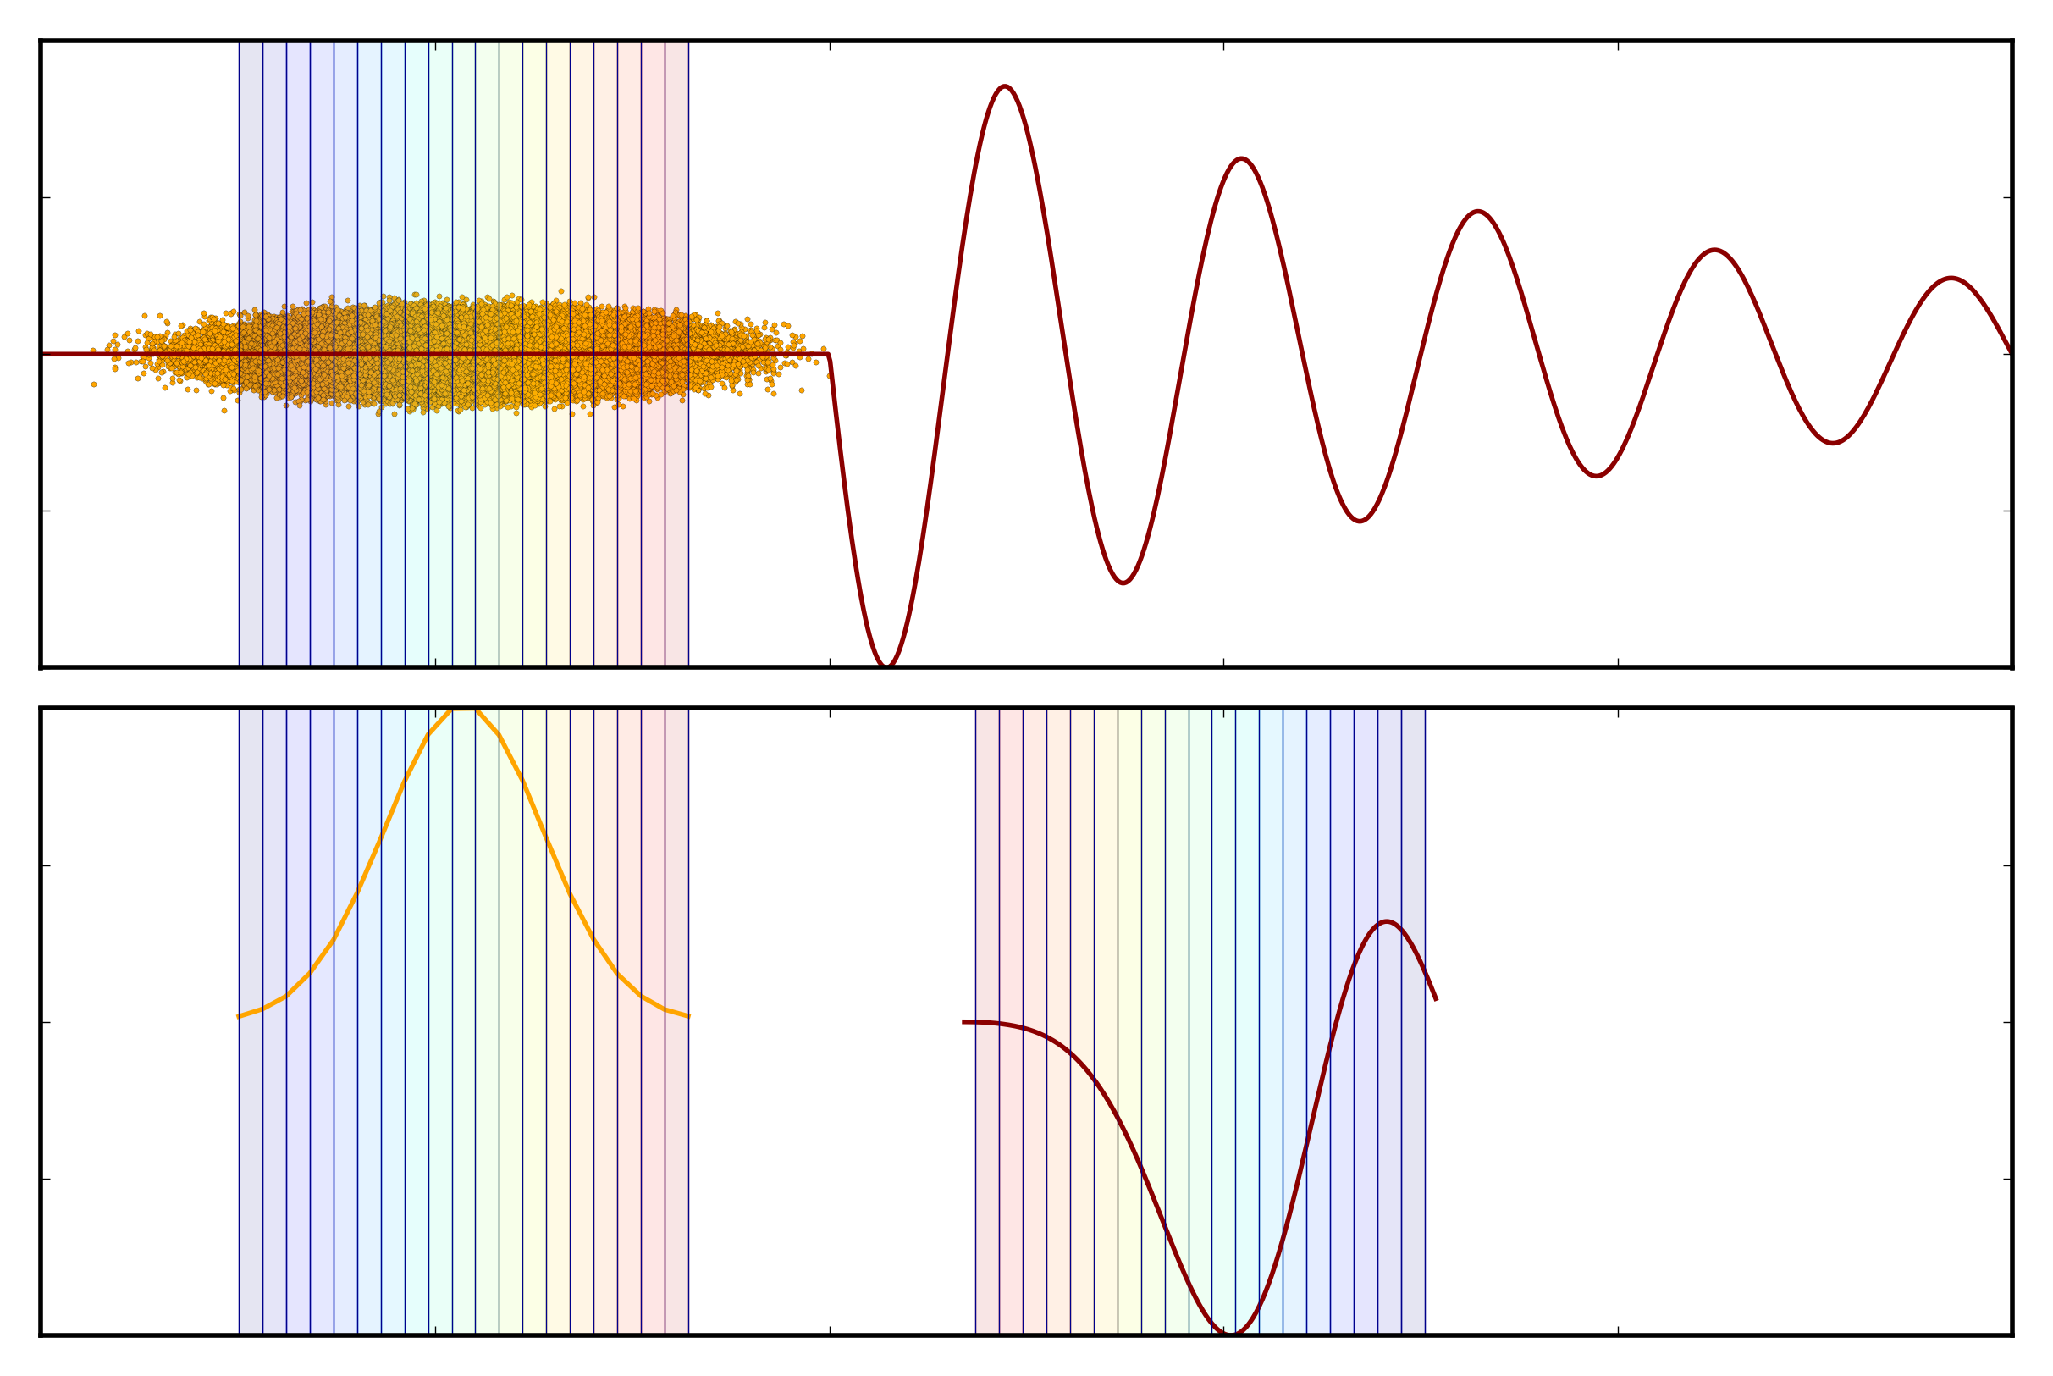
PyHEADTAIL
Simulation code for collective effects: impedance, e-cloud instability, etc.
  Developed and maintained at CERN since 2014 by H. Bartosik, K. Li et al.
  Based on the HEADTAIL code (G. Rumolo et al., 2000)
  2D macro-particle code
  Written in Python with C (CYTHON) extensions
Features
  RF systems and synchrotron motion
  Chromaticity
  Transverse feedback
github.com/PyCOMPLETE
  PyHEADTAIL
  PyECLOUD
  PyPIC
Wakefield
Wake kick
Kevin Li

Slide 29
FBII with PyECLOUD and PyHEADTAIL
For e-cloud studies: HEADTAIL → PyECLOUD + PyHEADTAIL
  Since FASTION based on HEADTAIL for e-cloud, decided to follow suite
Calculate e-fields
Generate ions
Give velocity kick
Drift ions
PyECLOUD
PyHEADTAIL
PyHEADTAIL
Introduce bunch
Transport bunch

Slide 30
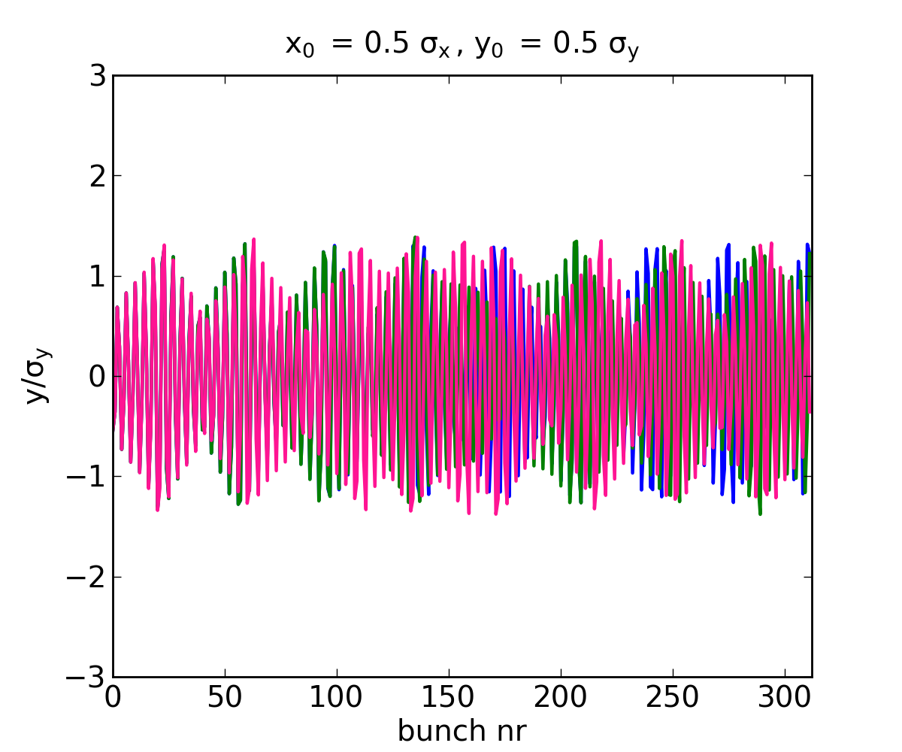
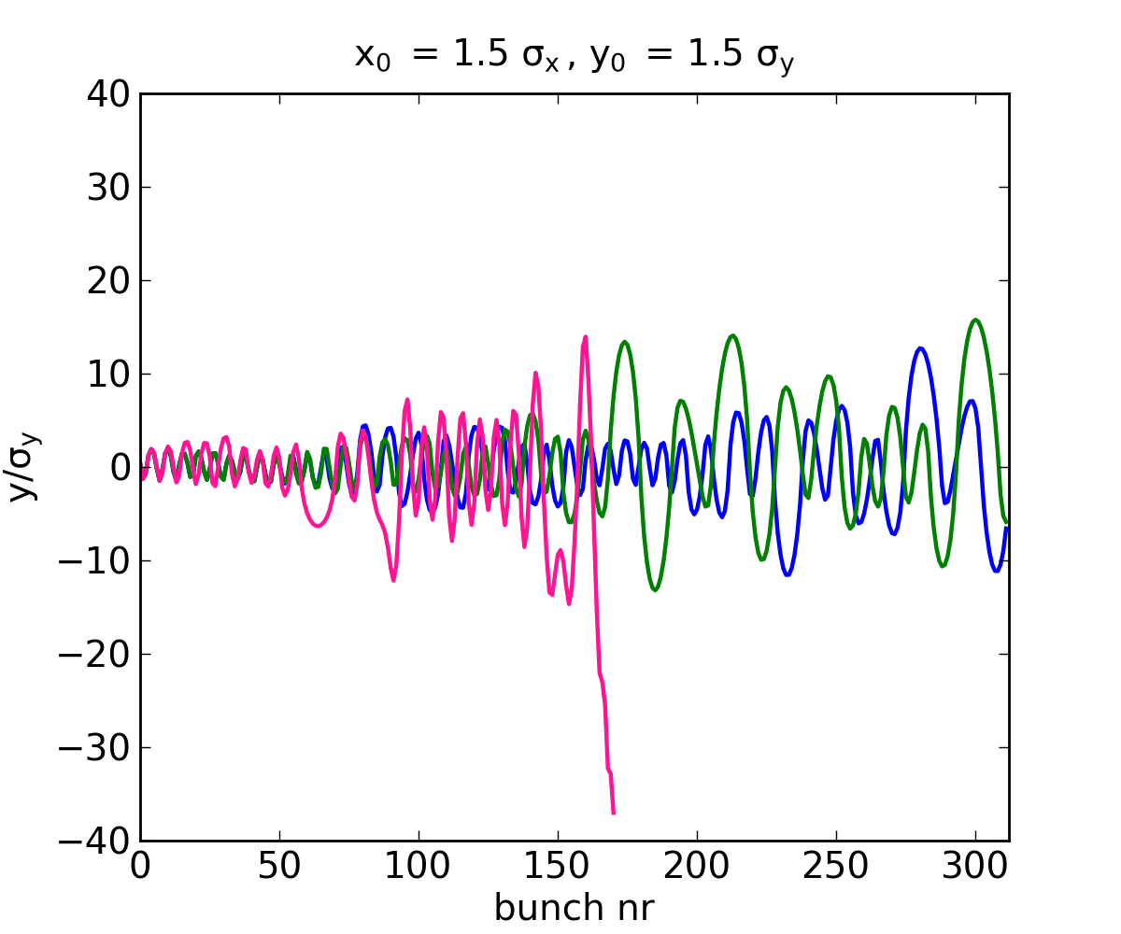
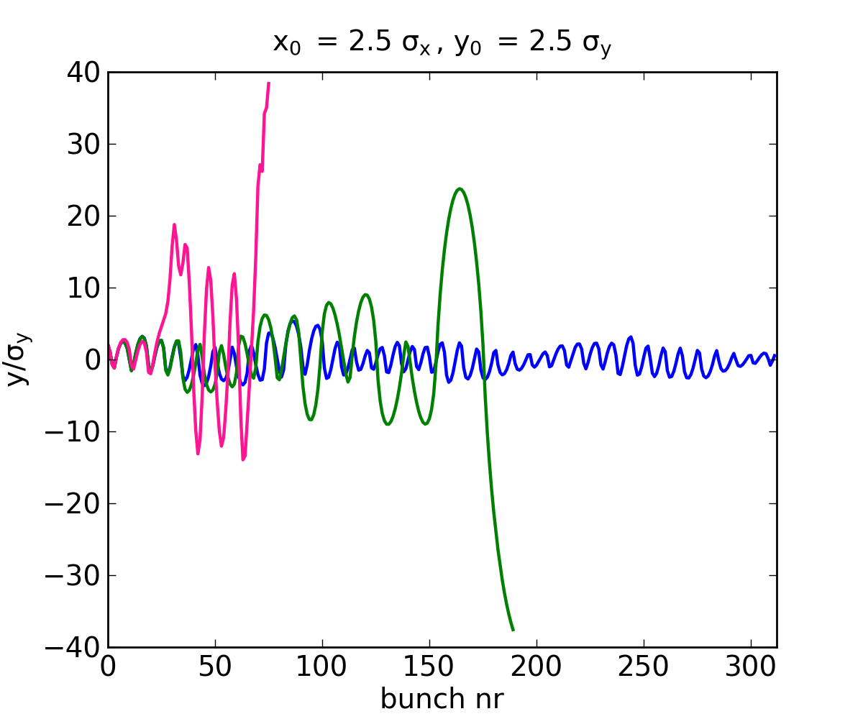
Motivation
Facilitate continued maintenance
Share workload of common developments, e.g. parallelization
Benefit from features already implemented in PyECLOUD/PyHEADTAIL
  Separate build-up and instability simulations for multi-turn ion trapping
  Ion self space charge
  E-field boundary
  Magnetic fields
  Bunch slices
  Synchrotron motion
  Transverse feedback
Trajectories for H₂O ion during passage of CLIC-like bunch train
B-field off
Dipole
Quadrupole

Slide 31
Progress
Generalization to arbitrary charge and mass in PyECLOUD + PyHEADTAIL
Implementation of multi-bunch in PyHEADTAIL
Extension of PyECLOUD gas ionization routines
  Multiple species, field ionization
Implementation of grid methods
  Rectangular (non-square) grid cells (for flat electron beams)
  Two-grid method
Testing
  Compare with FASTION results
Parallelization?
In progress
To do

Slide 32
Summary & conclusions
The FBII can affect electron machines with clearing gaps
  Usually not a problem in current machines with nominal vacuum
  May be important for future machines: CLIC, FCC-ee, LHeC, new light sources
  Simulations to study effect of beam and vacuum parameters on instability
FASTION studies
  Code optimized, and modified for improved resolution and reliability
  Ready for new CLIC baseline parameters
    In good shape for simulating linear structures
    Allows first studies for damping rings, but still quite heavy for systematic scans
FASTION → PyECLOUD + PyHEADTAIL
  Add maintainability and flexibility, share workload of common development
  Introduces many new features and possibilities for studies
  Work in progress

Slide 33
Thank you!

Slide 34
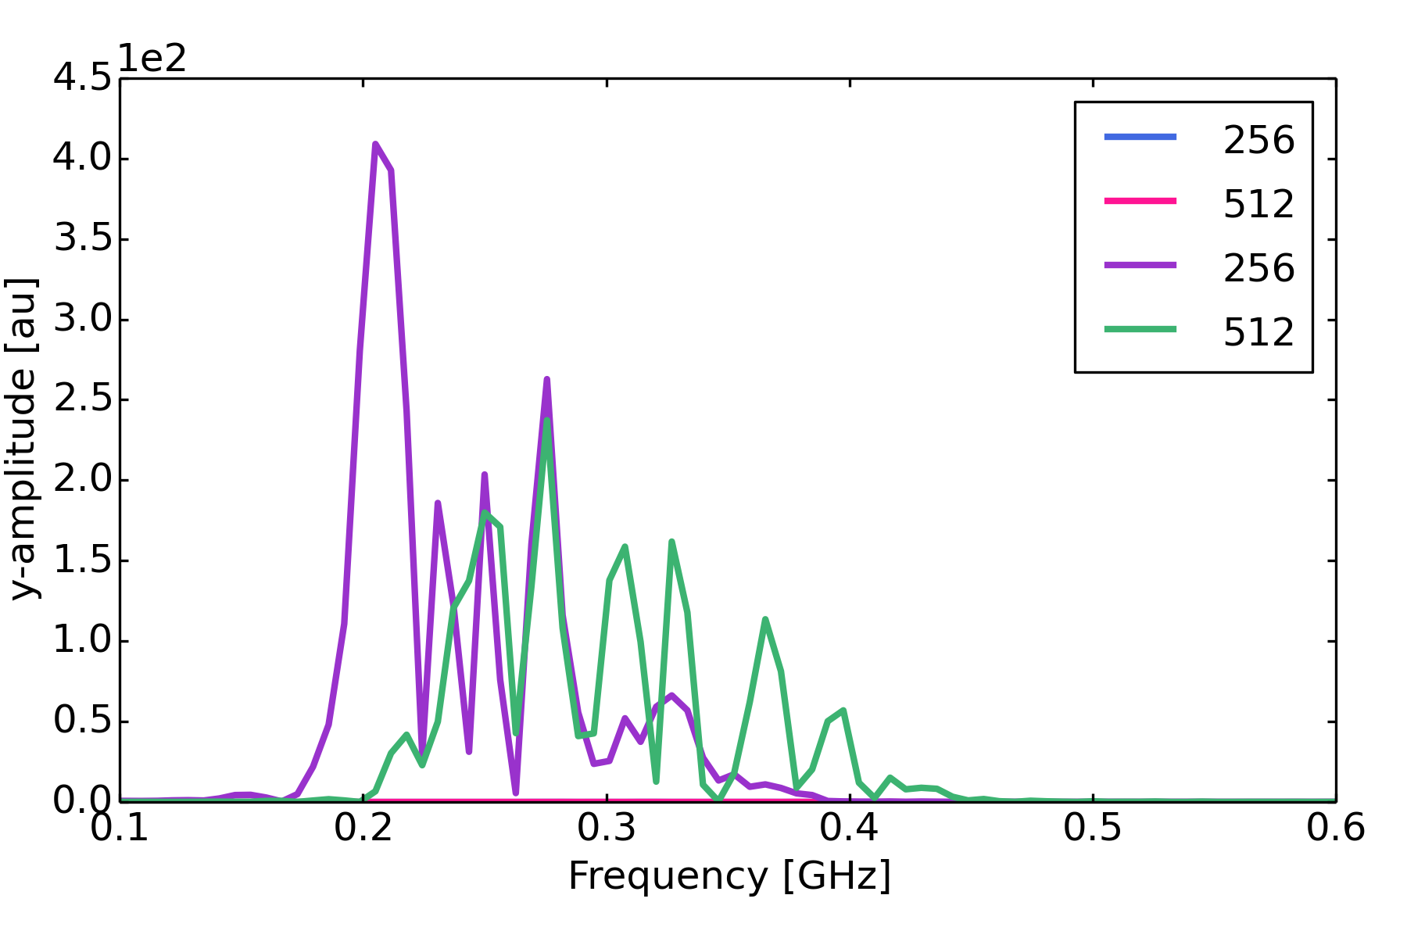
Grid convergence scans: Main Linac
Amplitude of vertical bunch train oscillation
Grid center shifted 0.5 cells

Slide 35
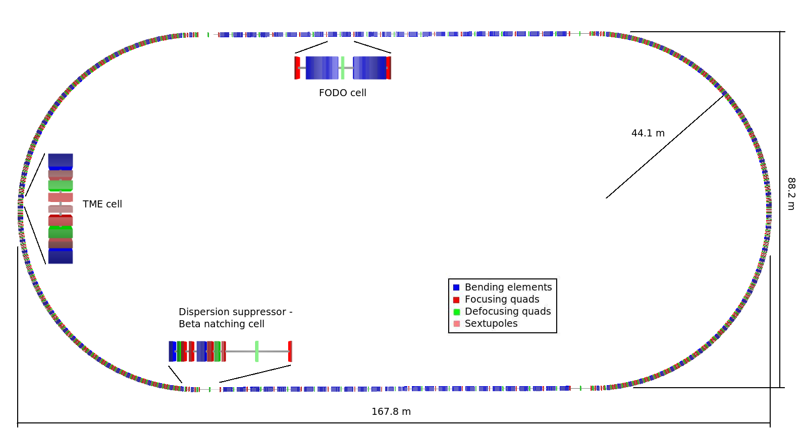
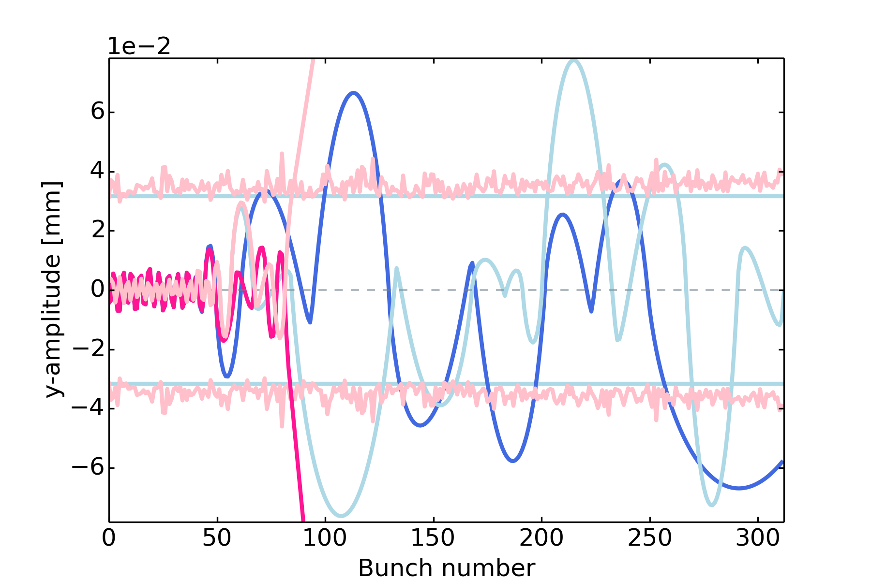
Dual-grid solver
Sample ion trajectories

