Slide 1


Review of FCC Detector Concepts
W. Riegler, H. Ten Kate, Mar. 30th 2016

Slide 2
Approach for Detector Design
Over the last year we worked out some detector concepts together with performance parametrizations that should be used for ‘fast’ simulation.
The software group had made significant progress and the software tools and examples for a ‘DELPHES’ type FCC detector simulation will be available by the FCC week in April.
Scanning performance parameters in the parametrized simulation will allow to narrow down the detector requirements.
In parallel we will stay quite open for different detector concepts and will perform specific full GEANT simulation of performance parameters.
The magnet system is the key driver for the overall dimensions, cavern, installation etc., so it is important to have an engineering design for a ‘worst case’ baseline together with some ‘scaling laws’.

Slide 3
Baseline Parameters for the FCC-hh Machine
The present working hypothesis is:
- peak luminosity baseline: 5x10³⁴ cm⁻²s⁻¹
- peak luminosity ultimate: ≤ 30x10³⁴ cm⁻²s⁻¹
- integrated luminosity baseline ~250 fb⁻¹ (average per year)
- integrated luminosity ultimate ~1000 fb⁻¹ (average per year)
An operation scenario with:
- 10 years baseline, leading to 2.5 ab⁻¹
- 15 years ultimate, leading to 15 ab⁻¹
would result in a total of O(20) ab⁻¹ over 25 years of operation.

Slide 4
Parameters Assumed for the Detector Design
L_{peak} [5x10³⁴ , 30x10³⁴] cm⁻²s⁻¹
→ Average N_{pileup} [170, 1020] at 25ns
→ Average N_{pileup} [34, 204] at 5ns
L_{int} [3, 30] ab⁻¹
These upper limits of L_{peak} and L_{int} should be read as Phase II goals that we use for detector studies and not as numbers promised by the machine!
The 5ns vs. 25ns bunch crossing time will stay an open parameter for some time.

Slide 5

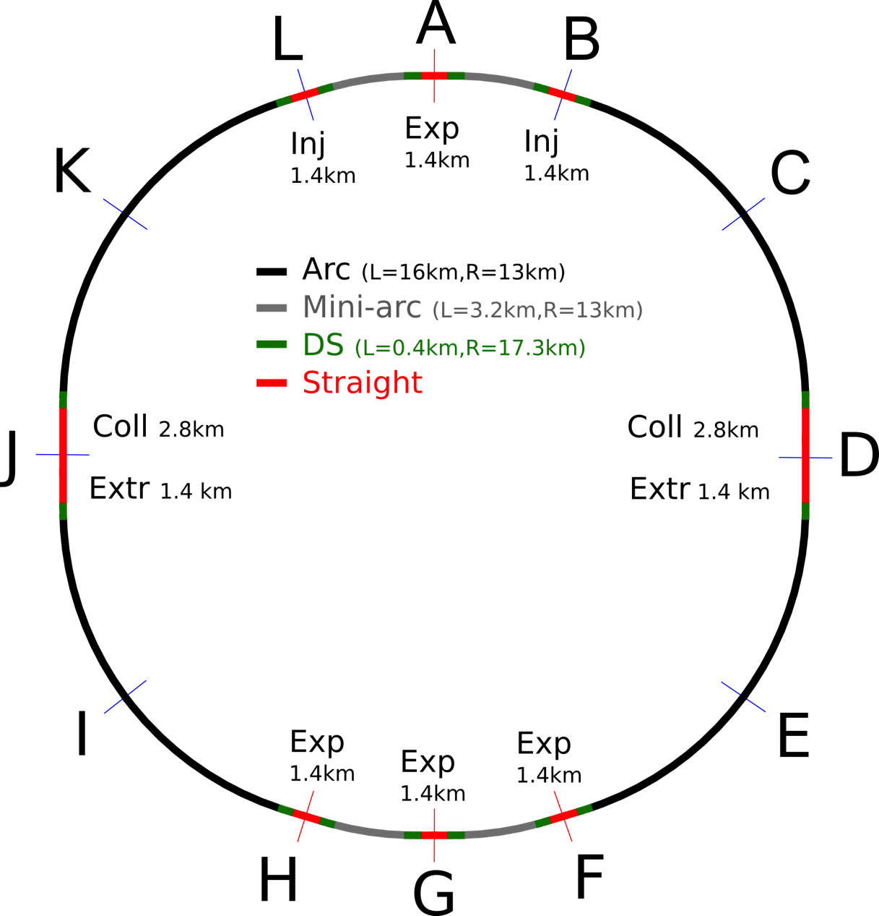
FCC-hh Preliminary Layout
100 km layout for FCC-hh
(different sizes under investigation)
Two high-luminosity experiments (A and G)
Two other experiments (F and H) grouped with main experiment in G
Two collimation lines
Two injection and two extraction lines

Slide 6
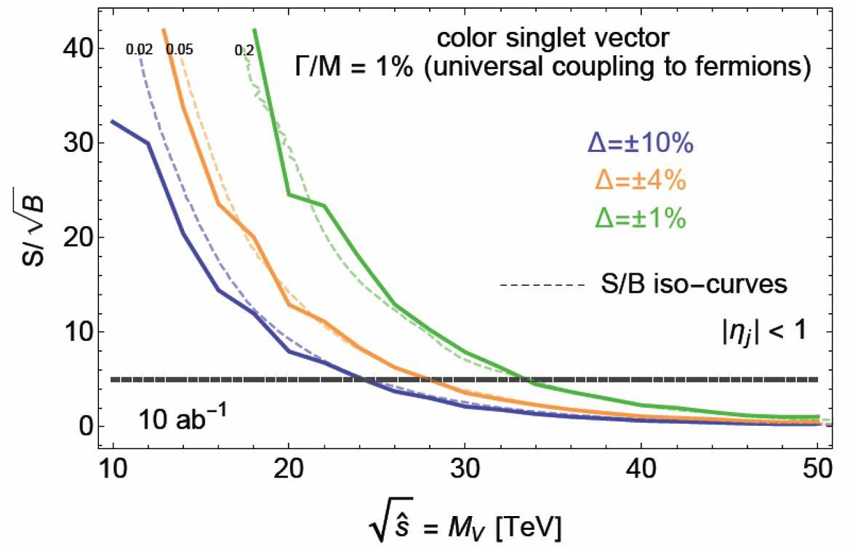
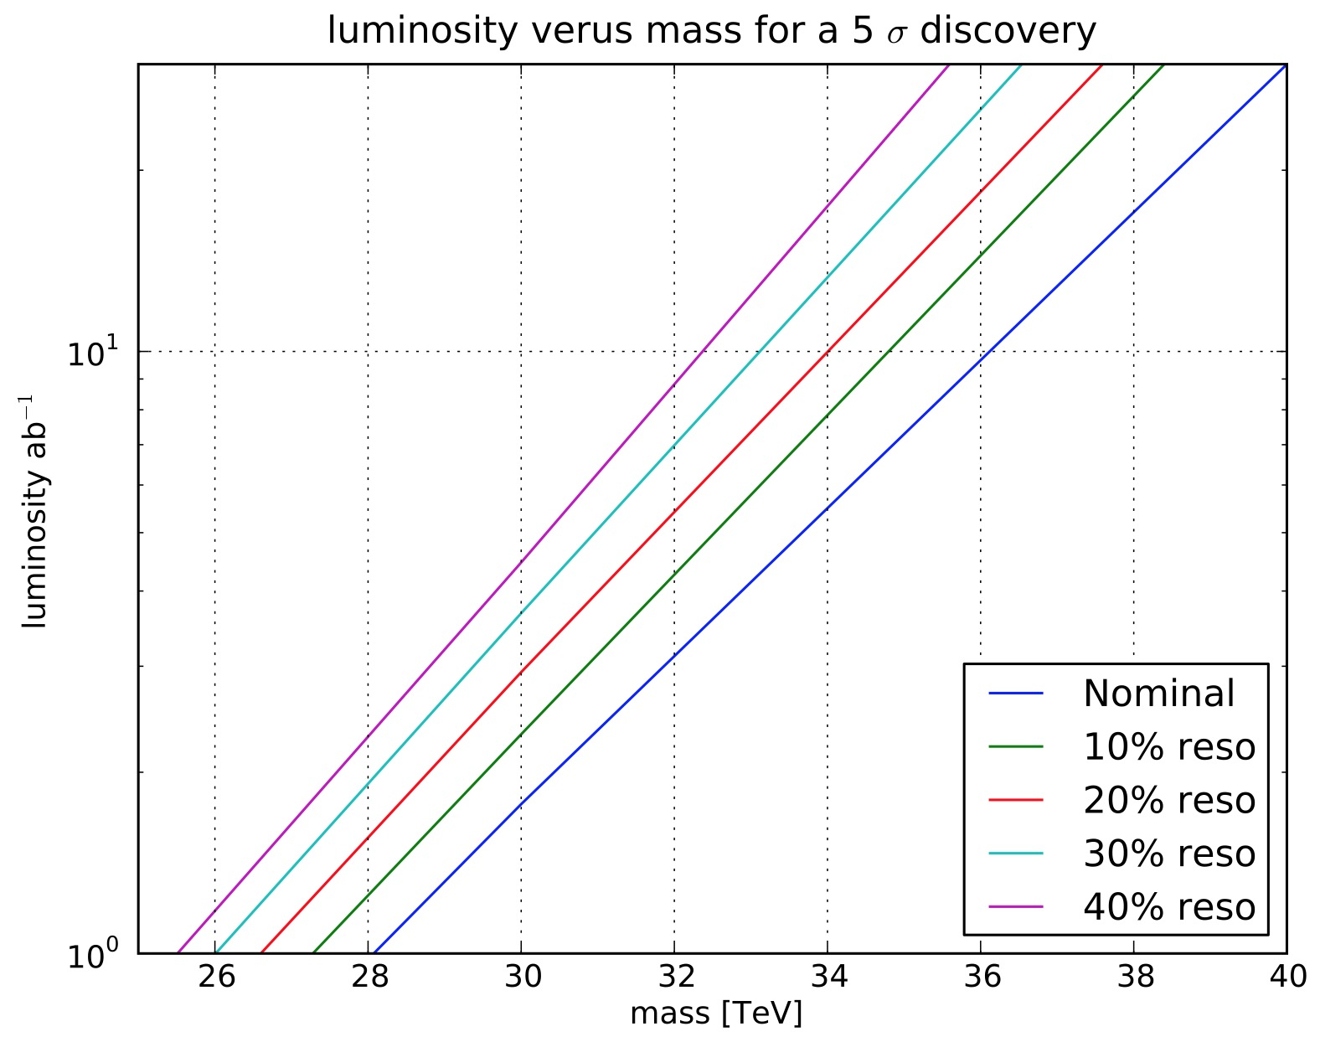
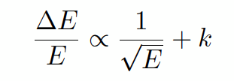
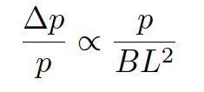
Physics at the Lσ Limit
Exploration potential through higher energy, increased statistics, increased precision
Example: Z’ _{SSM} discovery
luminosity versus mass for a 5σ discovery
20 ab⁻¹
Di-jet resonances: Extend discovery potential by 10TeV between mass resolutions of Δ=±10% to Δ=±1%
2% jet resolution a reasonable choice (Δ=±4%)
Constant term dominates, ≈ 2% goal
→ full shower containment is mandatory !
→ HCAL depth of 12 λ_{int} !
Muon momentum resolution:
O(15%) at 10TeV.
Compare to 10% at 1TeV spec. at LHC

Slide 7
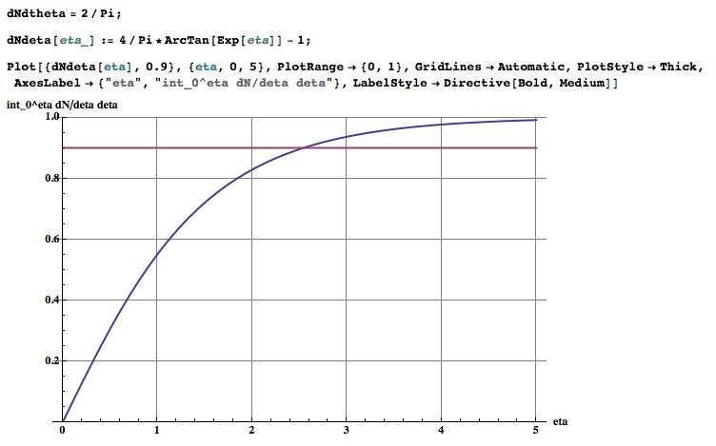
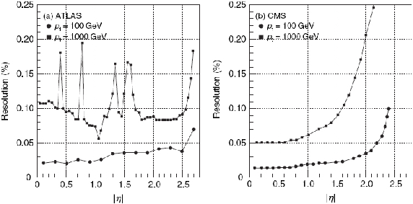
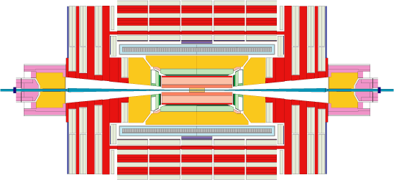
Rapidity distribution of an ‚Isotropic Track‘
Probability that the track has η<2.5 is 90%
2 tracks η < 2.5 = 0.9²=0.81
3 tracks η < 2.5 = 0.73
4 tracks η < 2.5 = 0.66
Probability that the track has η<1.5 is 72%
2 tracks η < 1.5 = 0.52
3 tracks η < 1.5 = 0.37
4 tracks η < 1.5 = 0.27
η
W. Riegler (CERN)
7

Slide 8
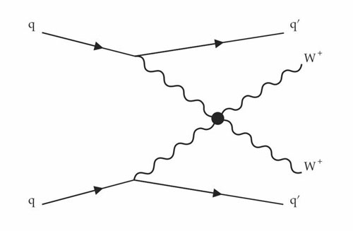
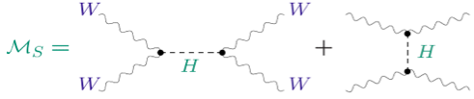
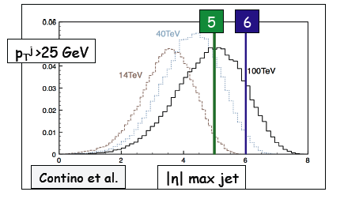
WW Scattering by VBF Mechanism
WW→WW scattering violates unitarity at high energies
A scalar, such as the Higgs boson, fixes this (partially)
Probing characteristics of VV scattering is an important test of the nature of electroweak symmetry breaking
New Physics would modify interferences between diagrams → modified V p_{T} and di-boson mass. Also: Are there high mass resonances WW, ZZ, HH, …
VBF jets also important for tagging of Higgs produced though VBF, like H->bb, H->tautau etc.
VBF jets between η~2 and η~6
need to be well measured and
separated from pile-up

Slide 9
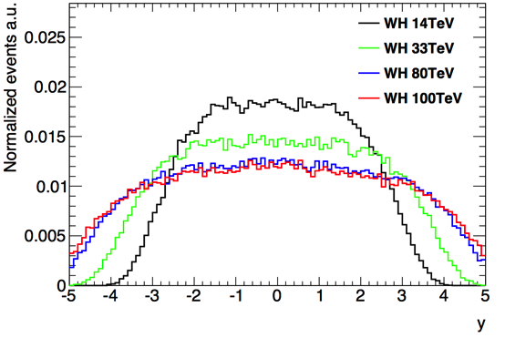
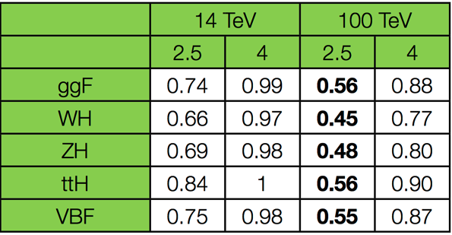

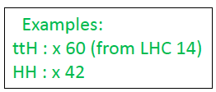
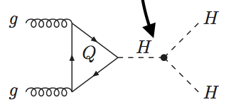
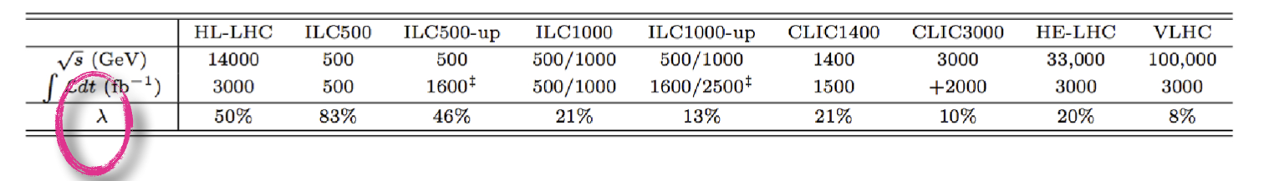
Higgs Measurements
H→ 4l acceptance vs η coverage (p_{T} cuts applied)
→ 30-50% acceptance loss for H→ 4l at 100 TeV wrt 14 TeV if tracking and precision EM
calorimetry limited to |η|<2.5 (as ATLAS and CMS)
→ can be recovered by extending to |η|~ 4
“Heavy” final states require high √s, e.g.:
HH production (including measurements of self-couplings λ)
ttH (note: ttH→ ttμμ, ttZZ “rare” and particularly clean)
g_{HHH}~ λv
FCC

Slide 10
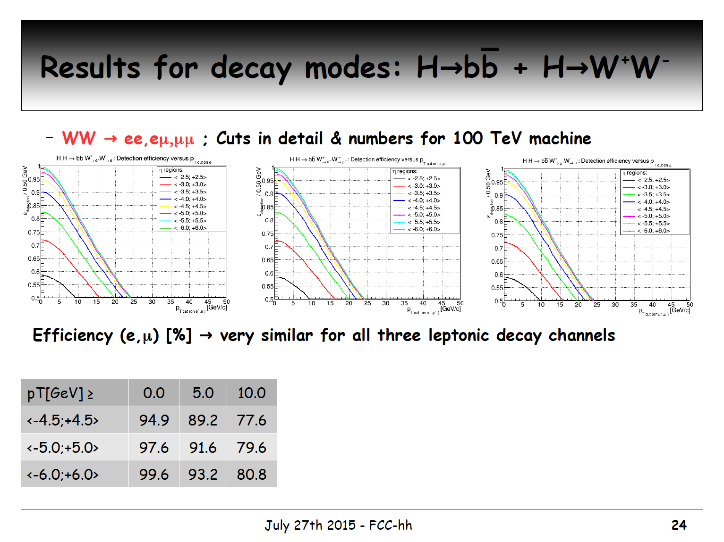
Circle diameter of 1GeV Pt particle in 6T field is 1.1m

Slide 11
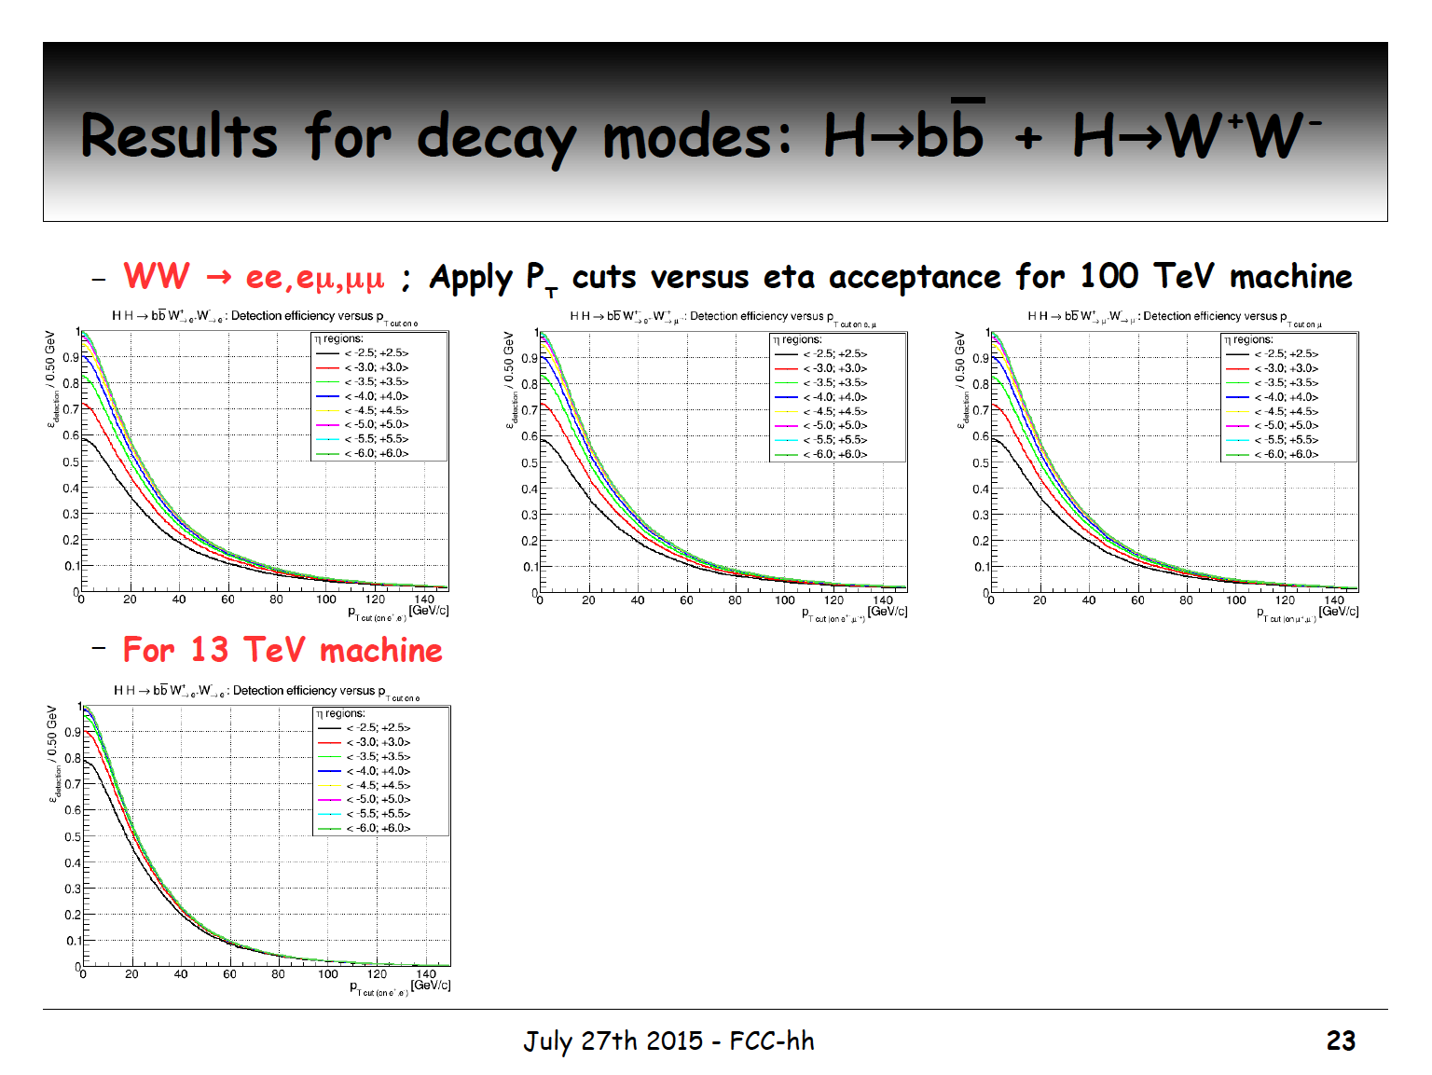

Slide 12
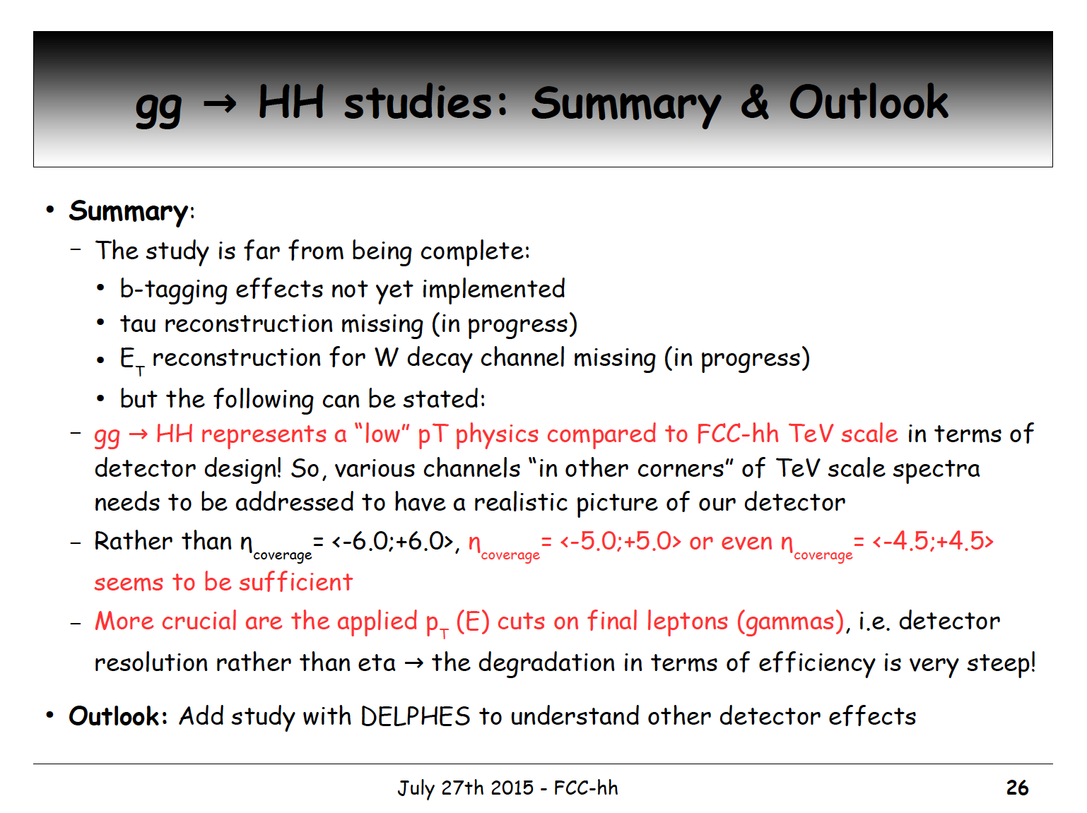

Slide 13
Physics at a 100 TeV Hadron Collider
Exploration + Higgs as a tool for discovery
Numerous physics opportunities with a large number of possible measurements.
How to specify detectors for such a machine ?
ATLAS and CMS are general purpose detectors that were benchmarked with the ‘hypothetical’ Higgs in different mass regions with precision tracking and calorimetry up to η=2.5.
The Higgs is also key benchmark for the FCC detectors, with highly forward boosted features (E_{cm}= 100TeV, Higgs mass = 125GeV)
FCC detectors must be ‘general general’ purpose detectors with very large η acceptance and extreme granularity.

Slide 14
Approximate Overall Needs
Tracking: Momentum resolution ≈15% at p_{T}=10TeV
Precision tracking (momentum spectroscopy) and ECAL up to η=4
ECAL fine granularity for track-cluster matching (or particle flow) to mitigate pile-up and recover Bremstrahlungs losses
Tracking and calorimetry for jets up to η=6.
12 λ_{int} calorimetry ≈2% constant term.
HCAL granularity of 0.05x0.05 or 0.025x0.025 to mitigate pileup and measure jet substructure and boosted objects.
B-tagging, timing for pileup rejection etc. …

Slide 15
What Do Inelastic Collisions at 100TeV Look Like
Minimum Bias events scaling 14TeV → 100TeV:
Inelastic cross-section changes from 80 → 108mb.
Multiplicity changes from 5.4 → 8 charged particles per rapidity unit.
Average p_{T} of charged particles changes from 0.6 → 0.8 GeV/c.
Hard scatter events (events of interest) with p_{T} up to 7 times higher (100/14).
→ Transverse energy sum increases by about a factor of 2.
→ The Min. Bias events at FCC are quite similar to the Min. Bias events at LHC.

Slide 16
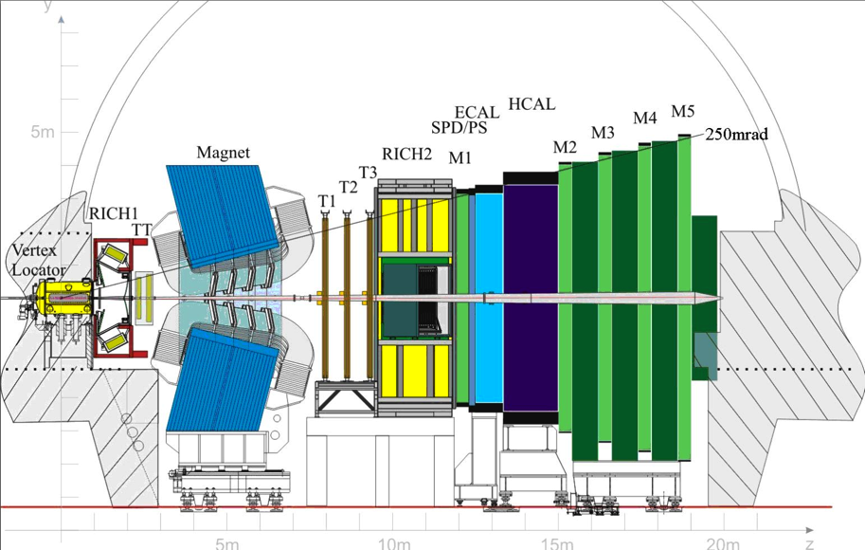
LHCb: Tracking, Calo η = 2 - 5
… all with impressive performance …
ATLAS, CMS: tracking, calo η -2.5,2.5
η=1.0
η=1.5
η=3

Slide 17
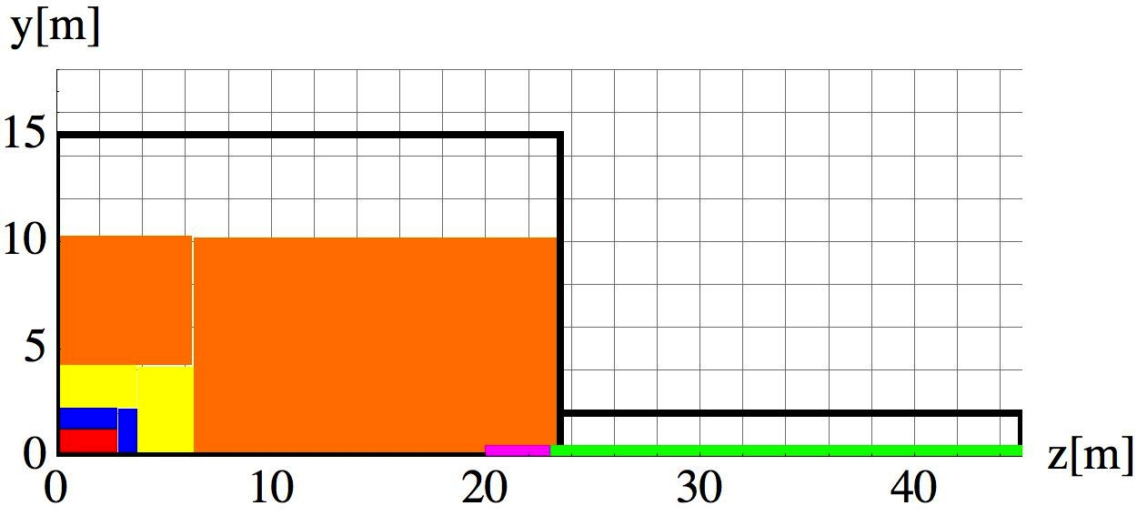
ATLAS
Tracker r=1m, B=2T thin solenoid coil in front of the calorimeters
LArg ECAL, HCAL and 7.4 λ_{int} that returns the flux
Large air core toroid, B=0.5T ‘standalone muon system’
Tracker
Emcal
Hcal
Muon
Coil
TAS
Triplet

Slide 18
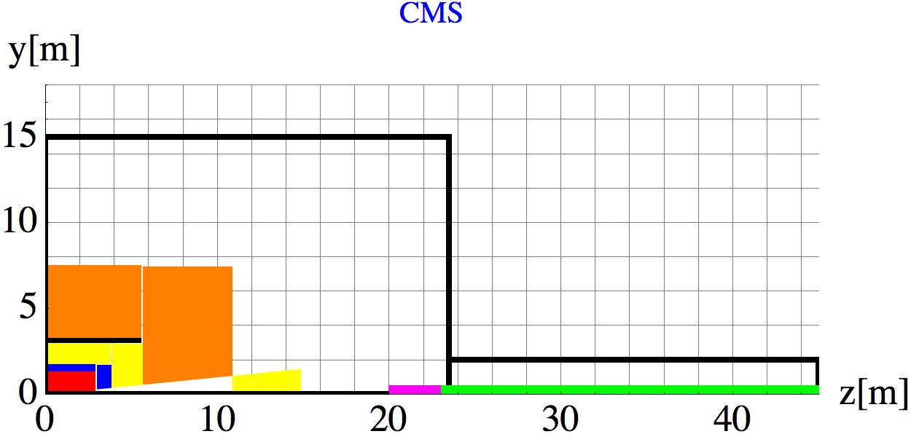
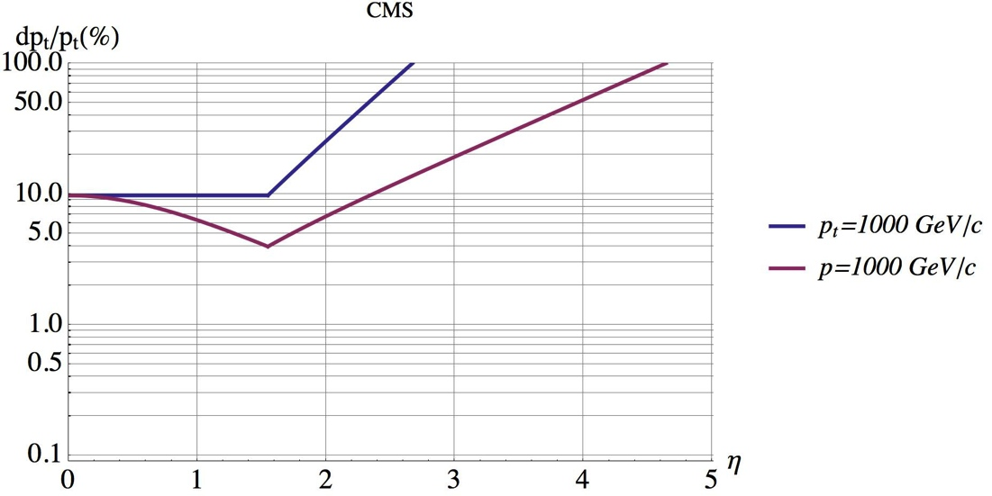
CMS
Tracker r=1.2m
Compact Crystal ECAL, ‘short’ HCAL of and 5.82 λ_{int}, cut at η = 3 to move FCAL away.
R=3m solenoid coil with 3.8T field.
Iron Yoke to return Flux, instrumented with muon chambers.
CMS muons are relying on a properly working tracker.
Tracker
Emcal
Hcal
Muon
Coil
TAS
Triplet
Muon
Hcal
Emcal
Tracker
Coil
1TeV

Slide 19
How to Scale LHC Experiments to FCC ?
Let’s assume a tracking resolution of 10-15% for 10TeV particles and a calo constant term of ≈2% which requires full shower containment and therefore 12 λ_{int} of calo i.e. ≥3m
Coil with high B-field and low material budget in front of ECAL/HCAL seems very difficult, so scaling the ATLAS approach is questionable.
Leaving the tracker radius similar to LHC values of r=1m, which is extremely challenging, with 12λ_{int} calo a coil radius of at least 4m is needed (→ CMS+).
  An iron yoke to return the flux for such a coil might still be affordable.
With a more realistic approach for calorimetry and tracking we end up with coil radii of 6m, which requires an iron yoke that is probably unaffordable.
In this case one uses either active shielding (twin solenoid) or a yoke that only returns part of the flux (partial shielding) - stringent requirements on the equipment in the environment.

Slide 20
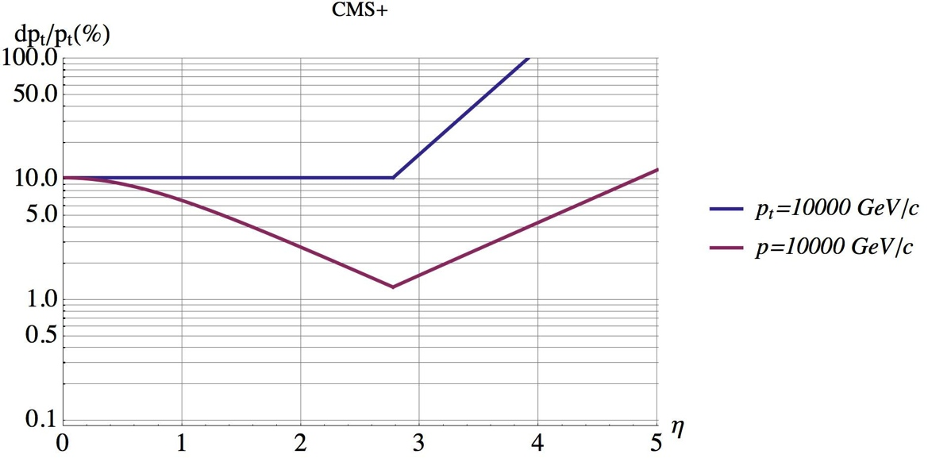
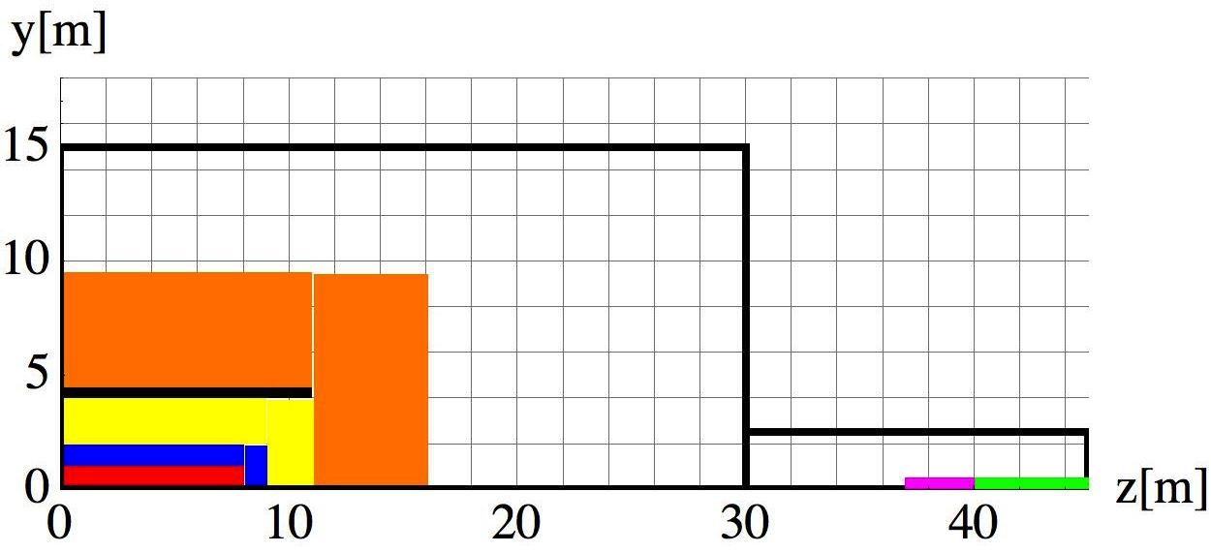
CMS Scaled Detector with Very Long Extreme Resol. Tracker
Maximum coil producing 6T with affordable iron yoke (r=4m)
Tracker radius 1m, 6T → resolution has to be improved by factor 6 with respect to CMS → 5µm layer resolution and less material (multiple scattering)
8m long tracker gives large η acceptance.
2.8m available for EMCAL+HCAL e.g. very compact W/Si particle flow calorimeters
Very high granularity forward calorimeters needed
Muon system a’la CMS
→ ‘extreme’ technology challenge.
10TeV
15 layers
Tracker
Emcal
Hcal
Muon
Coil
TAS
Triplet

Slide 21
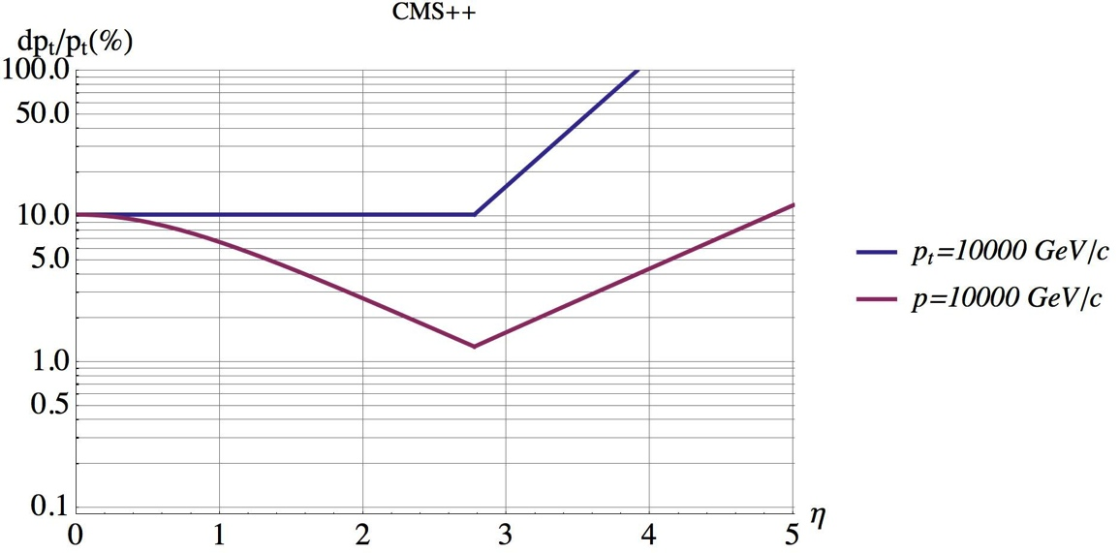
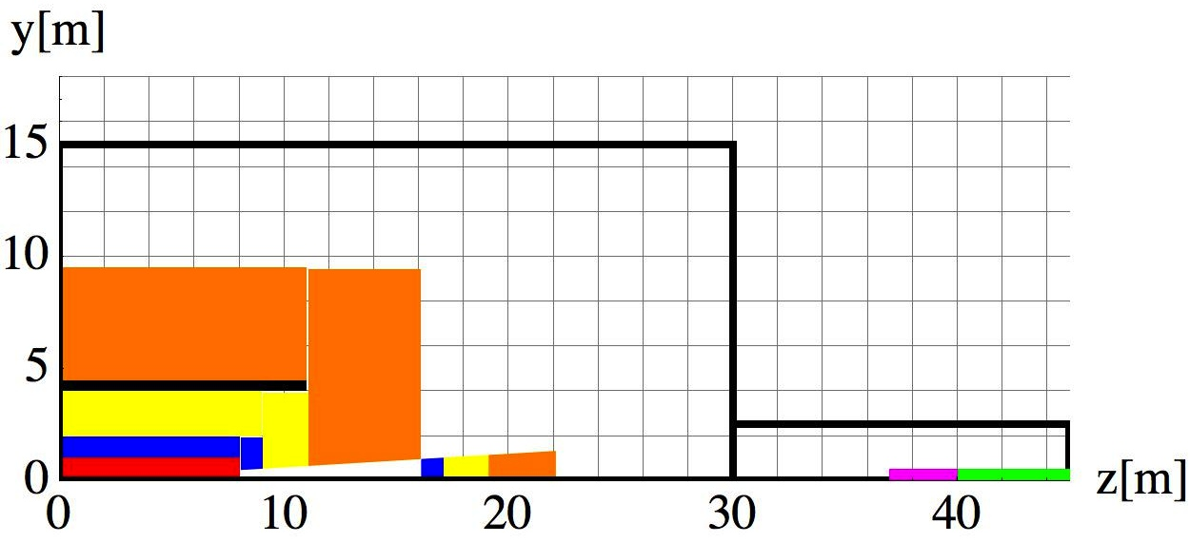
CMS Scaled Detector, Forward Calorimetry Moved Out
Forward calorimetry moved to large distance from η = 3.5 for reduced occupancy and radiation load
10TeV
15 layers
Tracker
Emcal
Hcal
Muon
Coil
TAS
Triplet

Slide 22
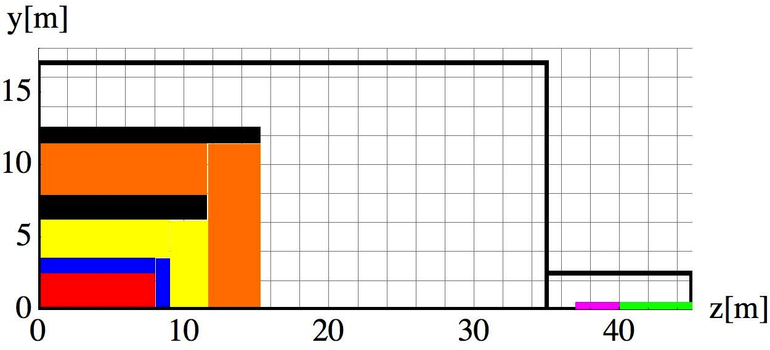
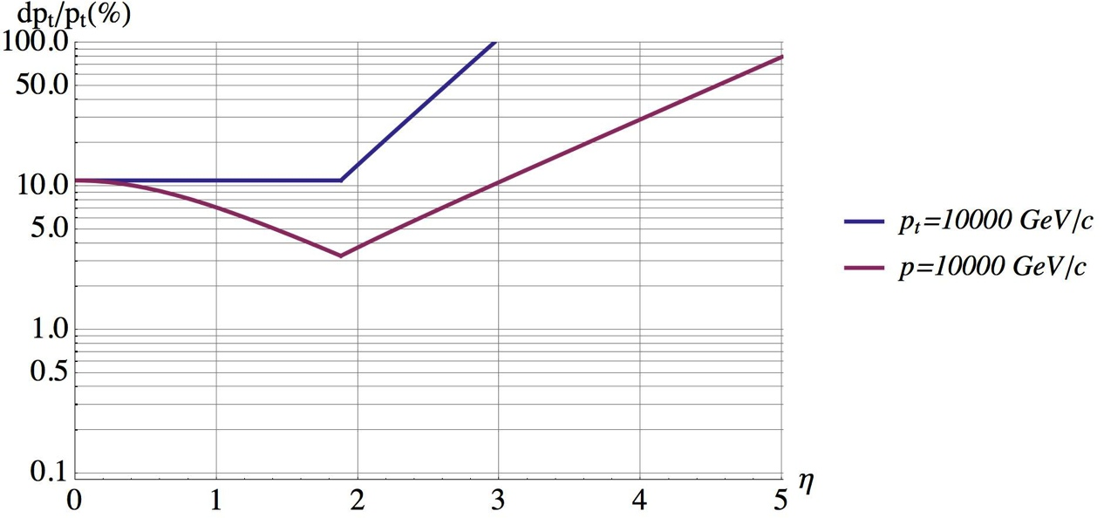
Twin Solenoid BL² Scaling
How to achieve 10% for a 10TeV charged particle assuming tracker with nowadays layer resolution (~20µm)?
Solenoid and shielding solenoid with B=6T in Tracker and B=2.5T in Muon System
Tracker r=2.5m, L=16m, tracking layer resolution similar to CMS detector
ECAL+HCAL = 3.4m = 12 λ_{int}
Momentum resolution gets marginal at η>3.
Tracker
Emcal
Hcal
Muon
Coil
TAS
Triplet
15 layers
10TeV

Slide 23
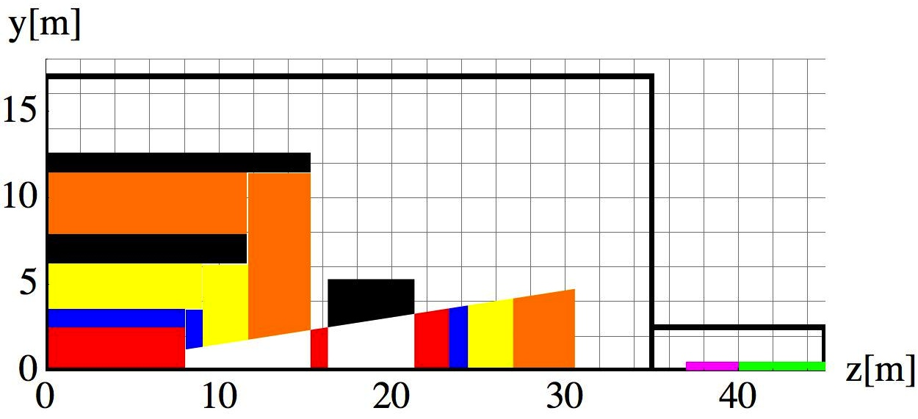
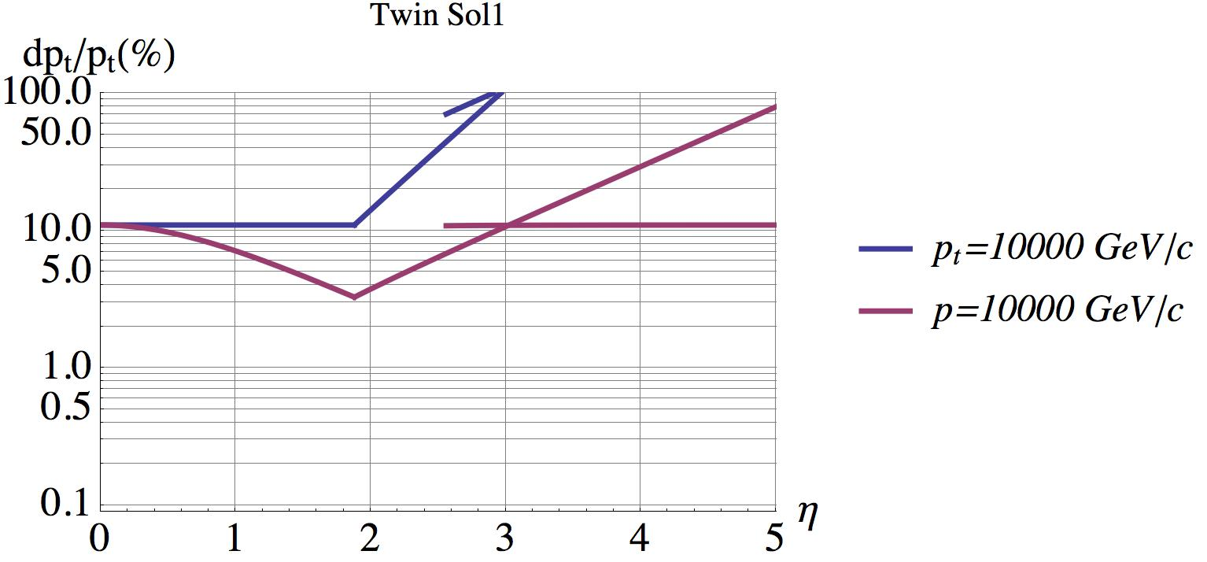
Twin Solenoid BL² Scaling + Forward Dipole
Opening at η = 2.5
Adding a forward Dipole for momentum spectroscopy.
Moving forward calorimeters to larger distance decreasing the particle densities and overlaps.
Allows separate instrumentation and upgrade of forward detectors
Integration and maintenance is a challenge
Tracker
Emcal
Hcal
Muon
Coil
TAS
Triplet
10TeV
15 layers

Slide 24
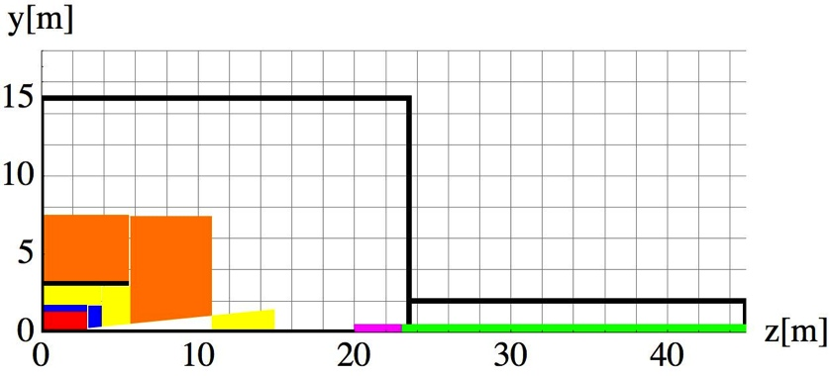
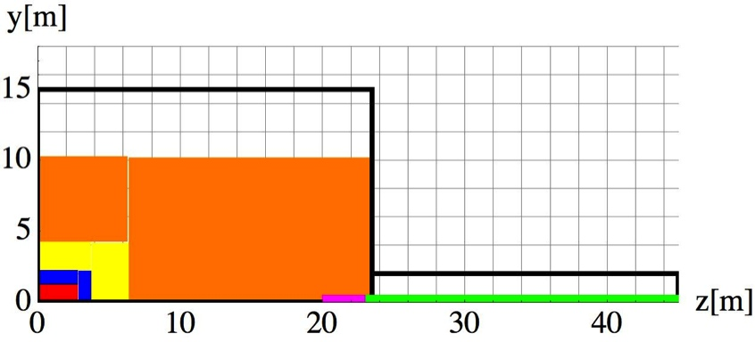


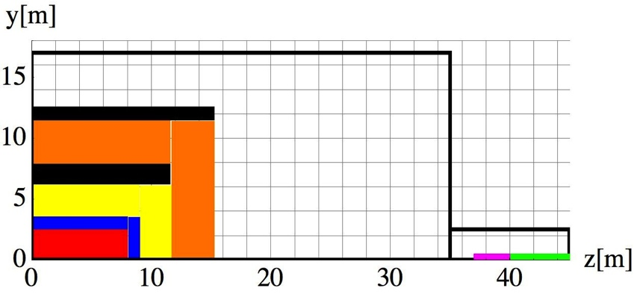
CMS & ATLAS
Twin Solenoid
+ Dipole
Popular at Present
CMS+
Partially shielded large solenoid

Slide 25
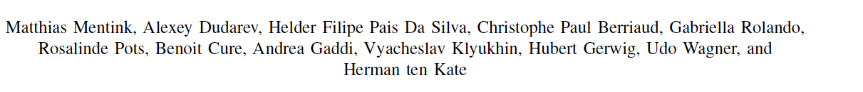
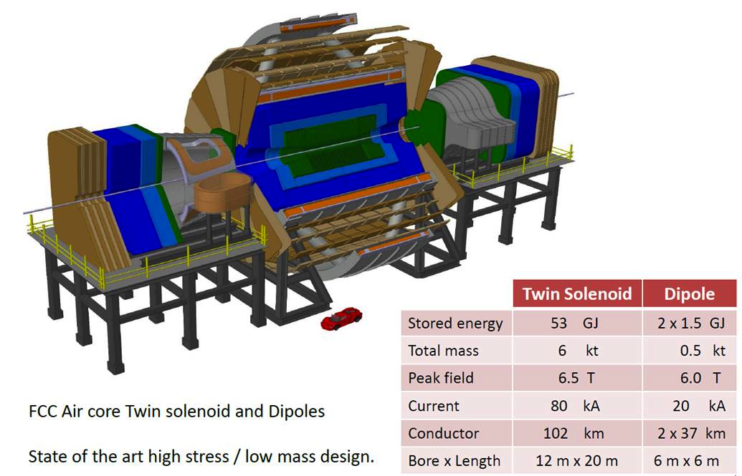
Twin Solenoid + Dipole Magnet System

Slide 26
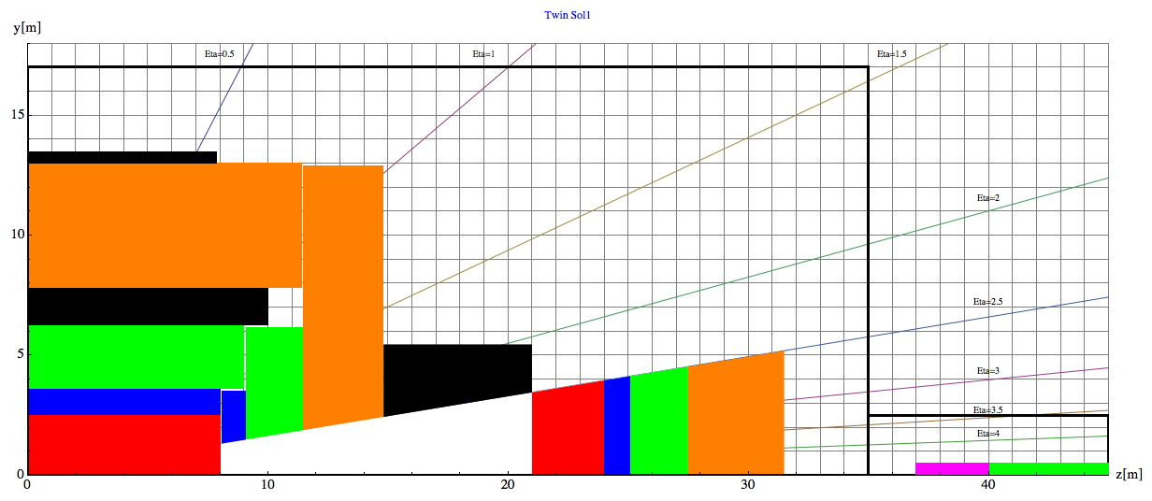
Barrel:
Tracker available space:
R=2.1cm to R=2.5m, L=8m
EMCAL available space:
R=2.5m to R= 3.6m → dR= 1.1m
HCAL available space:
R= 3.6m to R=6.0m → dR=2.4m
Coil+Cryostat:
R= 6m to R= 7.825 → dR = 1.575m, L=10.1m
Muon available space:
R= 7.825m to R= 13m → dR = 5.175m
Coil2:
R=13m to R=13.47m → dR=0.475m, L=7.6m
31.5m
40m
45m
Endcap:
EMCAL available space:
z=8m to z= 9.1m → dz= 1.1m
HCAL available space:
z= 9.1m to z=11.5m → dz=2.4m
Muon available space:
z= 11.5m to z= 14.8m → dz = 3.3m
Forward:
Dipole:
z= 14.8m to z= 21m → dz=6.2m
FTracker available space:
z=21m to R=24m, L=3m
FEMCAL available space:
Z=24m to z= 25.1m → dz= 1.1m
FHCAL available space:
z= 25.1m to z=27.5m → dz=2.4m
FMuon available space:
z= 27.5m to z=31.5m → dz=4m

Slide 27
Tracking

Slide 28
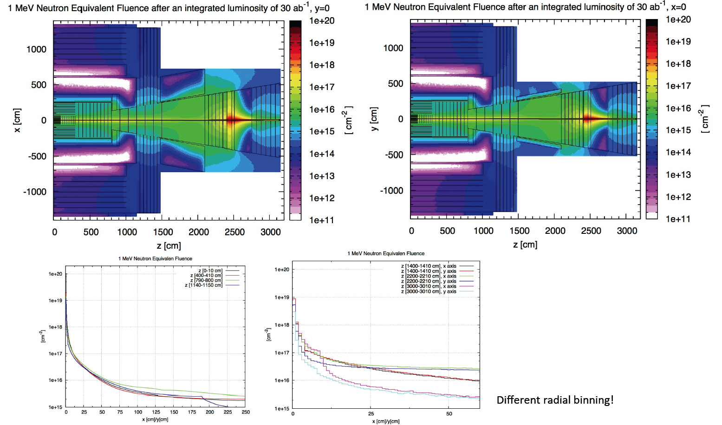
1 MeV Neutron Equivalent Fluence (FLUKA simulation, M.I.Besana)
Detailed radiation simulations with FLUKA for the baseline detector exist.
Radiation load in the trackers shows primarily radial dependence from the beamline, weak dependence on z (as expected).
For radii <50cm we exceed the HL-LHC numbers (10¹⁶ cm⁻²) by up to 2 orders of magnitude
→ Technology challenge !
ATLAS Phase II Tracker innermost pixel layer

Slide 29
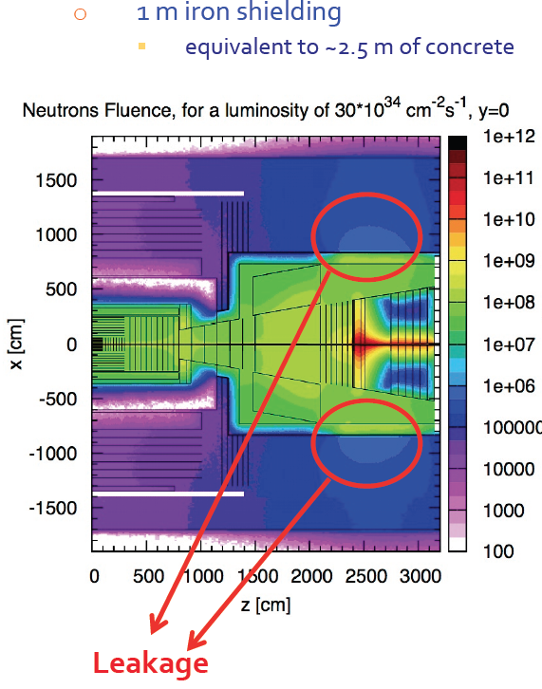
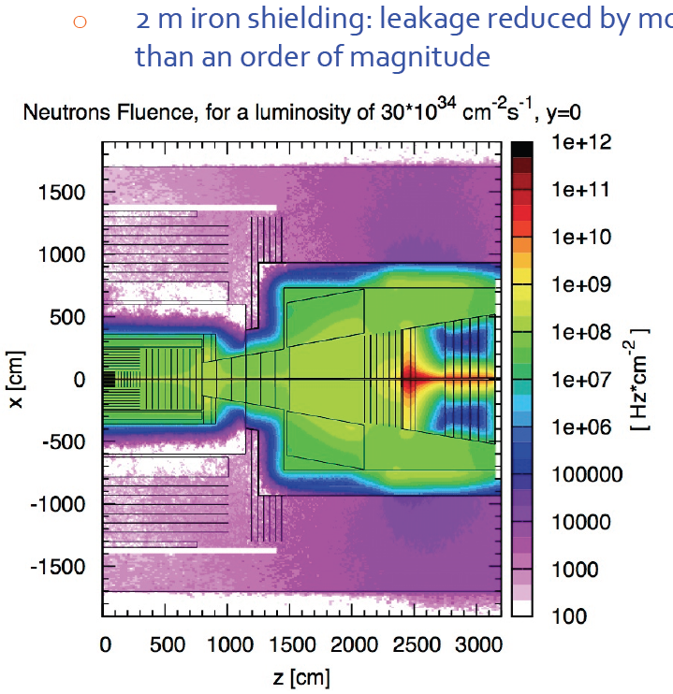

Slide 30
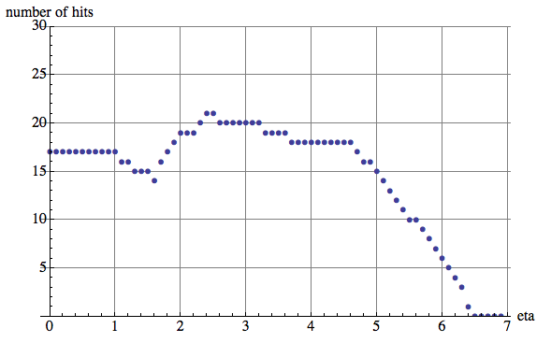
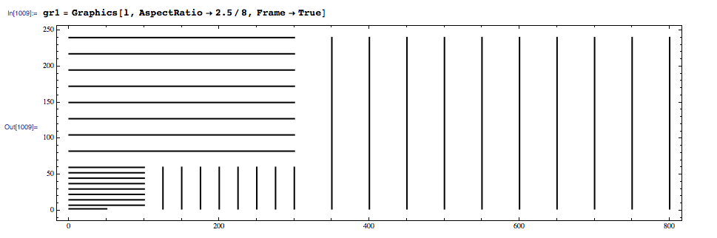
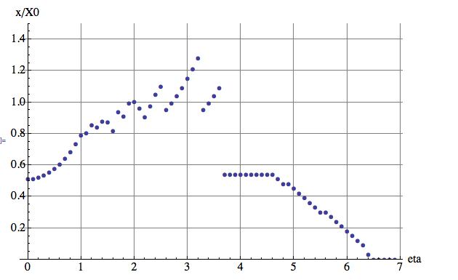
Simplified Tracker Assumptions
Neglecting radiation for a moment: is 10% resolution achievable (for 10TeV)?
Material composition in Volume (%):
Si 20%, C 42%, Cu 2%, Al 6%, Plastic 30%
X₀ of this mix: 14.37cm
We assume 3% of radiation length per layer,
i.e. each layer has a thickness of 0.43cm.
R_{out}=2.4m
Half the leaver arm at eta=2.6→ L=8m

Slide 31
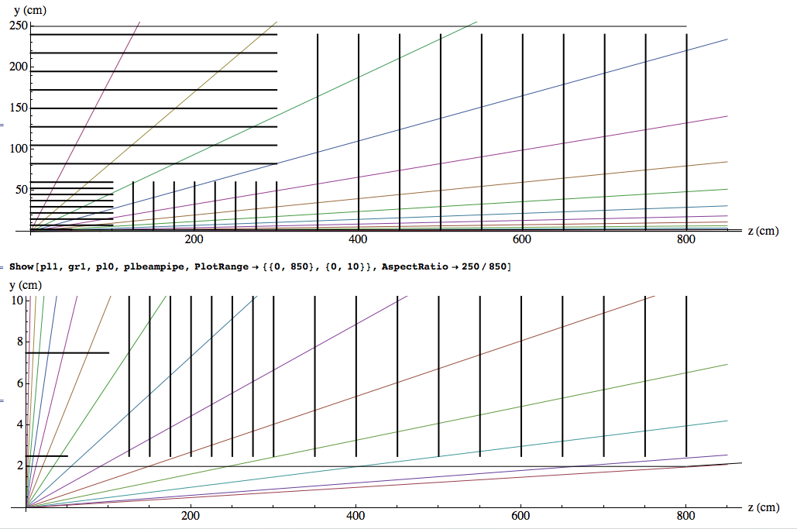
Tracker
Eta=0.5
1
1.5
2
2.5
3
3.5
4
4
4.5
5.
5.5
6.
6.5
6.7

Slide 32
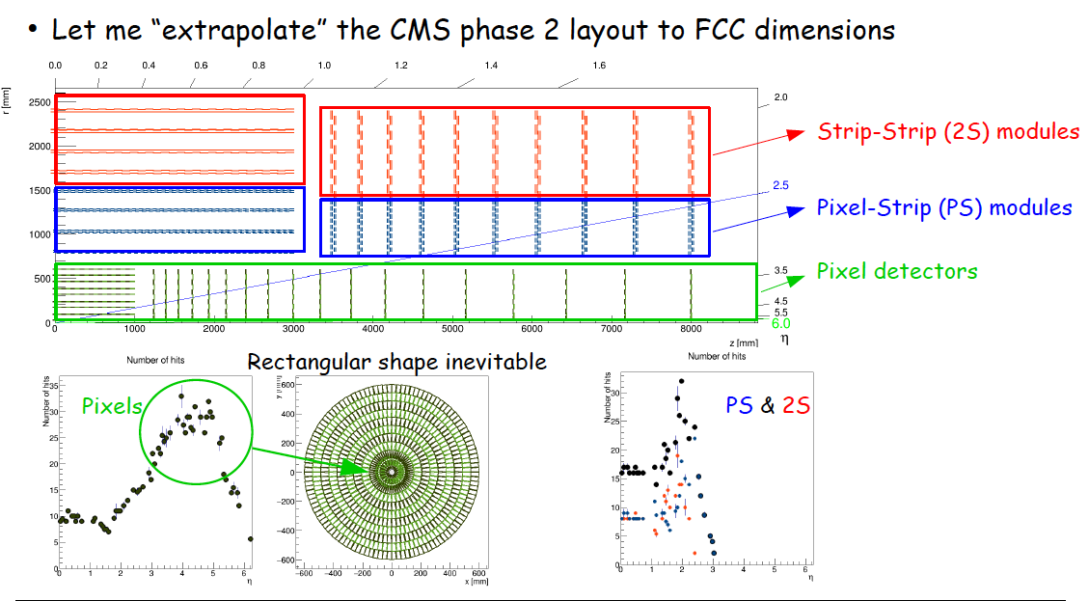

Slide 33
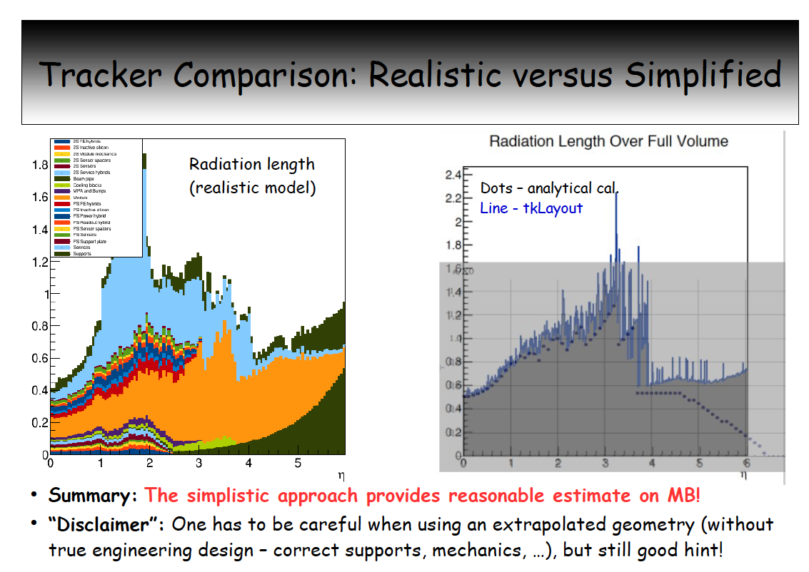

Slide 34
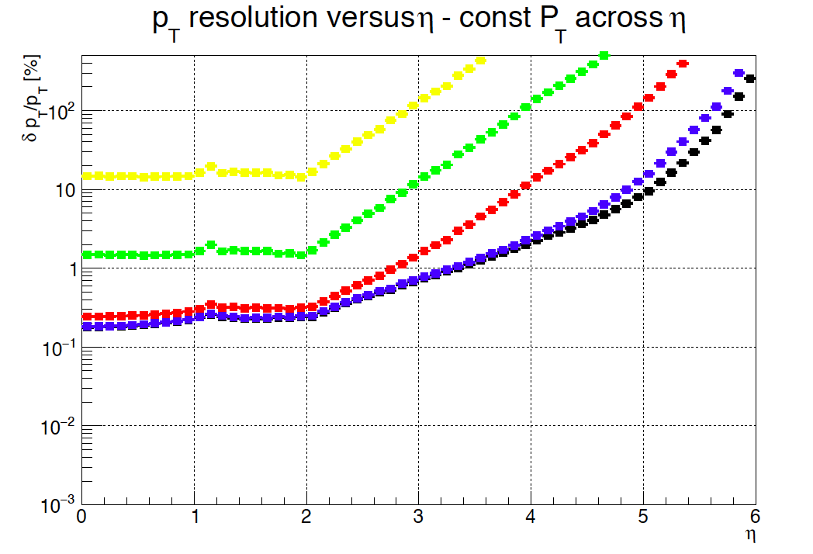
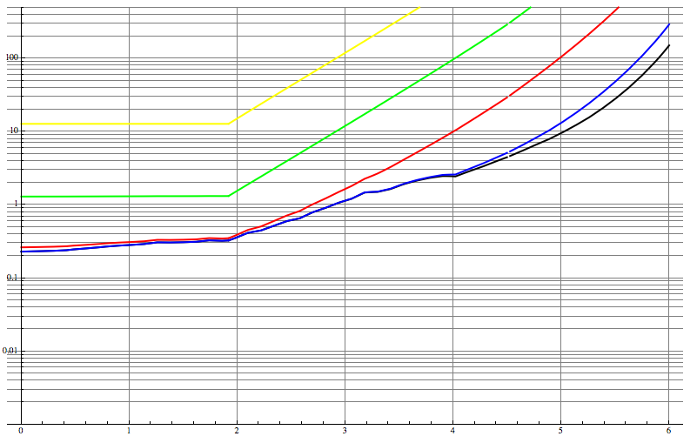
Tracker
The points are results from the TKLayout Tool (Z. Drasal), the solid lines are the standard formulas.
10 000GeV, 1000GeV, 100GeV, 10GeV, 5GeV

Slide 35
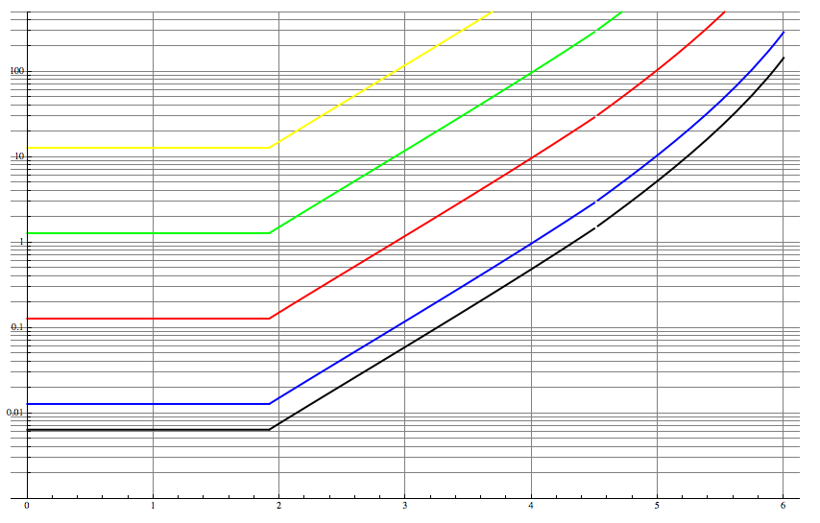
Tracker
Solid lines show the formulas from the previous slide, multiple scattering neglected.
10 000GeV, 1000GeV, 100GeV, 10GeV, 5GeV

Slide 36

Tracker
Large BL² needed for high momenta, but large BL also key to minimize multiple scattering contribution → 10% for a 10TeV charged particle within reach for tracker radius of 2.5m (|eta|<2)!
Could we also reach that with a CMS like design (smaller tracker radius): How to scale the system and keep the performance constant ?
At constant B and 1/2 the tracker radius (2.5m → 1.2m) → free bore of solenoid from 12m to 10m we need:
4 times the tracker resolution (20µm → 5µm) and
4 times less material budget (x/X₀=50% at eta=0 to x/X₀=12.5% at eta=0 i.e. 3% per Layer to 0.75% per layer)
These values are challenging but not out of reach.
A final choice is part of an optimization that depends on future technologies

Slide 37
Forward Tracking

Slide 38
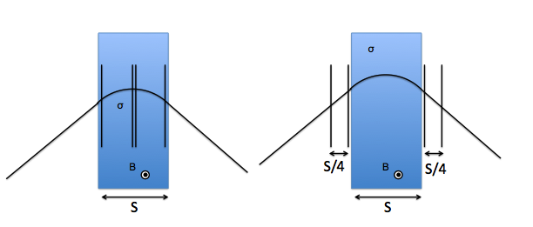
Forward Tracking Resolution, Position Resolution
Using 4 tracking stations for a dipole with constant magnetic field and length S, the optimum spectrometer resolution is achieved by placing 2 stations in the center and one on each end to measure the sagitta.
The same performance is achieved by placing the chambers outside the dipole at separation of S/4.
This is what LHCb uses, because if space is available it is more easy to implement the detectors outside, and also avoid occupancy from loopers in the field (details on catching Ks etc. are of curse to be considered …)
We use this idea for now (is also easier to calculate ! It is just the
Int B dl that counts)

Slide 39

Forward Tracker Resolution, Position Resolution
σ
σ
θ
σ
σ
B
L
L

Slide 40

Forward Tracker Resolution, Multiple Scattering
L
Δα₁
θ
B
L
Δα₂

Slide 41



Forward Tracker Resolution, Measurement of angle
Material budget of first layer dominates !
Δθ
Pixel L2
θ
Pixel L1
IP

Slide 42



Forward Tracker Resolution
σ=30μm
Int Bdl=10 Tm
L=2m
X_{f}/X₀=0.06
Int Bdl=10 Tm
X_{t}/X₀=0.03

Slide 43

Forward Tracker Resolution
10 000GeV, 1000GeV, 100GeV, 10GeV, 5GeV
Solid lines show the performance of the forward dipole

Slide 44


Slide 45
Solenoid Field extended to Z=22m
Replacing the dipole by a solenoid that extends the B=6T field up to Z=22m,
we can extend shift the resolution curves by one unit of eta,
i.e. flat resolution (10% at p_{T}=10TeV/c) up to η =3 and ¼ of the resolution at η =3.5
This competed with our present performance parametrization of the Dipole up to η≈4.5

Slide 46
Forward Tracker Resolution
10 000GeV, 1000GeV, 100GeV, 10GeV, 5GeV
→Interesting ! Parametrized simulations will give indications

Slide 47
Muon System

Slide 48

At B₀=6T and R₀=6m,
Muons below 7GeV do not enter the muon system.
No Muon Trigger below 7GeV.
Possibly muon ID with HCAL.
9 GeV
7 GeV
20 GeV
Outer twin solenoid
50 GeV
100 GeV
Tracker
HCAL
ECAL
Solenoid
Muon system

Slide 49
Muon Momentum Can Be Measured by…
1) The inner tracker
resolution plots from before
2) A ‘standalone’ sagitta measurement in the muon system (no iron → precise !)
3) The track angle at the entrance of the muon system → Trigger
4) The combined fit of inner tracker and outer layers of the muon system.

Slide 50

CMS Muon Performance
30%
20%
10%
5%
P_{T}=1TeV/c, 0<eta < 0.8: 20% muon standalone (angle) 10% inner tracker only
5% combined
P_{T}=1TeV/c, eta 0<eta<2.4: 40% muon standalone (angle) 20% inner tracker only
10% combined

Slide 51
Sagitta Measurement in the Muon System
The return field is 2.45T
Measuring over the 5m lever arm with stations of sig=50µm resolution we have
dp_{T}/p_{T}= sig*p_{T}/(0.3*B*L²)*8
= 20% @ 10TeV
with possibly excellent performance at low p_{T} due to the absence of iron (vs. CMS) .
but very hard to beat the angular measurement and the inner tracker
(10% at 10TeV)
Surface > 5000 m²
CMS sagitta measurement in the muon system is limited to dp_{T}/p_{T} = 20% due to multiple scattering alone.

Slide 52


Radiation Length and Angular Deflection (Mult. Scattering)
s₄
s₃
s₂
s₁
10 TeV/s

Slide 53

Momentum Resolution for a 10 TeV/s Muon
9 GeV
Muon system only (angle measurement)
7 GeV
20 GeV
50 GeV
Inner tracker only
★
★
100 GeV
Combined fits
(meas. at large or small radius)
★
★
Twin Solenoid assuming inner tracker with baseline resolution curves and multiple scattering limit in the muons system.
P_{T}=10TeV/c eta = 0: 5% muon standalone (angle)
10% inner tracker only
2% combined
P_{T}=10TeV/c eta=2.: 35% muon standalone (angle) 12.5% inner tracker only
8% combined
Compare to the CMS numbers:
P_{T}=1TeV/c, 0<eta < 0.8: 20% muon standalone (angle)
10% inner tracker only
5% combined
P_{T}=1TeV/c, eta 1.2<eta<2.4: 40% muon standalone (angle) 20% inner tracker only
10% combined

Slide 54
Calorimetry

Slide 55


Requirements ECAL
ECAL:
Depth only moderately sensitive to √s: 30X₀ enough for fully contained e/γ (ATLAS ~22X₀)
Large acceptance up to |η|=6
High granularity
  highly collimated final states (high boost)
  Pile-up mitigation (up to 1000 events per BC)
  Track-cluster matching, position resolution
  Pointing resolution
  Tau reconstruction
Excellent timing resolution could help for pile-up mitigation.
High radiation tolerance and stability
L1 triggering (low p_{T} thresholds for W and Z will be challenging!)

Slide 56

Requirements ECAL
Some general thoughts:
High magnetic field and large radius: Bremsstrahlungs photons will end up far away from electron (i.e. will mostly not be contained in the same cluster)
  e.g. distance of e⁻ and brem γ is up to ~30cm for 20GeV e⁻, similar problem for photon conversions
High pile-up: pile-up rejection (e.g. for isolation requirement for EM objects) will also need to rely on tracker information
→ EM energy measurement will not be able to rely on the ECAL only → EM energy measurement in FCC will consist in an intelligent combination between tracker measurement and ECAL measurement (of course the jet and E_{T}^{miss} measurement even more so)
Track-cluster matching is essential to achieve the above → fine (lateral) granularity and good position resolution should be achieved
7 GeV
9 GeV
20 GeV

Slide 57



Requirements HCAL
HCAL:
Jet containment: 8% of single hadron constituents of 30TeV jets have E>1TeV. 98% containment requires 12λ
Large acceptance up to |η|=6
Highly collimated (boosted) final states
  Minimal distance between two partons proportional to m/p_{T} (e.g. top)
→ high granularity also in the HCAL
  Sub-structure identification will become difficult as the jet cone tends to be very narrow when particles enter the calorimeter → object overlap
  Tau reconstruction

Slide 58



HCAL Energy Resolution
C. Solans
Jet p_{T} > 5TeV: constant term dominates
Reduction of the constant term:
e/h ≠ 1
dead material,
longitudinal and lateral energy leakage,
non-uniformity calibration,
transition region, etc.
Achievable resolution at 12λ (ATLAS like HCAL):

