Slide 1
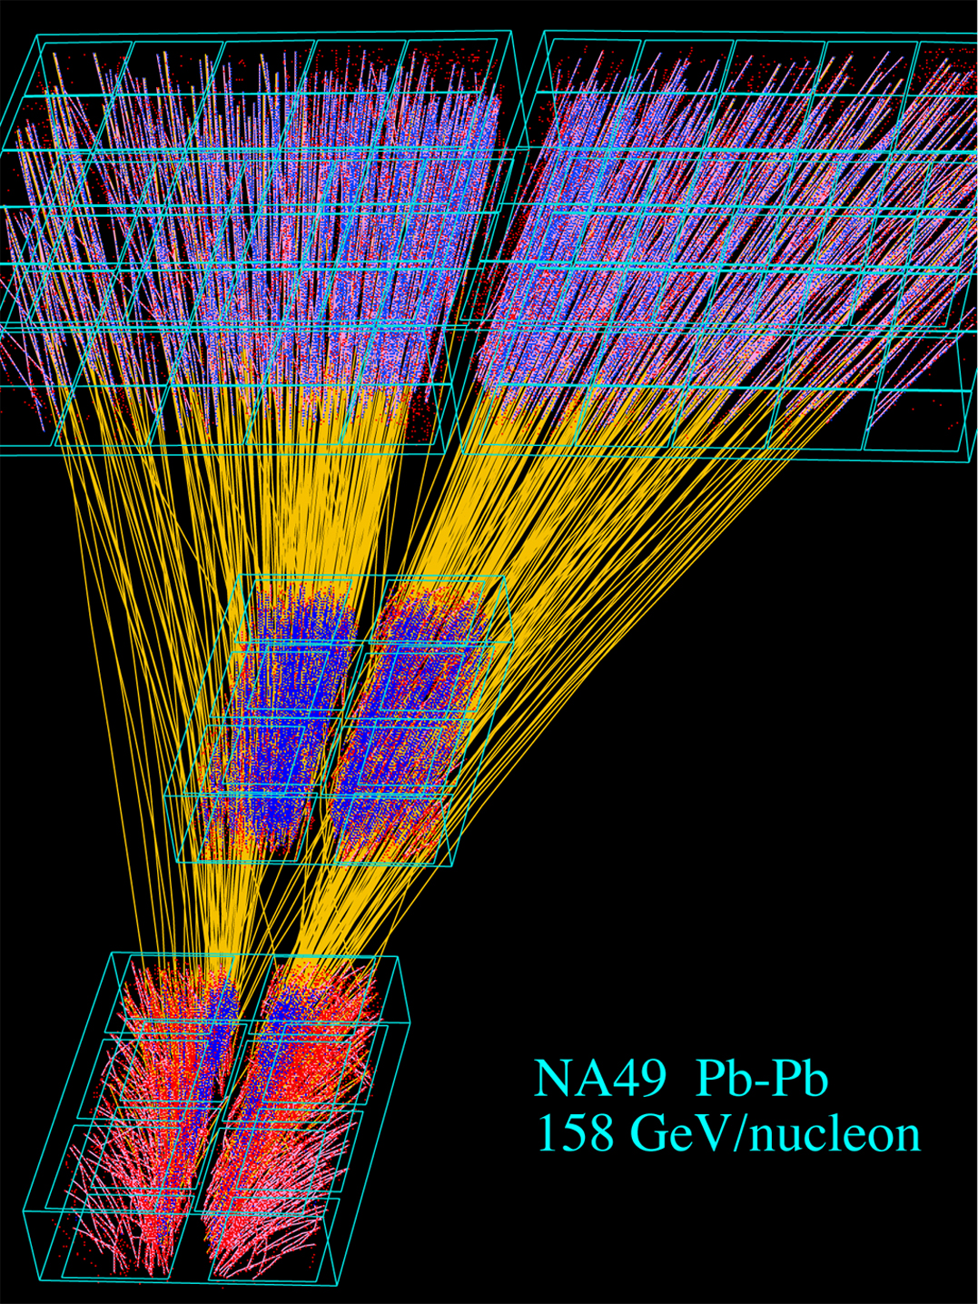
The NA61 TPCs (1)
Overview:
principle
Mechanics
readout
Position resolution
Particle identification
Calibration

Slide 2
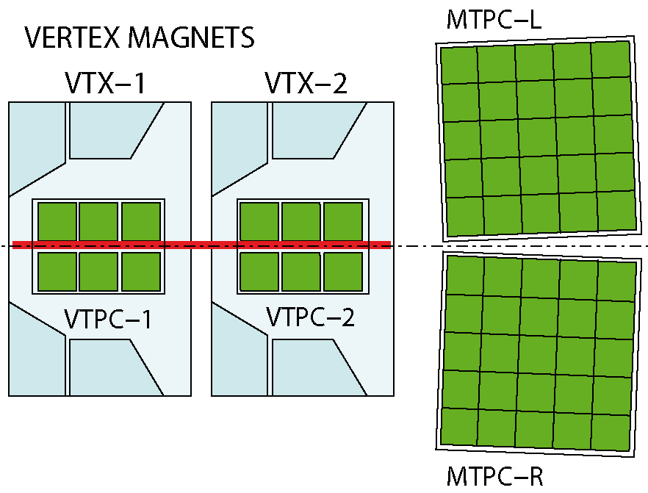

Slide 3
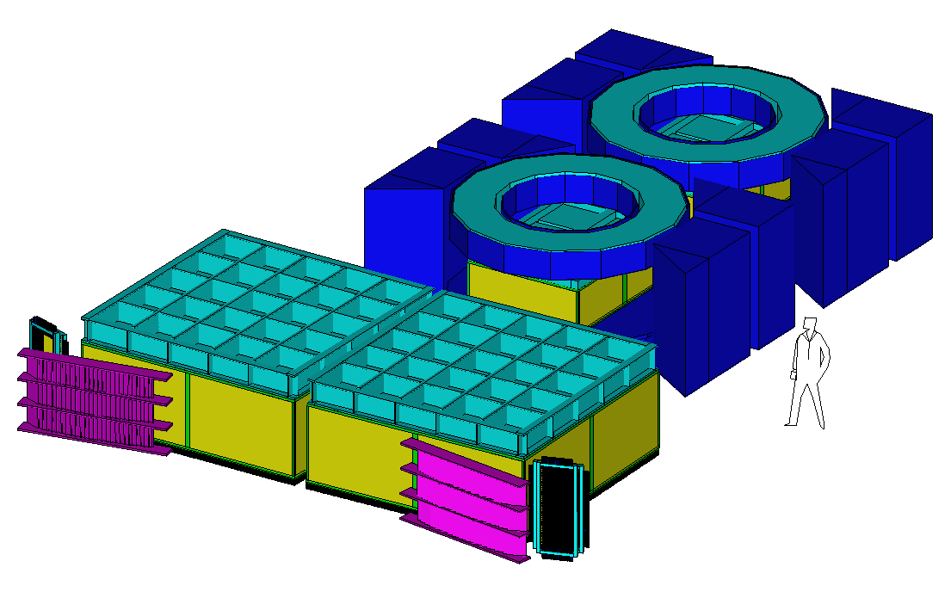

Slide 4
Working principle of a TPC
Field cage
High voltage electrode (negative)
Driftgas
R
R
R
R
Electric field (elctron drift)
Magnetic Field (measure particle momentum)
Voltage divider
R
R
R
R
R
Multiwire proportional chamber (0V)

Slide 5
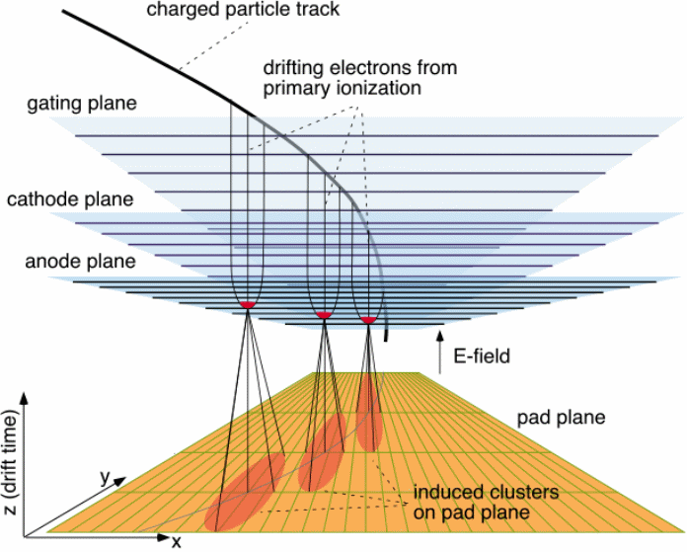
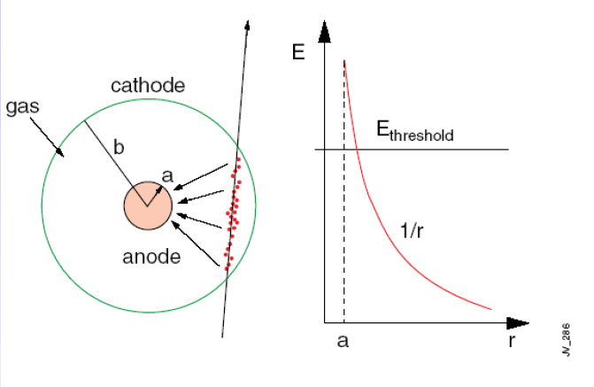
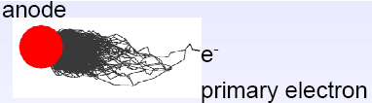
Signal generation in a multiwire proportional chamber with pad readout

Slide 6
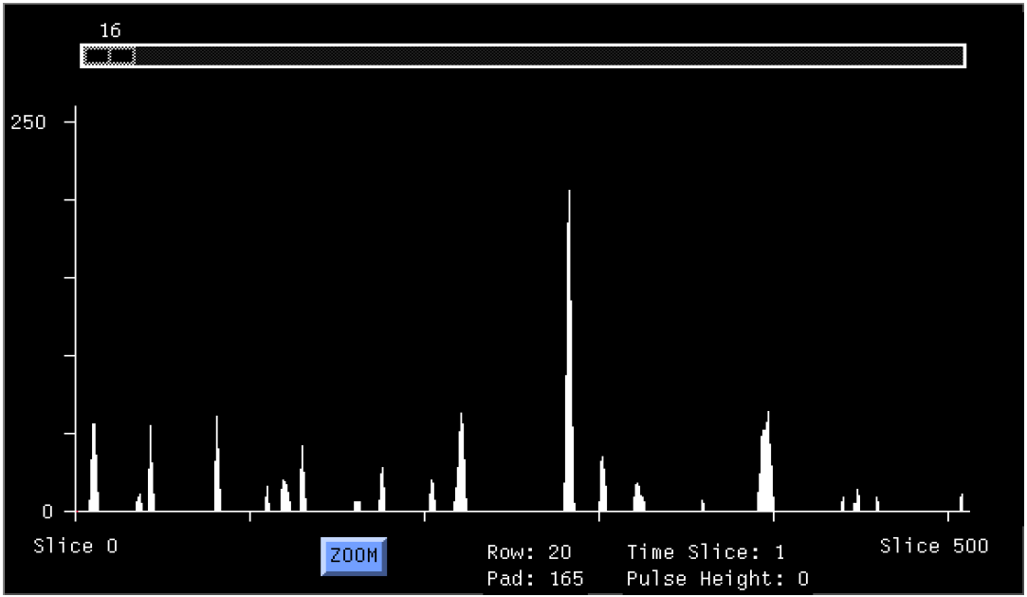
Signals of one pad after digitization and zero suppression
(NA49 online monitor)
Amplitude (ADC counts)
Drift time of electron cloud

Slide 7
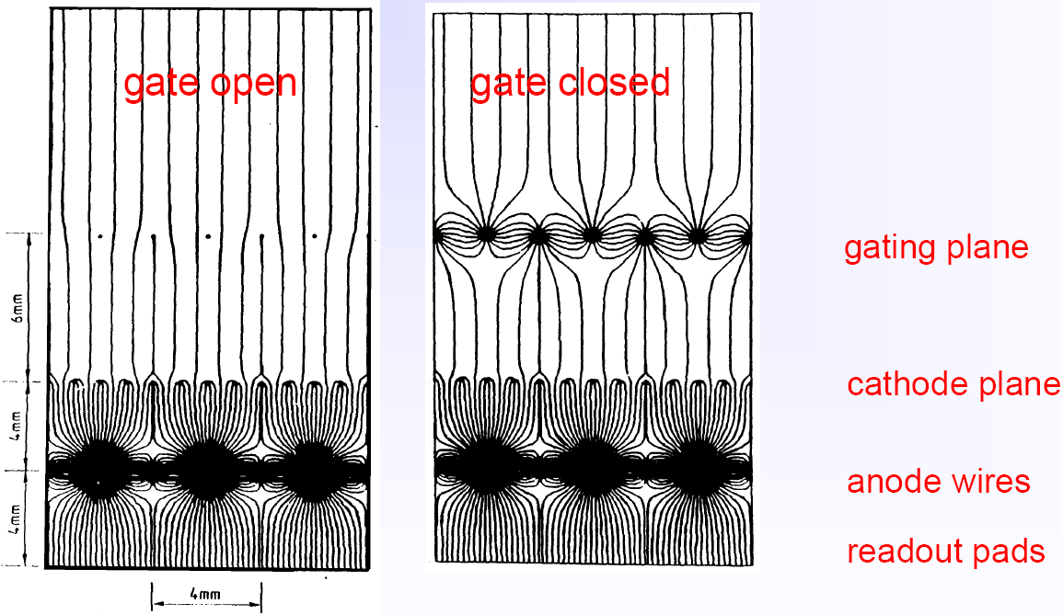
The gating grid
prevents positive ions from drifting back into drift volume: space charge distortions
prevents electrons from entering the amplification region: ageing
Garfield calculation of
field lines

Slide 8
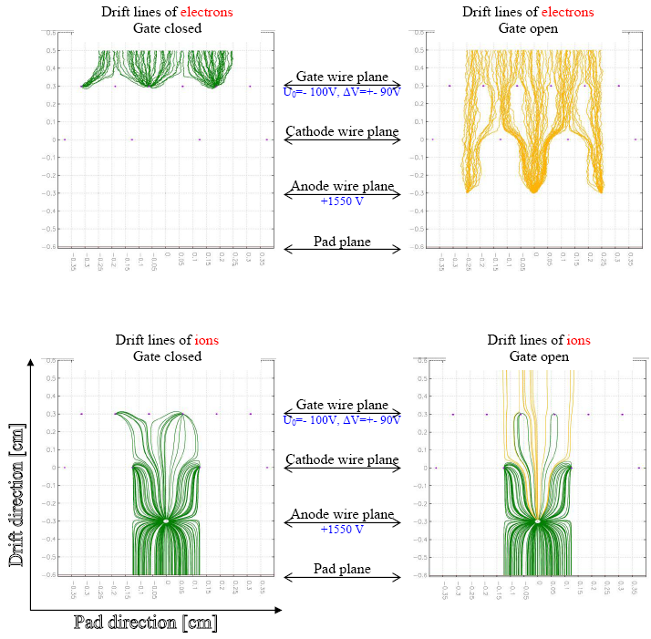
The gating grid
Different way of presentation:
drift lines of electrons/ions
Garfield calculation for OROC
chambers of ALICE (no field
wires → larger signals on pads)

Slide 9
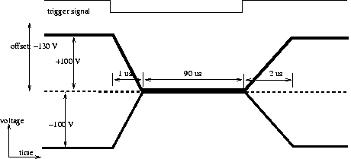
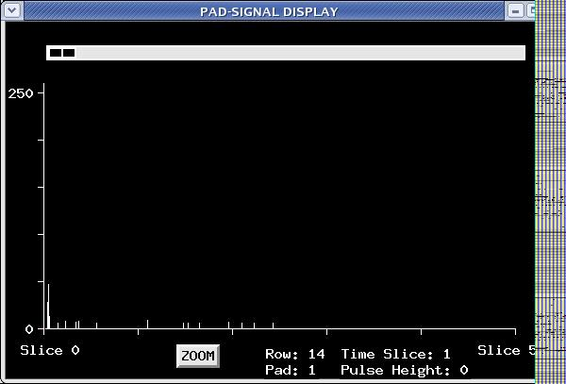
Gating grid pulser
Principle of operation:
Badly tuned pulser causes noise in the first
couple of time bins
ONE THING TO BE CHECKED BY
SHIFT CREWS!

Slide 10
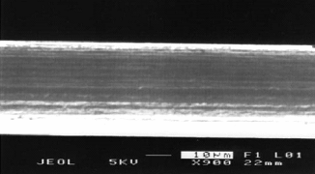
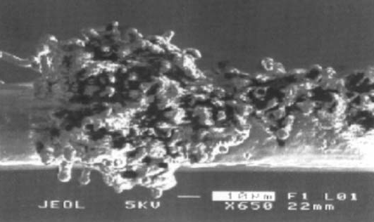
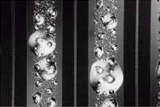
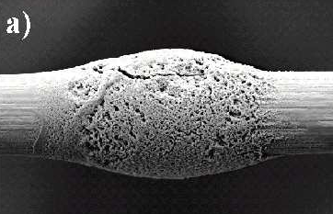
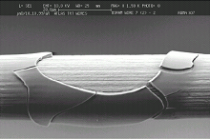
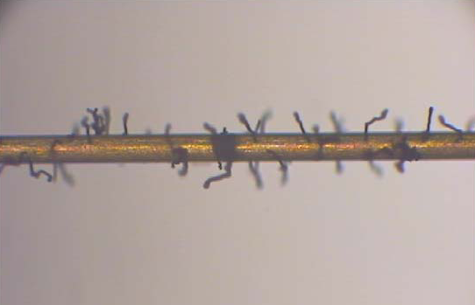
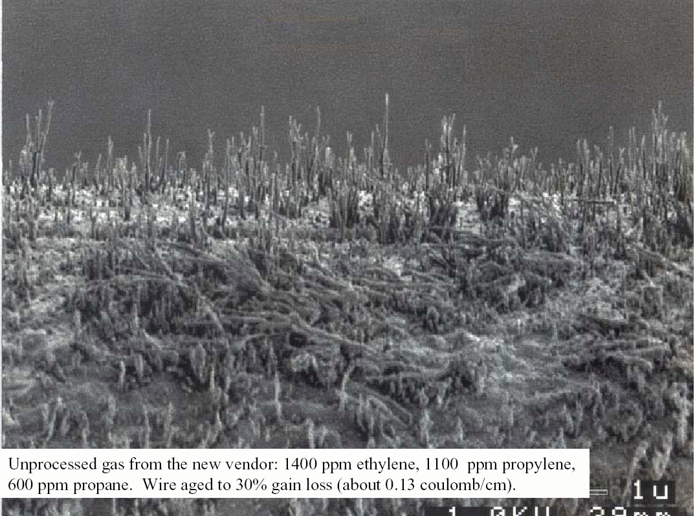
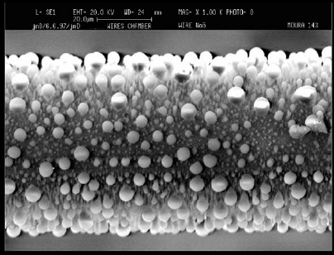
Ageing effects

Slide 11
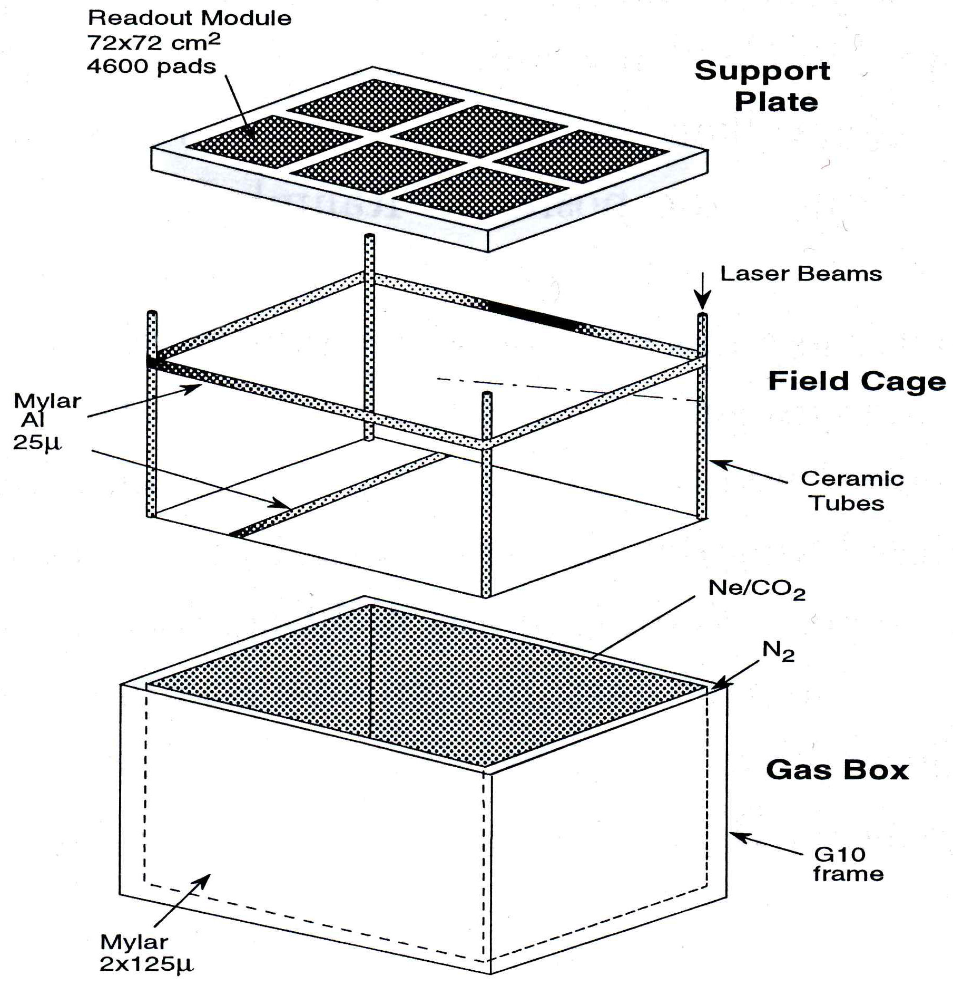
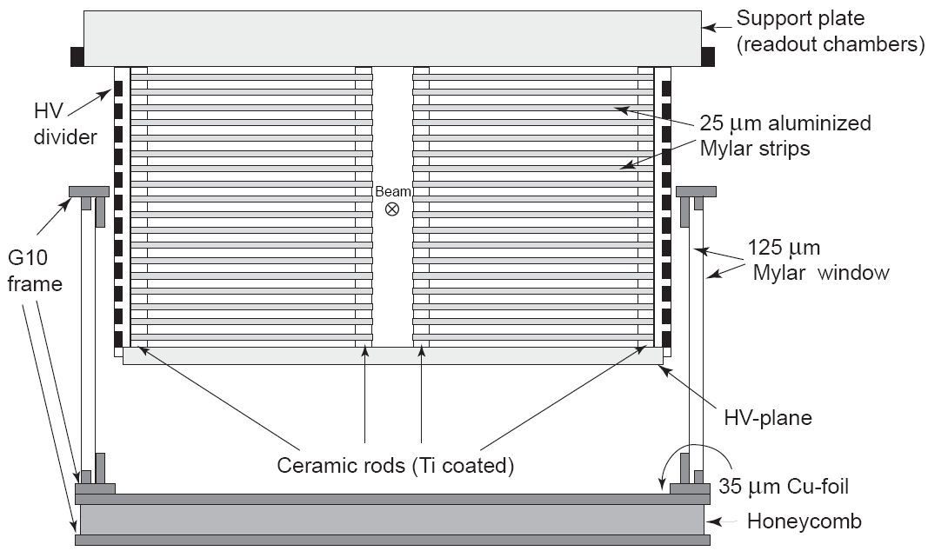
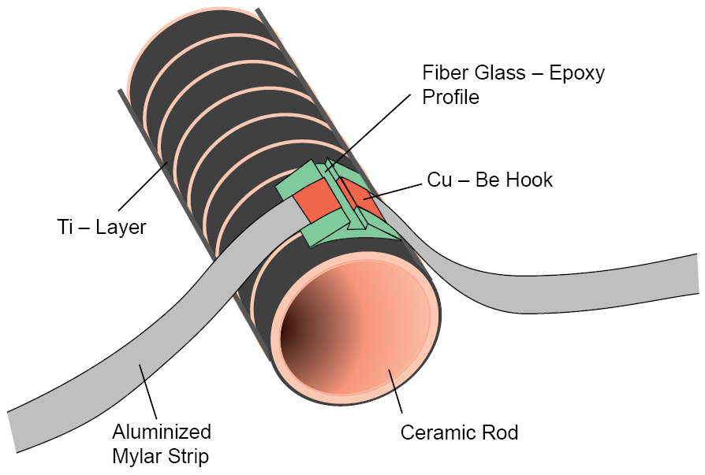
Construction of the VTPCs
This design allows very light construction:
multiple scattering is minimized

Slide 12
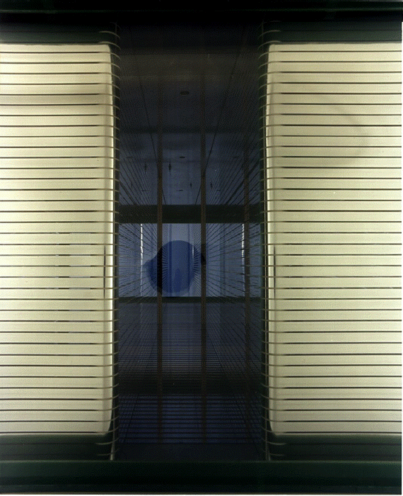
VTPC:
looking along the beam
direction
field cage is split in two halfs,
the beam area is outside the field
cage

Slide 13
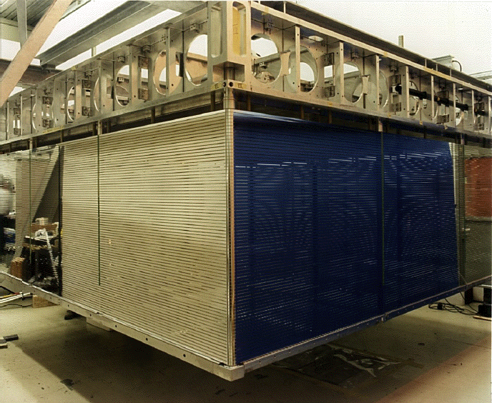
MTPC field cage

Slide 14
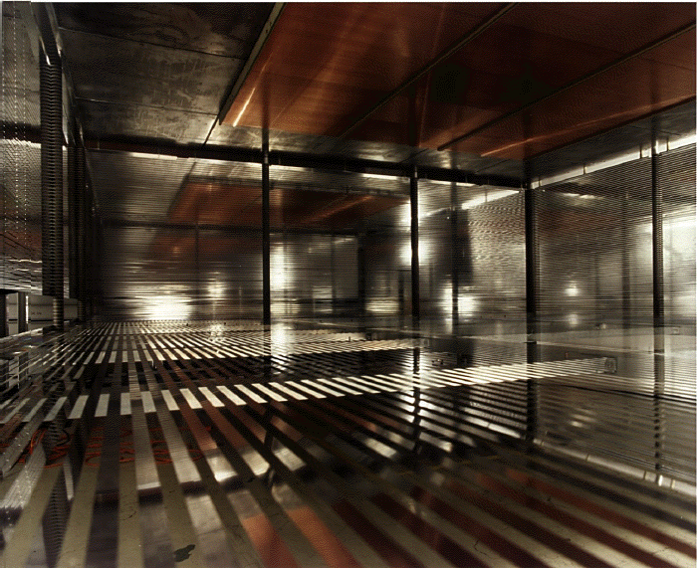
Inside the MTPC

Slide 15
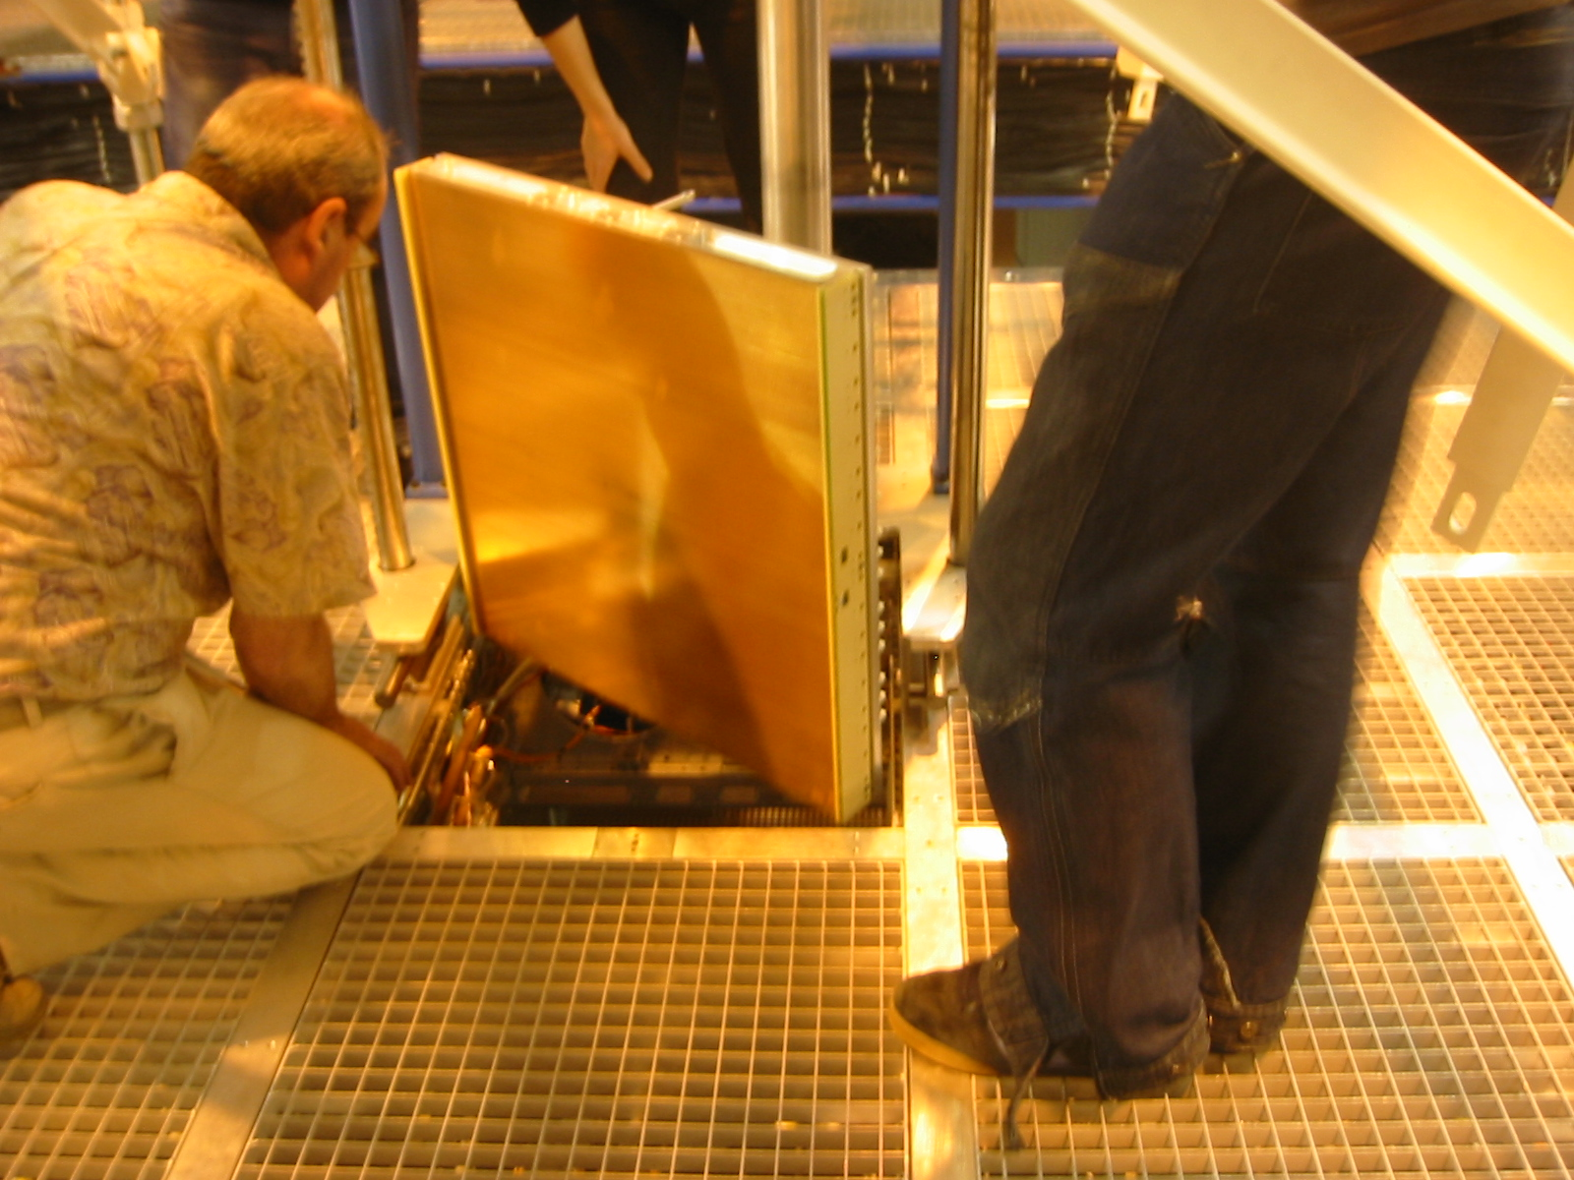
MTPC chambers are first inserted through the opening,then pulled back sealing with O-ring

Slide 16
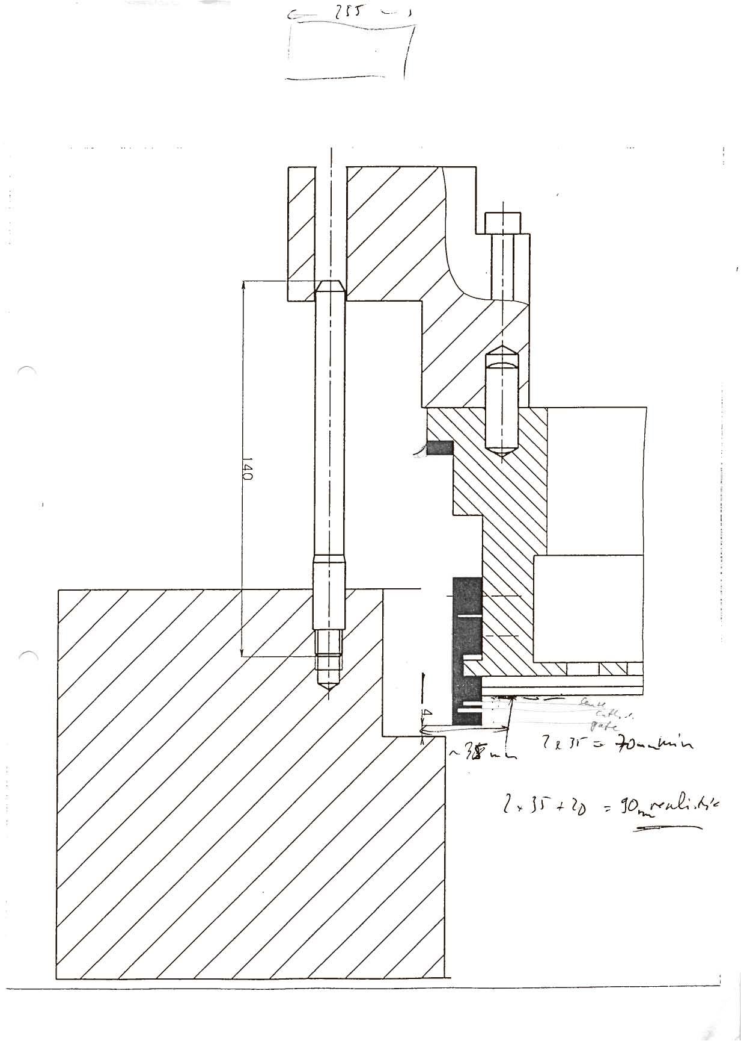
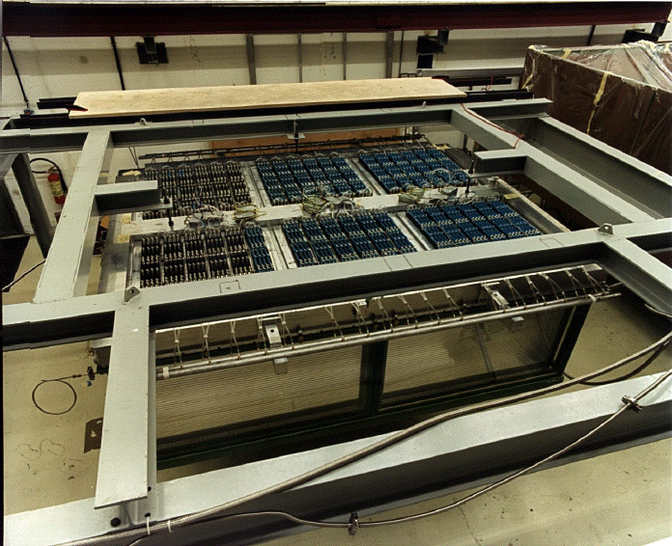
VTPC chambers are inserted from top
and sealed with RTV (silicone)
Chamber body
Support frame
(end plate)

Slide 17
TPC readout

Slide 18
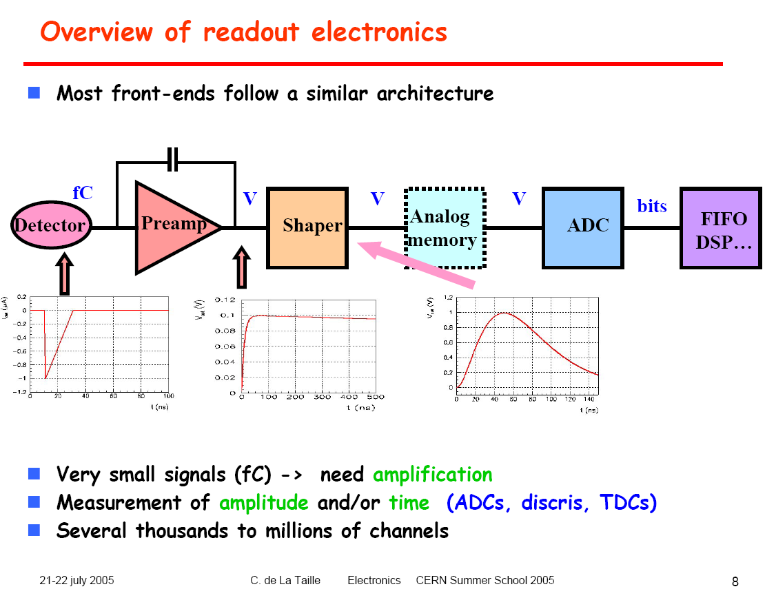

Slide 19
Frontend
Na49 DAQ (schematically)
CT board
70 ms for 512 tb
35 ms for 256 tb
242 Optical links
2.2s to fill
Receiver
32 (64) event buffer
ml
mr
V1
V2
VSB bus
6x2.5MB/s
Uneven distribution over 6 links:
different noise levels
Eventbuilder
Spill structure
7s
FDDI
4.5s
3.2s
2.4s
PC
Tape
CERN backbone
14.4 (19) s
new:38 s
CDR
16 MB/s

Slide 20
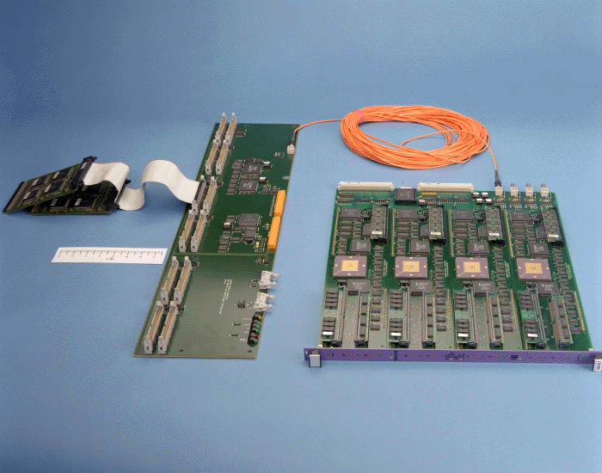

Slide 21
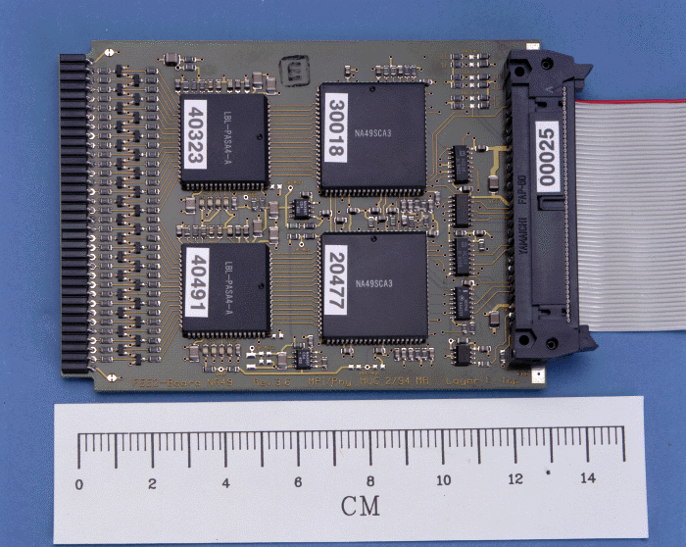

Slide 22
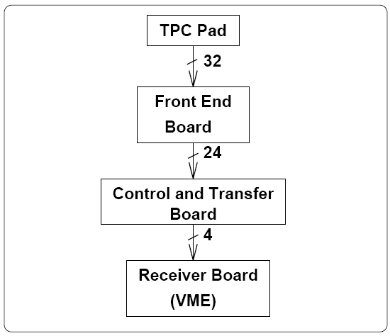
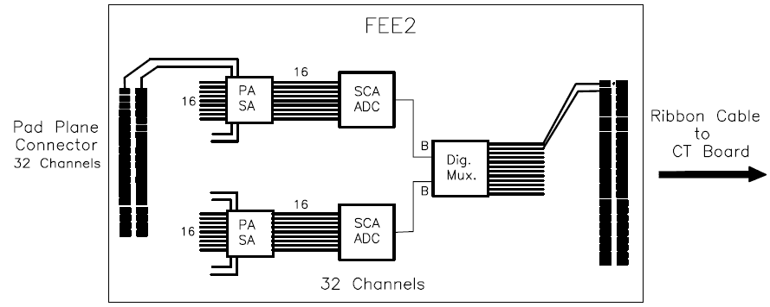
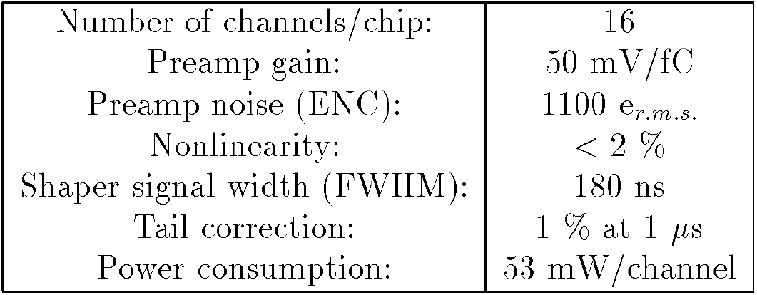
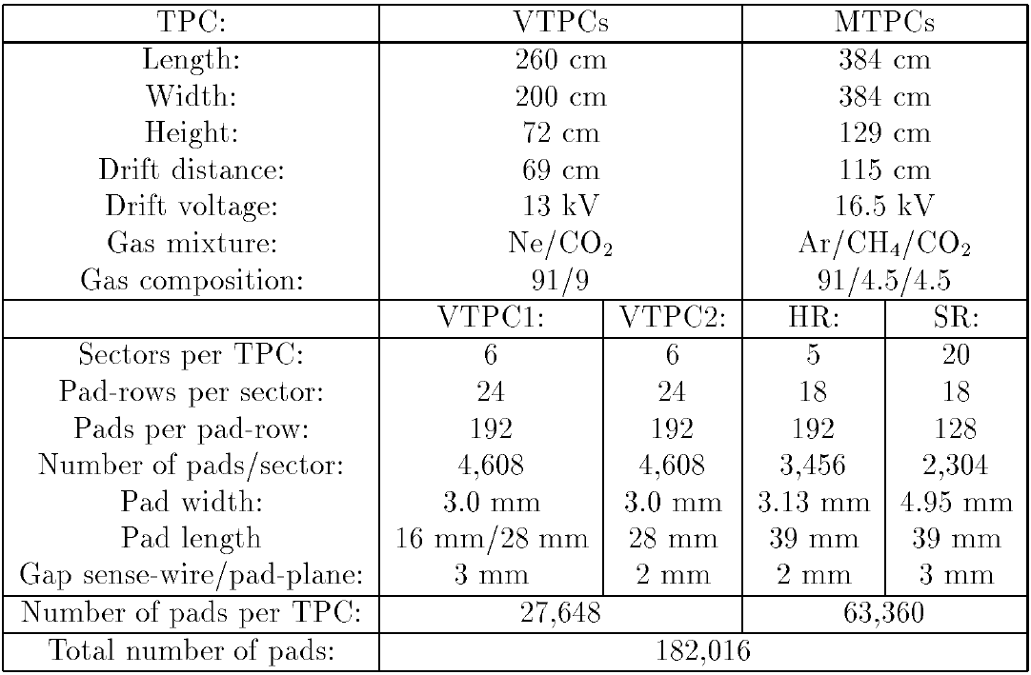

Slide 23
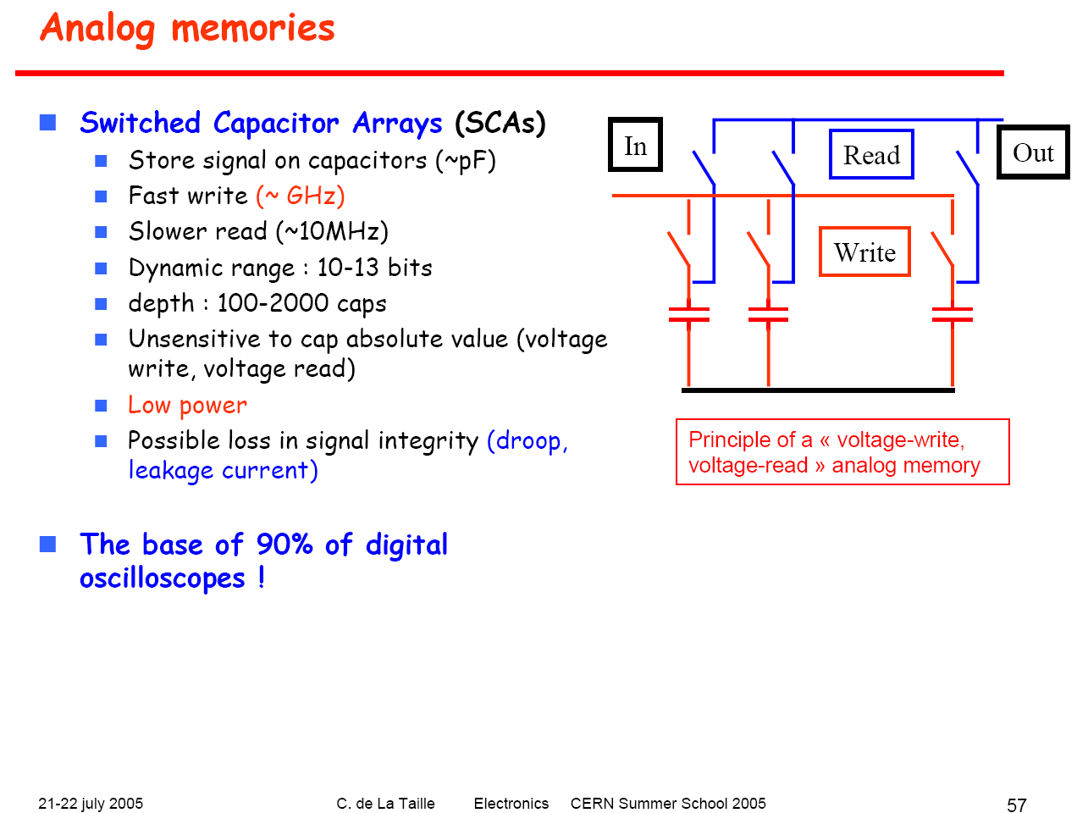

Slide 24
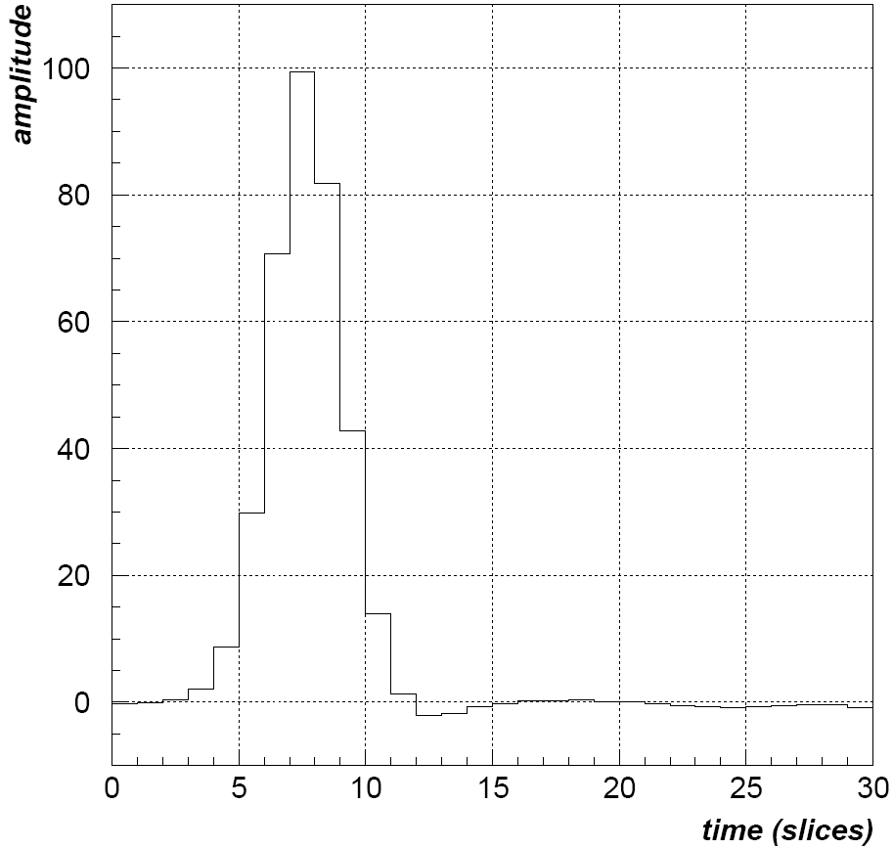
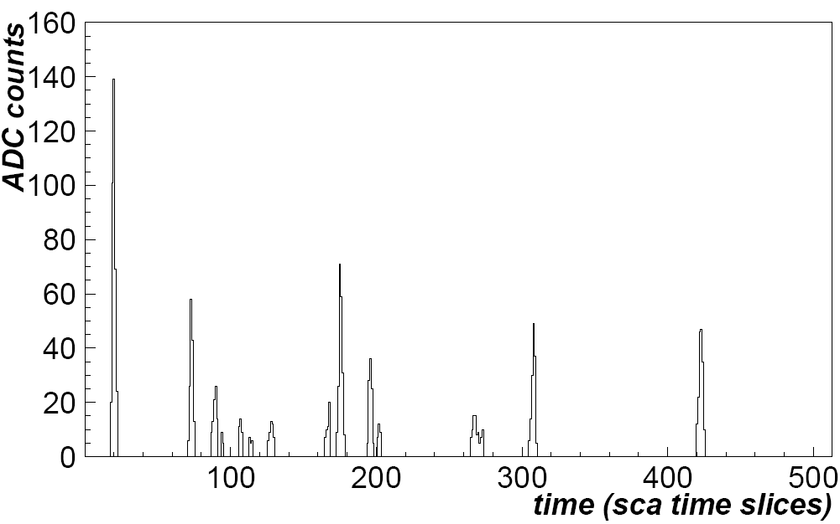
Digitized signal of one pad (with zero suppression)

Slide 25
Resolution issues: position resolution
Important for momentum (vector) determination: curvature in magnetic field
emission angle

Slide 26
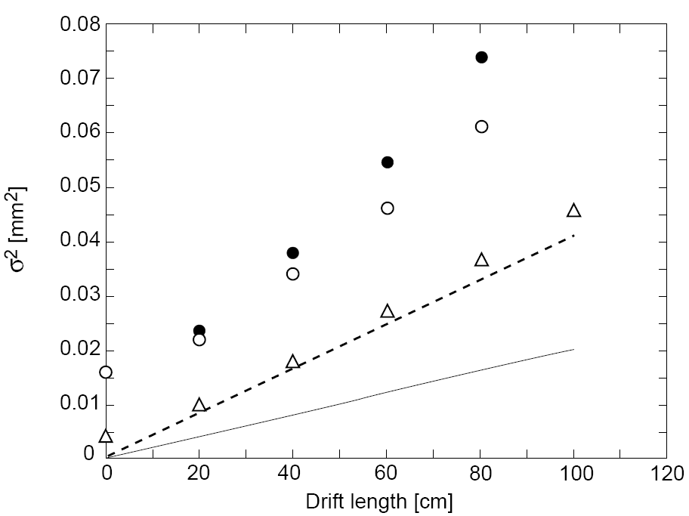
Position resolution (pad direction) as fu of drift length (MTPC)
Diff & gas gain fluct &
pad size &
electr. Noise & threshold
measurement
Diffusion & gas gain fluct
2 x Diffusion
Diffusion only

Slide 27
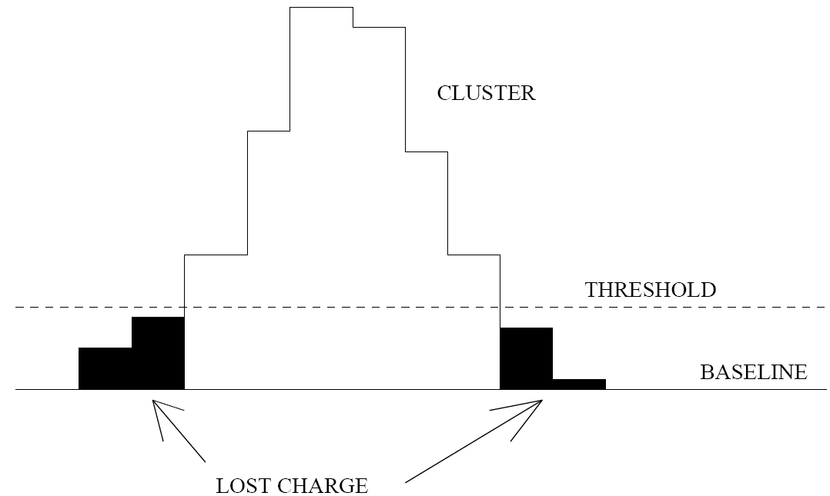

Slide 28
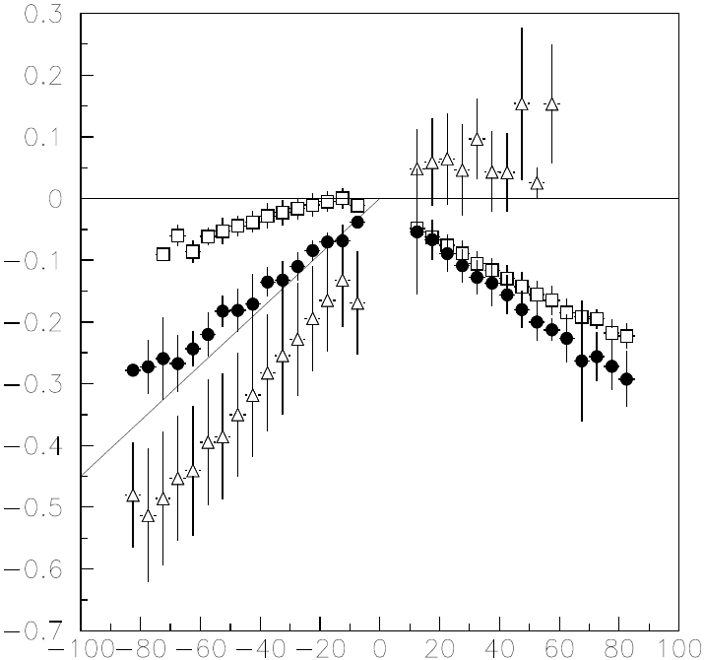
Optimization of pad angles:
track angle relative to beam direction at center of VTPC2
π- from Lambda
P from Lambda
Angle (rad)
All neg tracks
All pos tracks
Final pad angle
RMS
X (pad direction [cm]

Slide 29
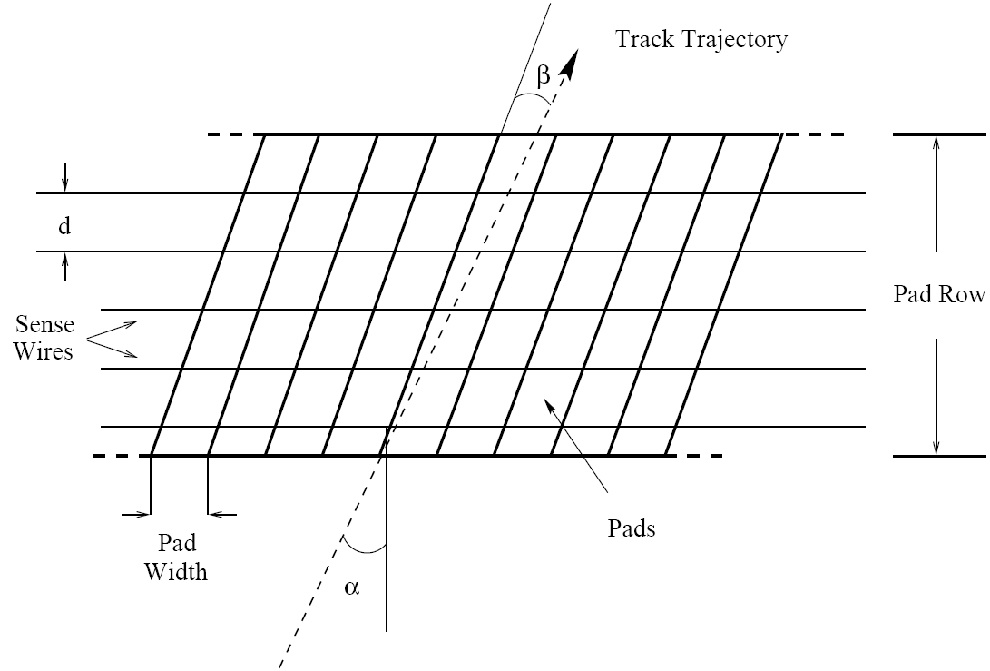
Effect of track angle
L
projection
δx ~ L*σ *tanα/√Neff
Neff ~ 12/cm (not 40)
centroid

Slide 30
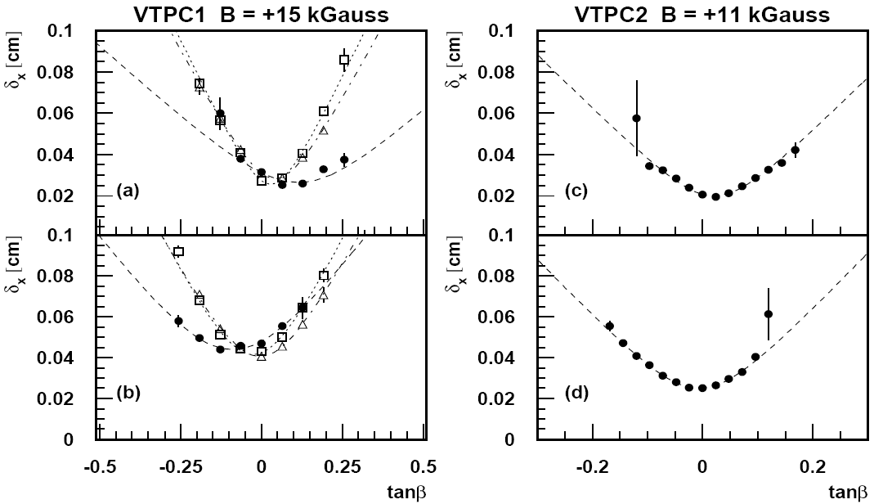
Position resolution as function of track angle
Sectors 4 - 6
Sectors 1 - 3

Slide 31
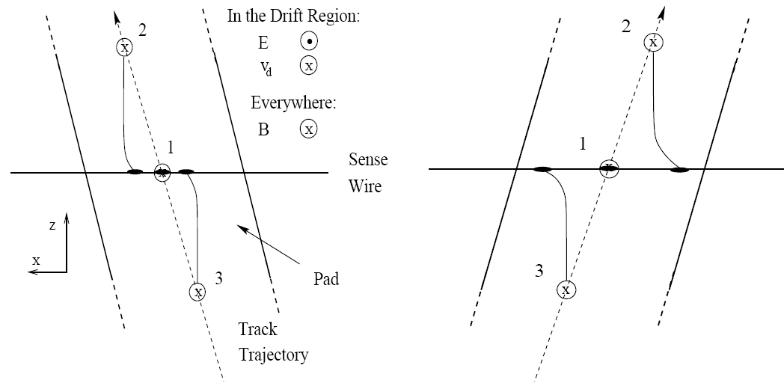
Effect of Lorentz angle at wire on cluster width and resolution
asymmetric relative to beam direction, i.e. Positive and negatice particles

Slide 32
to be continued

