Slide 1
Update on HL-LHC BPM design
T. Lefevre, D. Draskovic, C. Boccard, R. Jones, BE/BI
N. Chritin, A. Demougeot, EN/MME
7th HL-LHC TCC April 28, 2016

Slide 2
Outline
HL-LHC specifications
  Expecting higher performance with more constrains
Different BPM Design
  RF simulations for optimization of the stripline incl shielding
  Mechanical design : Different shapes investigated
Plans and conclusions

Slide 3
Initial specifications
Expected to have sub micron beam orbit resolution
Larger aperture and larger dynamic range
Cryogenic BPM : Mechanical constrain during thermal cycle
Inermet shielding for absorbing collision debris
Higher heat load

Slide 4
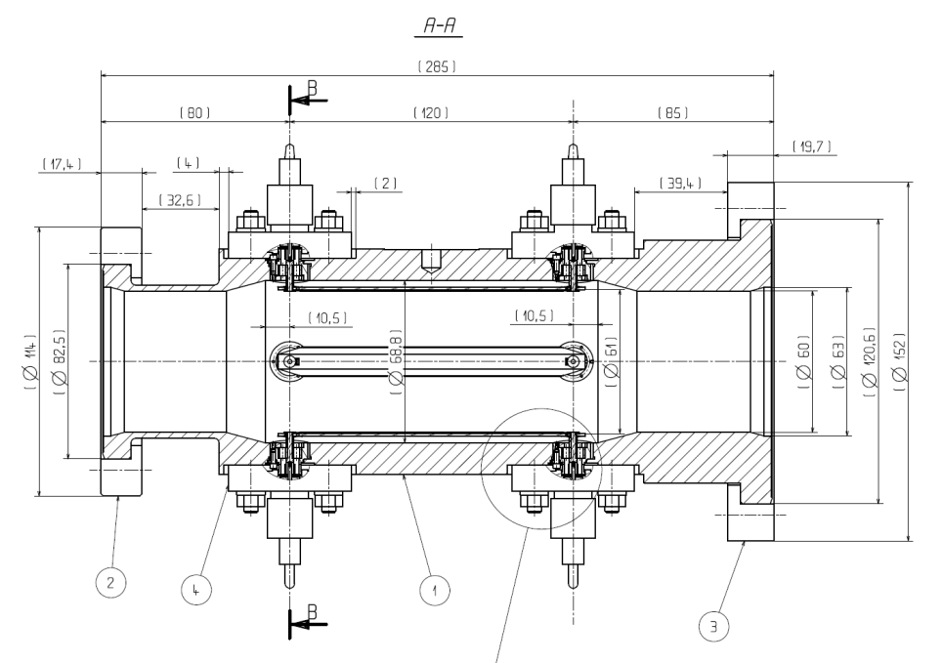
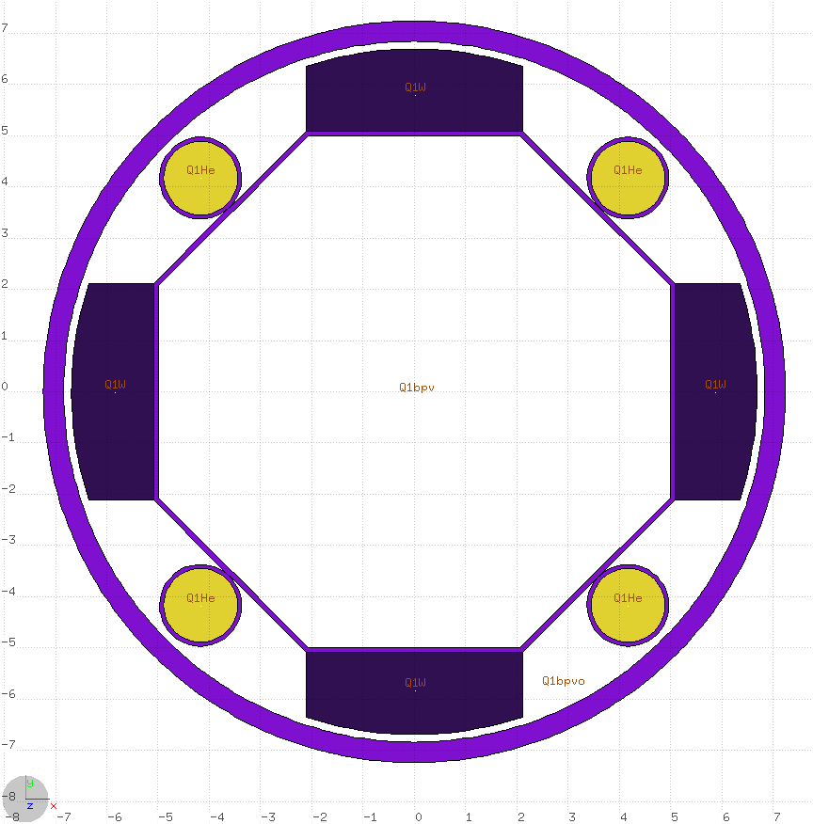
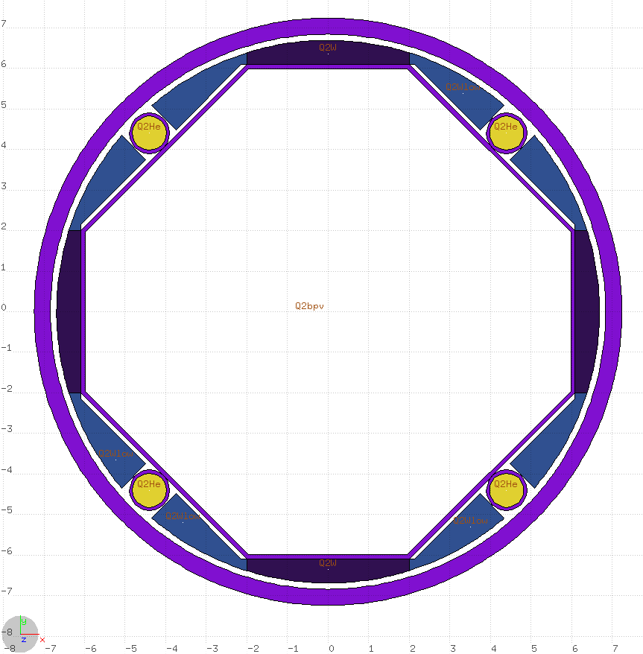

Larger aperture and higher dynamic range
Larger beam screen aperture (max 120mm) compared to actual BPMSW diameter of 61mm in LHC
    BPM output signal getting proportionally smaller
Need to guarantee best possible performance with Pilot bunch used for beam commissioning and tuning
  Keep the length of the stripline to 120mm to maximize output signal ampitude
  Length of BPM similar to what we have now (around 280mm)
Beam screen @ HiLumi
BPMSW @ LHC
Q1
Q2 and beyond
99.8mm
119.8mm
112.4mm

Slide 5
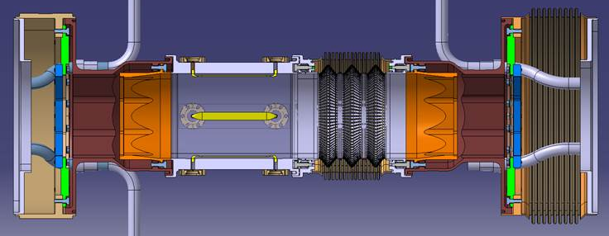
High availability & redundancy
Proposed BPM Layout
  7 monitors on each side of IP for better tuning and redundancy
  (compared to 3 in LHC)
  Located in interconnection between magnets
    Difficult to access in case of problem
    Experience from LHC is encouraging : only few BPMs with issues in cryostat so far
    Should favour a robust and reliable design
BPM Integration crucial to avoid positioning BPMs where two beams encounter
If not, BPM performance relies on the stripline directivity

Slide 6
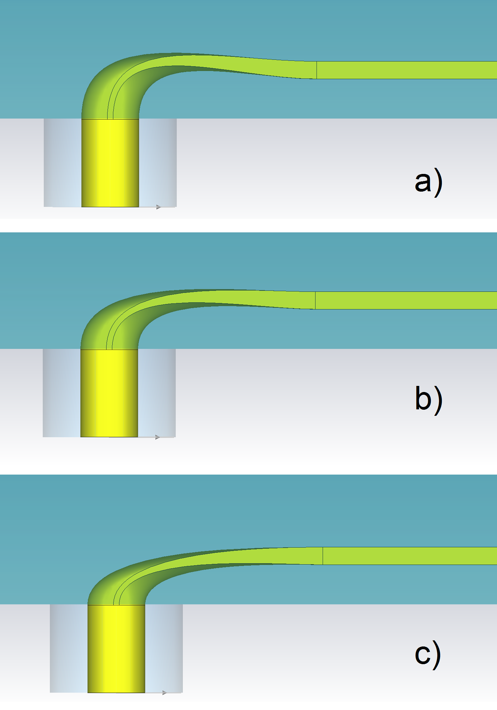
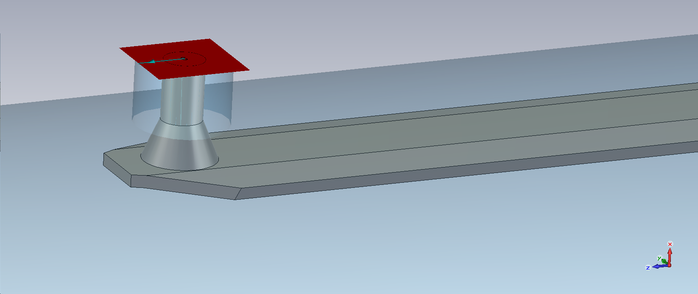
Strip-line directivity
RF simulations
  Optimizing the strip-line directivity by redesigning the electrode shape and transition to coaxial
  RF simulations showed 7 to 10dB improvement
  compared to current LHC design
Beam measurements assessing the impact of stripline’s directivity on BPM accuracy (MD in July 2015)
new
old
Depending on processing electronic : ‘dead zone’ reduces to 3ns
Measured beam offset larger than 100um
Assuming an optimised stripline, the offset will still be in the order of 30um
Unperturbed beam position
Perfect overlap of the two beam in time

Slide 7
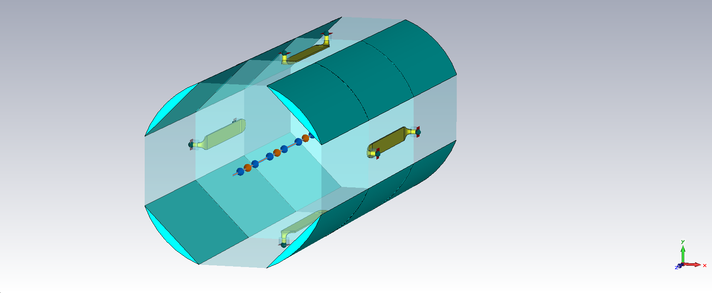
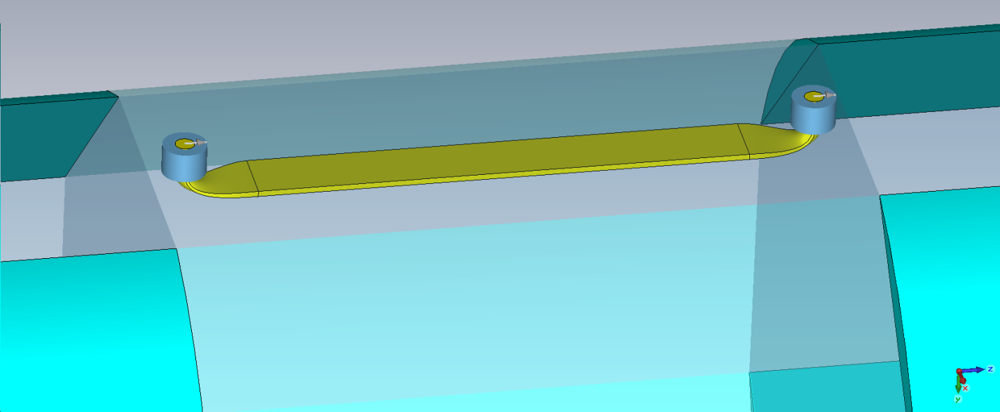
BPM with Inermet shielding
Simulations with CST showed a decrease in voltage output signal level of 35% for beam pipe diameter of 100mm
  Still acceptable for BPM sensitivity
Broadband directivity 27dB (20dB for current LHC BPMSW)
Octogonal-shaped BPM
6mm Inermet absorbers
in H/V plane
Flat electrode rotated by 45 degrees
With inermet
Without inermet

Slide 8
From RF to Mechanical design
Option 1 : complete BPM body in Inermet
  Expensive, Heavy, difficult machining (tolerances ?) , vacuum tighness ?
Option 2 : BPM body in stainless steel with Inermet insert from inside
  Mounting Inermet inside the BPM body was considered as not negligible risk of failure
Option 3 : BPM body in stainless steel with inermet insert on outside (similar to beam screen)
  Simpler and more reliable
  Better cooling

Slide 9
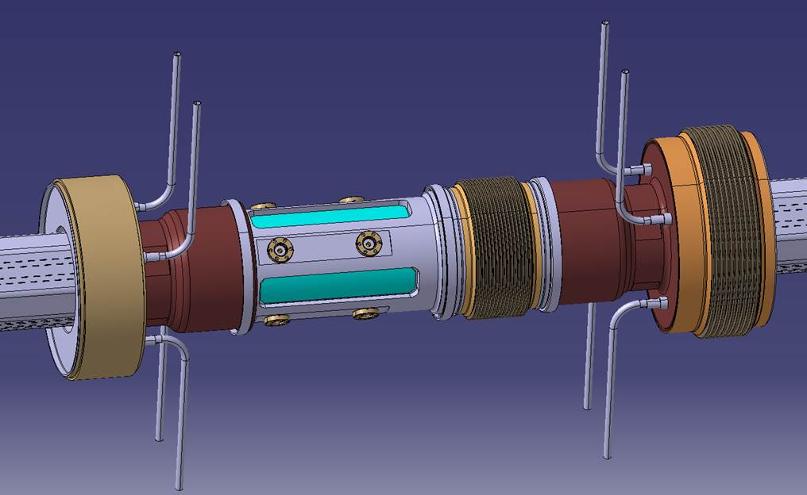
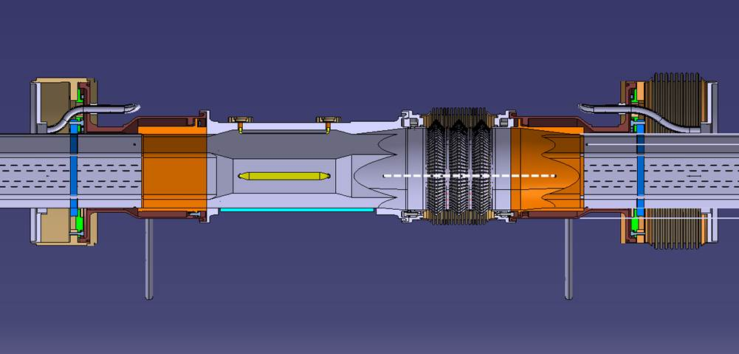
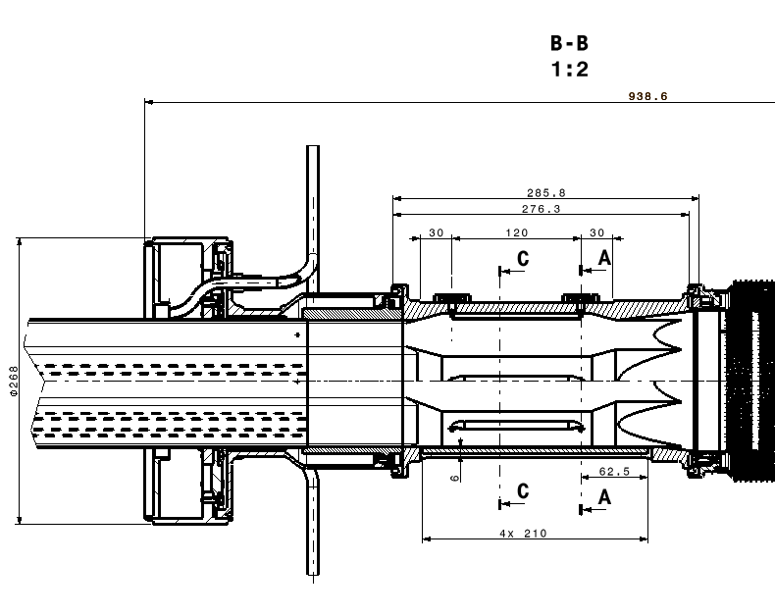
Octogonal BPM design (1)
Octogonal to circular transition between the BPM and PIMS
Outer BPM body machined to house Inermet insert

Slide 10
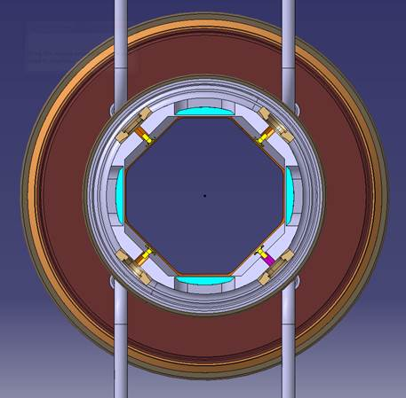
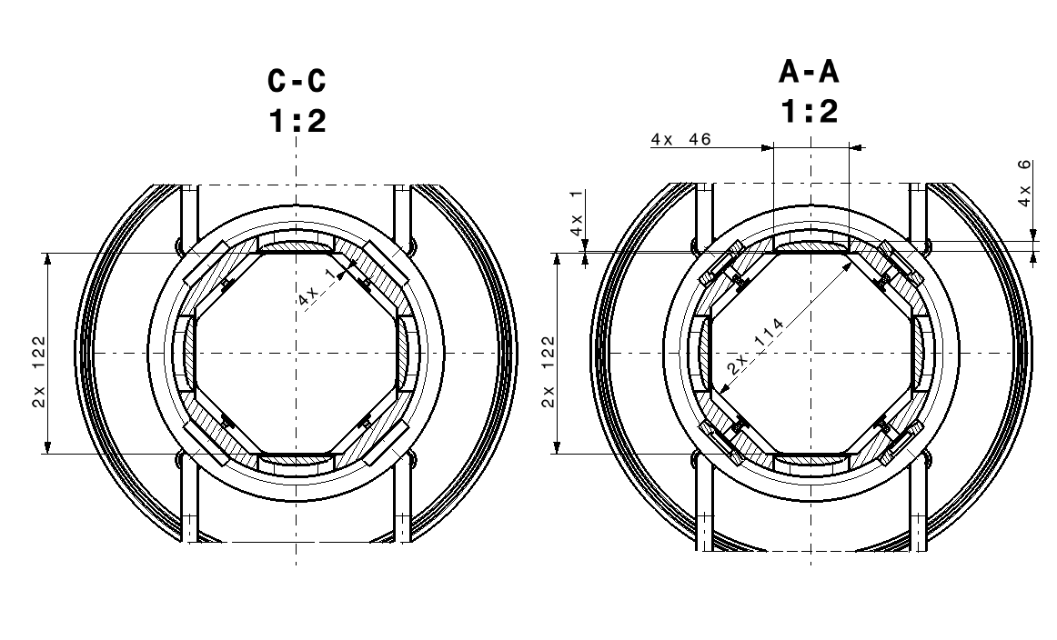
Octogonal BPM design (2)
Stripine retracted by 1mm with respect to beam screen
Inermet inserts retracted by 1mm with respect to their position in beam screen

Slide 11
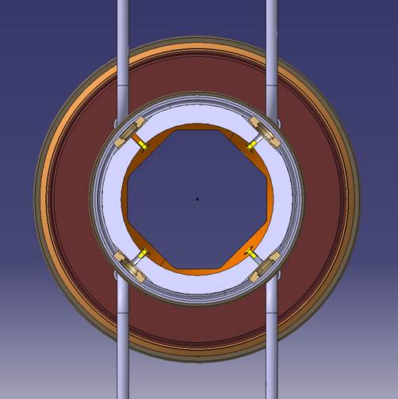
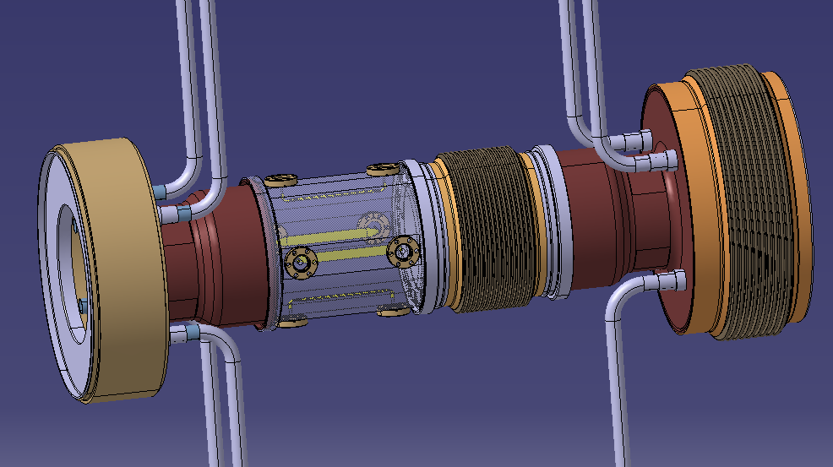
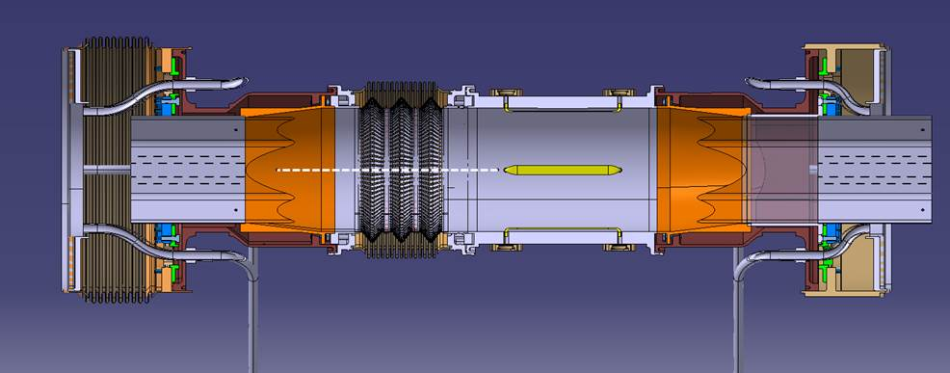
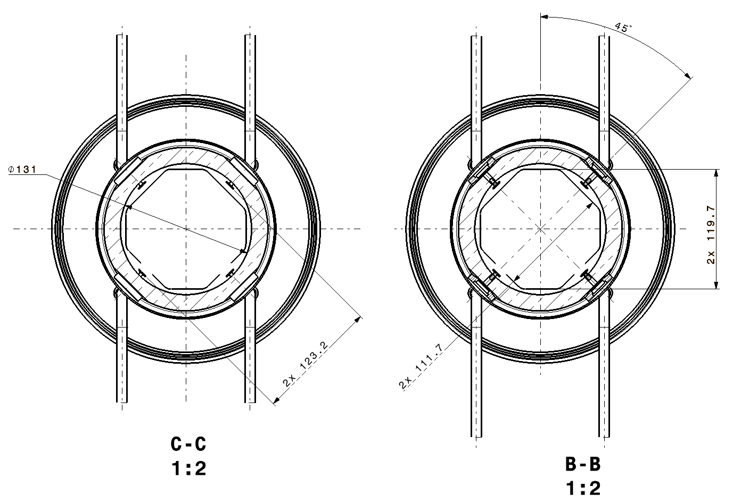
Simpler alternative
Fluka simulations with the current position of the inermet in the BPM have shown a limited collimation efficiency
We also studied a circular shaped BPM without Inermet absorbers

Slide 12
Heat deposition and transfer
  The static heat load for the BPM cables was estimated to be 58 mW per cable for a 1.25m cable going from the cold BPM at 25K to the cryostat flange. (for a 0.141” Outer jacket°)
  The dynamic heat load added by BPM signal was estimated to 50mW/cable for HL-LHC bunch intensities
  Heat load from collision debris will be 1-2W on BPM body, 100mW on striplines
Need to cool BPM body : Next step in the design

Slide 13
CONCLUSIONS
CST Simulations for improved RF stripine designs that work both with and without Inermet absorbers
Two mechanical designs investigated so far
  Circular BPM (Ø131mm) with no absorber
  Octogonal BPM with absorber retracted by 1mm with respect to beam screen
    Closer would require to mount the Inermet inside the BPM body, which deemed risky for long term reliability
Next steps for 2016 :
  Confirmation from Fluka simulations that design including Inermet has little impact on overall dose in Q2A
  Study and integrate the cooling circuitry
  Study mechanical deformation during thermal cycle
  Launch functional specifications and build prototype

