Slide 1
Q6 at 1.9 K
E. Todesco, L. Bottura, H. Prin (CERN)

Slide 2
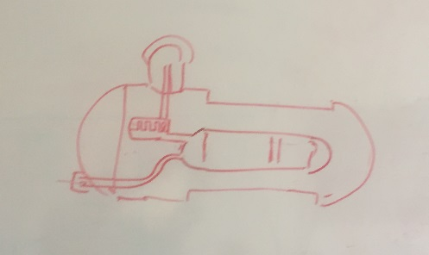
THE PROBLEM
The matching section in HL LHC needs to be at 1.9 K
  The only exception is Q6, for which no modification is required (the same magnet will be used)
  No interest in pushing up to gradient from 160 to 200 T/m
  The initial choice was to avoid having only one magnet at 4.5 K, and therefore the assumption was to have everything at 1.9 K
Further studies show that
  Transformation of 4.5 to 1.9 K does not require a heat exchanger as in the string of dipoles, but it can be done via an box to be added outside the cold mass, connected to the cold mass
  This avoids large modification of cold mass, but still requires opening the 1.9 K enclosure, and therefore a test in SM18
  The test is not trivial in this configuration
Sketch from H. Prin

Slide 3
OUR WISH
Resources to carry out this work were presented by H. Prin in TCC
  This was recently reviewed with L. Bottura
  We confirm the estimate of 800 kCHF
    This corresponds to material and a 1 year work of a team of 2.5 FSU at 180
    Staff resources not included in this
  The TE/MSC wish is to avoid this work since is not strictly necessary, and its impact on the group workload is not completely negligible

