Slide 1
Update on the beam screen/cold bore tolerances and apertures in the triplet area
C. Garion, TE/VSC
HL-LHC TCC, 28th April 2016

Slide 2
Outline
Beam screen and cold bore geometries
Tolerances:
  Positioning tolerances
  Shape tolerances
Conclusions and outlook

Slide 3
Beam screen and cold bore geometries
Beam screen
Tungsten absorbers
Magnet coil
Cold bore
Heaters and coil insulation
Cold bore insulation
Cooling channels

Slide 4
Nominal dimensions
Cold bore
Nominal values of the beam screen aperture are defined by:
Cold Bore:
1. The coil inner radius at 1.9 K is 74.350 mm [P. Ferracin]
  a. The insulated cable inner radius position at room temperature, with no stress, is 75 mm.
  b. The deformation due to pre-load and cool-down is 0.400 mm
  c. Quench heaters and insulation: 0.1 mm + 0.15 mm
2. Gap coil/insulated cold bore at 1.9 K:1.5 mm [R. Van Weelderen]
3. Cold bore insulation: 0.2 mm [P. Ferracin]
4. Tolerance on the cold bore outer diameter (thickness): 0/+0.5 mm
→ Nominal cold bore outer radius at 1.9 K: 72.15 mm
Nominal cold bore outer radius at room temperature: 72.35 mm
Nominal cold bore inner radius (thickness 4 mm for Q1 to D1) at room temperature: 68.35 mm
Magnet coil
Beam screen:
Gap w.r.t cold bore: 1.5 mm
Shielding thickness Q1: 16mm , Q2-D1: 6 mm
Beam screen wall thickness: 1 mm
 | Nominal aperture H(V);+/-45 °
Q1 | 99.7; 99.7
Q2-D1 | 119.7; 110.7
➔

Slide 5
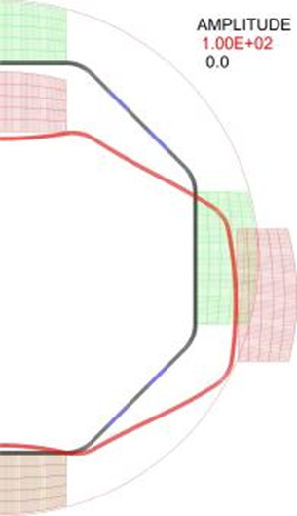

Nominal dimensions
In addition, the aperture has to take into account:
Cu layer, -0.16 mm
Self deformation due to the weight: Q1: -0.2 mm ; Q2-D1:-0.07 mm
Thermal contraction: Q1: - 0.26 mm ; Q2-D1: -0.31 mm
Tolerances on aperture can be decomposed into:
Tolerance on positioning:
  Initial straightness of the cold bore and beam screen
  Sag of the cold bore and beam screen as a function of the supports in the cold mass (number, gap)
Tolerance on the shape
The present analysis is based on our best guess at the time being. Values may change (decrease… or increase) with the output from:
Quench tests
Thermal tests
Prototyping

Slide 6
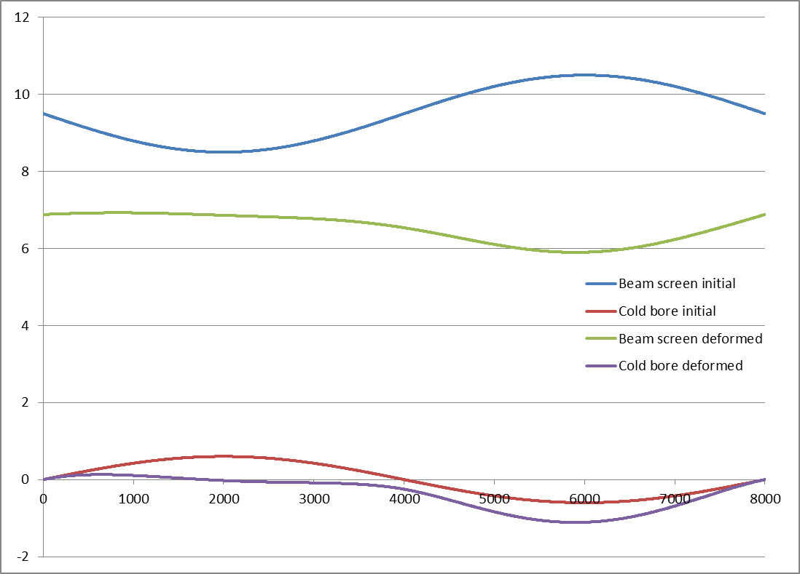
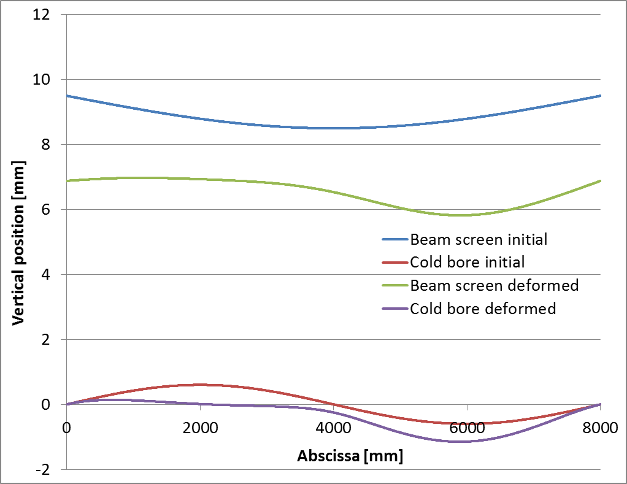
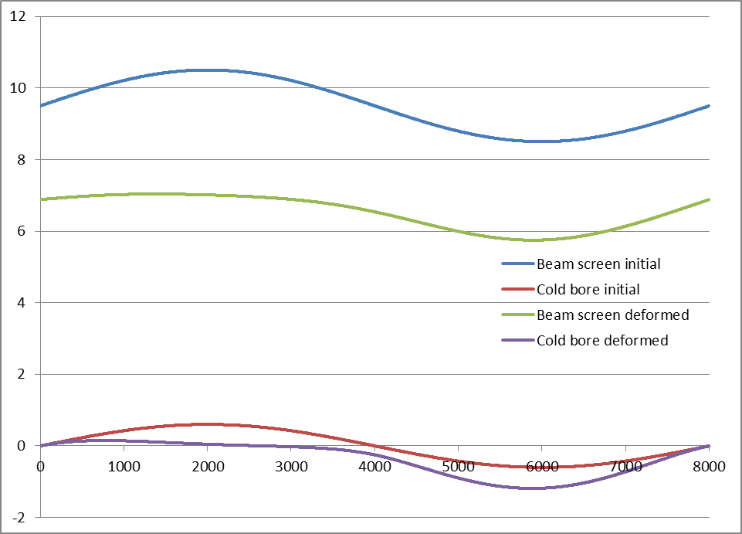
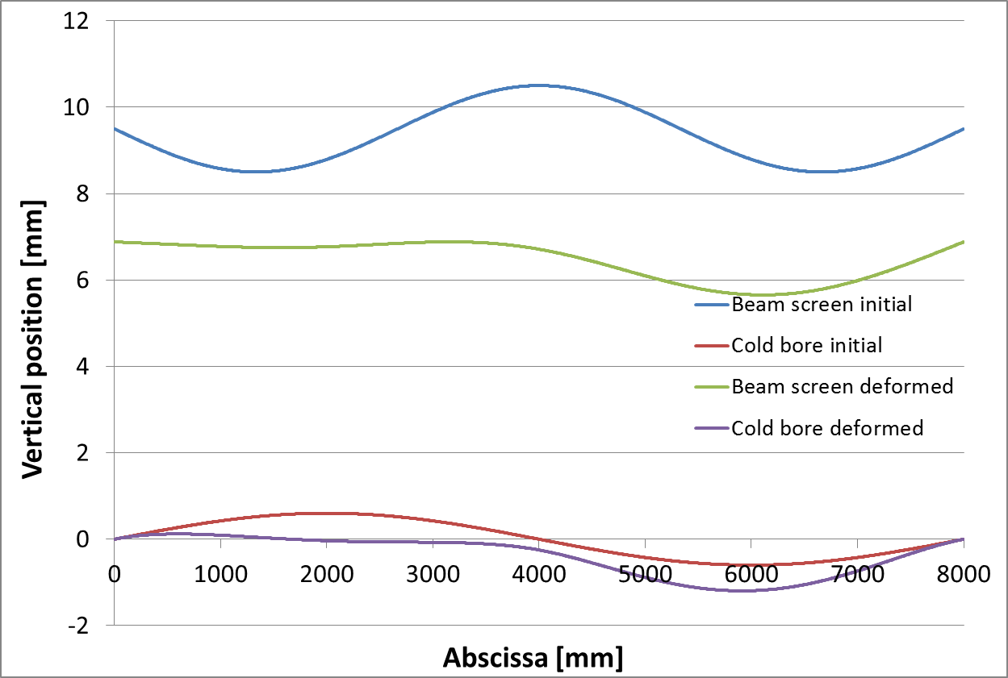
Vertical positioning tolerance
Q1
Spring:
Equivalent to 75 N/mm;
every 10 cm
Free length 7.5 mm
Beam screen;
1 mm thick, I ~ 4.5.10⁵ mm⁴
47 kg/m
Straightness +/-1 mm
Cold bore:
OD 147 mm (assumption for the study, marginal influence of the difference with the present baseline); 4 mm thick
Clamped at the extremities
Additional support(s) along the cold bore, nominal radial gap 0.25 mm
Straightness: 0.3 mm/m
Nominal position is defined as:
No initial straightness defect
Perfectly supported cold bore (no sag)
Position of the beam screen for different initial shape
Δy: -1/+0.05
Δy: -1.13/+0.15
Δy: -1.23/+0
Position of the BS % nominal Δy: -1.1/+0.1
→ Vertical beam screen position of Q1 driven by the cold bore sag.
Vertical positioning tolerance: -1.23/+0.15
Notes:
Nominal is defined as
No initial straightness defect
Perfectly supported cold bore (no sag)

Slide 7
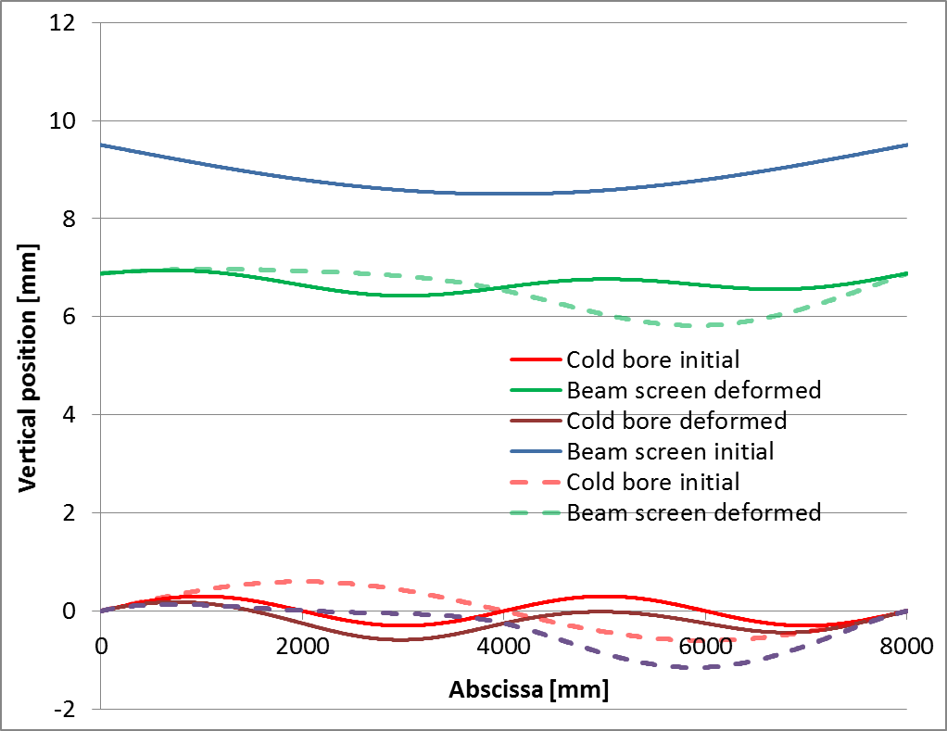
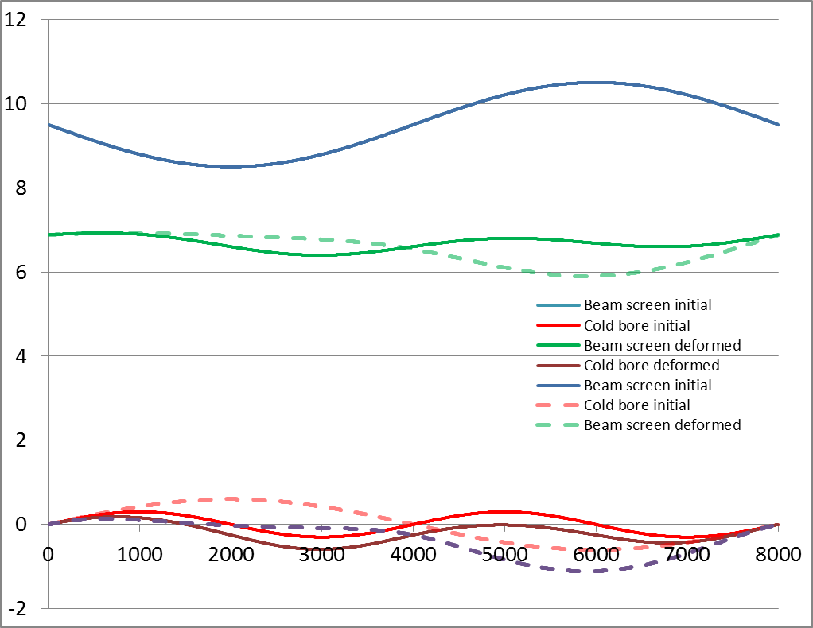
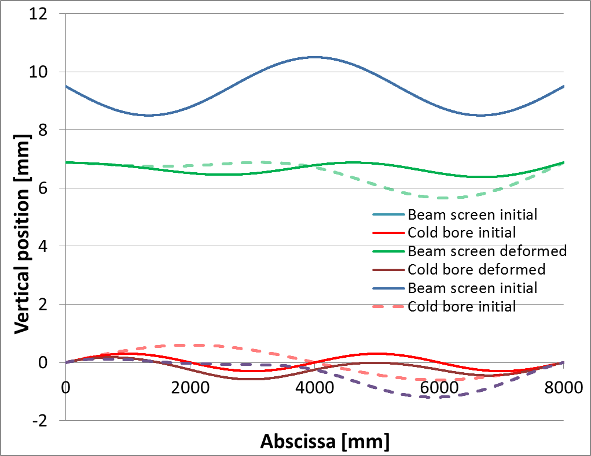
Vertical positioning tolerance
Q1
Influence of number of additional supports for different initial shapes
1 support: Δy: -1.1/+0.1
3 supports: Δy: -0.45/+0.06
1 support: Δy: -1/+0.05
3 supports: Δy: -0.48/+0.04
1 support: Δy: -1.23/+0
3 supports: Δy: -0.51/+0
With 3 supports instead of 1, important reduction of the vertical tolerance from ~ 1.2 mm to ~ 0.5 mm.

Slide 8
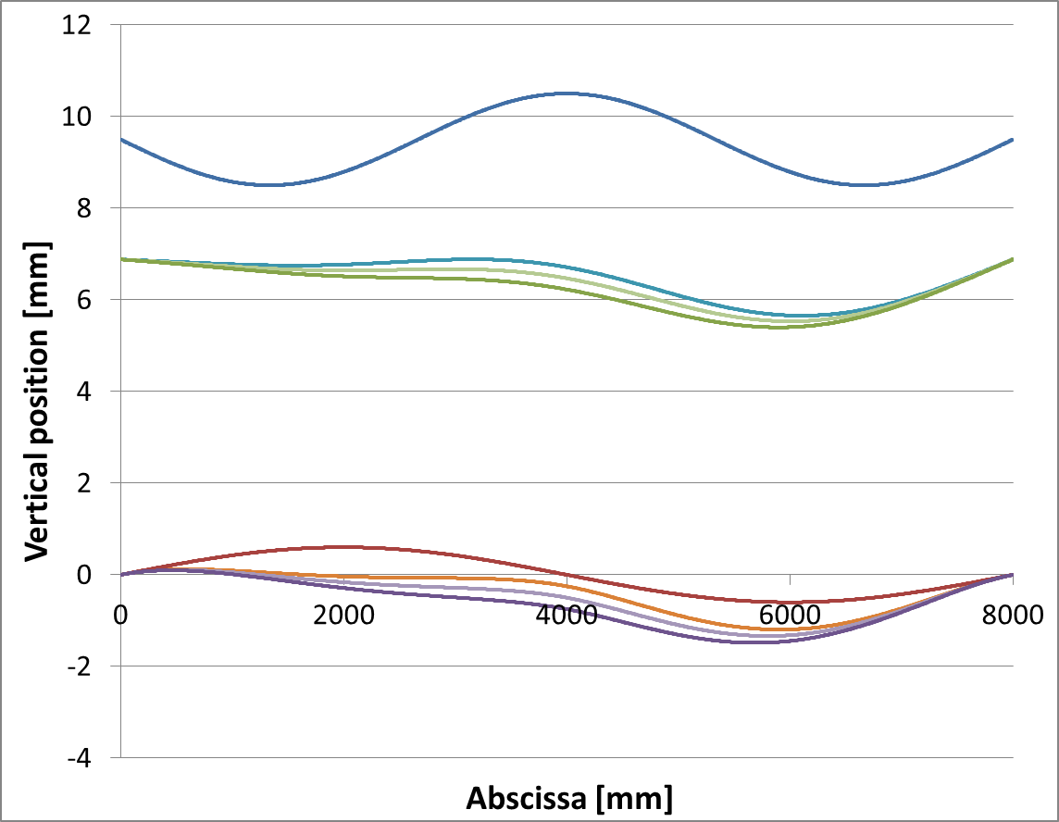
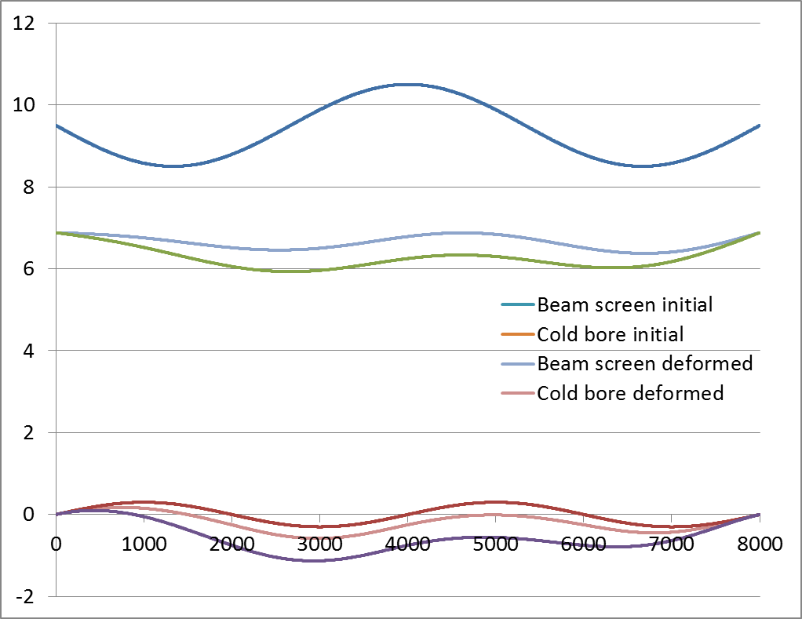
Vertical positioning tolerance
Q1
Influence of the gap in the additional support(s)
1 support
3 supports
Gap 0.25 → Δy: -1.23/+0
Gap 0.5 → Δy: -1.35/+0
Gap 0.75 → Δy: -1.5/+0
Gap 0.25 → Δy: -0.51/+0
Gap 0.75 → Δy: -0.95/+0
Significant impact of the gap in the support.

Slide 9
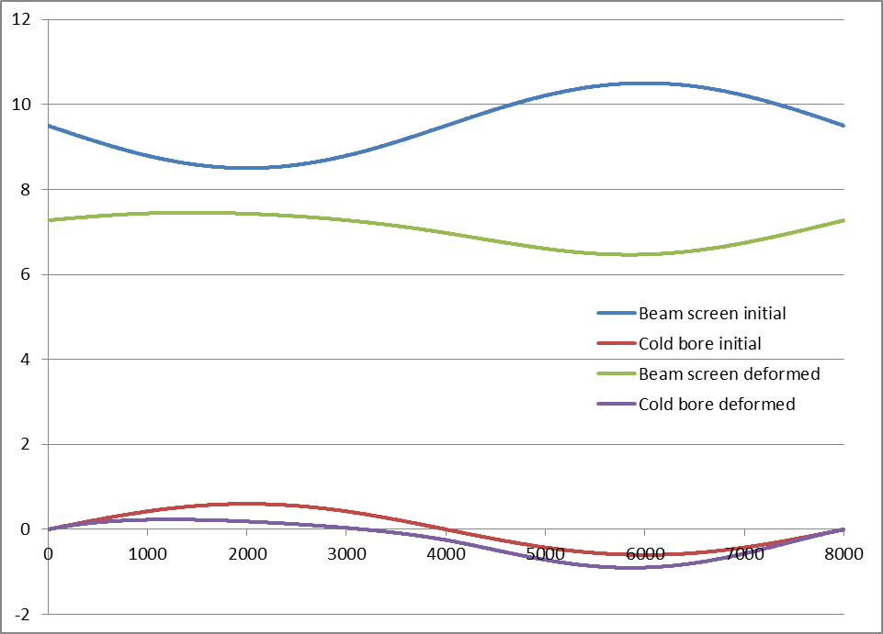
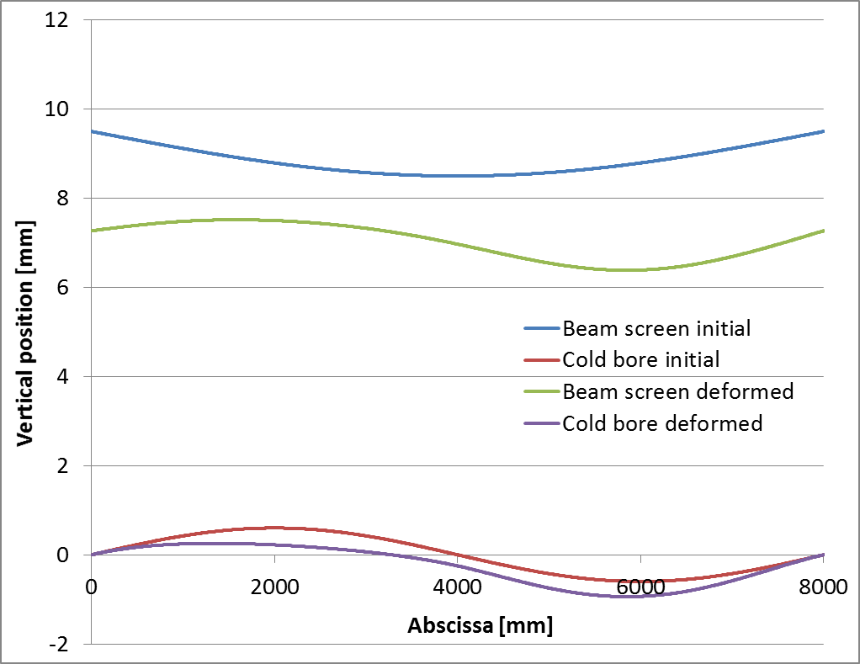
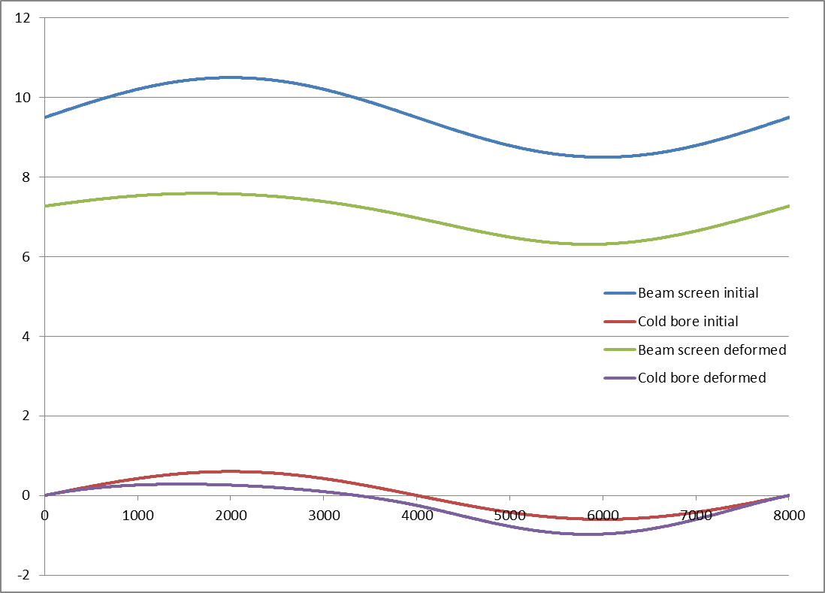
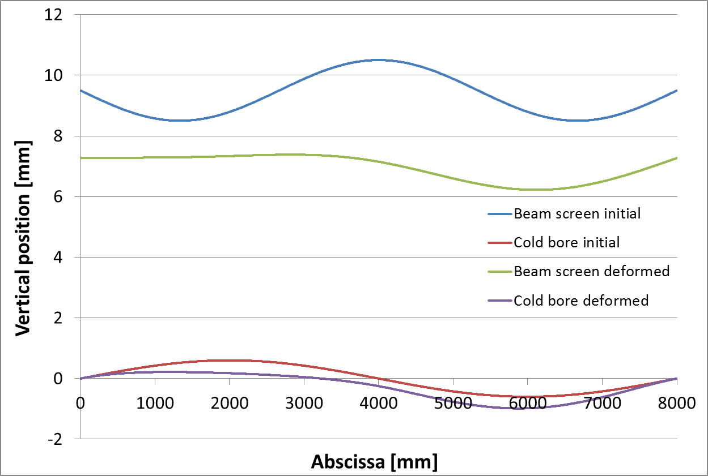
Vertical positioning tolerance
Q2-D1
Beam screen;
1 mm thick, I ~ 4.5.10⁵ mm⁴
17.5 kg/m
Straightness +/-1 mm
Spring:
75 N/mm;
every 10 cm
Free length 7.5 mm
Cold bore;
OD 147; 4 mm thick
Clamped at the extremities
Additional support(s) along the cold bore, nominal radial gap 0.25 mm
Straightness: 0.3 mm/m
Position of the beam screen for different initial shape
Δy: -0.81/+0.18
Δy: -0.96/+0.32
Δy: -1.05/+0.11
Position of the BS % nominal Δy: -0.89/+0.25
→ Vertical position of Q2 to D1 beam screen driven by the cold bore sag.
Vertical positioning tolerance: -1/+0.3

Slide 10
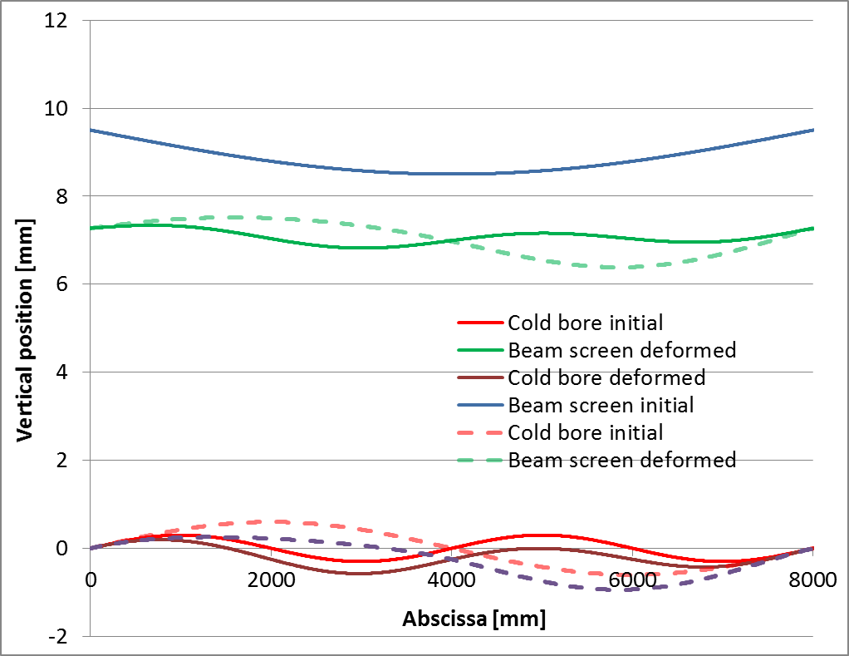
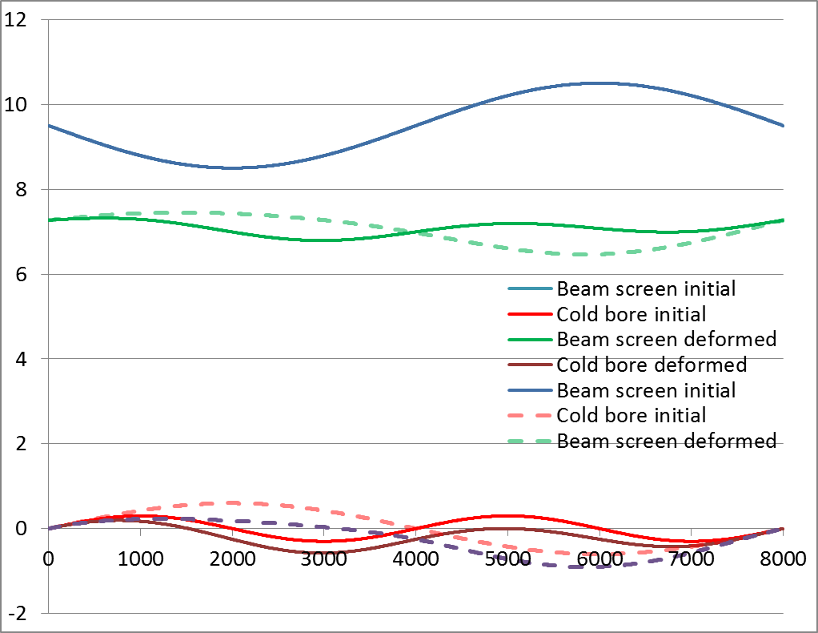
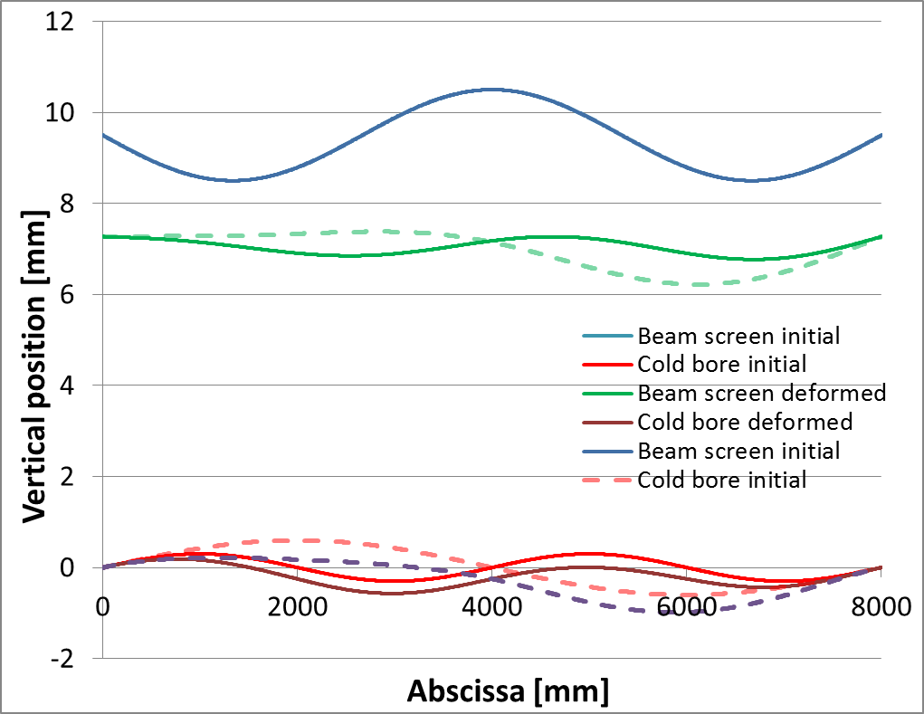
Vertical positioning tolerance
Q2-D1
Influence of number of additional supports for different initial shapes
1 support: Δy: -0.89/+0.25
3 supports: Δy: -0.45/+0.07
1 support: Δy: -0.81/+0.18
3 supports: Δy: -0.48/+0.05
1 support: Δy: -1.05/+0.11
3 supports: Δy: -0.5/0
With 3 supports instead of 1, reduction of the vertical tolerance from ~ 1 mm to ~ 0.5 mm.

Slide 11
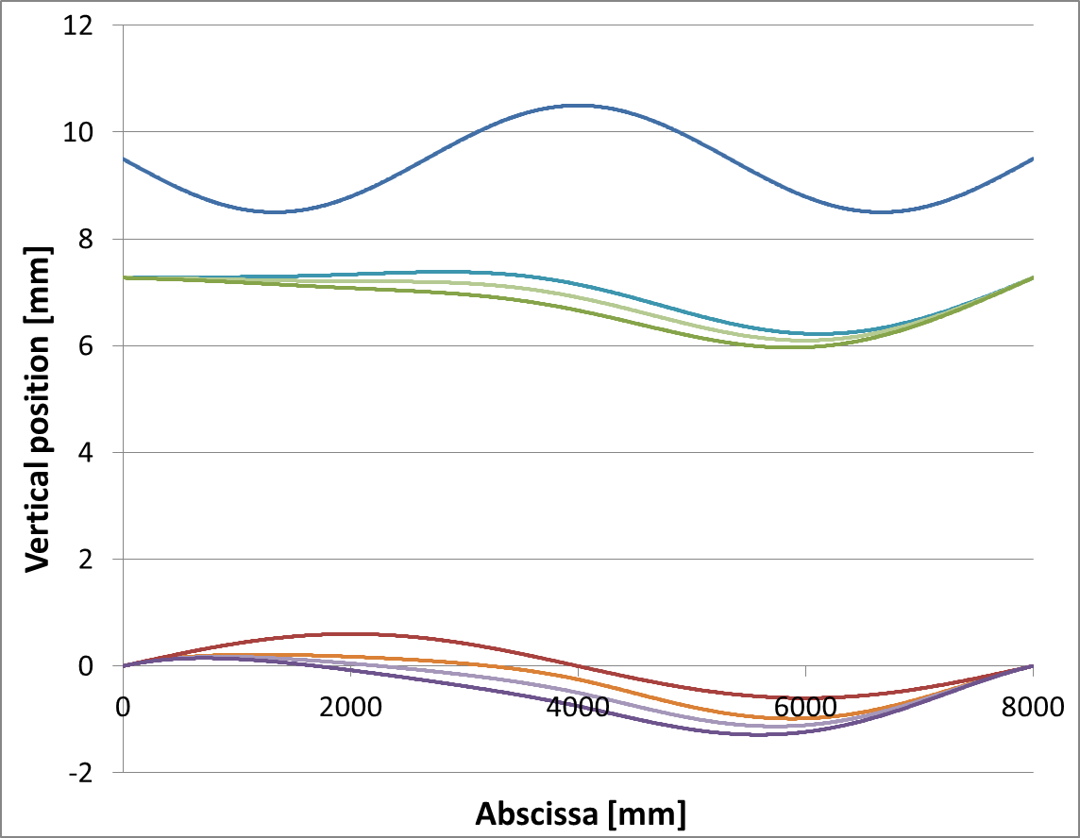
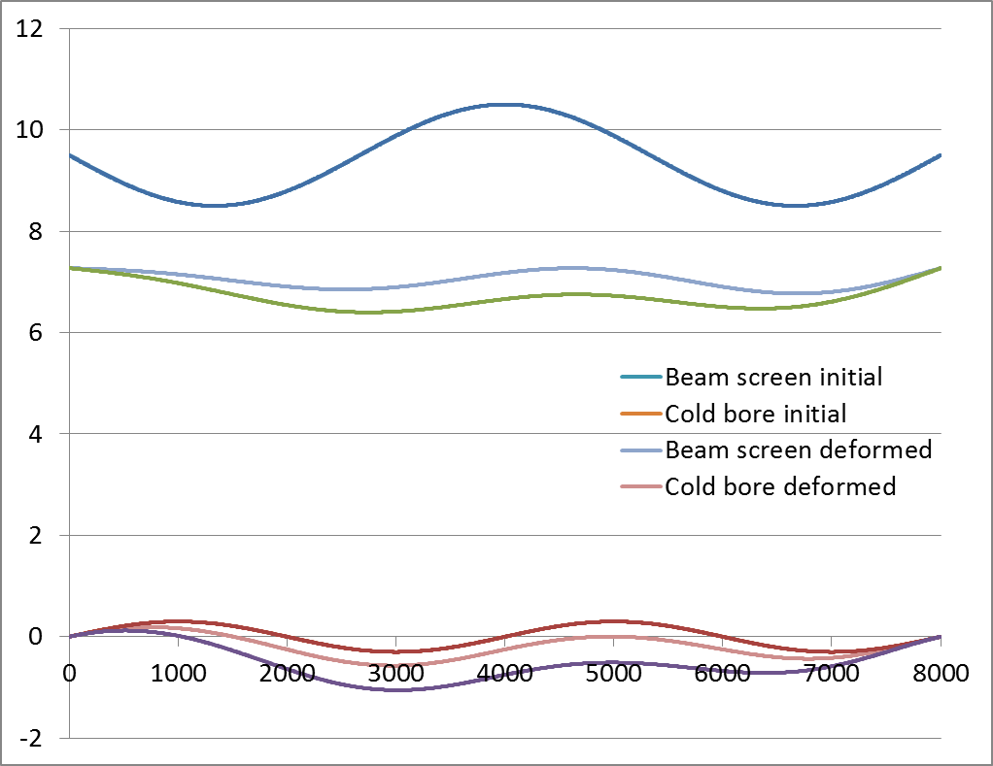
Vertical positioning tolerance
Q2-D1
Influence of the gap in the additional support(s)
1 support
3 supports
Gap 0.25 → Δy: -1.05/+0.11
Gap 0.5 → Δy: -1.17/0
Gap 0.75 → Δy: -1.31/0
Gap 0.25 → Δy: -0.5/0
Gap 0.75 → Δy: -0.87/0
Significant impact of the gap in the support.

Slide 12
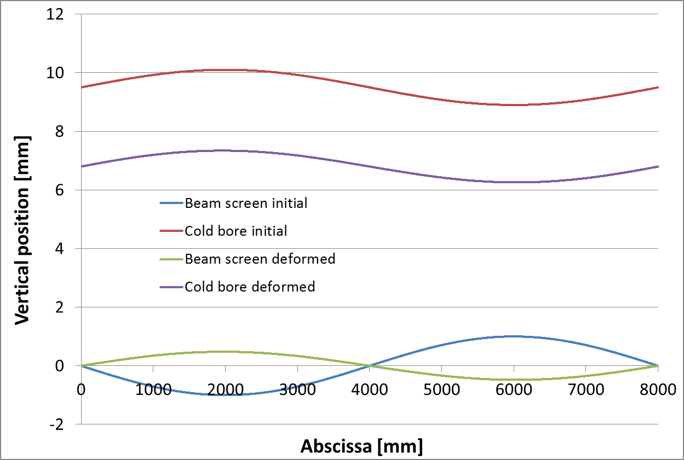
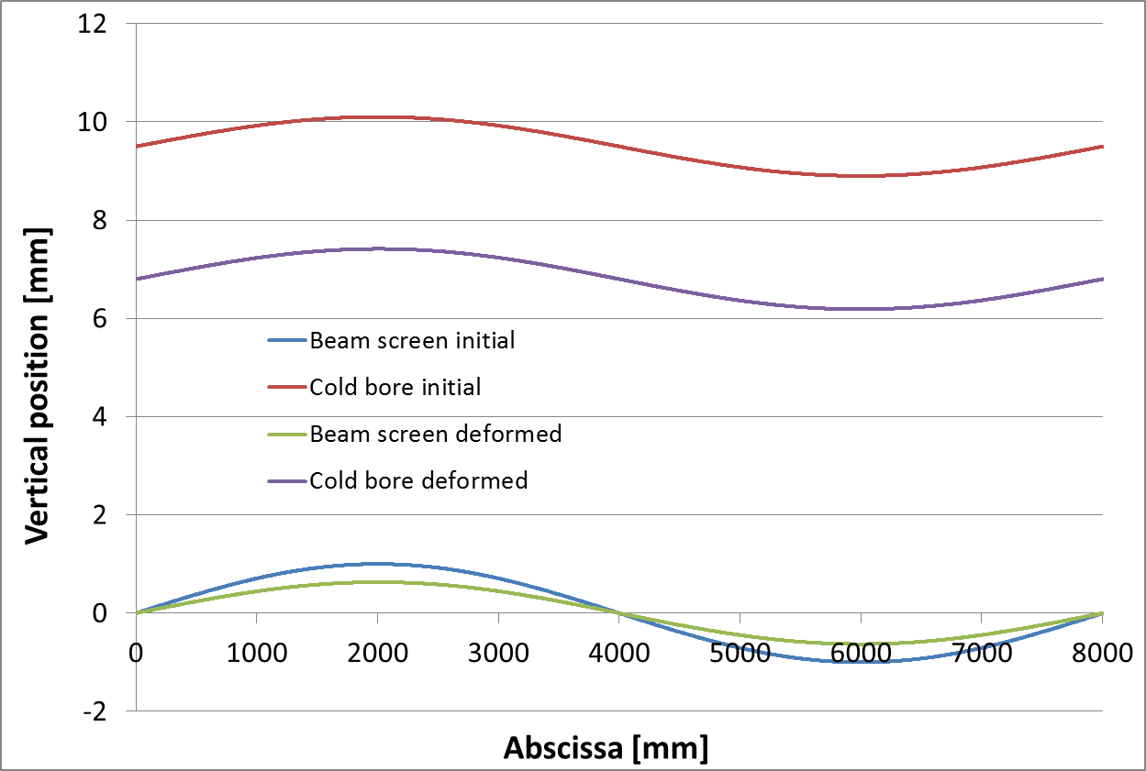
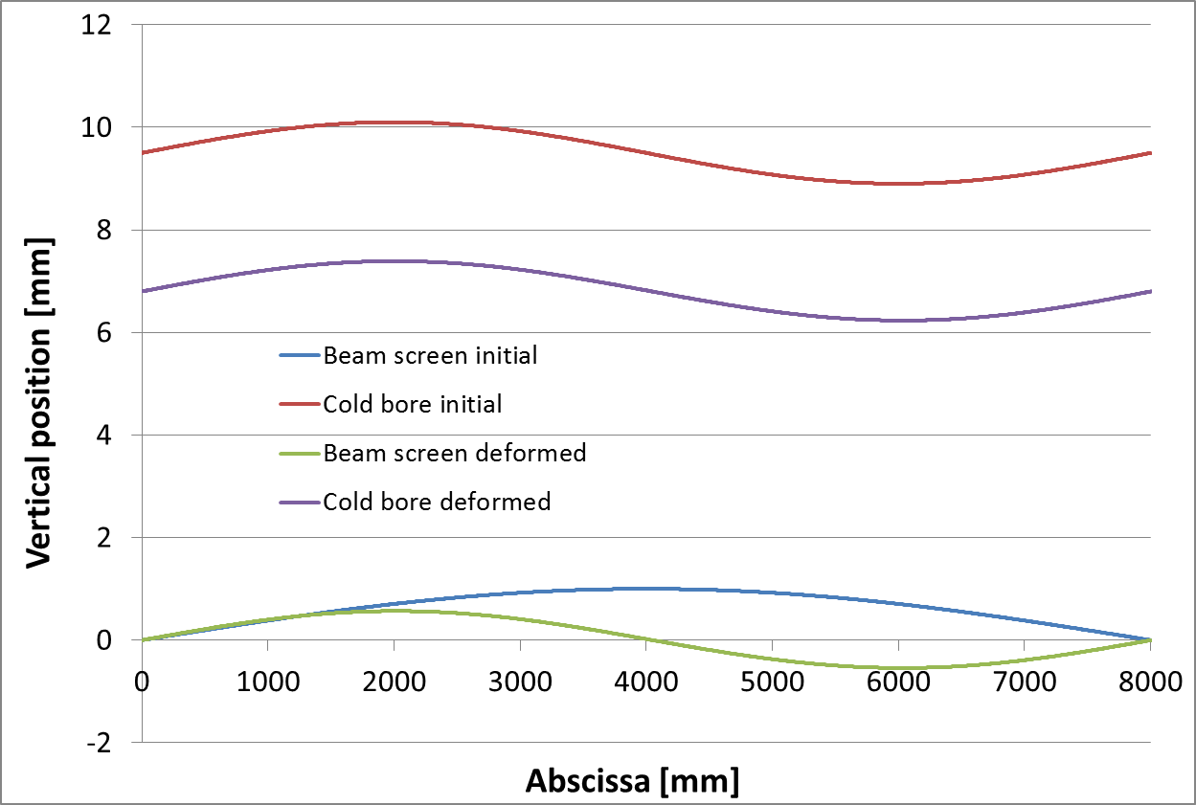
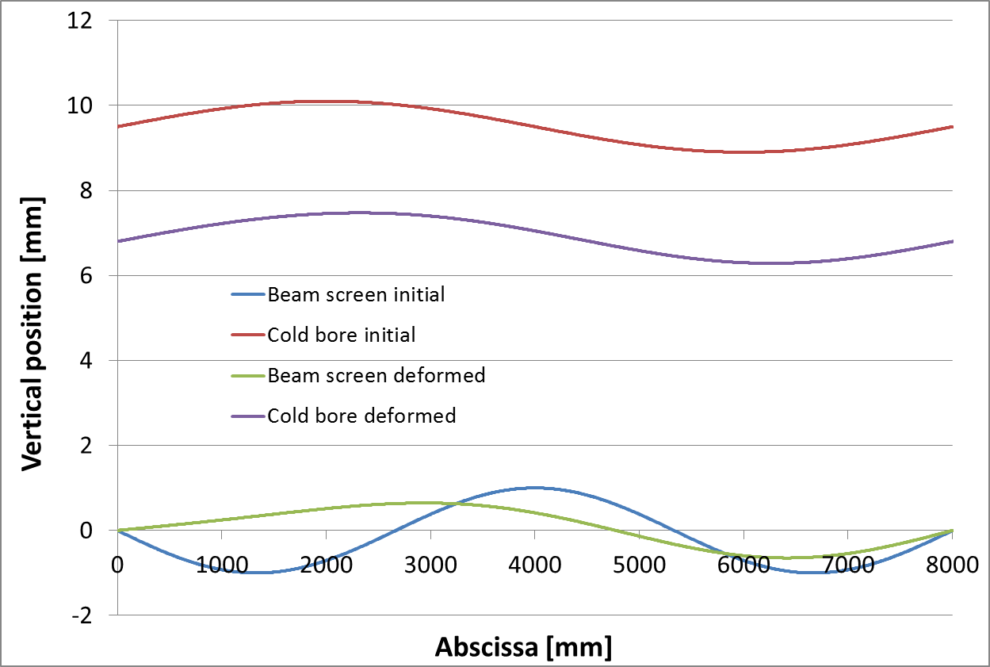
Horizontal positioning tolerance
Horizontal plane
Beam screen;
1 mm thick, I ~ 4.5.10⁵ mm⁴
Straightness +/-1 mm
Spring:
37.5 N/mm;
every 10 cm
Free length 7.5 mm
Cold bore;
OD 147; 4 mm thick
Clamped at the extremities
Additional support(s) along the cold bore, nominal radial gap 0.25 mm
Straightness: 0.3 mm/m
Beam screen tolerance +/- 0.63
Arbitrary absolute position of cold bore
Cold bore: +/- 0.6 mm
Beam screen tolerance +/- 0.48
Beam screen tolerance ~ +/- 0.65
Beam screen tolerance -0.54/+0.57
→Horizontal beam screen position driven by the cold bore position.
Horizontal positioning tolerance: ~ +/- 0.65 mm

Slide 13
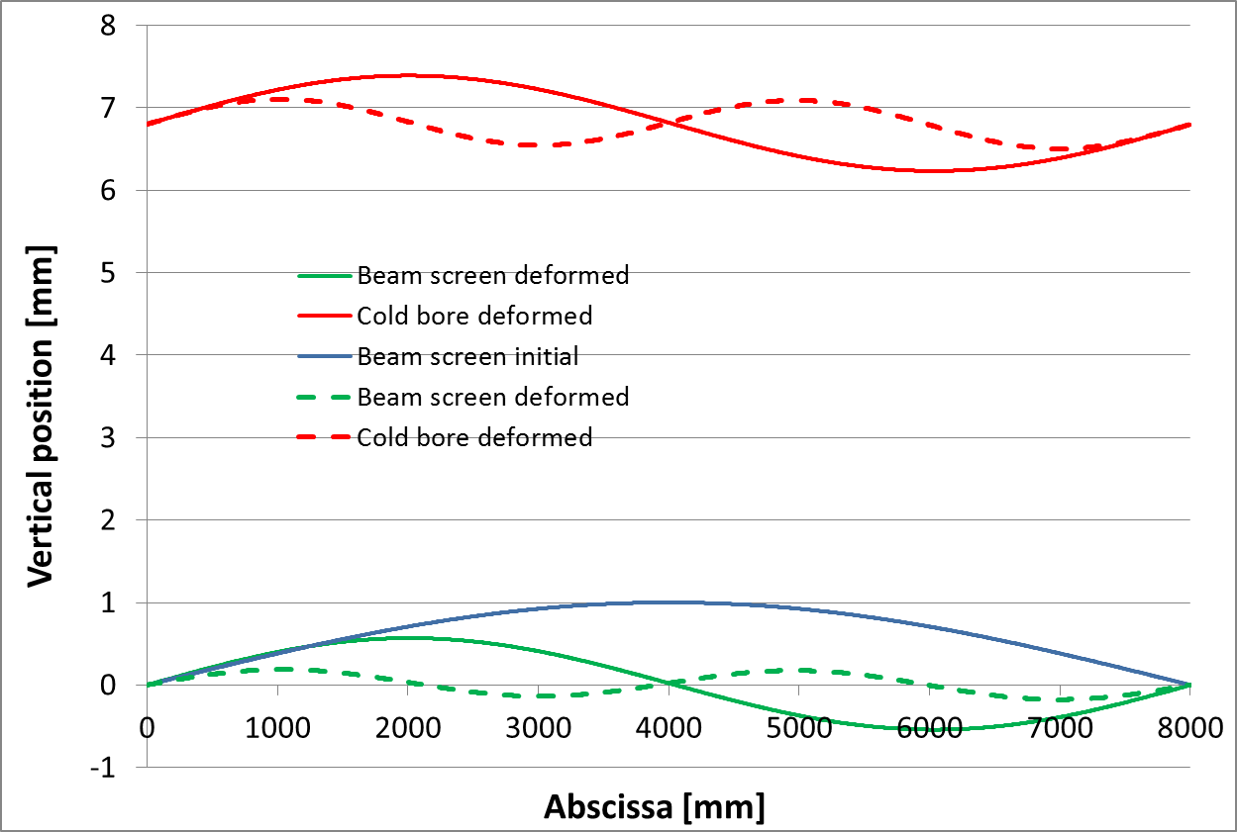
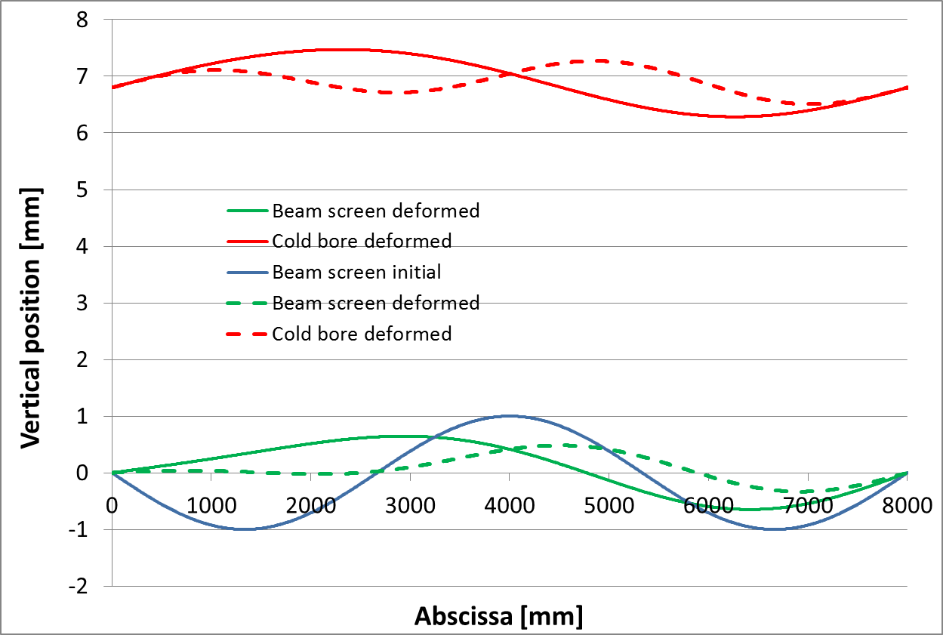
Horizontal positioning tolerances
Horizontal plane
Influence of number of additional supports
1 support: Δy: ~ +/- 0.55
3 supports: Δy: ~ +/- 0.19
1 support: Δy: ~ +/- 0.65
3 supports: Δy: -0.33/+0.48

Slide 14
Shape tolerances
Cold Bore (machined):
Results obtained on a short prototype (~1.2 m)
Tungsten blocks (machined):
Shape +/- 0.1
Ceramic balls :
diameter: +/- 0.0002 (neglected)
Titanium spring (3D printed):
Length: +/- 0.2 mm
 | Target for long cold bore | Specified | Obtained
Inner diameter | ID 0/+0.1 | 139 0/+0.063 (H8) | 139 -0.003/+0.087
Thickness | t 0/+0.5 | 4 0/+0.25 | 4 -0.04/+0.085
Straightness | 0.3 mm/m | 0.3 mm/m | 0.042 mm
Beam screen (sheet metal work):
Shape tolerance: +/- 1 mm (values from manufacturer)
 | Beam screen 1 | Beam screen 2
Minimal value | 103.62 | 103.92
Maximal value | 104.29 | 104.4
Standard deviation | 0.22 | 0.15
Measurement of the external dimension (nominal 104 mm) obtained on 2 short prototypes (1.2 m, 5 sections of measurements, 20 measures in total per screens):
→ +/- 0.5 mm retained for the analysis
Tolerance on thickness neglected.

Slide 15
Shape tolerances – vertical
The aperture is decomposed into the position of the upper and lower part of the beam screen with respect to the cold bore axis.
=
A
+
B
Aperture

Slide 16
Shape tolerances – vertical
 |  |  | A max | A min
a1 | CB inner radius | 0/+0.05 | 0 | -0.05
a2 | Spring | +/- 0.2 | 0.2 | -0.2
a3 | Absorber | +/- 0.1 | 0.1 | -0.1
a4 | Beam screen | +/- 0.5 | 0.5 | -0.5
a5 | BS thickness | - | 0 | 0
A |  |  | +0.8 | -0.85
a5
A
a4
a1
a3
a2

Slide 17
Shape tolerances – vertical
 |  |  | B max | B min
b1 | BS thickness | - | 0 | 0
b2 | Absorber | +/- 0.1 | 0.1 | -0.1
b3 | Spring | +/- 0.2 | 0.2 | -0.2
b4 | CB inner radius | 0/+0.05 | 0.05 | 0
B |  |  | +0.35 | -0.3
B
b4
b1
b2
b3
→ Tolerance on vertical aperture due to shape tolerances of the components: +/-1.15

Slide 18
Shape tolerances – horizontal
b4
 |  |  | B max | B min
b1 | CB inner radius | 0/+0.05 | - | -
b2 | Spring | +/- 0.2 | 0.2 | -0.2
b3 | Absorber | +/- 0.1 | 0.1 | -0.1
b4 | BS thickness | - | 0 | 0
 |  |  | +0.3 | -0.3
a5
a4
a3
b2
b3
a2
a1
b1
 |  |  | A max | A min
a1 | CB inner radius | 0/+0.05 | - | -
a2 | Spring | +/- 0.2 | 0.2 | -0.2
a3 | Absorber | +/- 0.1 | 0.1 | -0.1
a4 | Beam screen | +/- 0.5 | 0.5 | -0.5
a5 | BS thickness | - | 0 | 0
 |  |  | +0.8 | -0.8
Tolerance on horizontal aperture due to shape tolerances of the components: +/- 1.1.
This is a conservative value (all components with maximal dimensions in one side and minimal sizes on the other). In practice, tolerance probably closer to +/- 0.5.

Slide 19
Summary table
 | Cold bore |  | Beam screen
 | Inner diameter | Thickness | Nominal aperture* H(V);+/-45 ° | Vertical tolerance |  | Horizontal tolerance |  | Cooling tube Nb * OD * thickness | Shielding maximum height
 |  |  |  | Shape | Positioning** | Shape | Positioning**
Q1 | 136.7 H8 | 4 0/+0.5 | 99.7; 99.7 | +/-1.15 | -1.23/0 | +/-1.1 | +/- 0.65 | 4 * 16 * 1 | 16
Q2a | 136.7 H8 | 4 0/+0.5 | 119.7; 110.7 | +/-1.15 | -1.05/+0.11 | +/-1.1 | +/- 0.65 | 4 * 10 * 1 | 6
Q2b | 136.7 H8 | 4 0/+0.5 | 119.7; 110.7 | +/-1.15 | -1.05/+0.11 | +/-1.1 | +/- 0.65 | 4 * 10 * 1 | 6
Q3 | 136.7 H8 | 4 0/+0.5 | 119.7; 110.7 | +/-1.15 | -1.05/+0.11 | +/-1.1 | +/- 0.65 | 4 * 10 * 1 | 6
CP | 136.7 H8 | 4 0/+0.5 | 119.7; 110.7 | +/-1.15 | -1.05/+0.11 | +/-1.1 | +/- 0.65 | 4 * 10 * 1 | 6
D1 | 136.7 H8 | 4 0/+0.5 | 119.7; 110.7 | +/-1.15 | -1.05/+0.11 | +/-1.1 | +/- 0.65 | 4 * 10 * 1 | 6
DFXJ | To be defined | ~4 0/+0.5 | To be defined |  |  |  |  | To be defined | -
D2 | 94 | 3 0/+0.5 | 86; 77 |  |  |  |  | ? * 6 * 0.8 | -
Q4 | 79.8 | 2.6 0/+0.5 | 72.8; 62.8 |  |  |  |  | ? * 6 * 0.8 | -
* Cu layer thickness, thermal contraction, self weight deformation not accounted (see slide 5)
** 1 additional support, 0.25 mm radial clearance between the support and the cold bore.
Notes:
For Q2-D1, it takes into account the 2*0.5 mm reduction in the +/- 45 planes (needed to increase the filling factor of absorbers and the strength of the extension)

Slide 20
Conclusions and outlook
Cold bore thickness of 4 mm can be used for Q1 to D1 magnets.
Tolerances on the beam screen aperture are given by:
the positioning of the beam screen/cold bore system in the magnet.
the beam screen and cold bore shape tolerances.
The beam screen position is driven by the cold bore sag which depends on the number of additional supports and the gap between the supports and the cold bore.
Integration of the cold bore in the magnet and the related supports have to be studied and designed: interface VSC-MSC.
Impact of the shape tolerances on the aperture is in the range of +/- 1.1 mm.
A summary working table is proposed.
Tolerances have been given according to our present best guess. Values may evolve.
A second prototyping phase has started:
1 long cold bore prototype (10.5 m), and 2 short bores (2.5 m) will be manufactured by summer 2016.
→ check tolerance achievable for Q1-D1 cold bore thickness.
2 ~ 2 m long beam screens will be manufactured by end 2016.
→ Need to agree (or change, if needed) quickly on the cold bore dimensions (slide 4)

Slide 22
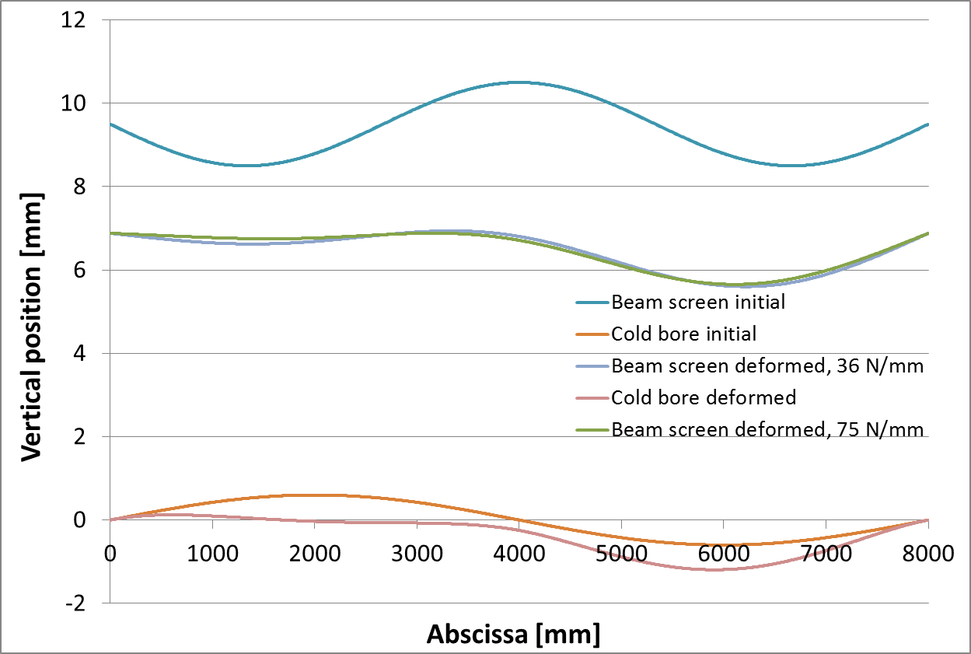
Vertical positioning tolerance
Q1
No significant impact of the spring stiffness on the beam screen deformation.

