Slide 1
Follow-up of the TAXS integration
8th HL-LHC TCC
02 June 2016
F Sanchez Galan on behalf of WP8
Special thanks to C. Adorisio, J. Albertone, I. Bergstrom, C. Boccard, D. Brethoux, I. Efthymiopoulos, S. Evrard, P. Fessia, A. Gaddi, L. Krzempek, M Lazzaroni, D. Mergelkuhl, J. Perez Espinos, M. Raymond, H. Vincke

Slide 2
Outline
Recall on space constraints
Current lay-out, (BPM, beam pipe supports, shielding modifications)
Services integration
RP studies
TAXS Survey and alignment

Slide 3
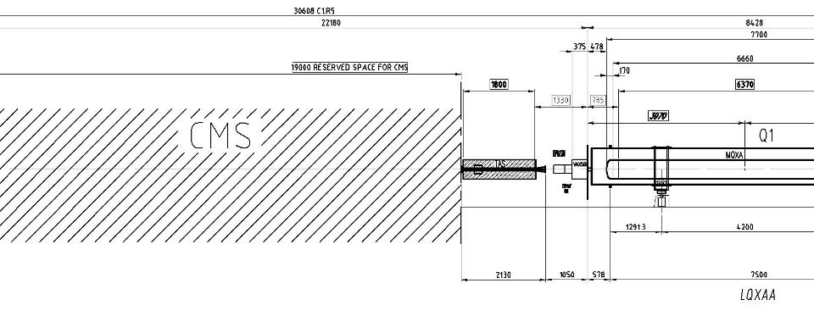
Recall on available space constraints [LHC]
    Q1-TAS: 1.3 m. Equipment installed: warm BPM, 2 vacuum valves, bellows, bake-out equipment, He tightness dome, Z-stops.
Very thigh environment & difficult access. Interventions need to be improved (ALARA). Static.

Slide 4
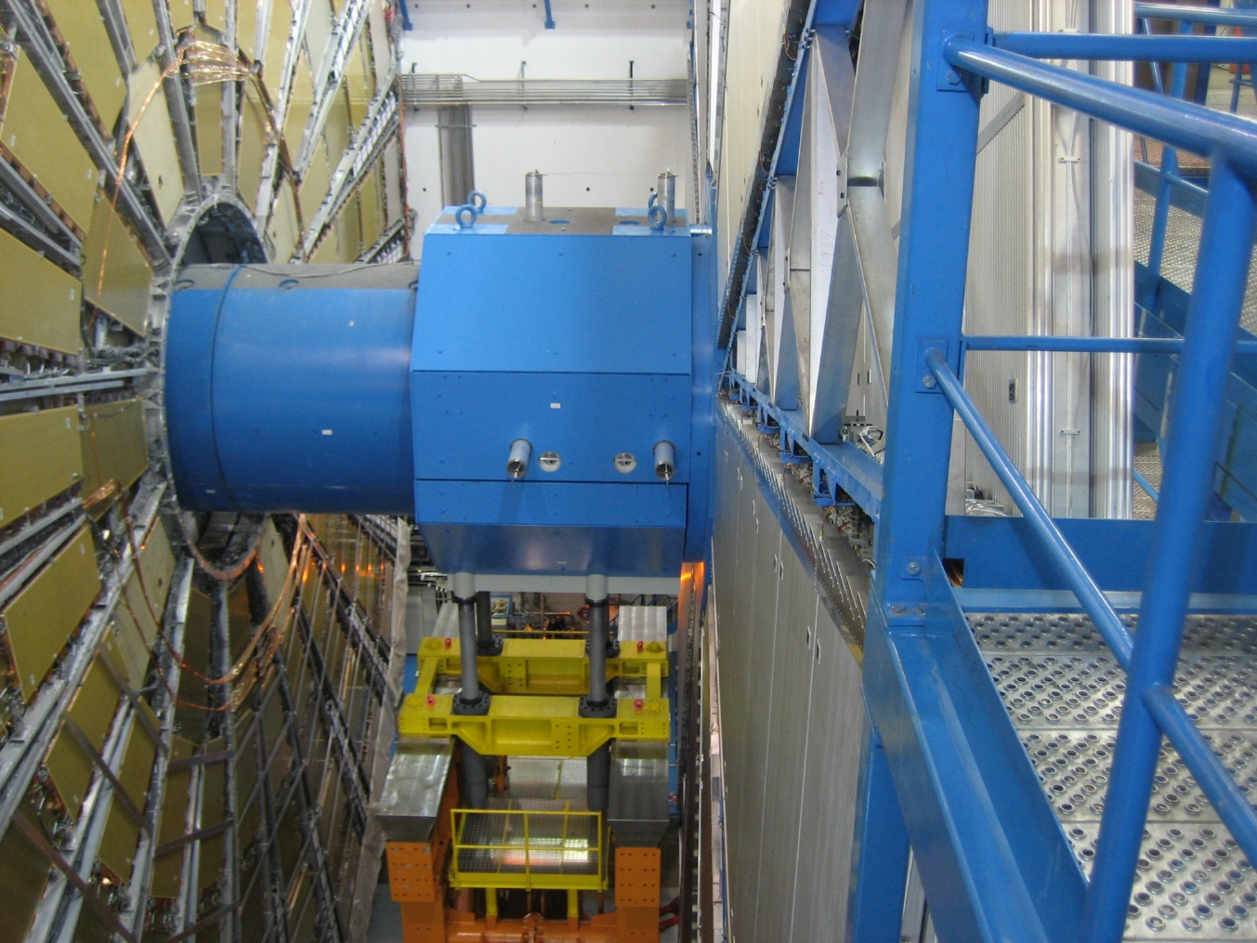
ATLAS Forward shielding

Slide 5
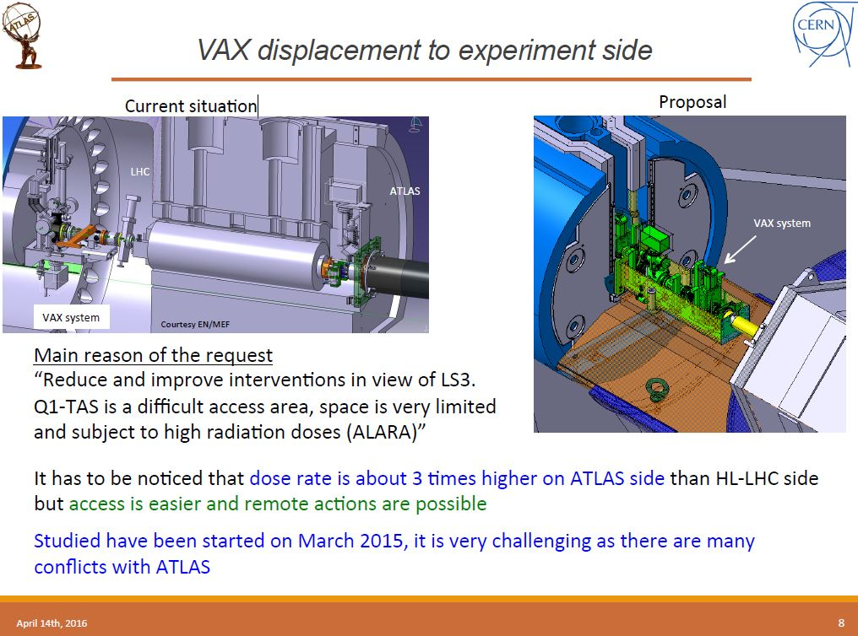
Courtesy M. Raymond

Slide 6
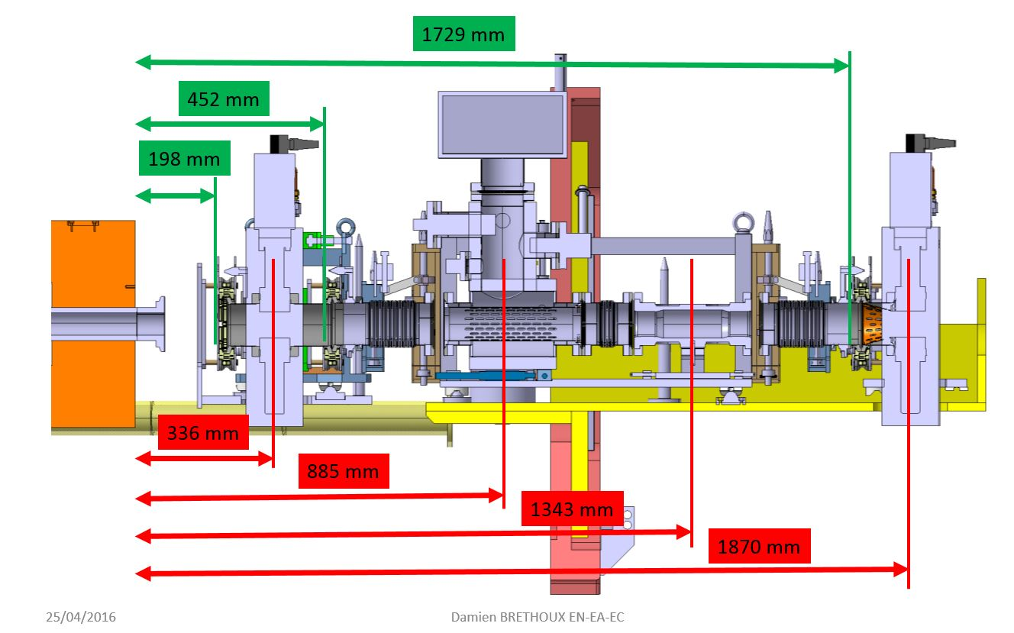
VAX Relocation (CMS)
430 mm

Slide 7
During Shutdown period: Toroid moved toward the octagon
To avoid clash with new HL vacuum configuration, the JTT 1 has to be modified.
JTT1
Octagon
Big wheel
M. Lazaronni, 37th WP8 meeting

Slide 8
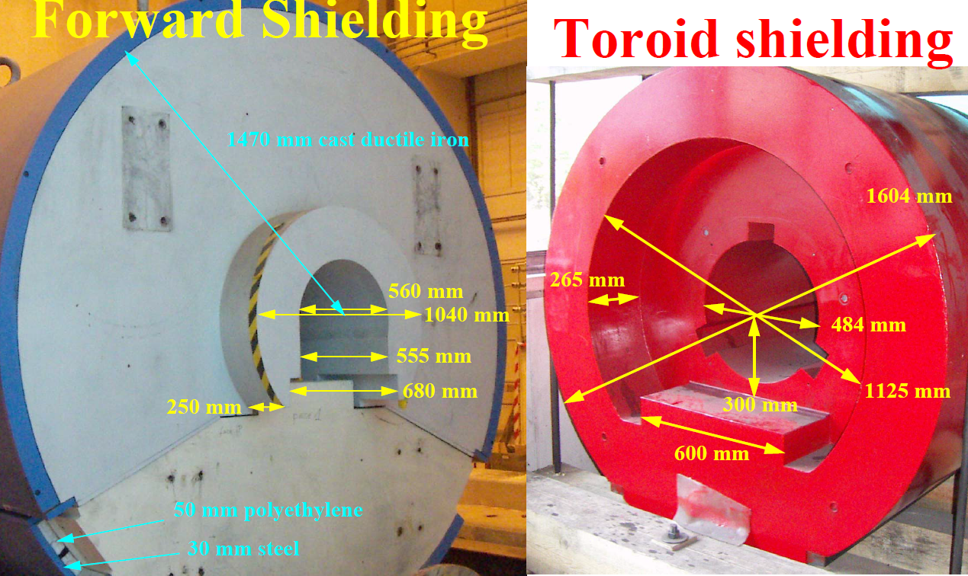

Slide 9
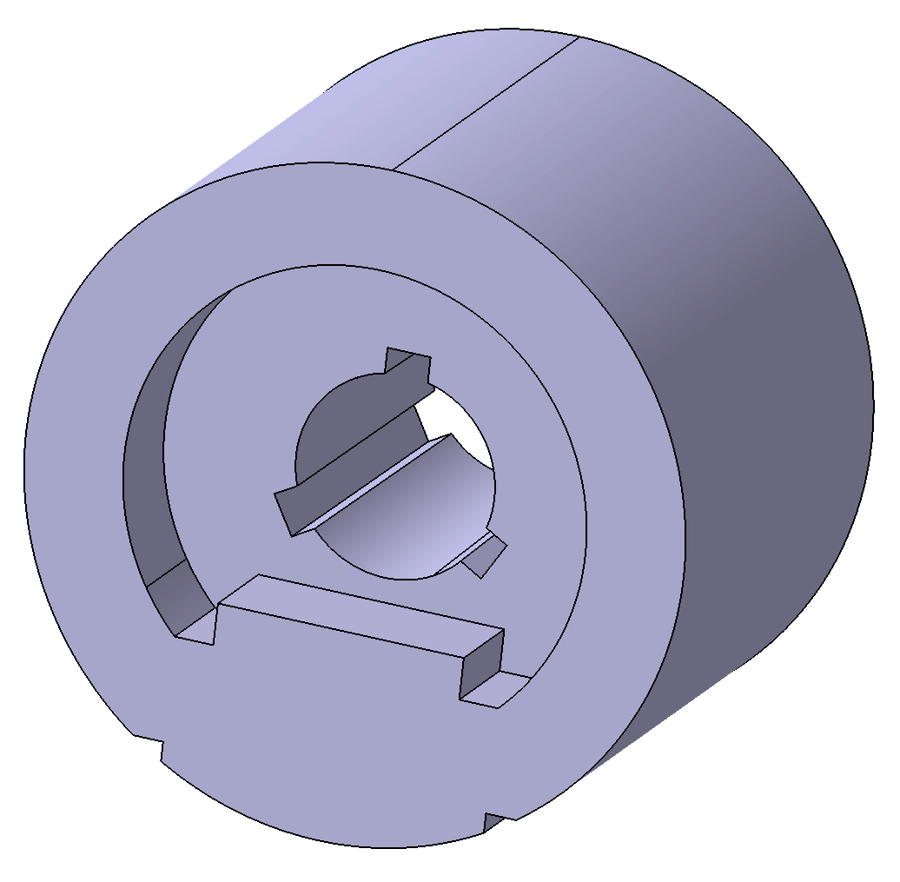
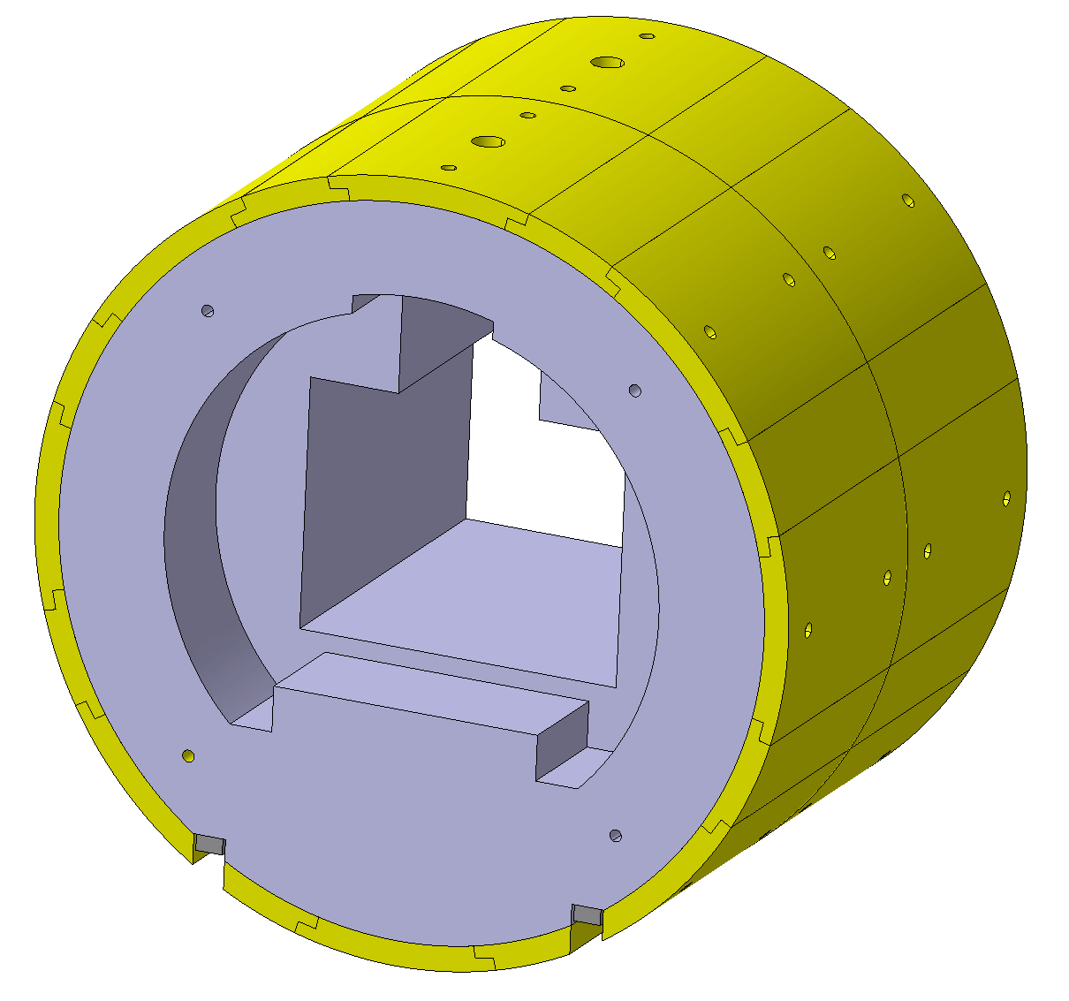
Add a shielding extension JFC2 (1.2 t)
Shielding's modifications on JTT1&JFC2
M. Lazaronni
Actual plug JTT1
JTT1 modification

Slide 10
JFC 2 removal scenario
M. Lazaronni

Slide 11
JFC 2 removal scenario : step 1
Clearance depends on Gate Valve position
M. Lazaronni

Slide 12
JFC 2 removal scenario : step 2
M. Lazaronni

Slide 13
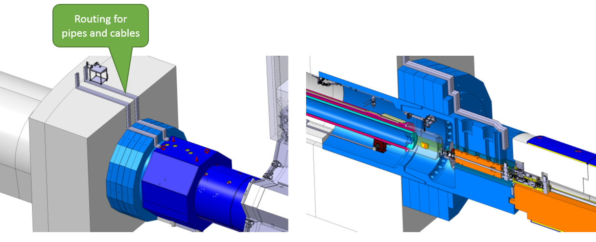
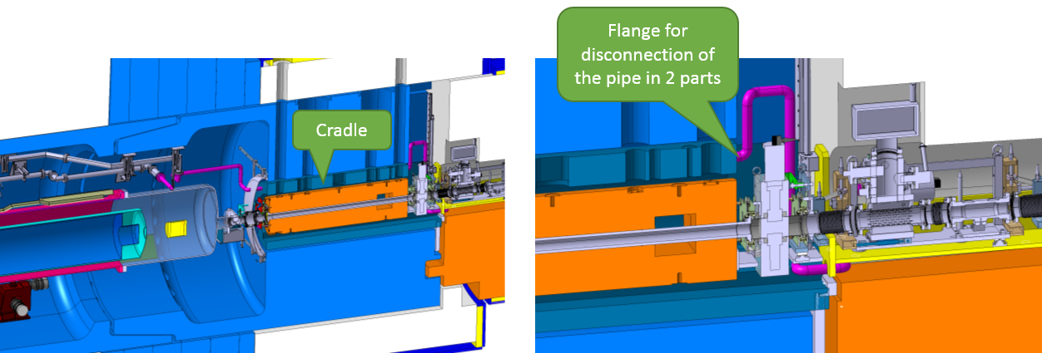
Services routing

Slide 14
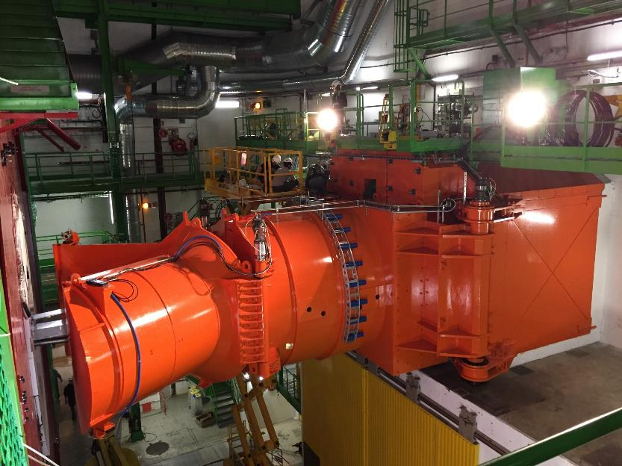
CMS Forward Shielding

Slide 15
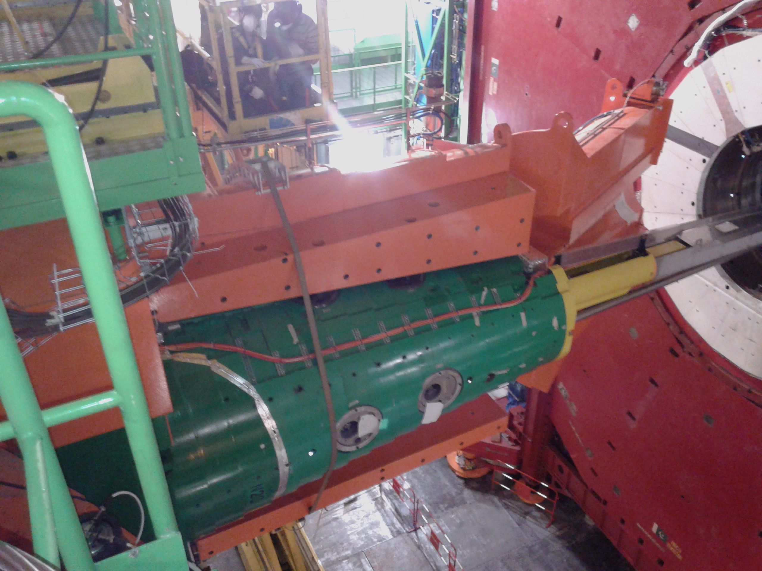

Slide 16
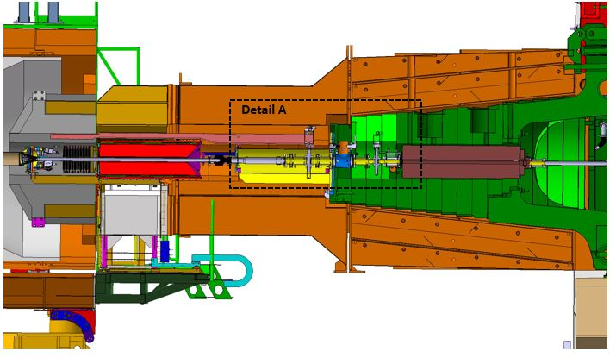
Shielding modifications (1/2)
Machining of plug of FIN
Removal of chicane
New support for Vacuum Chamber- Advance installation to LS2 (!)
Re-routing of services to pumps
Courtesy A. Gaddi

Slide 17
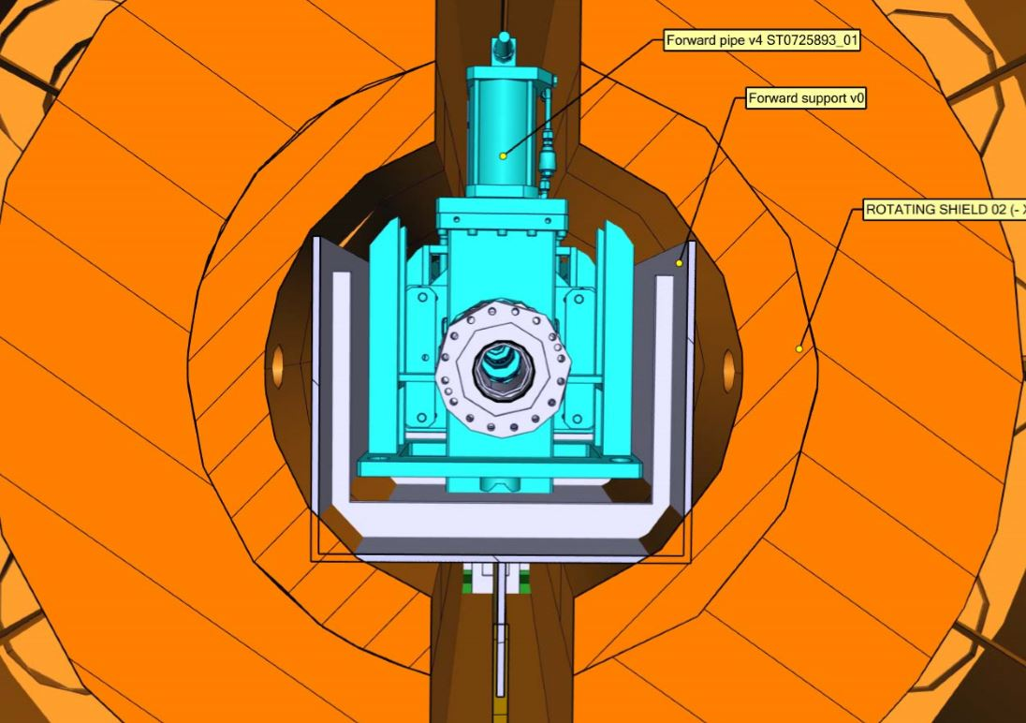
Shielding modifications (2/2)
Courtesy A. Gaddi

Slide 18
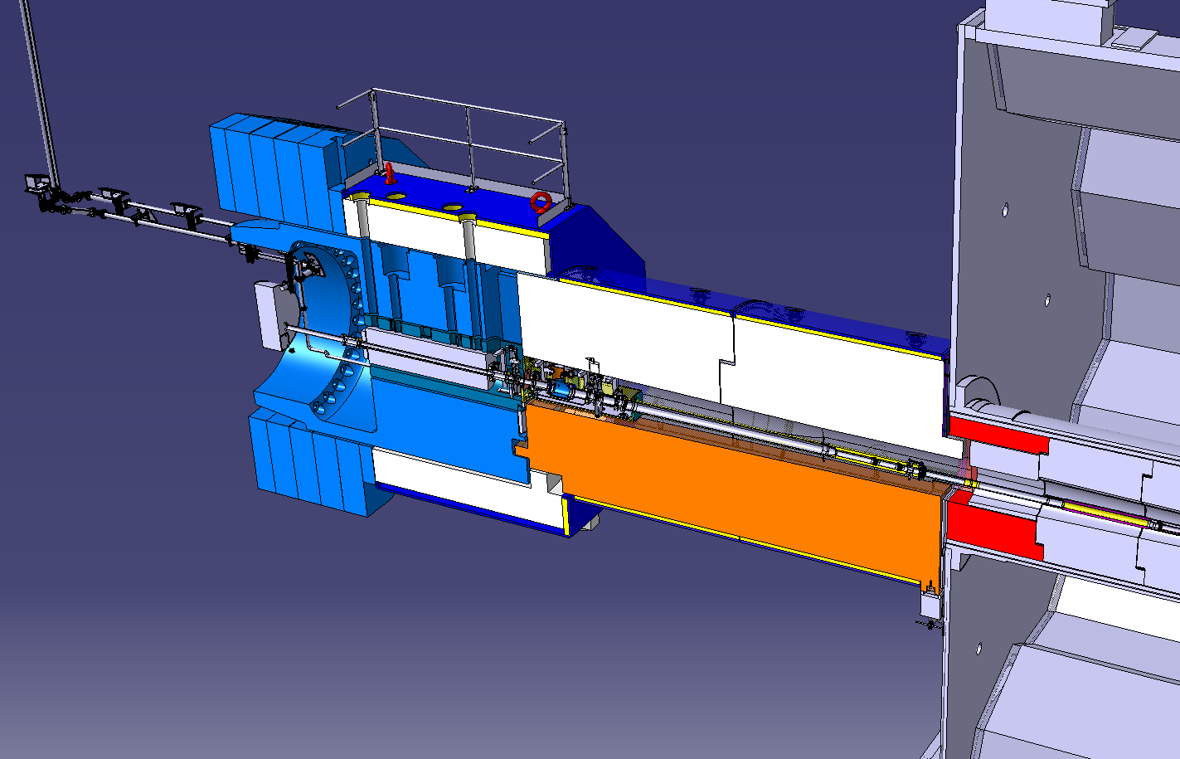
ATLAS. Modifications in existing shielding structures
Machining slots in JFC1, JFC3, octagonal shielding
Modification of JTT, JFC2
Services routing- (Machining TX1S?)
New support for VAX + VAX
VJ and VT supports

Slide 19
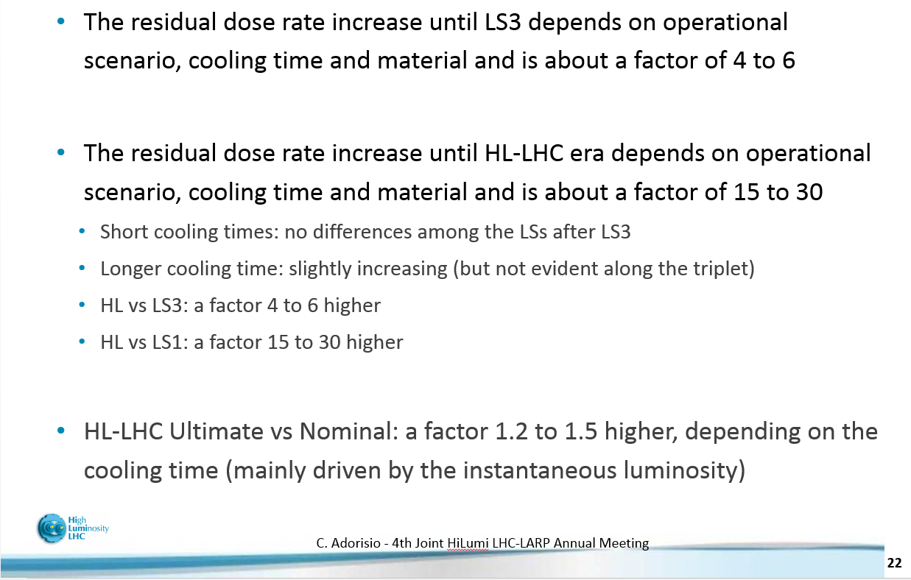
Overview of Radiation (EDMS 1434476)

Slide 20
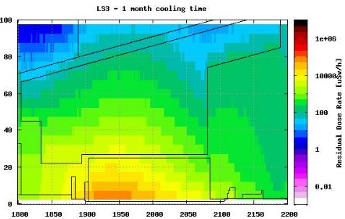
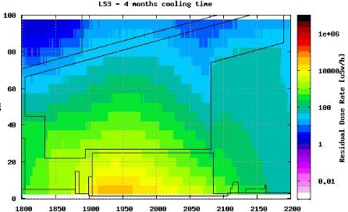
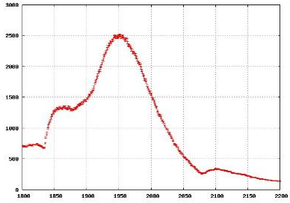
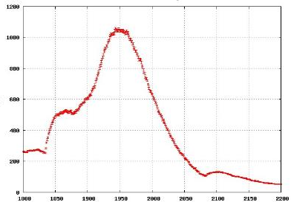
LS3 estimation
Experiment side dose rates @considered position are ~3 times higher than tunnel side ones.
32.5 ÷ 42.5
TAS
TAS
Residual Dose Rate [μSv/h]
Residual Dose Rate [μSv/h]
~700
~250
~230
~85
Distance from IP [cm]
Distance from IP [cm]
C. Adorisio, EDMS 1434476

Slide 21
ECFA Oct 2014
CMS & ATLAS joint talk

Slide 22
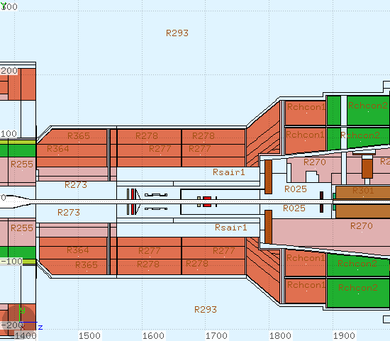
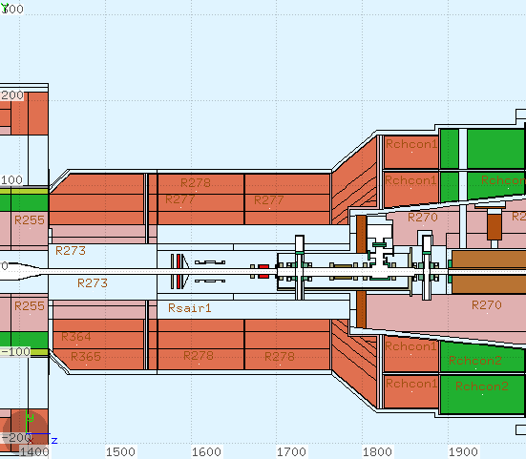
VAX installation in CMS
Geometry: S.Chitra (CMS BRIL Rad Sim)
←18 cm

Slide 23
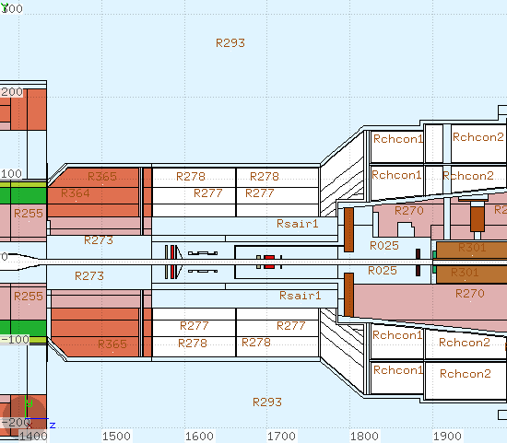
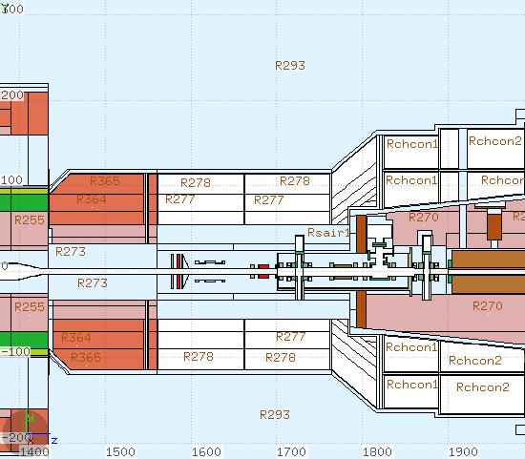
Rotational Shielding (RS) fully open

Slide 24
Irradiation assumptions
Integrated lumi: 300/fb per year in HL-LHC
  3 years operation, 1 year shutdown
  Previous contribution (total 320/fb) ignored.
  H*(10) in HL- shutdowns increase by factor 5-6 compared to LS3#.
Peak lumi: 7.5E34 cm⁻²s⁻¹ (levelling)
7+7 TeV pp-collisions, 75 mb inelastic cross section
Cooldown: 1 day, 1 month, 6 months, 1 year
(#) see scaling factor in extra slides

Slide 25
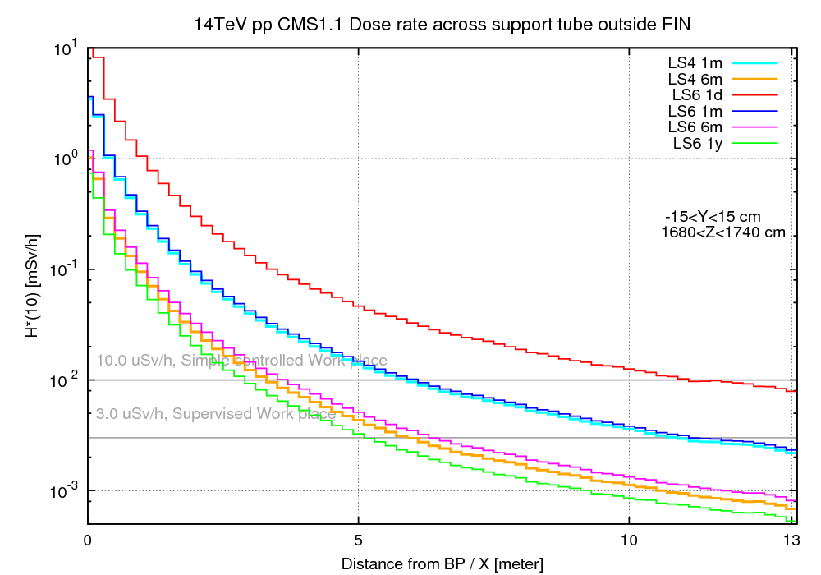
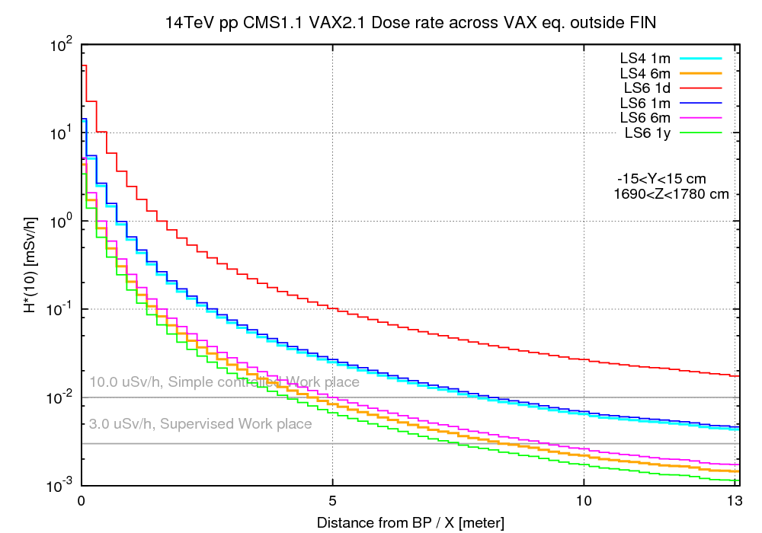
H*(10) in mSv/h across beam line [1/2]
Preliminary results
Preliminary results
Dose rate in CMS cavern in hottest region with RS open
…. and with VAX installed.

Slide 26
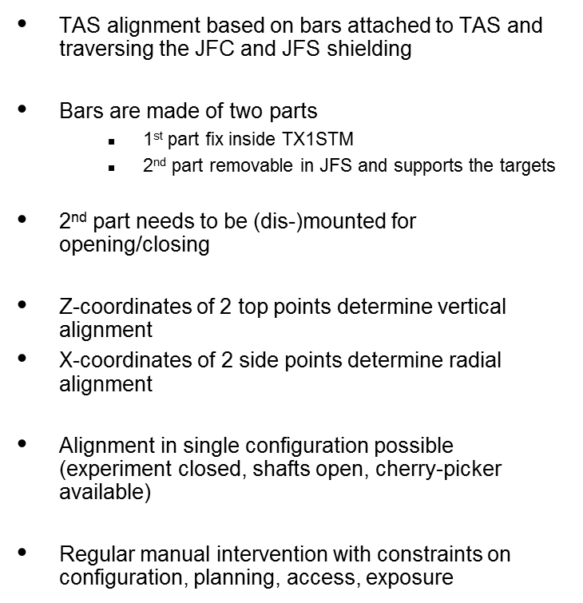
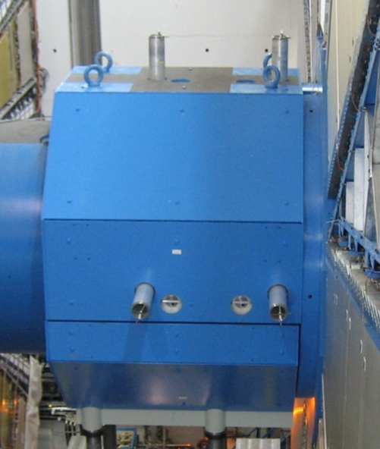
ACTUAL ATLAS TAS ALIGNMENT CONCEPT
Survey targets
TAS
Alignment rods
  D. Mergelkuhl EN-ACE-SU
  WP8 meeting, 10-05-2016

Slide 27
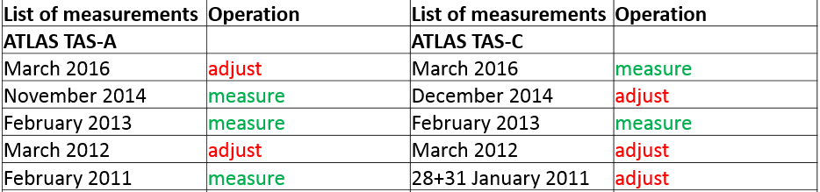
ATLAS TAS survey history
A-side
Only measurement dates with the possibility (configuration) of adjustment shown.
Data during installation not shown
Courtesy D. Mergelkuhl: History of ATLAS TAS alignment 2008-2016, available at 35th WP8 bi-weekly meeting https://indico.cern.ch/event/512614/

Slide 28
ATLAS TAS survey history
C-side
Only measurement dates with the possibility (configuration) of adjustment shown.
Data during installation not shown
Courtesy D. Mergelkuhl: History of ATLAS TAS alignment 2008-2016, available at 35th WP8 bi-weekly meeting https://indico.cern.ch/event/512614/

Slide 29
ATLAS TAS survey history
C-side
Only measurement dates with the possibility (configuration) of adjustment shown.
Data during installation not shown
Courtesy D. Mergelkuhl: History of ATLAS TAS alignment 2008-2016, available at 35th WP8 bi-weekly meeting https://indico.cern.ch/event/512614/

Slide 30
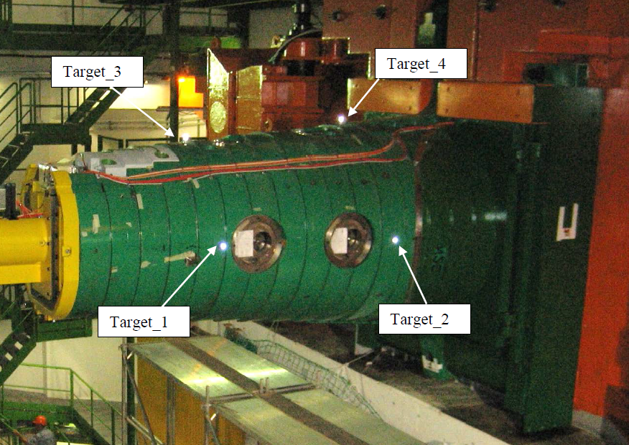
CMS TAS survey targets
Courtesy D. Mergelkuhl

Slide 31
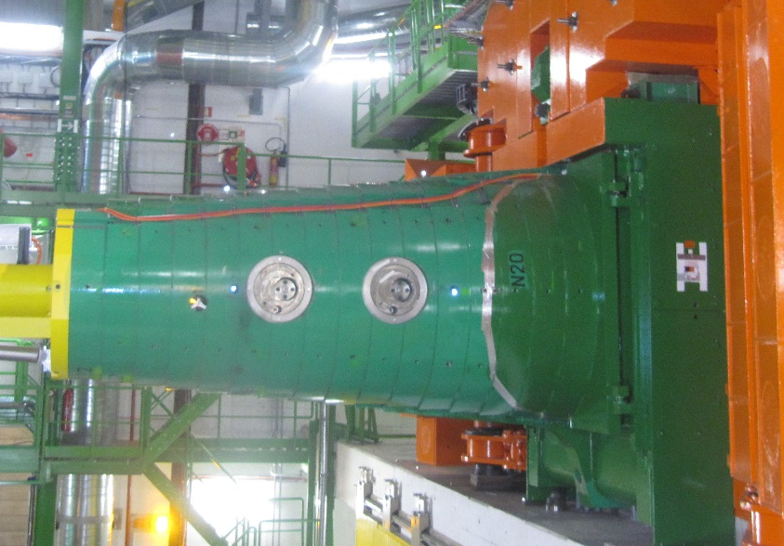
Actual CMS TAS concept
TAS alignment based on bars attached to TAS and traversing the FIN shielding (green)
Single parts of bars stay permanently
  1st fix part inside FIN
  Retro-targets are mounted as targets
Rotating shielding needs to be open for measurement
Z-coordinates of 2 top points determine vertical alignment
X-coordinates of 2 side points determine radial alignment
Manual intervention with constraints on configuration, planning, access, exposure

Slide 32
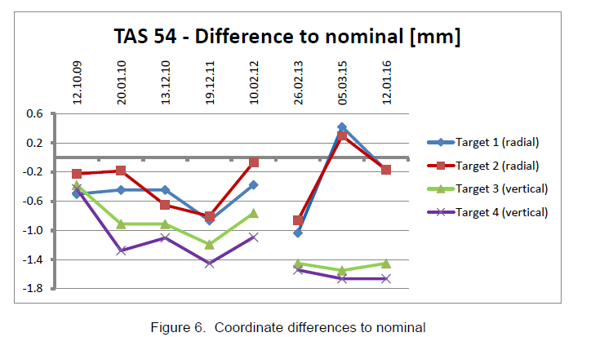
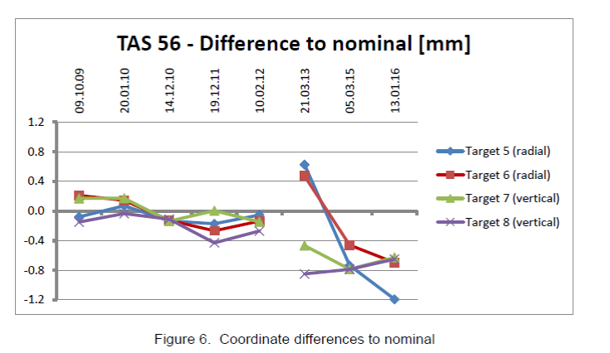
Motorization: CMS TAS survey history
35th WP8 Biweekly meeting https://indico.cern.ch/event/512614/
Courtesy D. Mergelkuhl

Slide 33
Motorization: CMS TAS survey history
35th WP8 Biweekly meeting https://indico.cern.ch/event/512614/
Courtesy D. Mergelkuhl

Slide 34
TAXS Alignment strategy
No alignments done for CMS since 1st Run
Few alignments for ATLAS, installation of survey targets takes most of the intervention time.
An electric motor for alignment with such a low level of use… good approach?→ ALARA
Following the lessons learned from the actual system the list of propositions is:
Change to single fixed bar (as CMS) or tubes
Change to Laser Tracker
Change to permanent retro reflectors
Major advantages:
Less interventions in ATLAS as no mounting/dismounting of bars
Measurement of 6DOF for TAS
Controlled measurements
Shorter interventions
More precise measurements
Measurement system exists (AT401) => no development, high reliability
No active components on TAS or shielding => limited maintenance on TAS
Constraints:
No real-time monitoring
No measurement in run configuration! At least top of JFS to be dismounted respectively rotational shielding open
Cost of prisms as permanent targets
Modification of plugs (ATLAS)
New configuration for survey network
  D. Mergelkuhl EN-ACE-SU

Slide 35
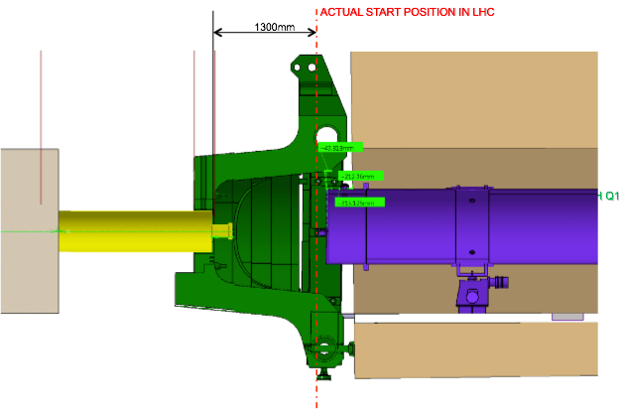
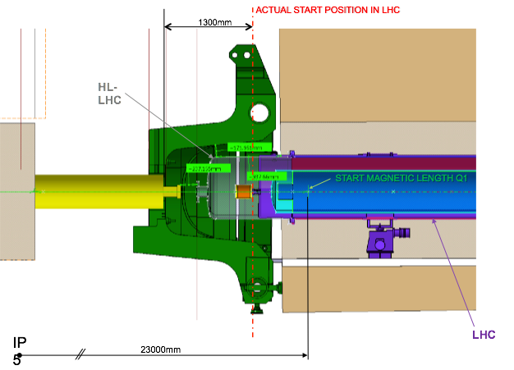
Recall on available space constraints [HL-LHC]
Remote operations need always more space: (Additional bellows & bigger connectors)
Q1-TAS: 550 mm
TAS- Experiments: Available space has to be compatible with Forward shielding structures & dynamic environment. Space is mainly limited transversally in CMS longitudinally in ATLAS.

Slide 36
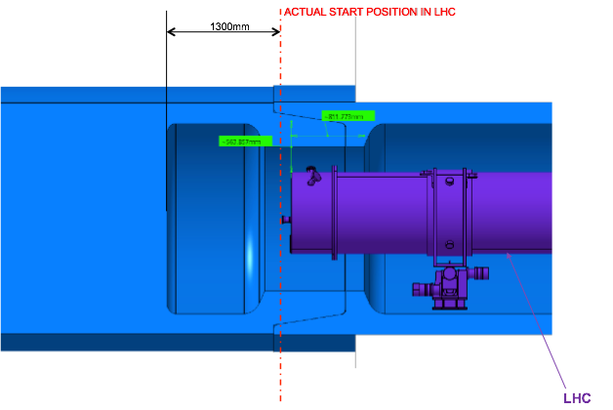
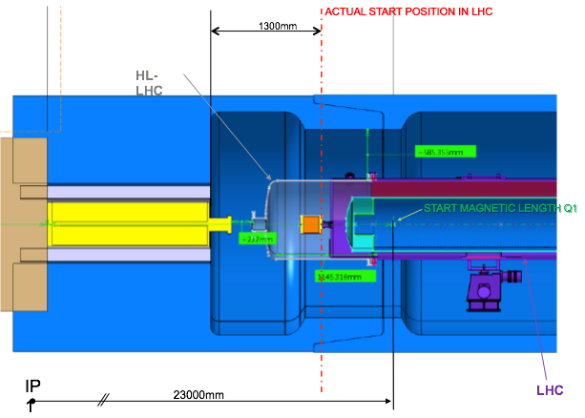
TAS-Q1 Layout proposal for HL-LHC operation
Present Situation
ATLAS/IR1
Proposed HL-LHC Layout ATLAS/IR1
Courtesy
P. Fessia

Slide 37
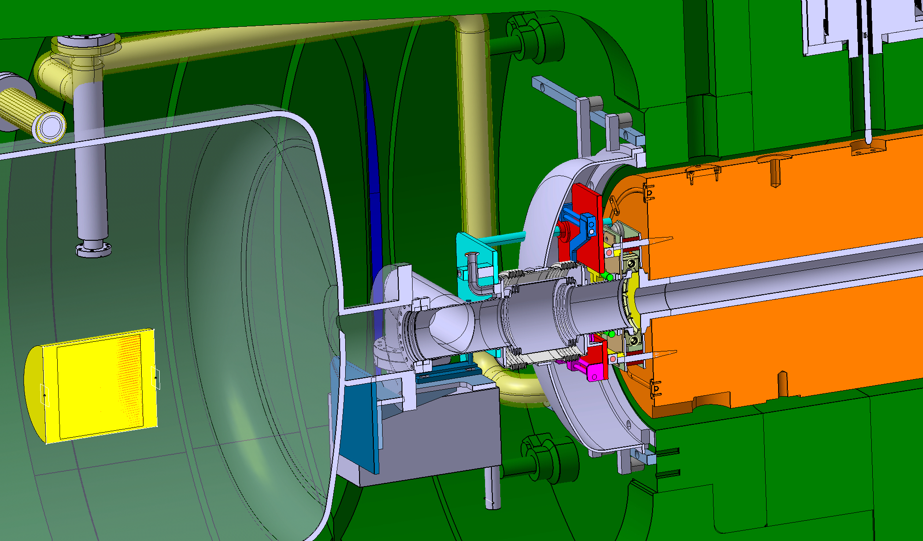
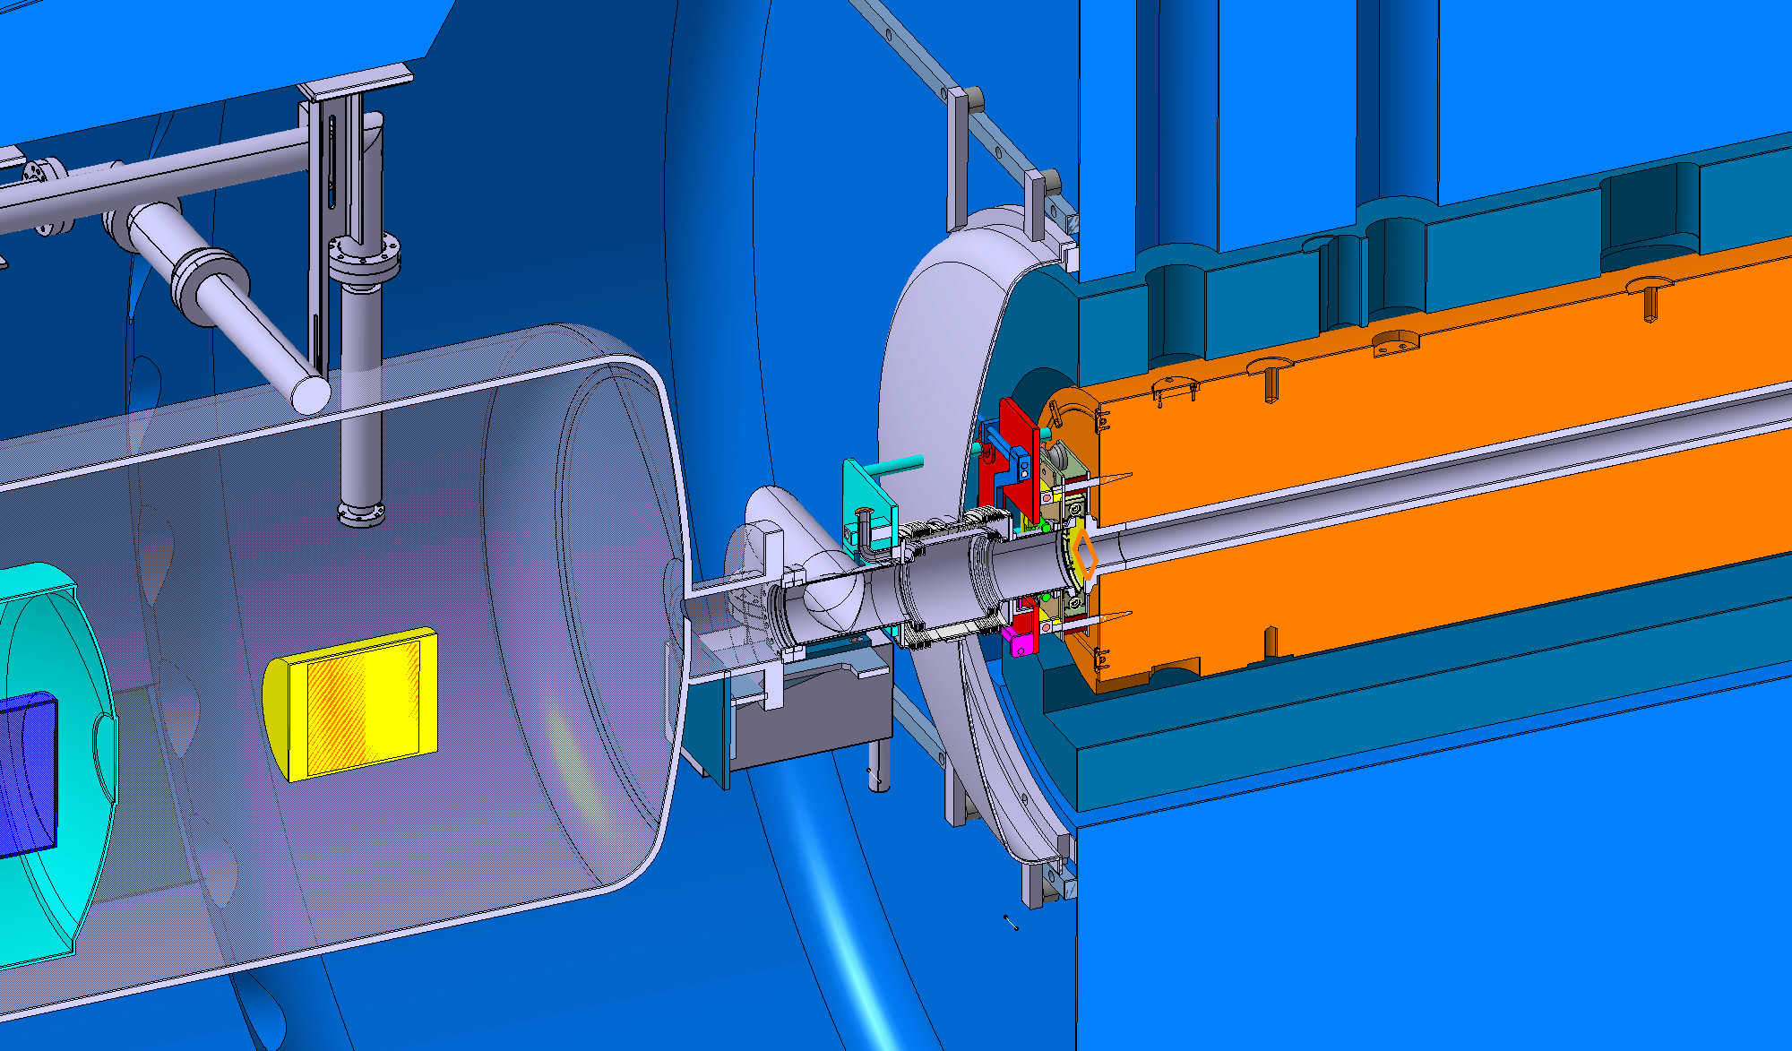
Q1-TAXS
In 550 mm
He leak protecting dome
Double pump
Quick connector
Installation & removal scenarios to be developped

Slide 38
TAXS, next steps
  Services integration: Choice between services routing (ATLAS).
  Survey proposal.
  TAXS remote alignment.
  Quick connections & supports with Beam Pipe
  BPM position- beam pipe supports, shielding modifications.
  Q1-TAXS region
Review meeting(s)

Slide 39
Conclusions
Very good collaboration & support from experiments (Thanks!)
Shielding modifications could be advanced to LS2, reducing exposure and relaxing LS3 planning. Close contact with beam pipe team.
Relocation of vacuum equipment from the tunnel to the experimental area (from 22-21m to 19 to 17m) seems feasible, but has implications on experiments:
  Modifications in experiment shielding.
  Modifications in auxiliary systems.
  BPM decision on hold, outside of Exp. Area relaxes space constraints, reduces interventions and improves alignment. It has a major implication on beam pipe supports, shielding modifications, alignment requirements.
Radiation levels 3x on the experiment side, remote operations compulsory for VAX exchange…
No alignment done in CMS, few in ATLAS where most of the dose comes from the installation/removal of survey targets. Alignment philosophy to be agreed.
Q1-TAS remains one of the most difficult access areas to access in the accelerator. He leak protecting dome, quick connector Q1-TAS and double pump integrated in 550 mm

