Slide 1
6th HL-LHC Collaboration Meeting
Paris, 14-16 November 2016
Programme: overview and meeting rooms
C.Noels, ATS-DO
TCC Meeting – 23 June 2016

Slide 2
Overview

Slide 3
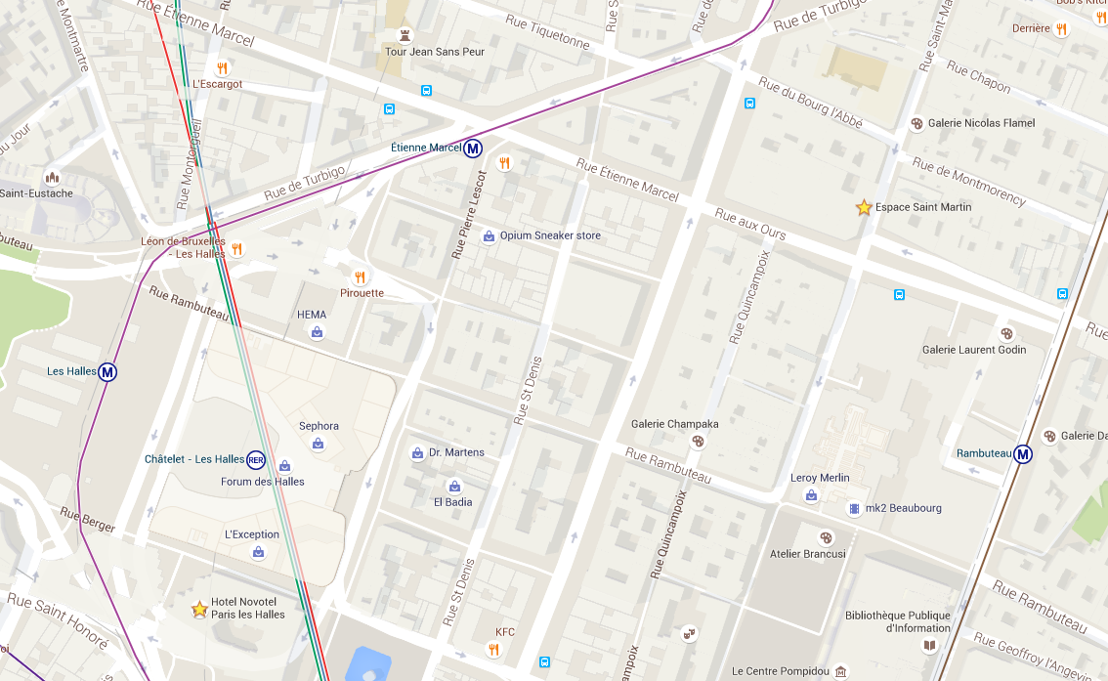
Espace St Martin
199 bis rue St Martin 75003 Paris
Lines 4 and 11: 2 metro stations nearby (short walk, less than 5 minutes to venue)
Easy access from Gare de Lyon: Line 1, change at Hotel de Ville and take Line 11 to Rambuteau.

Slide 4
Espace St Martin
One auditorium for plenary sessions: up to 200 participants
4 meetings rooms for joint and parallel sessions
  Karnak
  Denderah
  Louxor
  Heliopolis
One space for coffee breaks and welcome drink

Slide 5
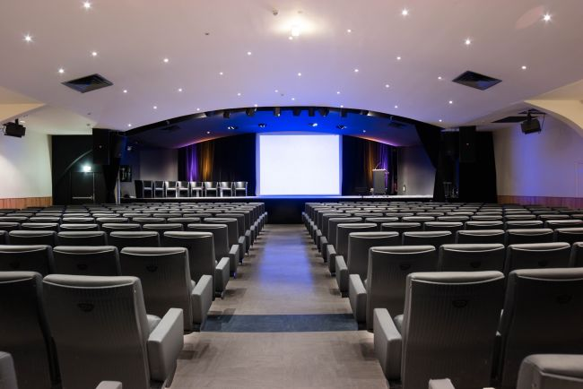
Auditorium
Available from 8h to 18h
Microphone, video projector + technician
WIFI

Slide 6
Parallel sessions on Tuesday 15 Nov.
Configuration | Karnak | Denderah | Louxor | Heliopolis
Theatre | 100 | 50 | 60 | 60
Class | 56 | 35 | 40 | 40
U | 36 | 20 | 25 | 20
Available from 8h to 18h
Equipped with video projector and paperboard
WIFI
Daylight for two of them

Slide 7
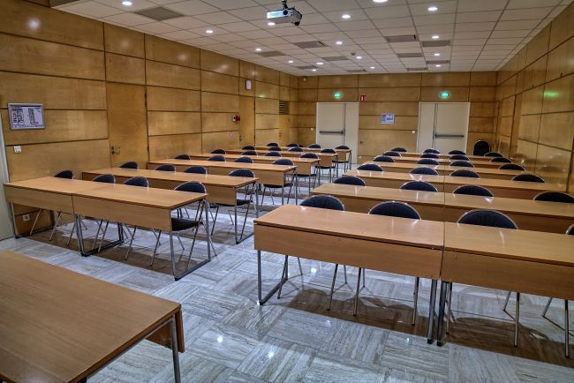
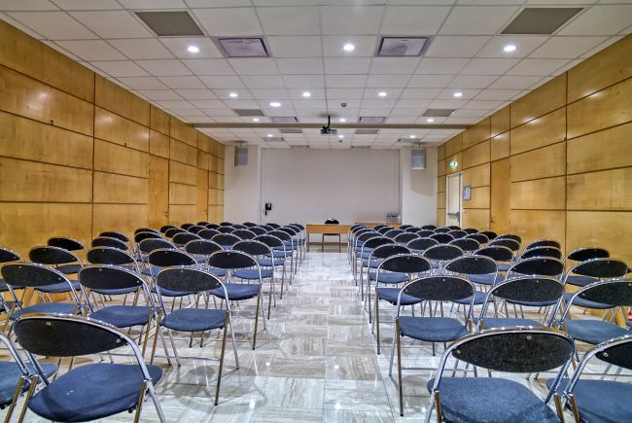
Karnak

Slide 8
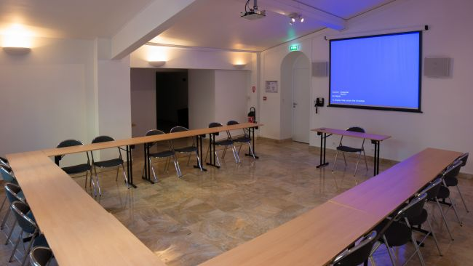
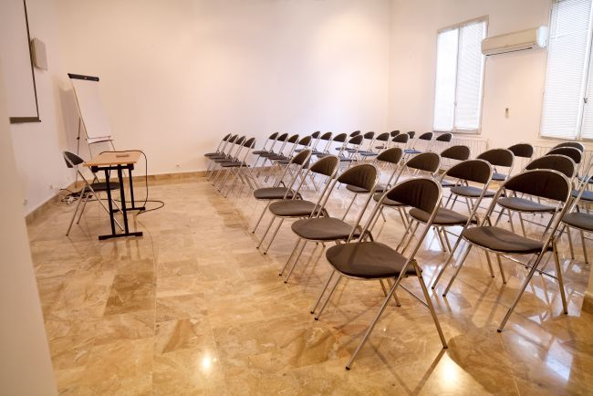
Denderah

Slide 9
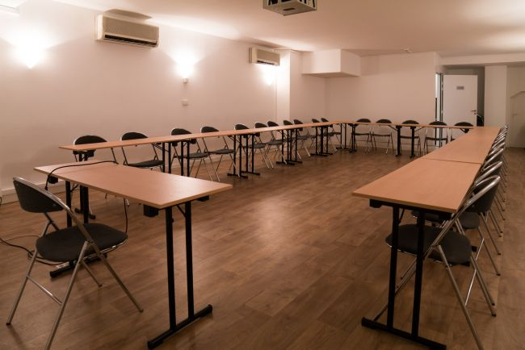
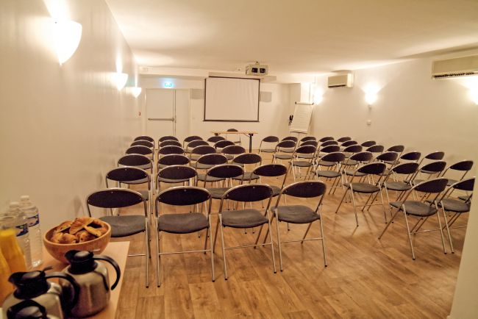
Louxor

Slide 10
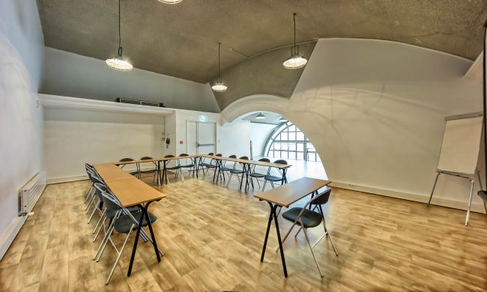
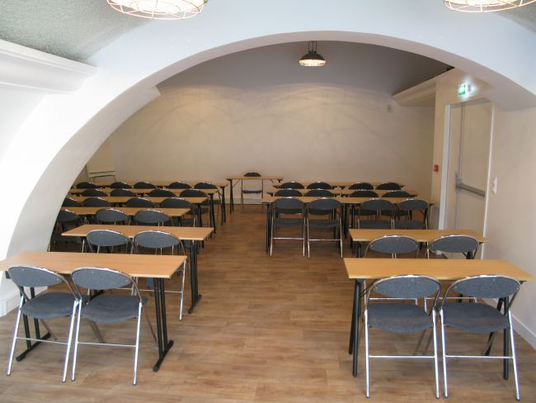
Heliopolis

Slide 11
Satellite meetings at CEA Saclay
Optional meetings rooms for satellite meetings at CEA, Saclay on 17-18 November:
  Room 311: up to 25 participants
  Room Berthelot: up to 80 participants
Could be combined with a visit of CEA facilities upon request of WPLs
CEA would provide a shuttle from Paris to Saclay and return to RER B Massy Palaiseau

Slide 12
What’s next?
Before 30 June: send topics to Lucio & Oliver for plenary sessions
Before 7 July: send topics for parallel sessions to Rogelio Tomas Garcia
Before 7 July: WPLs are requested to send a draft list of CERN participants to Lucio & Oliver, and their feedback on possible satellite meetings at CEA to Lucio & Cecile
The Project Office will:
  Validate the CERN participants’ list and submit it for approval to the DHs and Freddy.
  Allocate the meeting rooms according to sessions and optimize the configuration: theatre, class or U shape.
  Decide if we really need the Auditorium on Tuesday 15 Nov. (as potential savings of 2’500 EUR).
Presentation of the preliminary programme to the TCC on 21 July.

