Slide 1
Update on Magnet Circuits Configuration
F. Rodriguez Mateos
TCC July 7 2016

Slide 2
Outline
The main recommendations from the Magnet Circuits Review in March 2016
The main aspects of the re-baselining in June 2016
The follow-up given to the main recommendations
The Magnet Circuits Forum

Slide 3
The main recommendations from the Magnet Circuits Review in March 2016
The main aspects of the re-baselining in June 2016
The follow-up given to the main recommendations
The Magnet Circuits Forum

Slide 4
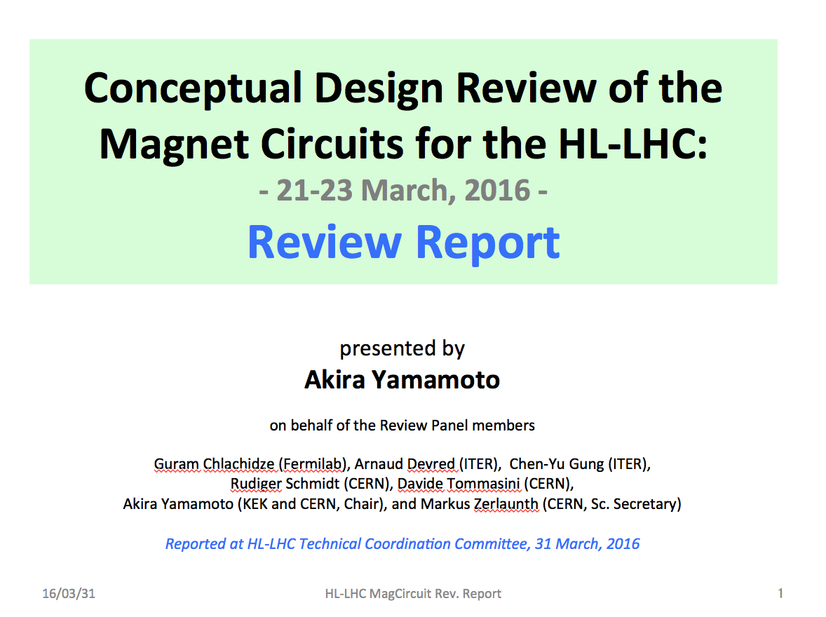

Slide 5
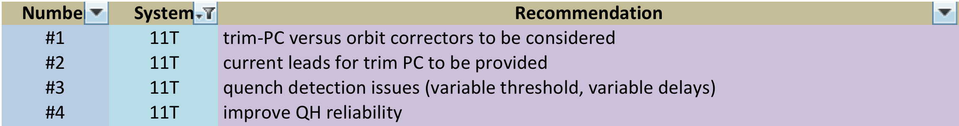
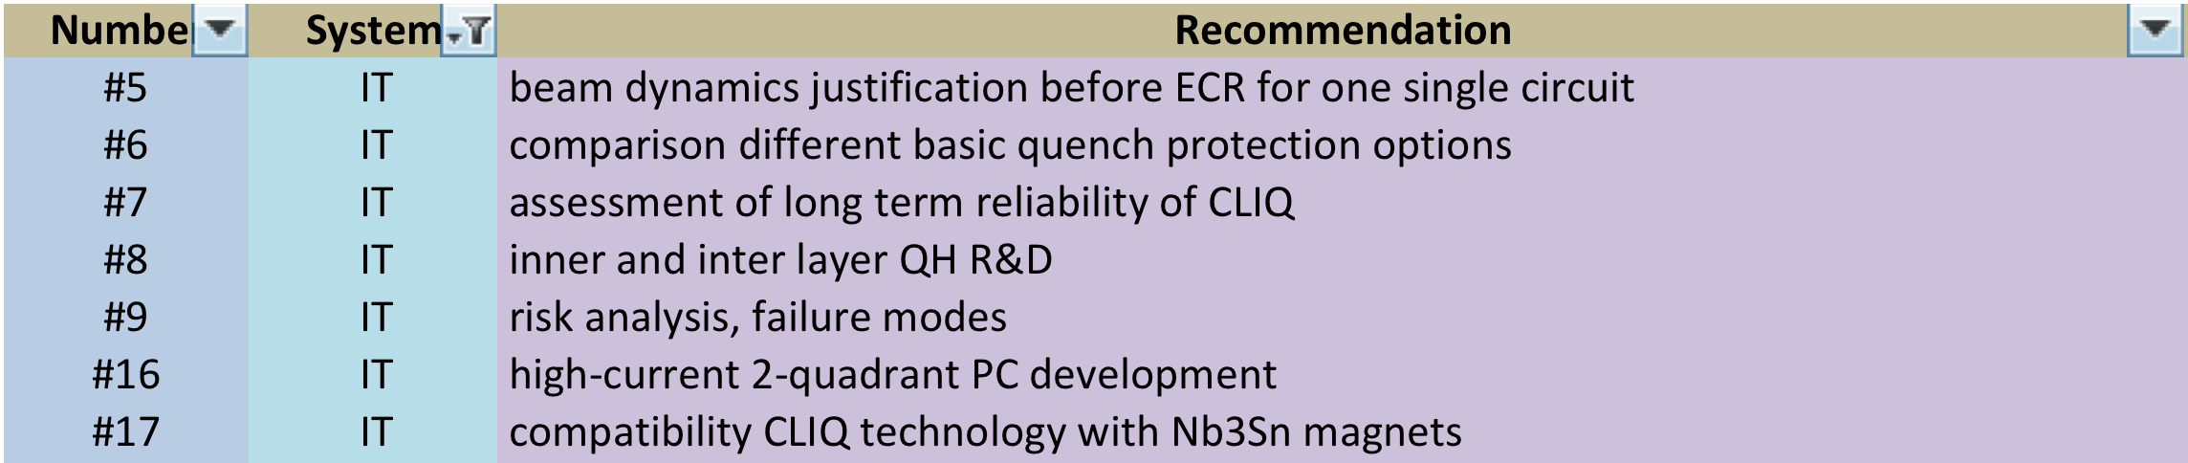
Recommendations per circuit type (1/2)
11 T
Inner Triplet

Slide 6
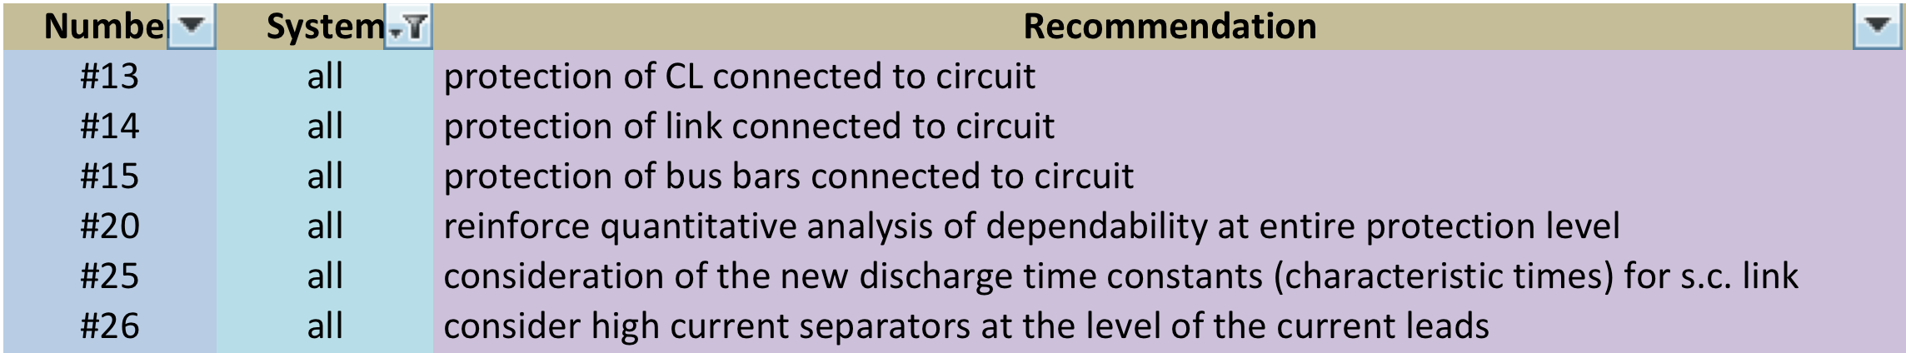
Recommendations per circuit type (2/2)
D2
IT correctors
All circuits

Slide 7
Recommendations for specific elements/activities
ElQA
HDS

Slide 8
Recommendations on general aspects
STRING
Plan, Schedule and Documentation

Slide 9
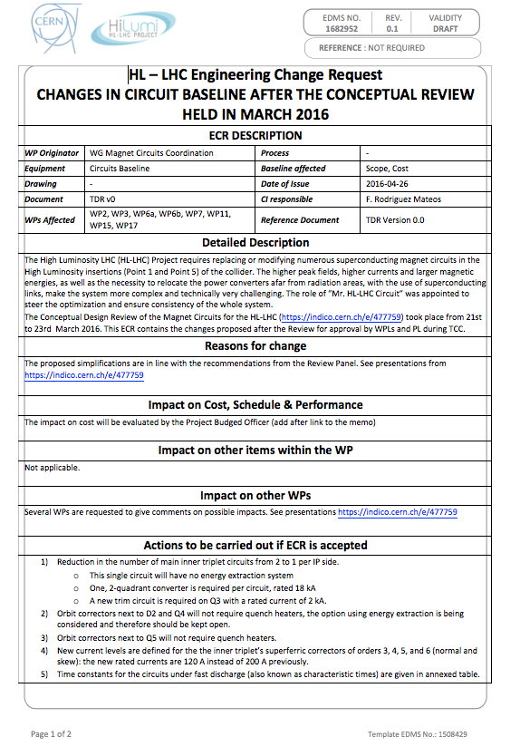
ECR after review

Slide 10
The main recommendations from the Magnet Circuits Review in March 2016
The main aspects of the re-baselining in June 2016
The follow-up given to the main recommendations
The Magnet Circuits Forum

Slide 11
Outcome of June 2016 «crises exercise» from Lucio’s talk at TCC on June 23 2016
Staging installation of new MQYY as new Q4 (90 mm aperture) to after HL-LHC end (i.e in LS4), if needed, mantaining present 70 mm MQY, i.e. Q4 modified for 1.9 K operation.
QPS for the MQXF maintaining all systems (QH_{out}, Qh_{inn}, (Qh_{intr}), and CLIQ) however with a minimal configuration with redundancy.
  Integration of CLIQ in LHC UL
Powering the IPQs (Q6-Q5-Q4) from the RR, via existing EPCs, DFBLs (and links?)…

Slide 12
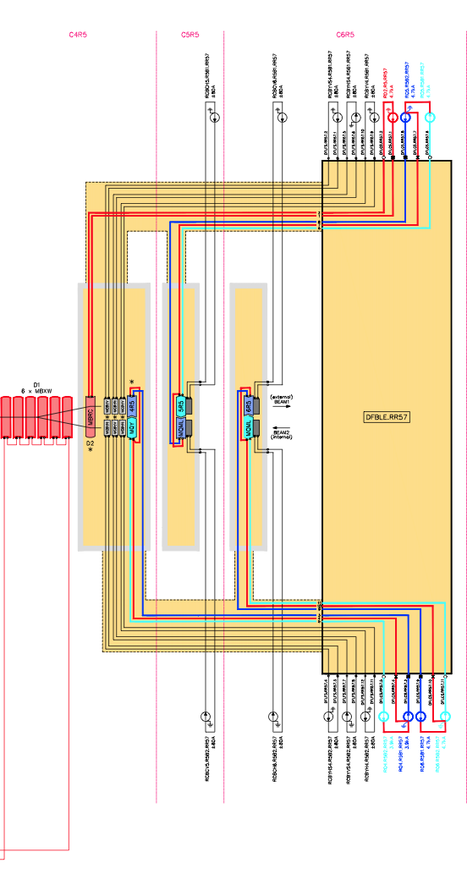
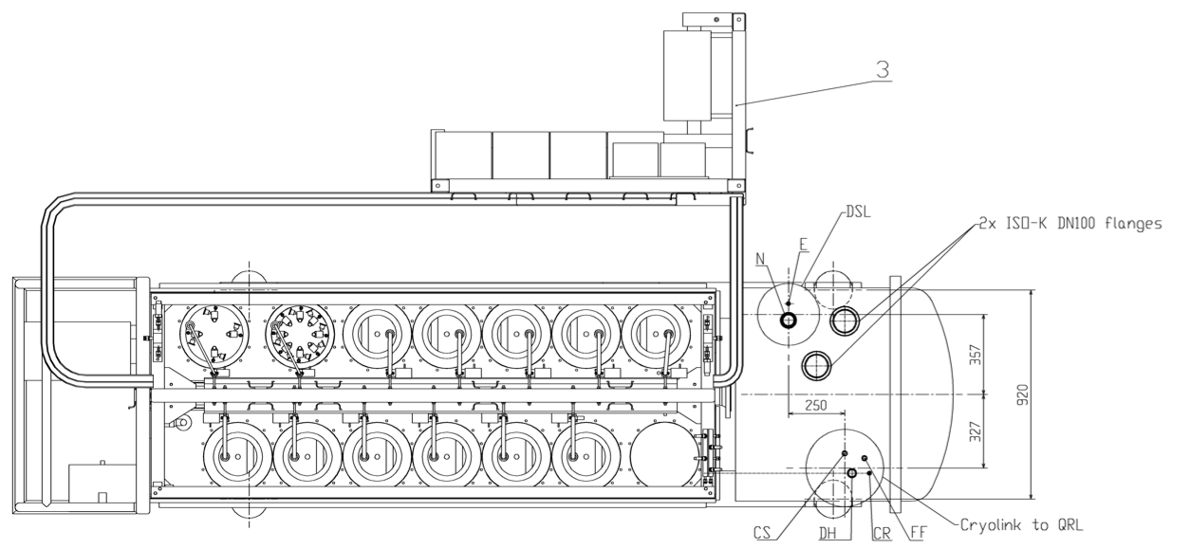
Q6 remains as is in LHC now
Q5 will be the present Q4
Q4 will be an MQY @ 1.9 K + 4 correctors/beam
DFBL:
11 CL 6 kA
12 CL 120 A
DSL is constituted of:
12 cables of 6 kA
12 cables of 600 A
Today there are 8 DCF leads to power locally correctors
Infos from L Tavian, H Prin and P Fessia

Slide 13
Circuits Table after Review
with re-Baseline
D. Wollmann

Slide 14
The main recommendations from the Magnet Circuits Review in March 2016
The main aspects of the re-baselining in June 2016
The follow-up given to the main recommendations
The Magnet Circuits Forum

Slide 15
Follow up given to the Review’s recommendations
Further analysis of normal and failure scenarios on QXF circuit, confirmation of the baseline scheme
  Analysis of CLIQ leads sections
  Analysis of CLIQ currents
  Interaction with link as well as implications to bus bars and current leads remain to be discussed (in the agenda for the second meeting of the MCForum)
Reconsideration of the strategies for high voltage withstand levels
  Agreement reached with LARP for QXF
Opening a development line for bipolar energy extraction systems in the 2kA range
  Heaters vs energy extraction in correctors programmed for first meeting of MCForum
Development of quench detectors is advancing well
A detailed model for CLIQ failure analysis has been developed and is giving first results
Trying to gain as much experience with CLIQ as possible (recent commissioning of two units at FNAL)
Organization of a Forum to deal with all aspects of circuits related to powering and protection
And much more …

Slide 16
Recent work
Two complete and recent presentations :
  CLIQ : space requirements and circuit protection - https://indico.cern.ch/event/544204/
    Re-baselining Meeting, June 17, 2016
  HL-LHC WP7: Machine Protection and Availability - https://indico.cern.ch/event/546270/
    TE-TM, June 28, 2016
  HVWL WG efforts gave first agreement for QXF magnets:
Agreed upon

Slide 17
The main recommendations from the Magnet Circuits Review in March 2016
The main aspects of the re-baselining in June 2016
The follow-up given to the main recommendations
The Magnet Circuits Forum

Slide 18
One of the recommendations of the recent review on HL-LHC Magnet Circuits was:
“… to realize close and regular interaction (communication) between the involved experts and work-packages. This could be possibly done by setting-up of a dedicated working group or by using existing structures to discuss circuit integration and protection on a regular basis and to identify the optimum scheme for each magnet circuit system.”

Slide 19
(Draft) Mandate – to be approved by HL-LHC Project Leader
Within the framework of the HL-LHC Circuits Coordinator (Mr Circuit), the mandate for the new Magnet Circuits Forum (MCF) is as follows:
  The Forum is the meeting where all aspects related to powering and protection are discussed, in particular the ones pertaining to the optimization of circuit layouts and definition of protection means
  Subjects in the agenda are defined in close collaboration with the relevant WPs
  Interface aspects between systems are clarified through meetings at the Forum. To this end, a documentation plan has to be developed and completed. The aim is to prepare a set of functional interface specifications that can be used as input for the design (technical specifications) of the different systems
  Assessment on realistic failure scenarios and required mitigation strategies on a global basis is part of the activities of the Forum
  The Forum is the meeting where aspects related to high voltage withstand levels are discussed and harmonized
  The Forum reports regularly to TCC and takes up any relevant discussion within the domain of cold/warm powering and protection of the HL-LHC circuits in collaboration with the relevant WPs

Slide 20
Two participants have been nominated by the Work Package Leaders.
WP Leaders and Deputies as well as Group Leaders receive invitations ex-officio and are invited to attend at their own discretion depending on the agenda.
Leaders of involved Groups have endorsed the membership and in some cases proposed additional names.
First meeting has been organized for July 12th, the second for July 26th.
Meetings will be organized on a 2-week basis.

Slide 21
Membership
Chair and Scientific Secretaries:
Felix Rodriguez Mateos
Hugo Bajas
Samer Yammine
Representation from MP3:
Arjan Verweij
Daniel Wollmann
Representation from ELQA:
Mateusz Bednarek
Giorgio D’angelo
For info list:
Lucio Rossi
Oliver Bruning
Andrzej Siemko
Luca Bottura
Dimitri Delikaris
Mike Lamont
Rudiger Schmidt
Markus Zerlauth
Jean-Philippe Tock
Work Packages | WP Leader | Deputy WP Leader | HL-MC Forum Member 1 | HL-MC Forum Member 2
WP2 | Gianluigi Arduini | Rogelio Tomas Garcia | Massimo Giovannozzi | Riccardo De Maria
WP3 | Ezio Todesco | Paolo Ferracin | Juan Carlos Perez | Susana Izquierdo Bermudez
WP6a | Amalia Ballarino | Vittorio Parma | Patrick Retz | Amalia Ballarino Vittorio Parma
WP6b | Jean-Paul Burnet | Michele Martino | Michele Martino | Hugues Thiesen
WP7 | Daniel Wollmann | Reiner Denz | Arjan Verweij | Jens Steckert
WP9 | Serge Claudet | Rob Van Weelderen | Rob Van Weelderen | Juan Casas-Cubillos
WP11 | Frederic Savary | Herve Prin | Arnaud Foussat | Ludovic Grand-Clement
WP15 | Paolo Fessia |  | Paolo Fessia
WP16 | Marta Bajko Mirko Pojer |  | -
WP17 | Laurent Tavian | Beniamino Di Girolamo | -

Slide 22
Many thanks for your attention!

