Slide 1

SM18 update and summary of Superconducting Magnet Test Facility Workshop
M. Bajko CERN
TCC 7th if July 2016

Slide 2
Content
Test stands @ CERN
Cluster G upgrade
Cluster D upgrade
Service upgrade
Status
SMTS Workshop

Slide 3
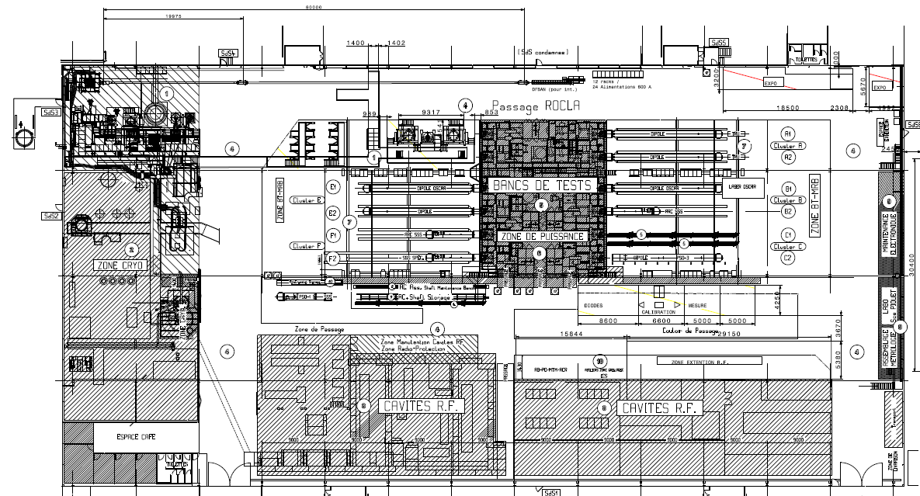
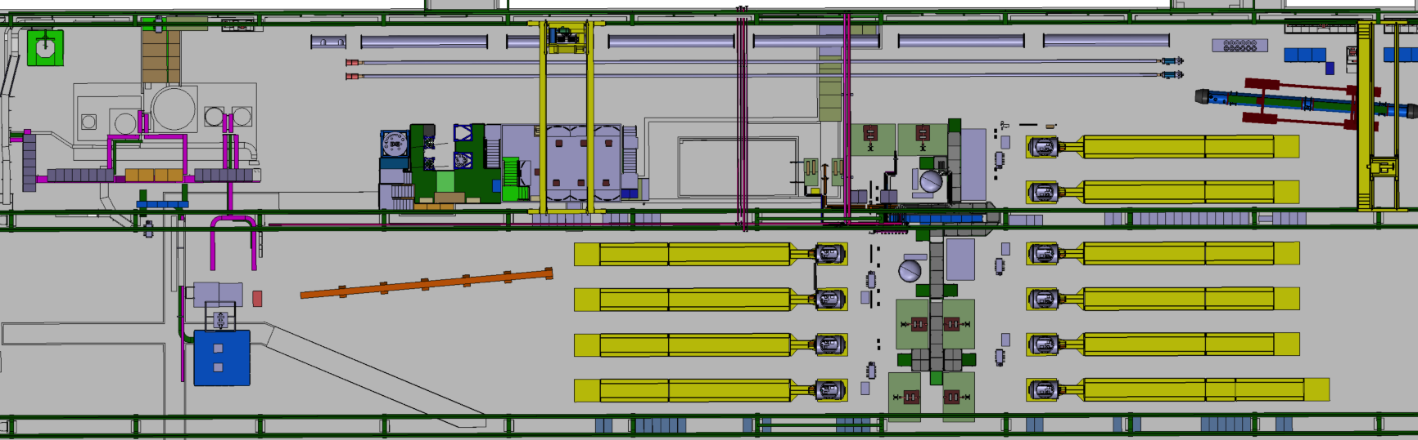
Magnet test stands layout @ CERN
THE SUPERCONDUCTING MAGNET TEST STAND AT CERN in SM18
STRING and SC LINK
CLUSTERS
F E D
HORIZONTAL BENCHES
CLUSTERS
C B A
Is in a building of 7200 m² over which the test stands for magnets occupies about 50%.
INSTALLATIONS
3 vertical cryostats ,
1 feed box for supercritical He,
1 cryostat for LN₂,
10 horizontal benches
OPERATION
I= 0.12 kA-20 kA
T = 1.9 K to 70 K He
withstanding U = 1V to 3 kV
CRYOGENIC ZONE
Superconducting RF CAVITY TEST ZONE
LN₂ TEST ZONE

Slide 4
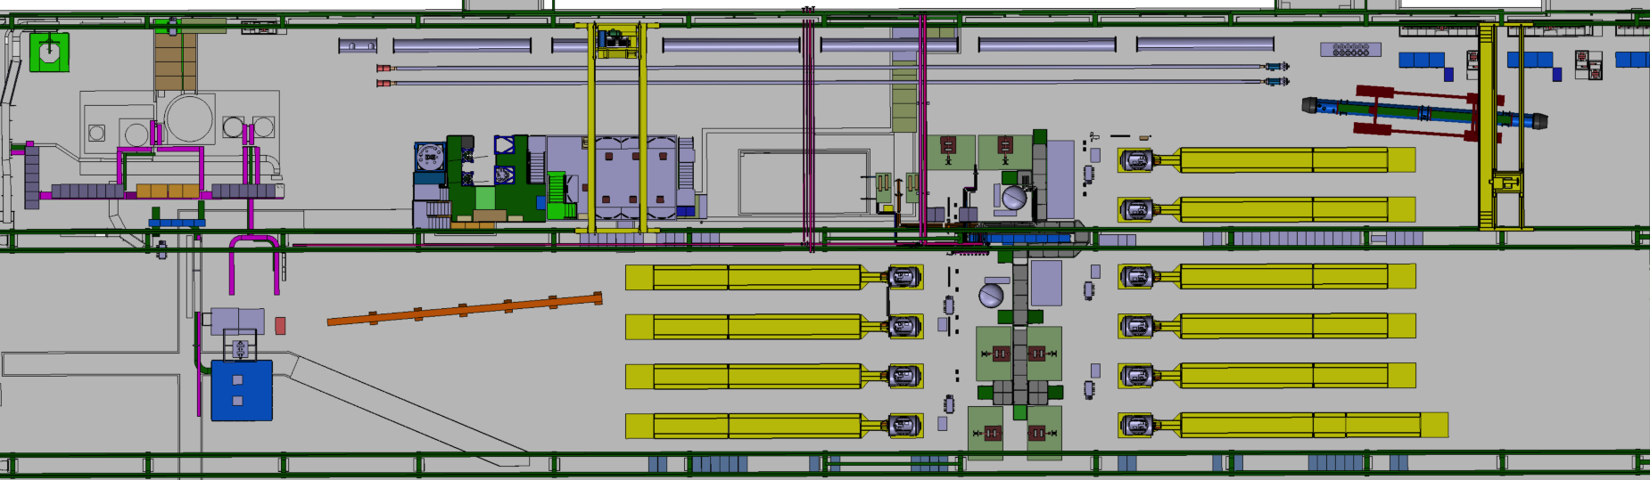
Vertical test stand upgrade
Cluster G
Cluster D
The vertical cryostats zone , called Cluster G of about 400 m² is under upgrade with an extra space called Cluster D of 150 m² to accommodate the test of larger diameter magnets @ higher operating current for HL LHC.

Slide 5
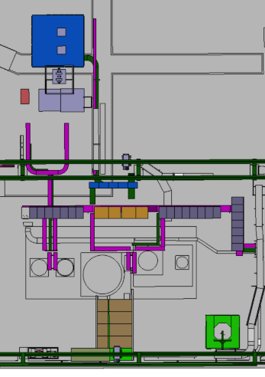
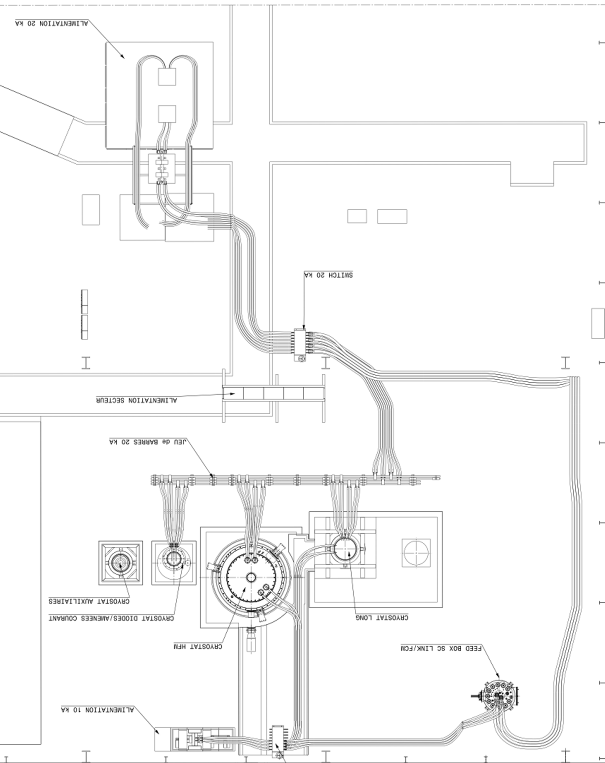
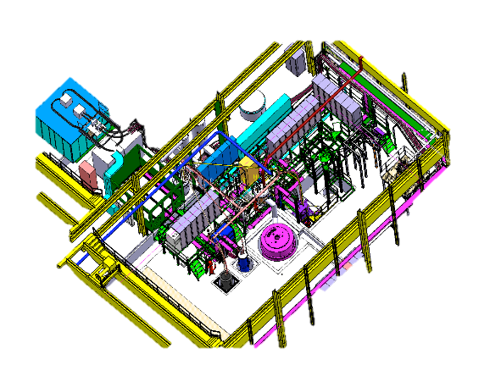
Cluster G upgrade:the FReSca2 cryostat(HFM)
PRE COOLING WITH He GAS AND QUENCH BUFFER FOR COLD He RECOVERY
20 KA POWER CONVERTER
with EE and DUMP RESISTOR
The circuit is distributing current towards vertical cryostats or the feed box via a commutator
“DIODE/LEAD” CRYOSTAT :
@ 4.2 K
“LONG” CRYOSTAT :
3.8 m long and 600 mm diameter @ 1. 9 K
“SIEGTAL” CRYOSTAT :
1.4 m long and 800 mm diameter @ 1. 9 K
The new cryostat in this zone is the:
“HFM” CRYOSTAT ALLOWING MAGNETS TO BE TESTED WITH
1500 mm diameter and 2. 5 m length
CRYOGENIC
FEED BOX FOR
He 4.2-80 K
Ref. HFM cryostats is financed by EUCARD and the WP19 task of HL LHC

Slide 6
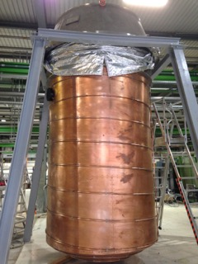
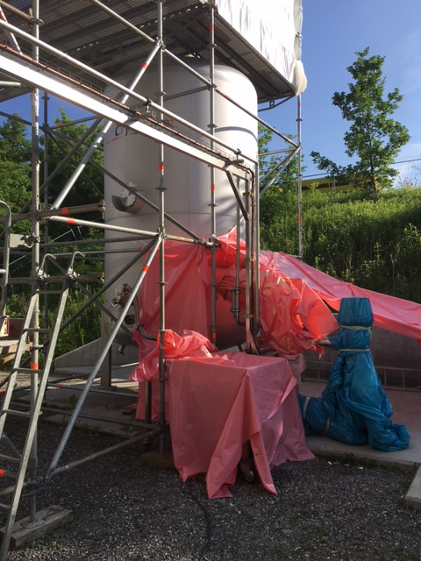
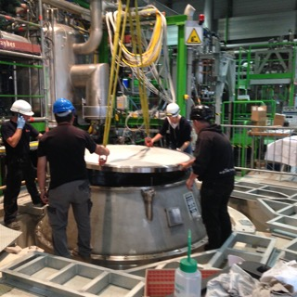
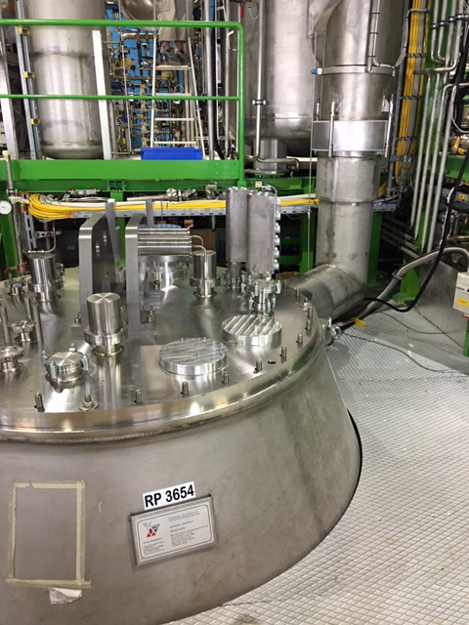
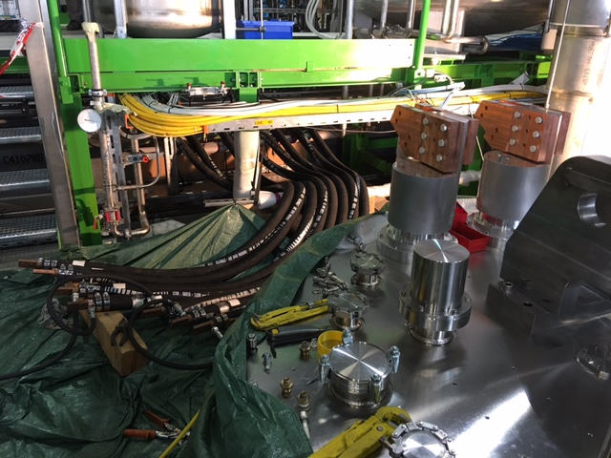
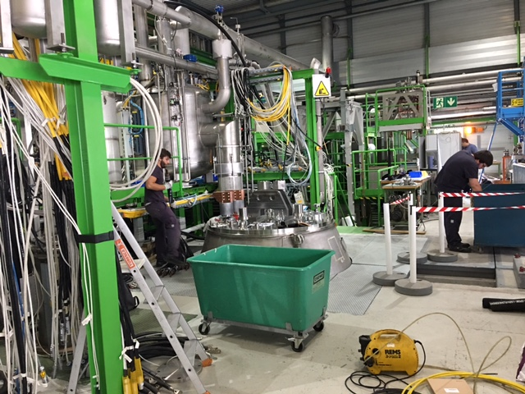
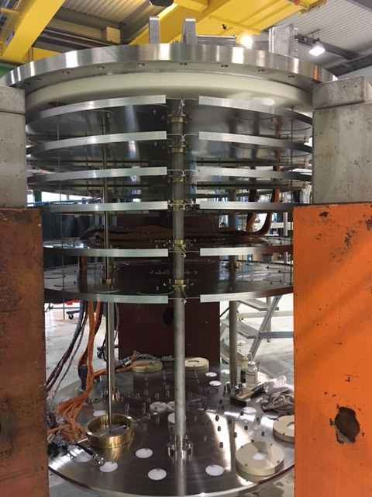
Cluster G upgrade :pictures

Slide 7
Vertical test stand upgrade
Cluster D

Slide 8
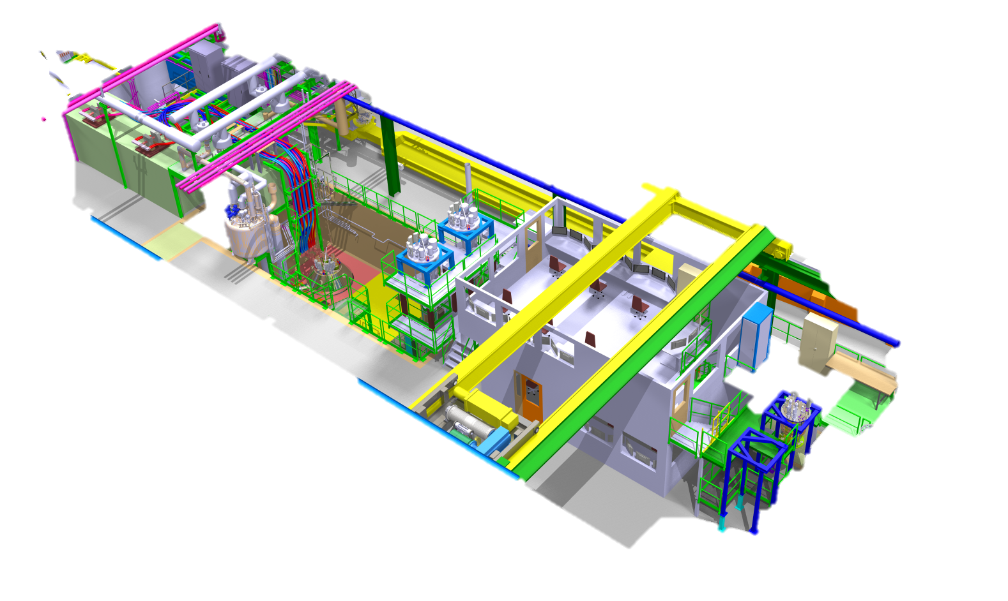
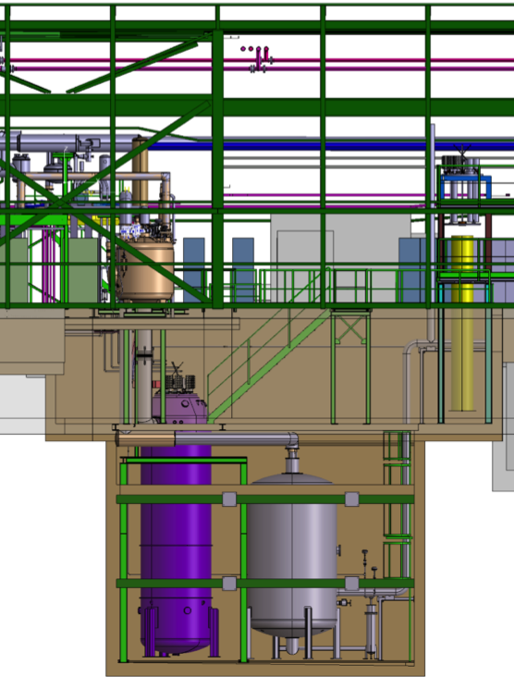
Cluster D: working area
EE and DUMP on the 2 m LEVEL
POWER CONVERTERS AT GROUND LEVEL
PREPARATION ZONE AT 0 AND -3 m LEVEL
5.5 m
ELECRICAL AND CRYO RACKS NEAR THE CONTROL ROOM
2 m
0 m
TWO ODH ARE IN THE -3 m ZONE ( mostly justified by presence of N₂)
-3 m
CONTROL ROOM NEAR THE CLUSTER
-10 m
COLD He RECOVERY BUFFER - 8 m³ à 5 bar, UNDER THE WORKING AREA IN CONFINED SPACE
NEW OVERHEAD CRANE ALLOWS HADLING 25 t AND AT -3 m LEVEL
Integration by A.Kosmicki

Slide 9
Services upgrade in the test facility
Remarks
UPGRADE DRIVEN BY The recommendation enabling to carry out the full test programme with no contraints
  CRYOGENIC COOLING PRODUCTION: + 35 g/s LHe
  NEEDS essentially for the running of the HL LHC IR STRING in parallel with magnet testing
  DEMINERALISED WATER PRODUCTION: + 150 m³/h
  NEEDS FOR DEMINERALISED WATER ENTIRELLY COMING FROM MAGNET operation
  HANDLING: 25 T and longer rope
  NEEDS FOR OVERHEAD CRANE CHANGE ENTIRELLY COMING FROM MAGNET OPERATION POWERING FROM THE NETWORK: 2 MVA
  NEEDS FOR NEW OR MODIFIED PC COMING FORM MAGNETS and IR STRING
  nCONTROL ROOM
  NEEDS TO EXTEND THE TOO SMALL CONTROL ROOM OF THE VERTICAL TEST FACILITY TO BE USED ALSDO FOR HORIZONTAL BENCHES AND Sc link

Slide 10
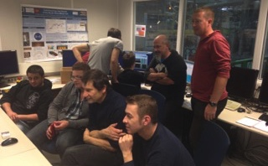
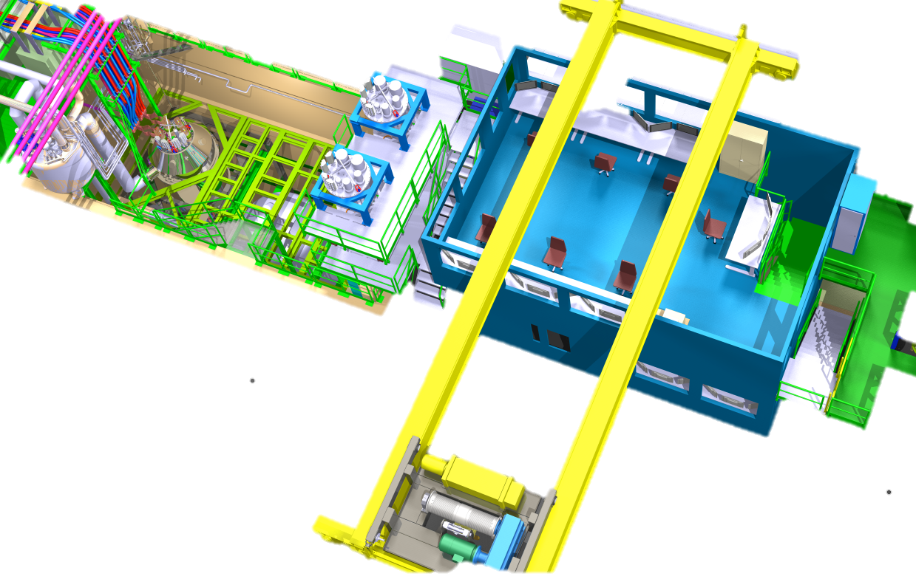
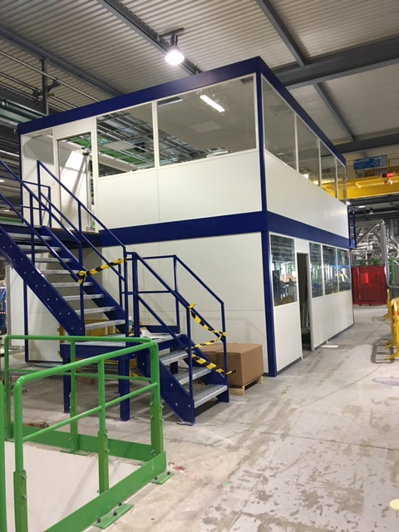
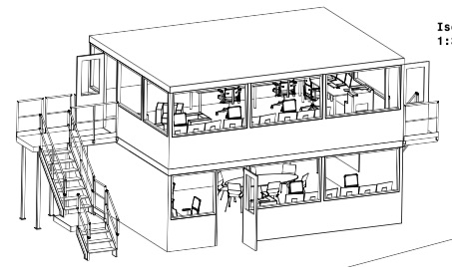
New Control room
CONTROL ROOM WITH LARGER SPACE than today
Foreesen for Jul 2016
Ref. M. Charrondier

Slide 11
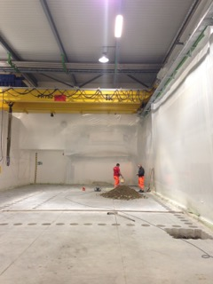
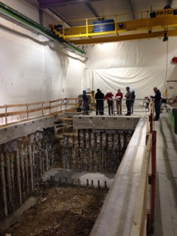
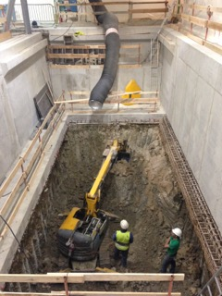
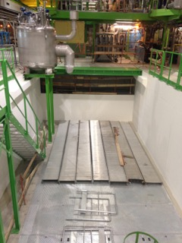
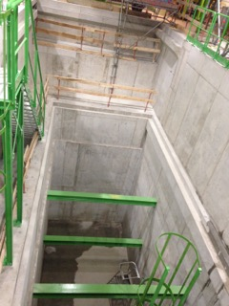
Cluster D in pictures
Ref.
Construction:
H. Botella, R. Morton, E. Perez Duenas,
Safety: E. Paulat

Slide 12
Planning
Cluster G
Cluster D
Installation finished
Commissioning in July-August
Operational in September????
Civil engineering finished
Installation started
Commissioning the earliest in September
Operational in December?

Slide 13
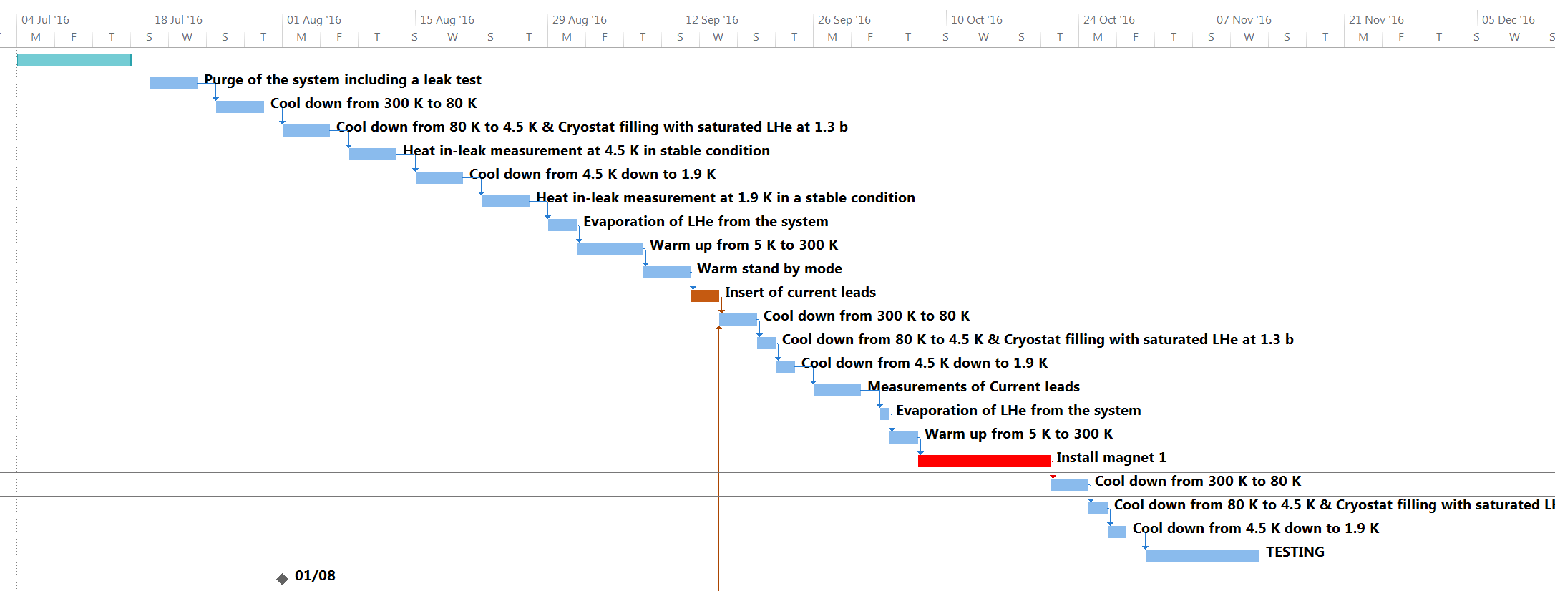
Present plan of commisioning
Magnet delivery

Slide 14
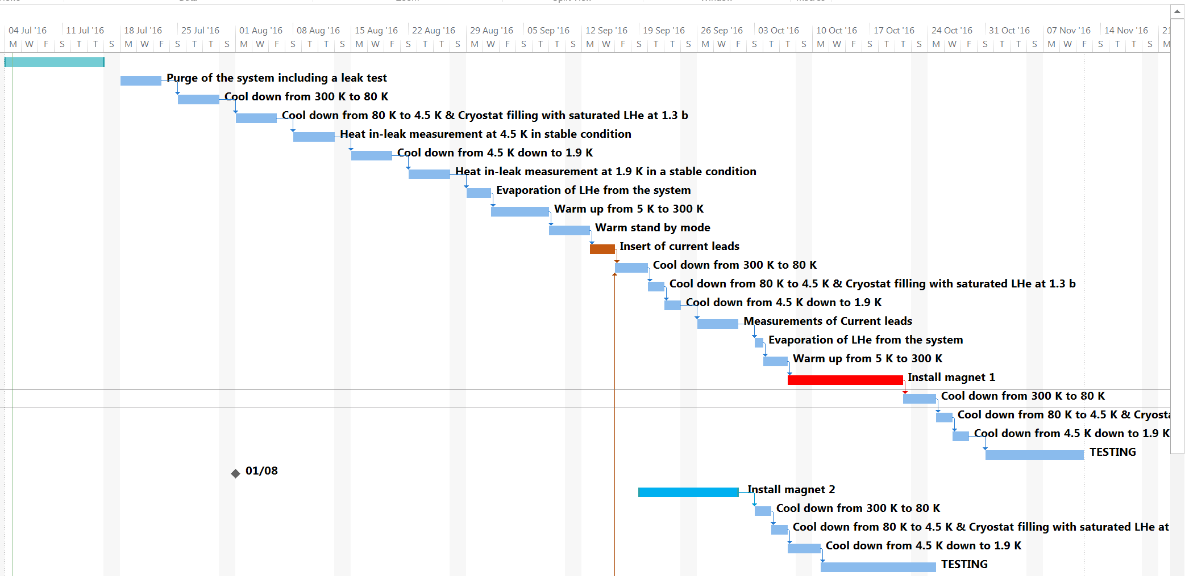
Alternative plan1 of commissioning
Magnet delivery

Slide 15
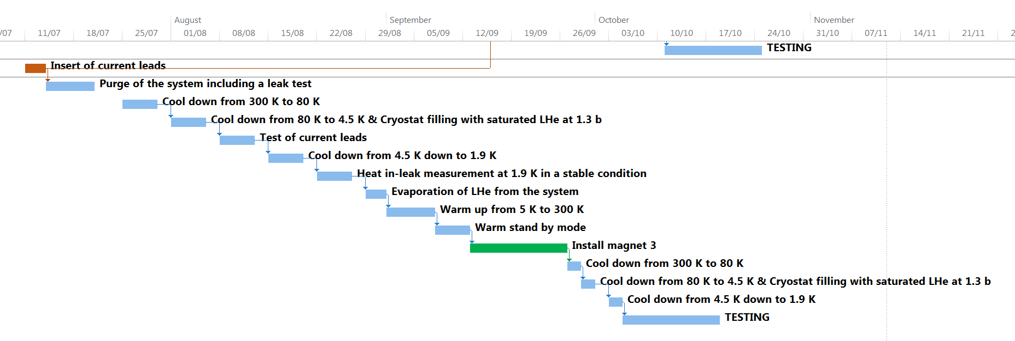
Alternative plan2 of commissioning
Magnet delivery

Slide 16
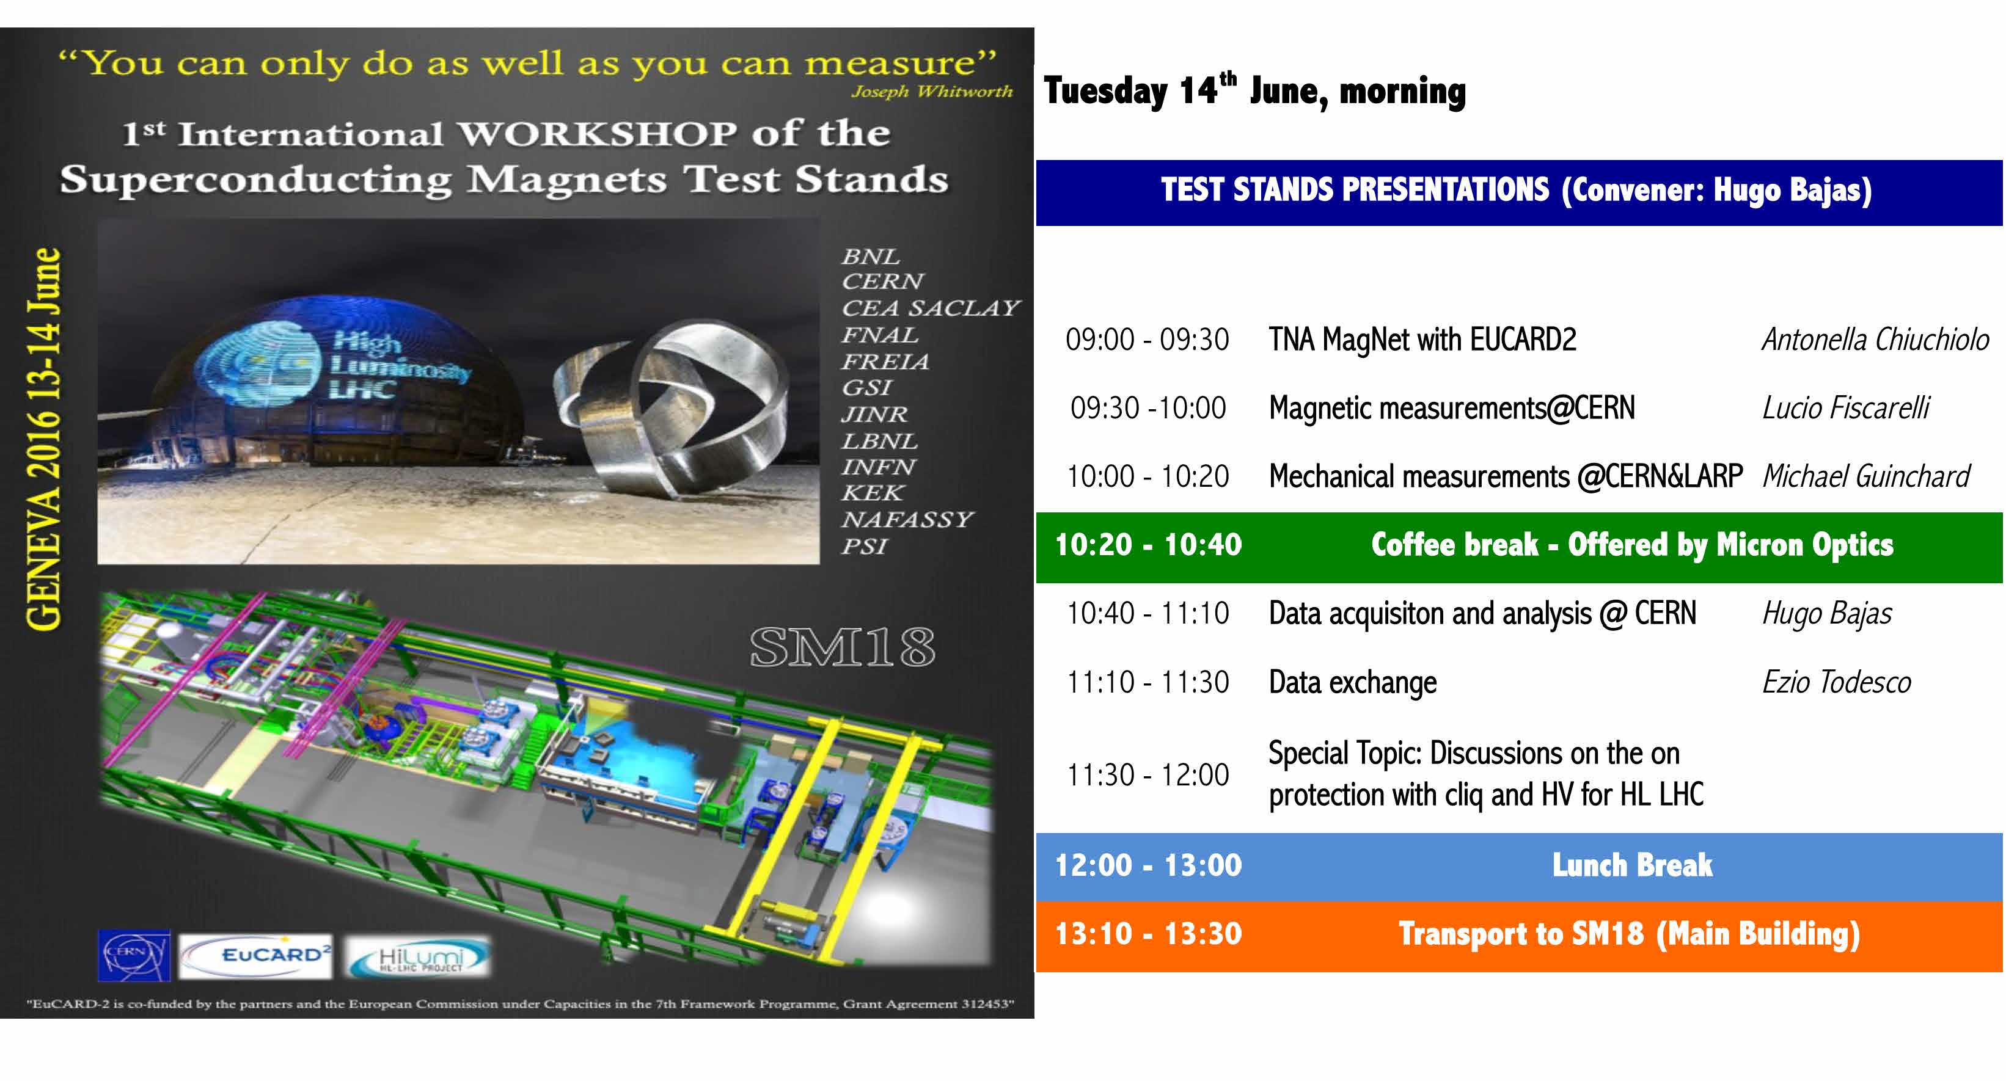
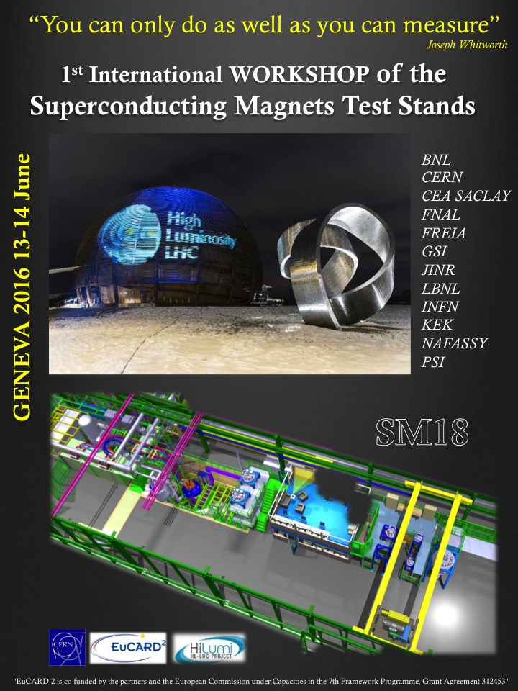
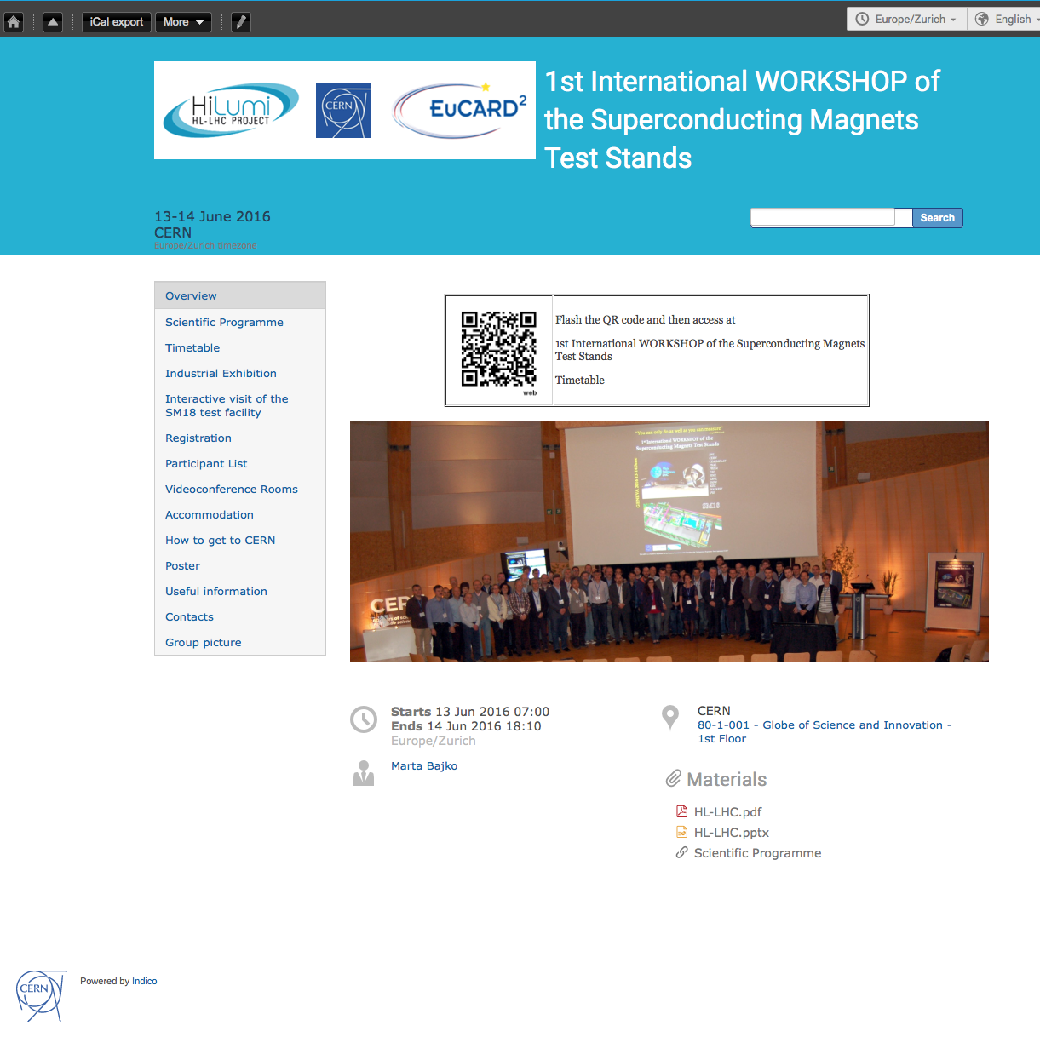

Slide 17
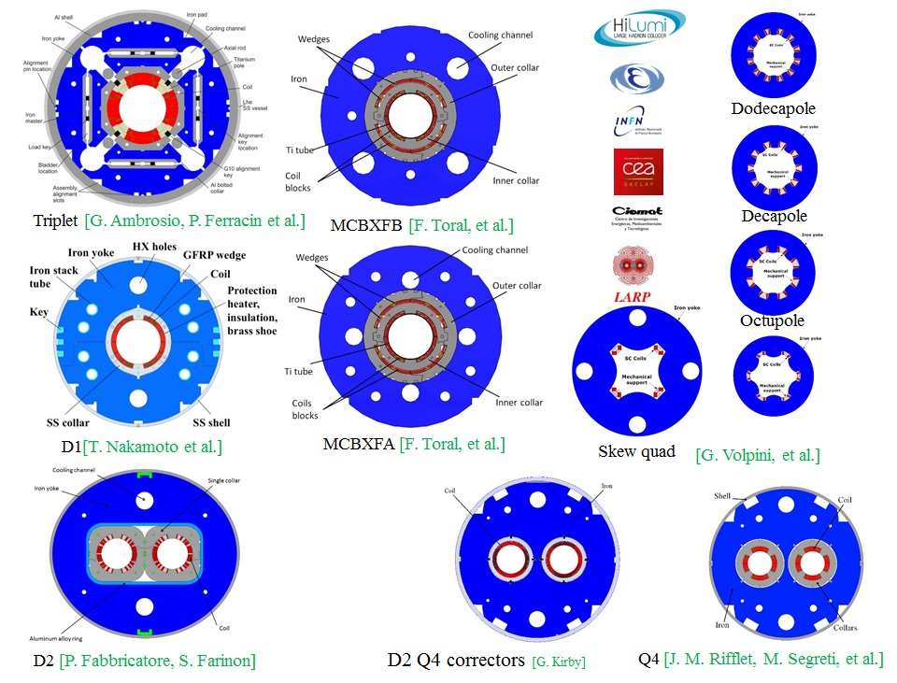
HL-LHC as a trigger for the workshop- present
The HL-LHC project with its 100 superconducting magnets to be built within a very large and international collaboration, triggered the idea of this workshop.
The goal is to HARMONIZE the tests performed in different places and to BUILD A GOOD COMMUNICATION CHANNEL between us: working in the same field at the four corners of the world.
Courtesy of E. Todesco HL-LHC WP3
See presentation of L. Rossi

Slide 18
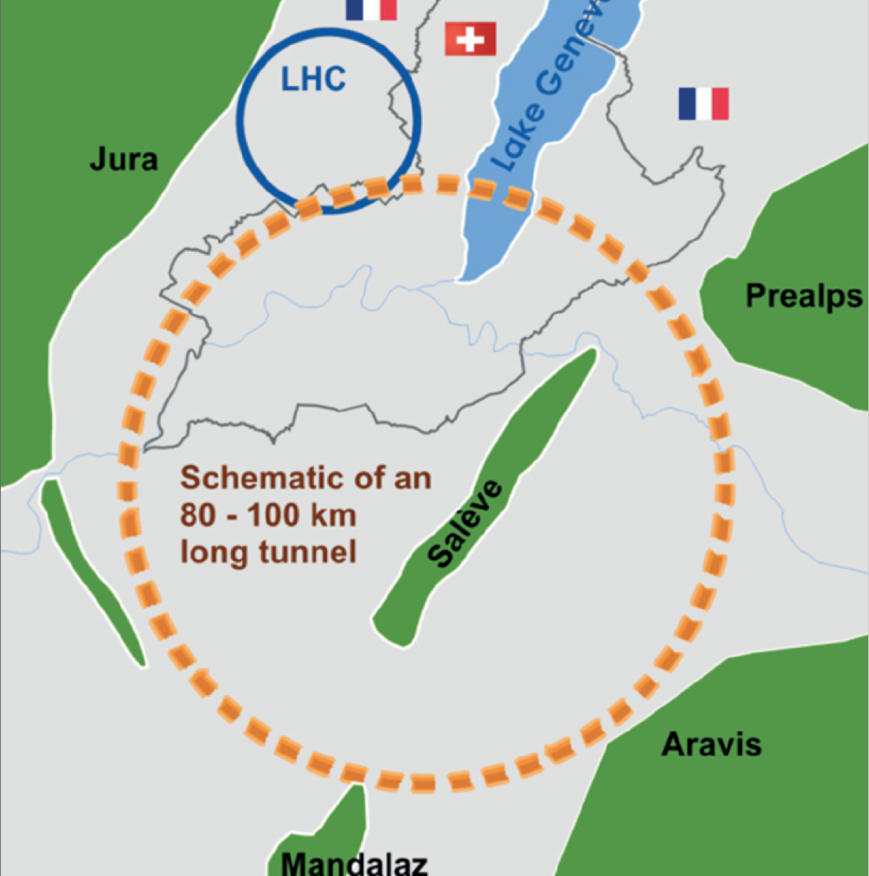
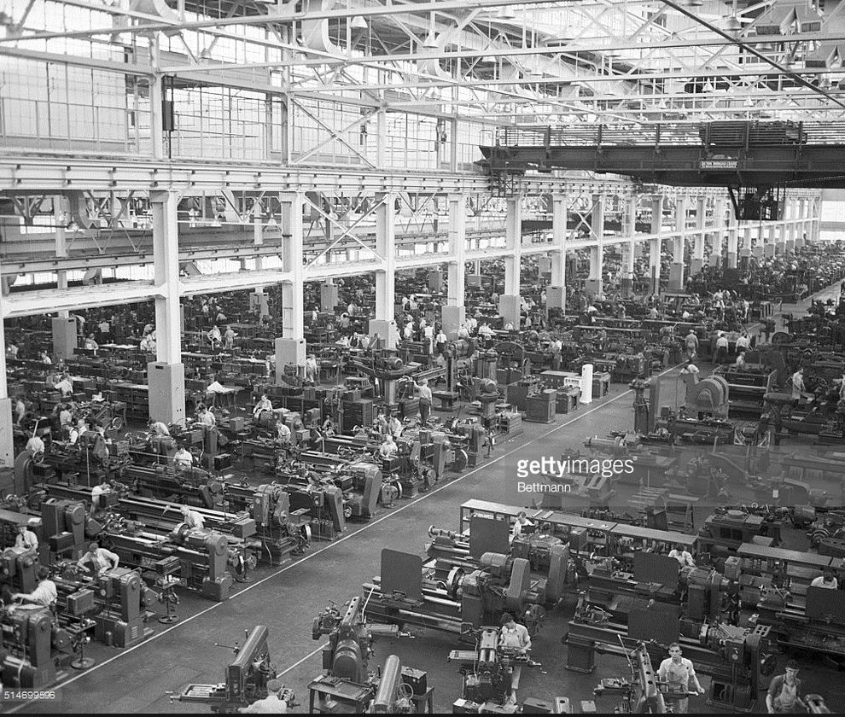
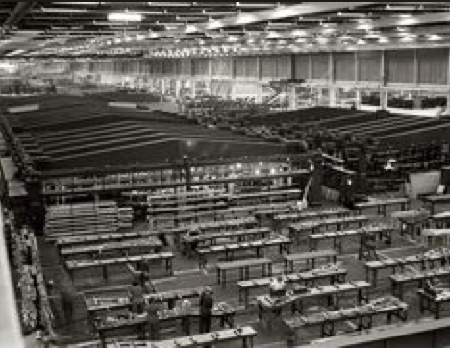
We are looking into the future
2015
2016
2017
2018
2019
2020
2025
2030
2035
2040
The SMTS Workshop would be held typically ONCE A YEAR and at the different test stations. It can be linked to events organized by HL-LHC project or conferences where the participants are usually present.
See presentation of L. Bottura
FCC production and test ?!?

Slide 19
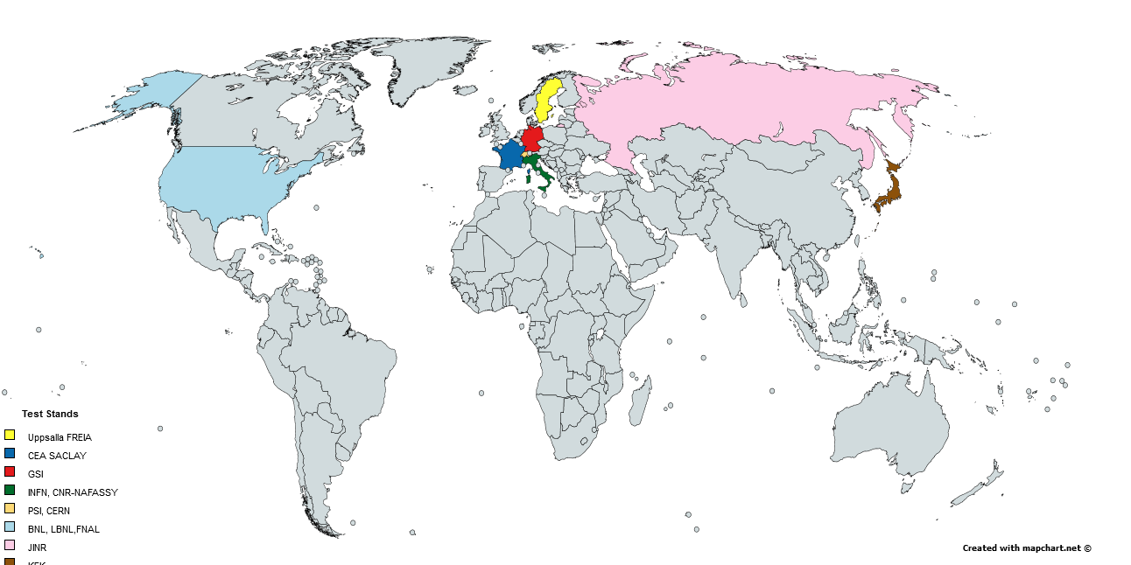











Welcome everybody!
Most of these participants has a valuable long experience and expertise
in superconducting magnet testing

Slide 20
