Slide 1
Feedback on quench heaters versus energy extraction on HL corrector magnets
F. Rodriguez Mateos, Ezio Todesco
with input from Fernando Toral (CIEMAT)
HL-LHC TCC July 21, 2016

Slide 2
Introduction
Following recommendations from the HL-LHC Magnet Circuits Review, energy extraction is under discussion for a number of corrector circuits as an alternative to quench heaters:
  Orbit correctors in IT (MCBXFA/B)
  Super-ferric quadrupole in IT (MQSXF)
  Orbit correctors in D2 (MCBRD)
As a decision has not yet been taken for these circuits, a strategy for all them is due for the development work within the upcoming months

Slide 3
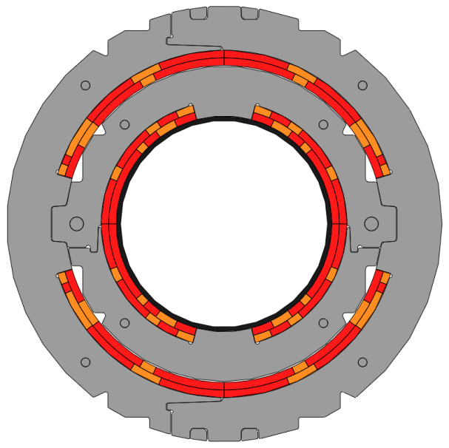

The MCBXF magnet
CIEMAT collaboration
  CERN project engineer: J. C. Perez
Magnet | Units | MCBXFB |  | MCBXFA
Inner Dipole (ID) & Outer Dipole (OD) parameters |  | ID | OD | ID | OD
Nominal field (Stand-alone) | T | 2.11 | 2.23 | 2.11 | 2.23
Nominal Field (Combined) | T | 3.07 |  | 3.07
Nominal current | A | 1630 | 1490 | 1530 | 1395
Coil peak field | T | 4.1 (ID) |  | 3.9 (ID)
Working point | % | 50.1 (ID) |  | 47 (ID)
Static self-inductance (nominal current) | mH | 59.2 | 134.8 | 108.5 | 247
Magnetic stored energy (nom. Current) | kJ | 78.6 | 149.6 | 127 | 240.3
Aperture | mm | 156 | 230 | 156 | 230
Iron yoke Inner Diameter | mm | 316 |  | 316
Iron yoke Outer Diameter | mm | 614 |  | 614
Total number of turns | - | 140 | 191 | 140 | 191
Cable length needed for each pole/coil | m | 357 | 481 | 637 | 863
Turns per block in inner layer | - | 50/10/11 | 45/39/21 | 50/10/11 | 45/39/21
Turns per block in outer layer | - | 28/28/13 | 43/38/5 | 28/28/13 | 43/38/5

Slide 4
Protection
Energy extraction on crowbar
  at the limit for protection of the long magnet
Results from simulations:
  Here 50 V assumed, i.e. resistance of 30 mΩ
  One gets 410 K at 108% of nominal …
Hot spot temperatures (K) | Magnet type | Combined powering | Stand-alone powering
Inner dipole | Short | 196 | 220
 | Long | 267 | 305
Outer dipole | Short | 232 | 260
 | Long | 311 | 355

Slide 5
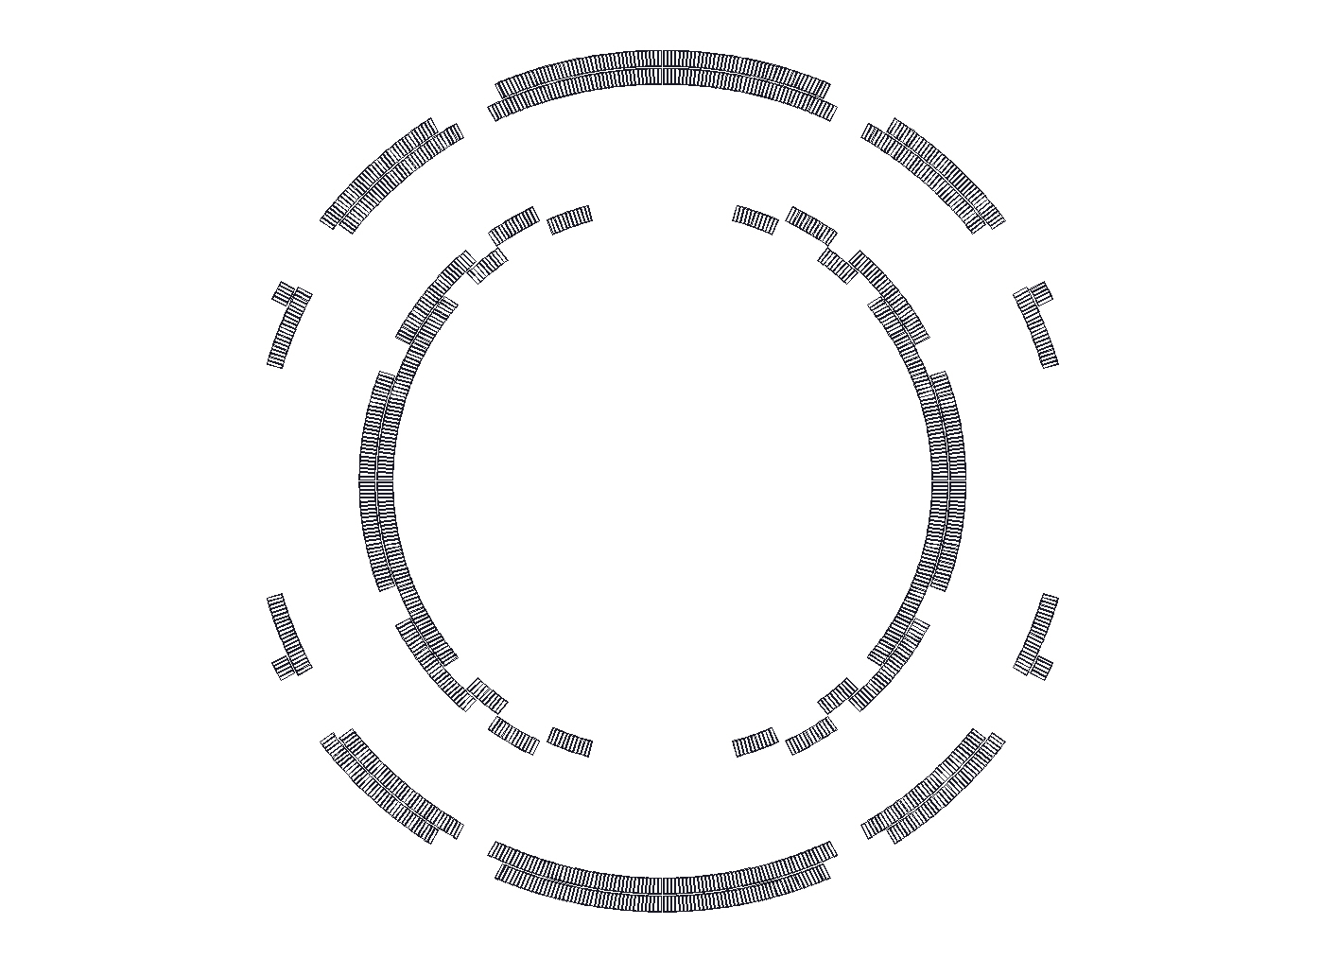
Simulation features
Some features are not modelled:
  The vertical transverse thermal conductivity is not properly modelled due to the spacers (optimistic).
  Quench-back is not included, but it is not likely to help because the current decay is slow (pessimistic).
  Adiabatic boundary conditions (pessimistic).
  AC losses in nearby metallic parts are not included (pessimistic).
  An approximate field map is used.
  Uncertainty about material properties (mainly resin and Nomex).
Heaters in short prototype
4
5
Decision is taken, that the ongoing short prototype will be equipped with heaters on blocks 4 & 5:
  To be on the safe side.
  To check the assembly feasibility.
  To ease assembly of internal voltage taps.
5
4

Slide 6
Protection strategy
Heaters will be explored
  The coil is impregnated, hence the heater will be impregnated with the coil
  The presence of double collaring implies difficulties, so if an energy extraction with reasonable cost is available this would reduce the risk
We should consequently also explore energy extraction at 100 V or larger voltage

Slide 7
Energy Extraction Systems
TE/MPE is now envisaging the following alternatives in order to propose solutions in the 1 to 2 kA range:
  as a by-product of the large effort put in place for the manufacturing of 7.5kA, IGBT-modules for SM18, IGBT-based systems have been designed also for these lower currents and a prototype is under construction with minor additional efforts
  an Addendum is being prepared with the Łodz University of Technology (PL) – existing Framework Agreement– as to study and possibly develop energy extraction systems based on vacuum switches with different commutation techniques

Slide 8
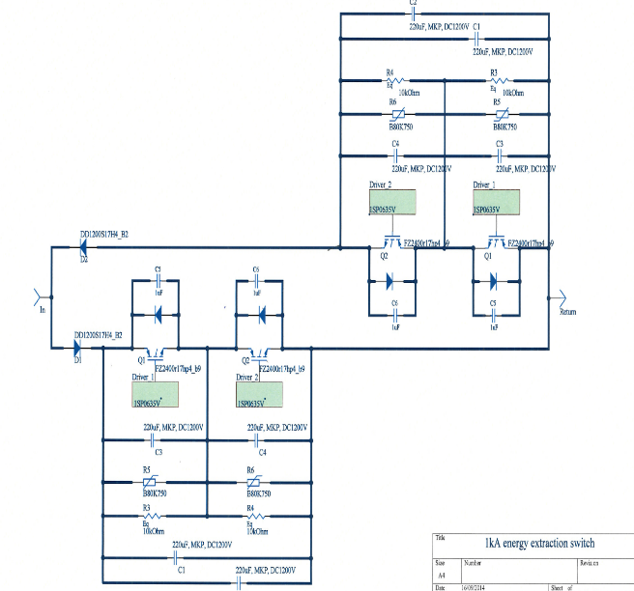
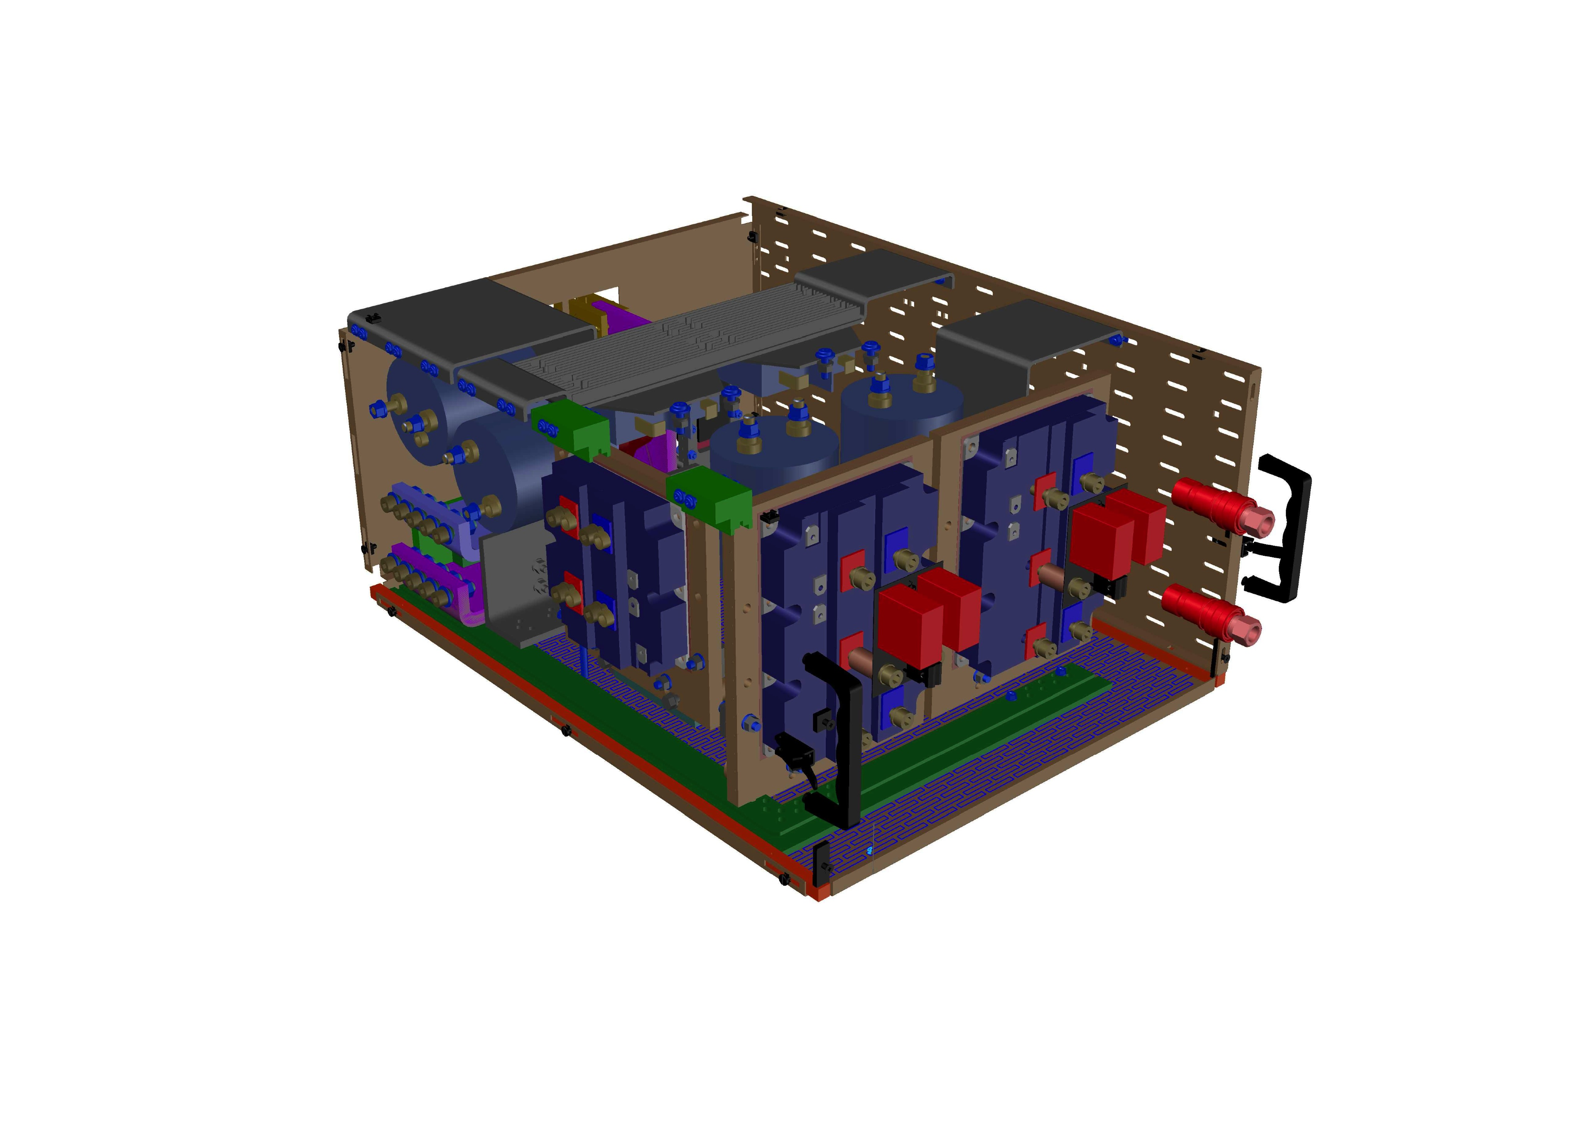
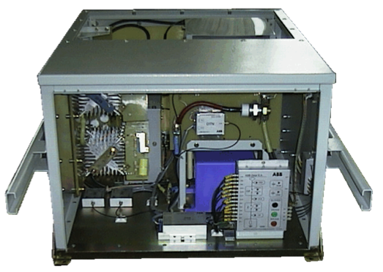
HL-LHC EE (some) alternatives
Bipolar 1 kA, IGBT-based system developed by MPE/EE (two basic modules).
Crossing through zero is not a trivial issue in this case (to be further discussed with EPC)
Switch system based on natural commutation, as developed by the Łodz University of Technology
i_{L}
i_{s}
i_{R}
i_{tr}
L
R
MVS
TR
3kV Vacuum circuit breakers family, 250, 400, 800 A for electrical railway traction vehicles (ŁUT, Łodz, Poland)

Slide 9
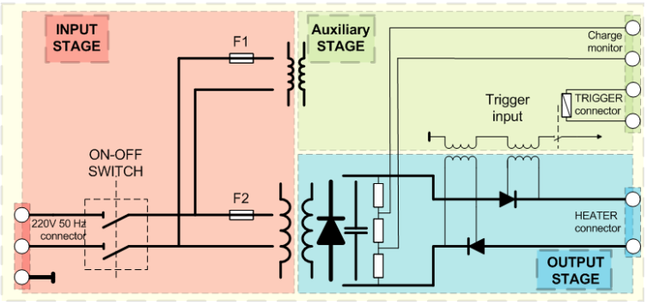
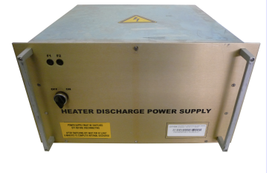
Quench Heater Discharge Supplies (HDS)
The plan is to use the same units as the ones existing for LHC
  Bipolar ± 450 V, 7.05 mF
  High reliability shown during years of LHC operation (around 1/mil/year)
Time for switching of thyristors in conduction has to be reduced to 1 ms from 4 to 5 ms at present
  Relays to be replaced by solid-state devices
Units have been sent to KEK and similar ones are being used at FNAL for the tests of the models and prototypes

Slide 10
EE vs QH comparison
Quench heater
Energy extraction
Intrusive element in magnet structure
Low maintenance
Heaters cost about 2 kCHF/meter of magnet
Power supply costs about 5 kCHF/unit (to this, cost of QH + wiring is to be added)
High availability
  Connections to be consolidated
Development costs (?)
Less space (19”, 6U) (x 2 units/magnet?)
External element
Yearly maintenance (if mechanical)
Permanent losses (if IGBT)
EE system costs about 32 kCHF/unit – based on IGBT systems
High availability
Development costs (estimated to 200kCHF)
Space is one full rack/system (700x900x2000mm)

Slide 11
Summary of conclusions
Heaters will be used on the first model
  Important feedback on the magnet manufacturing
Test results will allow to refine the model
  Contribution of AC losses and quench back
  Maybe the extraction at 50 V (crow-bar) is enough
Extraction on larger voltages (larger resistance, above 50 mΩ) should continue to be explored
  This implies energy extraction external to crow-bar
  TE/MPE will proceed with development on the different axis
Then (end of 2017) a decision will be taken for MCBXF
Same strategy to be applied to the other magnets

Slide 12
Many thanks for your attention!

