Slide 1
Collimation ECRs
R. Bruce
on behalf of the WP5 and collimation teams
R. Bruce, 2016.07.21
Notes:
1
1
21:02

Slide 2
Overview of ECRs
Several ECRs for collimation works in the EYETS 2016-2017 under review
  TCSPM: install a prototype of a secondary collimator with new low-impedance material
  TCPP: install a new primary collimator with BPM buttons
  Crystal: install 2 new crystals with improved goniometers in B2
  Wire collimators: install 2 units with integrated wires in IR5, for test of wire compensation of long-range beam-beam
Work carried out in close collaboration between many groups: ABP, STI, MME, BI, VAC, integration….

Slide 3
TCSPM
Low-impedance secondary collimators in IR7 part of the HL upgrade
  MoGr + coating instead of CFC provides a 90% reduction of the impedance
Prototype under construction at CERN by EN/MME, paid by WP5
  Design includes 3 longitudinal stripes of coating: Mo, TiN and uncoated MoGr
    10 mm wide areas, 5 µm thick coating
    Different surfaces exposed to beam by moving along the 5th axis
    (see ColUSM 27/5/2016)
  Includes also in-jaw BPM buttons
  New MoGr tapering
  Otherwise similar to existing TCSGs

Slide 4
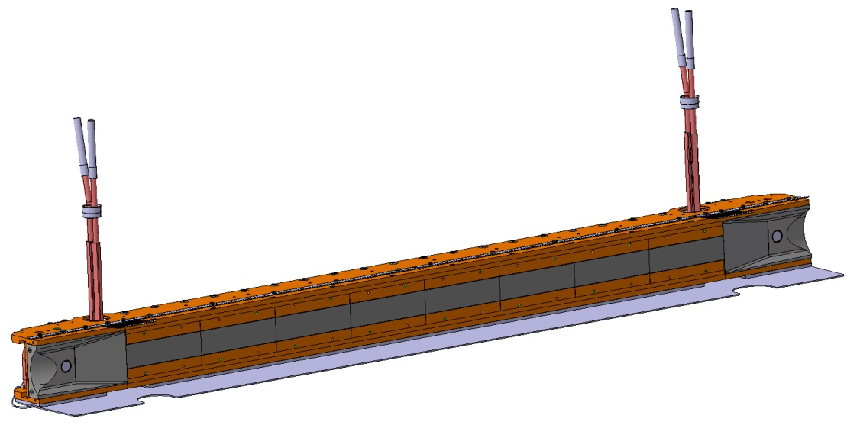
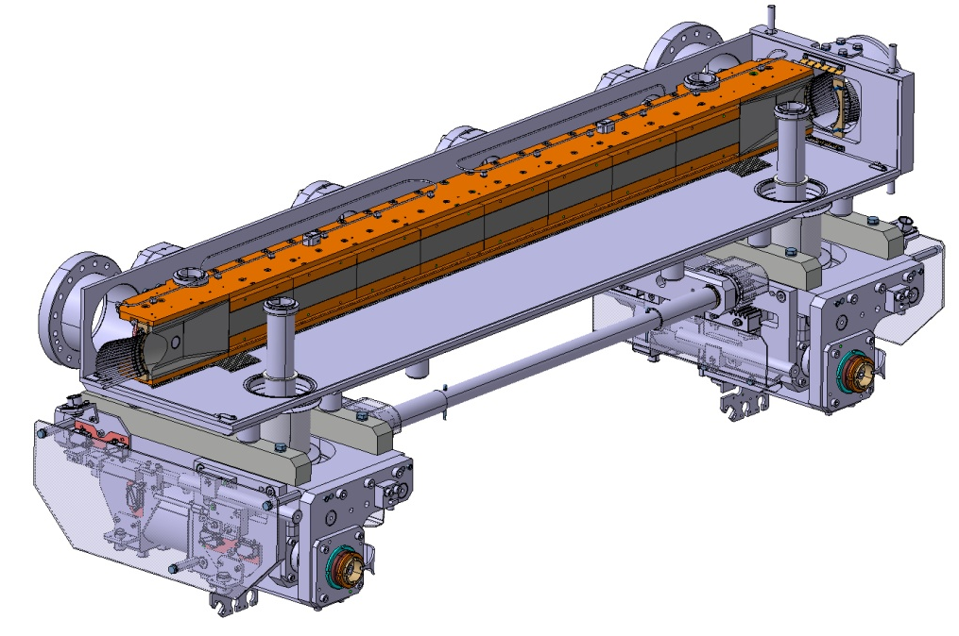
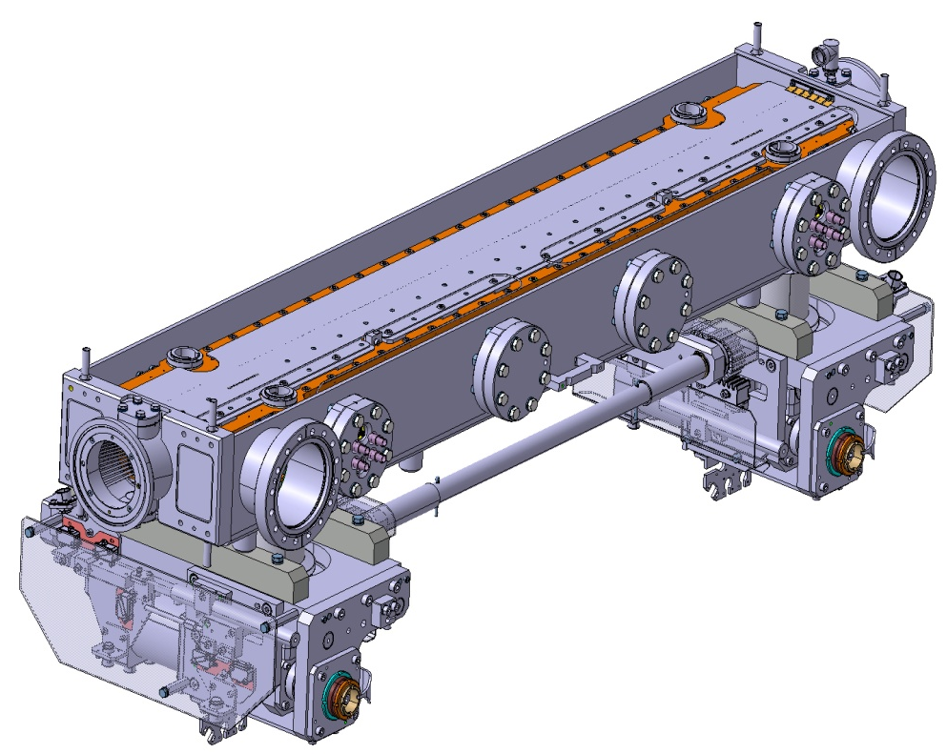
TCSPM

Slide 5
TCSPM
Planned to install prototype in empty upgrade slot next to TCSG.D4R7.B2, keeping the existing TCSG
  Vertical TCSG with highest individual impedance contribution
  Vertical plane: Cannot be hit by asynchronous dumps
  Cabling prepared already in LS1
Should be ready for installation in February 2017
  detailed schedule discussed in HiColDem meeting (HL-LHC Collimators: Design, Engineering and Prototyping) 14/7
Primary goal is use in impedance MDs, but it is a fully functioning collimator
EDMS document 1705738

Slide 6
TCPP
New design of primary collimator developed including BPM buttons
  Similar to existing TCP except for the BPMs
  Collimator design with in-jaw BPMs successfully deployed on other collimators (TCTs, TCSP)
  Allows a very large gain in alignment time
  Allows continues accurate monitoring of the orbit at the collimator
Prototype already built at Cinel and is ready for installation
  Paid by Consolidation project and LHC collimation project
Plan: replace the horizontal primary in IR7, B1, by the prototype
  Allow validation of design

Slide 7
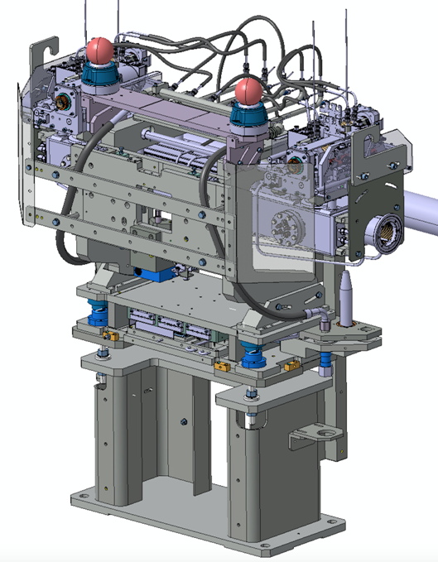
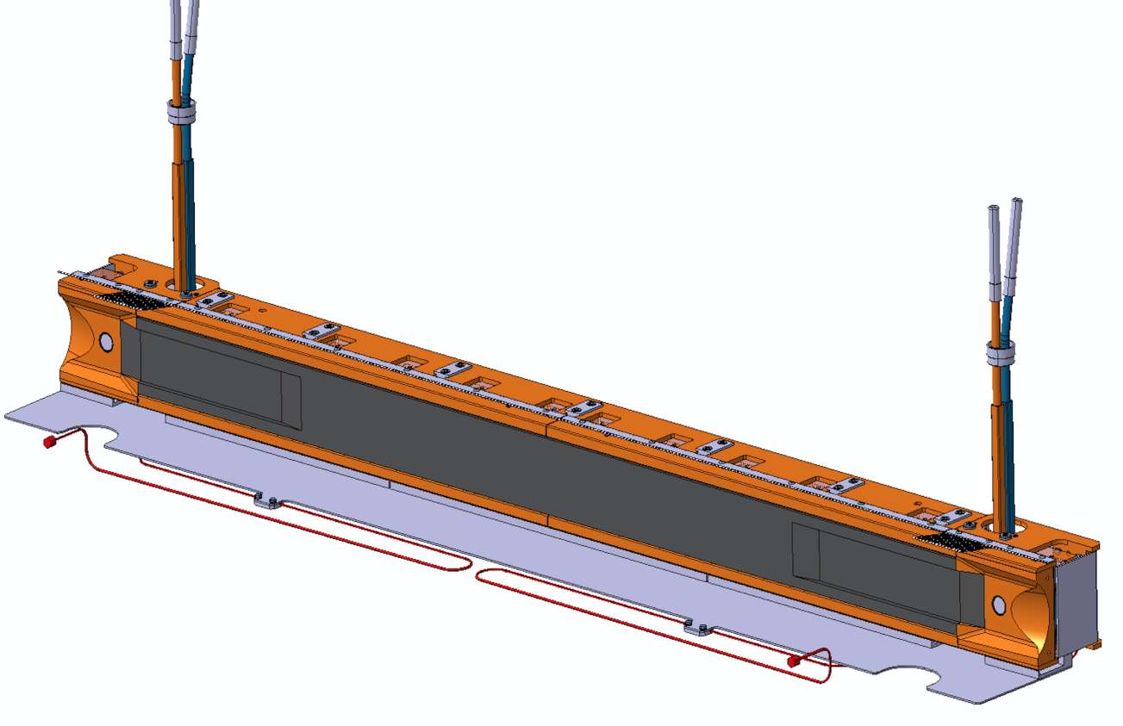
TCPP

Slide 8
Crystals
Already installed 2 crystals on B1, and several successful MDs carried out, but also some issues
  Goniometer not bakable above 110 deg
  Goniometer mechanics is not optimum for the precise sub-rad control of the angular position during executions of LHC ramp functions
  Bending angle of crystals were off by 25% from design value
Planned to install new goniometers, based on improved design, and new crystals on B2 (H+V)
  Will allow to validate new design with beam tests
  Having crystals on both beams allows more complete operational tests

Slide 9
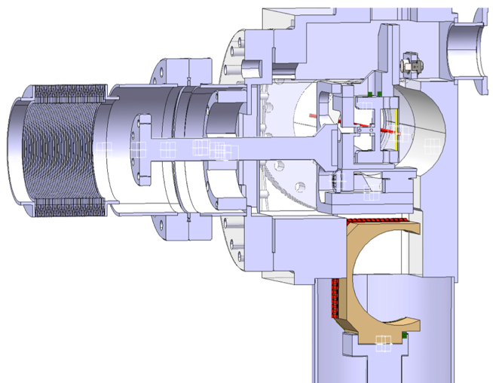
Crystals
View of goniometer

Slide 10
Crystals
Vertical goniometer to be installed in new slot 2m from TCSM.6R7.B1 (equivalent to B1 installation)
Horizontal goniometer: Equivalent B1 slot taken by TCSPM
    New proposed slot: TCSM.A5R7.B2
Installation of dedicated BLMs required
Paid by WP5, except for cabling, and crystals provided by UA-9

Slide 11
Wire collimators
Goal: replace two existing collimators in IR5 with new ones with built-in wires for tests of long-range beam-beam compensation (collaboration ABP – BI)
  TCTPH.4R5.B2 (incoming beam) and TCL.4L5.B2 (outgoing beam), both horizontal (crossing plane)
Design based on present TCTP (includes BPMs), but with Cu wires embedded in tungsten jaws and glidcop “T” insert for heat conduction

Slide 12
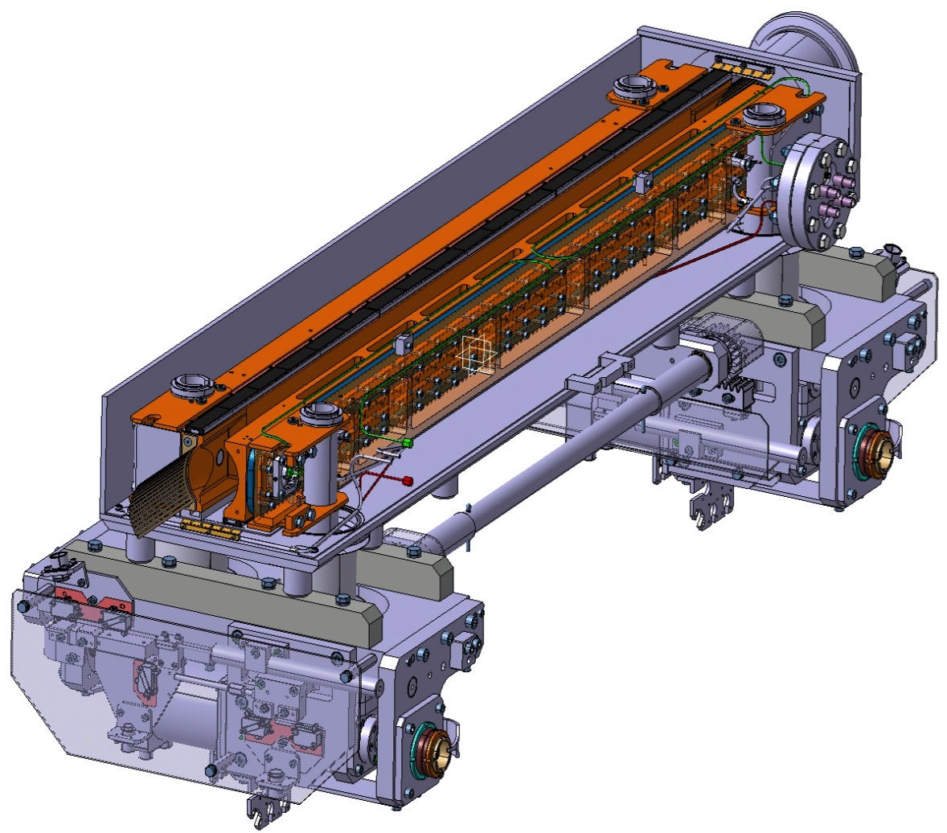
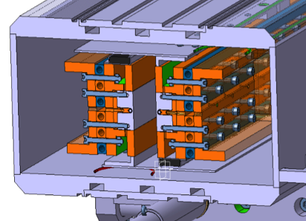
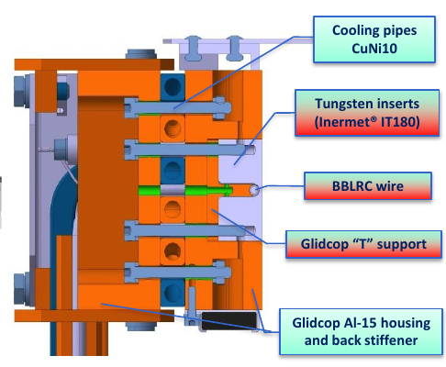
Wire collimators
Vacuum tank
Jaws

Slide 13
Wire collimators
The wire should be used / powered only in dedicated MDs
  Cooling designed for maximum current of 378 A.
During the rest of the time: to be used as standard collimators during normal operation
  Fulfill the same demands on robustness etc
EDMS document 1705791

Slide 14
Summary
4 collimation ECRs out for approval for EYETS installation
  TCSPM
  TCPP
  Crystals
  Wire collimators
Looking forward to your feedback

