Slide 1
Phase Calculation
And Its
Need in GBT
Developers from cru team:
(Jubin mitra, erno david, mazsi)

Slide 2
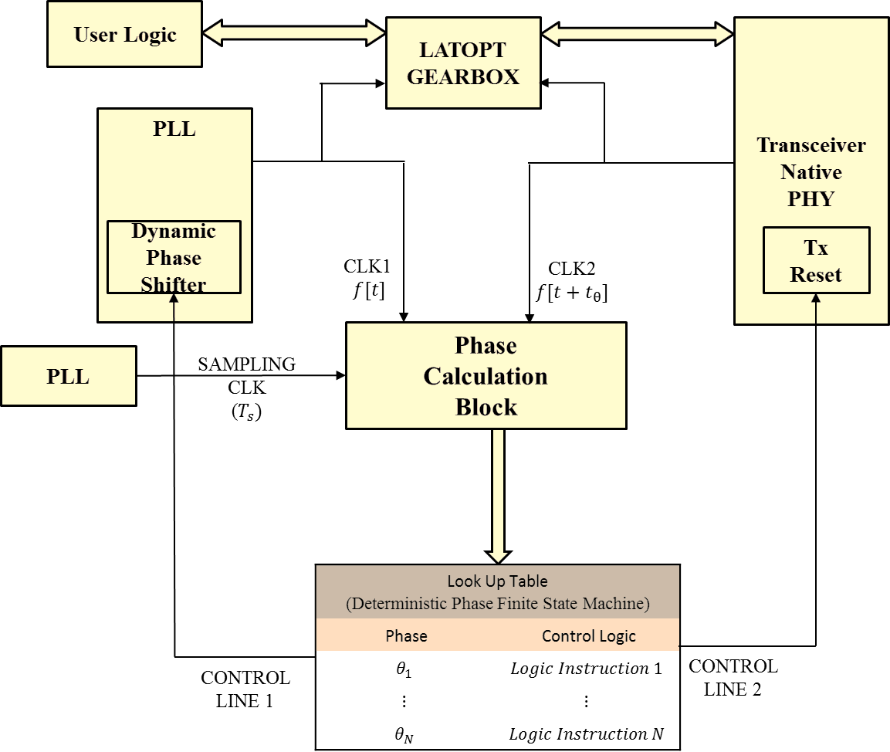
Deterministic Phase Finite State Machine for GBT Tx
Showing two control lines
available
For Proper
Phase Matching
(we have 2 options)

Slide 3
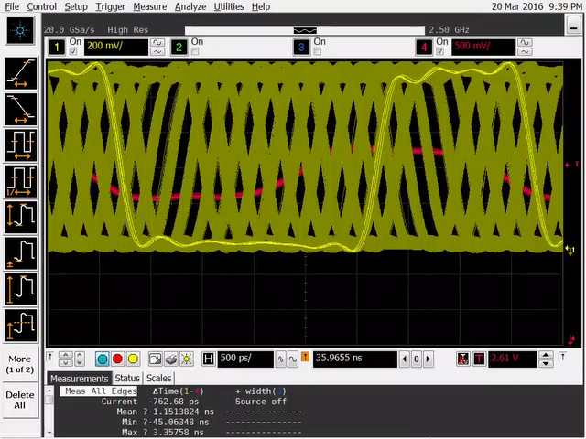
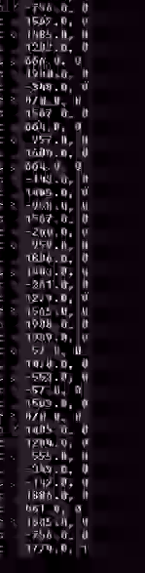
We Are Able To Control The Tx Phase In A Deterministic Manner Using the Phase
Component
(Needed for GBT Tx Side)
PHASE VALUE, LOCKED STATE

Slide 4
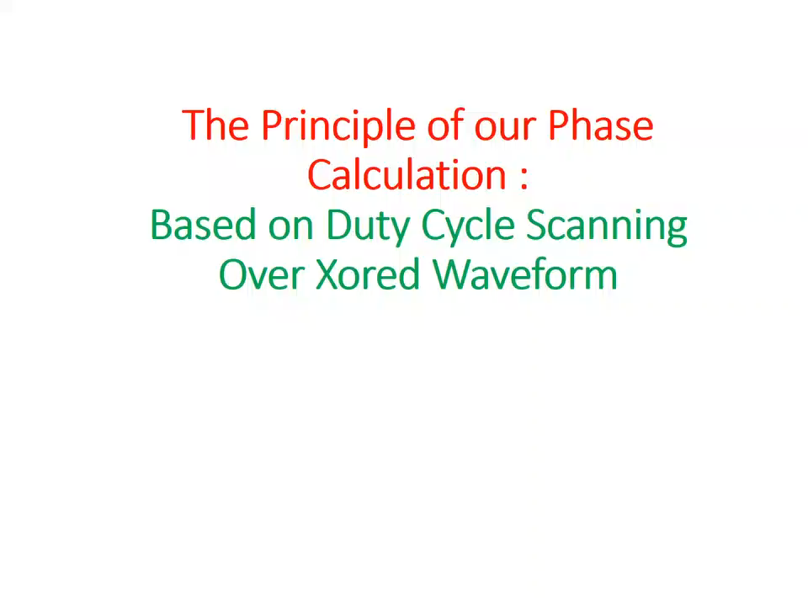

Slide 5
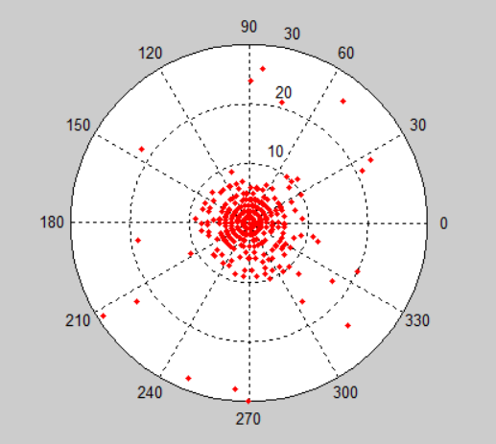

Shows Phase Measurement Accuracy for 1842 ps chosen as Phase Lock position over 10000 reset cycles
REGION OF INTEREST
SHOWS THAT THE PHASE CALCULATOR VALUE IS ACCURATE and PRECISE

Slide 6
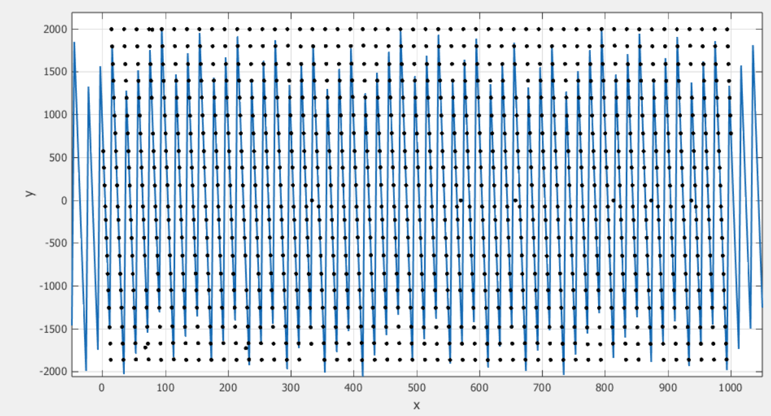
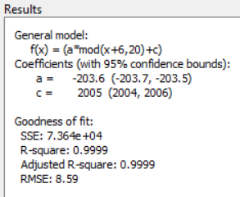
Linear Fit of Phase Calculator Values with 95% confidence Guard band
Over Input Data Vector Repeated every 20 instances (with 200 ps phase difference)
The Component is reliable to be used for Internal Phase Measurement with 100ps/200ps phase resolution.
However, more statistical evaluation needed for calibration.

Slide 7
By this method we can guarantee a constant phase difference between PON Rx and GBT Tx
(Between each Power, Reset and Fitter Cycle)
FIXED PHASE CERTAINTY
ARRIA 10 FPGA
TTC-PON’15
GBT
Fixed Phase
Rx Word Aligner
FSM
GBT Tx
Deterministic Phase Repeatability
FSM

Slide 8
Thank
You
&
Any Questioins

