Slide 1
TTC-PON and GBT
Csaba SOOS

Slide 2
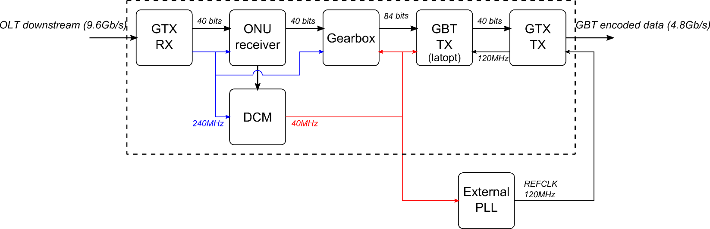
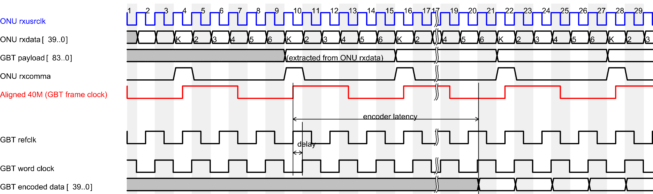
240M (ONU) to 40M (GBT)
1
2
3
Pro: standard solution
Contra: more clock domains
1
2
3

Slide 3
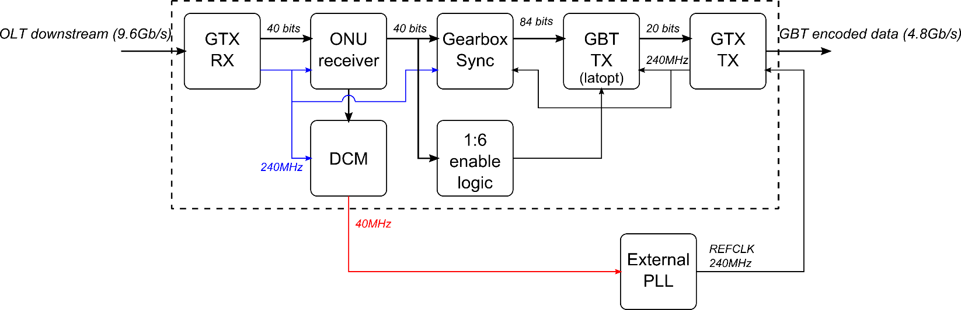
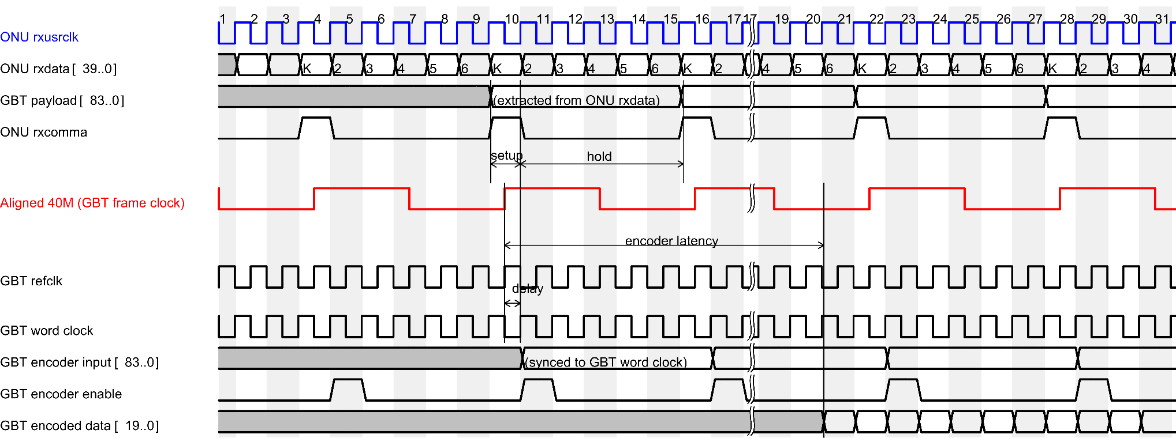
240M (ONU) to 240M (GBT)
Pro: less clock domains,
reduced latency (?)
Contra: custom solution,
timing critical (?)

Slide 4
PON framing
8B10B
40/32
40/32
40/32
40/32
40/32
40/32
240/192 80%
PON
User
240/160 67%
Hybrid
40/32
40/32
40/32
120/84
240/180 75%
PON
User
240/148 62%
FEC
H
X
Y
240/((240-H)*E_{FEC})
PON
User

Slide 5
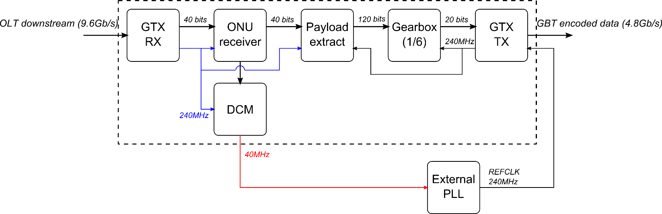
GBT Encoder in OLT
Hybrid
40/32
40/32
40/32
120/84
PON
User

Slide 6
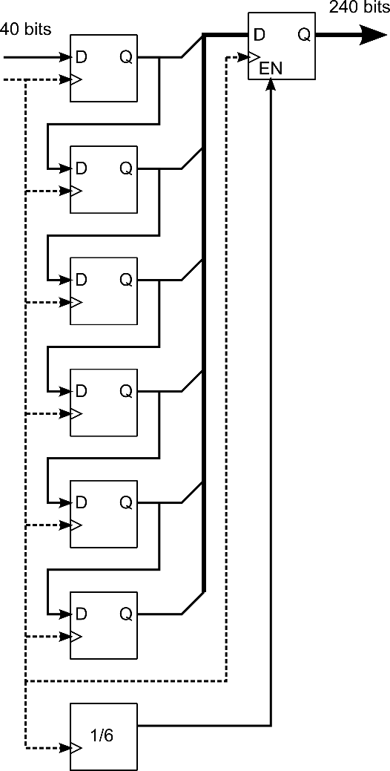
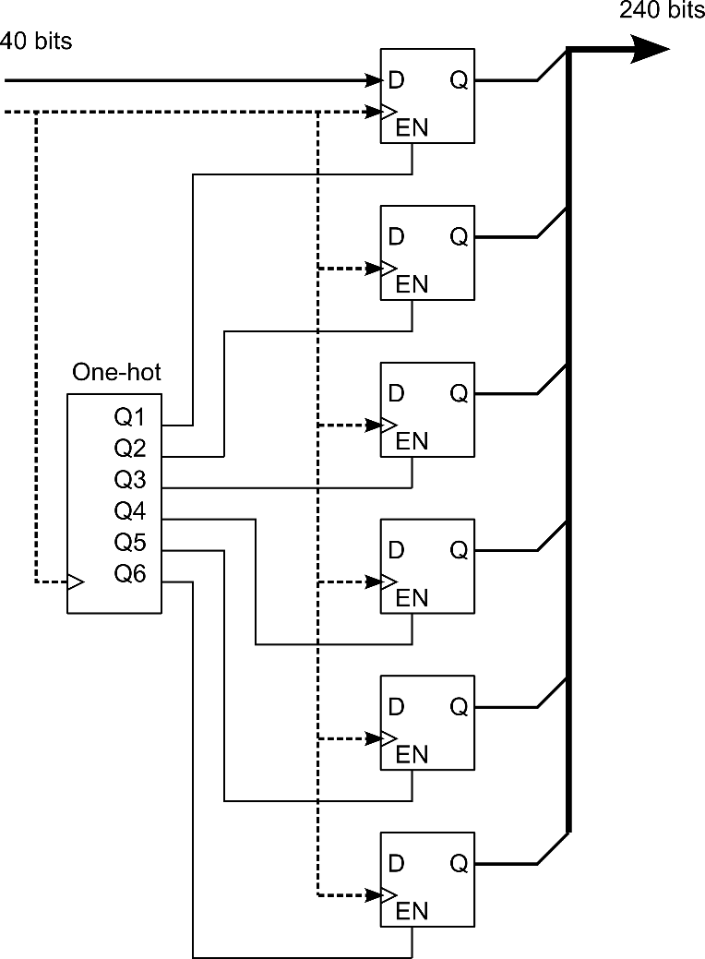
Gearbox/Payload extract
Simple registered logic to avoid latency issues

Slide 7
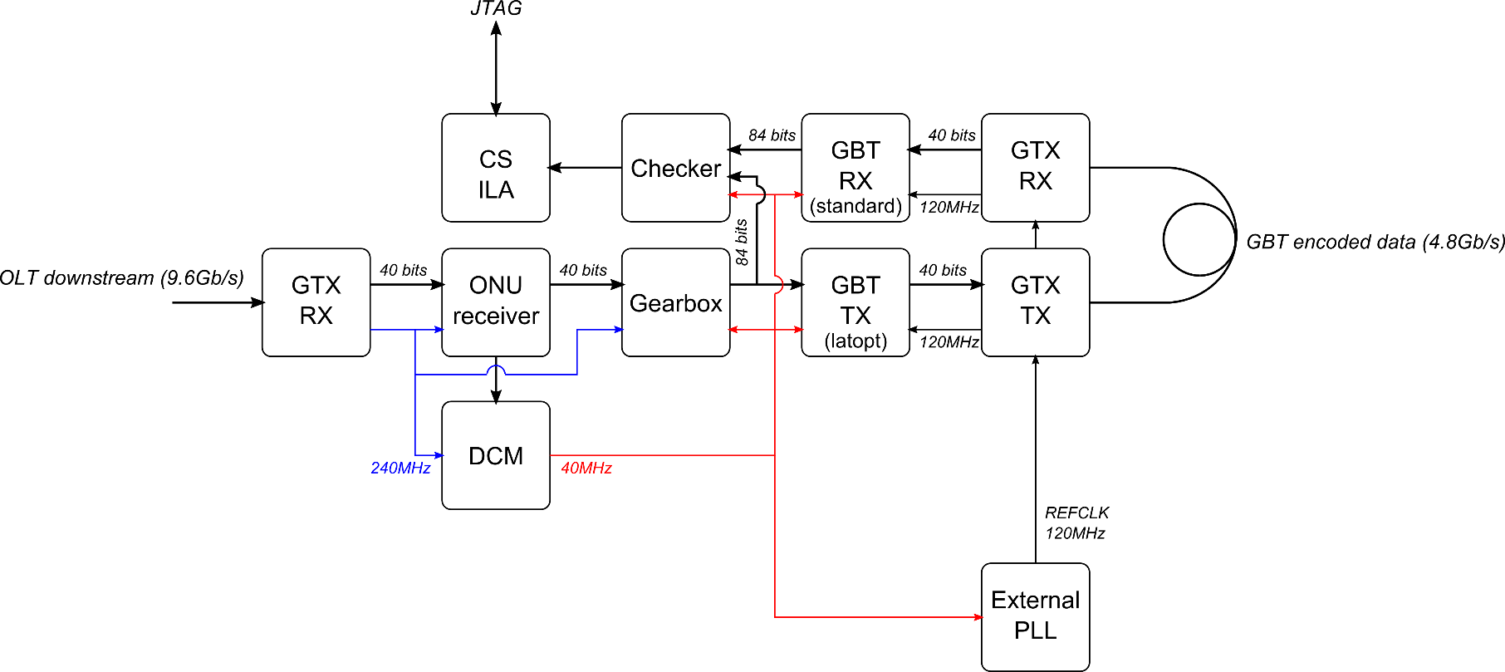
Simple test made on KC705
Loopback test to validate bridge
Latency was not yet verified

