Slide 1
Vacuum layout
Plug valve (manual)
Plug valve (manual)
VVS
VVS

Slide 2
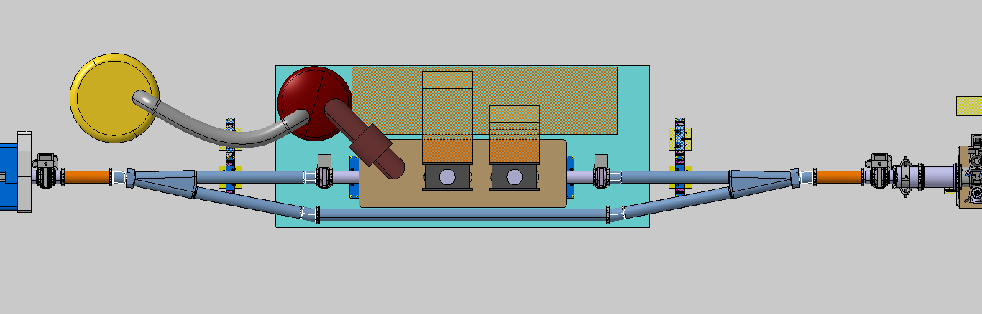
Configuration de la zone Crab cavity
Bellows
Bellows
Chamber with bellows and port VCPEB
VVS
Bellows chamber VEDI
VVS
Y-chamber
Transition chamber VEWJ
VVS

Slide 3
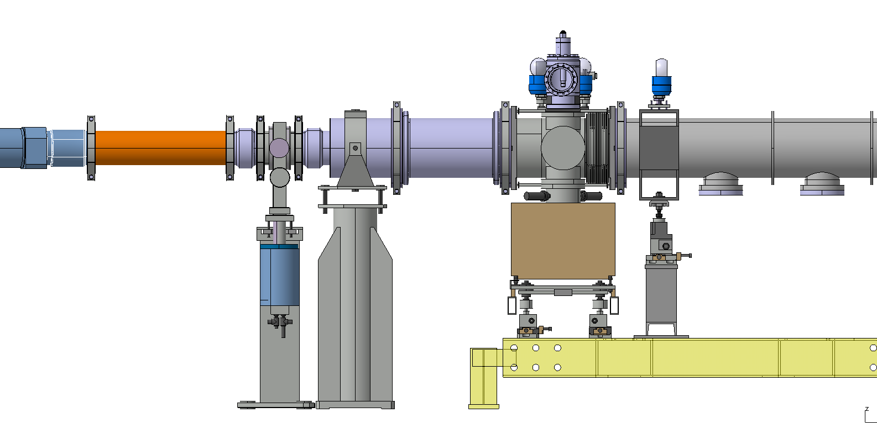
TPSG
1904 mm

Slide 4
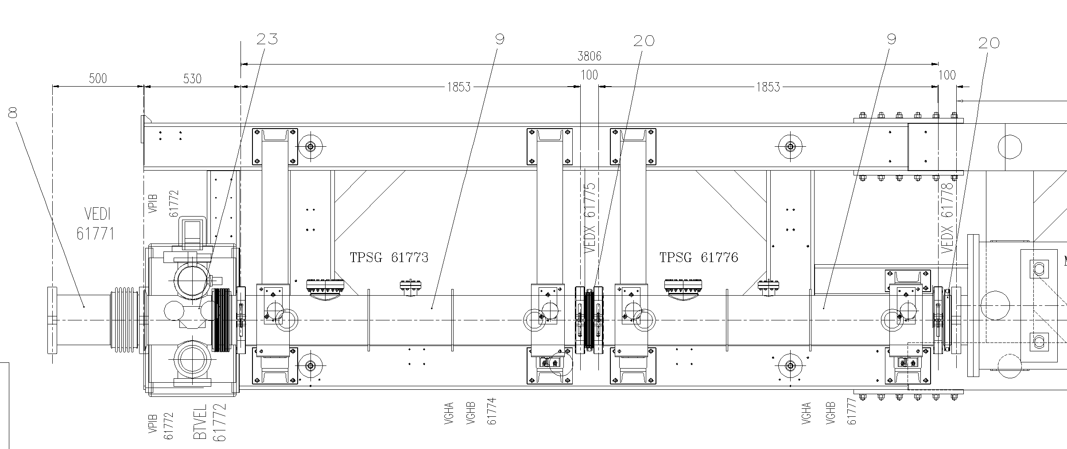
1953mm

