Slide 1
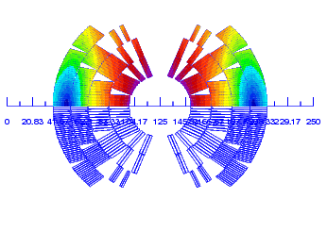
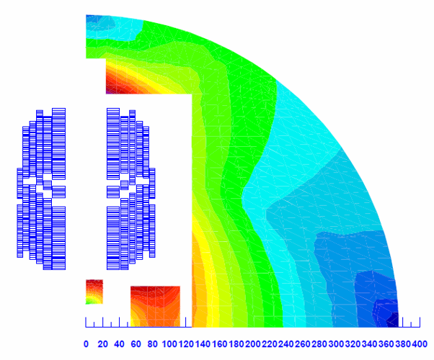
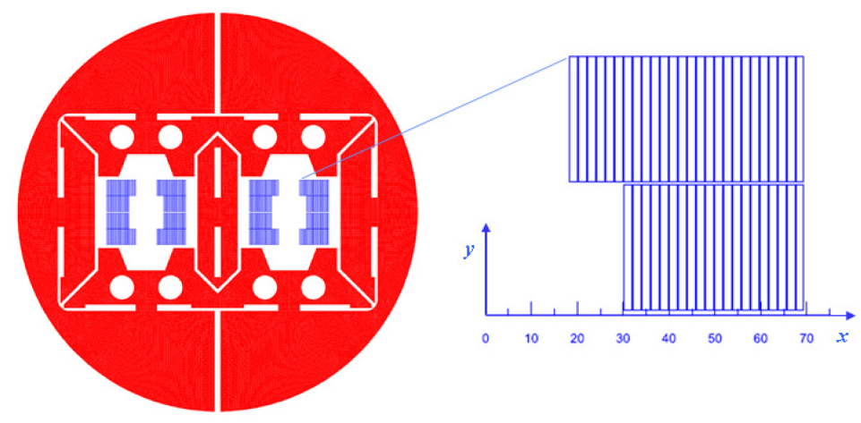
Comparison of magnet designs from a circuit-protection point-of-view
Arjan Verweij, M. Prioli, CERN, TE-MPE
A. Verweij, EuroCirCol review 11-13 May 2016

Slide 2
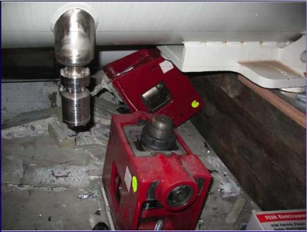
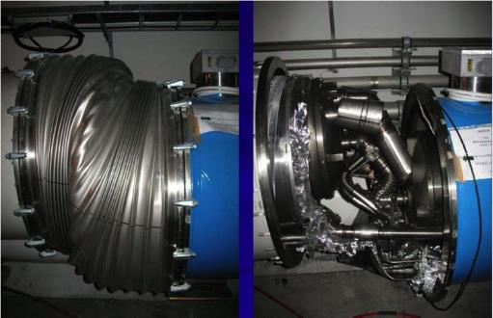
Reminder
Sept 2008: damage caused in the LHC by 0.6 GJ stored energy
The stored energy of all main dipoles in the FCC is about 200 GJ.
⇒ Circuit protection is extremely important
A. Verweij, EuroCirCol review 11-13 May 2016

Slide 3
Intro
The FCC main dipole magnets have to be powered in strings, so:
the magnet design has an impact on the protection and configuration of the string,
the string layout has an impact on the magnet requirements.
The following magnet designs are compared from a circuit protection point of view:
  Cos-θ, INFN, EuroCirCol collaboration
  Block, CEA, EuroCirCol collaboration
  Common coil, CIEMAT, EuroCirCol collaboration
  Block, LBNL
Quench protection of the magnet itself (characterised by the hot-spot temperature, voltage-to-ground, thermal gradients) is not discussed here.
(see presention T. Salmi).
A. Verweij, EuroCirCol review 11-13 May 2016

Slide 4
Recap: Powering of the LHC dipole circuits
The 154 twin-aperture magnets in each of the 8 sectors of the LHC are powered in series and each magnet has a bypass diode to decouple the current decay of a quenching magnet from the current decay of the circuit.
PC
Ramp up and down, assuming constant ramp rate:
Output voltage of the converter: V_{PC}=L(I)*(dI/dt) + I*R_{warm}
Power of the converter: P_{PC}=V_{PC}*I=L(dI/dt)*I + I²*R_{warm}
Ramp time: t_{ramp}=I_{nom}/(dI/dt)
Two room-temperature energy-extraction (EE) systems, each with a switch and a 75 mΩ resistor (R_{EE}) are present, to ensure a sufficiently fast decay of the circuit current (τ=100 s) in case of a Fast Power Abort (FPA) triggered by a quench/trip.
Diodes and (possibly non-SC) busbars therefore have to withstand this current decay.
A. Verweij, EuroCirCol review 11-13 May 2016

Slide 5
Quench/trip ⇒ Fast Power Abort (FPA)
the power converter is switched off,
the switches of the EE system(s) are opened,
quench heaters (or CLIQ) are activated,
the current in the quenching magnet(s) transfers into the bypass diode,
the voltage over the quenching magnet(s) equals the forward voltage of the bypass diode,
the circuit current decays ‘exponentially’ with τ_{circ}=L_{circ}/(N_{EE}*R_{EE}),
magnets
EE
magnets
EE
IR_{EE}/2
V_{gnd}
0
-IR_{EE}/2
A. Verweij, EuroCirCol review 11-13 May 2016

Slide 6
Required voltage withstand level
For a circuit with grounding in the centre of the EE resistor, the maximum voltage-to-ground without faults equals:
V_{gnd,max} = V_{Q,max} + V_{FPA,max} = V_{Q,max} + 0.5*I*R_{EE}
V_{Q,max} is given by the layout of the coils and magnet protection system.
(see presentation T. Salmi)
Fault scenario’s (for a circuit with one or two EE systems):
Malfunctioning of part of the magnet protection can give an increased V_{Q,max}.
An intermittent short (before the circuit fuse blows) could give:
V_{FPA,max,fault} = I*R_{EE} + N_{mag}*V_{diode} /NEE (private comm. E. Ravaioli)
N_{mag}: the number of magnets in the circuit
V_{diode}: the opening voltage of the cold bypass diode (6 V).
A safe voltage withstand level of the circuit is:
VWL = f * (V_{Q,max} + V_{FPA,max,fault}) with f a safety margin (for example f=1.2)
A. Verweij, EuroCirCol review 11-13 May 2016

Slide 7
Powering of the FCC dipole circuits
An “LHC-type” powering seems also for the FCC the best configuration.
However, some modifications could be envisaged:
Independent powering of the two apertures.
Powering of dipoles and quadrupoles in series.
More than one circuit per sector.
Different number of EE systems per circuit.
Cold EE systems.
Cold EE switches (persistent mode).
More than one diode per magnet.
The diode by-pass should preferably also cover the magnet-to-magnet busbar to avoid a ‘2008-like accident’.
A. Verweij, EuroCirCol review 11-13 May 2016

Slide 8
Circuit configuration
In general it is preferable to reduce the number of circuits ⇒ less power converters, warm busbars, electrical Distribution Feed Boxes (DFB), and current leads.
For a circuit, one would like to reduce:
current in the circuit → smaller size DFB & current leads, lower cost PC
V_{PC} and P_{PC} → lower cost and smaller size of the converter
ramping time → increased availability for beam physics
V_{FPA,max} → reduced voltage withstand level
τ_{circ} → faster cryo recovery, less quench propagation
dimensions cold busbars → ‘easier’ layout inside the cryostats
number of EE systems → lower cost, less maintenance, lower heat inleak
current rating of EE systems → lower cost, smaller size
stored energy per circuit → reduced risk in fault scenario’s
heating in the bypass diode → smaller diode heat sinks, faster cryo recovery
And of course, the EE systems and PC’s should be located in easily accessible areas.
Unfortunately, many of these demands are contradictory...
A. Verweij, EuroCirCol review 11-13 May 2016

Slide 9
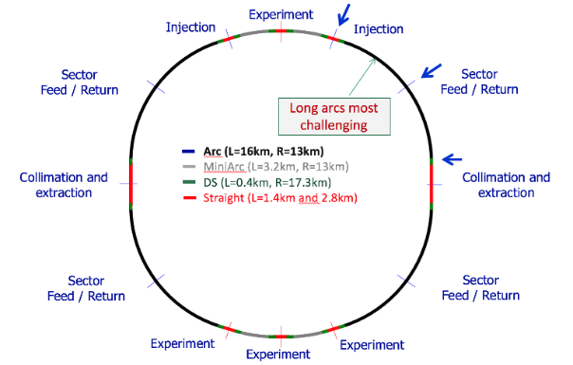
The FCC layout
Powering Sectors (4 km)
PC 1
Half-arc
(8 km)
PC 2
In total 20 Powering Sectors:
16 in the arcs
4 in the mini-arcs
A. Verweij, EuroCirCol review 11-13 May 2016

Slide 10
Strategy for circuit configuration
Locate power converters and EE systems in the access points.
Subdivide each Powering Sector in N circuits ⇒ 20N circuits for the entire machine
Power both apertures of the dipoles in series, independently from the quads.
Power the circuits via a superconducting link.
Use one EE system per circuit, located near the converter.
EE1a
EE1b
PC 1a
EE1c
PC 1b
EE1d
Superconducting link
PC 1c
EE1e
Example for N=5
PC 1d
PC 1e
Powering Sector (4 km)
A. Verweij, EuroCirCol review 11-13 May 2016

Slide 11
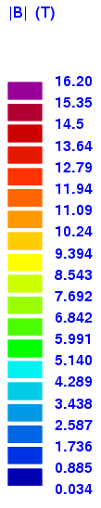
FCC magnet designs
Common coil
Cos-θ
Block
Block (LBNL)
A. Verweij, EuroCirCol review 11-13 May 2016

Slide 12
FCC magnet designs (B_{nom}=16 T, 14.3 m)
50 mm aperture
~82% on loadline at 1.9 K
J_{c}=1500 A/mm² at 16 T, 4.2 K
60 mm aperture
90% on loadline at 1.9 K
J_{c}=1500 A/mm² at 16 T, 4.2 K
Description | Cos-θ [1] | Block [2] | Common Coil [3] | Block - LBNL [4] | Units
Nr of turns per aperture | 230 | 306 | 394 [5] | 92 | -
Current @ nominal field | 10.275 | 8.47 | 9.03 | 25.8 | [kA]
Inductance (double aperture) | 734 | 1264 | 1824 | 120 | [mH]
Stored energy at nominal (double aperture) | 39 | 45 | 74 | 40 | [MJ]
[1] G. Bellomo, P. Fabbricatore, S. Farinon, V. Marinozzi, M. Sorbi, G. Volpini, INFN, Version 28b-38 v5, Minutes EuroCirCol WP 5 meetings.
[2] C. Lorin, M. Dunante, CEA/IRFU, Version v26cmag, Minutes EuroCirCol WP 5 meetings
[3] T. Martinez, J. Munilla, F. Toral, CIEMAT, Version v1h_intgrad, Minutes EuroCirCol WP 5 meetings.
[4] G.L. Sabbi et al, “Design study of a 16 T Block-Dipole for FCC”, EUCAS 2015.
[5] Total for a double aperture divided by 2
A. Verweij, EuroCirCol review 11-13 May 2016

Slide 13
Assuming 2x larger stored energy with same current
Same:
cable
circuit
ramp time
nr of EE systems (N_{EE})
V_{FPA,max}
 | Magnet protection
L_{M} | 2x larger
MIIts | larger
V_{Q,max} | larger
T_{hot} | larger
⇒ More copper in cable
 | Circuit powering
L_{circ} | 2x larger
V_{PC} | 2x larger
P_{PC} | 2x larger
A_{warm-leads} | equal
A_{current-leads} | equal
 | Circuit protection
E_{circ} | 2x larger
τ_{circ} | 2x larger
A_{busbar} | √2x larger
Q_{diode} | 2x larger
EE switch | equal
EE dump | 2x larger
⇒ Increase nr of circuits or number of EE systems
High priority: Minimize stored energy
A. Verweij, EuroCirCol review 11-13 May 2016

Slide 14
Stored energy vs. Cost and Availability
Two remarks:
Assuming 200 GJ (about 40 MJ/magnet) and a ramp time of 20 min, requires an average power consumption during ramping of 170 MW (+losses due to converter efficiency and warm busbars). Increasing the stored energy has a huge cost! Reducing the ramp time has a large impact on availability. (Ramping up/down in the LHC takes a few hrs per day)
Cryo recovery after a LHC dipole quench (7 MJ/magnet) takes about 10 hours. Any further increase in stored energy for the FCC will increase the cost for the cryogenic system or increase down-time of the machine.
A. Verweij, EuroCirCol review 11-13 May 2016

Slide 15
Assuming 2x larger cable (half number of turns) with same stored energy
 | Magnet protection
L_{M} | 4x smaller
MIIts | 4x larger
V_{Q,max} | ~2x smaller
T_{hot} | equal
Same:
circuit
ramp time
nr of EE systems (N_{EE})
V_{FPA,max}
 | Circuit powering
I_{nom} | 2x larger
L_{circ} | 4x smaller
V_{PC} | 2x smaller
P_{PC} | equal
A_{warm-leads} | larger
A_{current-leads} | larger
 | Circuit protection
E_{circ} | equal
τ_{circ} | 2x smaller
A_{busbar} | √2x larger
Q_{diode} | equal
EE switch | 2x higher current rating
EE dump | equal
Not obvious what is preferable:
Low-I_{nom} & High-L_{M} versus High-I_{nom} & Low-L_{M}
A. Verweij, EuroCirCol review 11-13 May 2016

Slide 16
Are there hard limits for the magnet design?
A string of magnets can always be protected, for any magnet design and given constraints (voltage withstand level, τ_{circ}, …), by adapting the number of circuits, so by subdividing a powering sector in multiple circuits.
Magnet powering:
Trade-off between: Number of circuits
Converter voltage rating (V_{PC})
Ramp time (t_{ramp})
Circuit protection
Trade-off between: Number of circuits
τ_{circ} (busbar & diode size & quench propagation)
V_{FPA,max}
A. Verweij, EuroCirCol review 11-13 May 2016

Slide 17
Layouts for the EuroCirCol Cos-θ design
Nr of circuits per half-arc | 1 | 2 | 3 | 4 | 4 | 8
Nr of circuits entire FCC | 20 | 40 | 60 | 80 | 80 | 160
Magnets per circuit | 215 | 113 | 72 | 54 | 54 | 27
Inductance per circuit [H] | 158 | 79 | 53 | 39 | 39 | 20
Stored energy per circuit [GJ] | 8.3 | 4.2 | 2.8 | 2.1 | 2.1 | 1.1
Ramp time [min] | 20 | 20 | 20 | 20 | 20 | 20
V_{PC} [V] | 1350 | 676 | 450 | 338 | 338 | 169
V_{FPA,max} [kV] | 1 | 1 | 1 | 1 | 0.5 | 0.5
V_{FPA,max,fault} [kV] | 3.3 | 2.6 | 2.4 | 2.3 | 1.3 | 1.2
τ_{circ} [s] | 810 | 405 | 270 | 203 | 405 | 203
A_{busbar} [mm²] | 539 | 387 | 316 | 273 | 387 | 273
Q_{diode} [MJ] | 8.3 | 4.2 | 2.8 | 2.1 | 4.2 | 2.1
A. Verweij, EuroCirCol review 11-13 May 2016
A. Verweij, EuroCirCol review 11-13 May 2016

Slide 18
Layouts for the EuroCirCol Block design
Nr of circuits per half-arc | 1 | 2 | 4 | 6 | 6 | 12
Nr of circuits entire FCC | 20 | 40 | 80 | 120 | 120 | 240
Magnets per circuit | 215 | 108 | 54 | 36 | 36 | 18
Inductance per circuit [H] | 272 | 136 | 68 | 45 | 45 | 23
Stored energy per circuit [GJ] | 9.7 | 4.9 | 2.4 | 1.6 | 1.6 | 0.8
Ramp time [min] | 20 | 20 | 20 | 20 | 20 | 20
V_{PC} [V] | 1920 | 960 | 480 | 320 | 320 | 160
V_{FPA,max} [kV] | 1 | 1 | 1 | 1 | 0.5 | 0.5
V_{FPA,max,fault} [kV] | 3.3 | 2.6 | 2.3 | 2.2 | 1.2 | 1.1
τ_{circ} [s] | 1150 | 575 | 288 | 192 | 384 | 192
A_{busbar} [mm²] | 538 | 380 | 269 | 220 | 310 | 220
Q_{diode} [MJ] | 9.7 | 4.9 | 2.4 | 1.6 | 3.2 | 1.6
A. Verweij, EuroCirCol review 11-13 May 2016

Slide 19
Layouts for the EuroCirCol Common coil design
Nr of circuits per half-arc | 1 | 4 | 6 | 8 | 8 | 12
Nr of circuits entire FCC | 20 | 80 | 120 | 160 | 160 | 240
Magnets per circuit | 215 | 54 | 36 | 27 | 27 | 18
Inductance per circuit [H] | 392 | 98 | 65 | 49 | 49 | 33
Stored energy per circuit [GJ] | 16 | 4 | 2.7 | 2 | 2 | 1.3
Ramp time [min] | 20 | 20 | 20 | 20 | 20 | 20
V_{PC} [V] | 2950 | 740 | 492 | 370 | 370 | 246
V_{FPA,max} [kV] | 1 | 1 | 1 | 1 | 0.5 | 0.5
V_{FPA,max,fault} [kV] | 3.3 | 2.3 | 2.2 | 2.2 | 1.2 | 1.1
τ_{circ} [s] | 1770 | 443 | 295 | 221 | 443 | 295
A_{busbar} [mm²] | 710 | 355 | 290 | 251 | 355 | 290
Q_{diode} [MJ] | 16 | 4 | 2.7 | 2 | 4 | 2.7
A. Verweij, EuroCirCol review 11-13 May 2016

Slide 20
Layouts for the LBNL Block design
Nr of circuits per half-arc | 1 | 2 | 3 | 4 | 4 | 8
Nr of circuits entire FCC | 20 | 40 | 60 | 80 | 80 | 160
Magnets per circuit | 215 | 108 | 72 | 54 | 54 | 27
Inductance per circuit [H] | 26 | 13 | 8.6 | 6.5 | 6.5 | 3.2
Stored energy per circuit [GJ] | 8.6 | 4.3 | 2.9 | 2.1 | 2.1 | 1.1
Ramp time [min] | 20 | 20 | 20 | 20 | 20 | 20
V_{PC} [V] | 555 | 277 | 185 | 139 | 139 | 69
V_{FPA,max} [kV] | 1 | 1 | 1 | 1 | 0.5 | 0.5
V_{FPA,max,fault} [kV] | 3.3 | 2.6 | 2.4 | 2.3 | 1.3 | 1.2
τ_{circ} [s] | 333 | 166 | 111 | 83 | 166 | 83
A_{busbar} [mm²] | 880 | 622 | 508 | 440 | 622 | 440
Q_{diode} [MJ] | 8.6 | 4.3 | 2.9 | 2.1 | 4.3 | 2.1
A. Verweij, EuroCirCol review 11-13 May 2016

Slide 21
Conclusion 1/2
Magnet designers should try to minimize the stored energy. Cos-θ and block designs have clear advantages as compared to the common-coil design. But recent design of common coil with aux. coils is much better.
Subdivision of a 4 km long half-arc in several dipole circuits seems the most feasible solution for proper circuit protection within the required constraints, while at the same time having all converters and EE systems at the access points (using a SC link).
Assuming t_{ramp}=20 min, V_{FPA,max}=1 kV, τ_{circ}≈200 s, gives:
Changing t_{ramp} (10-30 min) affects the rating of the converters (V_{PC} and
P_{PC}) but not the number of circuits.
 | Cos-θ | Block | Common coil | LBNL block
Nominal current [kA] | 10.275 | 8.47 | 9.03 | 25.8
Nr of circuits | 80 | 120 | 160 | 40
A. Verweij, EuroCirCol review 11-13 May 2016

Slide 22
Conclusion 2/2
High voltage withstand levels of the circuits and all its components are needed to reduce the number of circuits and hence reduce the complexity of the layout.
High-current low-inductance magnets are favourable in terms of quench voltage and number of circuits, which seem to outweigh the drawbacks. Another advantage is shorter unit lengths, hence increasing the production yield of the conductor.
I suggest to design several cos-θ and block dipoles with the usual EuroCirCol requirements, but with I_{nom}=15-25 kA.
A. Verweij, EuroCirCol review 11-13 May 2016

Slide 23
Final remarks
The possibility of independent powering of the dipole apertures, each in series with a RQD/F circuit, should be explored from optics point-of-view. This might significantly reduce the number of busbars, power converters, DFB’s, and current leads.
Large τ_{circ} in combination with large magnet stored energy will result in significant magnet-to-magnet quench propagation, hence very long cryogenic recovery. Thermal magnet-to-magnet propagation and possibilities to cryogenically decouple the magnets should be studied. This might have an impact on the spacing between dipoles (hence integrated field).
The tunnel layout should foresee space for an additional cryo link to power the circuits.
Connection from the link to the circuits should be studied, as this might also affect the spacing between the dipoles.
A. Verweij, EuroCirCol review 11-13 May 2016

