Slide 1
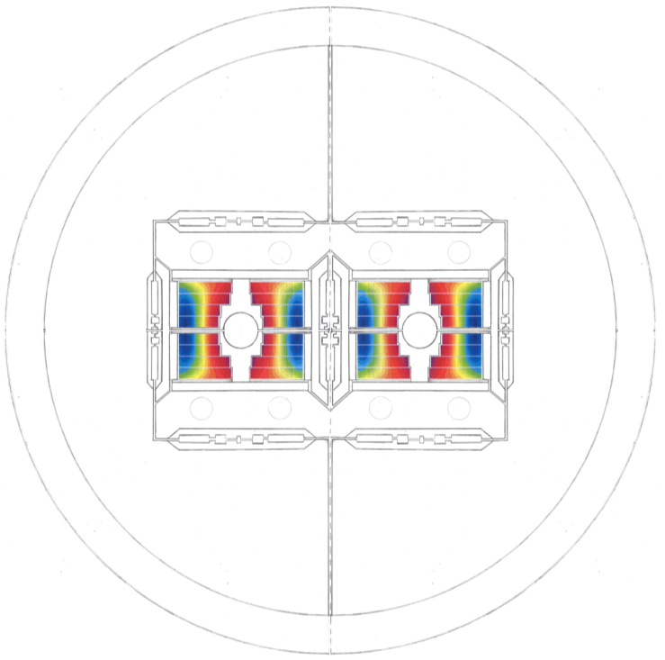
EuroCirCol
Status of block design mechanics
ECC WP5 1st review
Clément Lorin
Maria Durante
Michel Segreti
CEA
Cern, 12 May 2016

Slide 2
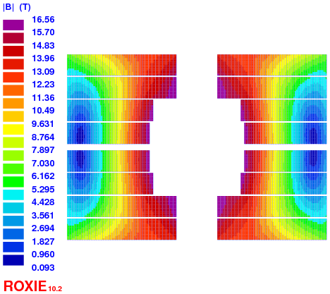
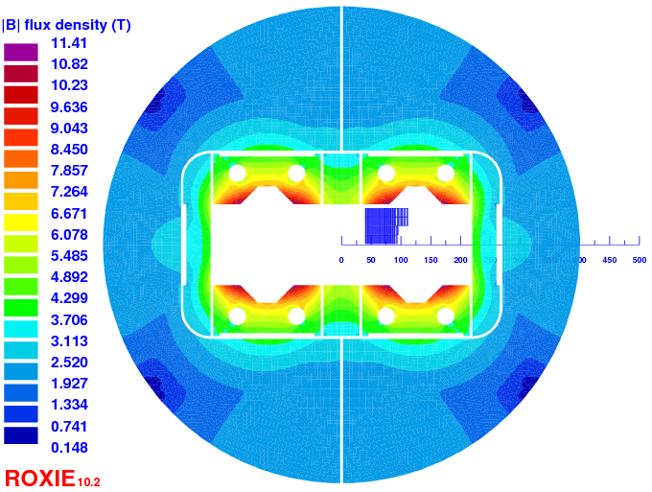
Reminder of the block magnet
  Two cables
    HF cable: Ф = 1.1 mm, 24 strands
      13.85 mm x 2 mm
    LF cable Ф = 0.7 mm, 37 strands
      13.85 mm x 1.25 mm
Quantity | Value | Unit
I_{nom} | 8470 | A
B_{peak} | 16.56 | T
LL margin | 9.3 | %
Inductance diff. (2 ap) | 88.19 | mH/m
Stored energy (2 ap) | 3340 | kJ/m
Conductor area (2 ap) | 190* | cm²
Fx (per ½-coil) | 8817 | kN/m
Fy (per ½-coil) | -3703 | kN/m
Hotspot | 310 | K
*10800 tons

Slide 3
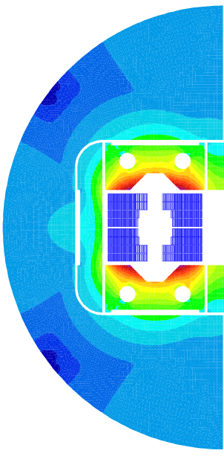
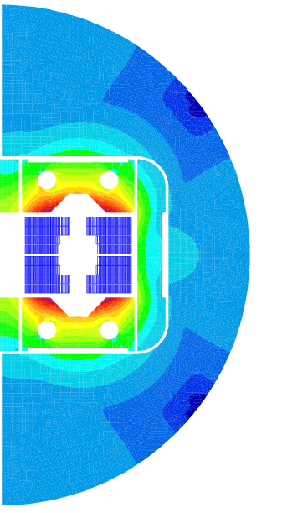
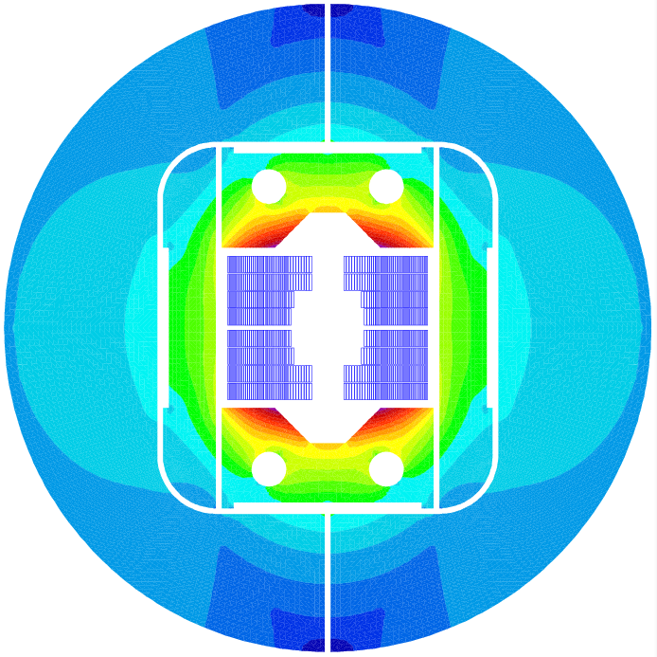
Mechanical specifications
  Single Aperture (SA) configuration: Ф_{yoke} = 800 -250 = 550 mm
  Baseline :
  Investigation at 16.8 T central field
  (105% of nominal current)
  Mechanical structure must withstand 18 T
  Coil maximum stress
    @ 4.2 K: 200 MPa
    @ 300 K: 150 MPa

Slide 4


Mechanical specifications
  Single Aperture (SA) configuration: Ф_{yoke} = 550 mm [(800-250)]
  Investigation at 16.8 T central field (105% of nominal current)
  Mechanical structure must withstand 18 T
  Coil maximum stress
    @ 4.2 K: 200 MPa
    @ 300 K: 150 MPa
Material | E [GPa] |  | pr | (L_{4.3K}-L_{293K})/L_{293K}
 | 293 K | 4.3 K | 293K /4.3K | 293 K -> 4.3K
Coil | EX = 44 EY = 52 GXY = 21 | EX = 44 EY = 52 GXY = 21 | 0.3 | X = 3.36e-3 Y = 3.08e-3
StSt | 193 | 210 | 0.28 | 2.84e-3
Iron | 213 | 224 | 0.28 | 1.97e-3
Aluminum | 70 | 79 | 0.34 | 4.2e-3
Titanium | 130 | 130 | 0.3 | 1.74e-3
Nitronic 40 | 210 | 225 | 0.28 | 2.6e-3
Material | R_{p 0.2} [MPa]
 | 293 K | 4.3 K
Al 7075 | 480 | 690
SS 316 LN | 286 | 930
NITRONIC 40 | 353 | 1240
MAGNETIL | 180 | 723
Ti 6Al 4V | 827 | 1654
Iron @ 4.2 K stress < 200 MPa in tension (brittle) ?

Slide 5
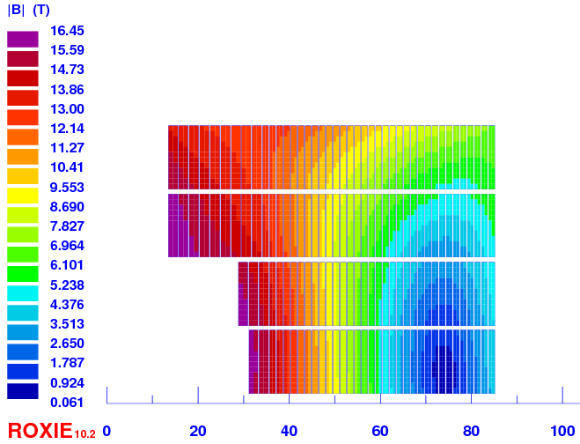
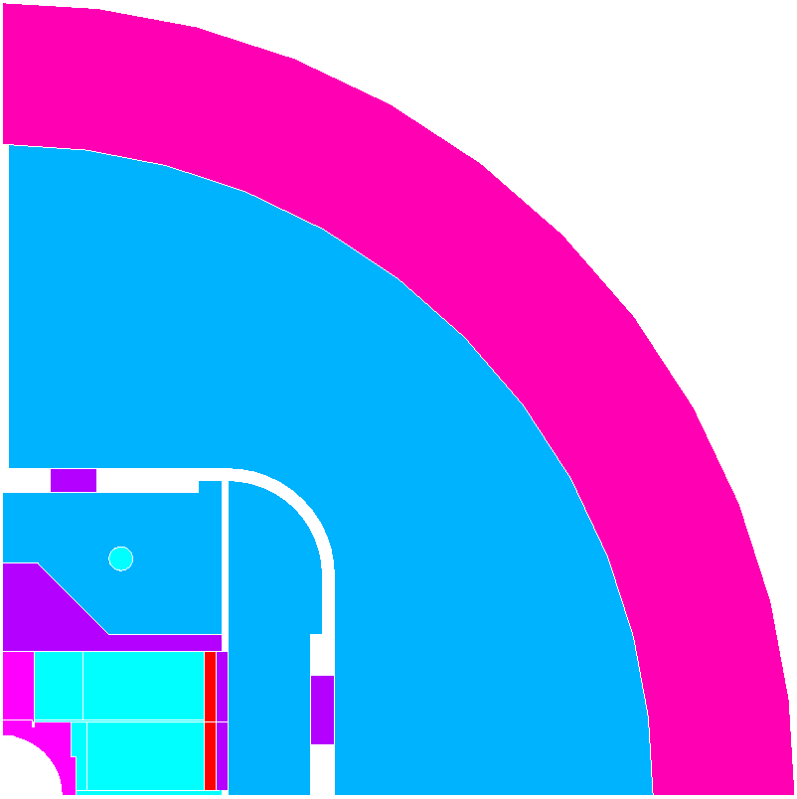
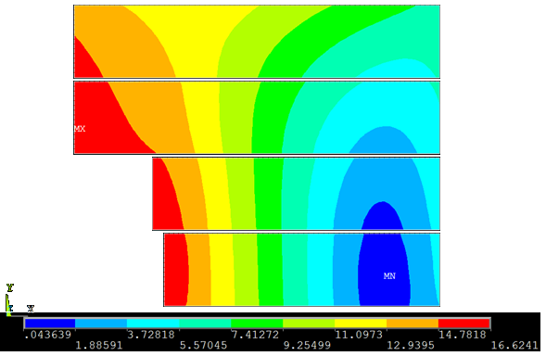
Lorentz forces
Comparison Roxie @ 16 T central field (Ansys + Cast3m)
Roxie Bp = 16.45T
Al
Iron
Steel
Ti
CuAl
Ansys Bp = 16.62 T

Slide 6
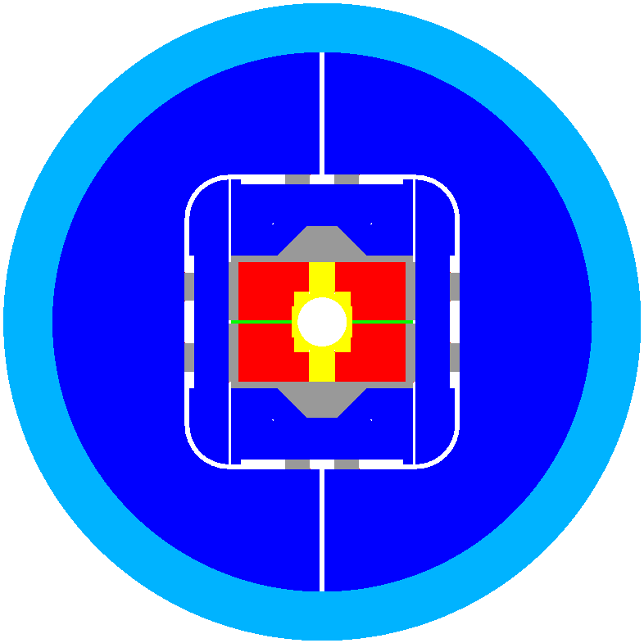

Assembly steps

Slide 7

Assembly steps
Pole Ti6Al4V

Slide 8

Assembly steps
Pole Ti6Al4V
Windings Nb₃Sn
Pad StSt

Slide 9
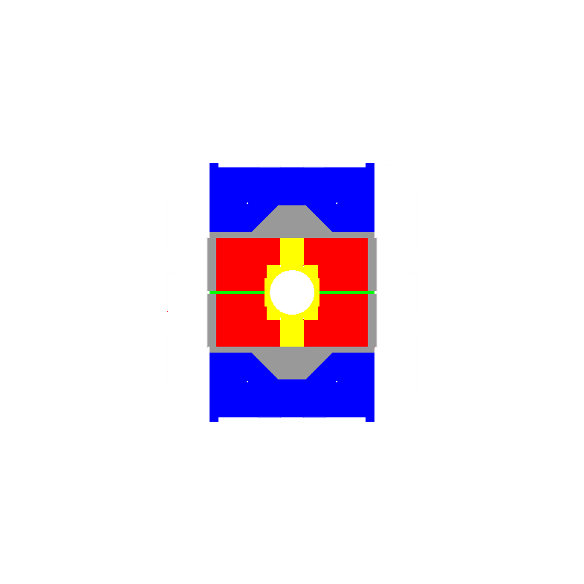
Assembly steps
Pole Ti6Al4V
Windings Nb₃Sn
Pad StSt
Pad Iron

Slide 10
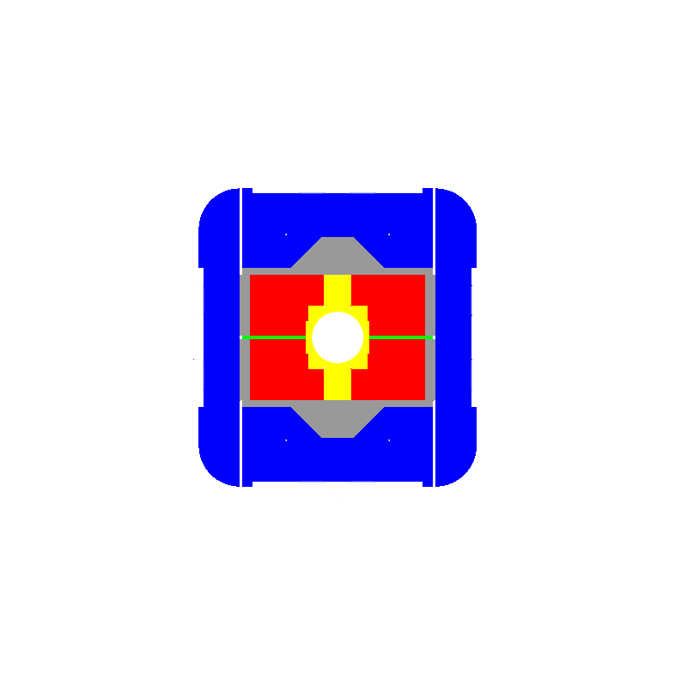
Assembly steps
Pole Ti6Al4V
Windings Nb₃Sn
Pad StSt
Pad Iron
-> Coil pack

Slide 11

Assembly steps
Yoke Iron
Shell Aluminium

Slide 12
Assembly steps
Pole Ti6Al4V
Bobines Nb₃Sn
Pad StSt
Pad + Yoke Iron
Shell Aluminium

Slide 13
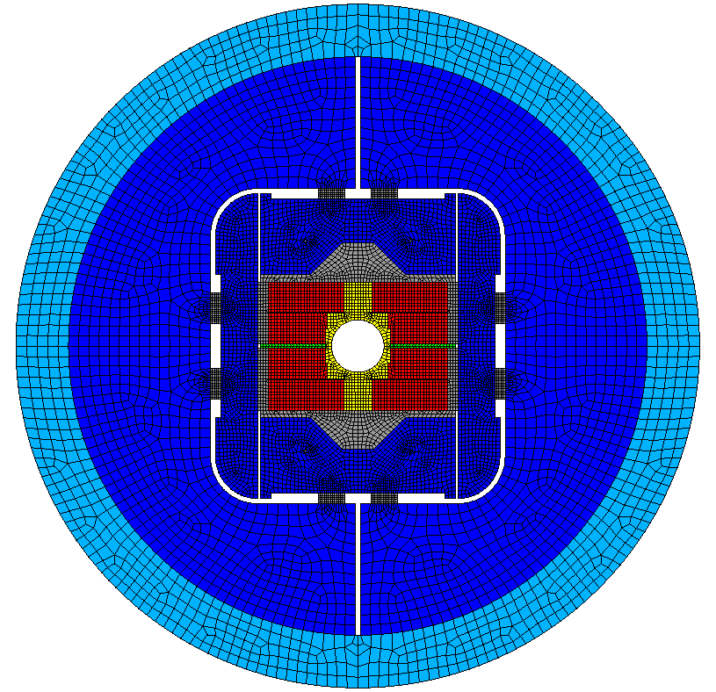
Magnet at ease

Slide 14
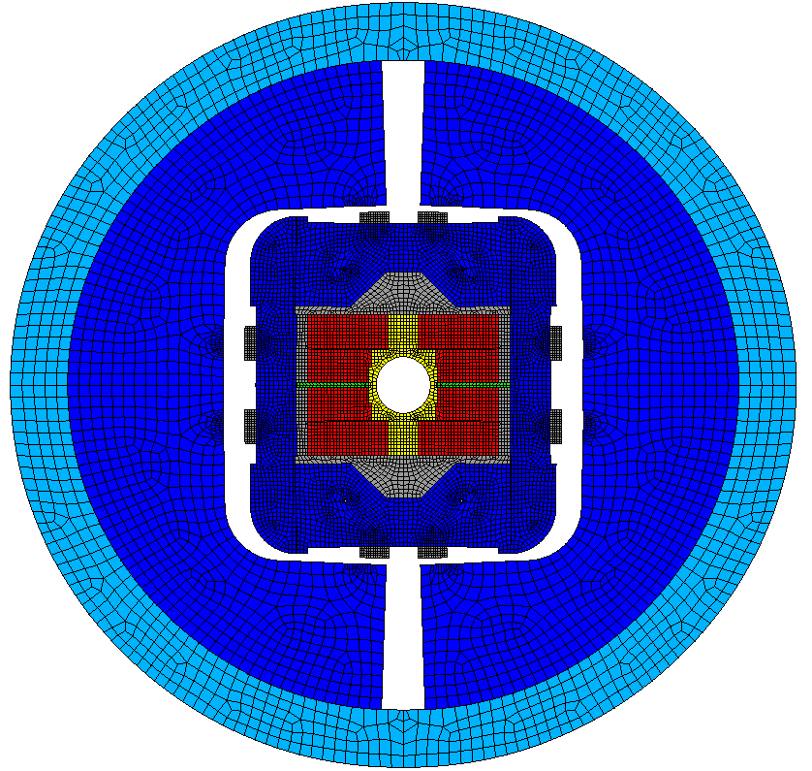
Bladder inflation
Not simulated so far, estimated only

Slide 15
Key insertion
σ_{x}

Slide 16
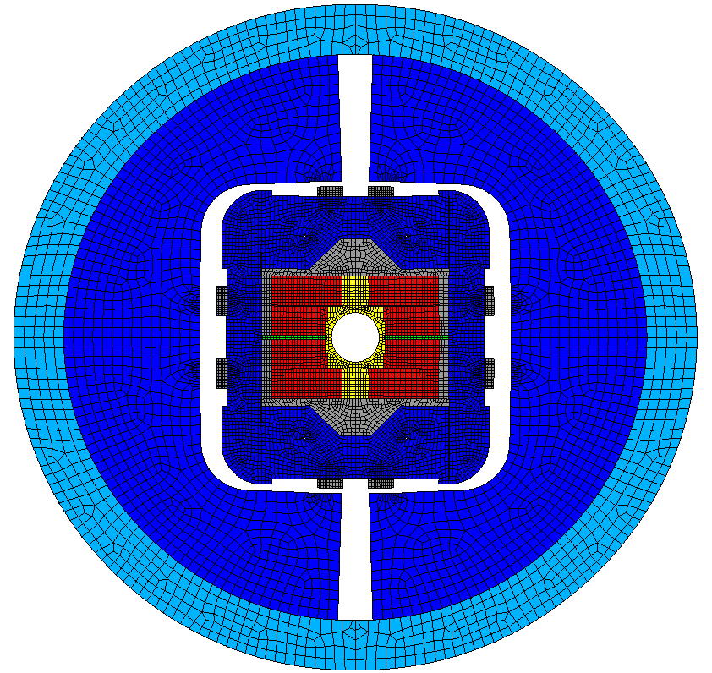
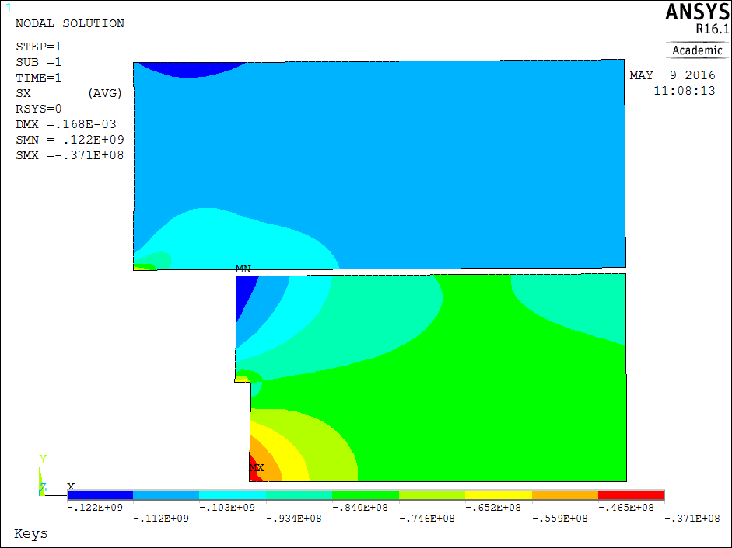
Spring back
σ_{x}
↓ Horizontal key: nominal + 150 µm
← Vertical key: nominal + 1050 µm
scale: -122 MPa to -37 MPa

Slide 17
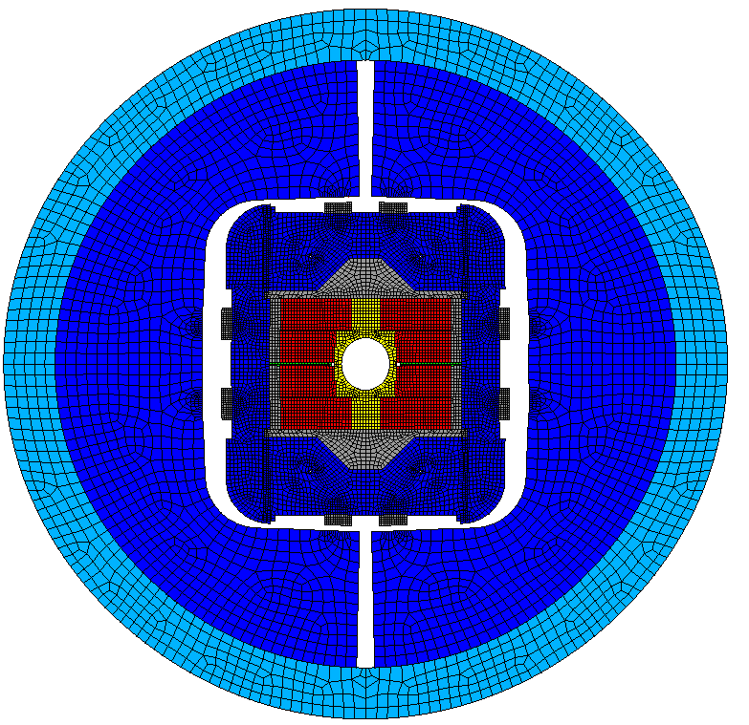
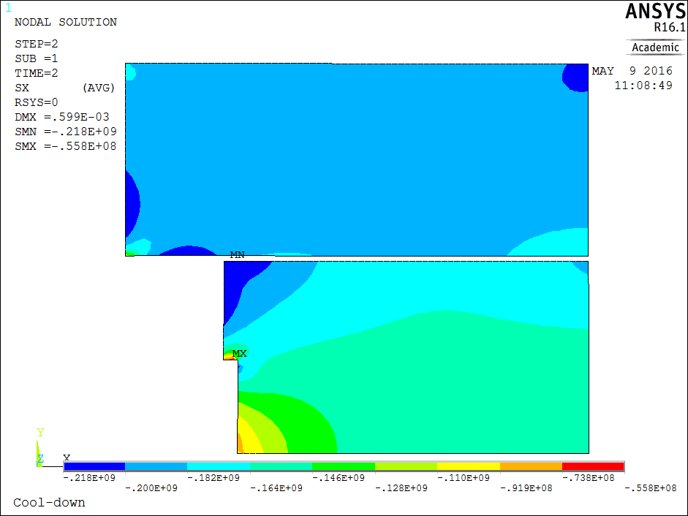
Cool-down
σ_{x}
Shell thickness: 50 mm
scale: -218 MPa to -56 MPa

Slide 18
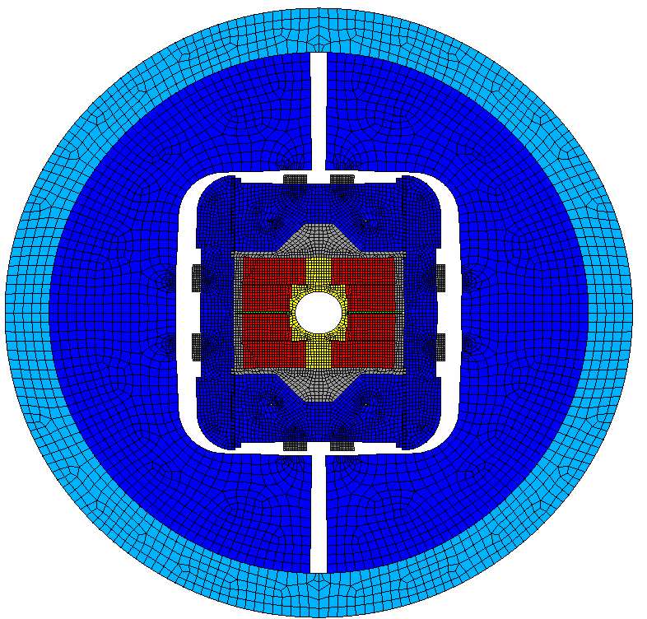
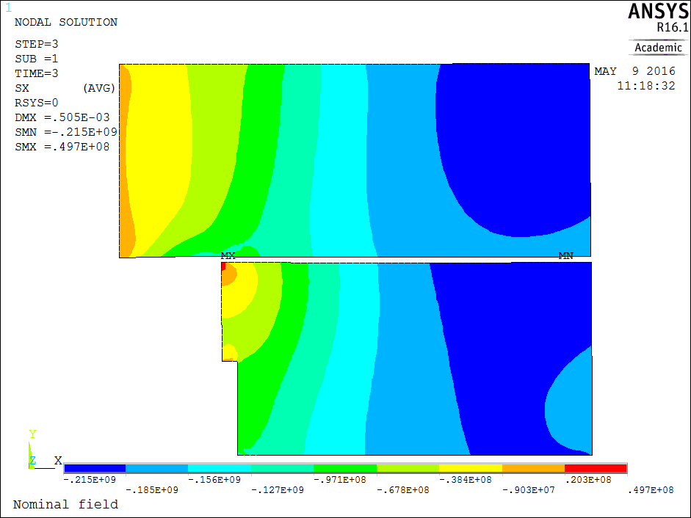
Powering to 105% (16.8 T)
σ_{x}
16.8 T
scale: -215 MPa to +50 MPa

Slide 19
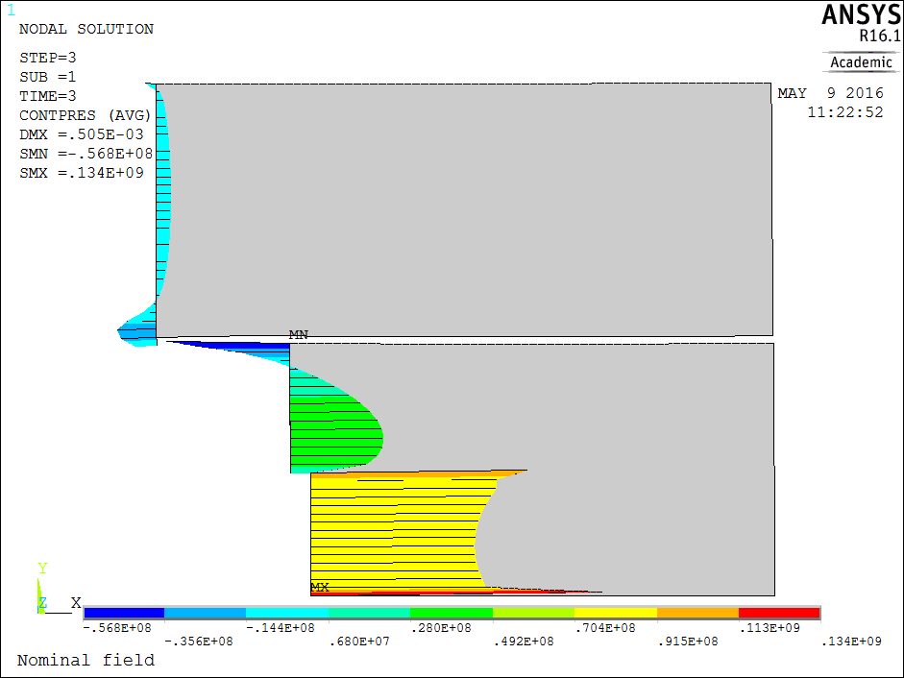
Contact coil-pole at 105 % (16.8T)
σ_{x}
16.8 T
Contact: 2 MPa in the middle of the cable
scale: -57 MPa to +134 MPa

Slide 20
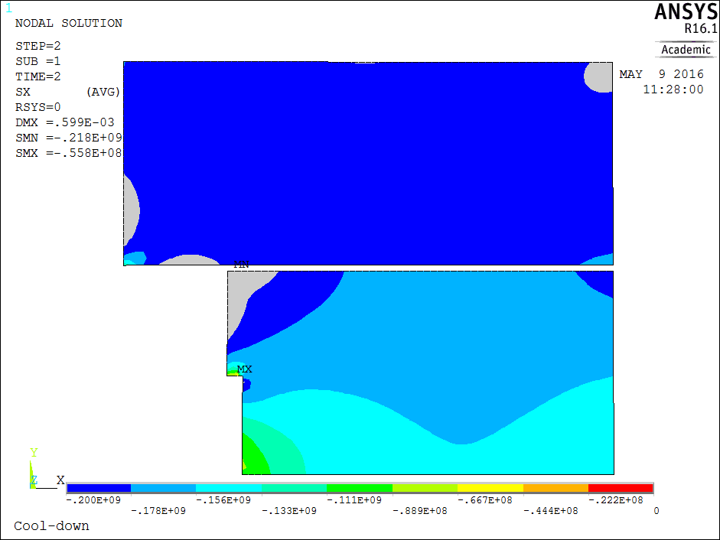
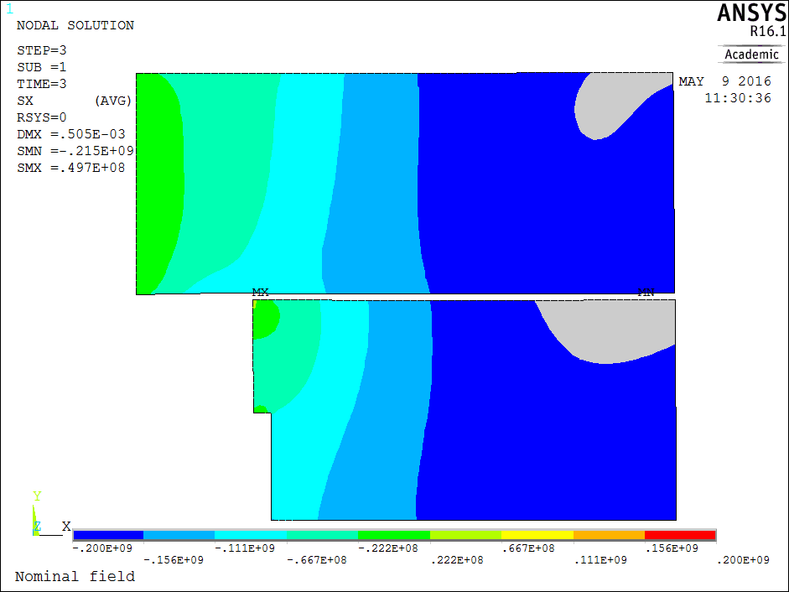
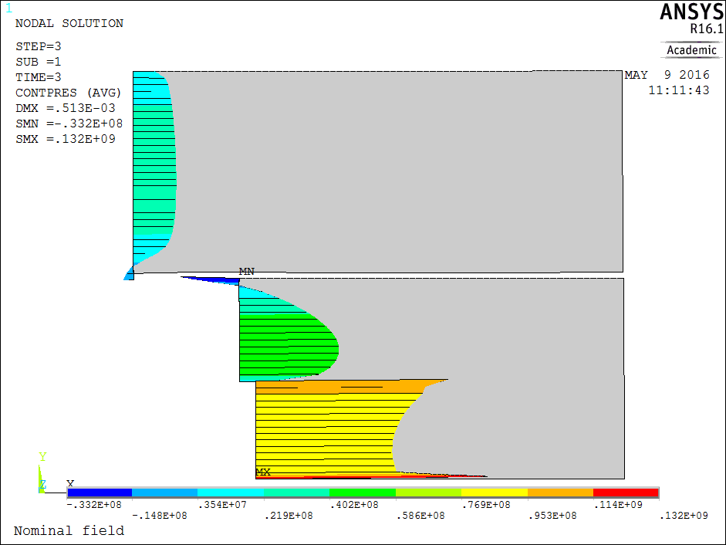
Summary for windings + contact
Key (bladder tbc)
Cool-down
Powering 105%
σ_{x}
σ_{x}
σ_{x}
Peak 218 MPa
Peak 215 MPa
Contact coil-pole 105%
Contact coil-pole 100%
scale: -57 MPa to +134 MPa
scale: -34 MPa to +132 MPa

Slide 21
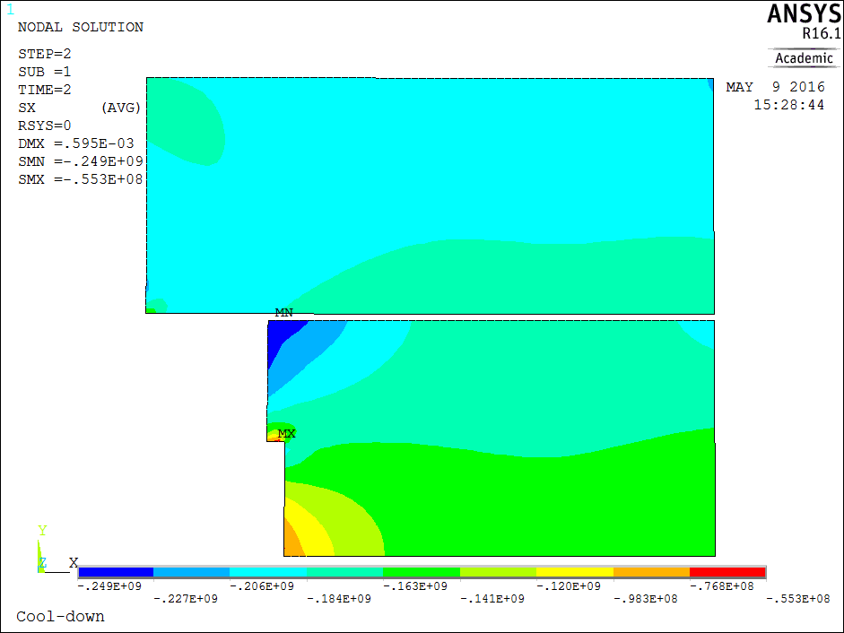


Pole slit
Initial pole
  249 MPa at cold
Pole with slit
  218 MPa at cold
Cool-down step: 4.2 K, 0 T
Cool-down step: 4.2 K, 0 T
pole slit to make the pole flexible and avoid too high peak stress in the coil

Slide 22
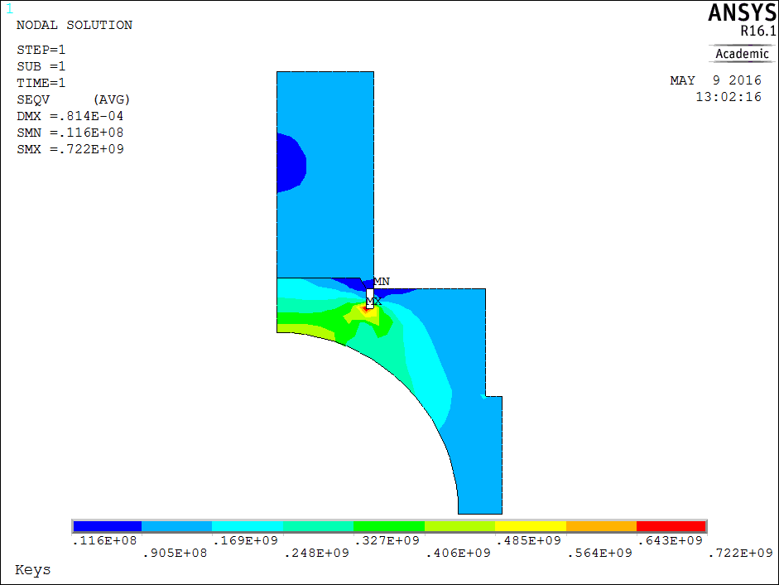
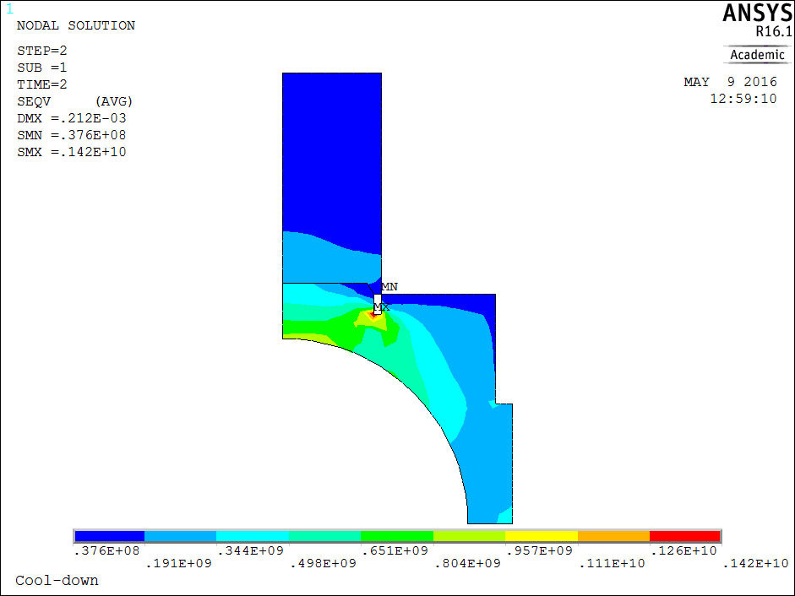
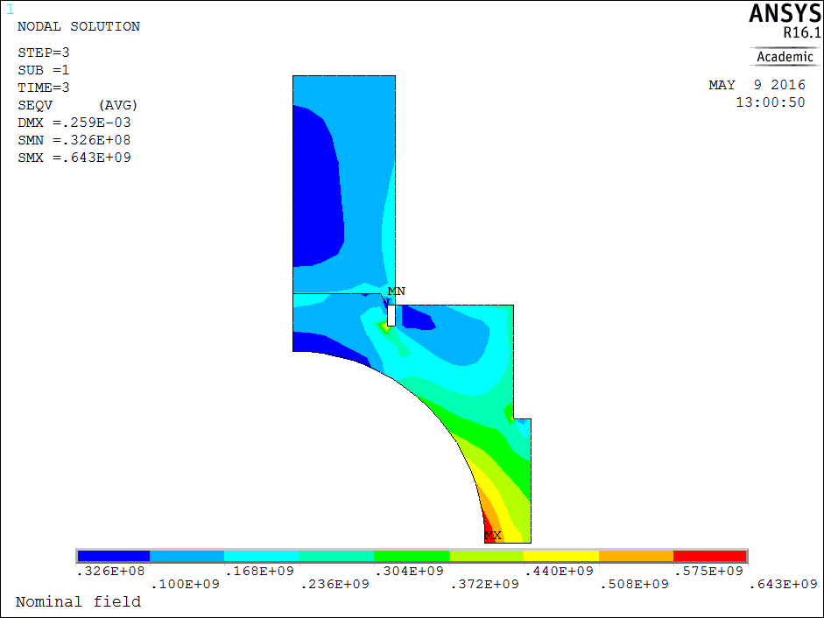
Mechanical structure (18 T)
von Mises stress
Key in
Cool-down
18 T
17 MPa to 722 MPa
38 MPa to 1420 MPa
33 MPa to 643 MPa
Material | R_{p 0.2} [MPa]
 | 293 K | 4.3 K
Ti 6Al 4V | 827 | 1654

Slide 23
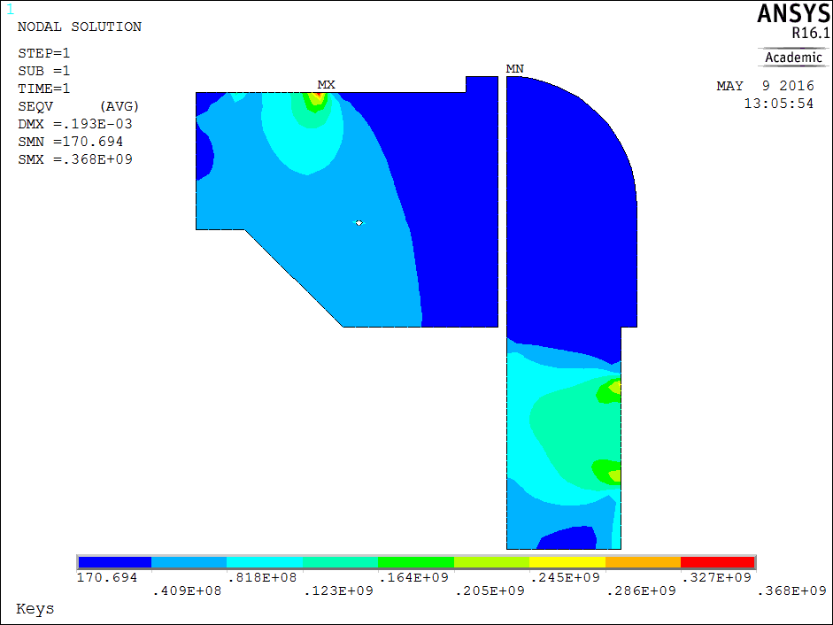
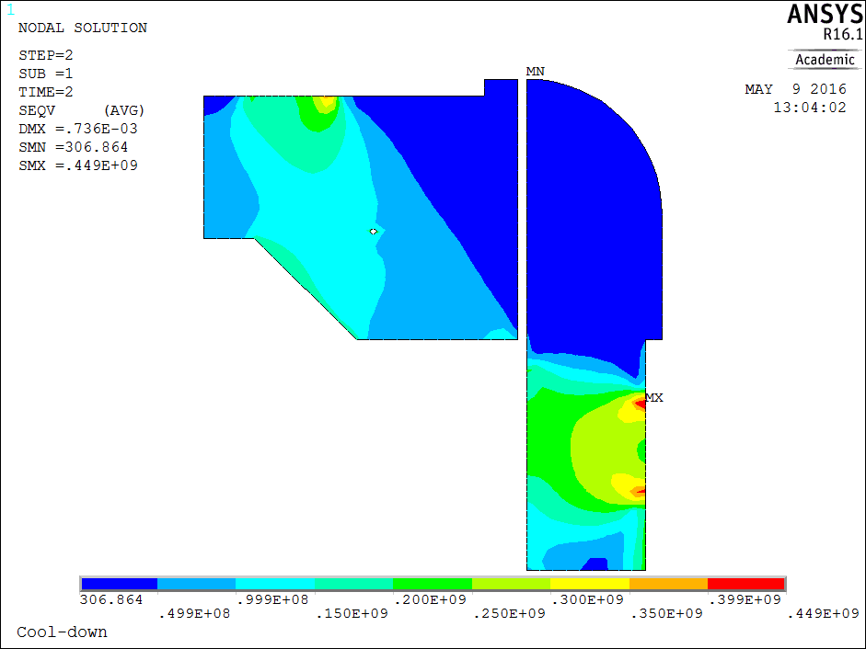
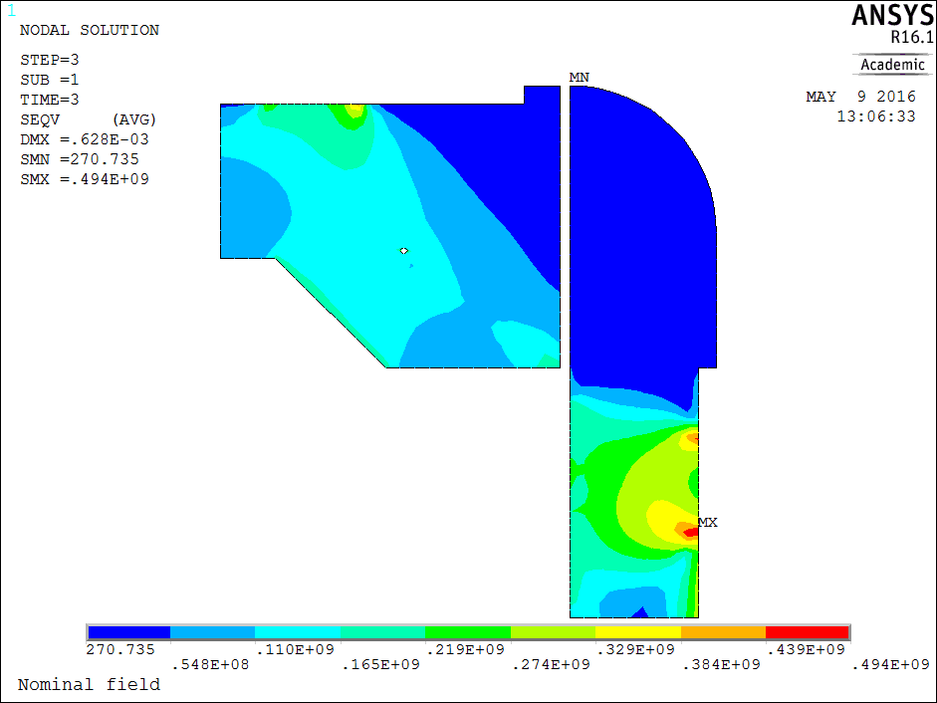
Mechanical structure (18 T)
Key in
Cool-down
18 T
0 MPa to 368 MPa
0 MPa to 450 MPa
0 MPa to 494 MPa
Material | R_{p 0.2} [MPa]
 | 293 K | 4.3 K
Magnetil | 180 | 723
Iron @ 4.2 K stress < 200 MPa in tension (brittle) ?

Slide 24
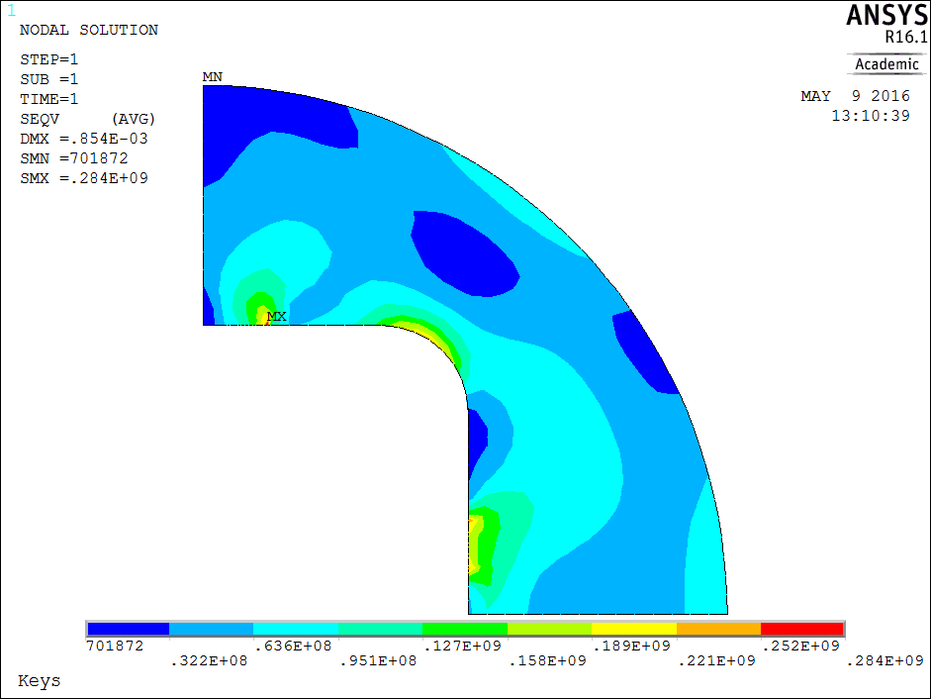
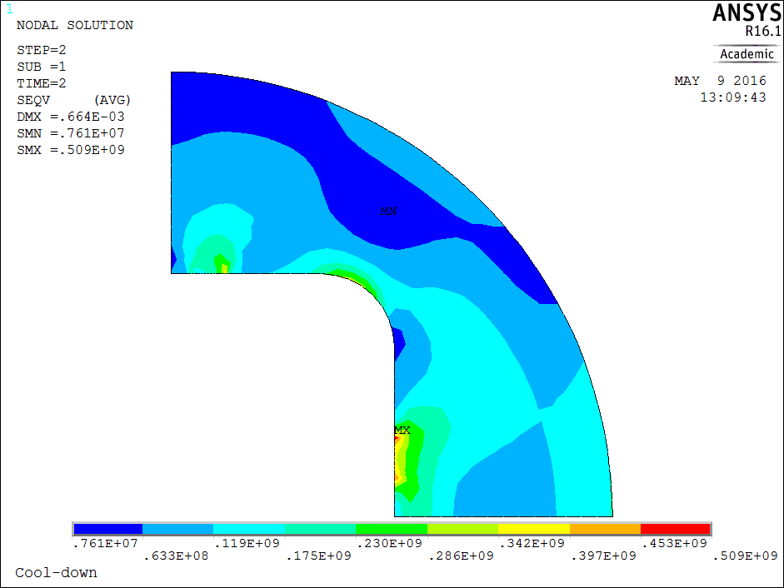
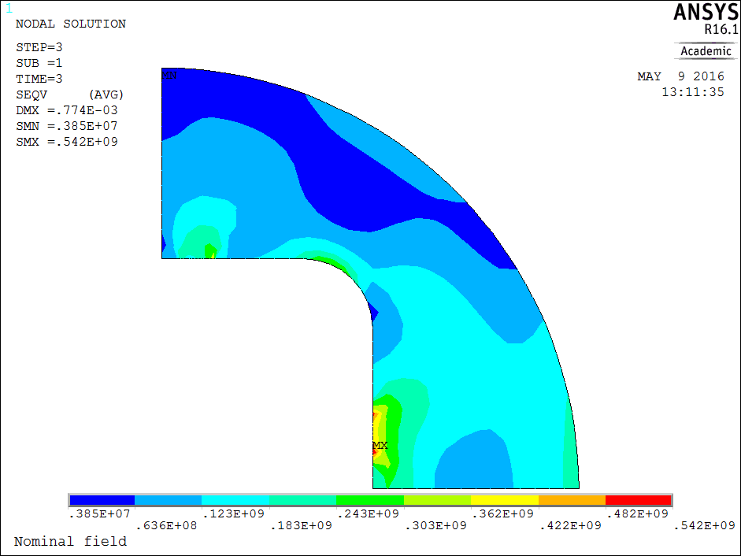
Mechanical structure (18 T)
Key in
Cool-down
18 T
0 MPa to 284 MPa
0 MPa to 509 MPa
0 MPa to 542 MPa
Material | R_{p 0.2} [MPa]
 | 293 K | 4.3 K
Magnetil | 180 | 723
Iron @ 4.2 K stress < 200 MPa in tension (brittle) « SSC », investigation on going at Cern

Slide 25
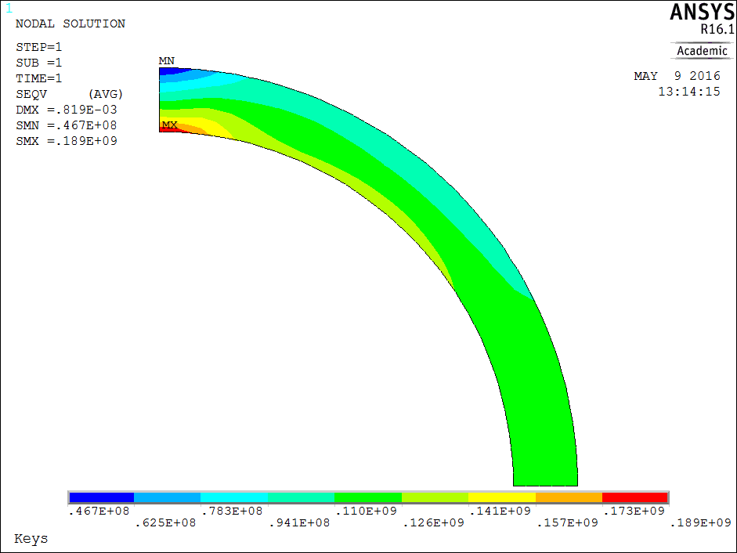
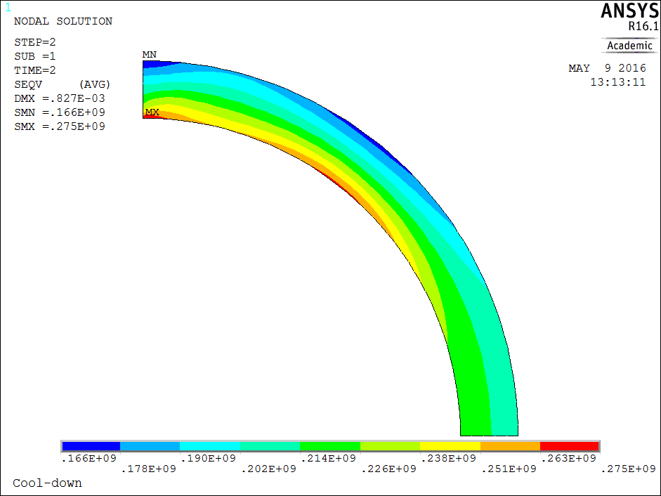

Mechanical structure (18 T)
Key in
Cool-down
18 T
0 MPa to 189 MPa
0 MPa to 275 MPa
0 MPa to 301 MPa
Material | R_{p 0.2} [MPa]
 | 293 K | 4.3 K
Al 7075 | 480 | 690

Slide 26
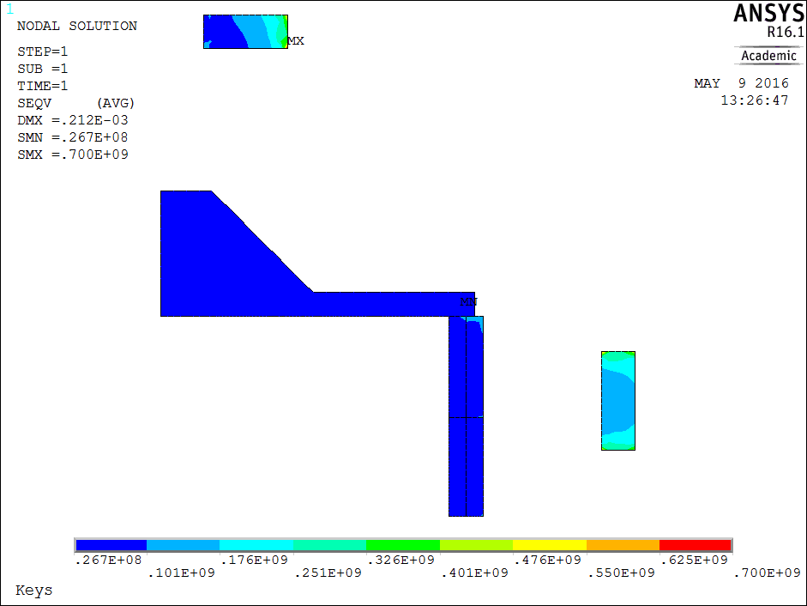
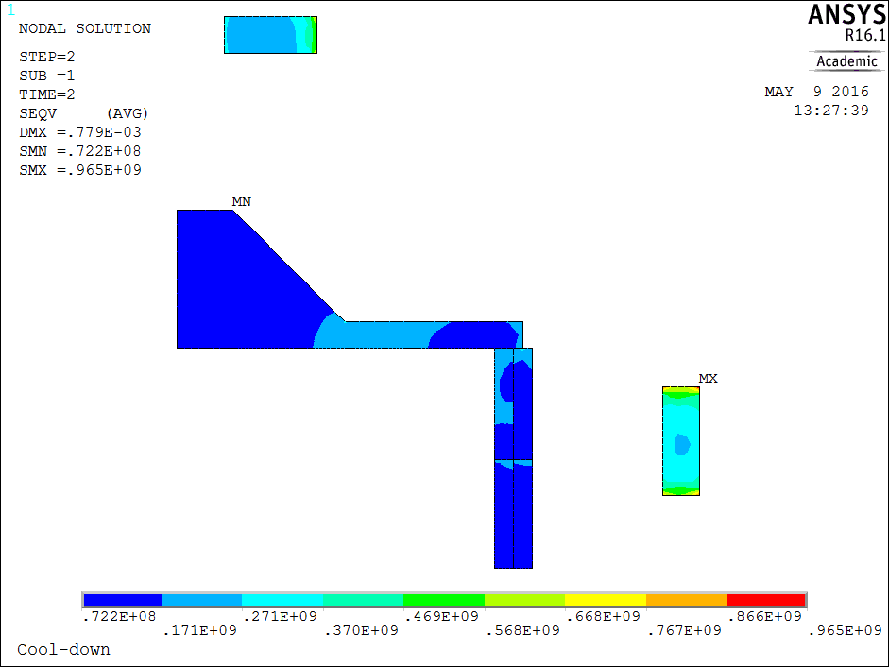
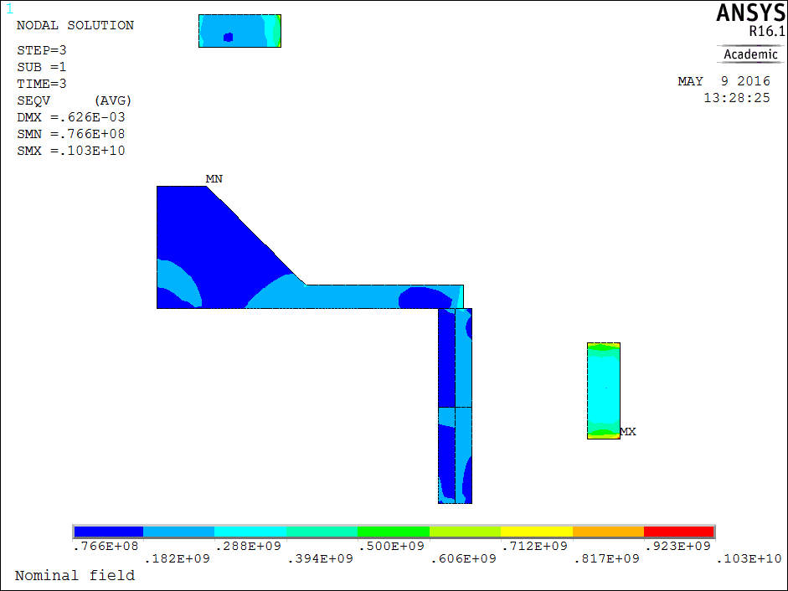
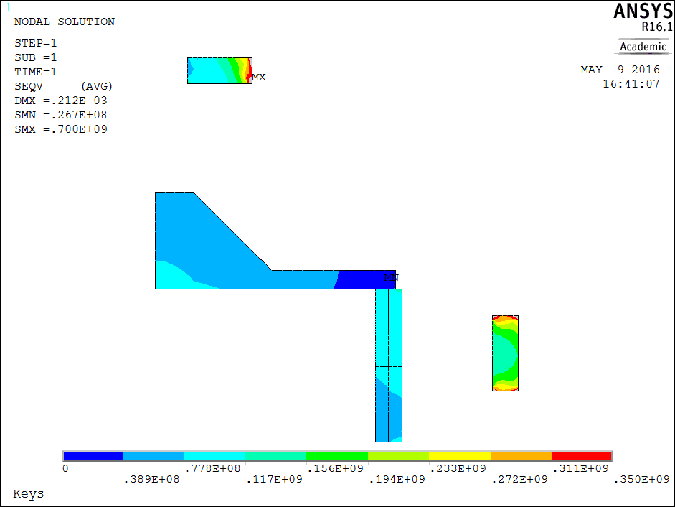
Mechanical structure (18 T)
Key in
Cool-down
18 T
0 MPa to 700 MPa
0 MPa to 965 MPa
0 MPa to 1030 MPa
Material | R_{p 0.2} [MPa]
 | 293 K | 4.3 K
SS 316 LN | 286 | 930
NITRONIC 40 | 353 | 1240
Key in

Slide 27
Peak stress in the structure
Von Mises max [MPa] | Material | Key in | Cool-down | 105% power
Pole | Ti6Al4V | 722 | 1420 | 643
Pads | Iron | 368 | 450 | 494
Pads | SS 316 LN | 121 | 298 | 386
Key | Nitronic40® | 760 | 965 | 1030
Yoke | Iron | 284 | 504 | 542
Shell | AL 7075 | 189 | 275 | 301
Material | R_{p 0.2} [MPa]
 | 293 K | 4.3 K
Al 7075 | 480 | 690
SS 316 LN | 286 | 930
NITRONIC 40 | 353 | 1240
MAGNETIL (IRON) | 180 | 723
Ti 6Al 4V | 827 | 1654
PAGE 25

Slide 28
Summary – single aperture
Bladder&key pre-stress method
Windings:
  Peak stress values up to 220 MPa
  Good contact up to nominal (100% powering)
  Contact degraded at 105% (still acceptable?)
Mechanical structure:
  Shell, pole in the yield stress limit
  Iron parts in tension need deeper investigation (200 MPa or more?) and better shaping

Slide 29
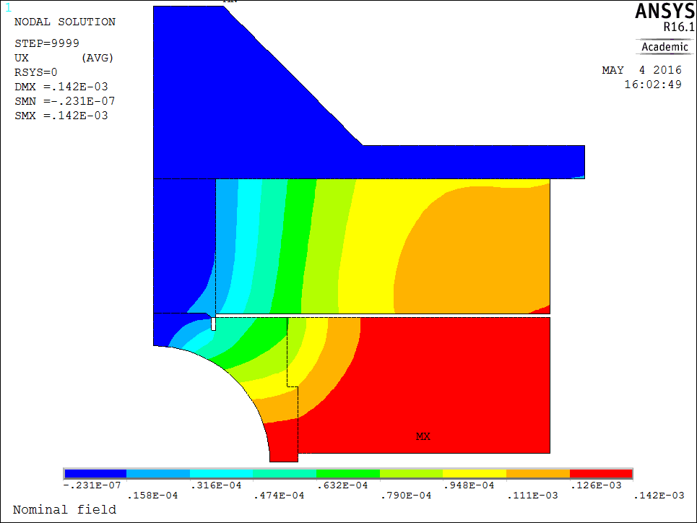
Extra
Relative x-displacement between CD and NF
NF – CD

Slide 30
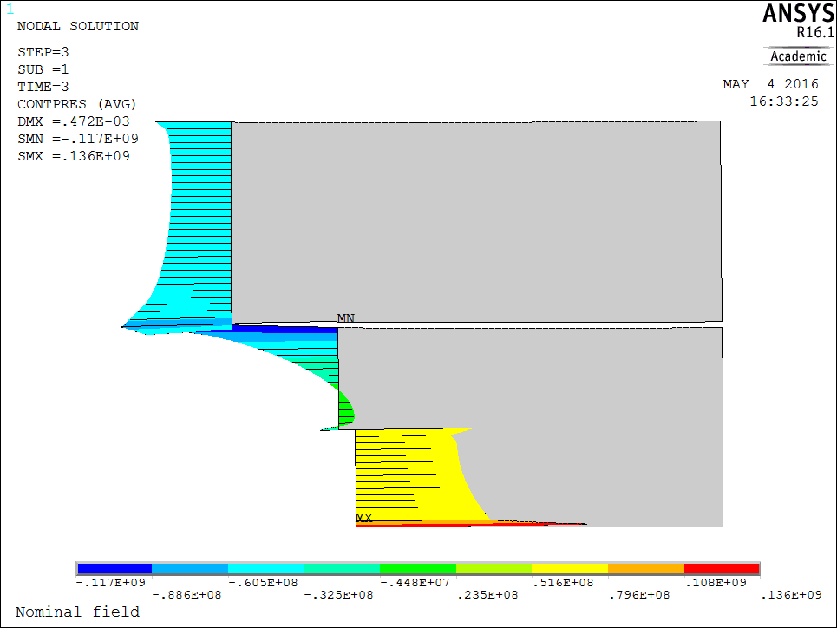
Contact at 18 T
18 T

