Slide 1




EuroCircol – The Cosine-theta Configuration:
Electromagnetic Design
Massimo Sorbi
on behalf of INFN team:
Giovanni Bellomo, Barbara Caiffi, Pasquale Fabbricatore,
Stefania Farinon, Vittorio Marinozzi, Giovanni Volpini
1st Review of EuroCirCol WP5 , CERN, 11-13 May 2016

Slide 2

Massimo Sorbi, 1st Review of EuroCirCol WP5 , 11-13 May 2016
Outline:
  Main design parameters
  Magnetic design
  Protection
  Some considerations
  Conclusions

Slide 3
Massimo Sorbi, 1st Review of EuroCirCol WP5 , 11-13 May 2016
1.1 Main design parameters
Constraints for the magnet design
Bore inner diameter | 50 mm
Beam distance | 250 mm
Bore nominal field | 16 T
Operating temperature | 4.2 K
Operation point on the load line | 90 %
Maximum strand number per cable | 40
Cable insulation thickness | 0.15 mm
Cu/NCu | ≥1
Field harmonics (geometric/saturation) | ≤3/10 units
Peak temperature (105 % of operating current) | 350 K
Yoke outer radius | 400 mm
Maximum voltage to ground | 2 kV
1.9 K
Magnetic design for a double aperture magnet
Mechanical design for a single aperture magnet

Slide 4
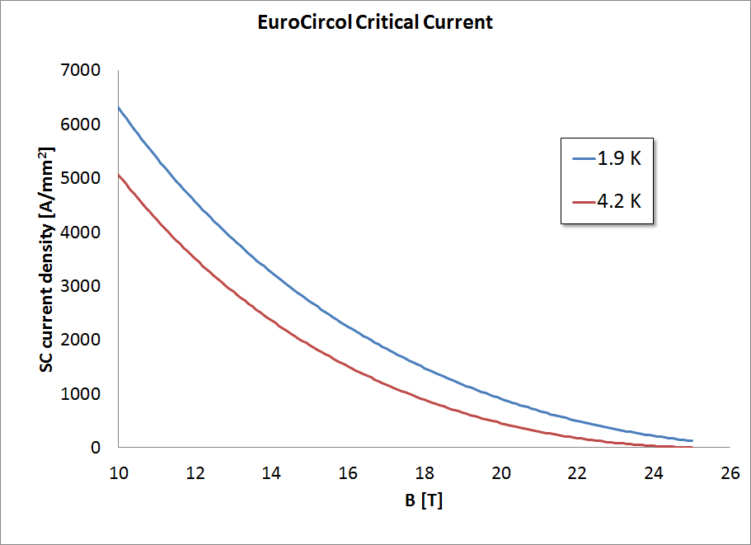
Massimo Sorbi, 1st Review of EuroCirCol WP5 , 11-13 May 2016
1.2 Main design parameters
Jc @ 16T, 1.9 K
~2250 A/mm²
Jc @ 16T, 4.2 K
~1500 A/mm²
Jc @ 18T, 4.2 K
~890 A/mm²
Jc @ 18T, 1.9 K
~1500 A/mm²

Slide 5
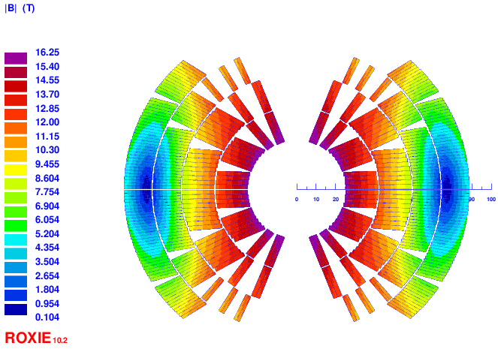
Massimo Sorbi, 1st Review of EuroCirCol WP5 , 11-13 May 2016
B peak
16.3 T (with strand ’’self-field’’)
Main characteristics:
2 double-pancakes
2 conductor size
Splitting of pole blocks to decrease peak-field
Turn number:
Layer 1: 14
Layer 2: 21
Layer 3: 37
Layer 4: 43
Tot: 230/ap.
high-field cond.
low-field cond.

Slide 6
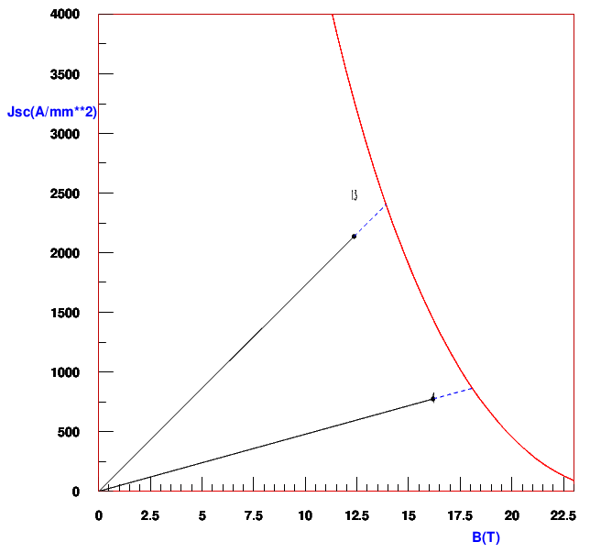
Massimo Sorbi, 1st Review of EuroCirCol WP5 , 11-13 May 2016
2.1 Magnetic design – cross section
2
1
4.2 K
All the parameters are within the constraints
2
1
 | Cable 1 (inner) | Cable 2 (outer)
Strand number | 28 | 38
Strand diameter | 1.1 mm | 0.7 mm
Bare width | 16.5 mm | 14 mm
Bare inner thickness | 1.892 mm | 1.204 mm
Bare outer thickness | 2.036 mm | 1.326 mm
Insulation | 0.15 mm | 0.15 mm
Keystone angle | 0.5° | 0.5°
Cu/NCu | 1.0 | 2.0
Operating current | 10275 A | 10275 A
Operating point on LL (4.2 K) | 90% | 90%
Operating point on LL (1.9 K) | 82.0% | 82.4 %
including the ’’self-field’’

Slide 7
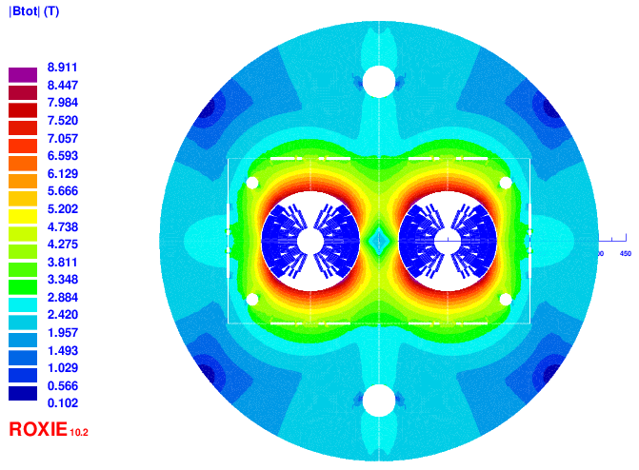
Massimo Sorbi, 1st Review of EuroCirCol WP5 , 11-13 May 2016
2.2 Magnetic design – iron yoke
Bladder & key
Inductance@I_{op} (1 ap) | Stored energy (1 ap)
25 mH/m | 1.5 MJ/m

Slide 8
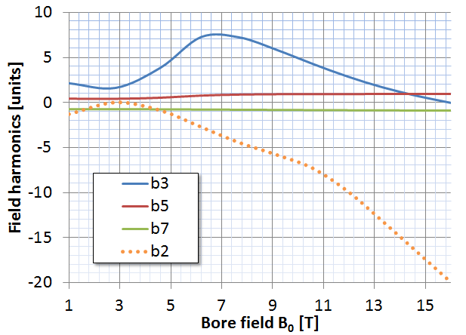
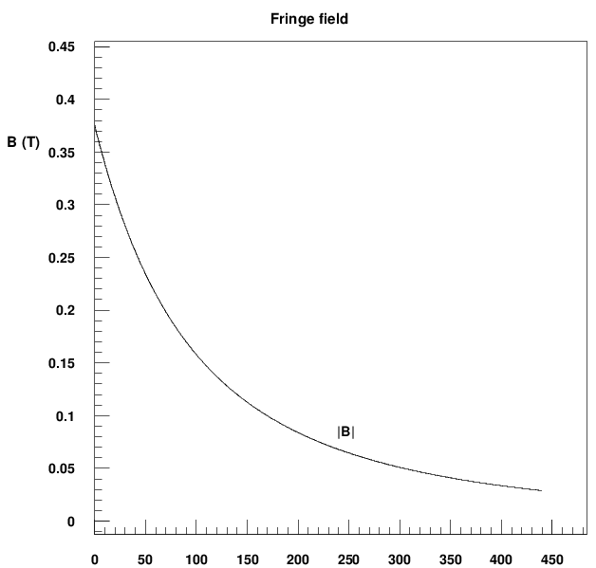
Massimo Sorbi, 1st Review of EuroCirCol WP5 , 11-13 May 2016
2.3 Magnetic design – field quality
b2 optimization not performed
Persistent currents not considered
NORMAL RELATIVE MULTIPOLES @ 16 T:
b 1: 10000 b 2: -19.94 b 3: -0.01
b 4: -0.49 b 5: 0.97 b 6: -0.01
b 7: -0.87 b 8: -0.00 b 9: 0.28
b10: 0.00 b11: 0.66 b12: 0.00
b13: -0.13 b14: 0.00 b15: 0.03
Fringing field < 0.1 T at 200 mm from yoke

Slide 9
Massimo Sorbi, 1st Review of EuroCirCol WP5 , 11-13 May 2016
2.4 Magnetic design – strand area
High Cu content
for protection reasons!
Conductor 1:
28 strands
∅ = 1.1 mm
Cu/NCu = 1
J_{cu} = 772 A/mm²
Strand Area = 37.3 cm²/apert.
Weight (FCC) = 4.3 ktons
Conductor 2
38 strands
∅ = 0.7 mm
Cu/NCu = 2.0
J_{cu} = 1047 A/mm²
Strand Area= 46.8 cm²/apert.
Weight (FCC) = 5.3 ktons
COND. AREA (double ap.): = 168.1 cm²
FCC-hh dipoles:
COND. MASS: = 9.6 ktons
Data for FCC-hh collider
Number of dipole units | 4578
Dipole lenght | 14.3 m
Conductor density | 8.7 kg/dm³

Slide 10
Massimo Sorbi, 1st Review of EuroCirCol WP5 , 11-13 May 2016
2.5 Magnetic design – strand area
Option to reduce cost
Conductor 2
25 (SC)+13 (Cu) strands
∅ = 0.7 mm
Cu/NCu = 1
J_{cu} = 1047 A/mm²
Strand Area (SC)= 30.7 cm²/apert.
Strand Area (Pure Cu) = 16.0 cm²/apert.
SC weight (FCC) = 3.50 ktons
Pure Cu weight (FCC) = 0.75 ktons
Pure Cu cost << SC cost
Stability as in cable 1 (Cu/NCu = 1)
Current diffusion time in the Cu strands to be evaluated and compared with discharge time
  Zero order evaluation seems ok (few ms)
TOTAL SC STRANDS: = 9.6 7.8 ktons

Slide 11
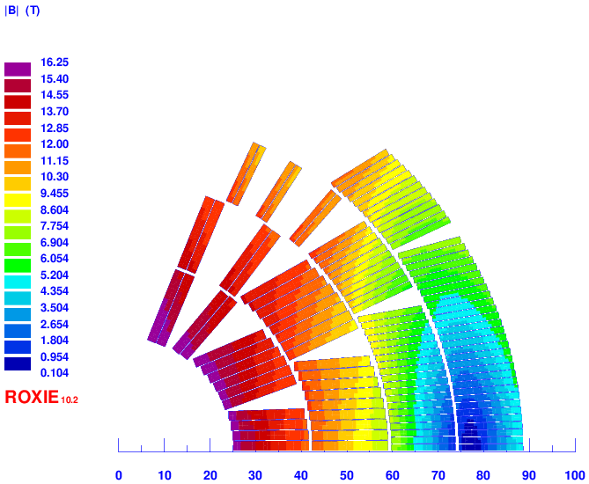

Massimo Sorbi, 1st Review of EuroCirCol WP5 , 11-13 May 2016
3.1 Protection
Simulations from Coodi (Tiina Salmi)
Main assumptions:
  No energy extraction
  Quench induced in the whole magnet 40 ms after initial quench start
  Inductance dependence on the current
  Material properties from NIST
Results (105 % of I_{op}):
  Hot spot temperature: ~330 K
  Maximum voltage to ground: ~1400 V
More details in the Tiina Salmi talk

Slide 12
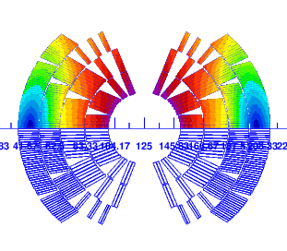
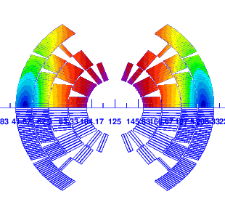
Massimo Sorbi, 1st Review of EuroCirCol WP5 , 11-13 May 2016
4.1 Other considerations
Similar configurations are possible:
    same conductor area but different turn number distribution on layers
    possible to re-distribute the Lorentz forces or reduce number of blocks
The minimum curvature radius of high-field conductor
(∅ = 1.1 mm) is 6.3 mm (in LHC dipole is 7.3 mm with
∅ = 1.07 mm )
The present configurations have been optimized in order to minimize the conductor area (inside the general constrains)
Important limitations come from protection constrains (40 ms delay & T_{max} < 350 K ⇒ Cu/NCu = 2.0 L.F. cond.)

Slide 13
Massimo Sorbi, 1st Review of EuroCirCol WP5 , 11-13 May 2016
5.1 Conclusions
The presented 16 T cosine-theta accomplishes the Eurocircol design constraints
  Operating point on the load-line is 90% at 4.2 K → 82% at 1.9 K
  Good field quality
  Hot spot temperature 330 K @ 105% I_{op}
cosine-theta advantage: less conductor area, less costs
  168.1 cm² (total 9.6 ktons) → 136.0 cm² (total 7.8 ktons)
5.2 Critical aspects
Maximum voltage during discharge (see section on protection study). Possible cure:
  Decrease turn number and increase current (both decreasing the margin and increasing the conductor strands n. to > 40)
  Increase the subdivision of the layers to better mix high field region (resistive) with low field region (inductive) → increase the number double pancake

