Slide 1



Quench protection
of the 16T dipoles for the FCC
Tiina Salmi and Antti Stenvall,
Tampere University of technology, Finland
Marco Prioli, CERN
In collaboration with EuroCirCol wp 5 members (CERN, CEA, INFN, CIEMAT)
1st EuroCirCol review
CERN, May 12th , 2016

Slide 2

How to design 16 T dipoles that can be protected?
And keep the magnets as compact as possible.
Quench protection analysis was integrated into the magnet design:
Quench protection system and its efficiency
Hotspot temperature and internal voltages
Quench in a designed manget
2
Assumptions
3
Tools for the analysis
1
Assumptions of safe values
The designed magnet is not impossible to protect
4
Notes:
Iteration of the assumptions

Slide 3
1. Assumptions about the safe temperatures and voltages
Maximum allowed hotspot temperature: 350 K
  Same reference than HiLumi: Based on experiments with LARP Nb₃Sn magnets, and epoxy transition temperature (~380 K).
Note: Need more experiments with cored cables to confirm this.
(G. Ambrosio, WAMSDO 2013.)
  Computed from MIITs (adiabatic)
Maximum voltages inside the coil: 2 kV
  Design choice, based on insulation thickness .
Impact of thermal gradients still to be analyzed – for now no set limitations

Slide 4
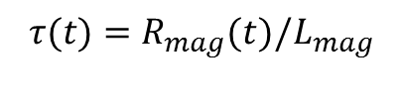
2. Assumptions about the protection system
Quench detection by measuring the resistive voltage
  Assumed detection delay = 20 ms (includes validation + switches’ delay)
  Based on the LHC experience
Quenching magnet by-passed using a diode, like in LHC:
Protection by either quench heaters or/and CLIQ, which quench the coil and drive the current decay
  Quench delays were estimated based on improved HiLumi heater-technology (to get the first assumption for the protection efficiency)
L_{mag}(I)
R_{mag}(t)
Notes:
The simulations were done using CoHDA, and with various assumptions. Details in the appendix. Preliminary analysis has shown that CLIQ may be faster, so in this sense this errors on the safe side.

Slide 5
2. Obtainable quench delay
Assuming HiLumi heater technology applied to FCC dipole
  Stainless steel strip heaters insulated from the coil by polyimide
  Assumed improvement: All coil surface can be covered
Heater delay simulations using CoHDA
Case A: Optimistic: 150 W/cm² peak power, 50 µm polyimide
Case B: Less optimistic: 50 W/cm² peak power, 100 µm polyimide
  Average delay ~20 ms (at Inom)
Notes:
The simulations were done using CoHDA, and with various assumptions. Details in the appendix. Preliminary analysis has shown that CLIQ may be faster, so in this sense this errors on the safe side.

Slide 6
2. Obtainable quench delay
Assuming HiLumi heater technology applied to FCC dipole
  Stainless steel strip heaters insulated from the coil by polyimide
  Assumed improvement: All coil surface can be covered
Heater delay simulations using CoHDA
  The design requirement: If the magnet is completely resistive 40 ms after the initial quench, the peak temperature must be below 350 K at 105% of Iop
Time margin - see E. Todesco, proc. WAMSDO 2013
  Average delay ~20 ms (at Inom)
Notes:
The simulations were done using CoHDA, and with various assumptions. Details in the appendix. Preliminary analysis has shown that CLIQ may be faster, so in this sense this errors on the safe side.

Slide 7

3. Methods and tools for quench analysis
Two new tools developed for fast feedback during the magnet design
  ”Temperature calculation work sheet” and ”Coodi”
Both use adiabatic temperature calculation
  In the spreadsheet discretization in block level, in Coodi cable level
Cable current from SC to Cu at t = total protection delay (input)
Material propersties from NIST (T and B dependence accounted)
    Cable heat capacity includes the cable insulation and voids (G10)
No heat diffusion
Magnetic field map and inductance from ROXIE
Cable temp. Increase during a time step (in K)
The heating energy during one time step (in J/m³)
The heating power when all Imag flows in Cu
Cable specific heat (in J/(Km³))
Notes:
The simulations were done using CoHDA, and with various assumptions. Details in the appendix.

Slide 8


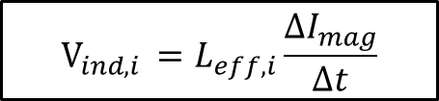
3. Calculation of voltages (only in Coodi)
1. Total voltage computed is at each turn:
A sum of resistive and inductive component.
The turn resistance is based on the Cu resistivity and area and turn length.
V2
V3
V1
The ”effective inductance” accounts the turn self inductance and the mutual inductances with the other turns.
R2
R4
R3
R1
Notes:
The simulations were done using CoHDA, and with various assumptions. Details in the appendix.

Slide 9
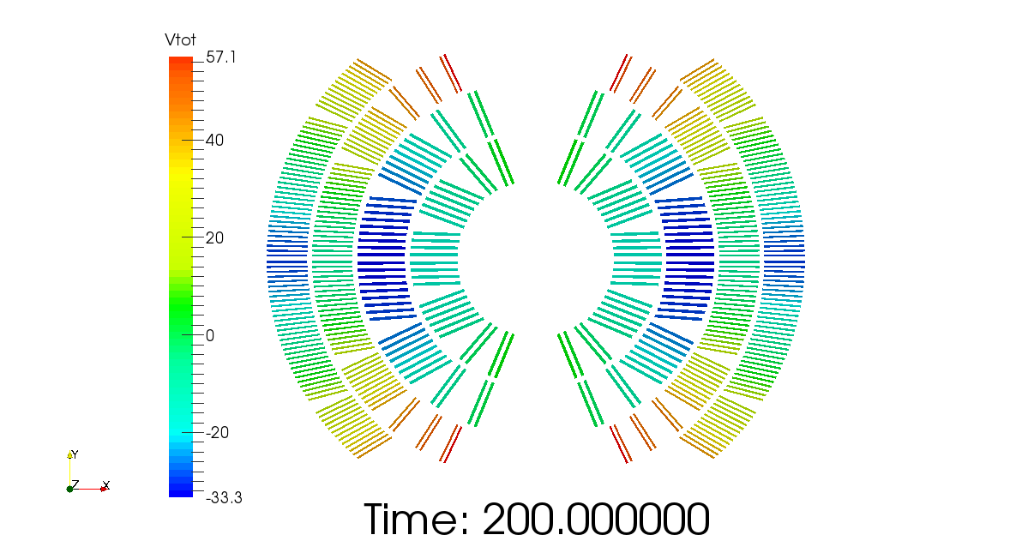
V_{tot,turn} (V)
3. Calculation of voltages (only in Coodi)
2. Potential to ground is obtained by summing the turn voltages (in the order of current flow).
U3 = V1+V2+V3
V_{tot,turn} (V)
IN
U1 = V1
V2
V3
V1
OUT
U2 = V1+V2
0 V (gnd)
Notes:
The simulations were done using CoHDA, and with various assumptions. Details in the appendix.

Slide 10
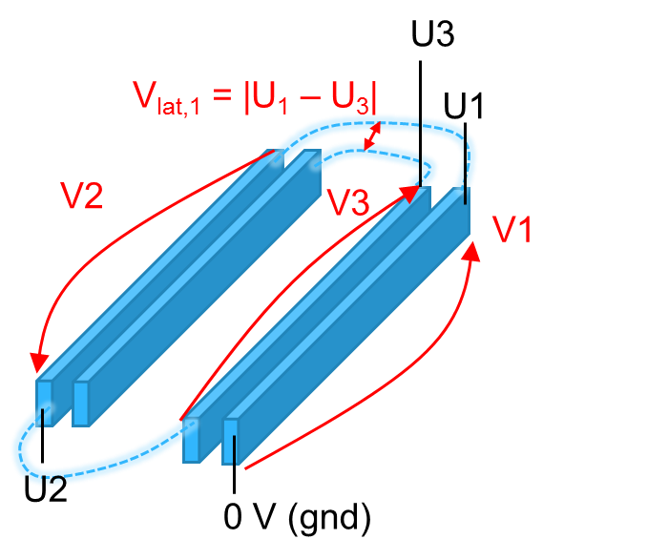
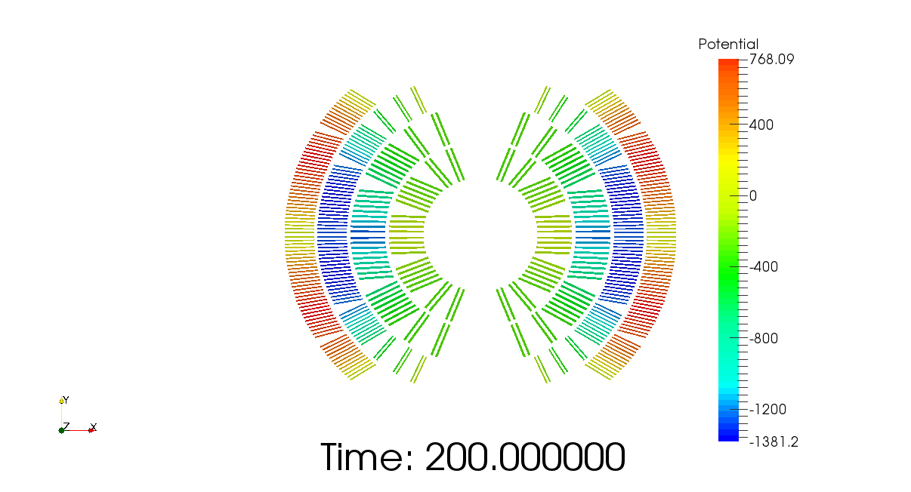
V_{tot,turn} (V)
3. Calculation of voltages (only in coodi)
3. Critical peak values are defined from the potential:
Voltage to ground
Voltage between layers
Voltage between turns
Notes:
The simulations were done using CoHDA, and with various assumptions. Details in the appendix.

Slide 11
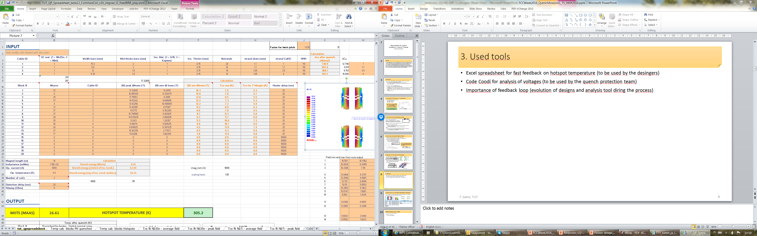
Cable parameters
Tcs calculated based on the agreed Jc-fit.
Coil blocks: #of turns, cable, field
”heater” delay
Iop, induct., det. delay, ..
OUTPUT: Worst case hotspot
- updates in seconds when changing the input.
T. Salmi, TUT
Notes:
Heater delay is a general quench delay that could be also for an other method
Tcs calculated based on the fits agreed within the group
The hotstpot temperature calculation is in the other tabs. Here is shown the result. It updates in a few seconds after changing an input parameter.
If you could scrol down it show a plot of the current decay and the temperature in each block vs. time.
Hotspot is reported for the worst case. The location is indicated below (the block wher it happens).

Slide 12
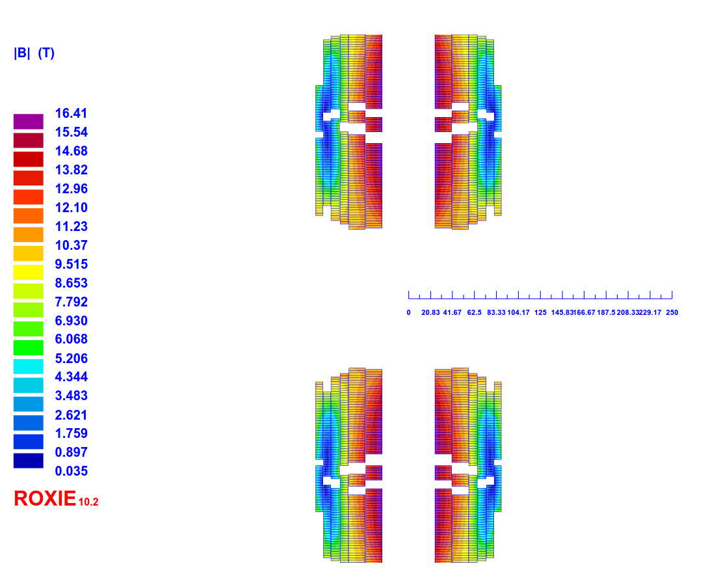
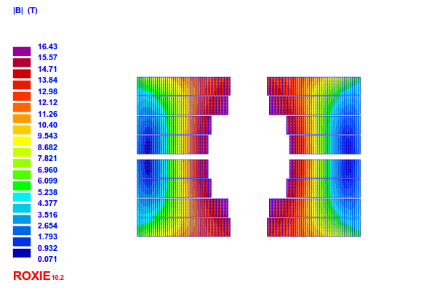
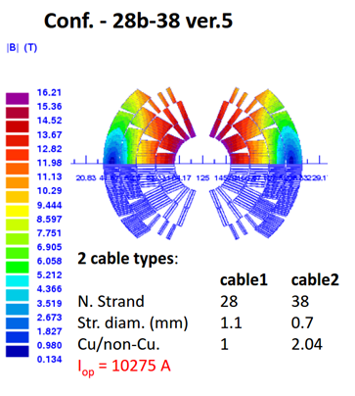
4. Analysis of the designed magnets
Design, cable | A_{ins.} (mm²) | f_{Cu} | F_{Nb3Sn} | f_{G10}
Block, 1 (HF) | 32.5 | 0.36 | 0.36 | 0.27
Block, 2 (LF) | 21.9 | 0.34 | 0.34 | 0.33
Cosθ, 1 (HF) | 38.0 | 0.36 | 0.36 | 0.28
Cosθ, 2 (LF) | 22.4 | 0.45 | 0.22 | 0.32
CC, 1 (HF) | 33.9 | 0.36 | 0.36 | 0.29
CC, 2 (HMF) | 23.2 | 0.43 | 0.25 | 0.32
CC, 3 (LMF) | 19.0 | 0.51 | 0.15 | 0.34
CC, 4 (LF) | 19.0 | 0.53 | 0.13 | 0.34
Block
(v26_b)
CommonC (v1h_intragrad_t2)
CosT
(16T_v28b-38-opt5d)
 | I_{mag,nom} (A) | L (mH/m)
Block | 8440 | 42.5 x 2
Cosθ | 10275 | 26.0 x 2
CommonC | 9000 | 110

Slide 13
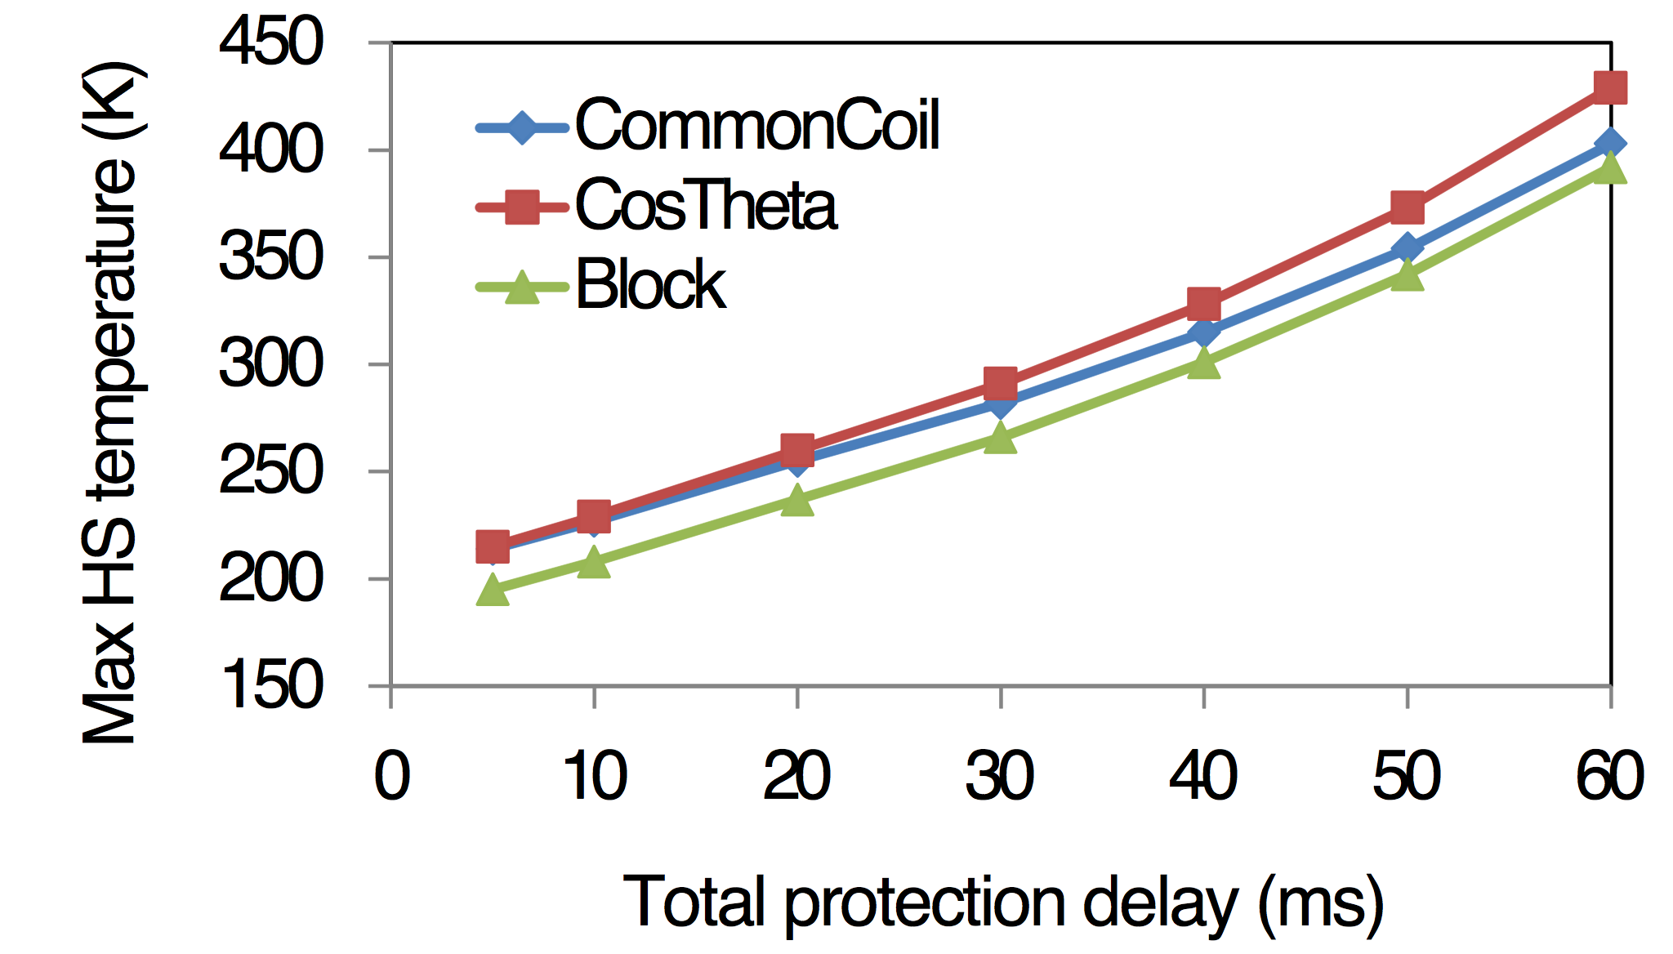
4. Simulated hotspot temperatures assuming uniform protection delay
All the coil resistive after the protection delay
  Assume worst-case location for hotspot
All designs valid from hotspot temperature point of view (< 350 K with 40 ms protection delay).
105% of Iop

Slide 14
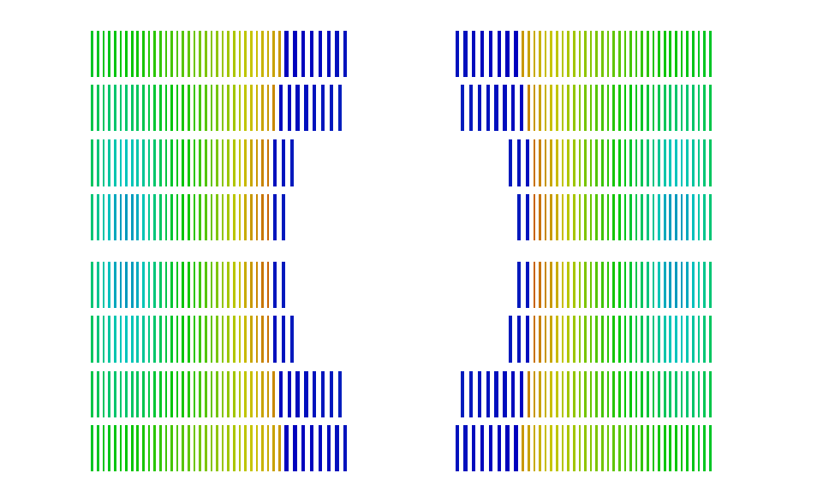
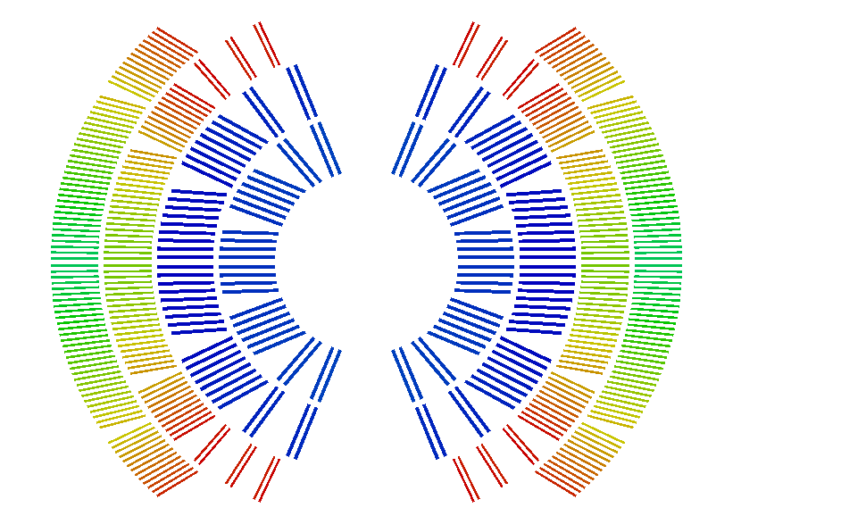
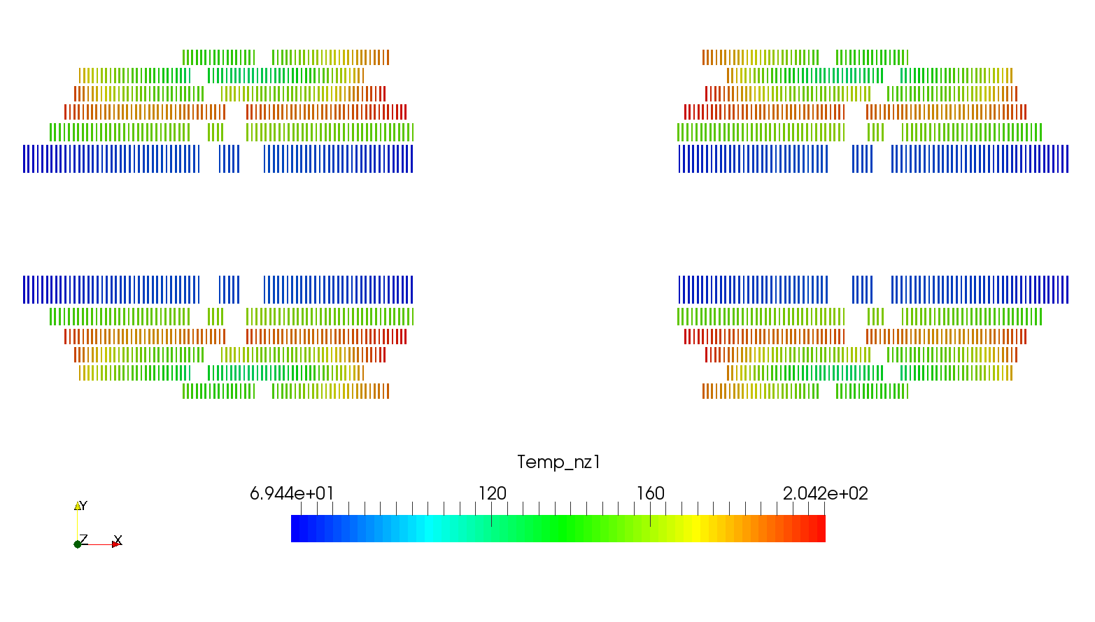
Simulated temperature distributions
(40 ms uniform quench delay)
Final temperature (K)
70
200
Notes:
The simulations were done using CoHDA, and with various assumptions. Details in the appendix. Preliminary analysis has shown that CLIQ may be faster, so in this sense this errors on the safe side.

Slide 15
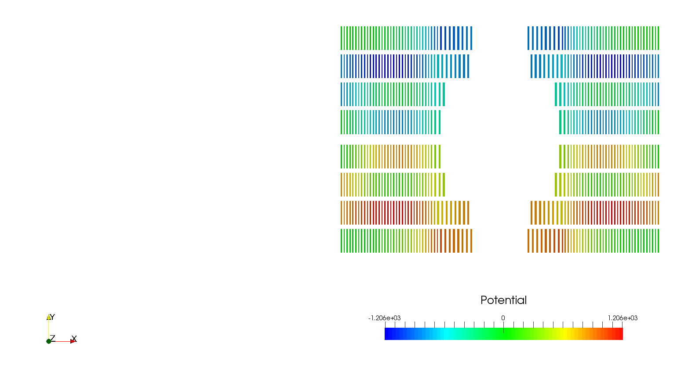
Simulated potential to ground
Peak potential to ground ~160 ms
82 V btw adj. turns
-1.2 kV to gnd
1.1 kV btw layers
+1.2 kV to gnd
(V)
-1200
1200
Notes:
The simulations were done using CoHDA, and with various assumptions. Details in the appendix. Preliminary analysis has shown that CLIQ may be faster, so in this sense this errors on the safe side.

Slide 16
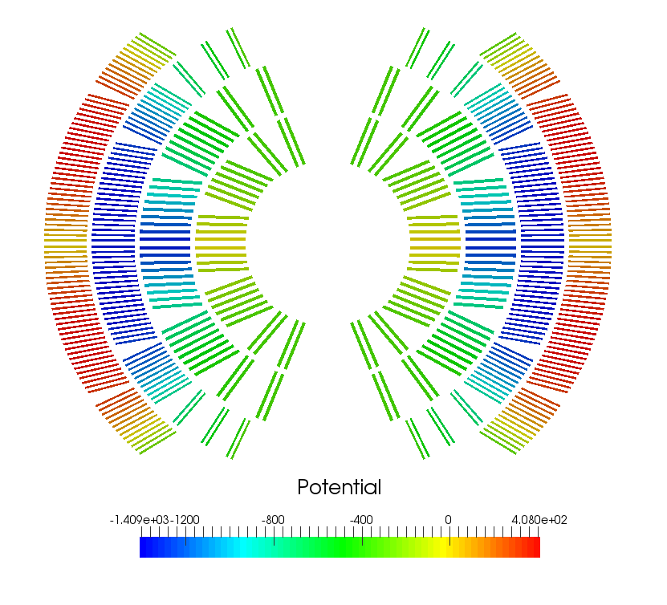
Simulated potential to ground
Peak potential to ground ~190 ms
103 V btw adj. turns
-1.4 kV to gnd
1.8 kV btw layers
(V)
-1410
410
Notes:
The simulations were done using CoHDA, and with various assumptions. Details in the appendix. Preliminary analysis has shown that CLIQ may be faster, so in this sense this errors on the safe side.

Slide 17
Simulated potential to ground
Potential to ground at ~200 ms
-2300
1380
Notes:
The simulations were done using CoHDA, and with various assumptions. Details in the appendix. Preliminary analysis has shown that CLIQ may be faster, so in this sense this errors on the safe side.

Slide 18
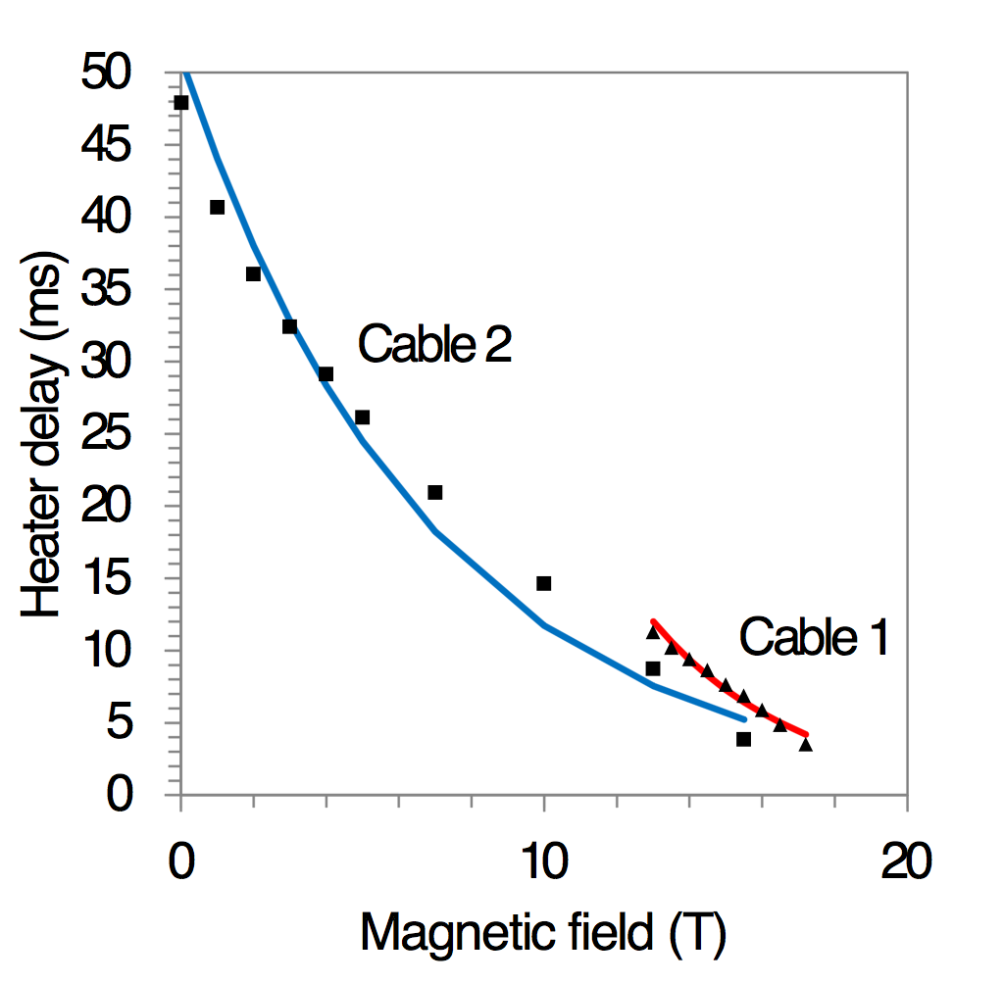
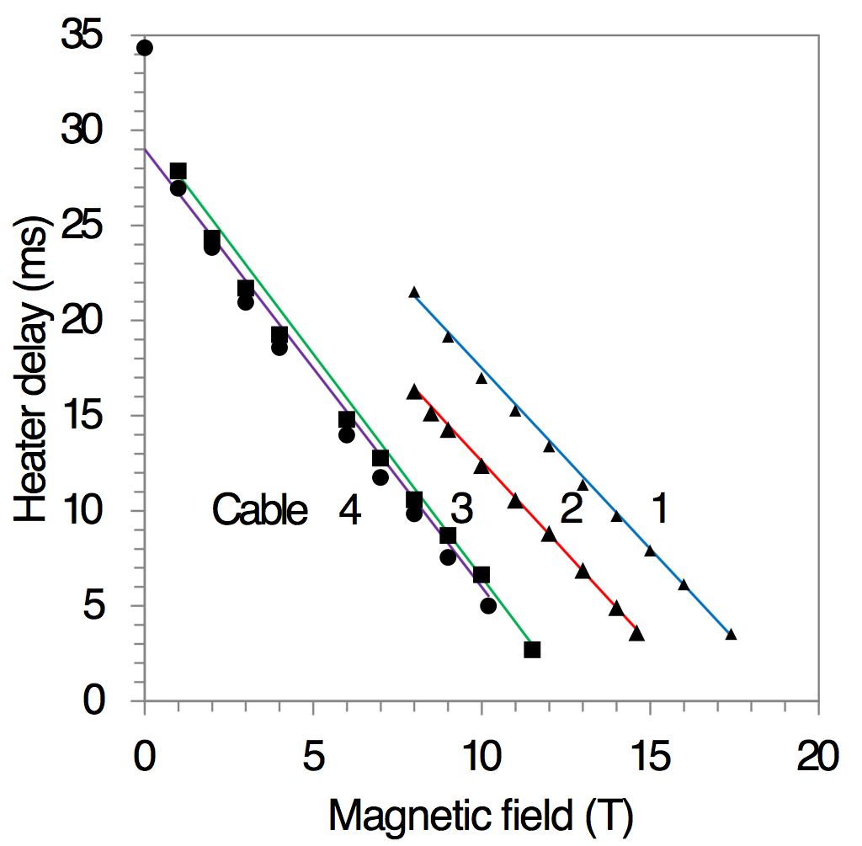
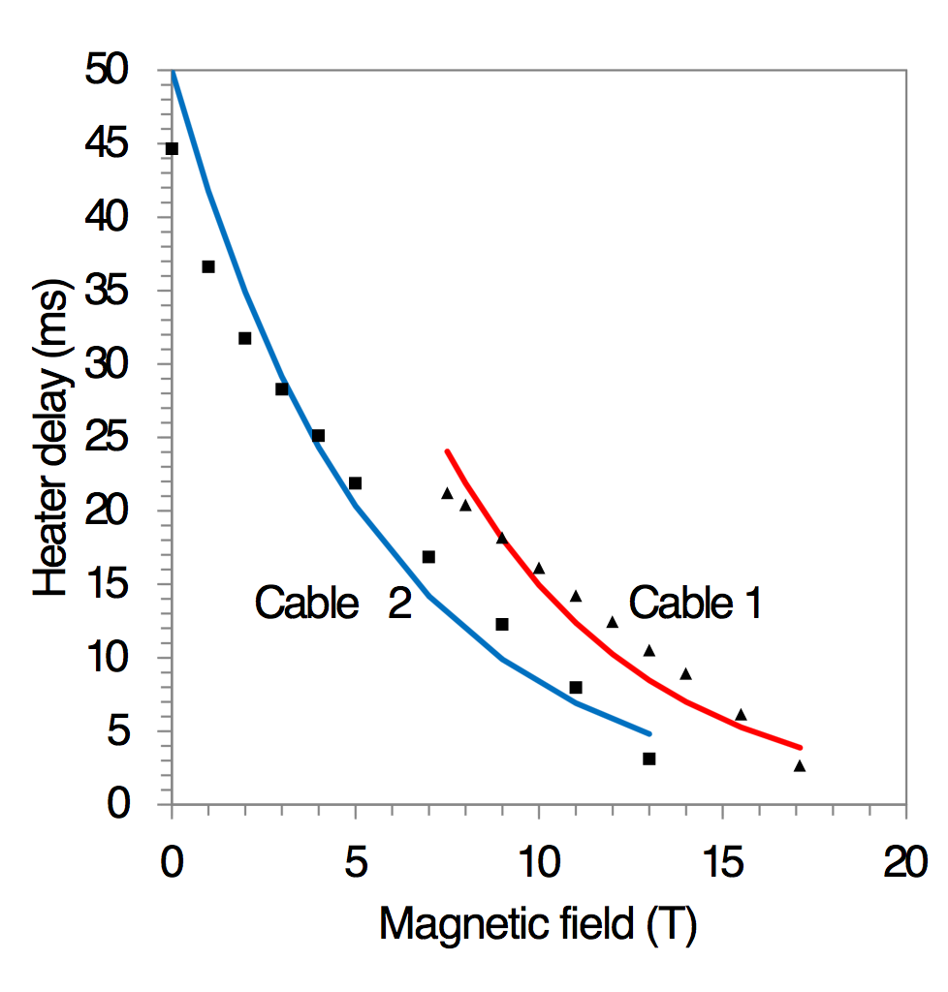
4. Simulation with distributed heater delays
Heater delay simulation assuming
  25 um thick stainless steel heaters with 75 um polyimide insulation to coil
  Peak power 100 W/cm², circuit time constant 50 ms
  Heaters cover all the coil turns entirely
105% of Iop (4.5 K)
First heater delays 3-4 ms in all magnets
Block
CosT
CommonC
Notes:
Going from 4.5 K to 1.9 K -> Heater delays increase 1-3 ms (Block)

Slide 19
4. Results at 105% of Iop
Temperatures OK!
Tdelay = 40 ms
 | T max (K) | V to gnd (kV) | V turn-to-turn (V) | V layer-to-layer (kV)
Block | 308 | -1.2 …+1.2 | 82 | 1.1
CosT | 328 | -1.4 … 0.4 | 103 | 1.8
CommonC | 315 | -2.3 … 1.4 | 75 | 3.3
But voltages are large… Analysis ongoing.
Distributed heater delays (+ detection 20 ms)
 | T max (K) | |V| to gnd (kV) | V turn-to-turn (V) | V layer-to-layer (V)
Block | 291 | 1.6 | 107 | 1.6
CosT | 305 | 1.4 | 123 | 2.2
CommonC | 293 | 2.7 | 93 | 4.1

Slide 20
Coupling-Loss Induced Quench protection system
CLIQ is a new technology for the protection of superconducting magnets. The core component is the capacitor bank that generates:
An alternated transport current in the magnet
A variable magnetic field in the coils
High inter-filament and inter-strand coupling losses
Heat on the superconductor
Quick spread of the normal zone after a quench
CLIQ starts quenching a magnet few milliseconds after it is fired
5 ms for the considered block coil
M. Prioli

Slide 21
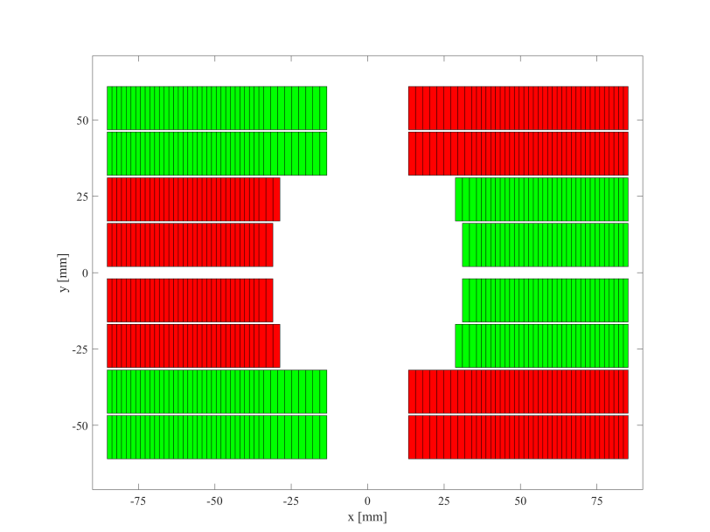
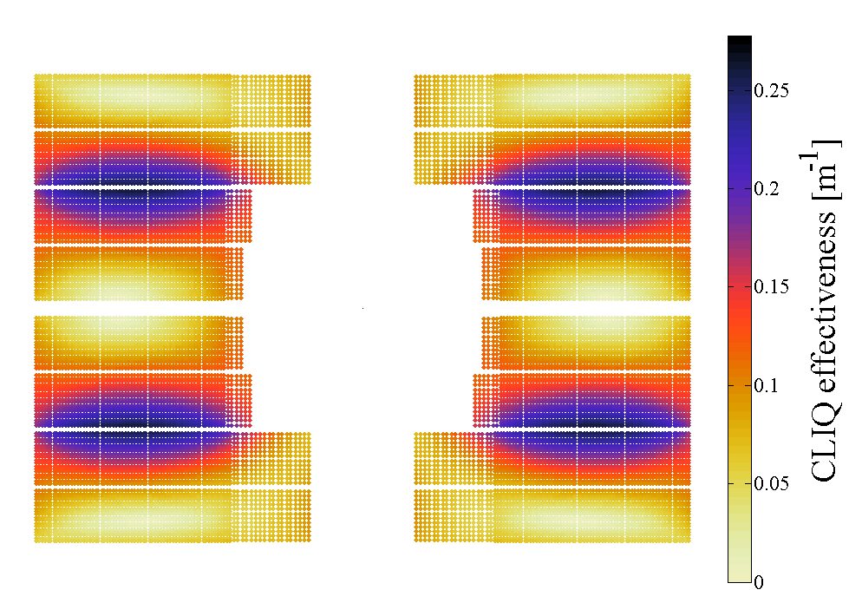
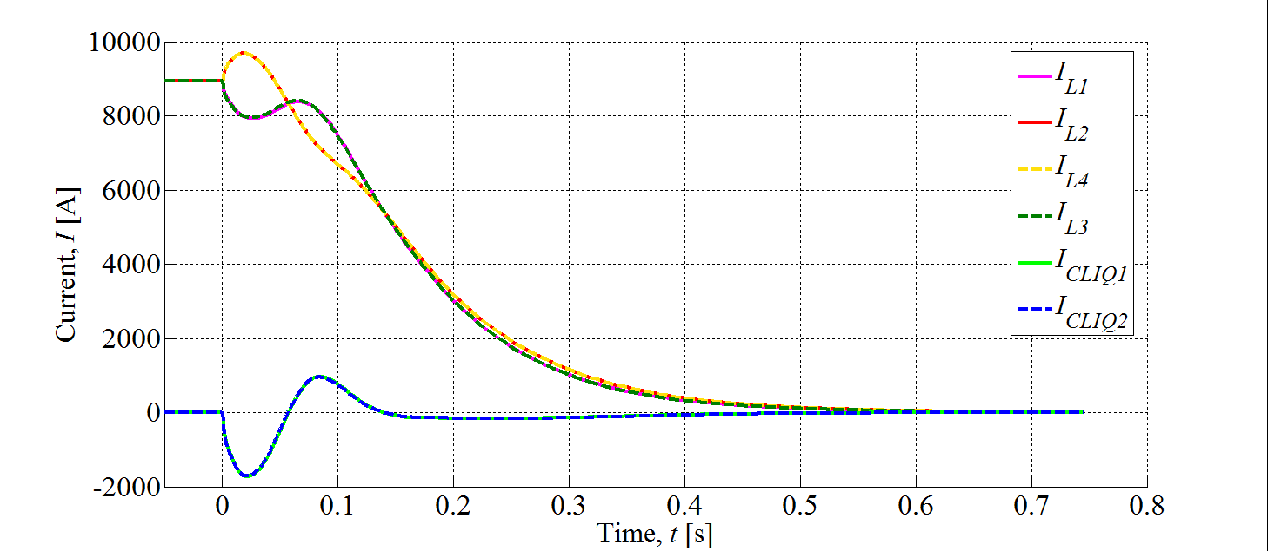
Connecting CLIQ to the magnet
The two connections are electrically equivalent
The second is better for redundancy
L₂
L₁
L₃
L₄
M. Prioli

Slide 22
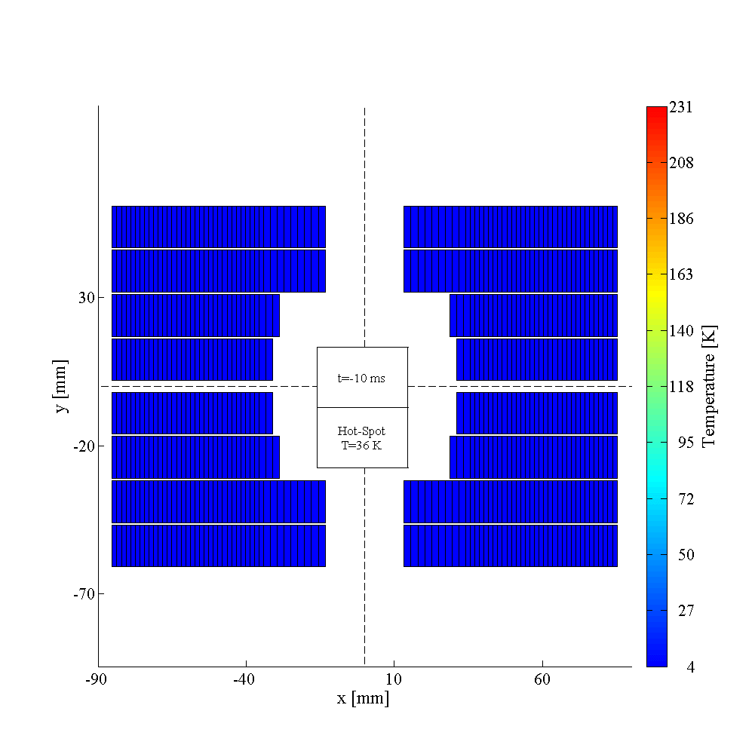
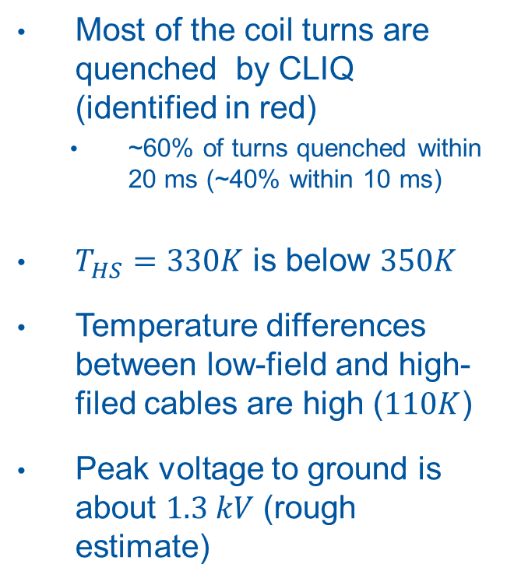


CLIQ temperatures
Most of the coil turns are quenched by CLIQ (identified in red)
  ~60% of turns quenched within 20 ms (~40% within 10 ms)
$T_{HS}=330K$ is below $350K$
Temperature differences between low-field and high-filed cables are high ($110K$)
Peak voltage to ground is about $1.3 kV$ (rough estimate)
$$C_{CLIQ1}=40 mF$$
$$V_{CLIQ1}=1 kV$$
$$C_{CLIQ2}=40 mF$$
$$V_{CLIQ2}=1 kV$$
M. Prioli

Slide 23
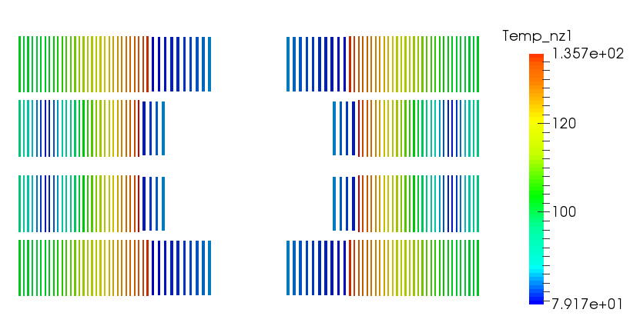
Decrease in voltages with larger cable (and operation at 1.9 K)
Block V101: Iop = 15600 A, L = 11.5 mH/m/ap. Top = 1.9 K
38 / 60 strands, diam 1.1 / 0.7, Cu/Ncu 0.8 / 1.5
At 105% of Iop with 40 ms protection delay:
Tmax = 318 K
Vgnd = -570 V
Vlat = 55 V
Vvert = 510 V
Temperature distribution at t = 150 ms (hotspot not shown)

Slide 24
Conclusion
Integrated quench protection analysis applied to 16 T dipole design
  Goal was to ensure temperatures stay < 350 K
  The protection efficiency, 40 ms delay, was based on LHC and HiLumi experience and foreseeable improvements in the technology
  Goal was obtained by fast feedback loop and team work
40 ms seems a good aproximation for heaters OR CLIQ separately. Probably we can get faster delays considering heating from BOTH.
Voltages were above 1 kV even in the nominal case
Designs with larger cable, smaller Cu/SC on HF cable and higher current (smaller inductance) at 1.9 K seem to help
During the magnet design phase focus was on nominal cases to ensure it is not impossible to protect
  Future analysis includes more details and failure scenarios
Notes:
Fast feedback loop: (Excel sheet)

Slide 25
References
Maximum temperature: .G. Ambrosio, proc. WAMSDO 2013
Available online: https://arxiv.org/ftp/arxiv/papers/1401/1401.3955.pdf
Time margin: E. Todesco, proc. WAMSDO 2013
Available online: http://cds.cern.ch/record/1643430/files/p10.pdf
Heater delay modeling with CoHDA: T. Salmi, IEEE TAS, 24(4), 2014
And T. Salmi, PhD Thesis
Available online: https://tutcris.tut.fi/portal/files/3827151/salmi_1311.pdf
Current decay with Coodi: T. Salmi, IEEE TAS, 26(4), 2014
CLIQ: E. Ravaioli, PhD Thesis
Available onlline: https://cdsweb.cern.ch/record/2031159/files/Thesis-2015-Ravaioli.pdf

Slide 26
Extra material

Slide 27
Calculated voltages with uniform quench delay
 | % of Iop | Vmax gnd (V) | V turn-to-turn (V) | V layer-to-layer (V) | Tmax (K)
Block V101 | 105 | -570 | 55 | 510 | 318
Daniel Slide 1 | 100 | -501 | 71 | 654 | 321
Daniel Slide 1 | 105 | 572 | 80 | 734 | 352
Daniel Slide 2 | 105 | 530 | 72 | 513 | 366
Daniel Slide 3 | 105 | 426 | 76 | 633 | 354
Daniel Slide 4 | 105 | 526 | 73 | 516 | 360
Daniel Slide 5 | 105 | 390 | 72 | 632 | 392
Daniel Slide 6 | 105 | 389 | 68 | 402 | 390
Delay time=40ms (uniform quench)

Slide 28
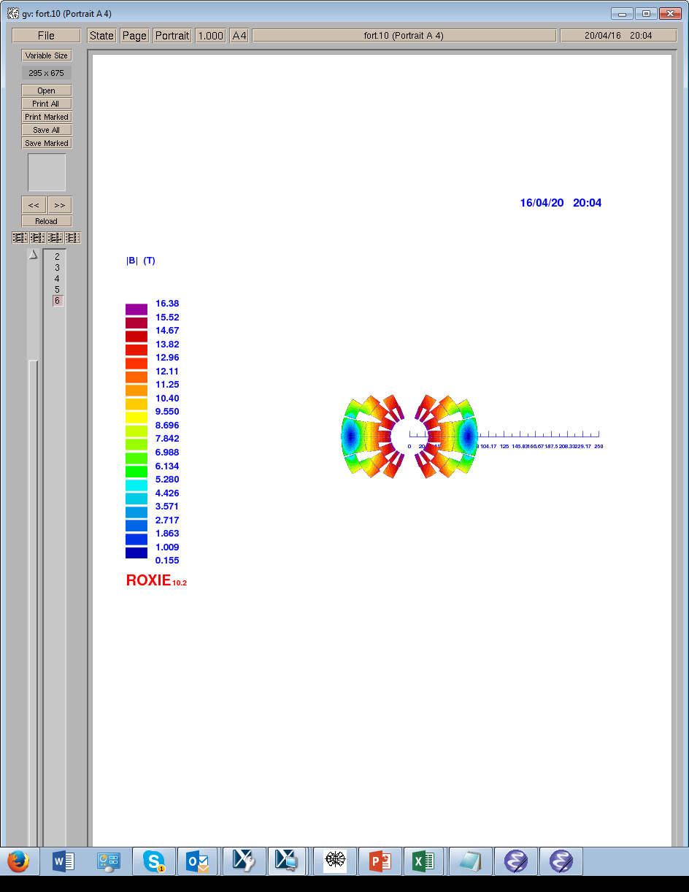
Cross-section, 13.5 kA, φ 1.1, Cu 1.0
Operating current | (kA) | 13.5 kA
Field in the aperture | (T) | 16.0
Field in the aperture at SS current | (T) | 18.5
Stored magnetic energy per unit length/ap | (MJ/m) | 1.4
Inductance/aperture | (mH/m) | 14.0
Diameter IL | (mm) | 1.1
Strands/cable IL | - | 28
Cu/Non-Cu IL | - | 1.0
Diameter OL | (mm) | 0.75
Strands/cable OL | - | 38
Cu/Non-Cu OL | - | 2.03
Total area of Cu/aperture | (mm²) | 4142
Total area of Sc/aperture | (mm²) | 2932
Total mass of Sc for FCC-hh | (t) | 3340
Total mass of conductor for FCC-hh | (t) | 8058
J_{eng} IL | (A/mm²) | 507
J_{eng} OL | (A/mm²) | 804
J_{overal} IL | (A/mm²) | 344
J_{overal} OL | (A/mm²) | 513
Average stress in Layer 1 | (MPa) | 74
Average stress in Layer 2 | (MPa) | 126
Average stress in Layer 3 | (MPa) | 142
Average stress in Layer 4 | (MPa) | 103

Slide 29
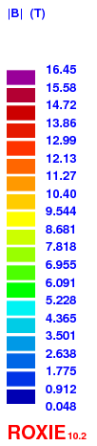
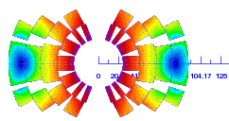
Cross-section, 15.1 kA, φ 1.1, Cu 0.8
Operating current | (kA) | 15.1
Field in the aperture | (T) | 16.0
Field in the aperture at SS current | (T) | 18.5
Stored magnetic energy per unit length/ap | (MJ/m) | 1.3
Inductance/aperture | (mH/m) | 10.6
Diameter IL | (mm) | 1.1
Strands/cable IL | - | 28
Cu/Non-Cu IL | - | 0.8
Diameter OL | (mm) | 0.77
Strands/cable OL | - | 38
Cu/Non-Cu OL | - | 2.44
Total area of Cu/aperture | (mm²) | 3671
Total area of Sc/aperture | (mm²) | 2816
Total mass of Sc for FCC-hh | (t) | 3208
Total mass of conductor for FCC-hh | (t) | 7389
J_{eng} IL | (A/mm²) | 566
J_{eng} OL | (A/mm²) | 852
J_{overal} IL | (A/mm²) | 384
J_{overal} OL | (A/mm²) | 546
Average stress in Layer 1 | (MPa) | 83
Average stress in Layer 2 | (MPa) | 142
Average stress in Layer 3 | (MPa) | 119
Average stress in Layer 4 | (MPa) | 84

Slide 30
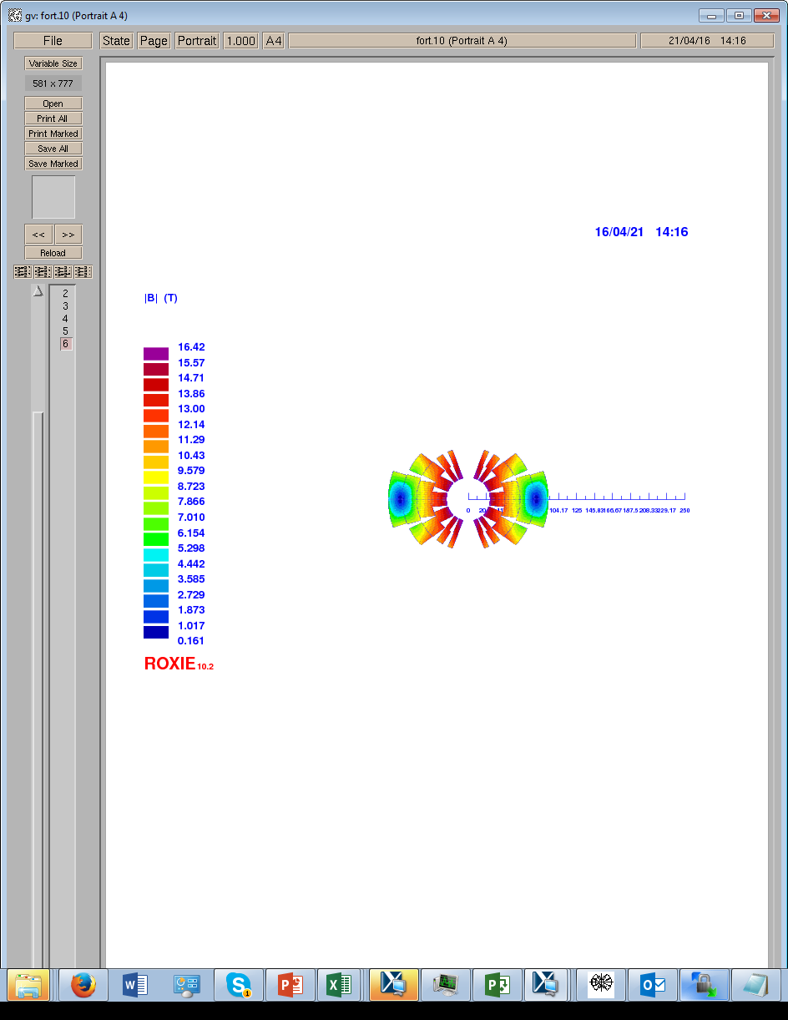
Cross-section, 14.9 kA, φ 1.2, Cu 1.0
Operating current | (kA) | 14.9
Field in the aperture | (T) | 16.0
Field in the aperture at SS current | (T) | 18.5
Stored magnetic energy per unit length/ap | (MJ/m) | 1.4
Inductance/aperture | (mH/m) | 11.1
Diameter IL | (mm) | 1.2
Strands/cable IL | - | 26
Cu/Non-Cu IL | - | 1.0
Diameter OL | (mm) | 0.78
Strands/cable OL | - | 38
Cu/Non-Cu OL | - | 2.16
Total area of Cu/aperture | (mm²) | 4067
Total area of Sc/aperture | (mm²) | 2894
Total mass of Sc for FCC-hh | (t) | 3297
Total mass of conductor for FCC-hh | (t) | 7929
J_{eng} IL | (A/mm²) | 507
J_{eng} OL | (A/mm²) | 821
J_{overal} IL | (A/mm²) | 347
J_{overal} OL | (A/mm²) | 527
Average stress in Layer 1 | (MPa) | 81
Average stress in Layer 2 | (MPa) | 127
Average stress in Layer 3 | (MPa) | 156
Average stress in Layer 4 | (MPa) | 60

Slide 31

Cross-section, 16.6 kA, φ 1.2, Cu 0.8
Operating current | (kA) | 16.6 kA
Field in the aperture | (T) | 16.0
Field in the aperture at SS current | (T) | 18.5
Stored magnetic energy per unit length/ap | (MJ/m) | 1.3
Inductance/aperture | (mH/m) | 8.4
Diameter IL | (mm) | 1.2
Strands/cable IL | - | 26
Cu/Non-Cu IL | - | 0.8
Diameter OL | (mm) | 0.8
Strands/cable OL | - | 38
Cu/Non-Cu OL | - | 2.63
Total area of Cu/aperture | (mm²) | 3556
Total area of Sc/aperture | (mm²) | 2808
Total mass of Sc for FCC-hh | (t) | 3199
Total mass of conductor for FCC-hh | (t) | 7249
J_{eng} IL | (A/mm²) | 565
J_{eng} OL | (A/mm²) | 869
J_{overal} IL | (A/mm²) | 387
J_{overal} OL | (A/mm²) | 561
Average stress in Layer 1 | (MPa) | 91
Average stress in Layer 2 | (MPa) | 143
Average stress in Layer 3 | (MPa) | 132
Average stress in Layer 4 | (MPa) | 43

Slide 32
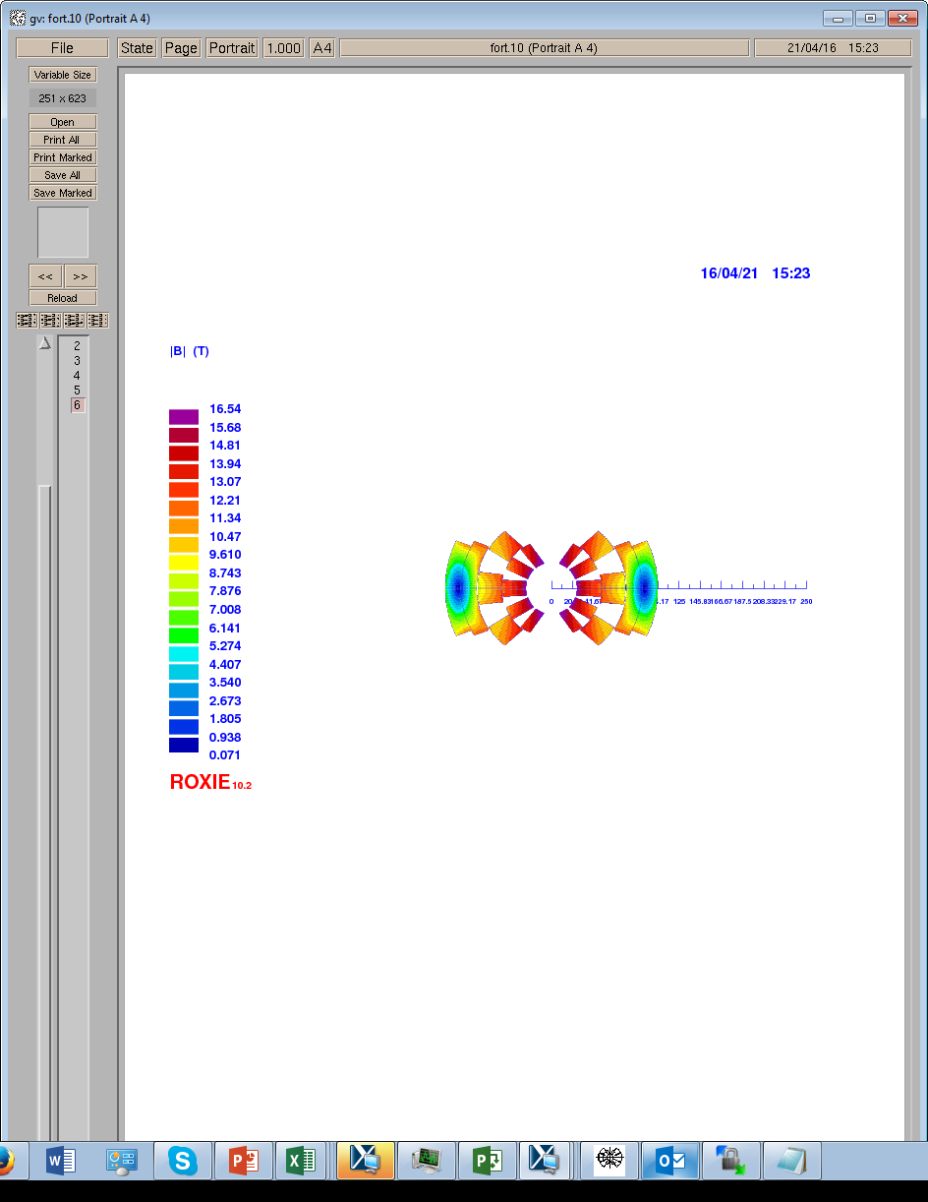
Large cable Cross-section, 18.8 kA
Operating current | (kA) | 18.8
Field in the aperture | (T) | 16.0
Field in the aperture at SS current | (T) | 18.5
Stored magnetic energy per unit length/ap | (MJ/m) | 1.8
Inductance/aperture | (mH/m) | 9.3
Diameter IL | (mm) | 1.1
Strands/cable IL | - | 40
Cu/Non-Cu IL | - | 1.0
Diameter OL | (mm) | 1.06
Strands/cable OL | - | 26
Cu/Non-Cu OL | - | 2.15
Total area of Cu/aperture | (mm²) | 4547
Total area of Sc/aperture | (mm²) | 3162
Total mass of Sc for FCC-hh | (t) | 3602
Total mass of conductor for FCC-hh | (t) | 8781
J_{eng} IL | (A/mm²) | 495
J_{eng} OL | (A/mm²) | 819
J_{overal} IL | (A/mm²) | 336
J_{overal} OL | (A/mm²) | 551
Average stress in Layer 1 | (MPa) | 75
Average stress in Layer 2 | (MPa) | 85
Average stress in Layer 3 | (MPa) | 140
Average stress in Layer 4 | (MPa) | 120

Slide 33
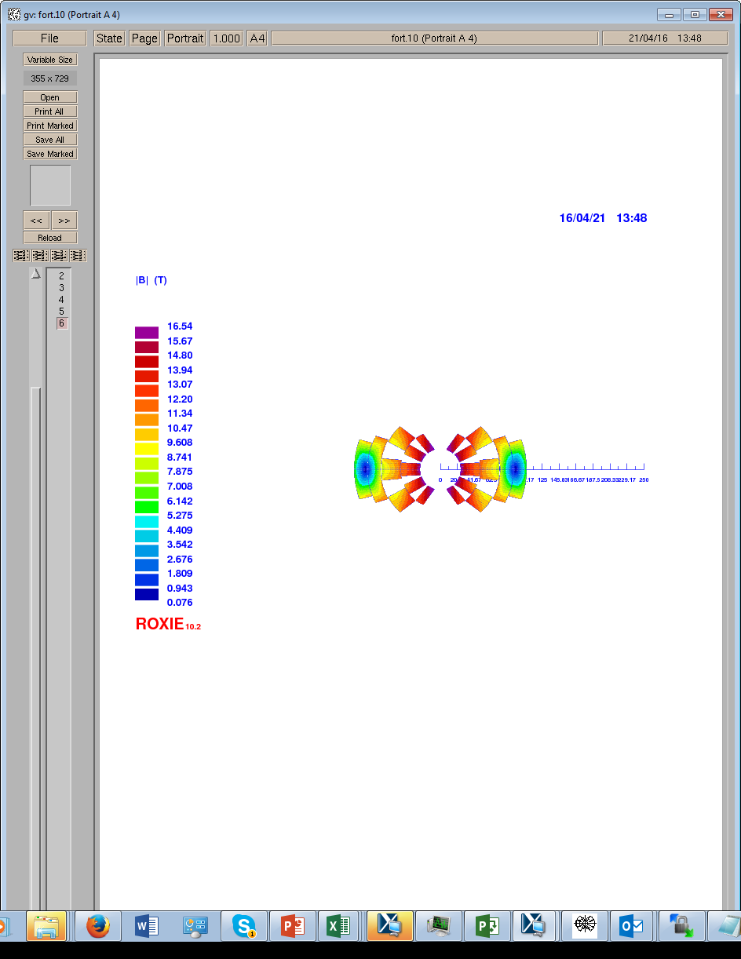
Cross-section, 20.9 kA
Operating current | (kA) | 20.9 kA
Field in the aperture | (T) | 16.0
Field in the aperture at SS current | (T) | 18.5
Stored magnetic energy per unit length/ap | (MJ/m) | 1.7
Inductance/aperture | (mH/m) | 7.0
Diameter IL | (mm) | 1.1
Strands/cable IL | - | 40
Cu/Non-Cu IL | - | 0.8
Diameter OL | (mm) | 1.1
Strands/cable OL | - | 26
Cu/Non-Cu OL | - | 2.39
Total area of Cu/aperture | (mm²) | 3988
Total area of Sc/aperture | (mm²) | 3130
Total mass of Sc for FCC-hh | (t) | 3565
Total mass of conductor for FCC-hh | (t) | 8108
J_{eng} IL | (A/mm²) | 550
J_{eng} OL | (A/mm²) | 846
J_{overal} IL | (A/mm²) | 373
J_{overal} OL | (A/mm²) | 572
Average stress in Layer 1 | (MPa) | 83
Average stress in Layer 2 | (MPa) | 88
Average stress in Layer 3 | (MPa) | 128
Average stress in Layer 4 | (MPa) | 90

Slide 34
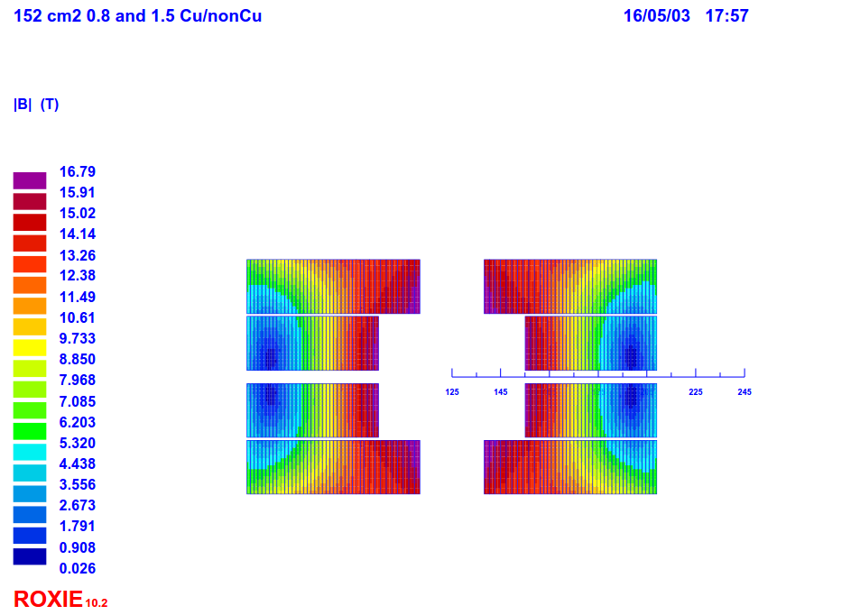
Block from Clement, V101
Cable ID | SC mat. (1 = Nb3Sn, 2 = Nbti) | Width bare (mm) | Mid thickn.bare (mm) | Nstrands | strand diam (mm) | strand Cu/SC | RRR
1 | 1 | 22 | 2 | 38 | 1.1 | 0.8 | 100
2 | 1 | 22 | 1.25 | 60 | 0.7 | 1.5 | 100
Magnet length (m) | 14.3
Inductance (mH/m) | 2 x 11.5
Op. current (A) | 15600
Op. temperature (K) | 1.9

Slide 35
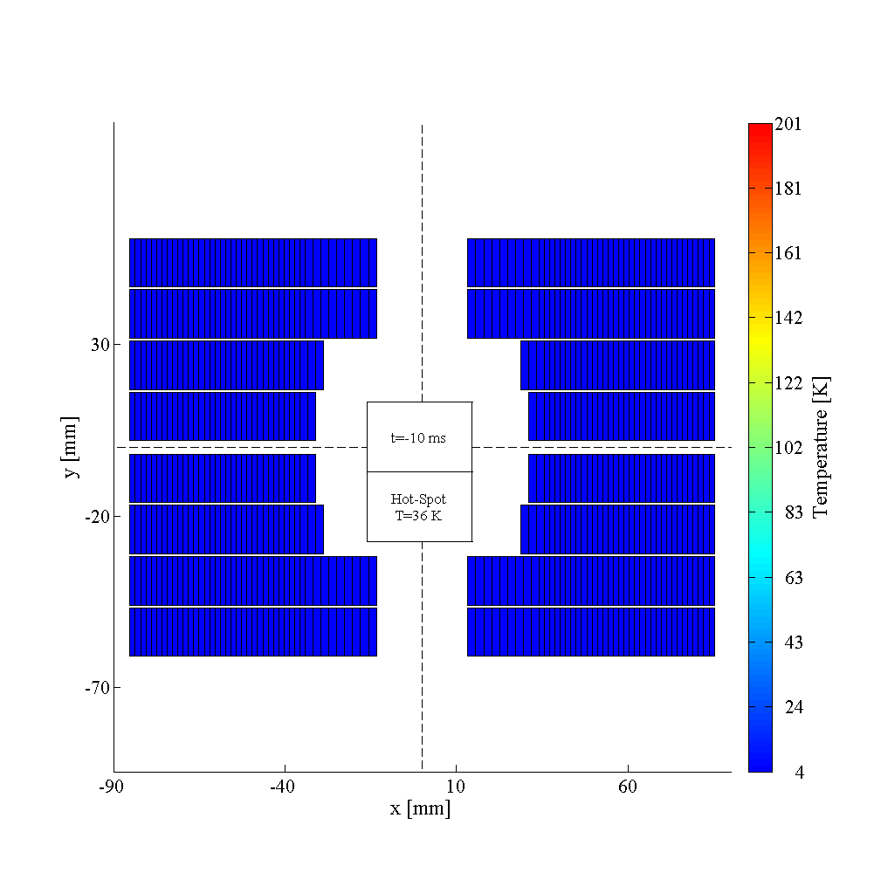
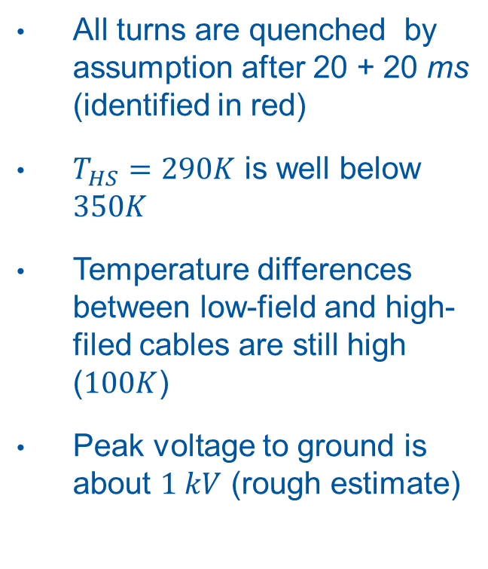

CLIQ temperatures, case 2
All turns are quenched by assumption after 20 + 20 ms (identified in red)
$T_{HS}=290K$ is well below $350K$
Temperature differences between low-field and high-filed cables are still high ($100K$)
Peak voltage to ground is about $1 kV$ (rough estimate)
$$C_{CLIQ1}=40 mF$$
$$V_{CLIQ1}=1 kV$$
$$C_{CLIQ2}=40 mF$$
$$V_{CLIQ2}=1 kV$$

Slide 36
LARP experiment to find maximum hotspot temperature
  Quench history at TQS01c test,
  G. Ambrosio, WAMSDO 2013

Slide 37
2. Obtainable quench delay
Assuming HiLumi heater technology applied to FCC dipole
  Assumed improvement: All coil surface can be covered
Heater delay simulations using CoHDA
Insulation (G10, 0.8 mm)
Heater (stainless steel, 0.025 mm)
Heater insulation (polyimide, 0.05-0.1 mm)
Cable insulation (G10, 0.15 mm)
Cable (Cu + nb3Sn + epoxy in the strand voids)
Insulation (G10, 0.8 mm)
PH power density
(W/m³):
J_{ss}²*ρ_{ss}
Quench when cable (max) temperature reaches Tcs
Notes:
The simulations were done using CoHDA, and with various assumptions. Details in the appendix. Preliminary analysis has shown that CLIQ may be faster, so in this sense this errors on the safe side.

Slide 38
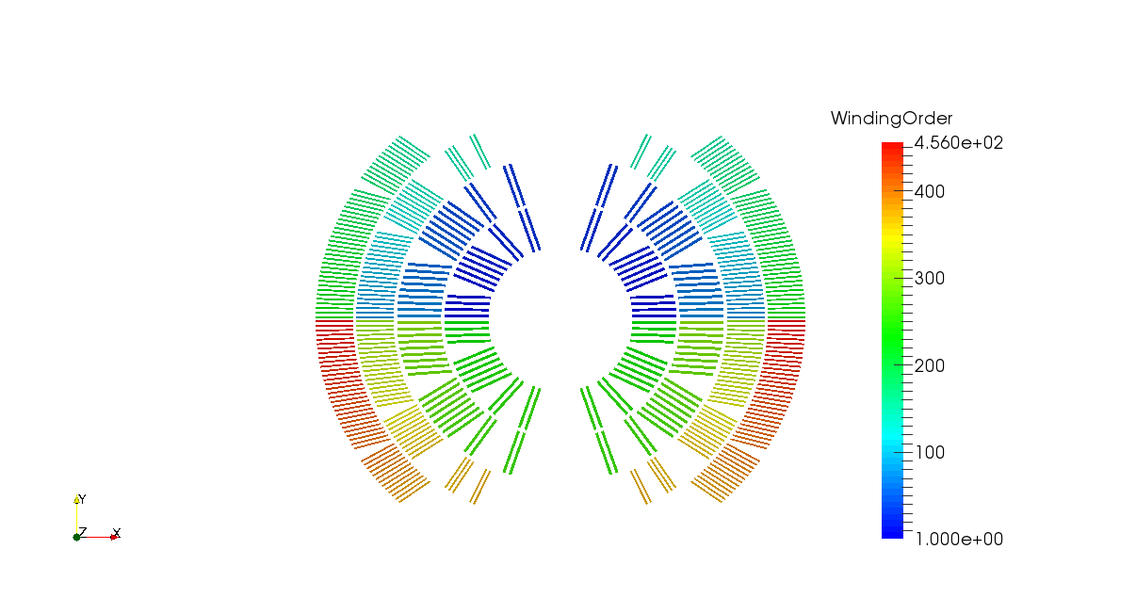
IN
OUT

Slide 39
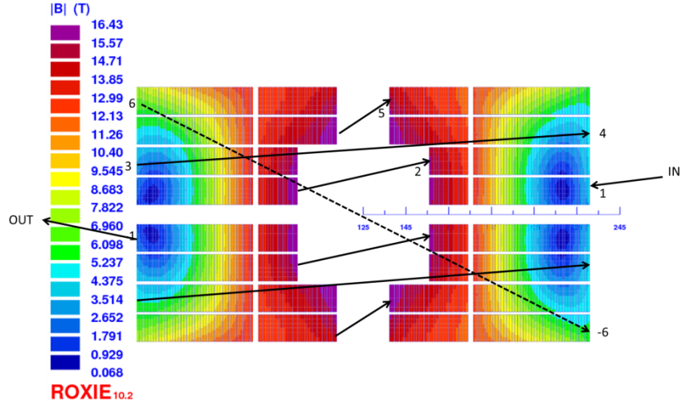

Slide 40
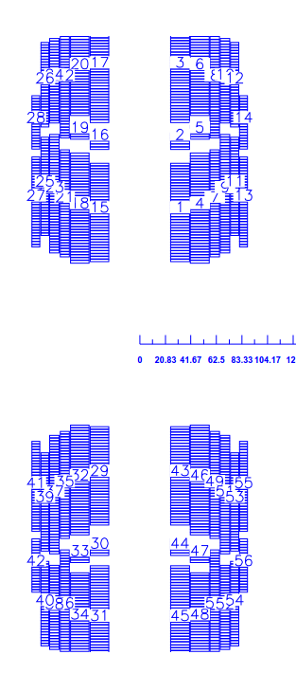
I in 1
1
9
2
6
4
7
I out 1 = I in 2
5
8
3

Slide 41
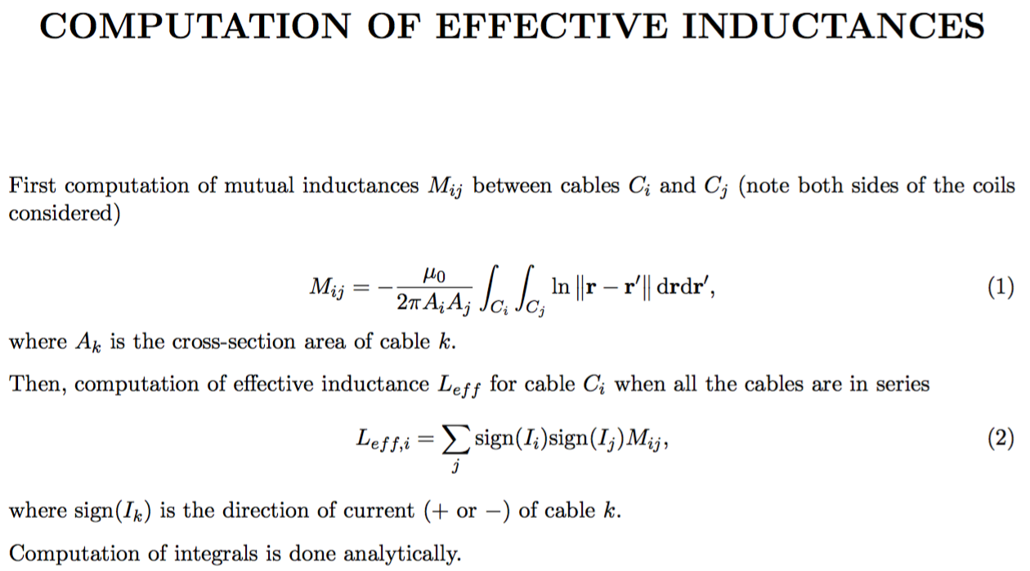

Slide 42
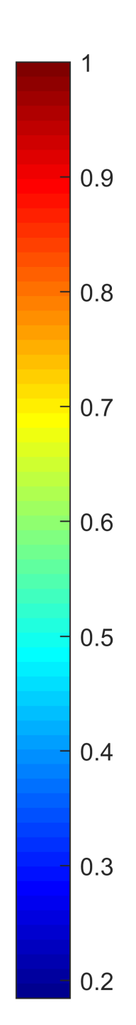
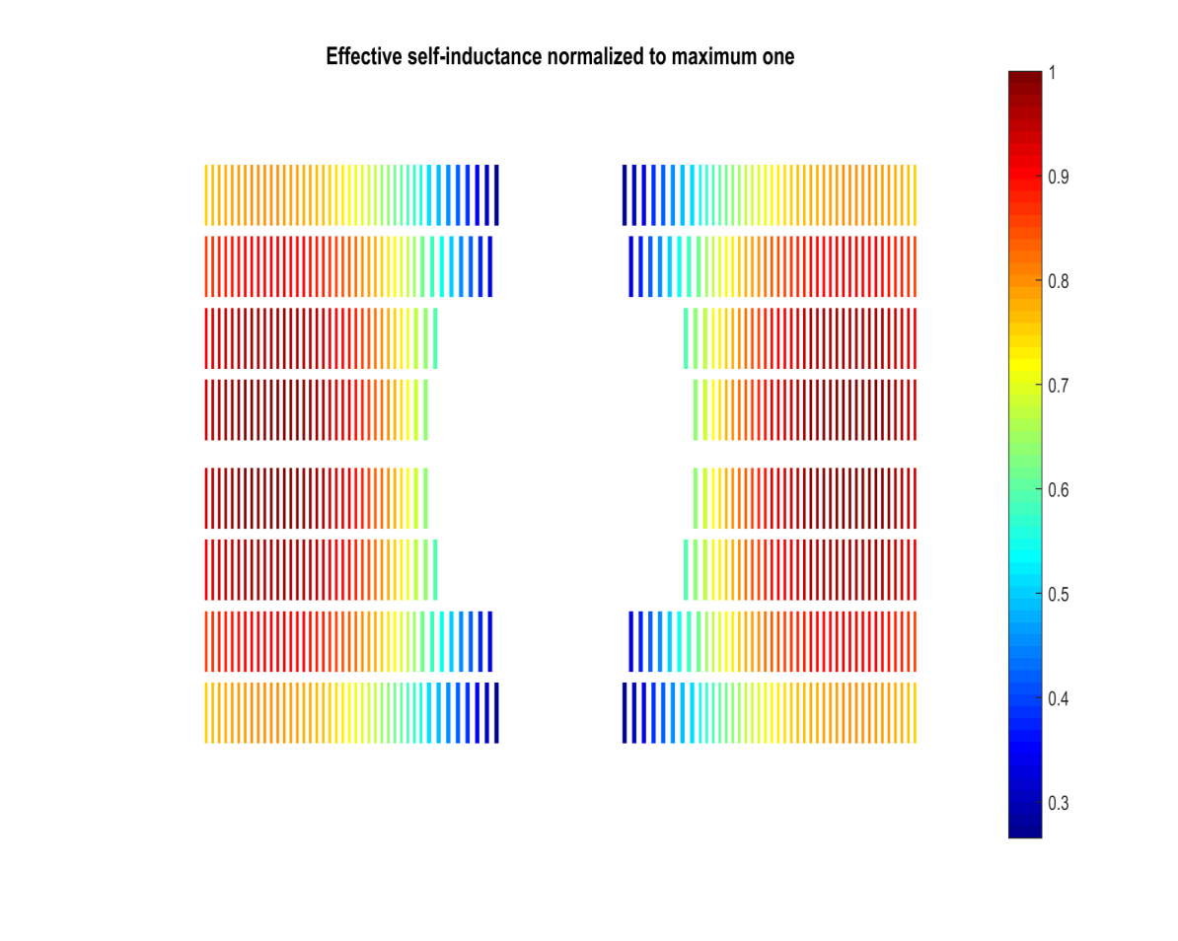

Effective self-inductance normalized to the maximum one

Slide 43
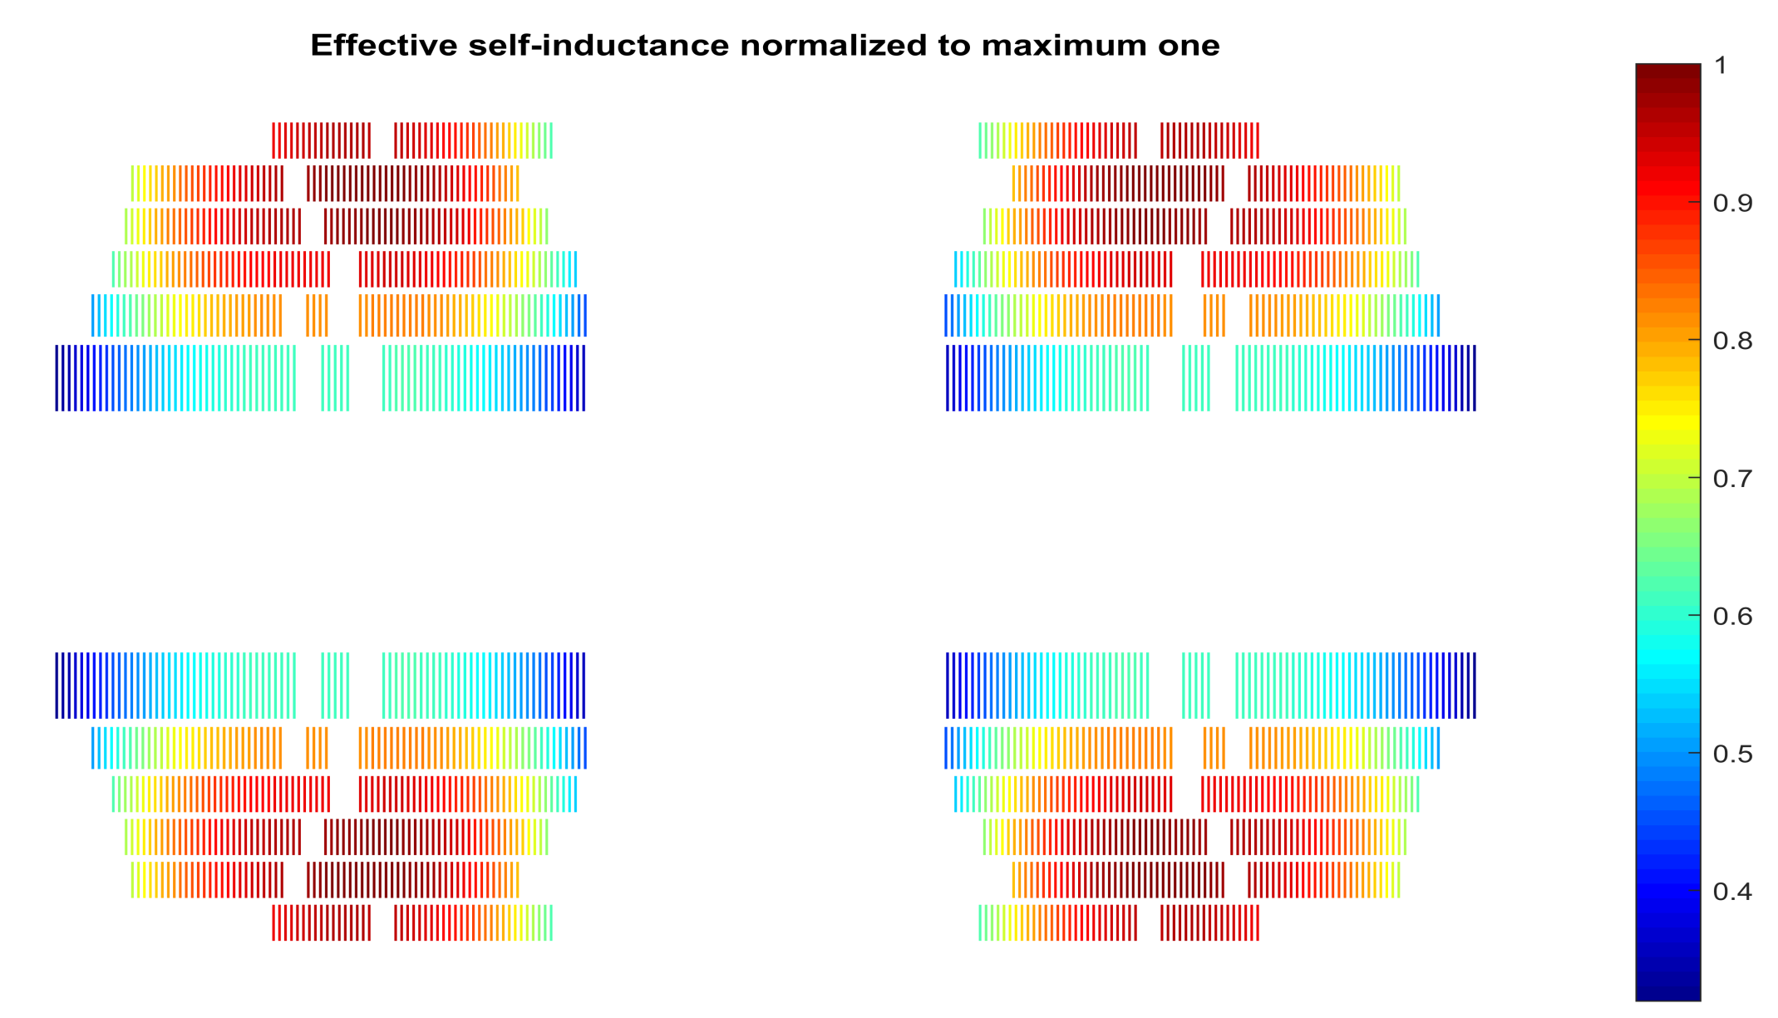
Effective self-inductance normalized to the maximum one

Slide 44
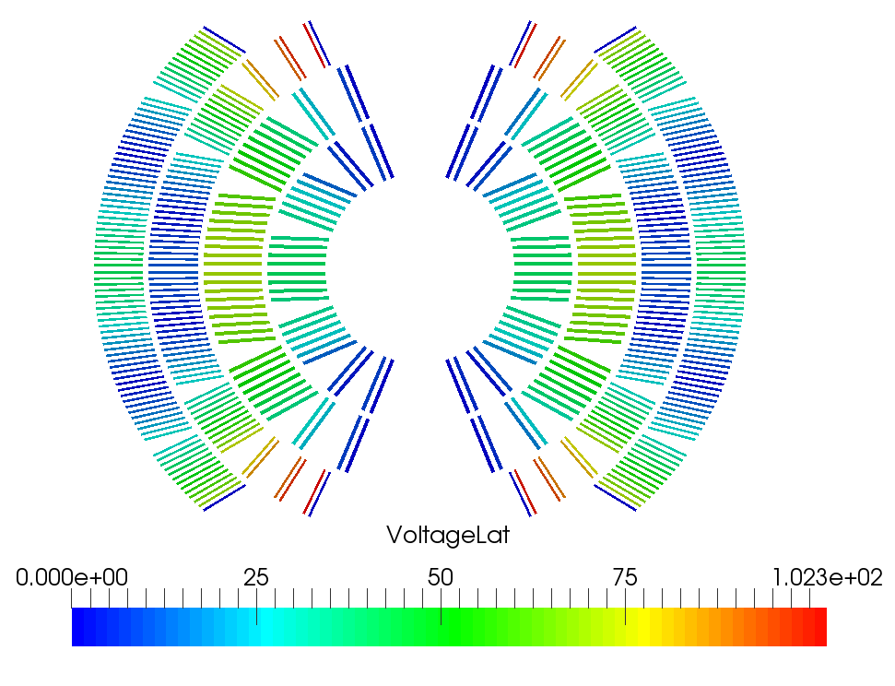
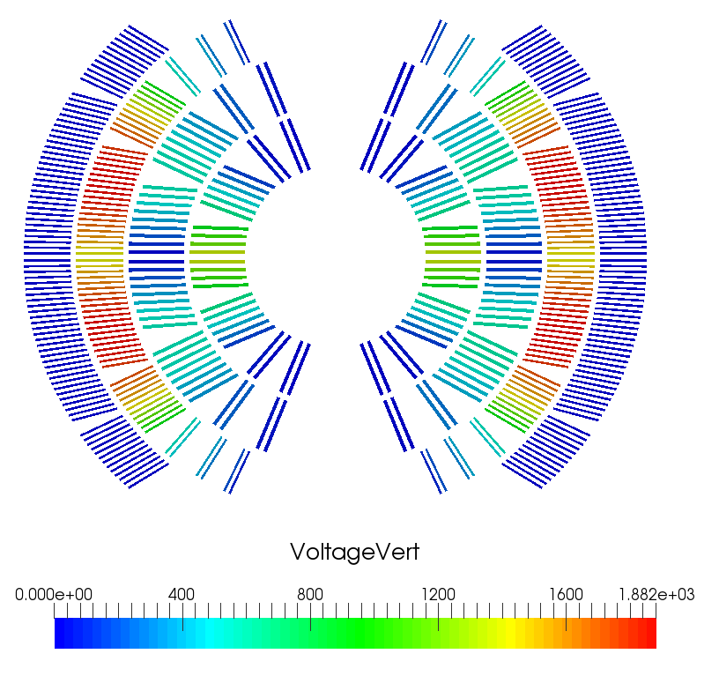
Costheta: Voltages between cables at 190 ms
Turn-to-turn (Laterally adjacent turns)
Layer-to-layer (vertically adjacent turns)

Slide 45
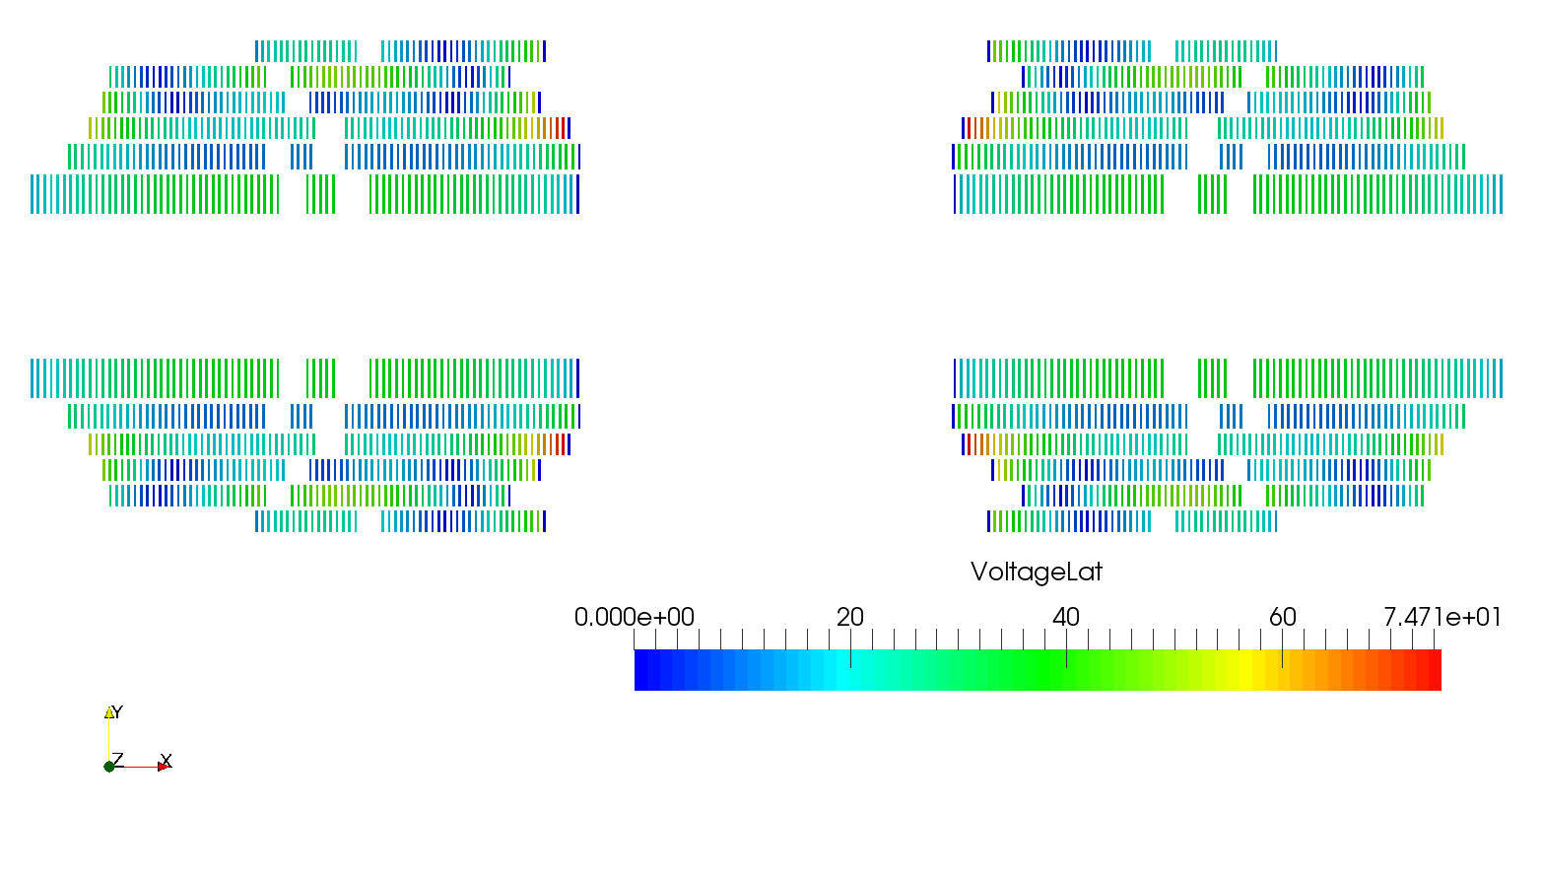
CommonCoil v1h_intragrad_t2: Turn-to-turn voltages at ~190 ms

Slide 46
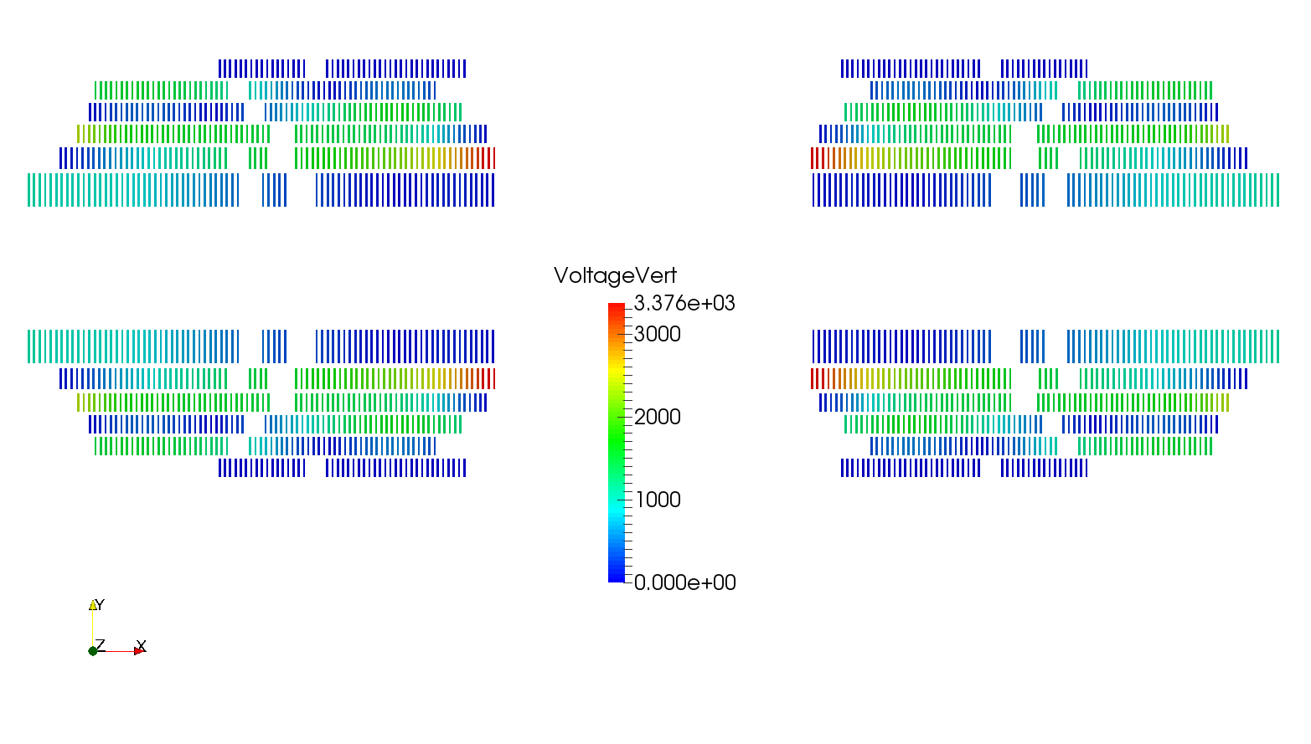
CommonCoil v1h_intragrad_t2: Layer-to-layer voltages at ~190 ms

Slide 47
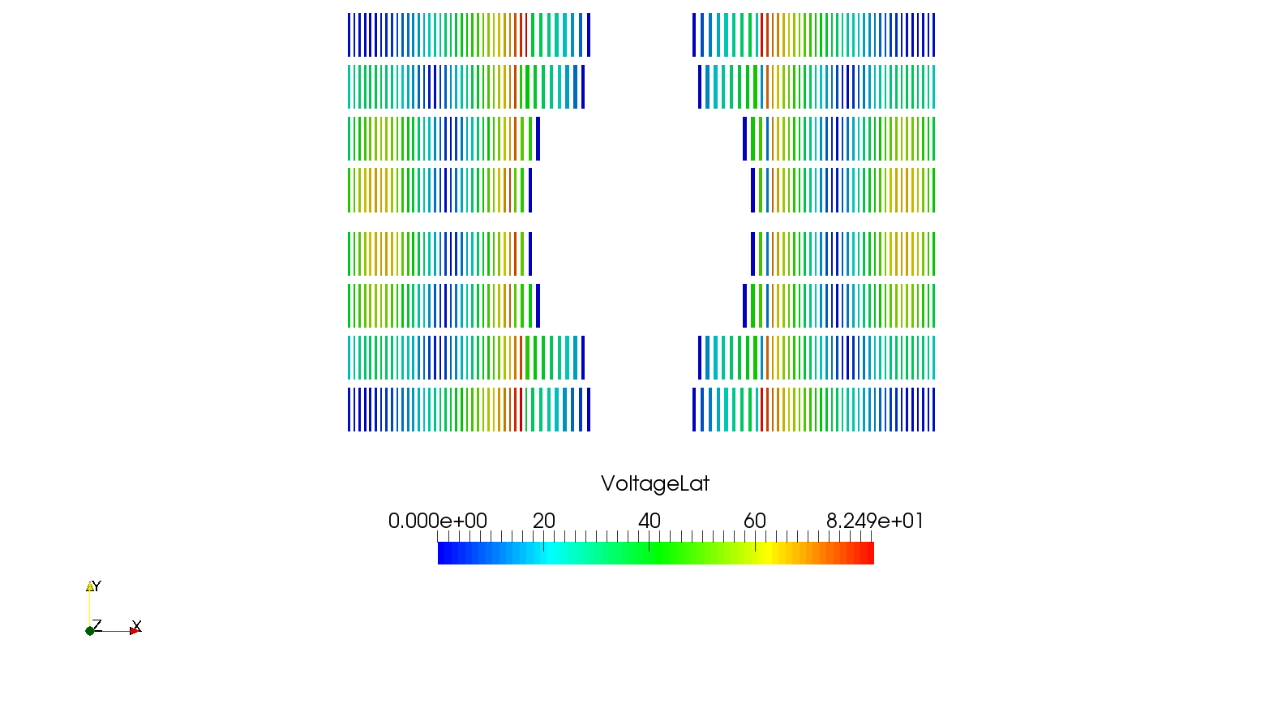
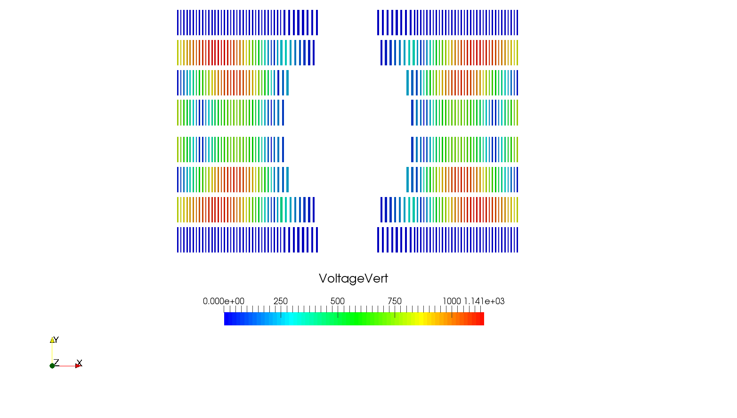
Block_v26b: Voltages between cables at ~160 ms
Turn-to-turn (Laterally adjacent turns)
Layer-to-layer (vertically adjacent turns)

