Slide 1


Cost considerations
D. Schoerling, CERN
Maria Durante, Clement Lorin, CEA
Teresa Martinez, Fernando Toral, CIEMAT
May 12th, 2016

Slide 2
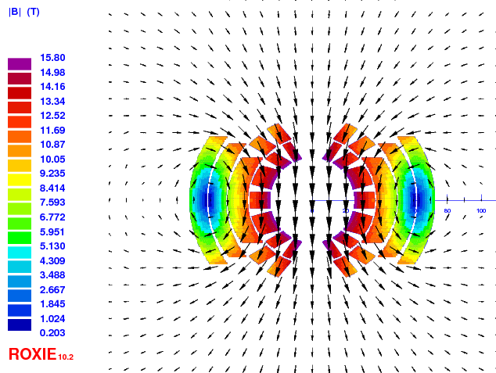
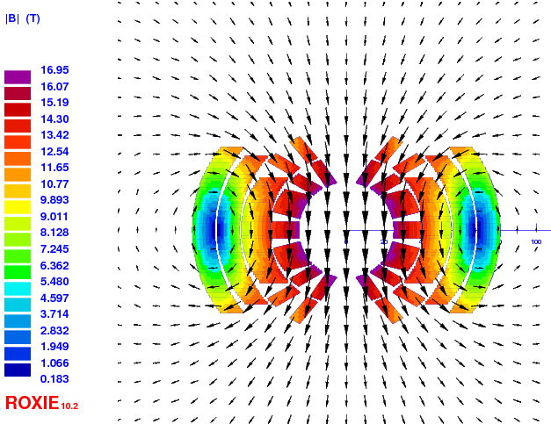
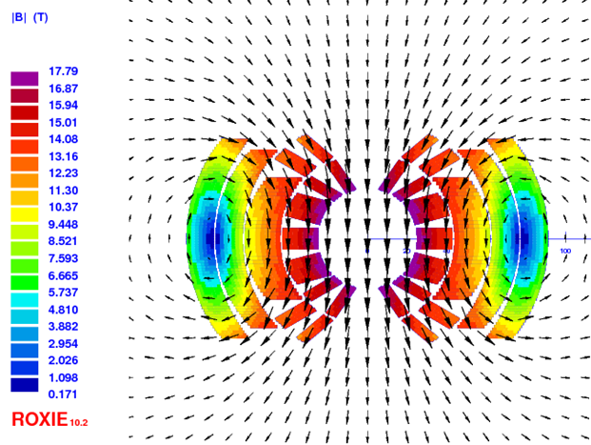
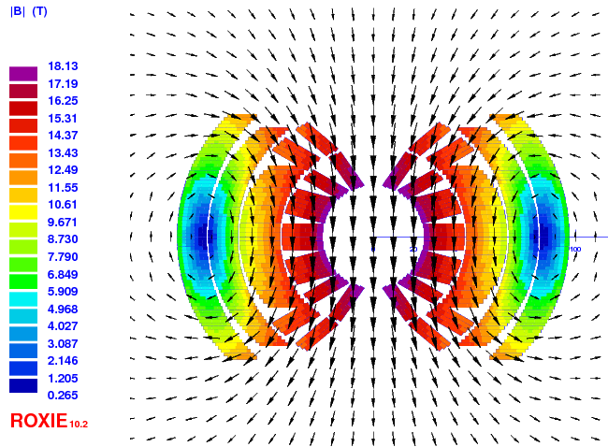
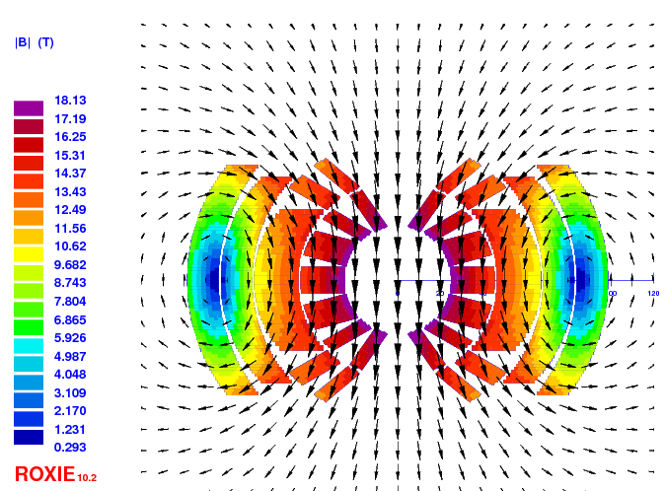
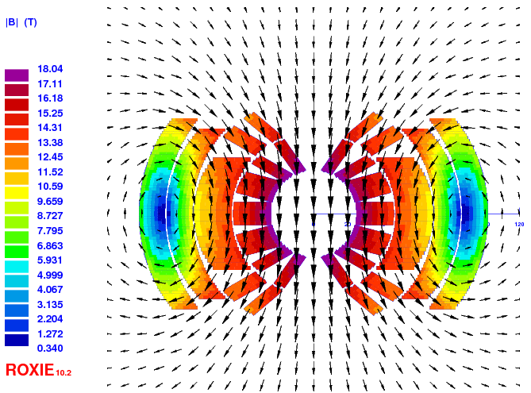
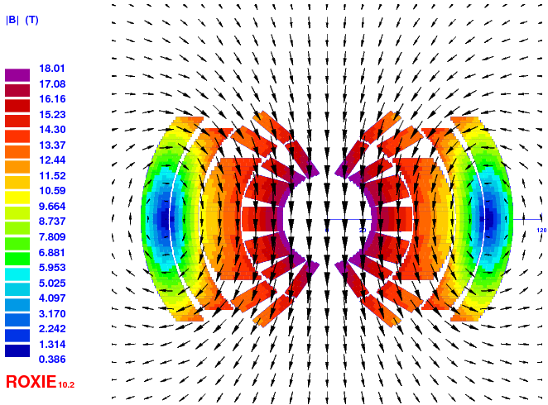
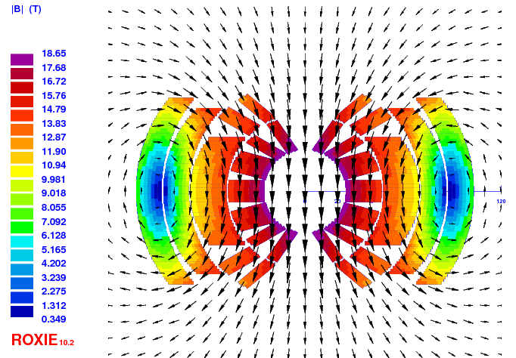
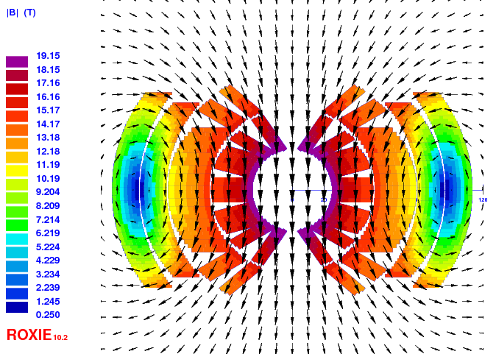
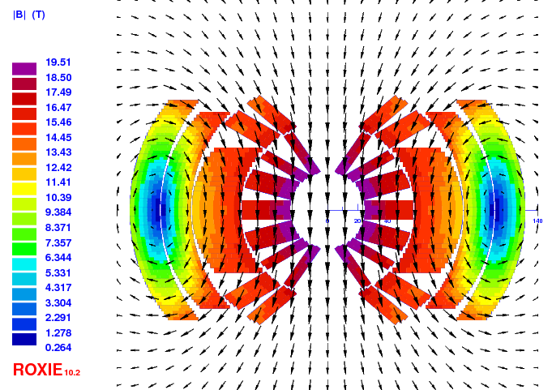
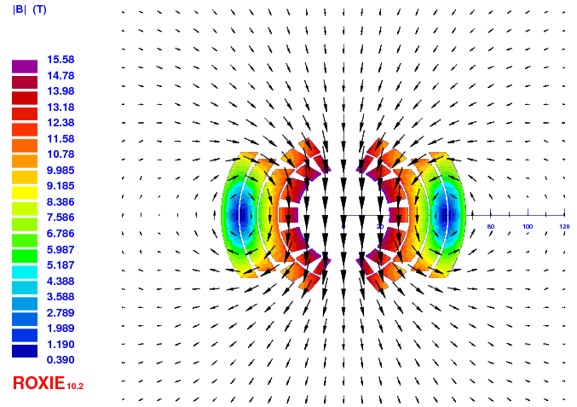
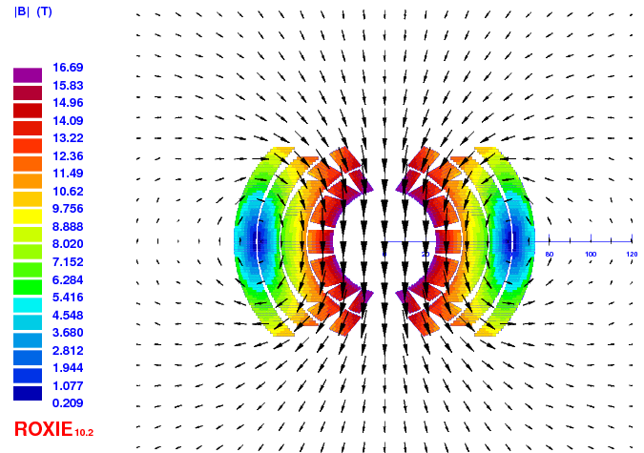
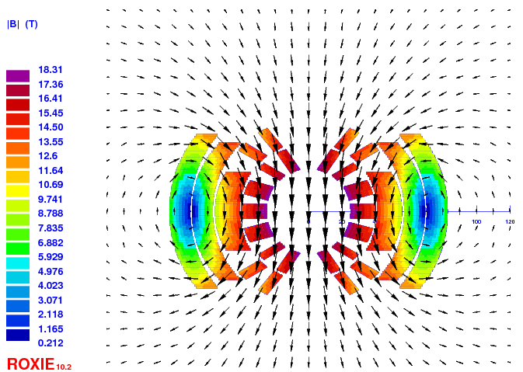
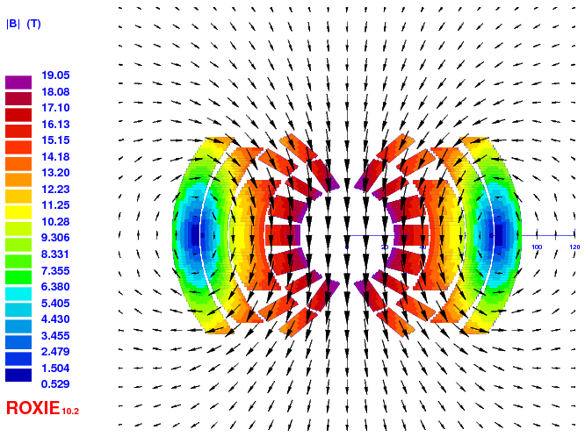
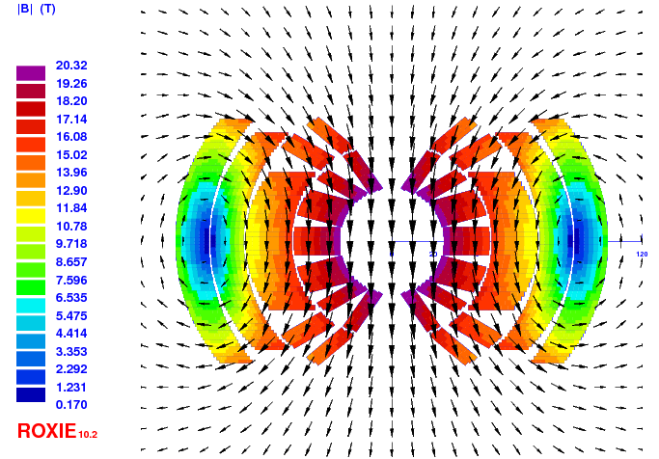
Status
Goal: Provide preliminary estimates of the cost of the dipole magnets as a function of field and temperature based on cross-sections scaled from the EuroCirCol 16 T dipole design and from LHC magnet cost
Reference parameters: 50 mm aperture, 4578 magnets, 14.3 m long, 16 T
J_{cu} ≤ 1200 A/mm² (magnet protection at short sample) and Cu/Non-Cu ≥ 1:1(optimized strand production)

Slide 3
Target cost of magnet
Cost of LHC dipole magnet taken as reference and target
LHC dipole cost was around 1 MCHF/dipole, 2000 (around 660 kEUR/dipole, 2000)
The conductor cost was around 200 kEUR/dipole, 2000
Assuming 2% inflation over 16 years for the dipoles one finds 900 kEUR/dipole, 2015
The cost of the LHC dipole without conductor is 630 kEUR/dipole, 2015
The volume of the structure is larger, the manufacturing process involves more steps due to heat treatment, different insulation technique, etc., but also number of units is larger. A detailed study started to work out the cost of the structure & assembly has been started with CEA & CIEMAT.

Slide 4
Analytical model (CIEMAT)
4

Slide 5
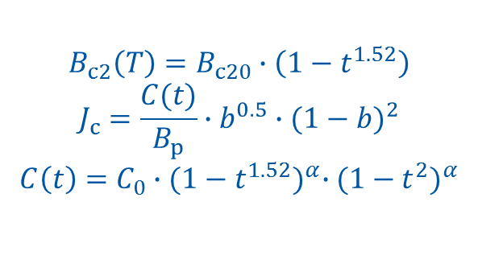
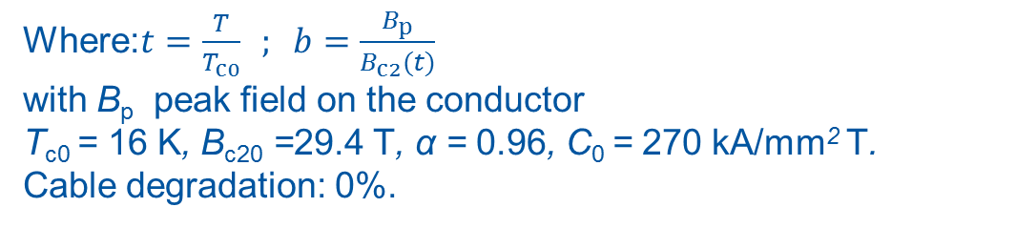
Conductor J_{c}-fit
Fit for the target value of J_{c}(4.2 K, 16 T) = 1500 A/mm²
$$B_{c2}\left(T\right)=B_{c20}∙\left(1−t^{1.52}\right)$$
$$J_{c}=\frac{C(t)}{B_{p}}∙b^{0.5}∙{(1−b)}^{2}$$
$$C\left(t\right)=C_{0}∙{(1−t^{1.52})}^{α}∙{(1−t^{2})}^{α}$$
Where:$t=\frac{T}{T_{c0}} ; b=\frac{B_{p}}{B_{c2}(t)}$
with B_{p} peak field on the conductor
T_{c0} = 16 K, B_{c20} =29.4 T, α = 0.96, C₀ = 270 kA/mm² T.
Cable degradation: 0%.

Slide 6
Conductor amount vs field @ 4.2 K
Conductor amount is very sensitive to the operational field and margin
Conductor mass in kt
kt | 15 T | 16 T
10% | 8 | 10
15% | 10 | 16
20% | 16 | >25
Constant integrated field

Slide 7
Conductor amount vs field @ 1.9 K
Conductor amount is sensitive to the operational field and margin
Conductor mass in kt
kt | 15 T | 16 T
10% | 6 | 7
15% | 8 | 9
20% | 10 | 12
Constant integrated field

Slide 8
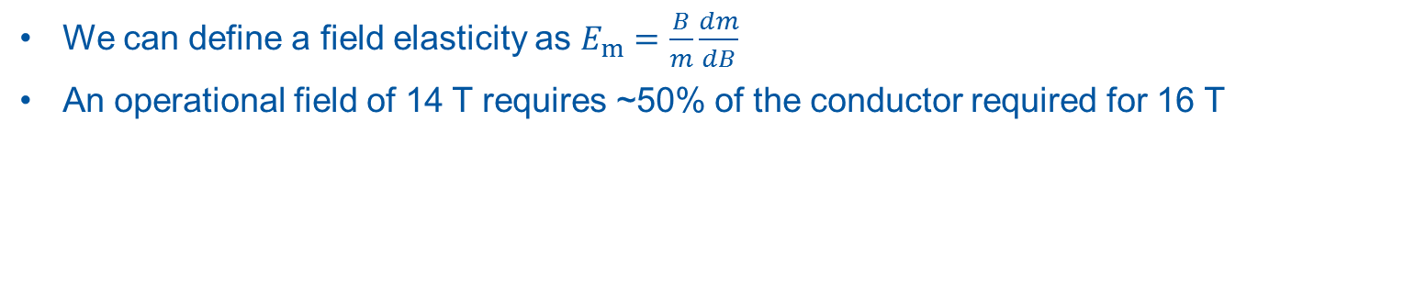
Elasticity of conductor mass (CEA)
We can define a field elasticity as $E_{m}=\frac{B}{m}\frac{dm}{dB}$
An operational field of 14 T requires ~50% of the conductor required for 16 T
1% more field at 14 T cost 3.5% more mass of conductor,
1% more field at 16 T cost 7.5% more mass of conductor

Slide 9
Conductor composition
Evaluation for 10% margin at 4.2 K and ~18% margin at 1.9 K
Non-Cu and conductor mass in kt
kt | 15 T | 16 T
Non-Cu | 3 | 4
Total | 8 | 10
Constant integrated field

Slide 10
Target cost of conductor
Discussion between mass and performance based cost is on-going
Target performance is set to J_{c}(4.2 K, 16 T) = 1500 A/mm²
Outer layers require larger Cu/non-Cu ratios than inner layers
Performance based cost c_{p} | Mass based cost c_{m}
c_{pt} = 5 EUR/kA.m at 4.2 K and 16 T | c_{mt} = 430 EUR/kg
c_{pp} = 10 EUR/kA.m at 4.2 K and 16 T | c_{mp} = 860 EUR/kg
C_{p} = c_{p} x J_{c} x A_{SC} x N x L = c_{m} x 2m_{SC} | C_{m} = c_{m} (A_{SC} + A_{Cu}) x ρ x N x L = c_{m} (m_{SC +} m_{Cu})
J_{c} (4.2 K, 16 T) =1500 A/mm²
A_{SC} & A_{Cu} : Total area of SC and Cu in conductor
m_{SC} & m_{Cu}: Total mass of SC and Cu
N = 4578 units
L = 14.3 m : Length of per magnet unit
ρ = 8.7 kg/dm³
We will then multiply these numbers by 1.3 to account for waste & testing

Slide 11
Conductor cost for FCC-hh dipoles
Target cost
Total cost of conductor | 15 T [MEUR] | 16 T [MEUR]
C_{mt} with 430 EUR/kg | 4,500 | 5,600
C_{pt} with 5 EUR/kA.m | 3,400 | 4,500
Pessimistic cost
Total cost of conductor | 15 T [MEUR] | 16 T [MEUR]
C_{mp} with 860 EUR/kg | 9,000 | 11,200
C_{pp} with 10 EUR/kA.m | 6,800 | 9,000

Slide 12
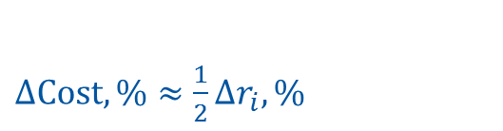
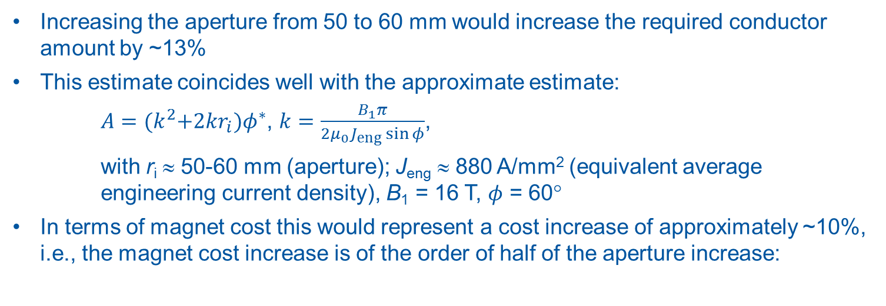
Conductor amount vs aperture
Increasing the aperture from 50 to 60 mm would increase the required conductor amount by ~13%
This estimate coincides well with the approximate estimate:
$A={(k}^{2}+2kr_{i})φ^{∗}$, $k=\frac{B_{1}π}{2μ_{0}J_{eng}\sin{φ}}$,
with r_{i} ≈ 50-60 mm (aperture); J_{eng} ≈ 880 A/mm² (equivalent average engineering current density), B₁ = 16 T, $φ$ = 60°
In terms of magnet cost this would represent a cost increase of approximately ~10%, i.e., the magnet cost increase is of the order of half of the aperture increase:
$∆Cost,\%≈\frac{1}{2}∆r_{i}, \%$
at around 50 mm and 16 T

Slide 13
Total cost of FCC-hh dipoles
FCC with LHC magnet cost without conductor: 630 kEUR/unit x 4578 unit= 2900 MEUR
Magnets at 4.2 K at 10% margin and at 1.9 K at ~18% margin have a similar cost
The cost for 15 T magnets is given for 4883 units (constant integrated field)
Target cost
Total cost | 15 T [MEUR] | 16 T [MEUR]
C_{mt} with 430 EUR/kg | 7,400 | 8,500
C_{pt} with 5 EUR/kA.m | 6,300 | 7,400
Pessimistic cost
Total cost | 15 T [MEUR] | 16 T [MEUR]
C_{mp} with 860 EUR/kg | 11,900 | 14,100
C_{pp} with 10 EUR/kA.m | 9,700 | 11,900

Slide 14
Conclusion
Margin is very expensive
5% (15%->20%) margin at 1.9 K => 25% more conductor cost (~ 2 GEUR)
The conductor cost represents more than half of the magnet cost: any effort shall be pursued to minimize this cost

