Slide 1
Control System for the LHCb upgrade
LHCb Upgrade Meeting
21.04.2016

Slide 2
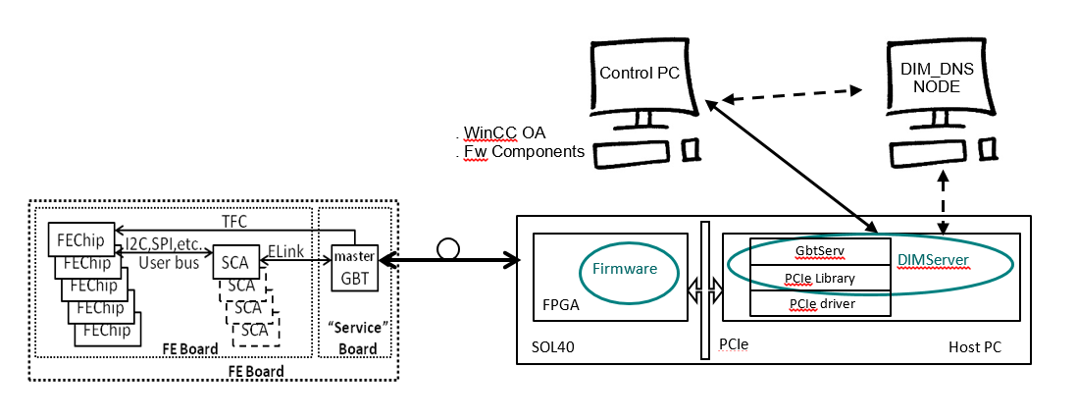
Control system
Main Components | Status
GbtServer (DIM Server) | ✓
fwGbt (GBT Client) | ✓
fwHw | ✓
Notes:
So, as a reminder, the architecture will go as follows. The Control PC, where one needs both WinCC OA and also the Framework components (fwGbt) installed, will act as a Gbt Client (DIM Client) to the Gbt Server installed in a host pc (host to a SOL40 board). They interact through DIM so a DIM_DNS_NODE needs to be set up. In the host PC GBtServer is compiled with the lbPCie libraries and uses the installed PCIe driver. Then through the SOL40 firmware one can talk to the Front Ends through the GBT-SCA chain. Right now we’ve released a version of the GbtServer, the new component to talk to it and control the GBT-SCA devices FwGbt and now you can also model your hardware that is controlled by the SCA in the hardware tool that existed already before.

Slide 3
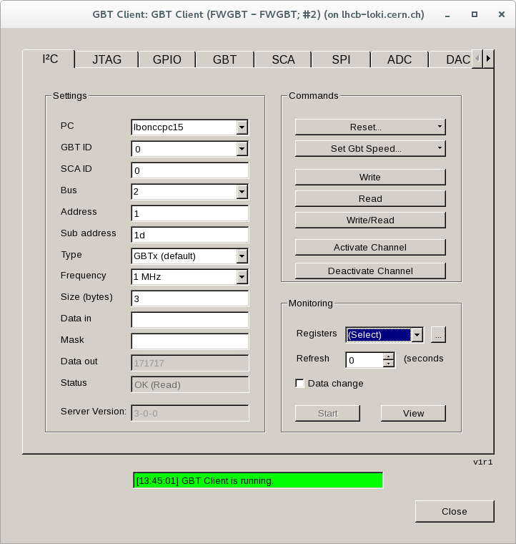
Gbt server
Most of the protocols implemented
GBTx | ✓
SCA | ✓
Local Bus | ✓
I2C | ✓
GPIO | ✓
ADC | ✓
DAC | ✓
SPI | ✓
JTAG | ✗
Local I2C | ✗
Local SPI | ✗
Notes:
In the GbtServer, most of the protocols are implemented, we just didn’t debug the JTAG totally yet. This allows for the raw use of all the field buses of the SCA but still abstracts all the commands and some of their specifications. All of the controller registers and actions are available (sometimes not in the rawest of formats). For instance, some SPI types make use of the GPIO lines to select the slave Front End Board. We still don’t how many of these protocols are going to be implemented in the Front-Ends, so we would like to ask people to come to us and tell us how to communicate with yours devices. Any multiplexing needs to be done? Two more protocols are to be added and these are I2C and SPI done through some FPGA IP Core registers to monitor the status of the PLLs, Minipods and also to duplicate the LED information physically available in amc40.

Slide 4
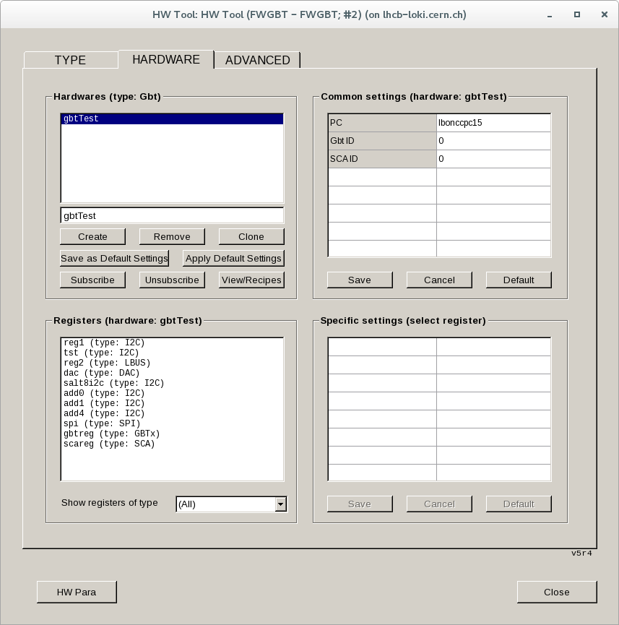
Hw tool
GBT Device type integrated
All the SCA available protocols integrated
Can model your GBT controlled devices with all the SCA available field buses
Create your model in XML and import it
Notes:
In the hardware tool we have all the SCA protocols available, with the exception of JTAG for now and integrated a GBT-SCA device type with all the protocols, so it’s already possible to model your devices with all the SCA available field buses, and one of the ways to do this is by describing your device in an XML file and import it here through the advanced tab. With this you can specify monitoring rates for your registers and whether you data to come to you “on change” basis.

Slide 5
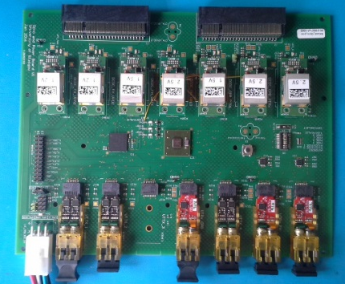
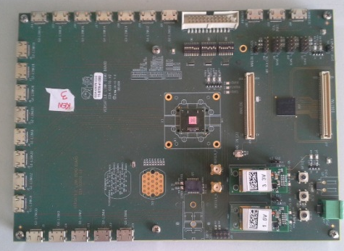
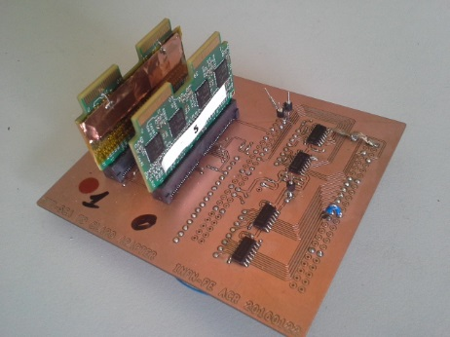
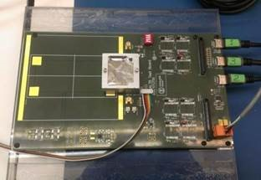
Tested BOARDS/CHIPS
VELO OPB (I2C + GPIO)
GBTx slave (I2C 16bit reg add, 7 bit chip add)
Claro (SPI + GPIO)
Salt8 (I2C 8bit reg add, 7 bit chip add + GPIO)
Notes:
So far we’ve tested these tools with some target devices, including the VELO board, which needs some further testing (ADC not fully working). SALT8 I2C and GPIO

Slide 6
WinCC component for MiniDAQ (fwminidaq)
Released on 13th April:
  Documentation here: https://lbredmine.cern.ch/documents/14
Provides control to:
  TFC
    Super ODIN
    SOL40
  TELL40
  10G Interface
Ready to use component
  All the devices are already created
    1 x SODIN core
    6 x SOL40 Links
    1 x TELL40
  Just configure CCPC and go
MiniDAQ FSM tree as aggregator for all the devices
  No commands implemented at the moment – only resets
  States DO reflect the state of the devices
Notes:
There was a release of the fwMiniDAQ component, you can check the documentation here in this link. This component provides control to SODIN, SOL40 and TELL40 boards, as well as the 10G interface. It’s a ready to use component, in the sense that it already has not only the types but also the devices instantiated, namely 1 SODIN core, 6 SOL40 links and 1 TELL40 device. The only thing you need to do is configure the ccpc and you will have this working, will elaborate on that in a few slides. There is an FSM tree for the MiniDAQ that serves as an aggregator for all these devices. At the time it doesn’t implement any commands apart from some reset, but the states of the FSM tree already reflect the states of the physical devices.

Slide 7
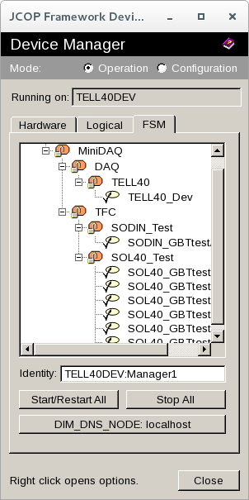
FSM Tree
MiniDAQ
TFC
DAQ
SODIN
TELL40
SODIN Core0
TELL40 Device
SOL40
SOL40 Link0
SOL40 Link5
SOL40 Link5
SOL40 Link5
SOL40 Link5
SOL40 Link5
Notes:
You will access these devices through the Device manager where you can navigate the FSM.

Slide 8
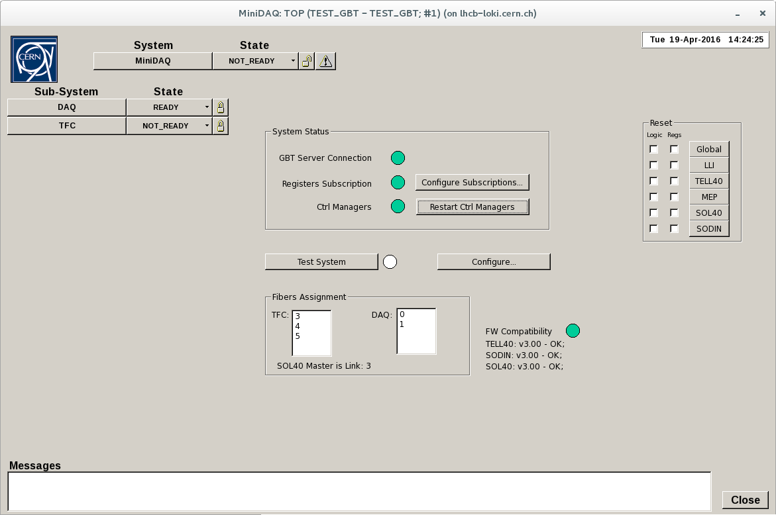
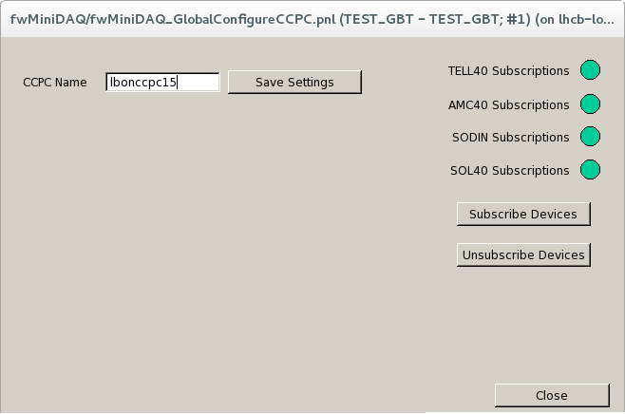
Configure CCPC and dim subcriptions
Notes:
So, if you open the Top entity panel, you will get these, where you get a view of the state of the connection with the devices and the GbtServer. After you have the GbtServer running, you will want to configure to which CCPC you want to connect and start the dim subscriptions to that Server. Once you’ve done that you should get these subscriptions green, and also the Gbt Server Connection should be ok. Then after you restart the control managers here, you should see something like this in the picture. Then you can test the system with a click here (will perform some writes and reads check if everything is ok). Here you will see what are the fiber assignments.

Slide 9
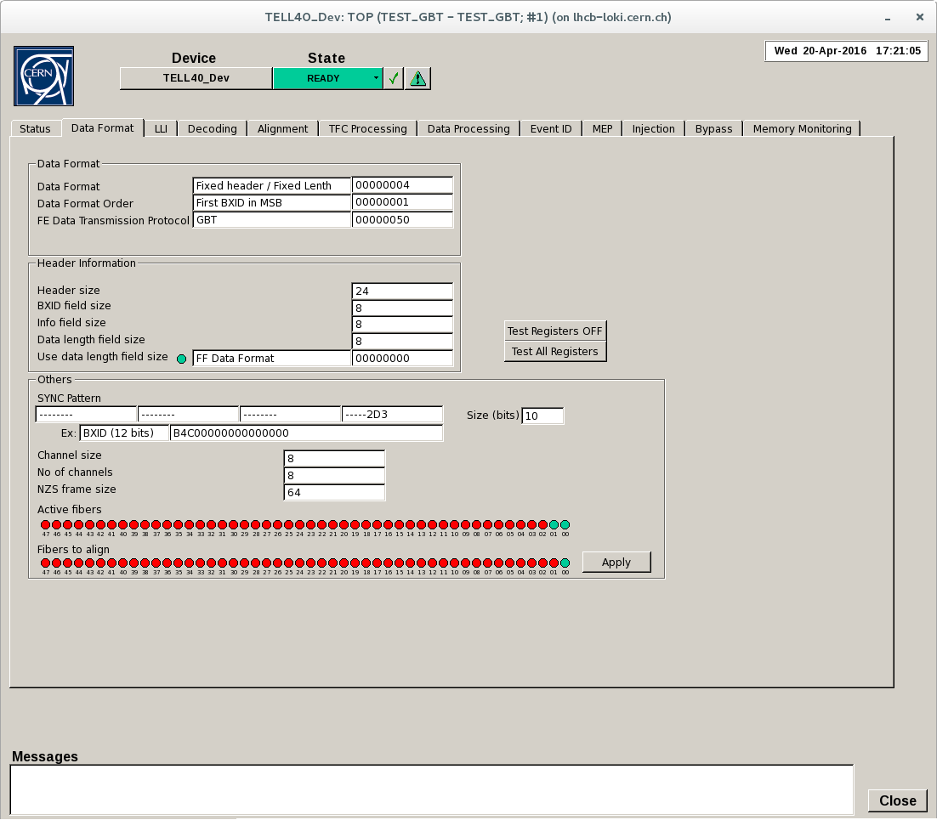
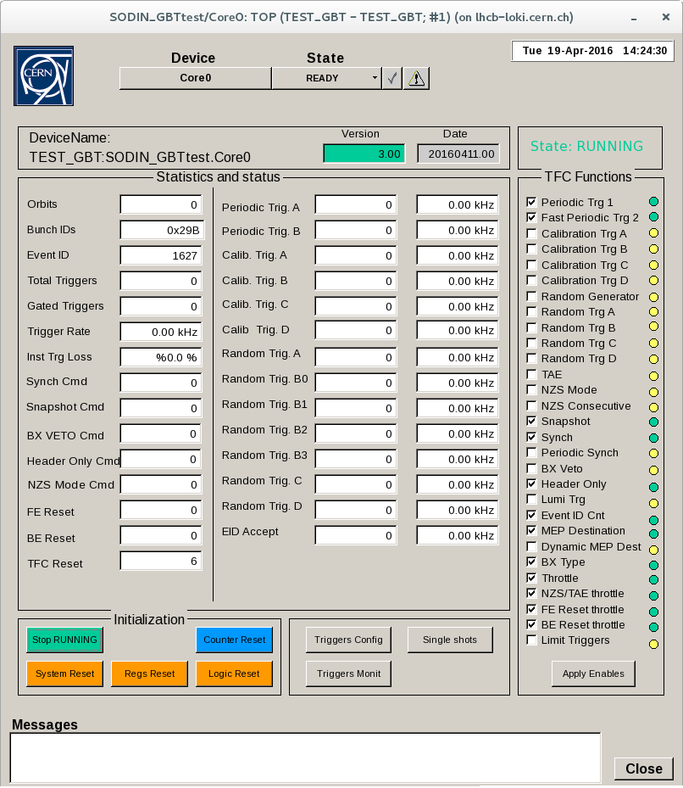
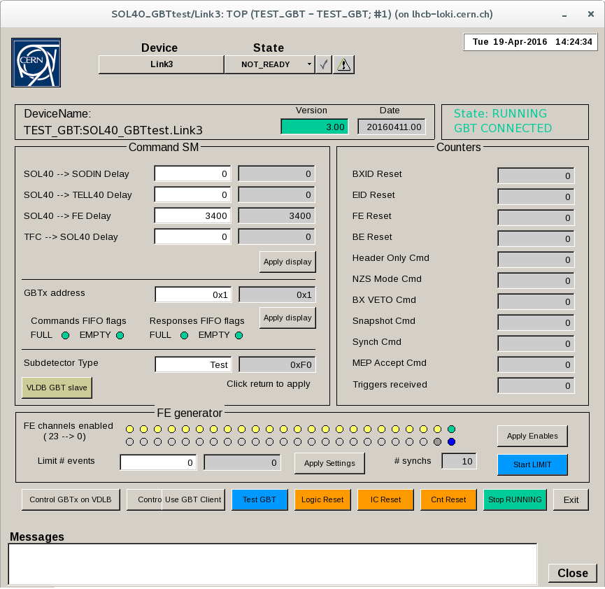
Device Control Panels
Notes:
You’ll also have the device control panels for the 3 types of devices, so SODIN, SOL40 and TELL40 with all the different aspects of it to monitor and control.

Slide 10
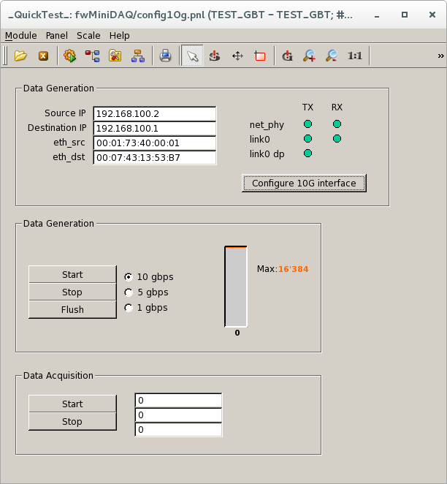
Plans
Integrate Paolo’s data checker control in WinCC
  Data Generation control already integrated
  Some developments on the Data Acquisition control
Implement actions on the FSM
Implement missing protocols on the GbtServer
  Basically JTAG…
  Local I2C and SPI (through FPGA IP Core)
  Remote FPGA configuration through GBT-SCA

Slide 11
SUmmary
Released on 13th April
fwMiniDAQ (SOL40, SODIN, TELL40, 10G interface, GBT-SCA)
GbtServ
Provided centrally (by us)
Tools for SOL40, TELL40, SODIN and Front End control
Front End control tests
Simple DAQ
Not provided
Testing of FEB specific functionalities
FEB device user panels

